Slide 1

Next-generation phenotyping
George Hripcsak, MD, MS
Department of Biomedical Informatics
Columbia University, New York, USA

Slide 2
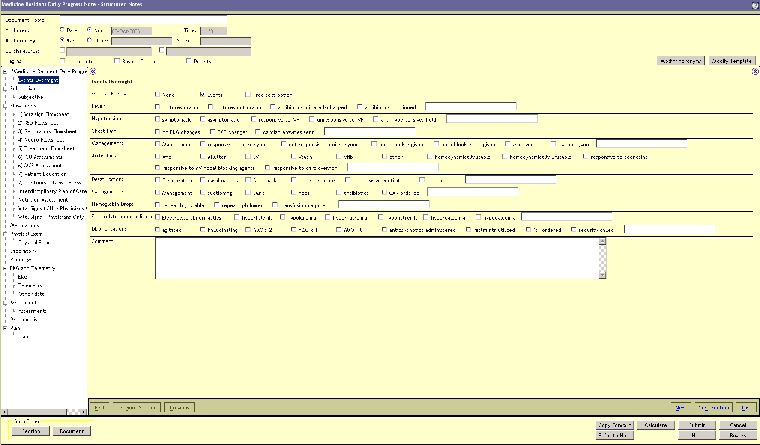
Electronic health record

Slide 3
National EHR data, per year
Healthcare $2.5 trillion industry in US
  can’t duplicate
1,000,000,000 | visit notes
35,000,000 | admit notes, discharge sum.
46,000,000 | procedure notes
3,000,000,000 | prescriptions
1,000,000,000 | laboratory tests
>50,000,000,000 | facts

Slide 4
Data quality
All medical record information should be regarded as suspect; much of it is fiction.
    Burnum JF ... Ann Intern Med 1989
Data shall be used only for the purpose for which they were collected. If no purpose was defined prior to the collection of the data, then the data should not be used.
    van der Lei J ... Method Inform Med 1991

Slide 5
EHRs augment research databases
Data — “manually curated”
  read record, enter into research database
Subjects — patient recruitment
Knowledge — sample size
Continuity — long term follow up
Fully EHR-based observational studies
  without case-specific curation
Fully EHR-based interventional trials

Slide 6
Solvable challenges
Lack of penetration of EHRs
  $30B HITECH in US
Distributed systems, inconsistent formats
  HL7, CDISC, …
Privacy
  policy

Slide 7
Hard challenges
Quality of the data
  Ambiguous or unknown meaning
  Accuracy
    50-100% accuracy [Hogan JAMIA 1997]
  Completeness
    mostly missing
  Complexity
    disease ontologies
Bias

Slide 8

Meaning
PERRLA
Pupils equal, round, reactive to light and accommodation

Slide 9
Missing
Data are mostly missing
  Sampled when sick
Implicit information
  Pertinent negatives by attending vs CC3

Slide 10
Missing
Missing completely at random (MCAR)
Missing at random (MAR)
Not missing at random (NMAR)

Slide 11
Missing
Missing completely at random (MCAR)
Missing at random (MAR)
Not missing at random (NMAR)
Almost completely missing (ACM)

Slide 12
Noisy
As low as 50% accuracy (Hogan JAMIA 1997)
… 36 year old man … 27 year old woman …

Slide 13
observe &
interpret
author
read
Truth
Health status of the patient
Concept
Clinician or patient’s conception
Record
EHR/PHR
Concept
2nd clinician’s conception of the patient (or self, lawyer, compliance, ...)
process
Model
Computable representation

Slide 14
observe & interpret
author
read
Truth
Health status of the patient
Concept
Clinician or patient’s conception
Record
EHR/PHR
Concept
2nd clinician’s conception of the patient (or self, lawyer, compliance, ...)
Error
Error
Implicit
Error
process
Model
Computable representation

Slide 15
Complex
Narrative text holds much of the useful info
  Slight increase of pulmonary vascular congestion with new left pleural effusion, question mild congestive changes
  s/p LURT 1998 c/b 1A rejection 7/07 back on HD

Slide 16
Natural language processing
pulmonary vascular congestion
  change: increase
  degree: low
“Slight increase of pulmonary vascular congestion with new left pleural effusion, question mild congestive changes”
pleural effusion
  region: left
  status: new
congestive changes
  certainty: moderate
  degree: low

Slide 17
Complex
Which is the right time?
  When specimen drawn
  When specimen received
  When test performed
  When result updated
  When result received by the patient
  When patient told clinician
  When clinician wrote the note

Slide 18
Biased
Completeness, noise, and complexity depend on the state we are trying to measure
Billing and liability are motivations

Slide 19
Completeness, sampling bias

Slide 20
Biased
Environment
Patient state
Therapy
Care team
Objective tests
Electronic health record

Slide 21
18715 cohort
+CXR
+fdg
-recent pneu
-recent visit
1935 cohort
above plus
+DSUM exist
+ICD9 (pneu
not sepsis)
Hripcsak ... Comput Biol Med 2007;37:296-304

Slide 22
Good news
Clinicians use the record for patient care
  Human interpretation
Can we deconvolve the truth?
  Need new tools to handle it

Slide 23
EHR-derived phenotype
Clinically relevant feature derived from EHR
  Patient has (a diagnosis of) type II diabetes
  Recent rash and fever
  Drug-induced liver injury
Then use the phenotype in correlation studies, etc.

Slide 24
State of the art
Knowledge engineer and domain expert iterate on a query that combines information from multiple sources
  Diagnosis, medication, laboratory tests, etc.
Can take months per query
  eMerge
Bias of developers, generalizability, ...
How to improve time and accuracy

Slide 25
High-throughput phenotyping
Elimination of case-by-case curation through queries
Generate thousands of phenotype queries with minimal human intervention such that they can be maintained over time

Slide 26
Solution
Top-down knowledge engineering +
bottom-up machine learning
Study the EHR as an object in itself
Health care process model
Quantify bias to avoid it or correct for it

Slide 27
Methods
Characterization
Dimension reduction
Latent variables
Temporal processing
Natural language processing
Derived properties
Causality

Slide 28
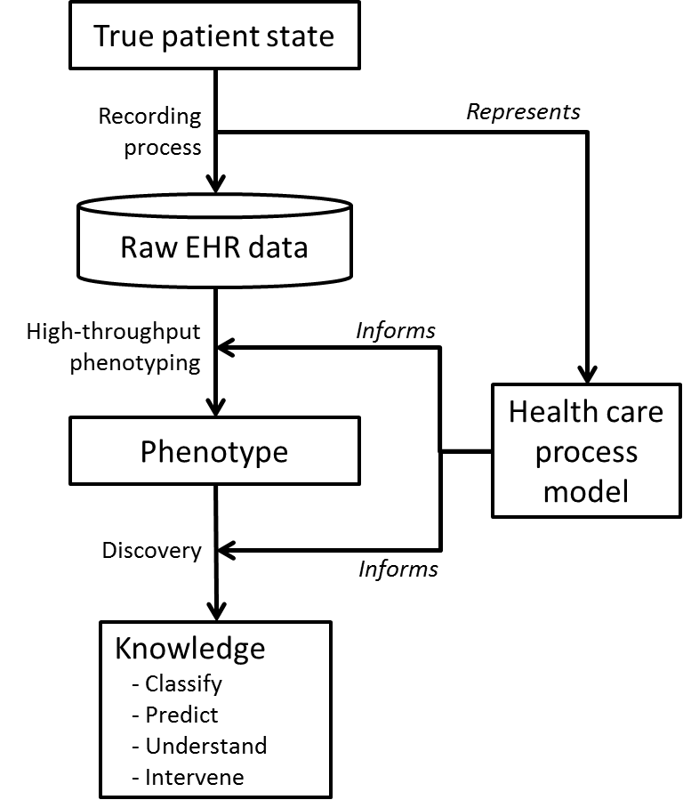
Health care process model

Slide 29

“Physics” of the medical record
Study EHR as if it were a natural object
  Use EHR to learn about EHR
  Not studying patient, but recording of patient
Aggregate across units and model
Borrow methods from non-linear time series

Slide 30
Glucose by Δt and tau
Albers ... Translational Bioinformatics 2009

Slide 31
Correlate lab tests and concepts
22 years of data on 3 million patients
21 laboratory tests
  sodium, potassium, bicarbonate, creatinine, urea nitrogen, glucose, and hemoglobin
60 concepts derived from signout notes
  residents caring for inpatients to facilitate the transfer of care for overnight coverage
  concepts likely to have an association + controls

Slide 32
Methods
Extract concepts using case-insensitive stemmed search phrases in signout notes, and assign time of note
Normalize laboratory test within patient to eliminate inter-patient effect
Interpolate both time series so every point has a partner
  Treat concepts as 0/1
Time lag by +/− 60 days
Calculate Pearson’s linear correlation
1
0

Slide 33
Lagged linear correlation
lab
positive correlation
concept
negative correlation
lab precedes concept (d)
lab follows concept (d)

Slide 34
Definitional association
Hripcsak ... JAMIA 2011

Slide 35
Intentional and physiologic associations

Slide 36
Timing of cause in disease vs. treatment

Slide 37
Shape of curve cause vs. definition

Slide 38
Specificity of the concept

Slide 39
Value of aggregation
Blood potassium vs aldactone
  all values: 5424 pts, 570,000 values
  ≤10 values: 444 pts, 2534 values (.4%), 6/pt

Slide 40
Value of using all time and normalization

Slide 41
Ranking association curves
Actual correlation is only 0.05
  Most are significant (not just 500 of 10000)
How to order association curves
  Size of association: maximum correlation
  Consistency of association: area under the curve
  Time dependence of association: range
    maximum correlation – minimum correlation over +/– 60 days

Slide 42
Ranking association curves
21 lab tests, 60 concepts
Expert: for each concept, 0-6 lab tests that ought to be most strongly correlated with the concept based on medical knowledge
  Anemia: hematocrit, hemoglobin, RBC
  Hyponatremia: sodium
  Diuretics: six electrolytes
Measure match between system and expert
  Proportion of labs algorithm places in “top”
  “Top” is number of labs selected by expert for concept

Slide 43
Ranking association curves
Examples:
  the six labs selected by the expert (potassium, sodium, urea nitrogen, creatinine, chloride, bicarbonate) had the six highest ranges for spironolactone
  anemia's three (hematocrit, hemoglobin, RBC) were also at its top
  atrial fibrillation expert chose anticoagulation tests, but the white blood count and bicarbonate ranked higher, perhaps reflecting the role of infection and electrolyte disturbance in atrial fibrillation

Slide 44
Ranking association curves
Algorithm | Proportion within top
Maximum correlation | 0.44*
Area under the curve | 0.33*
Range | 0.62*
*all differ by paired t-test
Hripcsak ... Translational Bioinformatics 2012

Slide 45
Ranking association curves
In 19 concepts, expert picked 1 lab
  Range ranked that test at the very top in 12 cases (63%)

Slide 46
Ranking association curves
How to factor out other effects
  Normalize one variable to reduce inter-patient effects
  Look for time dependence of the association

Slide 47
Meaning of lagged linear correlation
Usually used in surveillance to detect lag in information
What if one variable is dichotomous
  Concept in clinical notes
What if dichotomous one is rare and short lived
  Start of medication

Slide 48
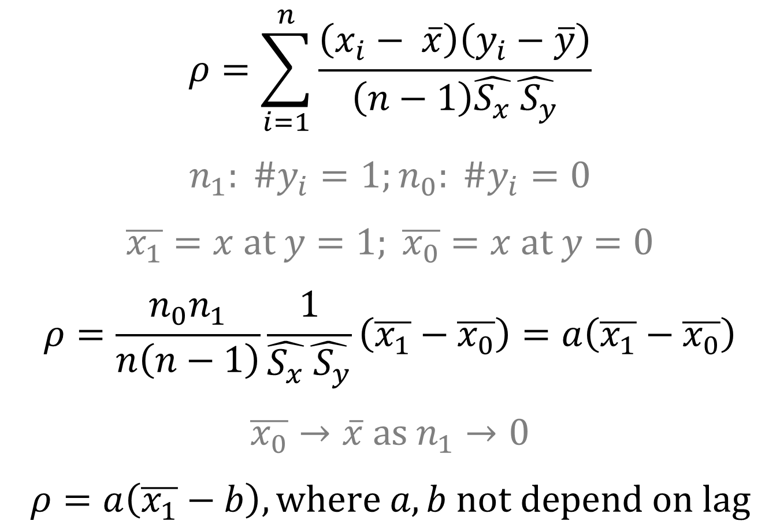
$$ρ=\sum_{i=1}^{n}{\frac{\left(x_{i}− \overline{x}\right)\left(y_{i}−\overline{y}\right)}{\left(n−1\right)\hat{S_{x}}\hat{{ S}_{y}}}}$$
$$n_{1}: \#y_{i}=1;n_{0}: \#y_{i}=0$$
$$\overline{x_{1}}=x at y=1; \overline{x_{0}}=x at y=0$$
$$ρ=\frac{n_{0}n_{1}}{n\left(n−1\right)}\frac{1}{\hat{S_{x}}\hat{{ S}_{y}}}\left(\overline{x_{1}}−\overline{x_{0}}\right)=a\left(\overline{x_{1}}−\overline{x_{0}}\right)$$
$$\overline{x_{0}}→\overline{x} as n_{1}→0$$
$$ρ=a\left(\overline{x_{1}}−b\right), where a,b not depend on lag$$
Hripcsak ... Translational Bioinformatics 2012

Slide 49
Lag
x
Sodium
y
Start of medication
Start of medication

Slide 53
Drug interaction example
From Tatonetti, et al.

Slide 54
x
Sodium
y
Serum concentration

Slide 55
Meaning
If one is dichotomous
  Lagged linear correlation is equivalent to aligning all instances of the condition and averaging the other variable forwards and backwards in time (window)
Virtual alignment
  While it is difficult to align cases for symbolic methods, numeric methods may accommodate the fuzzy and ambiguous start times

Slide 56
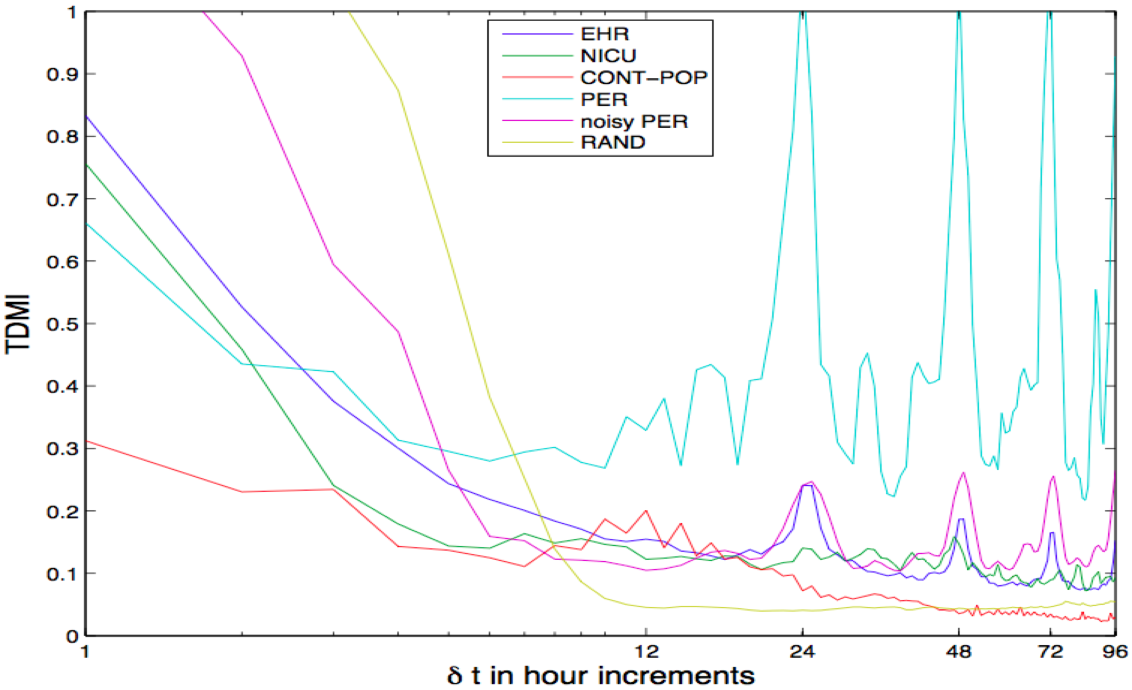
Population physiology
Albers DJ, Chaos 2012, and Albers DJ, Physics Letters A 2010

Slide 57
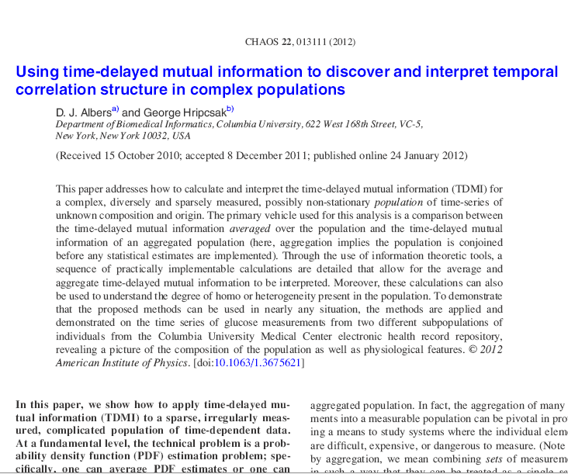
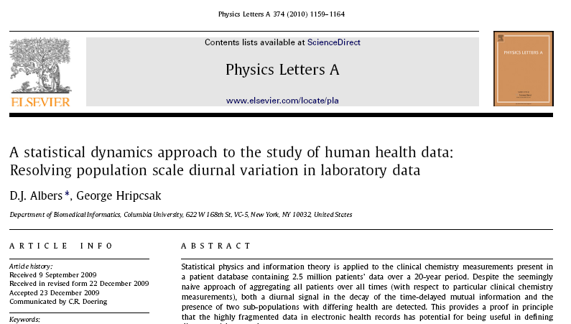
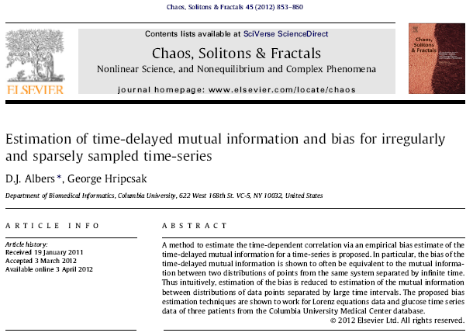
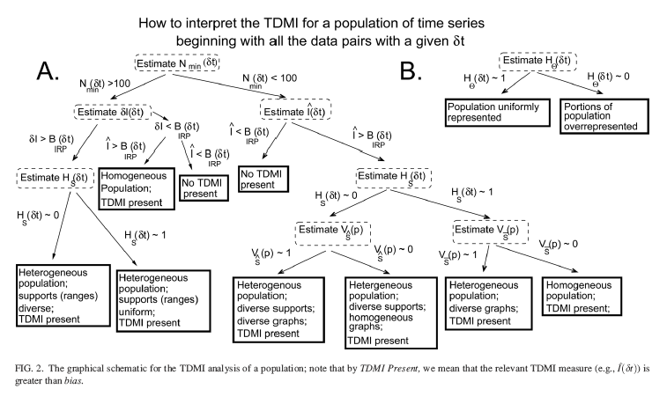

Slide 58
Conclusion
Numeric methods may be able to extract knowledge from noisy EHRs
Better performance when can factor out extraneous effects
EHR research can benefit from collaboration
  Informatics, Computer science, Statistics/Epi
  Non-linear physics (aggregation of short time series)
  Philosophy (causation)
Funded by National Library of Medicine, USA
R01 LM006910 and T15 LM007079

