Slide 1
Intonation and Computation: Deception
Julia Hirschberg
LSA 2017
julia@cs.columbia.edu

Slide 2
Deceptive Speech: A Case Study
How do you come up with an idea for an empirical speech study?
How do you go about doing it?
What problems might you run into along the way?

Slide 3
Deception & Culture
Not widely researched
What has been looked at:
  How culture affects when people deceive (e.g., Lapinski & Levine, 2000; Seiter et al, 2002)
  Beliefs about deceptive behaviors across cultures
    But contrasting findings (e.g., Al-Simadi, 2000; Bond & The Global Deception Research Team 2006)
Few studies on universal versus culture-specific verbal cues (e.g., Cody et al. 1989; Cheng & Broadhurst, 2005)
  But have examined one culture per study
Notes:
Before we get started, let’s review what is known about deception across cultures
(go through slide)
Also study you read in class:
As seen in a study by Cheng and Broadhurst (2005), Cantonese-English bilinguals were more often judged as being deceitful when they spoke in their second language than when they spoke in their first language, regardless of whether they were telling the truth or lying. When speaking in their second language, they displayed more visual cues of deception (e.g., hand and arm movements) and audio cues of deception (e.g., changes in pitch).
The Cheng and Broadhurst (2005) findings indicate that second-language speakers may be different than native-language speakers, but Cantonese-English bilinguals speaking English need to be compared to native English speakers before conclusions can be made as to whether the difference is due to culture or language. No study has yet to directly compare the effect of culture on deception behaviors when speakers from different cultures are all speaking one language.
What is needed?
Direct comparison across cultures

Slide 4
Defining Deception
Deliberate choice to mislead
  Without prior notification
  To gain some advantage or to avoid some penalty
Not:
  Self-deception, delusion, pathological behavior
  Theater
  Falsehoods due to ignorance/error
Everyday (white) Lies hard to detect
But Serious Lies?

Slide 5
Why are ‘serious’ lies difficult?
Hypotheses:
  Our cognitive load is increased when lying because…
    Must keep story straight
    Must remember what we’ve said and what we haven’t said
  Our fear of detection is increased if…
    We believe our target is hard to fool or suspicious
    Stakes are high: serious rewards and/or punishments
Makes it hard for us to control indicators of deception

Slide 6
Cues to Deception in Many Modalities
Body posture and gestures (Burgoon et al‘94)
  Complete shifts in posture, touching one’s face,…
Microexpressions (Ekman‘76, Frank‘03)
  Fleeting traces of fear, elation,…
Biometric factors (Horvath‘73)
  Increased blood pressure, perspiration, respiration, odor…other correlates of stress → polygraph
Changes in brain activity: true vs. false stories
Variation in what is said and how (Adam‘96, Pennebaker et al‘01, Newman et al ‘03, Streeter et al’77, Hirschberg et al ‘05, Levitan et al ’16)
Notes:
Burgoon – Interpersonal Deception Theory
attempts to explain how individuals handle actual (or perceived) deception at the conscious or subconscious level while engaged in face-to-face communication.

Slide 7
Lying and LIWC (Newman et al ’03)
Linguistic Inquiry and Word Count:
  Do false (text) stories differ from true ones?
  LIWC classifies 61-67% of stories in multiple topics
    Context/topic did matter
  Liars are less cognitively complex, use fewer self- or other-references, and use more negative emotion words
    Self-reference indicates ownership of statement
    Negative emotion words indicate guilt
    Creating false stories increases cognitive load
  LIWC can be useful but…
Notes:
Pennebaker one of LSA’s first Public lectures on language speakers
LIWC15: has diffs in categories and dictionary

Slide 8
Current Approaches to Deception Detection
Training humans
  John Reid & Associates
    Behavioral Analysis: Interview and Interrogation
    I didn’t take the money vs. I did not take the money
Laboratory studies: Production and Perception
‘Automatic’ methods
  Polygraph
  Nemesysco and the Love Detector
  No evidence that any of these work….but publishing this statement can be dangerous! (Anders Eriksson and Francisco La Cerda)
Notes:
Contractions may indicate truth or lie (Statement Analysis vs. John Reid (but non-native speakers use contractions much less…
Nemesysco develops vocal lie-detectors, emotion-detectors and love-detectors
claims to have built detectors based on vocal cues
Universal Lie Response
Anders Eriksson and Francisco La Cerda’s article "Charlatanry in forensic speech science: A problem to be taken seriously."
In the 2007 peer-reviewed academic article "Charlatanry in forensic speech science", the authors reviewed 50 years of lie detector research and came to the conclusion that there is no scientific evidence supporting that voice analysis lie detectors actually work.[8] Lie detector manufacturer Nemesysco threatened to sue the academic publisher for libel resulting in removal of the article from online databases. In a letter to the publisher, Nemesysco's lawyers wrote that the authors of the article could be sued for defamation if they wrote on the subject again.[9] [10] The full text of the article is available online.[11]

Slide 9
Our Research
Conduct objective, experimentally verified studies of cues to deception which predict better than humans or polygraphs
Our method:
  Collect speech data and extract acoustic, prosodic, and lexical cues automatically
  Take gender, ethnicity, and personality factors into account
  Use Machine Learning techniques to train models to classify deceptive vs. non-deceptive speech

Slide 10
Previous Work
Created Columbia/SRI/Colorado Deception Corpus
  Within-subject recordings of deceptive and non-deceptive speech
    32 adult native American English speakers
    25-50m interviews by trained interviewer (Reid technique): 15.2h of speech, 7h from subjects
    Subjects given tasks and incentivized to lie about performance
    Ground truth identified by subjects

Slide 11
Acoustic/Prosodic Features
Duration features
  Phone / Vowel / Syllable Durations
  Normalized by Phone/Vowel Means, Speaker
Speaking rate features (vowels/time)
Pause features (cf Benus et al ‘06)
  Speech to pause ratio, number of long pauses
  Maximum pause length
Energy features (RMS energy)
Pitch features
  Pitch stylization (Sonmez et al. ‘98)
  Model of F0 to estimate speaker range
  Pitch ranges, slopes, locations of interest
Spectral tilt features
Notes:
Useful features: Energy features, duration, unit position in interview
LTM model of f0

Slide 12
Lexical Features
Presence and # of filled pauses
Is this a question? A question following a question
Presence of pronouns (by person, case and number)
A specific denial?
Presence and # of cue phrases
Presence of self repairs
Presence of contractions
Presence of positive/negative emotion words
Verb tense
Presence of ‘yes’, ‘no’, ‘not’, negative contractions
Presence of ‘absolutely’, ‘really’
Presence of hedges
Complexity: syls/words
Number of repeated words
Punctuation type
Length of unit (in sec and words)
# words/unit length
# of laughs
# of audible breaths
# of other speaker noise
# of mispronounced words
# of unintelligible words
Notes:
Useful features: positive emotion words, filled pauses

Slide 13
Subject-Dependent Features
% units with cue phrases
% units with filled pauses
% units with laughter
Lies/truths with filled pauses ratio
Lies/truths with cue phrases ratio
Lies/truths with laughter ratio
Gender
Notes:
Useful features: use of filled pauses, laughter, and cue phrases

Slide 14
Results
88 features, normalized within-speaker
  Discrete: Lexical, discourse, pause
  Continuous features: Acoustic, prosodic, paralinguistic, lexical
Best Performance: Best 39 features + c4.5 ML
  Accuracy: 70.00%
  TRUTH F-measure: 75.78
  Lexical, subject-dependent & speaker-normalized features best predictors
  Interesting individual differences: how to predict?
Notes:
14
Positive emotion words → deception (LIWC)
Pleasantness → deception (DAL)
Filled pauses → truth
Some pitch correlations — varies with subject

Slide 15
Evaluation: Compared to Human Deception Detection
Most people are very poor at detecting deception
  ~50% accuracy (Ekman & O’Sullivan ‘91, Aamodt ‘06)
  People use unreliable cues, even with training
This study
  32 Judges, rating 2 interviews
  Received ‘training’ on one subject
Pre- and post-test questionnaires
Personality Inventory

Slide 16
A Meta-Study of Human Deception Detection
(Aamodt & Mitchell 2004)
Group | #Studies | #Subjects | Accuracy %
Criminals | 1 | 52 | 65.40
Secret service | 1 | 34 | 64.12
Psychologists | 4 | 508 | 61.56
Judges | 2 | 194 | 59.01
Cops | 8 | 511 | 55.16
Federal officers | 4 | 341 | 54.54
Students | 122 | 8,876 | 54.20
Detectives | 5 | 341 | 51.16
Parole officers | 1 | 32 | 40.42
Notes:
K is # of studies
N is number of participants

Slide 17
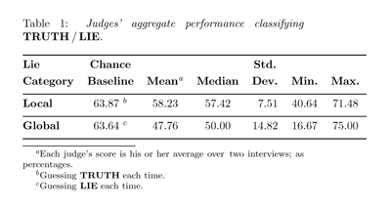
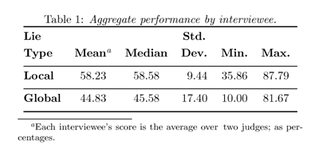
By Judge
58.2% Acc.
By Interviewee
58.2% Acc.
Notes:
Compare to 67% accuracy by machine.
Also note large differences between judges and also by speaker being judged.
Some judges are much better than others.
Some speakers are easier than others

Slide 18
What Makes Some People Better Judges?
Does personality play a role?

Slide 19
The Big Five (Costa & McCrae, 1992)
Openness to Experience: intellect/imagination, originality, curiosity, ingenuity, imaginative, insightful “I have a lot of intellectual curiosity.”
Conscientiousness: orderliness, responsibility, dependability, organized, thorough, planful
“I strive for excellence in everything I do.”
Extraversion: talkativeness, assertiveness, energy “I like to have a lot of people around me.”
Notes:
Costa & McCrae (1992) NEO-FFI Personality Measures
Openness to Experience: intellect/imagination, originality, curiosity, ingenuity, imaginative, insightful
“I have a lot of intellectual curiosity.”
Conscientiousness: orderliness, responsibility, dependability, organized, thorough, planful
“I strive for excellence in everything I do.”
Extraversion: talkativeness, assertiveness, energy
“I like to have a lot of people around me.”
Agreeableness: good-naturedness, cooperativeness, sympathetic, kind, affectionate, trust
“I would rather cooperate with others than compete with them.”
Neuroticism: anxiety, emotional instability,intense, moody,
“I often feel inferior to others.”

Slide 20
Neuroticism: anxiety, emotional instability, intense, moody, “I often feel inferior to others.”
Agreeableness: good-naturedness, cooperativeness, sympathetic, kind, affectionate, trust “I would rather cooperate with others than compete with them.”

Slide 21
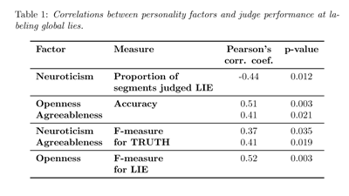
Neuroticism, Openness & Agreeableness
Correlate with Judge’s Performance
On Judging Global lies.
Notes:
Neuroticism was negatively correlated also with pre-test expectations of frequency of lying. Hence less inclined to label segments as lies; and, since data biased toward truthfulness, these people are better on measures favoring True.
Openness: if one is open to new experience, one may be better able to base judgments on data seen, rather than inject bias
Agreeableness: also associated with dependent personality disorder (extreme attention to the opinions and affective state of others); thus better able to assess their emotional state in deception?

Slide 22
Current Study: Hypotheses
Personality factors can help to predict differences in deceptive behavior
Subjects who deceive better can also detect deception better
Cultural differences and gender also play a role in deceptive behavior and in deception detection abilities (Cheng&Broadhurt 2005)
New task: Studies of pairs of American English and Mandarin Chinese native speakers, speaking English, interviewing each other

Slide 23
Cross-Cultural Deception Detection (Cheng&Broadhurst ‘05)
Immigration motivation
  Is it easier to judge deception in your own L1?
  Do verbal and non-verbal cues differ for L1 and L2?
26 criminology students judged 20 video interviews in 2x2 betw subjects opinion paradigm (Cantonese/English bilinguals)
  Better at judging lies but worse at judging truth in 2nd language
  2nd language affected subjects’ verbal and nonverbal behavior whether telling truth or lie
Notes:
Belief in capital punishment is low stakes
Videos not balanced for gender (17F, 3M)
Face and body al visible
Detection subjects fairly balanced (13F, 14M): most in criminology jobs

Slide 24
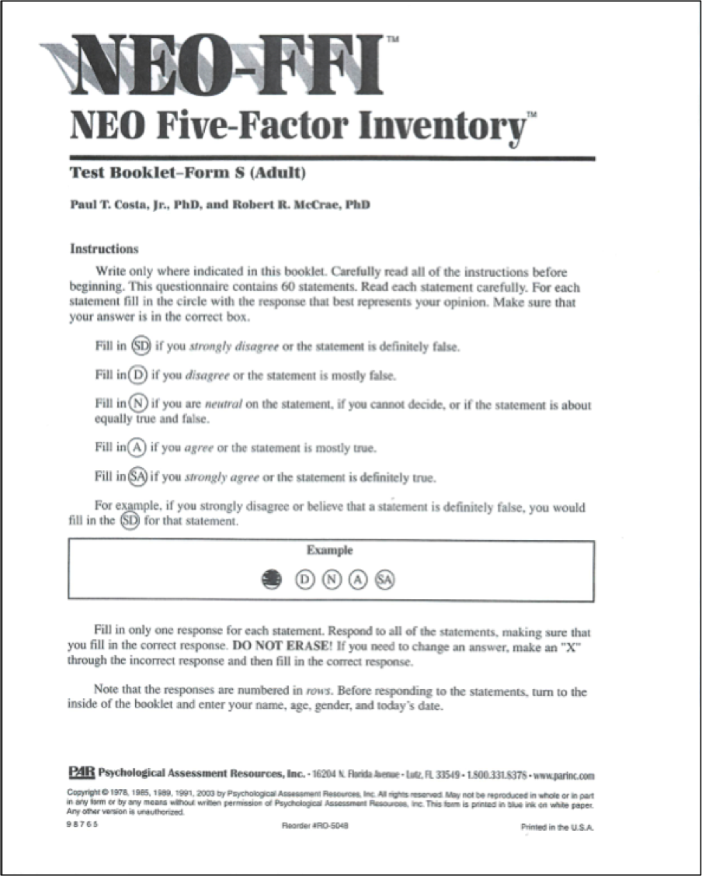
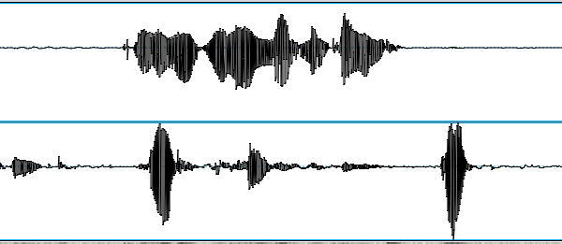
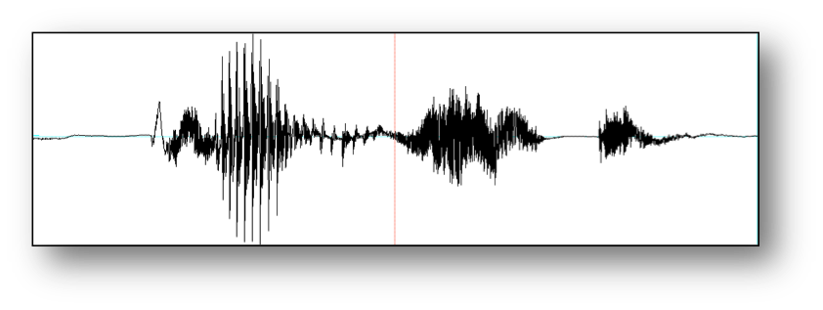
Our CxC Experiment
NEO-FFI
Survey
Background
survey
Lying game
Biographical
Questionnaire
Baseline sample

Slide 25
Our CxC Experiment
NEO-FFI
Survey
Background
survey
Lying game
Biographical
Questionnaire
Baseline sample

Slide 26
Our CxC Experiment
NEO-FFI
Survey
Background
survey
Lying game
Biographical
Questionnaire
Baseline sample

Slide 27
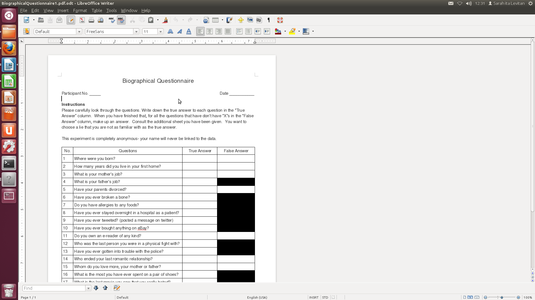
Biographical Questionnaire

Slide 28
Our CxC Experiment
NEO-FFI
Survey
Background
survey
Lying game
Biographical
Questionnaire
Baseline sample

Slide 29
Our CxC Experiment
NEO-FFI
Survey
Background
survey
Lying game
Biographical
Questionnaire
Baseline sample

Slide 30
Our CxC Experiment
NEO-FFI
Survey
Background
survey
Lying game
Biographical
Questionnaire
Baseline sample

Slide 31
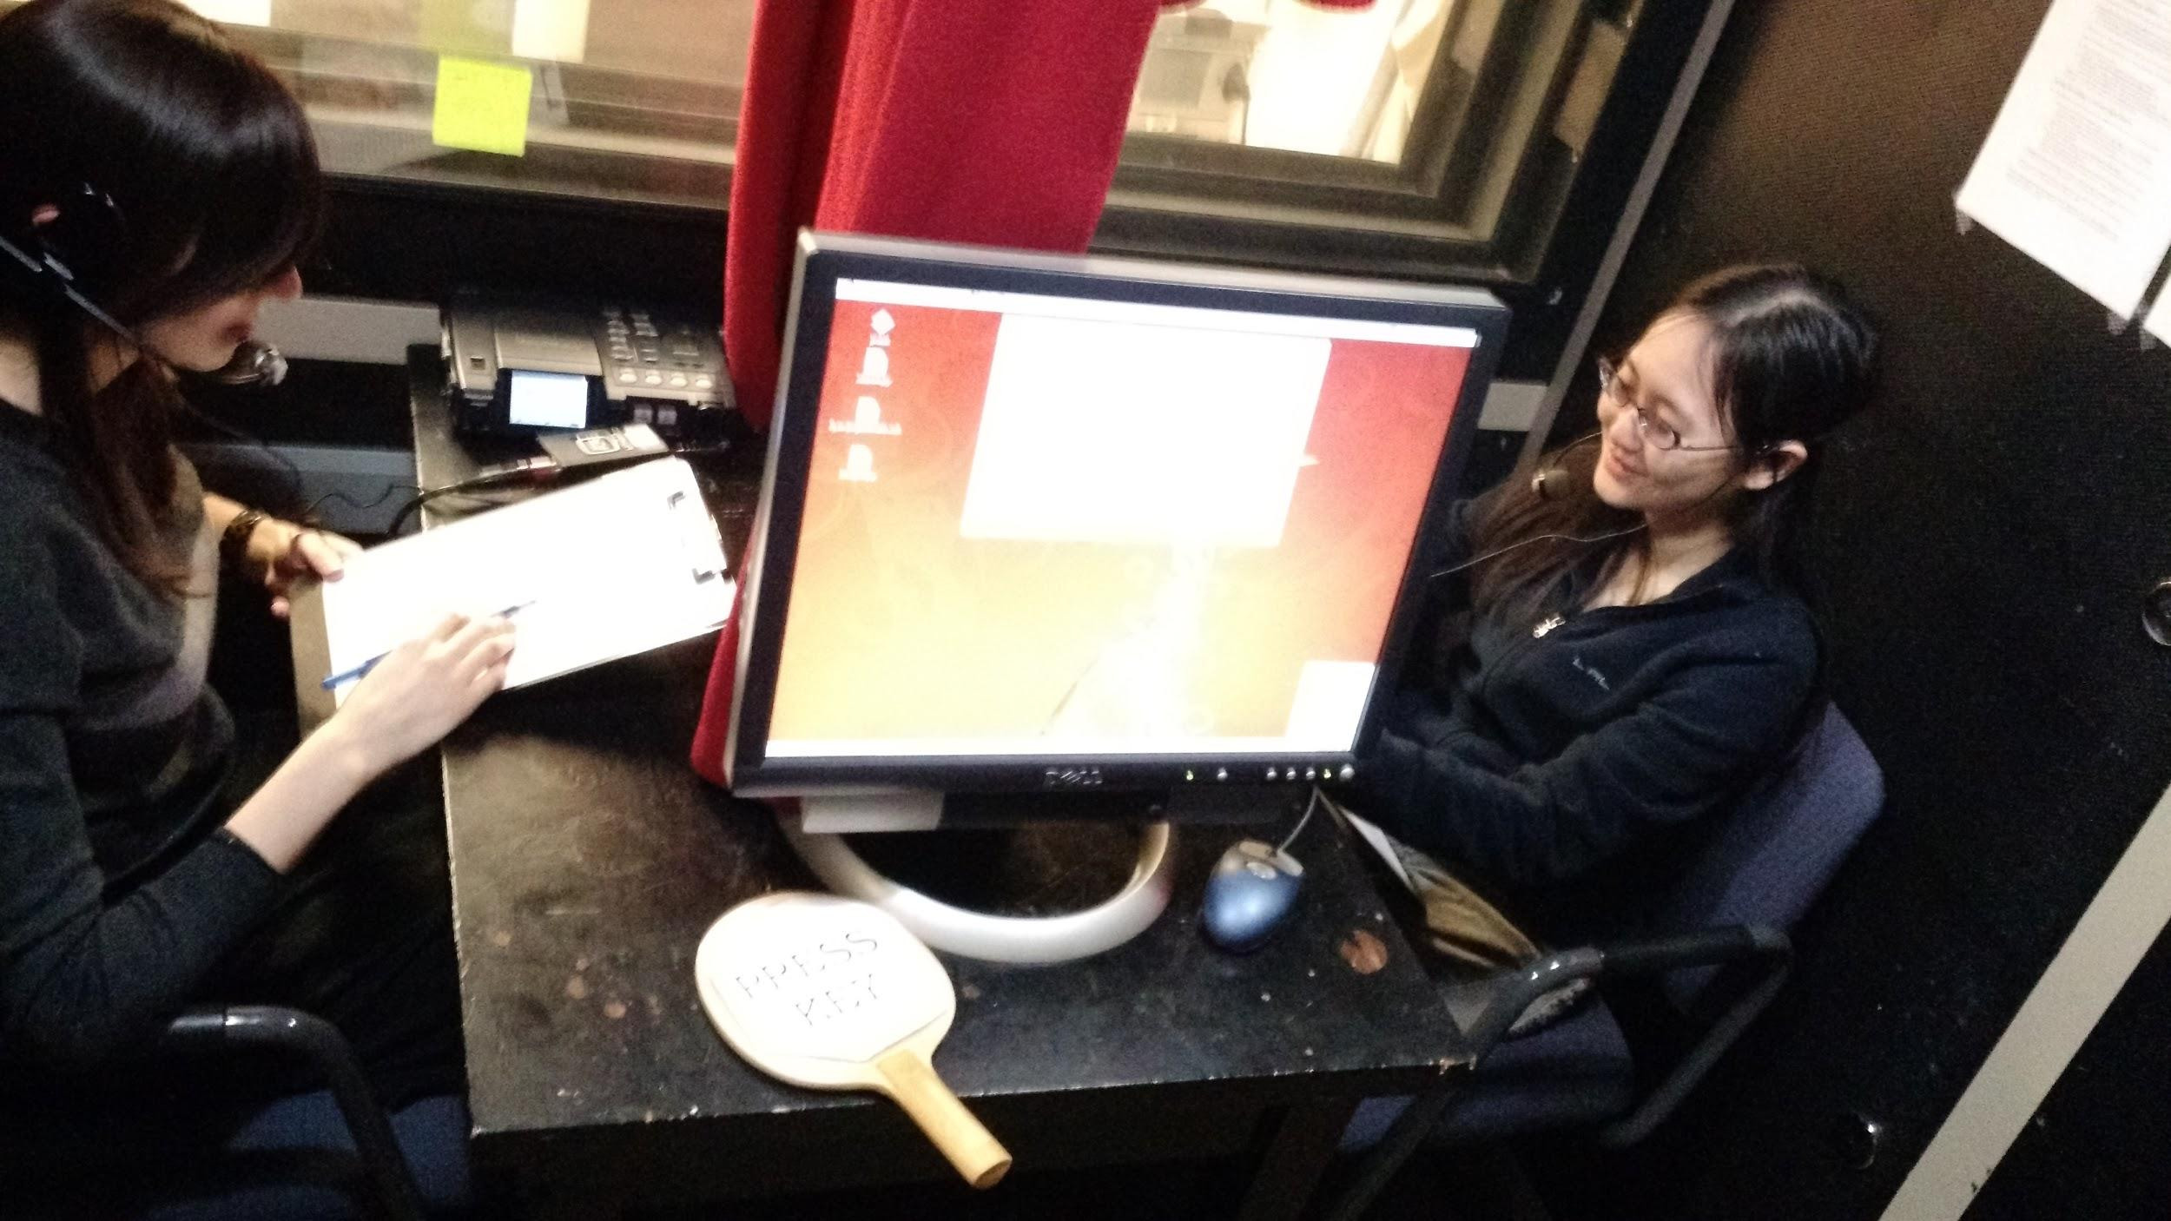
Our CxC Experiment

Slide 32
Our CxC Experiment
NEO-FFI
Survey
Background
survey
Lying game
Biographical
Questionnaire
Baseline sample

Slide 33
Scoring and Motivation
Success
  Ability to lie -> as interviewee, number of lies believed true by interviewer
  Ability to detect lies -> as interviewer, number of correct guesses for truth and lie
Note: $1 added or subtracted for each right or wrong decision

Slide 34

Example: “Where were you born?”
True or False?
Notes:
“I was born in Oakland California, but… I moved to LA like a few years, when I was like in third grade… or right before third grade.”

Slide 35
Example: “Where were you born?”
False!
Notes:
“I was born in Oakland California, but… I moved to LA like a few years, when I was like in third grade… or right before third grade.”

Slide 36
Annotation
Transcribed using Amazon Mechanical Turk
  5 Turkers per utterance, combined using Rover techniques
Automatically segmented using Praat into Inter-Pausal Units (IPUs) at 50ms silence
Automatically aligned with speech and truth/lie labels using aligner built with Kaldi

Slide 37
Rover Example
Index | 1 | 2 | 3 | 4 | 5 | 6 | 7 | 8 | 9 | 10
1 | its | really | fun | um | I | go | like | to | a | place
2 | its | really | fun |  | i | go | like |  | a | place
3 | it’s | really | fun | um | I | go | like | to | a | place
Rover output | its | really | fun | um | I | go | like | to | a | place
score | 1 | 1 | 1 | 2/3 | 2/3 | 1 | 1 | 2/3 | 1 | 1
ROVER Score = (1+1+1+2/3+2/3+1+1+2/3+1+1)/10=0.9
Notes:
Threshold for non-correction 7

Slide 38
Corpus
Two current versions:
  Balanced corpus: 140 pairs; 112h speech
  Larger corpus: 172 pairs; 122h speech
  Largest existing cleanly recorded corpus of deceptive/non-deceptive speech

Slide 39
Correlations: Deceptive Ability & Deception Detection
People’s ability to detect deception correlates with their ability to deceive r(280) = 0.12, p = 0.05
  Ability to lie -> as interviewee, # lies believed true by interviewer
  Ability to detect lies vs. truth -> as interviewer, # correct guesses for truth or lie
Holds across all subjects but strongest for females r(140) = 0.24, p = 0.005
Notes:
*changed this slide
1)updated statistical values
-- note: same overall finding
but now no diff if women broken up by language (significant for BOTH English speaking females and Mandarin speaking females)
-- the change in this finding makes sense to me because it must have been always due to being female and not the native language spoken

Slide 40
Correlations: Gender, Ethnicity, Personality & Ability to Deceive
Extraversion is significantly negatively correlated with ability to deceive for English males r(70) = -0.24, p = 0.04
Tendencies for
  Chinese/female extraversion positively correlated with ability to deceive
  American/female conscientiousness negatively correlated with ability to deceive
Notes:
*changed this slide
updated stat for English/Male
Took out:
a) Chinese/female extroversion and ability to deceive – now not significant
-- a bit confusing because the sample size is the same as before, just a slightly different group of participants. But before the p = .03 which maybe isn’t very strong for a correlation
b) English/female conscientiousness and ability to deceive is now marginal
-- we know if sample increases then p=.04…although that isn’t very strong for a correlation

Slide 41
Gender, Ethnicity, Personality & Deception Detection
No effect of personality factors in deception detection found so far
  Contra earlier findings for English speakers (Enos et al ’06)
  But this is real-time detection vs. later judgments
  Working on better ways representations
    Clustering using all factors
    Quantizing raw scores: high, medium, low
Notes:
F. Enos, S. Benus, R. Cautin, M. Graciarena, J. Hirschberg, and E. Shriberg, “Personality factors in human deception detection: Comparing human to machine performance.” Interspeech 2006. Pittsburgh.

Slide 42
Confidence in Judgments
Ability to detect deception negatively correlates with confidence in judgments for all subjects r(278) = -0.15, p = 0.01
  Strongest for females r(140) = -0.25, p = 0.003
Ability to deceive negatively correlated with confidence for males r(138) = -0.17, p = .05
  Strongest for Chinese males r(70) = -0.27, p = 0.02
Less confident interviewers may ask more follow-up questions and obtain more evidence for decisions?
Notes:
Some interesting correlations with confidence reported in individual judgments of truth/lie
The findings on this slide are for average confidence. I did not include the findings with confidence in judgments (post-experiment questionnaire) as I think that will make it too confusing and seem like we are fishing for findings.

Slide 43
Personality Factors and Confidence
Neuroticism negatively correlates with confidence for Chinese female subjects r(70) = -0.29, p = 0.02
Openness to experience negatively correlates with confidence for all subjects r(277) = -0.14, p = 0.02
  Strongest for females r(140) = -.20, p = 0.02
  Strongest for Chinese females r(70) = -0.29, p = 0.02

Slide 44
Classification Results (Unbalanced Corpus)
Features (z-score normalized):
  Acoustic features: f0, intensity, voice quality, speaking rate – raw and normalized 2 ways
  Gender: subject and partner
  Ethnicity: subject and partner
  Personality scores
  Lexical features not yet available for entire corpus
Weka experiments
  J48 decision trees
  Random Forests
  Bagging
Notes:
Session norm: z-score normlization across entire session
Baseline norm: same calculation using means and sd’s of baseline speaker collection
Random Forests: multiple decision trees trained on random subject of features: majority vote
Bagging: uniformly sampling from training data with replacement and training multiple modes: majority vote -- avoid over-fitting by reducing variance

Slide 45
Classification Results
Model | Raw | SessionNorm | BaselineNorm
J48 | 59.89 | 62.09 | 62.19
Bagging | 58.65 | 61.19 | 61.01
RF | 61.23 | 63.03 | 62.79
Baseline accuracy: 59.9%
Notes:
Two different speaker normalization approaches:
Session norm: z-score normlization across entire session
Baseline norm: same calculation using means and sd’s of baseline speaker collection

Slide 46
Added Features
Speaker gender
Speaker native language
NEO-FFI personality scores

Slide 47
Adding Gender, Ethnicity and Personality Features (SessionNorm)
Model | Acoustic/prosodic | Acoustic/prosodic +gender/ethn/NEO
J48 | 62.09 | 64.86
Bagging | 61.19 | 63.9
RF | 63.03 | 65.86
Majority class baseline accuracy: 59.9%
Notes:
Better than results on CSC corpus with acoustic features only (61.5% accuracy – with baseline of 60.2% predicting true)

Slide 48
Other Questions
Once you have a corpus….what other questions can you investigate?
Notes:
START AT SLIDE 43 FROM IGERT SLIDES

Slide 49
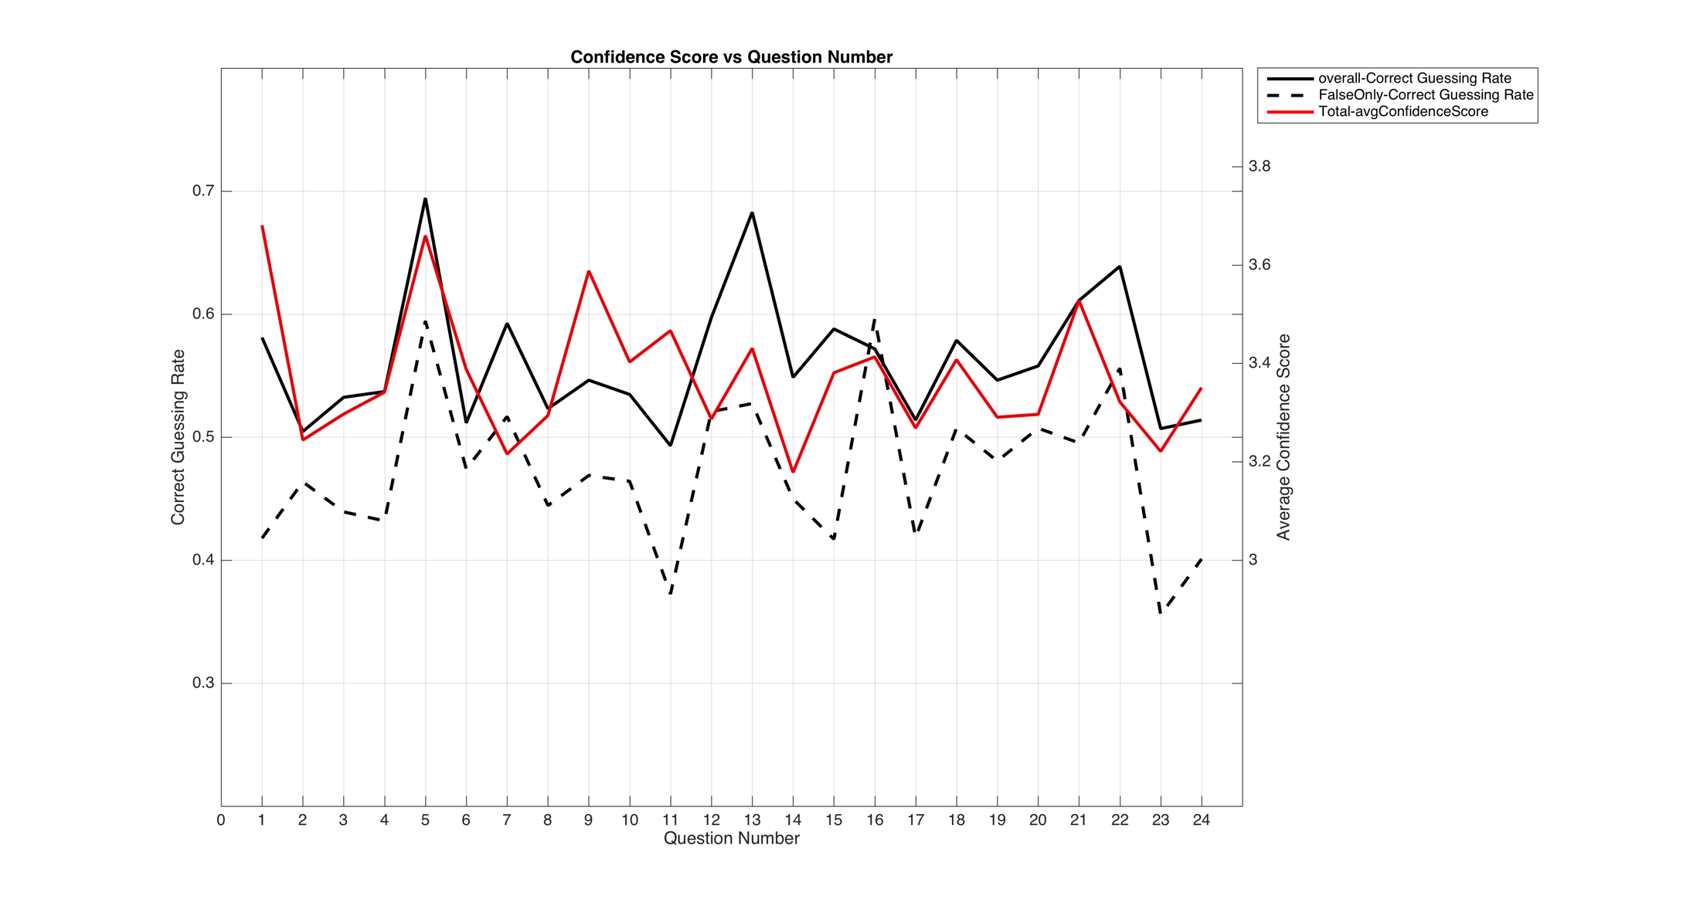
Interviewer Correctness and Confidence by Question
Notes:
We've started to examine whether question type is a factor in predicting deception:
Solid black line: overall correct truth/lie interviewer judgments (mean %); Dotted black: overall correct guess of lie %; Red line: Mean confidence self rating on truth/lie decisions
Peaks (easy?0): 5 (parents divorced), 13 (trouble with police), 22 (own a cat), 16 (most paid for pair of shoes)
Dips (hard?): 11 (own an e-reader), 15 (who do you love most?), 17 (last movie you hated), 23 (watched a person or pet die)

Slide 50
Which Question Types are Most Difficult?
Yes/no vs. open-ended questions
  Do you own an e-reader of any kind?
  Who ended your last romantic relationship?
Sensitive (intrusive, threat of disclosure, social desirability) vs. non-sensitive
  Who ended your last romantic relationship?
  Do you own an e-reader of any kind?
Notes:
Which are harder/easier to lie about or to detect lies?
Definitions: “Survey questions about drug use, sexual behaviors, voting, and income are usually considered sensitive; they tend to produce comparatively higher nonresponse rates or larger measurement error in responses than questions on other topics… There are three distinctive meanings of the concept of sensitivity: intrusiveness, threat of disclosure and social desirability”

Slide 51
Current Findings
All interviewers better at guessing T/F for yes/no questions than for open-ended questions
  Only English interviewers detected lies to ynq’s better than to open-ended questions
  Many differences in pair types wrt detecting lies to ynq’s (e.g. English females did better when interviewing Mandarin males than English males)
All interviewers detected T/F better in sensitive questions than non-sensitive, with some differences for pair types
Notes:
Yes/no questions easier to detect lies in than open ended questions
t-test: rateCorrectGuess for all interviewers
mean in group yesno : 0.5827273
mean in group open : 0.5466450
t = 2.7983, df = 557.85, p-value = 0.005315
t-test: rateCorrectGuess_lie for english interviewers
mean in group yesno : 0.5229082
mean in group open 0.4630385
t = 2.1894, df = 274.18, p-value = 0.02941
Sensitive questions easier to judge than non-sensitive
t-test: rateCorrectGuess for all interviewers
mean in group sens : 0.5961735
mean in group insens : 0.5487819
t = 3.5233, df = 534.02, p-value = 0.0004628

Slide 52
Baseline Interviews & Personality Predictions
3-4m pre-experiment interviews between subject and experimenter to use for normalizing interview data
Can we detect gender, ethnicity, personality types and even ability to lie or detect lies from this data alone?
Notes:
Some current results for usefulness of baseline interviews we collected just for norming interviews.
As you read about in the article assigned by Guozhen, this data set was also used to assess whether personality can….

Slide 53
Baseline Interview
Tell me how you decided to come to Columbia.
What are your favorite things to do in New York City?
What do you like the most about living in New York City?
What do you like the least about living in New York City?
Describe a typical weekend for you, from Friday night through Sunday night.
What was the best food you ever ate, where did you have it, and what made it so good?
Where was the last place you traveled, and what are some things you did while you were there?
What was the last movie you saw, and what was the premise of it?
Besides work or school, what do you do with your time?
What did you do this past summer?

Slide 54
Findings
3-4 minutes of ’normal’ speech turn out to yield good classification of ethnicity, gender, and success at deception detection, with some success at predicting NEO-FFI personality scores as well
Promising results for future work on classifying speakers from small amounts of ‘normal’ speech
Notes:
Provides a reliable way of identifying ethnicity, gender, and even success at detecting deception (altho not at deceiving)
Also predicts self-reported NEO-FFI personality scores well

Slide 55
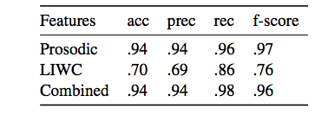
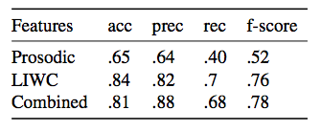
Gender Classification
Baseline: 61% female
f0 is the best feature
Useful LIWC categories: ‘anger’, ‘money’, ‘certainty’ -> male
Native Language
Baseline: 57% English
Useful LIWC categories: ‘apostrophe’ -> English (contractions)
‘dash’ -> Mandarin (false
starts)
Notes:
LIWC is a useful feature, even though everyone is answering the same questions

Slide 56
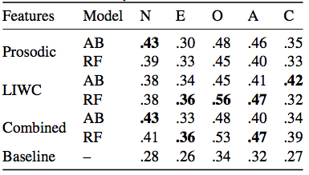
Personality Classification (F measure) (f1)measures)
Binning: high, medium, low for each factor, based on population means
Compare AdaBoost and RandomForest classifiers
Useful LIWC categories:
  Neuroticism: ‘power’, ‘money’
  Extraversion: ‘drives’, ‘focusfuture’
  Openness to experience: ‘interrogation’, ‘focuspast’
  Agreeableness: ‘social’, ‘assent’
  Conscientiousness: ‘work’, ‘time’
Notes:
Best results for openness to experience, worst for extraversion

Slide 57
Success at Deception Detection Ability
Baseline for ability to detect deception : 52%
  AdaBoost, prosodic + LIWC features: 61%
  Adding knowledge of gender, native language, personality: 65%
  Useful features: ‘focuspresent’, speaking rate
Currently unable to predict success at deception production above chance – but not yet using full set of lexical features

Slide 58
Other Questions
Is laughter in deceptive speech produced differently from laughter in non-deceptive speech?
Do people who entrain to their interlocutors detect deception better? Deceive better?
Do acoustic-prosodic and lexical features that predict deception differ across cultures?
Notes:
Implemented: pitch, energy, gender, ethnicity, NEO-FFI
Will discuss deception detection and trust in 2 weeks

Slide 59
Next Class
Emotional speech

