Slide 1
Intonation and Computation: Emotion
Julia Hirschberg
LSA 2017
julia@cs.columbia.edu

Slide 2
Announcement in Canvas about experimental procedures
Has everyone selected their article for presentation?
Discussion questions?
Any recordings?

Slide 3
Emotion and Speaker State
A speaker’s emotional state provides important and useful information
To recognize (e.g. anger/frustration in IVR systems)
To generate (e.g. any emotion for games)
Many studies have shown that acoustic information helps convey/identify ‘classic emotions’ (anger, happiness,…) with some accuracy
Similar approaches have been take to recognize other speaker states
Confidence vs. uncertainty in tutoring systems
Medical diagnosis e.g. depression, schizophrenia
Deception
Notes:
We have much practical motivation for detecting a speaker’s emotional state. There are other types of speaker state that may be important to model. Can prosody help us with these as well?

Slide 4
Interspeech Paralinguistic Challenges (2009--)
2009: Emotion (5)
2010: Age; Gender; Degree of Interest
2011: Intoxication; Sleepiness
2012: Personality; Likability; Pathology
2013: Social Signals (laughs, fillers); Degree of Conflict; Emotion (18); Autism
2014: Cognitive Load; Physical Load
2015: Degree of Nativeness; Parkinson's Condition; Eating Condition
Notes:
There have been many important studies of the role of prosody in defining a speaker’s emotional state: in IVR systems supporting travel arrangements, call centers. Other studies have investigated emotional speech more broadly, in meetings (irony, amusement) and in daily life in general.

Slide 5
Basic Emotions
6 basic emotions (Ekman):
Happiness, sadness, fear, anger, surprise & disgust
Universal and easily recognized
Some disagreement across the field as to number and types of emotions
Recent survey by Ekman shows greatest consensus across 5 universal emotions
Ekman’s Atlas of emotions (an interactive guide to human emotions)
For each emotion, there is a subset of emotional states, triggers, actions and moods
Notes:
Some classic work in psychology of emotions has argued for six basic emotions of happiness, sadness, fear, anger, surprise and disgust
From Ekman’s website:
(If there is time, refer to: Inside Out navigates through the minds of Riley and her parents, as they experience five different emotions: anger, sadness, disgust, fear, and happiness.)
MOODS: longer-lasting cousins of an emotion that cause us to feel the related emotion repeatedly without any clear trigger. (from website)

Slide 6
Plutchik’s Wheel
Notes:
https://en.wikipedia.org/wiki/Contrasting_and_categorization_of_emotions

Slide 7
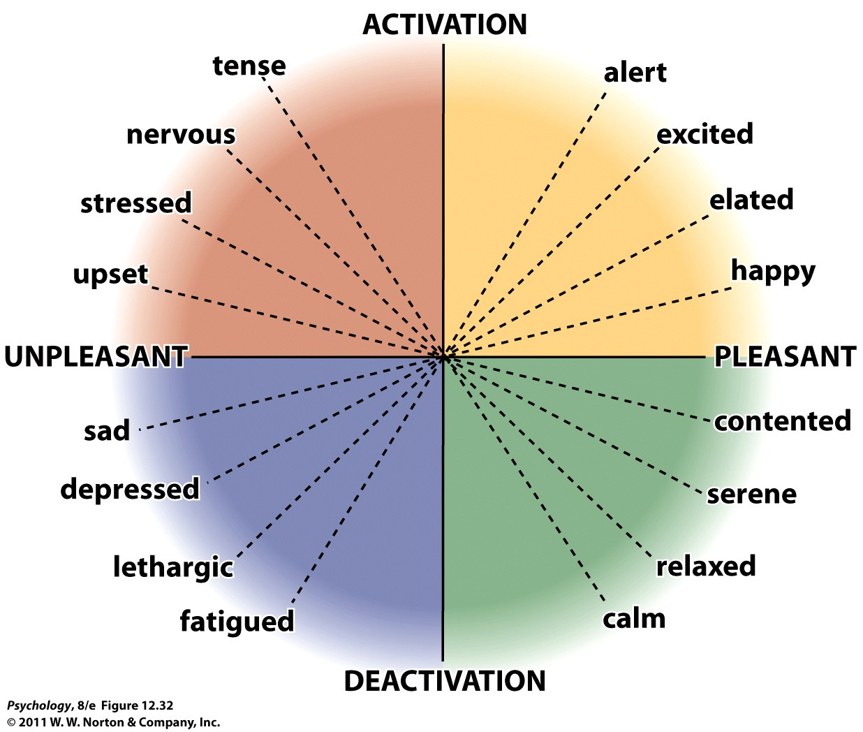
Notes:
The two major dimensions of emotional experience:
pleasantness
activation
Dimensions can be thought of as affects – feeling associated with emotion, independent of the object

Slide 8
Play Some Recorded Examples

Slide 9
Theories of Emotion
Emotions are a mix of:
physiological activation
expressive behaviors
conscious experience

Slide 10
Emotions and the Autonomic Nervous System
During an emotional experience, our autonomic nervous system mobilizes energy in the body that arouses us.
Notes:
Preview Question 2: What is the link between emotional arousal and the autonomic nervous system?

Slide 11
James-Lange Theory
William James and Carl Lange proposed a theory opposed to the common-sense view.
The James-Lange Theory:
Physiological activity precedes the emotional experience.
Notes:
OPPOSING COMMON SENSE VIEW:
Jamesian – bodily changes are automatic. Then we put a label on them, which is an emotion.
emotions arise from our bodily reactions
Stimuli → ANS → emotion
there is a unique pattern of physiological responses that leads to each unique emotion

Slide 12
Cannon-Bard Theory
Walter Cannon and Phillip Bard questioned the James-Lange Theory.
The Cannon-Bard Theory:
Both emotion and the body's arousal take place simultaneously.
Notes:
both emotion and bodily reaction are caused by brain activity triggered by a stimulus
Reasoning:
ANS reacts too slowly in some cases (e.g., blushing takes 15-30 sec to occur yet you feel embarrassed before that)
Often people cannot detect ANS changes
Nonemotional stimuli (e.g., temperature) can cause same changes in ANS yet doesn’t make us feel angry
Not enough unique patterns of ANS

Slide 13
Two-Factor Theory
Stanley Schachter and Jerome Singer proposed yet another theory.
The Schachter-Singer Theory:
Our physiology and cognitions create emotions.
Emotions have two factors–physical arousal and cognitive label.
Notes:
View these theories in contrast to:
Social theories -- conscious experience; we then label the experience as a certain emotional state
emotion arises from the way we interpret our bodily reactions
And then label them
In this case, you can interpret the same physiological reaction to all emotional stimuli, but you do so based on the specific occasion
Some evidence to support:
One study showed that when exercising, you find attractive people more attractive, annoying people more annoying
WHY??
- you are interpreting your exercised induced arousal as attention or annoying or funny depending on the context.
- shows that people make inferences about the causes of their arousal based on the context, and not necessarily the actual cause
However, research has shown that there are unique bodily responses for an emotional experience (see next slide)

Slide 14
Physiology of Emotion
Notes:
So what is this telling us??
1)….James-Lange correct to say a pattern of physiological response for an emotion.
2)….Cannon and Bard were right to say people not perfectly sensitive to them, which is what leads people to sometimes make inferences about what they are feeling.
What we know is the
Interplay between our bodily activity and our mental activity are both causes and consequences of our emotional experience.
The interplay of the 2 is not completely clear.

Slide 15
Acted Speech: LDC Emotional Speech Corpus
happy
sad
angry
confident
frustrated
friendly
interested
anxious
bored
encouraging
Notes:
One useful corpus of acted emotional speech is distributed by the LDC: 8 speakers, 15 emotions, semantically neutral utterances.

Slide 16
Natural Speech (thanks to Liz Shriberg, SRI)
Neutral
July 30
Yes
Disappointed/tired
No
Amused/surprised
No
Annoyed
Yes
Late morning
Frustrated
Yes
No
No, I am …
…no Manila...

Slide 17
Synthetic Affective Speech
Acapella (2013)
Neutral
Happy
Sad
Bad guy
Laughter
Greg Beller (2009)
Shiva Sundaram (2007)
Notes:
The readings focused on emotion recognition from text and speech. Motivated by the readings and the excellent class discussions, let’s talk about some decisions that we make in emotion recognition. We’ll focus on speech.

Slide 18
Elicited Emotion
“A framework for eliciting emotional speech: capitalizing on the actor’s process” (Enos & Hirschberg, 2006)
How do real actors produce emotions
Scenario approach
Script approach
Notes:
Scenario:
char description
Situation description
Goal of the actor
Text to accomplish the goal
Descriptions of other characters involved
Script:
Use existing well-crafted scripts
Can validate the data before using: ask judges to rate scenario or script for emotional content
Or, construct scenario based on actual subject experience
e.g. ISEAR project – people reported situations where they experienced a major emotion, and how they reacted
Does Mohammed et al’s approach fall into any of these categories? It’s natural emotion, but self-labeled, so should be ideal. But there are some problems with that approach too!
Many decisions to make, none are clearly right or wrong. Depends on the goal.
-> once we have data, we extract features

Slide 19
Decisions in Emotion Recognition
What kind of data should we use?
Acted vs. natural vs. elicited corpora
What can we classify?
“Classic” emotions
Additional emotions
Valence and activation
What features best predict emotions?
What techniques are best for classification?
Notes:
Valence: positive or negative?
Activation: how strongly is it felt (e.g. sad/despair)
Which emotions – domain dependent (e.g. frustration/annoyance -> SDS)
Discussion board – what kind of data, what is the most valid, does intention or perception matter more
Discussion board – big 6 (ekman) vs. 585 vs. valence/activation

Slide 20
What Features Are Useful in Emotion Classification?
Mel frequency cepstral coefficients (MFCCs)
Represents frequencies of the audio spectrum (20-20K Hertz) of human hearing broken in frequency bands
Different representations of prosodic features
Direct modeling via acoustic correlates (pitch, intensity, rate, voice quality) useful for activation
62% average baseline
75% average accuracy
Symbolic representations (e.g. prosody) better for valence
Final plateau contour correlated with negative emotions
Final fall with positive

Slide 21
Distinguishing One Emotion from the Rest: Direct Modeling (Liscombe et al 2003)
Emotion | Baseline | Accuracy
angry | 69.32% | 77.27%
confident | 75.00% | 75.00%
happy | 57.39% | 80.11%
interested | 69.89% | 74.43%
encouraging | 52.27% | 72.73%
sad | 61.93% | 80.11%
anxious | 55.68% | 71.59%
bored | 66.48% | 78.98%
friendly | 59.09% | 73.86%
frustrated | 59.09% | 73.86%
Notes:
Directly modeled acoustic/prosodic features classify emotions like happy and sad with high accuracy; anxiety with lower success. Note that states such as anger, confidence and frustration fall somewhere in the middle. We will compare this performance on acted versions with similar experiments on natural speech.

Slide 22
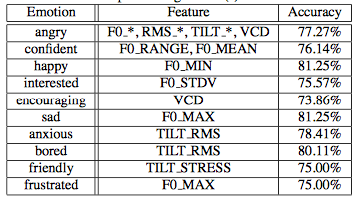
Classifying Subject Ratings of Emotional Speech Using Acoustic Features
Notes:
Best performing features for each emotion (Liscombe et al)
Different features were more useful for different emotions
Critique: acted speech
features

Slide 23
F0 Differentiates Activation
Notes:
It is useful to note where direct modeling features fall short: While mean f0 successfully differentiates between emotions with different valence, so long as they have different degrees of activation…

Slide 24
But not Valence
Notes:
When different valence emotions such as happy and angry have the same activation, simple pitch features are less successful.

Slide 25
Can We Identify Emotions in Natural Speech?
AT&T’s “How May I Help You?” system
Liscombe, Guicciardi, Tur & Gokken-Tur, 2005)
Customers are sometimes angry, frustrated
The Data
5690 operator/caller dialogues with 20,013 caller turns
Labeled for degrees of anger, frustration, negativity and collapsed to positive vs. frustrated vs. angry
Features:
Acoustic/prosodic (direct modeling)
Dialogue Acts
Lexical
Context for each of above
Notes:
In natural speech, the utility of direct modeling of prosodic features to classify emotions is similar to acted speech.

Slide 26
Direct Modeling of Prosody Features in Context
Notes:
We also notice however certain important effects of context which can be captured through direct modeling. Note how, for utterances labeled as positive, there is little change in features such as median pitch, mean energy and speaking rate.

Slide 27
Direct Modeling of Prosodic Features in Context
Notes:
However, for utterances labeled ‘angry’, it is rare that anger emerges suddenly, without some earlier changes in these features. So it seems that acoustic/prosodic context as well as contour type my indeed be useful in identifying a speaker’s emotional state. Note that ML classifications of this data perform quite similarly to experiments on acted speech id’ing anger and frustration, with performance in the mid 70% range.

Slide 28
Derived Emotions: Confidence vs. Uncertainty
The ITSpoke Corpus: physics tutoring (Liscombe, Hirschberg & Venditti 2005)
Collected at U. Pittsburgh by Diane Litman and students
17 students, 1 tutor
130 human/human dialogues
~7000 student turns (mean length ≈ 2.5 sec)
Hand labeled for confidence, uncertainty, anger, frustration
Notes:
One type of speaker state we thought it would be useful to explore was confidence and uncertainty in tutoring systems: if students give the correct answer but are uncertain, the human tutor will address their uncertainty; if they give an incorrect answer with confidence, this is also important for the human tutor to attend to.

Slide 29
A Certain Example
Notes:
Note that responses labeled as certain often exhibit a falling contour, e.g. this downstepped contour.

Slide 30
An Uncertain Example
Notes:
As opposed to uncertainty, which often is uttered with a rising contour and long intervening pauses.

Slide 31
What Features Signal Confidence vs. Uncertainty?
um <sigh> I don’t even think I have an idea here ...... now .. mass isn’t weight ...... mass is ................ the .......... space that an object takes up ........ is that mass?
[71-67-1:92-113]
Notes:
This utterances exhibits evens more features associated with uncertainty: sighs, filled pauses, lexical indicators of uncertainty.

Slide 32
Classifying Uncertainty
Human-Human Corpus
AdaBoost (C4.5) Machine learning algorithm with 90/10 cross-validation
Classes: Uncertain vs Certain vs Neutral
Results:
Features | Accuracy
Baseline | 66%
Acoustic-prosodic | 75%
+ contextual | 76%
+ breath-groups | 77%
Notes:
Again, using direct modeling of acoustic/prosodic features and their context, with obtain results similar to those for emotional speech.

Slide 33
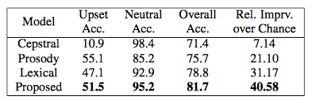
Incremental Emotion Recognition from Speech
Mishra & Dimitriadis, 2013
Real-time emotion recognition – sliding window
3 information streams: cepstral, prosodic, textual
HMIHY AT&T system – Pos/neutral vs. upset
Notes:
Results are comparable to the hand annotated features, showing that this is an effective approach for a deployed system
Benefit of this paper is that the recognition is done using a sliding window of data, so that parts of a user turn can be neutral while parts can be negative
The key is that by doing this incrementally, you have the chance to recognize problems as early as possible, without waiting for the entire turn to be over
People can recognize 5 basic emotions from 300-600 ms (2-3 words)
Anger is easier than others – 365ms
Average intonational phrase – 7-8 words in conversational speech
Don’t need phrase boundaries! Instead use word-based features

Slide 34
Emotion Recognition from Text
Data:
Social Media
Email
Reviews
Notes:
From text – much easier to collect large datasets

Slide 35
Lexicon-based
Use one or several lexical resources
Keyword-based (e.g. WordNet-Affect)
Lexicon-based (e.g. EmotiNet)
Notes:
WordNet-Affect: hierarchy of affective domain labels
EmotiNet
SentiWordNet
Keyword-based – shallow word-level analysis, usually ignores semantic features (e.g. negation)
Lexicon-based – relies on ontology, doesn’t cover everything, doesn’t extend to other langauges

Slide 36
Machine Learning Approaches
Supervised Learning
Requires large labeled corpus
Can we automatically assign emotion labels?
Better results, but domain specific
Unsupervised Learning
No labeled data, possibly ontologies
Flexible – can classify beyond basic emotions
Lower performance (generally)
Notes:
Hasan et al., 2014 – automatic labeled data from twitter – hashtags and emoticons (http://cci.drexel.edu/hi/hi-kdd2014/poster_7.pdf)
Hashtags are used at least once in 15% of tweets (wang et al 2011)
Emotion labels by experts (psychologists) matched hashtag labels in over 87% of tweets
Non expert annotation (psych students) – high agreement (.67 fleiss-kappa) for valence, low (.25) for arousal
Expert annotation – perfect agreement for valence (.84) and substantial for arousal (.64)
Challenges:
tweet can contain multiple emotions (e.g. “starting new job today #nervous #excited”)
Tweet can be sarcastic (e.g. “I love when I can’t find parking #joy”)

Slide 37
Emotions in Text: LiveJournal and WordsEye Image Descriptions
Task: Classify Ekman’s 6: happiness, sadness, anger, surprise, fear, and disgust
Corpora:
300K LiveJournal posts, labeled by authors
660 WordsEye image descriptions, labeled via AMT
+30K Features: TF-IDF of bigrams and emoticons, frequency features, syntactic features, lexical features, sentiment scores (LIWC, SentiWordNet, DAL) and more
Results of 6-way classification: 40% accuracy on LiveJournal posts, 63% on image descriptions
Notes:
TF-IDF: term frequency–inverse document frequency measures how rare are the words in one document compared to their occurrence in a set of documents -- tfidf = tf(t,d) * idf(t,D) – log of # of docs / over total docs containing t
SentiWordNet scores [10, 3]. SentiWordNet: lexical tool for opinion mining. Assigns three scores to every WordNet [13, 12] synset: a positivity score, a negativity score and an objectivity score.
Doc scores computed via the mean scores of every word in the document.
LIWC scores [17]. text analysis tool that calculates 81 language features in several categories including general descriptors, linguistic dimensions, psychological constructs, personal concerns, paralinguistic dimensions and punctuation.
to compute the posemo, uses 406 terms like love, nice, sweet
to compute sad uses 101 words like crying and grief.
Dictionary of Affect scores [18]. lexical tool to measure the emotional meaning of texts.
Assigns activation, evaluation and imagery scores to every word comparing each word to list of 8700+ words rated by their activation, evaluation and imagery.
Score of document is given by the average values of its word scores.
TF-IDF and LIWC most useful features

Slide 38
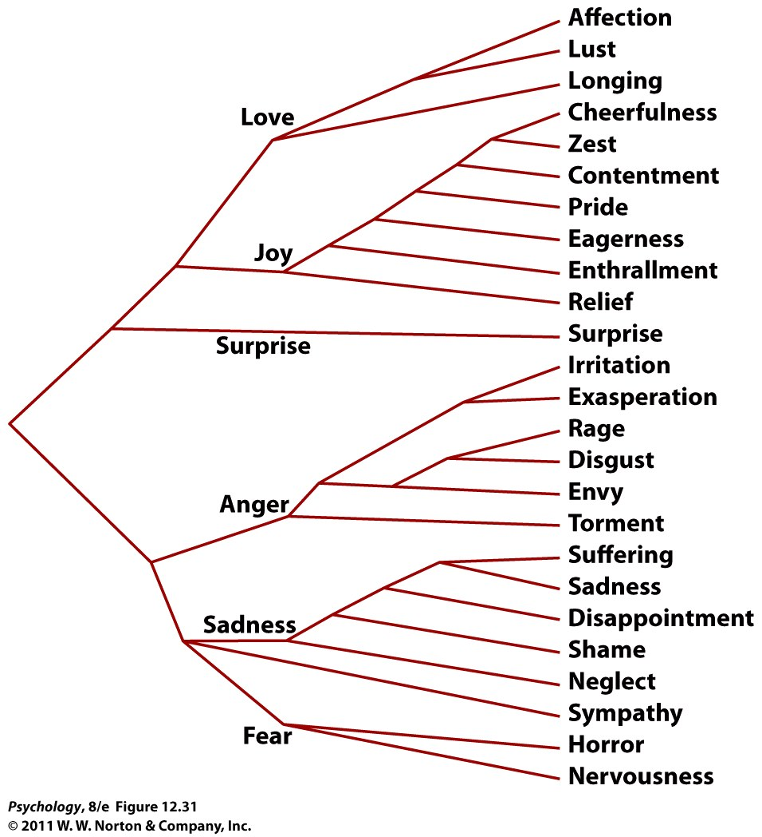
Notes:
Emotions can also be thought of as specific words.
What is also important to note is that the words people use to describe their emotional experiences tend to cluster into small groups of similar words.
And this holds true across cultures.
What are the basic emotions that tend to transverse across people and cultures?

Slide 39
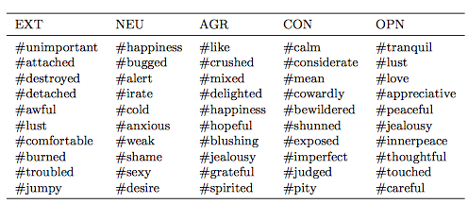
Using Hashtags to Capture Fine Emotion Categories from Tweets
Extrinsic evaluation – personality detection?
Notes:
Facebook dataset: top 10 hashtag emotion categories with highest information gain for personality classification
Question – does this push the definition of “emotion”?

Slide 40
Using Hashtags to Capture Fine Emotion Categories from Tweets (2013)
Saif M. Mohammad and Svetlana Kiritchenko
Kyungnam Kim presents

Slide 41
Tweets as a source of emotion-annotated text
Manual annotation of text with emotions
newspaper headlines, blog sentences
Basic 6 emotions(joy, sadness, anger, fear, disgust, and surprise)
→
Emotion labeled by hashtag(#) from Tweets
Labeled by users themselves
Basic 6 emotions → 585 fine emotions
Extraction through Tweet Archivist(http://www.tweetarchivist.com/)

Slide 42
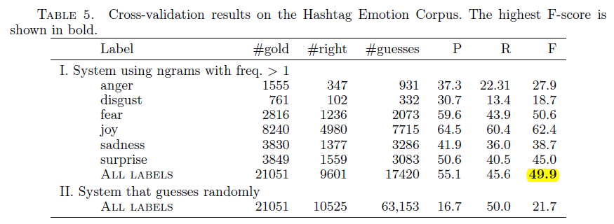
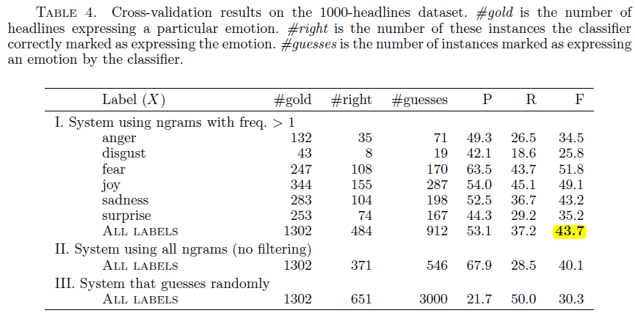
Hashtag Emotion Corpus
Consistency

Slide 43
Hashtag Emotion Corpus
Emotion classification in different domain
When used with target domain as a training data, the performance of classification is enhanced

Slide 44
Hashtag Emotion Lexicon
List of words and associated emotions
Victory → ‘joy’ and ‘relief’
Previous works(Manual)
WordNet Affect(1536 words, 6 emotions)
NRC Emotions Lexicon(14000 words, 8 emotions)
Result of evaluation (classifying emotions)
WordNet< Hashtag < NRC

Slide 45
personality and emotion
“Persistent situations involving emotions produce persistent traits or personality. … Emotions are considered to be more transient phenomenon whereas personality is more constant.”

Slide 46
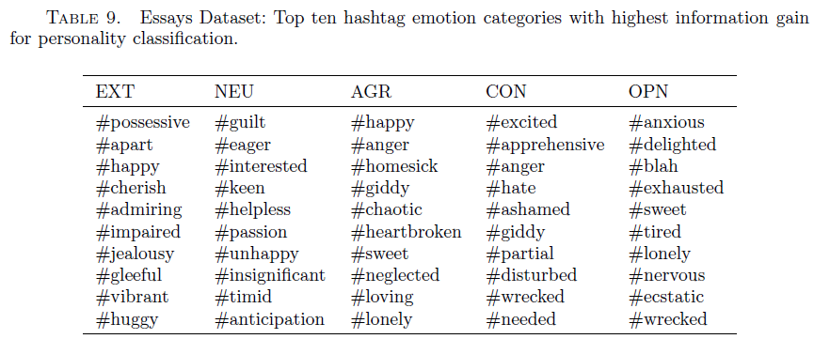
Detecting personality
Specific questionnaires to determine personality(Big 5)
Extroversion
Neuroticism
Agreeability
Conscientiousness
Openness
→
Identifying personality from free-form text
Stream-of-consciousness essays
Collections of Facebook posts
Fine emotion categories useful to determine personality(Big 5)

Slide 47
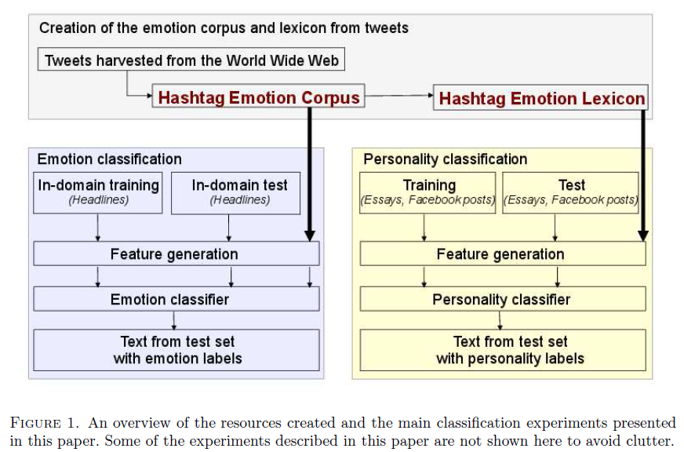

Slide 48
How about using Emoticons?
Goal: augment annotated evaluation corpus with tweets
Works well for anger in English
Does every language have the same set and meanings?
How often do they occur?
What emotions do they represent?

Slide 49
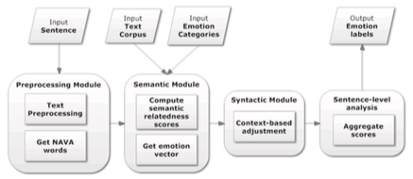
Machine Learning Approaches
Unsupervised Learning using emotion vectors
Agrawal & An, 2012
Notes:
Unsupervised – doesn’t require labeled data or predefined emotion classes – can classify beyond Ekman’s 6 basic emotions
Agrawal & An – completely unsupervised approach, no manually crafted affect lexicons (e.g. WordNet-Affect)
Use Pointwise Mutual Information (PMI) to compute the semantic relatedness which is further en- riched using context-dependency rules
http://www.cs.yorku.ca/~aan/research/paper/Emo_WI10.pdf
Steps:
Preprocessing – sentence parsing, POS tagging, dependency parsing
Word-level analysis – compute emotion vector for affect bearing words by calculating semantic relatedness to emotion concepts
- affect words: “NAVA” – noun adj verb adverbs
- use PMI to compute semantic relatedness
Phrase-level analysis – use context to adjust emotion scores computed in previous step
Sentence-level analysis – aggregates emotion vectors of all relevant words to compute emotion label of the sentence
Results: compared with other unsupervised and supervised approaches across different domains (blogs, dialogues) and found that this approach performs well across domains, different emotion classes. It’s better than other unsupervised approaches and comparable with supervised approaches.

Slide 50
Extract content (NAVA) words from text
Identify syntactic dependencies (e.g. negation, adjectival complements and modifiers)
Use semantic relatedness to compute emotion vector for each NAVA word: if words commonly appear together they must share the same emotion
What words to use as representatives of emotions?

Slide 51
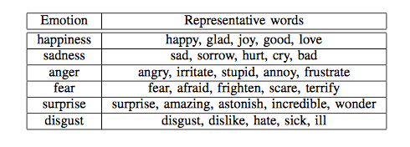
Synonyms for classic emotion labels from a thesaurus, adjusting based on syntactic dependencies, aggregating the NAVA emotion vectors across the sentence and taking the average

Slide 52
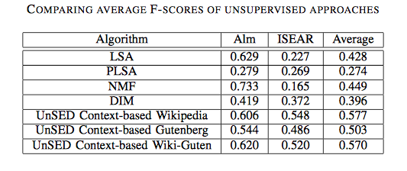
How well does this work?
Comparing unsupervised approaches to UnSED versions on 2 labeled corpora: Alm (fairy tales) and ISEAR (interviews about emotional experiences)
Notes:
UnSED trained on Wikipedia, Gutenberg audio books, or a combination
Does relatively well on fair tale corpus (ISEAR)

Slide 53
What are the Challenges in Recognizing Emotion
What emotion to examine
Anger? Interest?
Is emotion the same across languages?
Labeled training material
Spontaneous or acted
How to get consistent labels
What computational techniques to use
How large is the corpus? (DNNs?)
How cleanly is it recorded (for speech)?
Word embeddings (for text)

Slide 54
Next Class
Charismatic Speech

