Slide 1
Techniques for Emotion Classification
Kaushal N Lahankar
Oct 12,2009
COMS 6998

Slide 2
Topics covered
Describing the emotional states expressed in speech
Identification of Confusion and Surprise in Spoken Dialog using Prosodic Features
Emotion clustering using the results of subjective opinion tests for emotion recognition in Infants’ cries

Slide 3
Describing the emotional states expressed in speech
Emotions are not easily captured in symbols.
A suitable descriptive system for emotions does not exist as of yet.
Objective - To encourage the speech community towards standardization of key terms and descriptive techniques.

Slide 4
Emotion (WSD) from a philosophical point of view
Fullblown emotions – Natural discrete units which can be counted and possess distinct boundaries.
Is it worth researching? Can emotions be treated as tangible states distinguishable from each other?
Emotional states - An attribute of certain states. E.g. – “Her voice was tinged with emotion”.
Intangible and difficult to quantify , but definitely worth researching
These distinctions exist to that the domain and the scope of the research can be determined and to ensure that there is scope for research on one objective to support research on the others.

Slide 5
Cause and effect type descriptors
Cause type – The type of description that identifies the emotion related internal states and external factors that caused a person’s speech to have particular characteristics.
Effect type – This type of description would describe what effect the characteristics mentioned earlier would be likely to have on a typical listener.
Cause type descriptors ultimately tend to focus attention on the physiological systems which can be used to describe emotions.
Effect type descriptors favor describing emotional states in terms of categories and dimensions that people find natural.

Slide 6
Basic emotion categories
Basic or primary emotions – Few emotional states which are pure and primitive in a way that the other are not. E.g. – The big six (Ekman)–
  Fear, anger, happiness, sadness, surprise,disgust
Second order emotions – The emotional states that are not so basic can be termed as second order emotions.

Slide 7
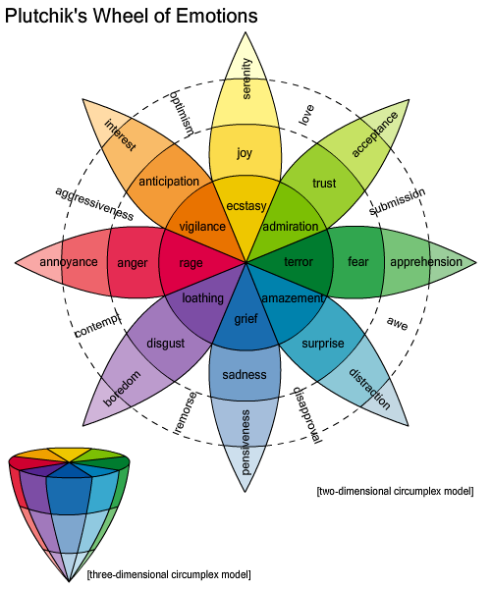
Wheel of emotions
More information

Slide 8
Complementary representation
Need to come up with a complementary representation that offers ways of drawing fewer, grosser distinctions to make things such as acquiring speech co-relates manageable.
Feeltrace might be such a system?

Slide 9
Emotion related states
emotion-proper property : An emotion-proper property is the property that is proper to, or ‘belongs to’, a type of emotion. . For example, being frightening is the emotion-proper property for fear
Emotion terms are surrounded by terms that bear resemblance with the terms in spite of being different on some levels. They are called emotion related terms and the states associated with them are called emotion related states.

Slide 10
The states discussed
Arousal – States of arousal have maximum vocal overlap with emotional proper.
  Problems faced while addressing this issue?
Attitude – “A person who exhibits a particular attitude approaches a situation prepared to find certain kinds of problem or opportunity and to take certain kinds of actions.”
  Similar problems faced.
Any other states?

Slide 11
Emotion and everyday terms
Some words used to describe emotions have a lot of implicit information. E.g. – vengeful
Basic vs Secondary emotions in terms of arousal and attitude.
Other factors involved in description of everyday emotional states?

Slide 12
Biological Representation
It is assumed that descriptions of emotions are surrogates for descriptions of physiological states. So, can we replace verbal descriptions with physiological parameters?
Which theoretical perspective does it seem to follow?
Pros and cons?

Slide 13
Continuous representation
Represent emotions in 2-D space in terms of
evaluation (X axis) and Activation (Y axis).
Dimensions can be increased to represent the relationships which lie very close in the 2-D space.
Pros and cons?

Slide 14
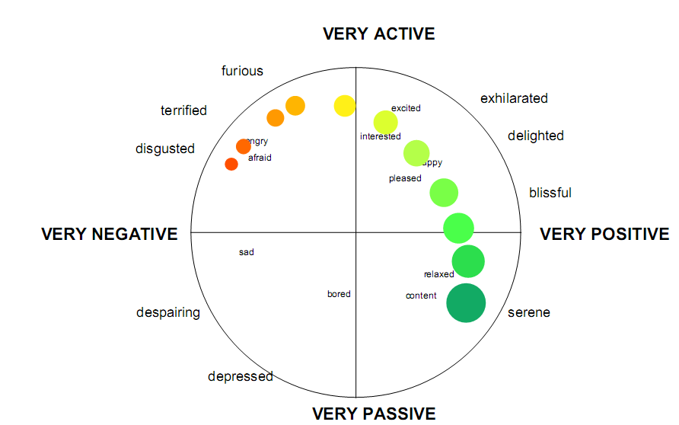
Feeltrace system

Slide 15
Structural models
Cognitive approach of describing emotions
Based on the hypothesis that distinct types of emotion correspond to distinct ways of appraising the situation evoking the emotion.

Slide 16
Timing
For the purpose of speech research, emotions can be analyzed over time and both the short and the long time span can be considered to synthesize as well as to recognize emotional speech, i.e., trainers can be trained on both type of data.
Pros and cons?

Slide 17
Interactions which determine how underlying emotional tendencies are expressed
Restraint
Ambivalence
Simulation

Slide 18
Tools to describe emotion for analyzing it’s relationship with speech
Naturalistic Database – Belfast Naturalistic Database annotated using Feeltrace
Feeltrace -
Basic Emotion Vocabulary -

Slide 19
Discussion
Can a descriptive system which captures everything described in the paper possible?
Which representation would make more sense? In which situations?
Everything described in this paper is concerned with natural emotions. What about simulated emotions?

Slide 20
Identification of Confusion and Surprise in Spoken Dialog using Prosodic Features
Objective – To detect the speaker’s states of confusion and surprise using prosodic features found in utterances.
Previous Work –
  High accuracies in detecting annoyance and frustration using prosodic and language based models trained on data that was manually annotated with categorical labels of emotions.
  Batliner proposed to look for indicators of trouble in communication as indirect evidence of emotional responses from users.

Slide 21
“Innovative experimental paradigm”
In this experiment, self-report questionnaires were used as a gold standard for training classifiers instead of data annotated by experimenters.

Slide 22
Confusion and
Surprise
The authors have related Uncertainty, Lack of Clarity and Inappropriateness to the emotions of Confusion and Surprise.

Slide 23
Methodology
Participants were invited to interact with an SDS.
Every participant was asked a set of 16 questions by the SDS which were meant to elicit emotions of uncertainty, lack of clarity and inappropriateness from the participants.
The participants were asked to rate the clarity of system’s intention, appropriateness of the questions and certainty of their responses on a scale of 0 to 5, 5 corresponding to perfect clarity, appropriateness and certainty in respective cases.

Slide 24
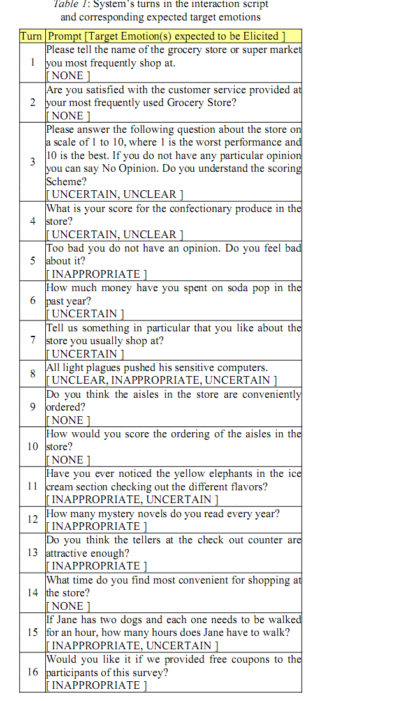

Slide 25
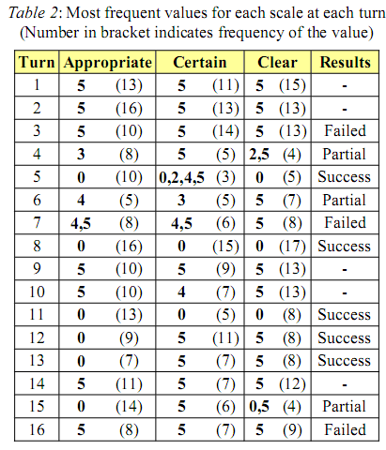
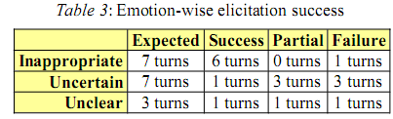
Evaluation of the elicitation

Slide 26

Features used for classification
52 features were used for each of the 257 utterances.
F0 and Power contours with fixed frame size were extracted for each utterance.
Example of an F0 contour for the following file
In the contour, analysis window length = 0.0075s
Frame interval = 0.01s

Slide 27
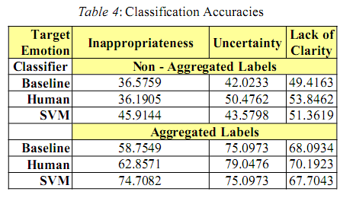
Classification experiments and results
The classifier was trained on the sets of labels
  Non-aggregated labels
  Aggregated labels
Classification accuracies-

Slide 28
Conclusion
Improvement in classification accuracy for both uncertainty and lack of clarity was inconclusive.
The classification accuracy for inappropriateness was higher than the human classification in both the experiments.
An improvement of >27% over the baseline and ≈12% over the human score. Seems too good?

Slide 29
Discussion
Were the selected humans experts?
Does listening to only 105 utterances and classifying them enough?
Only 7 instances of inappropriateness , out of which 6 elicited correctly….enough data?
Uncertainty, lack of Clarity and Inappropriateness were the 3 emotions selected and later, their selection was justified. Could any other emotions such as anger or boredom contribute as well?
Why were only prosodic features used?

Slide 31
Emotion clustering Using the results of subjective opinion tests for emotion recognition in infant’s cries
Objective – To design an emotion clustering algorithm for emotion detection in infants’ cries.
Previous work
  Acoustic analysis of an infant’s cries has been performed.
  Classification between “hunger” and “sleepiness” has been studied.
  Some emotion detection products currently available in the market employ simple acoustic techniques.

Slide 32
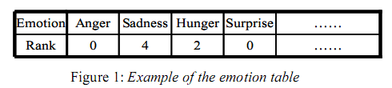
Methodology
Mothers were asked to fill up an emotion table , consisting of 10(!) emotion tags , after recording each cry.
Baby rearing experts were also asked fill up the same table based only on the recorded cries.

Slide 33
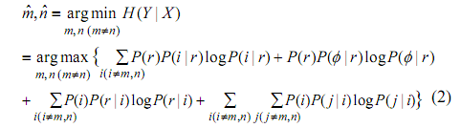
Clustering technique used
Here, an emotion i was selected from a cluster X={e1,…,eI} and j, j≠i was selected from cluster Y={e1,…,e(i-1),eΦ,e(i+1),…eI}.
This is a type of hierarchical clustering where the conditional entropy is the objective function to be minimized.

Slide 34

Emotion recognition
Let a cry z be represented by a series of N acoustic segments.
Using Bayes’ theorem, we can find the probability when the infant utters the sequence z caused by the emotion cluster e the acoustic evidence q will be observed. We can find e and z which maximize the conditional probability to ultimately find the emotional cluster to which the cry belongs to.

Slide 35
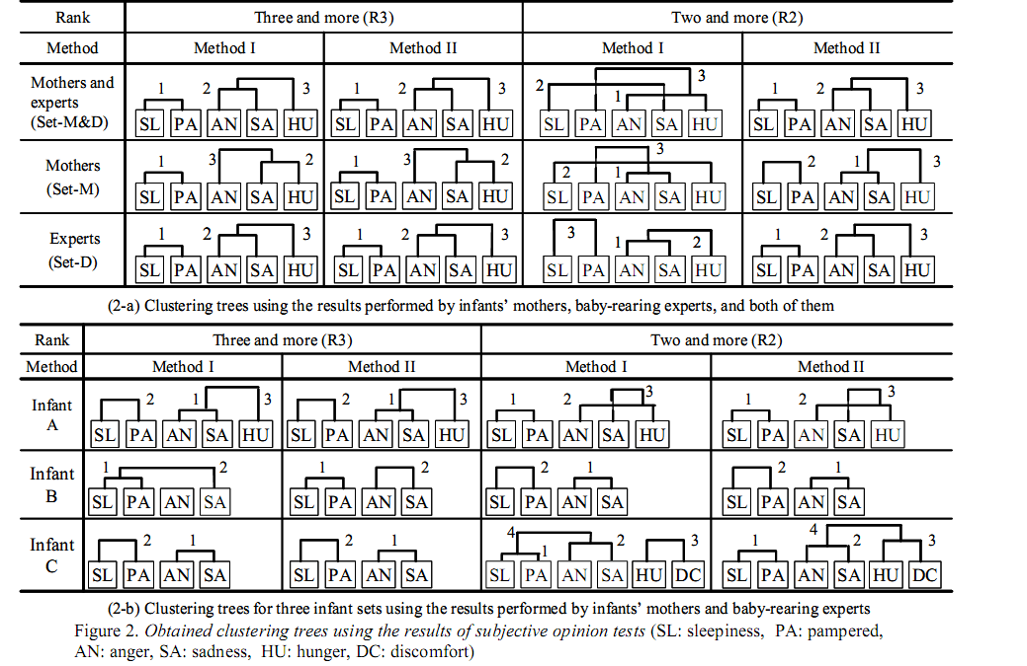
Clustering trees

Slide 36
Discussion
Are 10 emotions actually needed?
Instead of relying on the input from baby-rearing experts, could the inputs from the mothers have been used?
Is the input data reliable?
Improvements?

