Slide 1
Modeling Other Speaker State
COMS 4995/6998
Julia Hirschberg
Thanks to William Wang

Slide 2
Sarcasm
Usage: Often used to express humor or comment
Disbelief?
Cultural differences?
Occurrence: casual conversation
Context: Effect depends on mutual beliefs of all speakers
Applications: Production? Perception?

Slide 3
Tepperman et al 2006
Focus on “yeah right” only
Why?
Succinct
Common sarcastic and non-sarcastic uses
Hundreds in Switchboard and Fisher corpora
Direct contrast of turning positive meanings into negative
Spectral, prosodic and contextual features extracted

Slide 4
Context: Speech Acts
Acknowledgement (showing understanding)
A: Oh, well that’s right near Piedmont.
B: Yeah right, right…
Agreement/ Disagreement
A: A thorn in my side: bureaucratic
B: Yeah right, I agree.
Indirect Interpretation (telling a story)
A: “… We have too many pets!” I thought, “Yeah right, come tell me about it!” You know?
B: [laughter]

Slide 5
Phrase-Internal
A: Park Plaza, Park Suites?
B: Park Suites, yeah right across the street, yeah.
Results
No sarcastic Acknowledgement or Phrase-Internal cases and no sincere “yeah right” in Phrase-Internal
Disambiguating Agreement from Acknowledgement not easy for labelers

Slide 6
Context: Objective Cues
Laughter:
“yeah right” and adjacent turns always contains laughter
Question/ Answer:
“yeah right” as answer seems correlated with sincerity
Position within turn
Does “yeah right” come at the start or the end of speakers’ turn?
Or both? (likely to be sarcastic, since sarcasm usually elaborated by speaker)

Slide 7
Pause (defined as 0.5 second):
Longer pauses, less likely sarcasm
Sarcasm used as part of fast, witty repartee
Gender:
More often male than female?
What other features might indicate sarcasm?

Slide 8
Prosodic and Spectral Features
Prosodic:
19 features, including normalized avg pitch, duration, avg energy, pitch slopes, pitch and energy range, etc.
Spectral:
First 12 MFCC plus energy, delta and acceleration coefficients
2 five-state HMM Trained using HTK
Log likelihood scores of these two classes and their ratio

Slide 9
Manual Labeling of Sarcasm
Corpora: Switchboard and Fisher
Annotators: 2
Task1 (without context):
Agreement: 52.73% (chance: 43.93%, unbalanced classes)
Kappa: 0.1569 (Slight agreement)
Task2 (with context):
Agreement: 76.67% (new chance baseline: 66%)
Kappa: 0.313 (Fair agreement)

Slide 10
Data Analysis
Total: 131 occurrences of “Yeah Right” (30 sarcastic)
Laughter Q/A Start End Pause Male
Sarcastic 0.73 0.10 0.57 0.43 0.07 0.23
Sincere 0.22 0.20 0.94 0.48 0.19 0.51
Data Sparsity
Rockwell 2005 found only 48 examples of sarcasm out of 64 hrs of talk show

Slide 11
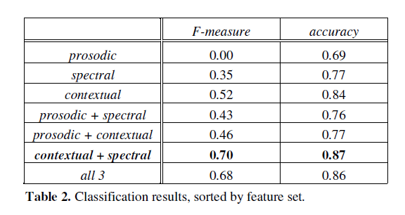
Evaluation
C4.5 CART, using Weka

Slide 12
Conclusions
Totally ignore prosody
Concentrate on contextual information
Future work:
1. Finer-grain taxonomy (eg. Good-natured / Biting)
2. Other utterances besides “yeah right”
3. Acquire more data
4. Visual cues
5. Check more prosodic features (!)

Slide 13
Positive vs. Negative Messages (Swerts & Hirschberg ‘11)
Can prosody predict whether the upcoming msg will convey good or bad news?
Mood assessment and induction
Production study:
Successful or unsuccessful job interview results left in voicemail
Two conditions: actual outcome left vs. call-back msg
Results: Desired mood induced

Slide 14
Perception Study
Initial msgs excised and used as stimuli to rate for ‘followed by good news vs. bad’ in text or in audio
Results:
Result included, significant diffence in +/- for audio but not text only
Results not included, no effect

Slide 15
Prosodic Correlates
Perception tests
Ratings on emotions significant only for those msgs in which job decision included
Reliable correlates of ratings mainly rms features

Slide 16
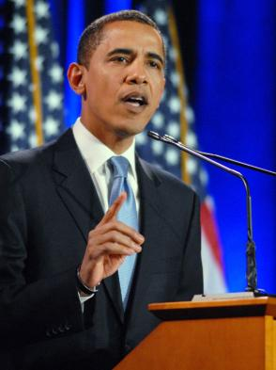
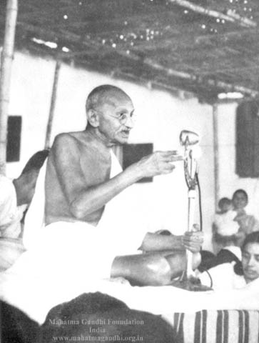
Charismatic Speech
Obama Style
Mao Style
Gandhi Style

Slide 17
Listening Exam
1 | 2 | 3 | 4 | 5
(1) Do you consider the above speeches as charismatic?
(2) Can you figure out who these speakers are?
(2) How different are these speaking styles?

Slide 18
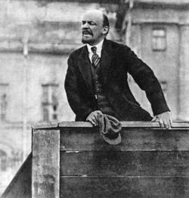
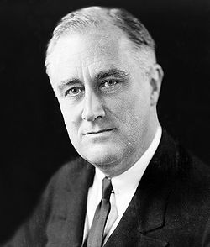
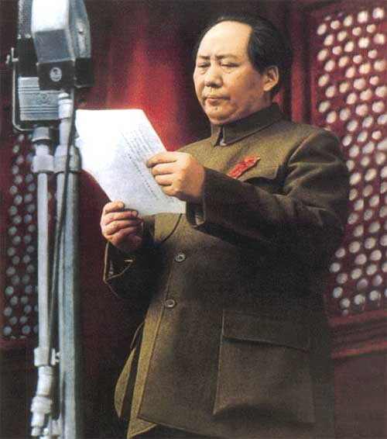
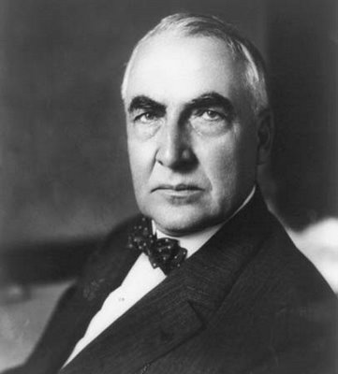
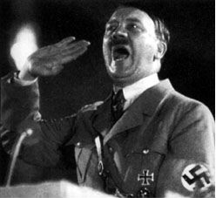
1. Vladimir Lenin
2. Franklin D. Roosevelt
3. Mao Zedong
4. Warren G. Harding
5. Adolf Hitler

Slide 19
Charisma?
Weber ‘47 says:
The ability to attract, and retain followers by virtue of personal characteristics -- not political and military institutions and powers
What features might be essential to charismatic speech?
Acoustic-Prosodic Features
Lexical Features

Slide 20
Why do we study Charismatic Speech?
Probably we can identify future political stars.
Charismatic speech is CHARISMATIC, so we, as ordinary people, are interested in that.
Train people to improve their public speaking skills.
Create TTS systems that produce charismatic, charming and convincing speech. (Business Ad? Automatic Political Campaign?)

Slide 21
Biadsy et al. 2008
Cross-culture comparison of the perception of Charismatic Speech
American, Palestinian and Swedish subjects rate American political speech
American and Palestinian rate Palestinian Arabic speech
Attributes correlate charisma:
American subjects: persuasive, charming, passionate, convincing
Neither boring nor ordinary
Palestinian subjects: tough, powerful, persuasive, charming, enthusiastic
Neither boring nor desperate

Slide 22
Data Source
Standard American English (SAE) Data:
Source: 9 candidates (1F 8M) of 2004 Democratic nomination to US President
Topics: greeting, reasons for running, tax cuts, postwar Iraq, healthcare
Segments: 45 of 2-28s speech segments, mean 10s
Palestinian Arabic Data:
Source: 22 male native Palestinian speakers from TV programs in 2005
Topics: Assassination of Hamas leader, debate, Intifada and resistance, Israeli
separation wall, the Palestinian Authority and call for reforms
Segments: 44 of 3-28s duration, mean 14s

Slide 23
Experiments
First two experiments:
12 Americans (6F 6M) and 12 Palestinians (6F 6M) were presented speech
of their own languages, and were asked to rate 26 statement in a 5 points
scale.Statement are “the speaker is charismatic” and other related statements.
(eg. “the speaker is angry”. )
Following three experiments (native vs non-native speakers perception):
9 (6F, 3M) English speaking native Swedish speakers to do SAE task
12 (3F, 9M) English-literate native Palestinian speakers do SAE task
12(3M, 9F) non-Arabic-literate SAE speakers to do Arabic task

Slide 24
Kappas
SAE speakers on SAE: 0.232
SAE speakers on Arabic: 0.383
It suggests that lexical and semantic cues may lower agreement.
Palestinian speakers on SAE: 0.185
Palestinian speakers on Arabic: 0.348
Swedish speakers on SAE: 0.226
Why kappas are low?
Different people have different definition of charisma
Rating foreign speech depends on subjects’ understanding with the language

Slide 25
Findings
American rating SAE tokens report recognizing 5.8 out of 9 speakers and
rating of these speakers are more charismatic (mean 3.39). It may imply that
charismatic speakers are more recognizable.
2. Other studies are quite low. For Palestinian recognizing Palestinian studies,
0.55 out of 22 speakers. For American recognizing Arabic speakers, 0. For
Palestinian and Swedish recognizing SAE speakers, 0.33 and 0.11
3. Significant figures showed that the topic of the tokens influences the
emotional state of the speaker or rater. (p= .052)

Slide 26
Feature Analysis
Goal: Extracting acoustic-prosodic and lexical features of the charismatic
stimuli and see if there’s something correlate with this genre of speech.
Pitch, Intensity and Token Duration:
Mean pitch (re=.24; rpe=.13; raa=.39; ra=.2; rs=.2), mean (re=.21; rpe=.14; raa=.35; ra=.21; rs=.18) and standard deviation (re=.21; rpe=.14; raa=.34; ra=.19; rs=.18) of rms intensity over intonational phrases, and token duration (re=.09; rpe=.15; raa=.24; ra=.30; rs=.12) all positively correlate with charisma ratings, regardless of the subject’s native tongue or the language rated

Slide 27
Acoustic-Prosodic
Pitch range:
positively correlated with charisma in all experiments (re=.2;rpe=.12; raa=.36;
ra=.23; rs=.19).
Pitch accent:
Downstepped pitch accent (!H*) is positively correlated with charisma (re=.19; rpe=.17; raa=.15; ra=.25; rs=.14), while the proportion of low pitch accents (L*) is significantly negatively correlated (re=-.13; rpe=-.11; raa=-.25; ra=-.24) — for all but Swedish judgments of SAE (r=-.04; p=.4).
Disfluency:
The presence of disfluency (filled pauses and self-repairs) on the other hand, is negatively correlated with charisma judgments in all cases (re=-.18; rpe=-
.22; raa=-.39; ra=-.48), except for Swedish judgments of SAE, where there is only a tendency (r=-.09; p=.087).
(Do you think this may be true when testing on Chinese charismatic speakers?)

Slide 28
Acoustic-Prosodic
Conclusion:
Charisma judgments tend to correlate with higher f0, higher and more varied intensity, longer duration of stimuli, and downstepped (!H*) contours.
Subjects agree upon language specific acoustic-prosodic indicators of charisma, despite the fact that these indicators differ in important respects from those in the raters’ native language.
Other correlations of acoustic-prosodic features with charisma ratings do
appear particular not only to the native language of rater but also to the language rated.

Slide 29
Lexical Features
Features investigated:
For judgments of SAE,
Third person pronoun (re=-.19; rs=-.16), negative correlated.
First person plural pronouns (re=.16; rpe=.13; rs=.14), third person singular pronouns (re=.16; rpe=.17; rs=.15), and the percentage of repeated words (re=.12; rpe=.16; ra=.22; rs=.18) is positively correlated with charisma. Ratio of adjectives to all words is negatively correlated (re=-.12; rpe=-.25; rs=-.17).
For judgments of Arabic,
both Americans and Palestinians judge tokens with more third person plural pronouns (raa=.29; ra=.21) and nouns in general (raa=.09; ra=.1) as more charismatic.

Slide 30
Cross-cultural Rating
Consensus:
The means of the American and Palestinian ratings of SAE
tokens are 3.19 and 3.03. The correlation of z-score-normalized
charisma ratings is significant and positive (r=.47).
The ratings of Swedish (mean: 3.01) and Palestinian (mean: 3.03) subjects
rating SAE and again the correlation between the groups is significant (r=.55),
indicating that both groups are ranking the tokens similarly with respect to
charisma.
Examples are shown when absolute rating values vary, but the correlation is
still strong.
Conclusion:
These findings support our examination of individual features and their correlations with the charisma statement, across cultures.

Slide 31
Cross-cultural Rating
Differences:
Americans find Arabic speakers who employ a faster and more consistent speaking rate, who speak more loudly overall, but who vary this intensity considerably, to be charismatic, while Palestinians show less sensitivity to these qualities.
Tokens that Palestinian raters find to be more charismatic
than Americans have fewer disfluencies than tokens considered more charismatic by Americans.
These tokens?
How about these ones?
Swedish subjects may find higher pitched speech in a relatively
compressed range to be more charismatic than do Americans
Audios from slides of
Prof. Hirschberg

