Slide 1
Modeling Other Speaker State:
Sarcasm, Charisma, Urgent/ Personal
William Y. Wang
CS 6998 Emotional Speech,
Dept. of Computer Science,
Columbia University, Dec 14. 2009

Slide 2
Modeling Sarcasm
Tepperman, et al. 2006 “Yeah Right”: Sarcasm Recognition For Spoken Dialogue Systems”
Charismatic Speech
Urgent/ Personal
Future Studies?
Biadsy, et al. 2008 “A Cross-cultural Comparison of American, Palestinian, Swedish Perception of Charismatic Speech”
Ringel & Hirschberg, 2002, "Automated Message Prioritization: Making Voicemail Retrieval More Efficient"

Slide 3
Sarcasm

Slide 4
Sarcasm
Characteristics:
Usage: Often used to express humor or comment
( Cultural differences? Also sometime disbelief? )
Contextual: Effect depends on mutual beliefs of all speakers
Complex: Rich semantics and fundamental assumptions
Where it happens: Very frequent in casual conversation
5. Applications using automatic sarcasm detector?
Tepperman, et al. 2006
“Yeah Right”: Sarcasm Recognition For Spoken Dialogue Systems”

Slide 5
Tepperman et. al. 2006
Focus:
“yeah right”
Why?
Succinct
Common sarcastically used and other use
Hundreds in Switchboard and Fisher corpora
Direct contrast of turning positive meanings into negative
Approaches and features:
spectral, contextual and prosodic cues

Slide 6
Contextual Features
Speech Acts (subjective taxonomy):
Acknowledgement (showing understanding)
A: Oh, well that’s right near Piedmont.
B: Yeah right, right…
Agreement/ Disagreement
A: A thorn in my side: bureaucratic
B: Yeah right, I agree.
Indirect Interpretation (telling a story)
A: “… We have too many pets!” I thought, “Yeah right, come tell me about it!” You know?
B: [laughter]

Slide 7
Contextual Features
Speech Acts:
4. Phrase-Internal
A: Park Plaza, Park Suites?
B: Park Suites, yeah right across the street, yeah.
What authors found out:
1. No sarcastic Acknowledgement or Phrase-Internal
(no sincere “yeah right” into Phrase-Internal)
2. Disambiguating an Agreement from an Acknowledgement
could not always be easy

Slide 8
Contextual Features
Objective Cues:
1. Laughter:
“yeah right” and adjacent turns always contains laughter
2. Question/ Answer:
“yeah right” as an answer seems to be correlated with sincerity
3. Start/ End:
Does “yeah right” come at the start or the end of speakers’ turn?
Or it may functions both start and end, which is unlikely to be
sincere. Authors thought that people always need to explain
their points of the joke

Slide 9
Contextual Features
Objective Cues:
4. Pause (defined as 0.5 second):
Sarcasm used as witty repartee, so people have rejoinders
again and again.
Gender
This paper is claiming that sarcasm is used more often by male than female.
(Is it plausible? Again, what about cultural different?)
What else features that might objectively indicate sarcasm?

Slide 10
Prosodic and Spectral
Prosodic Features:
19 features, including normalized avg pitch, duration, avg energy, pitch slopes, pitch and energy range and so on.
Spectral Features:
1. First 12 MFCC plus energy, delta and acceleration coefficients,
2. 2 five-state HMM Trained using HTK
3. Log likelihood scores of these two classes and their ratio are
using as features in final decision-tree classification

Slide 11
Annotation
Corpora: Switchboard and Fisher
Tasks: 1. Without any context 2. With context
Annotators: 2
Task1:
Agreement: 52.73% (chance: 43.93%, unbalanced classes)
Kappa: 0.1569 (Slight agreement)
Task2:
Agreement: 76.67% (new chance baseline: 66%)
Kappa: 0.313 (Fair agreement)

Slide 12
Data Statistics
Laughter Q/A Start End Pause Male
Sarcastic 0.73 0.10 0.57 0.43 0.07 0.23
Sincere 0.22 0.20 0.94 0.48 0.19 0.51
Total: 131 occurrences of “Yeah Right”
Sarcasm: 30
Notable Problem: Data Sparsity
One study says there are only 48 sarcasms out of 64 hrs of talk show

Slide 13
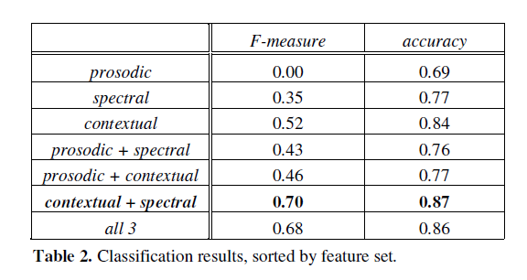
Evaluation
C4.5 CART, using Weka

Slide 14
Conclusion
Author says:
Totally ignore prosody (what do you think?)
Concentrate on extracting contextual information
Future works:
1. Finer-grain taxonomy (eg. Good-natured / Biting)
2. Other utterances besides “yeah right”
3. Acquire more data
4. Visual cues
5. Check more prosodic features

Slide 15
Charismatic Speech

Slide 16
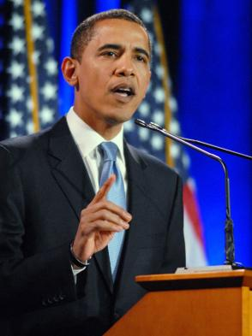
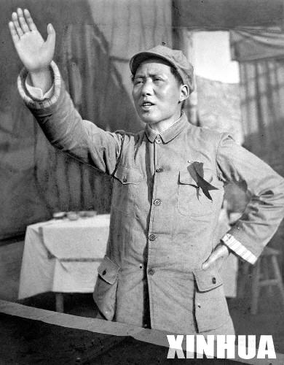
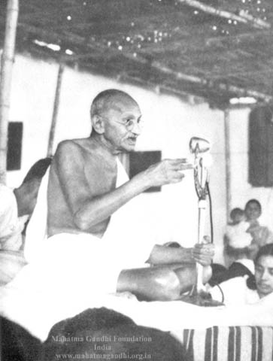
Charismatic Speech
Obama Style
Mao Style
Gandhi Style

Slide 17
Listening Exam
1 | 2 | 3 | 4 | 5
(1) Do you consider the above speeches as charismatic?
(2) Can you figure out who these speakers are?
(2) How different are these speaking styles?

Slide 18
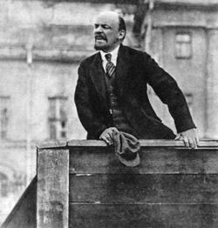
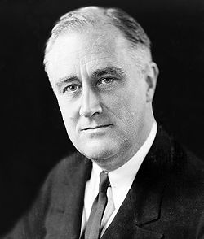
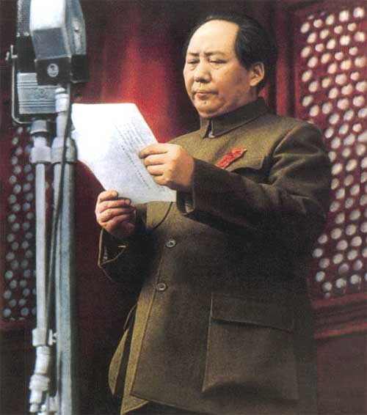
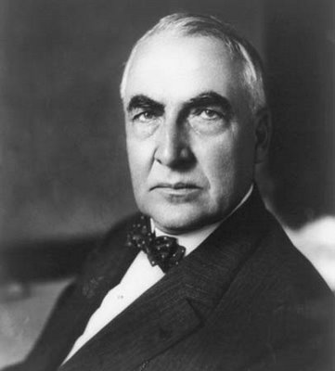
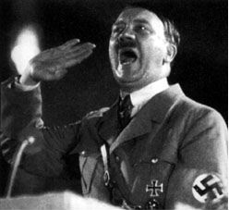
1. Vladimir Lenin
2. Franklin D. Roosevelt
3. Mao Zedong
4. Warren G. Harding
5. Adolf Hitler

Slide 19
Charisma?
Weber ‘47 says:
The ability to attract, and retain followers by virtue of personal characteristics -- not political and military institutions and powers
What features might be essential to charismatic speech?
Acoustic-Prosodic Features
Lexical Features

Slide 20
Why do we study Charismatic Speech?
Probably we can identify future political stars.
Charismatic speech is CHARISMATIC, so we, as ordinary people, are interested in that.
Train people to improve their public speaking skills.
Create TTS systems that produce charismatic, charming and convincing speech. (Business Ad? Automatic Political Campaign?)

Slide 21
Biadsy et al. 2008
Cross-culture comparison of the perception of Charismatic Speech
American, Palestinian and Swedish subjects rate American political speech
American and Palestinian rate Palestinian Arabic speech
Attributes correlate charisma:
American subjects: persuasive, charming, passionate, convincing
Neither boring nor ordinary
Palestinian subjects: tough, powerful, persuasive, charming, enthusiastic
Neither boring nor desperate

Slide 22
Data Source
Standard American English (SAE) Data:
Source: 9 candidates (1F 8M) of 2004 Democratic nomination to US President
Topics: greeting, reasons for running, tax cuts, postwar Iraq, healthcare
Segments: 45 of 2-28s speech segments, mean 10s
Palestinian Arabic Data:
Source: 22 male native Palestinian speakers from TV programs in 2005
Topics: Assassination of Hamas leader, debate, Intifada and resistance, Israeli
separation wall, the Palestinian Authority and call for reforms
Segments: 44 of 3-28s duration, mean 14s

Slide 23
Experiments
First two experiments:
12 Americans (6F 6M) and 12 Palestinians (6F 6M) were presented speech
of their own languages, and were asked to rate 26 statement in a 5 points
scale.Statement are “the speaker is charismatic” and other related statements.
(eg. “the speaker is angry”. )
Following three experiments (native vs non-native speakers perception):
9 (6F, 3M) English speaking native Swedish speakers to do SAE task
12 (3F, 9M) English-literate native Palestinian speakers do SAE task
12(3M, 9F) non-Arabic-literate SAE speakers to do Arabic task

Slide 24
Kappas
SAE speakers on SAE: 0.232
SAE speakers on Arabic: 0.383
It suggests that lexical and semantic cues may lower agreement.
Palestinian speakers on SAE: 0.185
Palestinian speakers on Arabic: 0.348
Swedish speakers on SAE: 0.226
Why kappas are low?
Different people have different definition of charisma
Rating foreign speech depends on subjects’ understanding with the language

Slide 25
Findings
American rating SAE tokens report recognizing 5.8 out of 9 speakers and
rating of these speakers are more charismatic (mean 3.39). It may imply that
charismatic speakers are more recognizable.
2. Other studies are quite low. For Palestinian recognizing Palestinian studies,
0.55 out of 22 speakers. For American recognizing Arabic speakers, 0. For
Palestinian and Swedish recognizing SAE speakers, 0.33 and 0.11
3. Significant figures showed that the topic of the tokens influences the
emotional state of the speaker or rater. (p= .052)

Slide 26
Feature Analysis
Goal: Extracting acoustic-prosodic and lexical features of the charismatic
stimuli and see if there’s something correlate with this genre of speech.
Pitch, Intensity and Token Duration:
Mean pitch (re=.24; rpe=.13; raa=.39; ra=.2; rs=.2), mean (re=.21; rpe=.14; raa=.35; ra=.21; rs=.18) and standard deviation (re=.21; rpe=.14; raa=.34; ra=.19; rs=.18) of rms intensity over intonational phrases, and token duration (re=.09; rpe=.15; raa=.24; ra=.30; rs=.12) all positively correlate with charisma ratings, regardless of the subject’s native tongue or the language rated

Slide 27
Acoustic-Prosodic
Pitch range:
positively correlated with charisma in all experiments (re=.2;rpe=.12; raa=.36;
ra=.23; rs=.19).
Pitch accent:
Downstepped pitch accent (!H*) is positively correlated with charisma (re=.19; rpe=.17; raa=.15; ra=.25; rs=.14), while the proportion of low pitch accents (L*) is significantly negatively correlated (re=-.13; rpe=-.11; raa=-.25; ra=-.24) — for all but Swedish judgments of SAE (r=-.04; p=.4).
Disfluency:
The presence of disfluency (filled pauses and self-repairs) on the other hand, is negatively correlated with charisma judgments in all cases (re=-.18; rpe=-
.22; raa=-.39; ra=-.48), except for Swedish judgments of SAE, where there is only a tendency (r=-.09; p=.087).
(Do you think this may be true when testing on Chinese charismatic speakers?)

Slide 28
Acoustic-Prosodic
Conclusion:
Charisma judgments tend to correlate with higher f0, higher and more varied intensity, longer duration of stimuli, and downstepped (!H*) contours.
Subjects agree upon language specific acoustic-prosodic indicators of charisma, despite the fact that these indicators differ in important respects from those in the raters’ native language.
Other correlations of acoustic-prosodic features with charisma ratings do
appear particular not only to the native language of rater but also to the language rated.

Slide 29
Lexical Features
Features investigated:
For judgments of SAE,
Third person pronoun (re=-.19; rs=-.16), negative correlated.
First person plural pronouns (re=.16; rpe=.13; rs=.14), third person singular pronouns (re=.16; rpe=.17; rs=.15), and the percentage of repeated words (re=.12; rpe=.16; ra=.22; rs=.18) is positively correlated with charisma. Ratio of adjectives to all words is negatively correlated (re=-.12; rpe=-.25; rs=-.17).
For judgments of Arabic,
both Americans and Palestinians judge tokens with more third person plural pronouns (raa=.29; ra=.21) and nouns in general (raa=.09; ra=.1) as more charismatic.

Slide 30
Cross-cultural Rating
Consensus:
The means of the American and Palestinian ratings of SAE
tokens are 3.19 and 3.03. The correlation of z-score-normalized
charisma ratings is significant and positive (r=.47).
The ratings of Swedish (mean: 3.01) and Palestinian (mean: 3.03) subjects
rating SAE and again the correlation between the groups is significant (r=.55),
indicating that both groups are ranking the tokens similarly with respect to
charisma.
Examples are shown when absolute rating values vary, but the correlation is
still strong.
Conclusion:
These findings support our examination of individual features and their correlations with the charisma statement, across cultures.

Slide 31
Cross-cultural Rating
Differences:
Americans find Arabic speakers who employ a faster and more consistent speaking rate, who speak more loudly overall, but who vary this intensity considerably, to be charismatic, while Palestinians show less sensitivity to these qualities.
Tokens that Palestinian raters find to be more charismatic
than Americans have fewer disfluencies than tokens considered more charismatic by Americans.
These tokens?
How about these ones?
Swedish subjects may find higher pitched speech in a relatively
compressed range to be more charismatic than do Americans
Audios from slides of
Prof. Hirschberg

Slide 32
Urgent / Personal Speech

Slide 33
Message Prioritization
Notions:
Navigating through new voicemail messages is time-consuming.
People have voicemail box because they are busy and cannot always answer to the phone call. So, they also have to process all voicemails in a short time.
But we must reply to urgent voicemails on time.
It is also necessary to separate business voicemails with personal ones.

Slide 34
Ringel and Hirschberg 02
Corpus:
3466 messages from 132 AT&T, 45 hours of speech.
2. Transcribed by hand, annotated with caller, including name, gender, and
age, where available. Entities such as dates, names, and phone numbers were also identified in the messages.
1-5 points rating by annotators in terms of urgency: Eg. Boss calling, Fedex delevery, pick up children and so on.
1-5 points rating by annotators in terms of personal: Eg. Using nicknames, children, pets and cars.
(So, who are these annotators? They must know a lot!)

Slide 35
Features and ML Algorithms
Total: 79 features from the message audio, from the message’s transcription, and from the state of the user’s inbox.
Examples of extracted features include the number of dates mentioned in the message, the distance of mentioned dates from the date the message was sent, the number of previous messages the current caller had left for
the user within the past n days, the caller’s speaking rate, the time of day the message was sent, the duration of the message, and key words appearing in the body of the message.
Machine Learning Algorithms: RankBoost, cross-validation

Slide 36
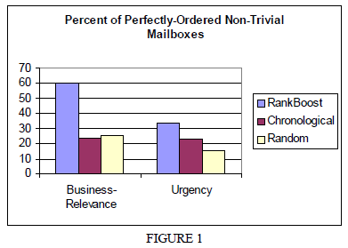
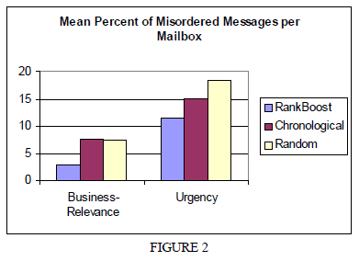
Results

Slide 37
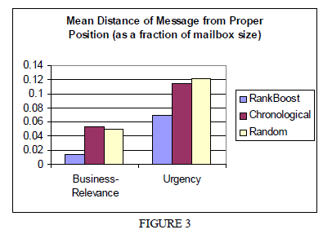
Results

Slide 38
Conclusion
Results are an encouraging demonstration that machine learning techniques can be successfully used to create new capabilities for communications interfaces. While our technique is not always accurate, we conjecture that it will be sufficiently precise to improve access for heavy voicemail users.
However, only actual user testing will tell us whether users will find this form of message ordering beneficial and how accurately our algorithm must rank messages in order to be useful.
Do they want to rank messages? Mess up chronological order?

Slide 39
Open Discussion
What can be some other interesting speaker states we can model?
Why do we need that?
What would be the new trends of emotional speech technology?

Slide 40
Thanks!

