Slide 1
Cultural Differences in Emotional Display
Julia Hirschberg
COMS 4995/6998

Slide 2
Do Members of Different Cultures Display Emotion Differently?
Ekman & Friesen 1996: universal recognition of emotions
Braun & Katerbow 2005: comparing English, German and Japanese versions of Allie McBeal productions and perceptions
Shahid et al 2007: emotion in children of different age groups perceived by Dutch and Pakistani adults

Slide 3
Why Might Emotion Display Differ by Culture?
Darwinian view: at least 6 “basic” emotions have evolved and are therefore universal (Ekman and Friesen)
Social constructivist view: “Emotions are cultural products that owe their meaning and coherence to learned social rules.” (Cornelius)
A third view: Although emotions are biologically programmed, the way they are displayed and perceived depends on cultural factors (Matsumoto)

Slide 4
Universal Expressions
Found
  Anger
  Disgust
  Fear
  Happiness
  Sadness
  Surprise
Not for moods or attitudes (irritation, liking)

Slide 5
Past and Present Views
  Facial expression is determined totally by social factors (Bridwhistell, 1970)
  But what about biological expressions? (Ekman, 1973)
  Claim: There is unique, highly recognizable, pan-cultural facial expression for six universal emotions -- which are the product of evolutionary forces

Slide 6
Is Contempt Just Disgust?
  Properties of Contempt
    Not observed in other primates whereas other emotions have been
    One of the last emotions to appear in humans
    Involves unilateral facial actions
  Disgust
    One of the Pan Cultural Emotion
    Involves only bilateral facial actions

Slide 7
Facial Expressions of Contempt
  Three different expressions
    Tightening and Slightly raising the corner of the lip unilaterally.
    The above expression bilaterally
    Raising the entire lip slightly, without tightening or raising the lip corners

Slide 8
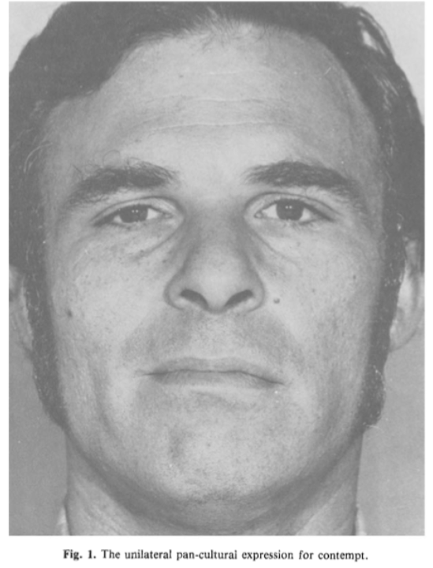

Slide 9
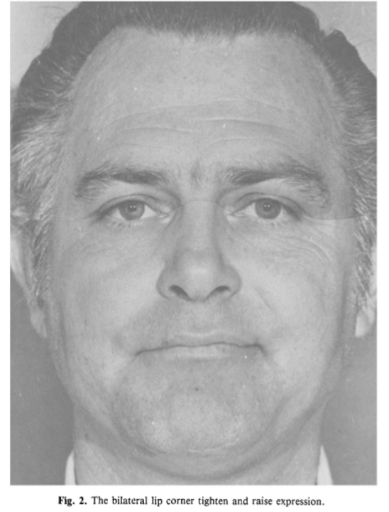

Slide 10
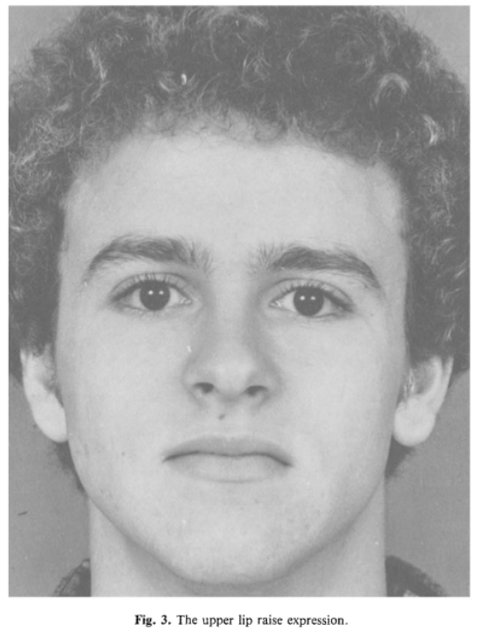

Slide 11
  Pictures scored with Ekman and Friesen’s Facial Acting Coding System
  Subjects in each culture also saw other facial expressions (universal expressions)
  Judgments obtained in 10 countries – 2 non-western, 8 western cultures
    Sample sizes differed (29 in Hong Kong to 97 in Japan)
  Emotion terms translated and translated back to verify accurate translation

Slide 12
Results
  Results for the six universal expressions same as before
  Isolation of one expression that depicts contempt –
    ANOVA computed with one factor as three contempt expressions
    Amount of variance accounted for by culture was small
    Unilateral lip corner raise and tightened was judged 75% as contempt as compared to Bilateral.

Slide 13
Contempt and Related Emotion
  Subjects judge contempt as compared to some other expression more often or n
  Compared Unilateral Contempt expression with anger and disgust expression (why anger?)
  A 3 X 10 ANOVA was computed
  Expression with lip corner raised and tightened unilaterally was judged contempt much more often

Slide 14
Discussion
  Limitation –
    All subjects were college students
    Less number of countries
    Not tested on less educated or those not exposed to mass media
    Not tested on preliterate, completely visually isolated subjects (feasible?)

Slide 15
Open questions
  Prior observations on contempt were wrong?
  Whether contempt evolved same as other emotions that have universal expressions?
  Contempt originated through specific constant learning?
  FACS and FACEGEN

Slide 16
Emotions in dubbed speech: An intercultural approach with respect to F0
Used Ally McBeal in American English, German, and Japanese
  Acted speech but realistic
  Restrictions on selecting data
  Only used scenes on which 7 out of 10 native German speakers agreed on emotion
Looked at production and perception
Looked at “basic” emotions said to occur universally:
hot anger, cold anger, joy, sadness, fear

Slide 17
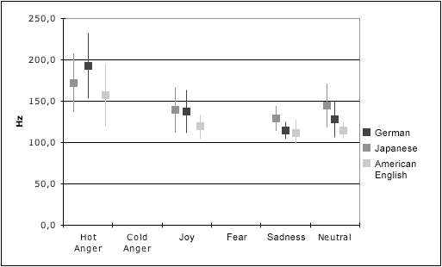
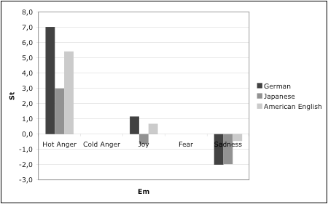
F0 in Production Studies: Males: Mean F0, SDev and F0 Range
F0 means and standard deviations
Change in F0 means for different emotions
American English speaker always exhibits the lowest values
Japanese speaker exhibits the highest values, except for hot anger, which is most clearly marked by the German speaker
All raise their F0 for hot anger and lower it for sadness
Only the Japanese speaker lowers his F0 for joy

Slide 18
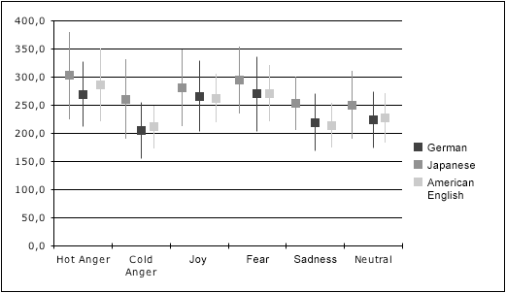
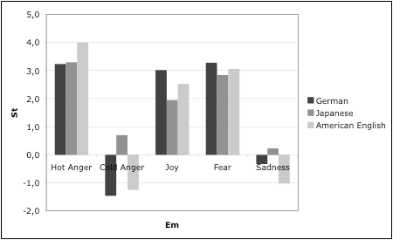
F0 in Production Studies: Females: Mean F0, SDev and F0 Range
F0 means and standard deviations
Change in F0 means for different emotions
Japanese speaker always exhibits highest values
Differences between other two minor, confirming hypothesis that linguistically and culturally more similar languages behave in more similar ways than culturally more distant ones
Does it?
No clear difference in average F0 for German speakers between hot anger, joy, and fear
All raise their F0 for hot anger, joy, and fear
American and German speakers lower their F0 for cold anger and sadness; the Japanese speaker does not

Slide 19
F0 Range in Hz
Ranges for hot anger and joy exceed those for neutral speech
The American speaker, as opposed to the other two, displays the most monotonous speech for sadness
Male speakers
 | Anger (h) | Joy | Sadness | Neutral
G | 139 | 95 | 40 | 90
J | 128 | 94 | 68 | 92
E | 170 | 61 | 55 | 40
Japanese speaker exhibits largest F0 range for all emotions including the neutral samples; German and American speakers are not far apart
Japanese and American speakers show largest range for hot anger
German speaker displays largest range for fear
Female speakers
 | Anger (h) | Anger (c) | Joy | Fear | Sadness | Neutral
G | 229 | 190 | 203 | 266 | 201 | 190
J | 299 | 242 | 242 | 228 | 166 | 199
E | 220 | 134 | 154 | 180 | 139 | 158

Slide 20
Perception Studies
3 different listener groups who were native speakers of American English, German, and Japanese
Undergraduate students who received credit for participation
Subjects who did not reach test-retest agreement of 80% excluded from analysis
60 Germans, 35 Americans, 34 Japanese

Slide 21
Results
German and American listeners could not reliably recognize joy in male Japanese speech, often confusing with sadness
  Consistent with data for German and English
  Sadness only emotion for which they lower their F0, as Japanese do for joy
  Japanese listener better able to identify joy, indicating that they use other cues to identify
German and Americans could not identify cold anger in Japanese speech, which is coded by increase in F0
Japanese listeners not confused
  Does division between hot and cold anger exist in Japanese?

Slide 22
Strengths and Weaknesses
Is there a difference in the encoding of emotions between speakers of different linguistic/cultural backgrounds with respect to F0 and related parameters?
Is there an additional gender difference in the encoding of emotions between speakers of different linguistic/cultural backgrounds with respect to F0 and related parameters?
Is there an intercultural difference in the perception of emotions in dubbed speech?

Slide 23
Shahid et al 2007
Looked at different cultures (Dutch and Pakistani) and age groups (8 and 12 year olds)
Assumption: children express their emotions in a more open and intense way than adults do
Is this a good assumption?
Used a game to elicit emotional speech
Was the game an effective method?
Used the data in a cross-cultural perception study
Only differentiating between positive and negative emotions
Is this useful?

Slide 24
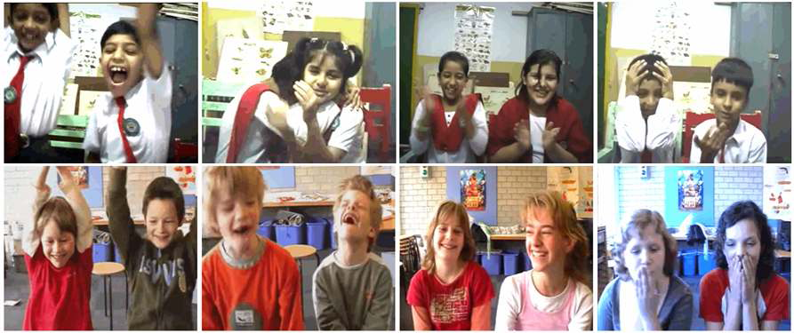
Audiovisual emotional speech of game playing children: effects of age and culture

Slide 25
Audiovisual emotional speech of game playing children: effects of age and culture
Representative stills for (L-R): 8 year olds winning, 8 year olds losing, 12 year olds winning, 12 year olds losing, for Pakistani players (Top) and Dutch players (Bottom)

Slide 26
Results
Game Players | Age Group | Game Status | Dutch Viewers | Pakistani Viewers
Dutch | 8 | Lost | 86.7 | 83.0
 |  | Won | 70.2 | 74.5
 | 12 | Lost | 75.6 | 76.1
 |  | Won | 36.8 | 45.9
Pakistani | 8 | Lost | 86.1 | 82.7
 |  | Won | 91.9 | 89.0
 | 12 | Lost | 93.0 | 86.0
 |  | Won | 91.5 | 87.3

Slide 27
Results
Game Players | Age Group | Game Status | Dutch Viewers | Pakistani Viewers
Dutch | 8 | Lost | 86.7 | 83.0
 |  | Won | 70.2 | 74.5
 | 12 | Lost | 75.6 | 76.1
 |  | Won | 36.8 | 45.9
Pakistani | 8 | Lost | 86.1 | 82.7
 |  | Won | 91.9 | 89.0
 | 12 | Lost | 93.0 | 86.0
 |  | Won | 91.5 | 87.3

Slide 28
Results
Game Players | Age Group | Game Status | Dutch Viewers | Pakistani Viewers
Dutch | 8 | Lost | 86.7 | 83.0
 |  | Won | 70.2 | 74.5
 | 12 | Lost | 75.6 | 76.1
 |  | Won | 36.8 | 45.9
Pakistani | 8 | Lost | 86.1 | 82.7
 |  | Won | 91.9 | 89.0
 | 12 | Lost | 93.0 | 86.0
 |  | Won | 91.5 | 87.3

Slide 29
Conclusions
Most classifications correct
  Pakistani adults a little better at classifying Dutch children
  Dutch adults a little better at classifying Pakistani children
  Does this disprove the alleged in-group advantage?
When 12 year old Dutch children win a game, hard to see -- most viewers, especially Dutch ones, perceive this as losing
Dutch observing Dutch leads to lowest percentage correct classification; Dutch observing Pakistanis leads to highest percentage of correct classification.
For Dutch 8 year olds, winning harder to classify for both Pakistani and Dutch observers; for Pakistani children, winning easier to detect
Notes:
Pattern: Dutch signal negative emotions more clearly; Pakistani signal positive emotions more clearly
Findings for Dutch children are in accordance with internalization of emotion theory, which says that younger children express their emotions more clearly than older ones; this pattern was not found for the Pakistani children, which is accordance with observations of Elfenbein et. Al comparing emotional expressivity of American and Indian adults

