Slide 1
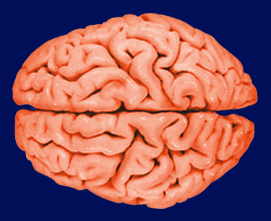
The voice of emotion: an FMRI study of neural responses to angry and happy vocal expressions
Tom Johnstone, Carien M. van Reekum, Terrence R. Oakes, and Richard J. Davidson
By Andrew Kisch

Slide 2
Questions
Are specific neural regions more engaged in the processing of some emotions than others?
How does directed attention towards or away from the expressed emotion affect the associated neural response?

Slide 3
Experiment
Play happy/angry expressive speech for people while showing them greyscale images of happy/angry facial expressions
  Both congruent and discrepant sets of emotions
    AA, AH, HA, HH
Monitor neurological activity via fMRI
  Measures change in blood flow within the brain
Also monitor skin conductance

Slide 4
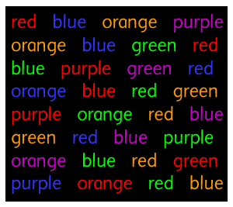
Congruent vs. Discrepant:
Class Experiment
Say the color in which the word is written:
Congruent:
Discrepant:

Slide 5
Congruent vs. Discrepant:
Class Experiment
Now, try saying word itself:

Slide 6
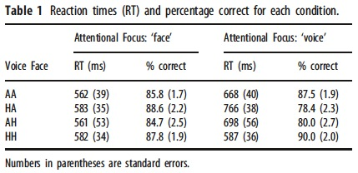
Congruent vs. Discrepant - Results

Slide 7
Brushing up on the Brain – Part 1
Middle Temporal Gyrus (MTG)
  Involved in the processing of complex auditory stimuli, including music, speech and emotional prosody
  Particularly vocal expressions of happiness
  Particularly in the right hemisphere

Slide 8
Brushing up on the Brain – Part 2
Amygdala - Significance detector that alerts other parts of the brain to potentially salient stimuli
Insula - Involved in generating reward-related autonomic responses

Slide 9
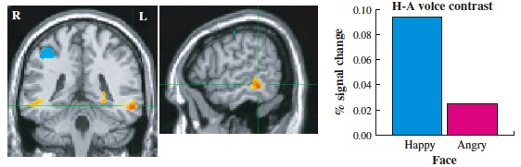
MTG Activation

Slide 10
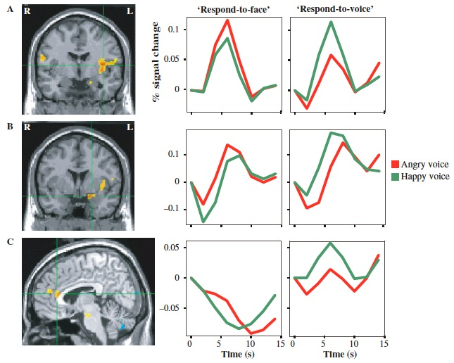
Left Insula
Left
Amygdala
Rostral ACC

Slide 11
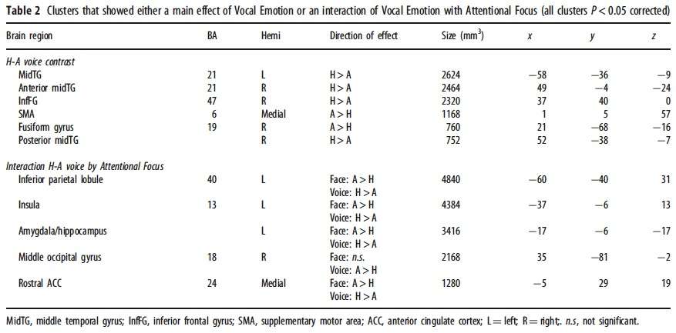

Slide 12
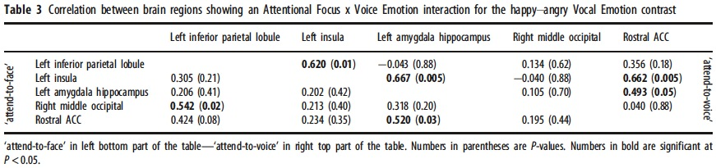

Slide 13
Questions For Discussion
Why only right-handed subjects?
What is the best use of this data?
Why isn’t the lateralization consistent?
Improvements?

Slide 14
Thank You!!!

