Slide 1
On Lying and Being Lied To: A Linguistic Analysis of Deception in Computer-Mediated Communication
Jeffrey T. Hancock, Lauren E. Curry, Saurabh Goorah and Michael Woodworth
2008

Slide 2
Fun Facts
It has been reported that people tell an average of one to two lies a day
12% of adults admit to telling lies “sometimes or often”
65% of teachers admitted to telling lies and 18% said that they lie “routinely”
The most dishonest time of day is between 9 and 9:30 in the evening
The most profligate liar in history was US President Nixon, who researchers found to have lied 837 times in one single day

Slide 3
Prior Research
Four categories of linguistic cues have been associated with deception
  Word quantity
  Pronoun use
  Emotion words
  Markers of cognitive complexity
Notes:
Rather than in conversational contexts. Given the fact that language use in conversation differs in important ways from language use in monologues, the focus of previous research on monologue-based deception may limit its applicability to conversation
Participants engaged in conversation tend to adjust their behavior in relation to their partner, from their use of language to their nonverbal behaviors

Slide 4
Word Quantity
Majority of previous research suggests that liars tend to use fewer words and offer fewer details when lying
Recent research examining word production in email reported that liars produced significantly more words when lying than when telling the truth

Slide 5
Pronoun Usage
Liars tend to be more non-immediate than truth tellers and refer to themselves less often in their deceptive statements
Data suggests that liars are more likely to use third-person pronouns
Notes:
Deceivers may refrain from using first-person pronouns due to either a lack of personal experience or a desire to dissociate themselves from the lie being told

Slide 6
Emotional Words
Research suggests that there are slight but consistent elevations of disparaging statements and negative emotion words during deception
Other research found that deceivers tend to use more emotional expressiveness (both positive and negative) than truth tellers

Slide 7
Distinction Markers
Liars may be particularly wary of using distinction markers that delimit what is in their story and what is not
From a cognitive perspective, truth tellers should be able to discuss exactly what did and did not happen, while liars would have to keep track of what they have previously said to avoid contradicting themselves

Slide 8
Motivation
Previous research suggests that motivation operates via a dual process, impairing nonverbal performance but facilitating verbal performance during deception
Empirical research to date suggests that higher levels of motivation facilitate the liar’s ability to deceive their partner when only verbal information is available

Slide 9
Issues with Prior Research
Limited primarily to analyses of deception in the context of monologues
Focused almost exclusively on the liar

Slide 10
Hypotheses
Liars will produce more words during deceptive conversations than truthful ones
Liars will ask more questions during deceptive conversations as compared to truthful conversations
Liars will use fewer first-person singular but more other-directed pronouns in deceptive conversations than in truthful conversations
Liars will use more negative emotion words during deceptive conversation than truthful ones
Notes:
Derived from previous data/research
Derived from Intrapersonal Deception Theory interactive principle which states that liars should attempt to engage the partner and increase the perceived interactivity of the communication in an effort to increase believability, such as asking questions
Based on theoretical and empirical observations that liars attempt to distance themselves from their deception
Based on previous research suggesting that increased levels of negative emotion terms are observed during deceptive communication

Slide 11
Hypotheses Cont’d
Liars will use fewer exclusive words and negation terms during deceptive conversations as compared to truthful ones
Liars will avoid causation phrases during deceptive interactions relative to truthful ones
Liars will use more sense terms during deceptive interactions as compared to truthful interactions
Notes:
5) Based on findings in previous research
6) Causation words (because, effect, hence) may be similar to distinction markers because they add specificity and detail to a story and increase the possibility of self contradiction.
7) e.g. see, touch, listen. These words add detail and specifics to narrative. Given that this context (i.e. mediated interaction, dialogic format, opinion-based deception) may shift liars into a persuasive mode, liars should be more likely to use sense words to flesh out their deception and demonstrate involvement in what they are discussing

Slide 12
Research Questions
Will partners change their linguistic style during deceptive conversations? If so, how will those changes relate to changes in the liar’s linguistic style?
How will motivation to deceive a partner affect the linguistic style of liars and partners across deceptive and truthful communication in text-based communication?

Slide 13
Participants
70 upper level students at a northeastern American university who participated for class credit in various courses
Randomly paired to for 35 same-sex (19 female, 16 male) unacquainted dyads
Communicated via CMC from separate rooms and did not meet the person with whom they interacted until after their session was completed
Two dyads (1 male, 1 female) had to be excluded from the study because the transcripts were not saved
Notes:
Why do you think same sex?

Slide 14
Procedure
Participants were first led separately to remote rooms to fill out initial questionnaires
They were instructed that they would discuss five topics, which were provided to the participant on a sheet of paper
  The first topic was always “When I am in a large group, I…”
  “Discuss the most significant person in your life”
  “Talk about a mistake you made recently”
  “Describe the most unpleasant job you have ever had to do”
  “Talk about responsibility”
Notes:
This first topic was designed to allow the participants to become comfortable interacting with their partner and was not included in any analyses
After this topic, participants began a discussion of the four experimental topics. The topics were selected based on a protocol developed in 2001.

Slide 15
Procedure Cont’d
No time limit and participants were asked to discuss until they had exhausted the topic
One of the two participants was randomly assigned the role of liar
  Asked to NOT tell the truth, the whole truth and nothing but the truth on two topics (marked on the sheet for the liar)
  Approximately 5 minutes to plan their story
Sequence in which topics were discussed and order in which the liar lied was counterbalanced
  One half of the liars followed a truth-first deception-second order and the remainder followed a reverse order
Notes:
What is a lie then?

Slide 16
Procedure Cont’d
Participants used one of two desktop computers
Experimenter monitored and recorded the interaction from a third computer
Participants completed a series of questionnaires based on their conversation
  Included items assessing how truthful the liar had been and how truthful the partner believed the liar had been

Slide 17
Motivation Manipulation
Liars were randomly assigned to “low motivation” or “high motivation” to lie
For high motivation, liars were informed that they had to make sure they could successfully lie because “research clearly shows that the ability to lie to others successfully is a good predictor of future success in social settings, various jobs like consulting and counseling and for the maintenance of friendships”
Likert scale ranging from 1 to 7 rating how important it was to lie
  Motivated liars: M = 5.22, SE = 0.29
  Unmotivated liars: M = 4.24, SE = 0.29
Notes:
During debriefing they were told that lying would not bring them success

Slide 18
Automated Linguistic Analyses
Total of 264 transcripts
  Separate transcripts for liar and partner of each dyad for each topic
  8 different transcripts for each dyad
Pre-processing
  Periods were placed at the end of each turn
  Question marks were inserted after questions and multiple question marks were reduced to 1
  Misspellings were corrected unless the participant explicitly corrected the spelling error

Slide 19
Automated Linguistic Analyses Cont’d
All transcripts were analyzed using LIWC
  Word counts
  Words per sentence
  Question marks
  First-person singular pronouns
  Second-person pronouns
  Third-person pronouns
  Negative emotion words
  Exclusive words
  Negations
  Causation words
  Words pertaining to the senses

Slide 20
Results
Deception affected both the liar and the conversational partner’s patterns of language use
An increased motivation to succeed in lying impacted the liar’s linguistic style
Between and within-subject factors
  2 (discussion type: truthful vs. deceptive) x 2 (role: liar vs. partner) x 2 (topic: first vs. second) x 2 (motivation: high vs. low)
  Motivation: between subject factor
Notes:
The model used to analyze the linguistic variables involved both between and within-subject factors
In particular a 2 x 2 x 2 x 2 mixed general linear model procedure was conducted on each dependent variable

Slide 21
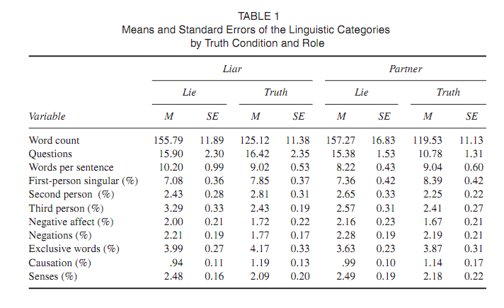

Slide 22
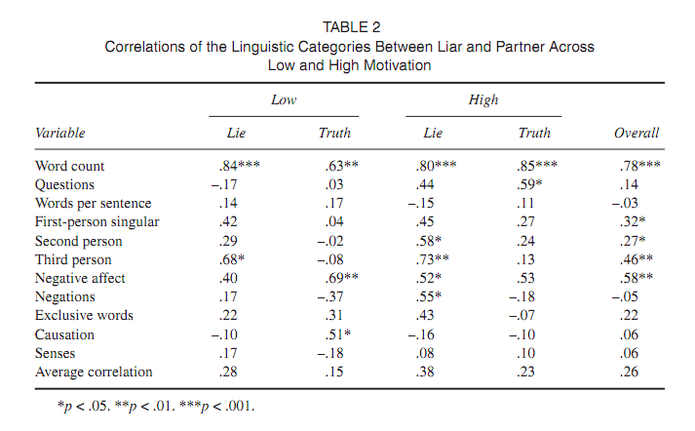

Slide 23
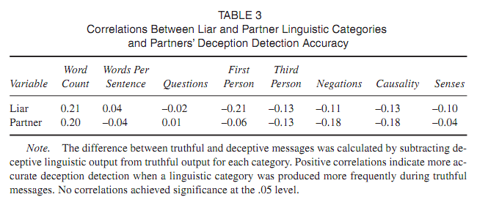

Slide 24
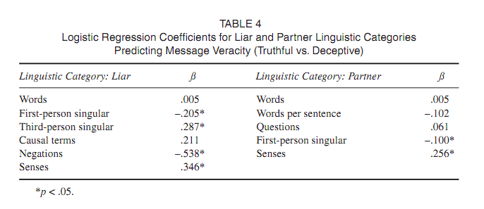

Slide 25
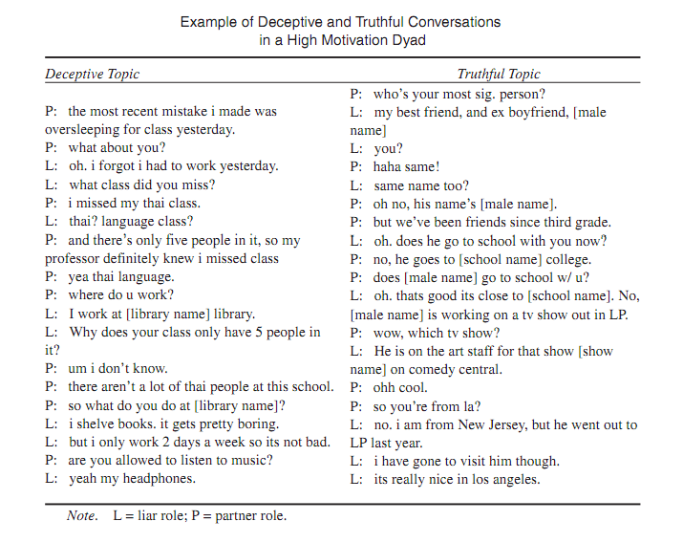

Slide 26
Conclusion
There are significant linguistic behavior changes in synchronous CMC according to the truthfulness of the discussion and the motivation
There are significant linguistic behavior changes of the person who is being lied to

Slide 27
Questions
How could this study be improved?
What is a lie?
Why did the researchers find it important to use same sex dyads?
Can people use this information to change their deceptive speech and avoid detection?

