Slide 1
Predicting the Semantic Orientation of Adjective
Vasileios Hatzivassiloglou and Kathleen R. McKeown
Presented By Yash Satsangi

Slide 2
Aim
To validate that conjunction put constraints on conjoined adjectives and this information can be used to detect their semantic orientation
Based on above information cluster adjectives into two groups representing adjectives with positive and negative orientation.

Slide 3
Constraint On Conjoined Adjectives
Validate constraints from conjunction on positive/negative semantic orientation of adjectives
Honest ‘and’ peaceful – same orientation
Talented ‘but’ Irresponsible – opposite orientation
Thus conjunction affect semantic orientation
Synonyms may have same semantic orientation
Antonyms may have opposite semantic orientation ( hot and cold).

Slide 4
Approach
Extract conjunction from corpus with their morphological relation
A log-linear regression model to predict orientation of two different adjectives
A clustering algorithm separates the adjectives into two subset of same or opposite orientation.

Slide 5
Data
21 million word 1987 Wall Street Journal Corpus annotated with part-of-speech tags
Remove adjectives occurring less than 20 times and those which had no orientation.
Manually assign orientation to each adjective based on use of adjective
Multiple validation of labeled adjectives was done.
Final Set – 1336 adjective – 657 positive and 679 negative – with 96.97% inter-reviewer agreement.

Slide 6
Validating the Hypothesis
Run parser on 21 million words dataset to get 15,048 conjunction tokens involving 9,296 pairs of distinct adjective pairs.
Each conjunction was classified into : 1.)conjunction used ; 2.)type of modification ; 3.)modified noun
Count percentage of conjunction in each category with adjectives of same or different orientation

Slide 7
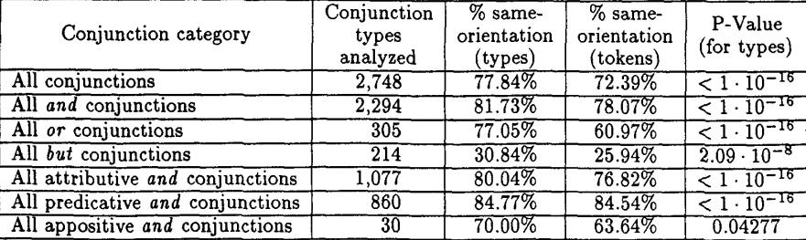
Validating Hypothesis

Slide 8
Validating Hypothesis
For almost all the cases p-values are low. Hence the statistics are significant.
There are very small differences in behavior of conjunctions
‘and’ usually joins adjectives of same orientation
‘but’ is opposite and joins adjectives of different orientation

Slide 9
Baseline Method to Predict Link
Simple baseline method – to call each link as same orientation will give 77.84% accuracy
Adjective con-joined by ‘but’ are mostly of opposite orientation
Morphological relationship (e.g. : adequate-inadequate) contains information as well

Slide 10

Better Idea – Use regression model
Train a log Linear Regression Model
x is the observed count of adjective pair in various conjunction category.
To avoid over fitting they used subsets of data.
Process of iterative stepwise refinement leads to building up of final model

Slide 11
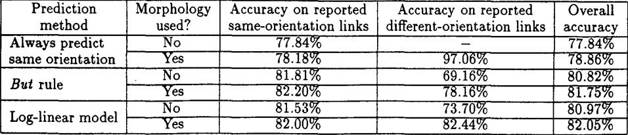
Result of Prediction
Log Linear Regression models performs slightly better than baseline
Mainly used to group adjectives into same group

Slide 12
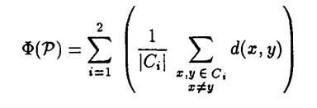
Grouping Adjectives into same pack
Log Linear model generates a dissimilarity score between two adjective between 0 and 1
Same and different adjectives thus form a graph
Iterative Optimization procedure is used to partition graph into clusters.
Minimize :
Hierarchical Clustering

Slide 13
Labeling Clusters
Same authors in ‘95 showed that a semantically unmarked member of gradable adjectives is the most frequent.
Now semantic markedness exhibit a strong correlation with orientation
Unmarked member always have positive orientation
So group with higher average frequency contains positive terms.

Slide 14
Evaluating Clustering of Adjectives
Separate the Adjective set A into training and testing groups by selecting a parameter named α.
α is the parameter which decides the number of link of each adjective in the selected training and test set.
Higher α creates subset of A such that more adjectives are connected to each other.

Slide 15
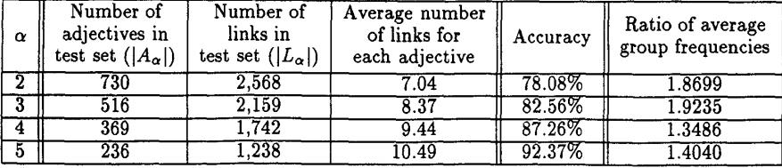
Clustering Results
Highest accuracy obtained when highest number of links were present.
Every time - ratio of group frequency correctly identified the positive subgroup

Slide 16
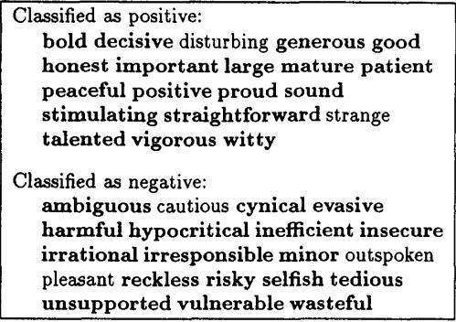
Classification Example

Slide 17
Performance
To measure performance of algorithm a series of simulation experiments were run.
Parameter P measures how well each link is predicted independently – Precision
Parameter k – number of distinct adjective each adjectives appears in conjunction with.
Generate Random Graph between nodes such that each node participated in k links and P% of all nodes connected same orientation and classify them

Slide 18
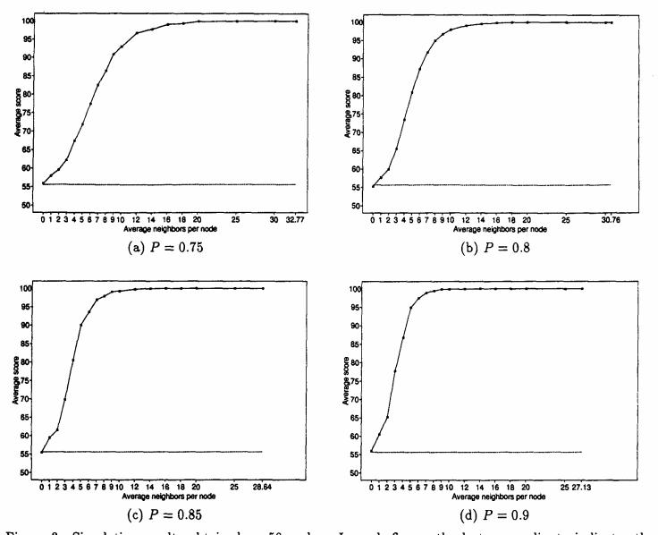
Results

Slide 19
Conclusion
A good ‘and’ comprehensive method for classification of semantic orientation of adjectives.
Can be used to find antonyms without accessing any semantic information
Can be extended to nouns and verbs.

Slide 20
Thank You!

