Slide 1
Extracting Social Meaning
Identifying Interactional Style in Spoken Conversation
Jurafsky et al ‘09
Presented by Laura Willson

Slide 2
Goal
look at prosodic, lexical, and dialog cues to detect social intention
crucial for developing socially aware computing systems
detection of interactional problems, matching conversational style, and creating more natural systems

Slide 3
SpeedDate Corpus
Grad students had 4 min dates with a member of the opposite sex
asked to report how often their date was awkward, friendly, and flirtatious, each on a scale of 1 to 10
hand transcribed and segmented into turns
991 dates total

Slide 4
Classification
For each trait, the top 10% on the 1 to 10 Likert scale was used as positive examples and the bottom 10% as negative examples
A classifier for each gender for the three traits
Trained 6 binary classifiers using regularized logistic regression

Slide 5
Prosodic Features
Computed the features of the person who was labeled by the traits, and also the person who labeled them, the alter interlocutor
features were extracted over turns

Slide 6
Prosodic Features
f0 (min, max, mean, sd)
sd of those
pitch range
rms (min, max, mean, sd)
turn duration averaged over turns
total time spoken
rate of speech

Slide 7
Lexical Features
Taken from LIWC
Anger
Assent
Ingest (Food)
Insight
Negative emotion
Sexual
Swear
I
We
You

Slide 8
Lexical Features
Total words
Past Tense Auxiliary, used to automatically detect narrative: use of was, were, had
Metadate, discussion about the date itself: use of horn, date, bell, survey, speed…
The feature values were the total count of the words in the class for each side

Slide 9
Dialog Act Features
Backchannels
Appreciations
Questions
Repair questions
Laughs
Turns

Slide 10
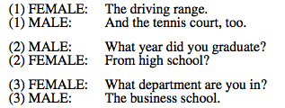
Dialogue Act Features
Collaborative Completions found by training tri-gram models and computing probability of the first word of a speaker’s turn, given interlocutor’s last words
Dispreferred actions- hesitations or restarts

Slide 11
Disfluency Features
uh/um
restarts
speaker overlaps
they were all hand transcribed

Slide 12
Data Pre-processing
standardized the variables to have zero mean and unit variance
removed features correlated greater that .7 so that the regression weights could be ranked in order of importance in classification

Slide 13
Results

Slide 14
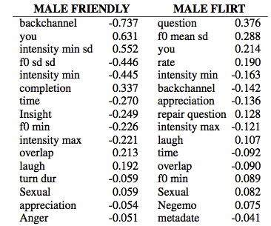
Analysis -Men

Slide 15
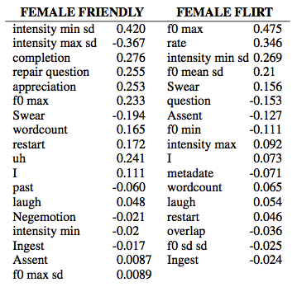
Analysis -Women

Slide 16
Analysis- Awkward
for women was 51%, not better than baseline
for men increased restarts and filled pauses,
not collaborative conversationalists, don’t use appreciations
prosodically, they there hard to characterize, but quieter overall

Slide 17
Results

Slide 18
Analysis- Alters
When women labeled a man as friendly, they were quieter, laughed more, said ‘well’ more, used collaborative completions, and backchanneled more
For men who labeled women as friendly, they used an expanded intensity range, laughed more, used more sexual terms, used less negative emotional terms, and overlapped more

Slide 19
Conclusion
Perception of several speaking style differs across genders
Some features held across gender, like collaborative completes for friendliness
Easy to extract dialog acts (repair questions, backchannels, appreciations, restarts, dispreferreds) were useful

