Slide 1
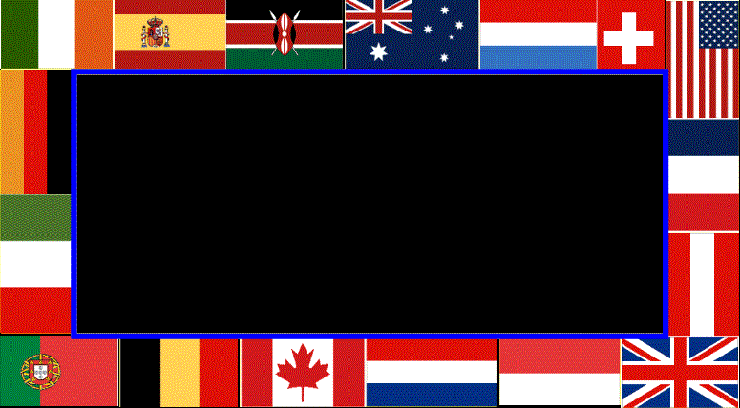
A New Pan-Cultural Facial Expression of Emotion
By Paul Ekman and Wallace Friesen
Presentation by Lishan Amde

Slide 2
Background: 1969 Study
Ekman, Sorenson, and Friesen write “Pan Cultural Elements in Facial Display of Emotion”
Results similar to 1986 study: Happiness easiest to recognize, disgust and anger hardest
Disgust and Contempt were same option

Slide 3
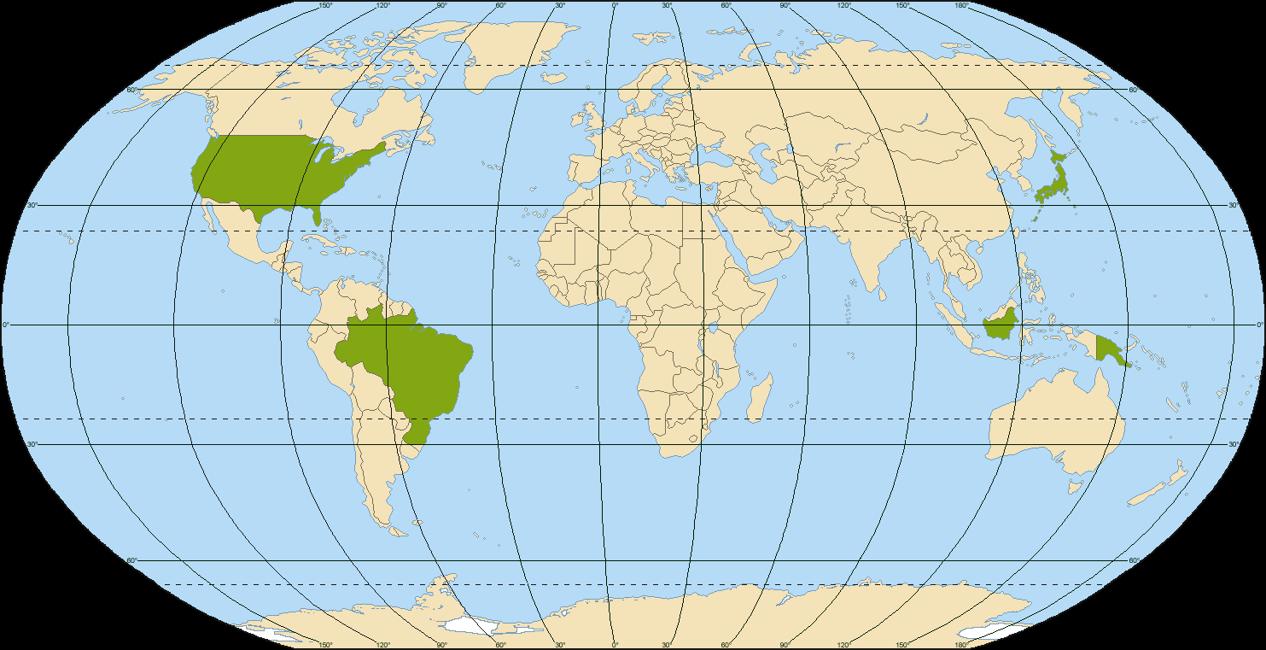
Background: 1969 Sample Populations
New Guinea, Borneo, United States, Brazil, and Japan

Slide 4
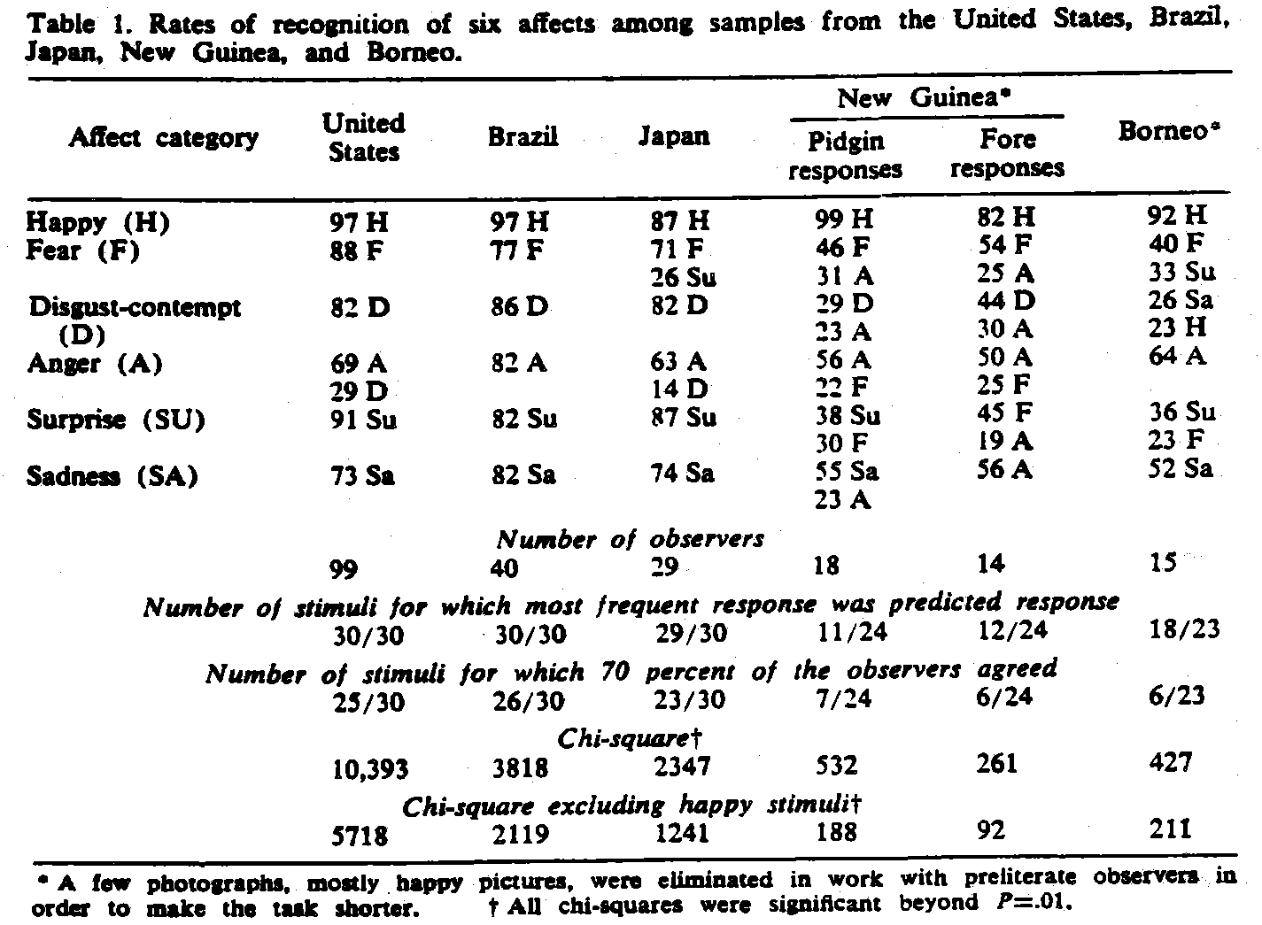
Background: 1969 Results

Slide 5
Ekman and Friesen 1986: Contempt
Major New Development: Testing for contempt specifically
Subjects given three different types of contempt
Subjects also given three different pictures of:
    Anger
    Disgust
    Fear
    Surprise
    Sadness
    Happiness
Pictures produced by telling models WHICH MUSCLE TO MOVE

Slide 6
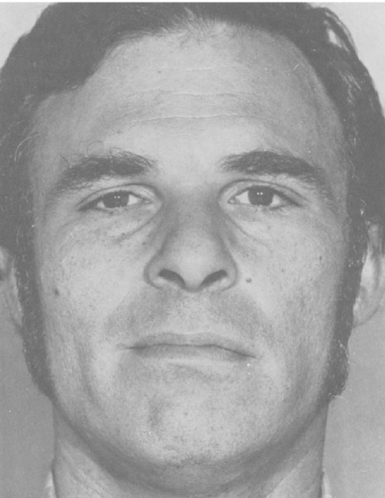
Unilateral Contempt Expression: Tighten and slightly raising the corner of the lip unilaterally

Slide 7
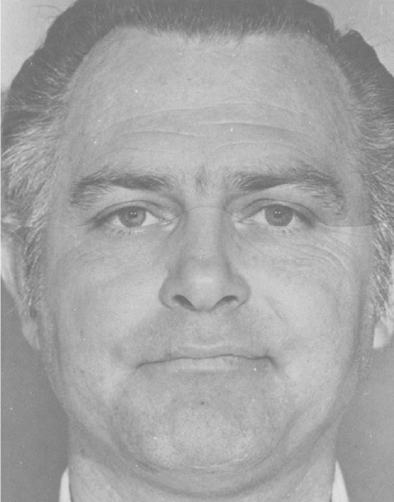
Bilateral Contempt Expression: Tightening and Slightly Raising Corners of the Lips Bilaterally

Slide 8

Upper Lip Raise Contempt Expression: Raising the entire upper lip slightly, without tightening or raising the lip corners

Slide 9
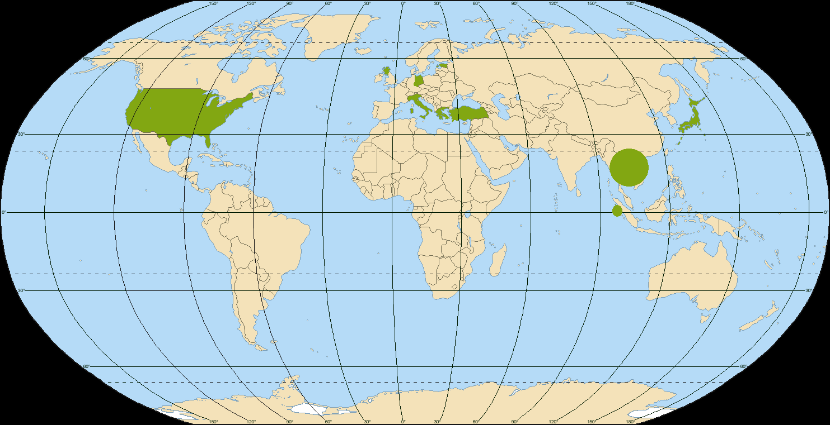
1986 Sample Populations
Estonia, Greece, Hong Kong, Italy, Japan, Scotland, Turkey, United States, West Germany, West Sumatra

Slide 10
Sample Size by Country

Slide 11
1986 Results
The type of contempt judged accounted for much of the variance than culture
Unilateral Expression of Contempt was easiest to identify
Cultural differences only found for one type of contempt: Upper lip raise

Slide 12
Correct Identification of Contempt in Each Contempt Expression (percent of subjects)

Slide 13
Correct Identification of Emotion (percent of subjects)
Happy 90.1%
Surprise 89.5%
Sad 85.8%
Fear 80.4%
Disgust 73.8%
Anger 73.8%
Compare with 75% Unilateral Contempt?

Slide 14
Question of Literacy
“Concerned that our findings of universal facial expressions might be attributed to the opportunity to learn the meaning of expressions from mass media examples rather than being a consequence of evolution, we examined subjects in visually isolated, preliterate cultures.”
Ekman and Friesen 1971: judgment of anger, disgust, fear, sadness, and happiness in preliterate countries are no different from college students in eight literate countries.
1986 vs. 1971
    Is exposure to mass media based on literacy?
    How have technology and accessibility of pop culture changed?

Slide 15
Do these results imply a “universal expression for contempt”?

