Slide 1
Audiovisual Emotional Speech of Game Playing Children: Effects of Age and Culture
By Shahid, Krahmer, & Swerts
Presented by Alex Park
2011-11-01

Slide 2
Motivations
Assumptions
Children show their emotions in a more open and intense way than adults
Cultural background influence the expression of emotions
Goals
Study both of the assumptions by exploring the way age and culture influence the production of positive and negative emotions.
Method
Elicit natural emotions in an ethical way by using a simple game.

Slide 3
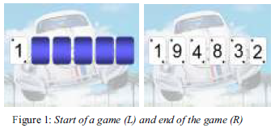
The Game
Design
Begin with 1 face-up card and 5 face-down cards on the screen
# between 1 and 10
Guess whether the number of an upcoming card will be higher or lower than the previous card
Game tells them if they’re correct or not by playing a characteristic sound.
One bad prediction => Lose
Predict all 5 correctly => receive a coin which they can trade in for prizes after the experiment

Slide 4
The Game
Developed using PowerPoint
Played full screen mode
Animations to turn cards around
Appropriate backgrounds to engage children
Six games per child => Max prize = 6 coins
Not involved: Clippy

Slide 5
The Game
Twist
Games are completely deterministic
Two variants
Reward rational choices
Punish rational choices
Start and end with the “reward” variant
Examples
Reward rational choices
9-2-8-1-10-7
3-8-2-10-9-2
1-3-9-2-7-6
Punish rational choices
8-3-9-7-2-1
7-2-8-3-9-10

Slide 6
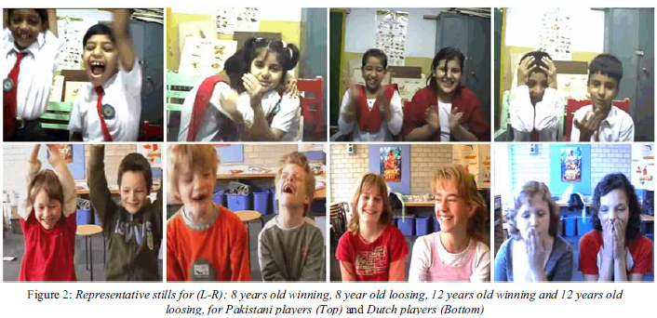
Subjects
48 Dutch and 40 Pakistani children
About half of each group of children around 8 years old, other half around 12 years old
Beautiful smiling (Dutch and Pakistani) Children

Slide 7
Experiment
Self-selected pairs in front of laptops to allow for a more natural interaction
Video camera behind the laptop recording face & upper body of the children
Laptop connected with another computer which the experimenter used to run the game.
Children could not directly see the experimenter
Procedure
Experimenter started off with small talk to ease the pressure on the children
Spoken instructions about the game and the coins
Practice game
Ask for questions
Start the first experimental game
Experimenter spoke as little as possible
Only spoke if children didn’t say anything or got into an argument
Average: 10~12 minutes

Slide 8
Results
Children indeed made the rational choices
Each lost at least two games and won at least two games
Data collected
Audiovisual emotional child speech
Decision-making
Audiovisual responses to winning or losing

Slide 9
Perception Experiments
Stimuli
From each child-pair, selected the first two of their winning games and the first two of their losing games (The moment the last card was turned)
Presented in a random order in a vision-only format to avoid auditory cues (“Jahoe!”)
Participants
131 adults: 71 Dutch and 60 Pakistani
Procedure
Four groups
Dutch adults judging Dutch children
Dutch adults judging Pakistani children
Pakistani adults judging Pakistani children
Pakistani adults judging Dutch children
Stimuli projected onto the wall of a classroom
Six seconds to fill in their score on the answer form
Preceded by a short training session with 3 clips

Slide 10
Perception Experiments
Logistic regression
Factors
Age group (8yo, 12yo)
Game status (win, lose)
Experiment (D→D, D→P, P→P, P→D)
Dependent variable
Classification (Correct, Incorrect)

Slide 11
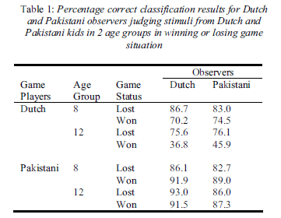
Results
Most classifications are correct
Correctly determined the status of the game based on the emotional response
No big differences between Dutch and Pakistani observers
Pakistani classify Dutch children better and vice versa (?)
Difference between Dutch and Pakistani children
% correct classification for Pakistani children uniformly high
% correct classification drops for Dutch12 year olds
Significant main effect of
Age group (12yo > 8yo)
Game status (Lose > Win)
Experiment (D→P > D→D)

Slide 12
Interaction Effects
Age group and Game status
Explained by the fact that for 8yos, winning and losing are mostly recognized correctly, but for 12yos, losing is recognized correctly more often
Age group and Experiment
Correct classification rate drops for Dutch 12yos
Game status and Experiment
Correct classification rate drops for Dutch children that lose the game
Age group, Game status, and Experiment
Harder to detect Dutch 8yos winning games for both Pakistani and Dutch adults
Easier to detect Pakistani 8yos winning

Slide 13
Conclusion
Dutch children signal negative emotions more clearly, Pakistani children signal positive emotions more clearly
Shown in another study in a completely different setting
Dutch children in accordance with the internalization of emotion theory (younger → more expressive
Not found in Pakistani children, in accordance with observations of Elfenbein et al ‘02
Dutch adults better at classifying Pakistani children, vice versa
Not what one would expect based on alleged in-group advantage (Elfenbein and Ambady ‘02)

Slide 14
Future Work
Why doesn’t the in-group advantage show?
Difference in how the children made their decisions
Pakistani children prayed, while Dutch never did
May explain why Pakistani children do not respond strongly to losing
Less interpersonal distance between Pakistani children
More touching, holding hands, etc.
Similarities
8 year old children used a winning gesture

