Slide 1

Evaluating Jouzu: A Mobile App for Japanese Learning
Zackary Rackauckas
Columbia University
Advanced Topics in Speech Processing
11 March, New York, NY

Slide 2
Challenges of Language Learning
Textbooks and traditional resources are
Not fun and engaging
Conversation practice
Inaccessible
Stress

Slide 3

Challenges of Japanese Learning
コロンビア大学は、ニューヨーク州ニューヨーク市に本部を置くアメリカの私立大学。各種大学ランキングで常に最上位に位置する全米屈指の名門校で、アイビーリーグの１校に数えられている。
Notes:
Dictionary is 636 pages

Slide 4
Role and Character Language
Role Language conveys stereotypical traits about a speaker (Kinsui 2003).
Male: そうだ、俺が知ってるぜ
souda, ore ga shitteruze
Female: そうよ、あたしが知っているわ
souyo, atashi ga shitteiruwa

Slide 5
Role and Character Language
Character Language focuses on “peculiar speech styles assigned to a certain character” (Kinsui and Yamakido 2015).

Slide 6
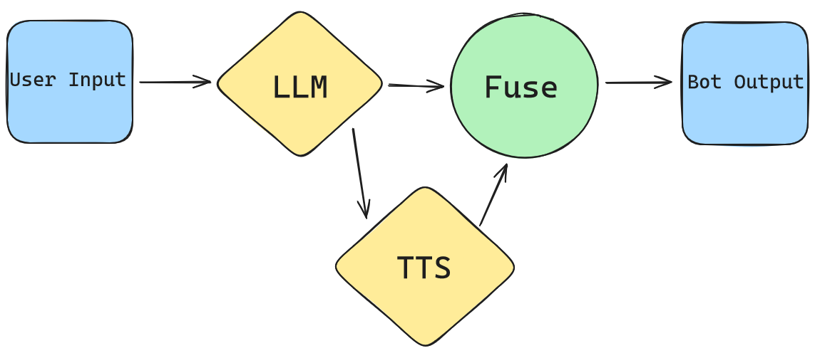
Voiced Character Language Chatbots
Conversational agents that bring anime-like characters to real life
  Text-to-Speech (TTS)
  Large Language Model (LLM)

Slide 7
Trailer + Demo
Trailer
Demo
Text-to-Speech Model

Slide 8
Participating in the Project
Requirements:
Own an iPhone or Android Mobile Device
Know at least some English
At least 1 hour of time

Slide 9
Participating in the Project
Data that will be collected:
Email address, age, native language, number of languages spoken, Japanese level
Survey and Japanese assessment after use
* Emails will be anonymized for analysis and publication.

Slide 10
To Reach Out
zcr2105@columbia.edu
Or post on Ed

