Slide 1
EDEN: Empathetic Dialogues for English Learning
Siyan Li, Teresa Shao, Julia Hirschberg, Zhou Yu
Columbia University

Slide 2
Motivation
Frustration and stumbling is common in English learning
  Could make learners give up
Wu et al. (2023) : perceived teacher affective support (correlates with empathy) positively correlates with student L2 grit (passion and perseverance in second language learning process) [1]
Can an English-teaching chatbot do the same?
[1] Wu, W., Wang, Y., & Huang, R. (2023). Teachers matter: exploring the impact of perceived teacher affective support and teacher enjoyment on L2 learner grit and burnout. System, 117, 103096.

Slide 3
Does an Empathetic Chatbot System increase L2 Grit?
Notes:
So a natural question would be, …

Slide 4
System Overview
Notes:
So, we design the following system.

Slide 5
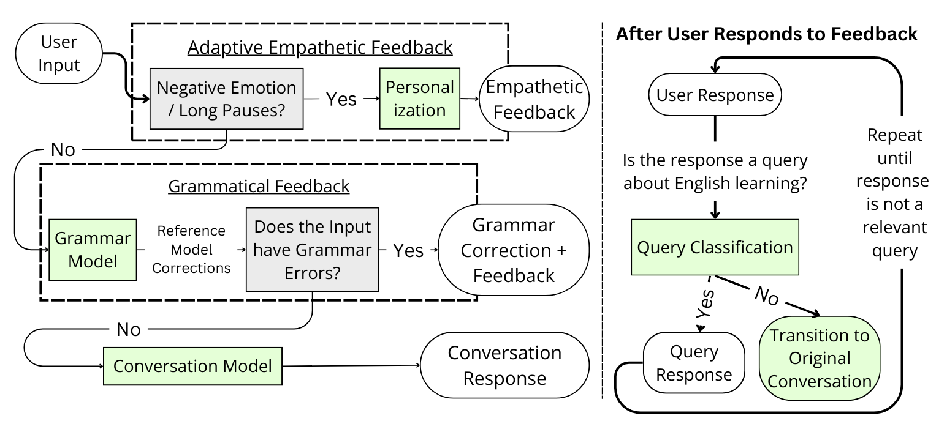
System Design
We improve upon Siyan et al. (2024); improvements highlighted in Green

Slide 6
Implementation
Notes:
So, we design the following system.

Slide 7
Negative Affect & Pause Detection
Perceived negative emotions
  Use existing wav2vec speech recognition model [1]
  Focus on Negative labeled audios
Pauses, since pauses are related to foreign language anxiety
  Use Silero-VAD (voice activity detection) for pause duration computation [2]
  Use the average pause length as a metric
  Focus on Pauses labeled audios
If we detect either, then trigger Empathetic Feedback Module
[1] https://huggingface.co/ehcalabres/wav2vec2-lg-xlsr-en-speech-emotion-recognition
[2] https://github.com/snakers4/silero-vad

Slide 8
Empathetic Feedback
No ground truth → Prompting LLMs; but LLMs are sensitive to how they are prompted
So we used DSPy as a prompt optimization framework [1]
  Selects proposed prompt based on metric performance
  Bootstraps in-context examples
Improvement on LLM-judge metrics; see details in prior work
[1] https://github.com/stanfordnlp/dspy

Slide 9
Grammatical Feedback
Synthesized grammar corrections for real Mandarin native speaker utterances using GPT-4
Fine-tuned Llama-2-chat-7B to provide grammar corrections
Use a template-based approach, coupled with POS tagging, to create the grammar feedback

Slide 10
Conversation
Current dialogue models tend to assume that both speakers in a dialogue are native English speakers
Used ChatGPT to synthesize conversations where one party is an ESL speaker
Fine-tuned Llama-2-Chat-7B to conduct conversations with ESL speakers on a variety of topics
  E.g. TV shows, movies, books, etc
Spoken chatbot; TTS using Amazon Polly, ASR using Whisper

Slide 11
User Study

Slide 12
Population
Recruited through social media and personal connections
31 Native Mandarin speakers
Self-reported English proficiency at least intermediate
Filled out questionnaire for perceived affective support from chatbot and L2 grit

Slide 13
PAS and Different Empathetic Feedback Mechanisms
 | Encourages me when struggling | Listens to me | Cares about my opinion | Appreciates and praises me when doing well | PAS
None | 3.53 | 4.12 | 4.00 | 3.47 | 3.78
Fixed | 3.83 | 2.83 | 3.00 | 3.67 | 3.33
Adaptive | 4.38 | 4.00 | 3.88 | 4.38 | 4.16

Slide 14
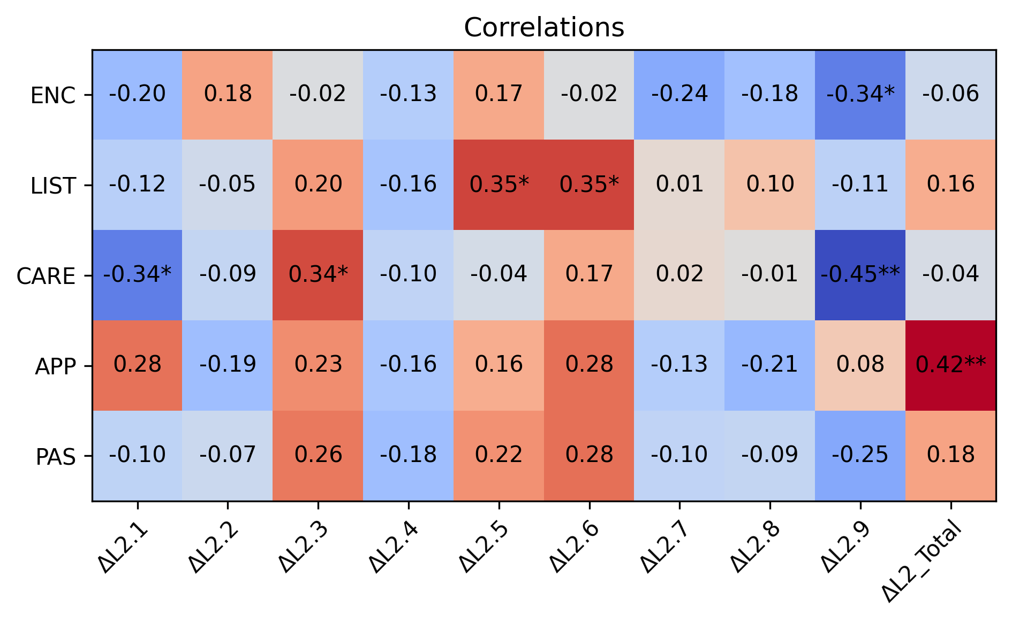
Correlation between PAS and Change in L2 Grit

Slide 15
Takeaways
The adaptive empathetic feedback approach is the most effective at increasing perceived affective support.
Some aspects of perceived affective support correlate with increasing student L2 grit post-interactions.
(Not shown here) Fixed empathetic feedback most significantly increases Grit.
Users appreciate how supportive the empathetic chatbot is; they are sometimes pleasantly surprised when they receive encouragement.
  Human subject studies are difficult, especially when there is little financial incentive and your study involves multiple rounds.

Slide 16
Thank You!
Any Questions?
Email: siyan.li@columbia.edu

