Slide 1
Tools for Speech Analysis
Julia Hirschberg
CS6998
Thanks to Jean-Philippe Goldman, Fadi Biadsy, and many more...

Slide 2
Assignment Information Update and Review
We will not ask you for writing assignments on weeks when a homework is due – just check the Assignments link in Courseworks2
  For Assignments again: please provide 100-200 words for each positive and each negative response for each assigned paper or chapter; this will give us a better chance to assess the quality of your responses.
  For some Assignments (not all) you will also be asked to provide “3 inciteful and potentially challenging questions each about one of the readings (paper or chapter).”
Notes:
Make sure to have the mac fold /Documents/CS6998-23/Slides/mywavefiles up on mac

Slide 3
A Speech Analysis Tool: Praat
Developed by Paul Boersma and David Weenink at the Institute of Phonetic Sciences, University of Amsterdam
General purpose speech tool for
  Editing, segmentation and labeling, prosodic manipulation and analysis, many tutorials, large user community, Praat-Users-List
  You can do many things with Praat (as you’ve seen in the Praat intro and the online video tutorials you’ve viewed) but today we will go through some basics
Notes:
first aim of Praat was to give students and scientists of Phonetics a handy tool for manipulating speech data and for creating stimuli for perception experiments
Please note that Praat changes a bit over time but usually tells you how to figure things out– and it just gets more useful

Slide 4
Today
We’ll go through some exercises recording and analyzing files through Praat
  First, make sure you have the latest version of Praat, (6.4.27 from 1/27/25 for Mac) or the latest version for Windows and install it on your laptop
  If you have not been able to record yourself before this class, please just download these files from our course Files -> Wav files
  It might be good for others to download these now as a backup
    mama-jh.wav will be your first wavfile today
Notes:
https://drive.google.com/drive/folders/1sy_kMnP1O1-ciHENKFuHkz-s6ADAzjb9?usp=sharing

Slide 5
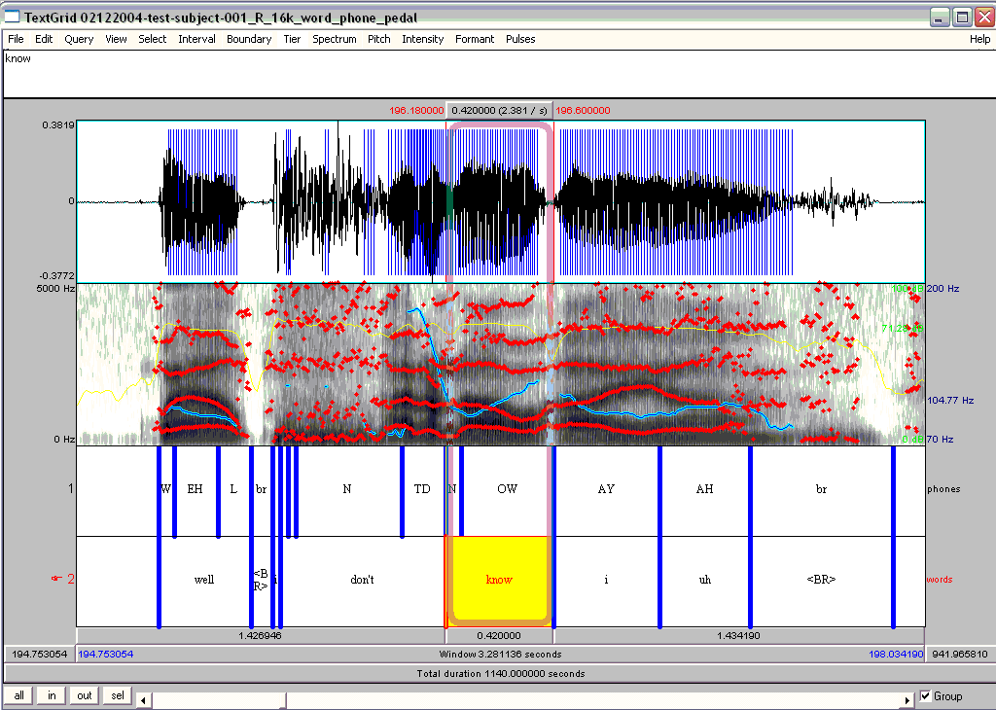
Notes:
This is what one form of a well-annotated speech file looks like in Praat, with a wav file, spectrogram, and phones and words. Now we’re going to find out how to produce one of these.

Slide 6
Obtaining Good Recording Quality
How many were able to do this?
“Record your own voice in a quiet room preferably using a head-mounted microphone. Recordings to produce and save where X is your name:
  “My mama lives in Memphis.” Save as “mama”-X
  Now record the same sentence as a whisper. Save as “whisper”-X
  And now record the same sentence in a creaky voice. Save as “creaky”-X
  Now record the same sentence as a yes-no question with pitch starting low and rising at the end “My mama lives in Memphis?” Save as “ynq”-X
  And now record “Where does my mama live?” as a wh-question with pitch starting high and gradually becoming low to the end. Save as “whq”-X
  Record “My mam lives in Memphis” again in 3 ways: as angry speech, as sad speech, and as happy speech. Save each as “angry”-X, “sad”-X, and “happy”-X”
How many used Praat to do the recordings? If so you don’t need to record again but can just upload your recordings in Praat
If you did not, let’s all learn how to do that and record the first file “mama”-X again in Praat – but those who have a better version already should use that for the rest of the class
Notes:
This is the assignment that you should have done for today: how many could do? How many could not? It was assigned so that the data you’ll use today is recorded in quieter settings.

Slide 7

How do we Record and Manage Files?
Open Praat on your laptop
  You’ll see 2 windows, an Objects window and a Picture window and today we’ll focus on the first
How to Record files and save them
  Select the New tab at top left of the Objects window:
    Record mono sound: “My mama lives in Memphis” as a statement, stop recording, play it to see if you like it, name it (bottom left) as “mama-<your name>” and Save-to-list-&-close
  If you have already recorded yourself, in Praat Objects select your file from your laptop using Open -> Read from file or select the downloaded file mama-jh.wav from Courseworks → Files → Wav files
Notes:
So everyone should do this recording but don’t lose your better version of “mama-X”
Show both in next slide: objects and picture windows then recording window
The Picture window basically let’s you save results in a more legible way
For How to Record go to slide 9
At end go to slide 10 at the end

Slide 8
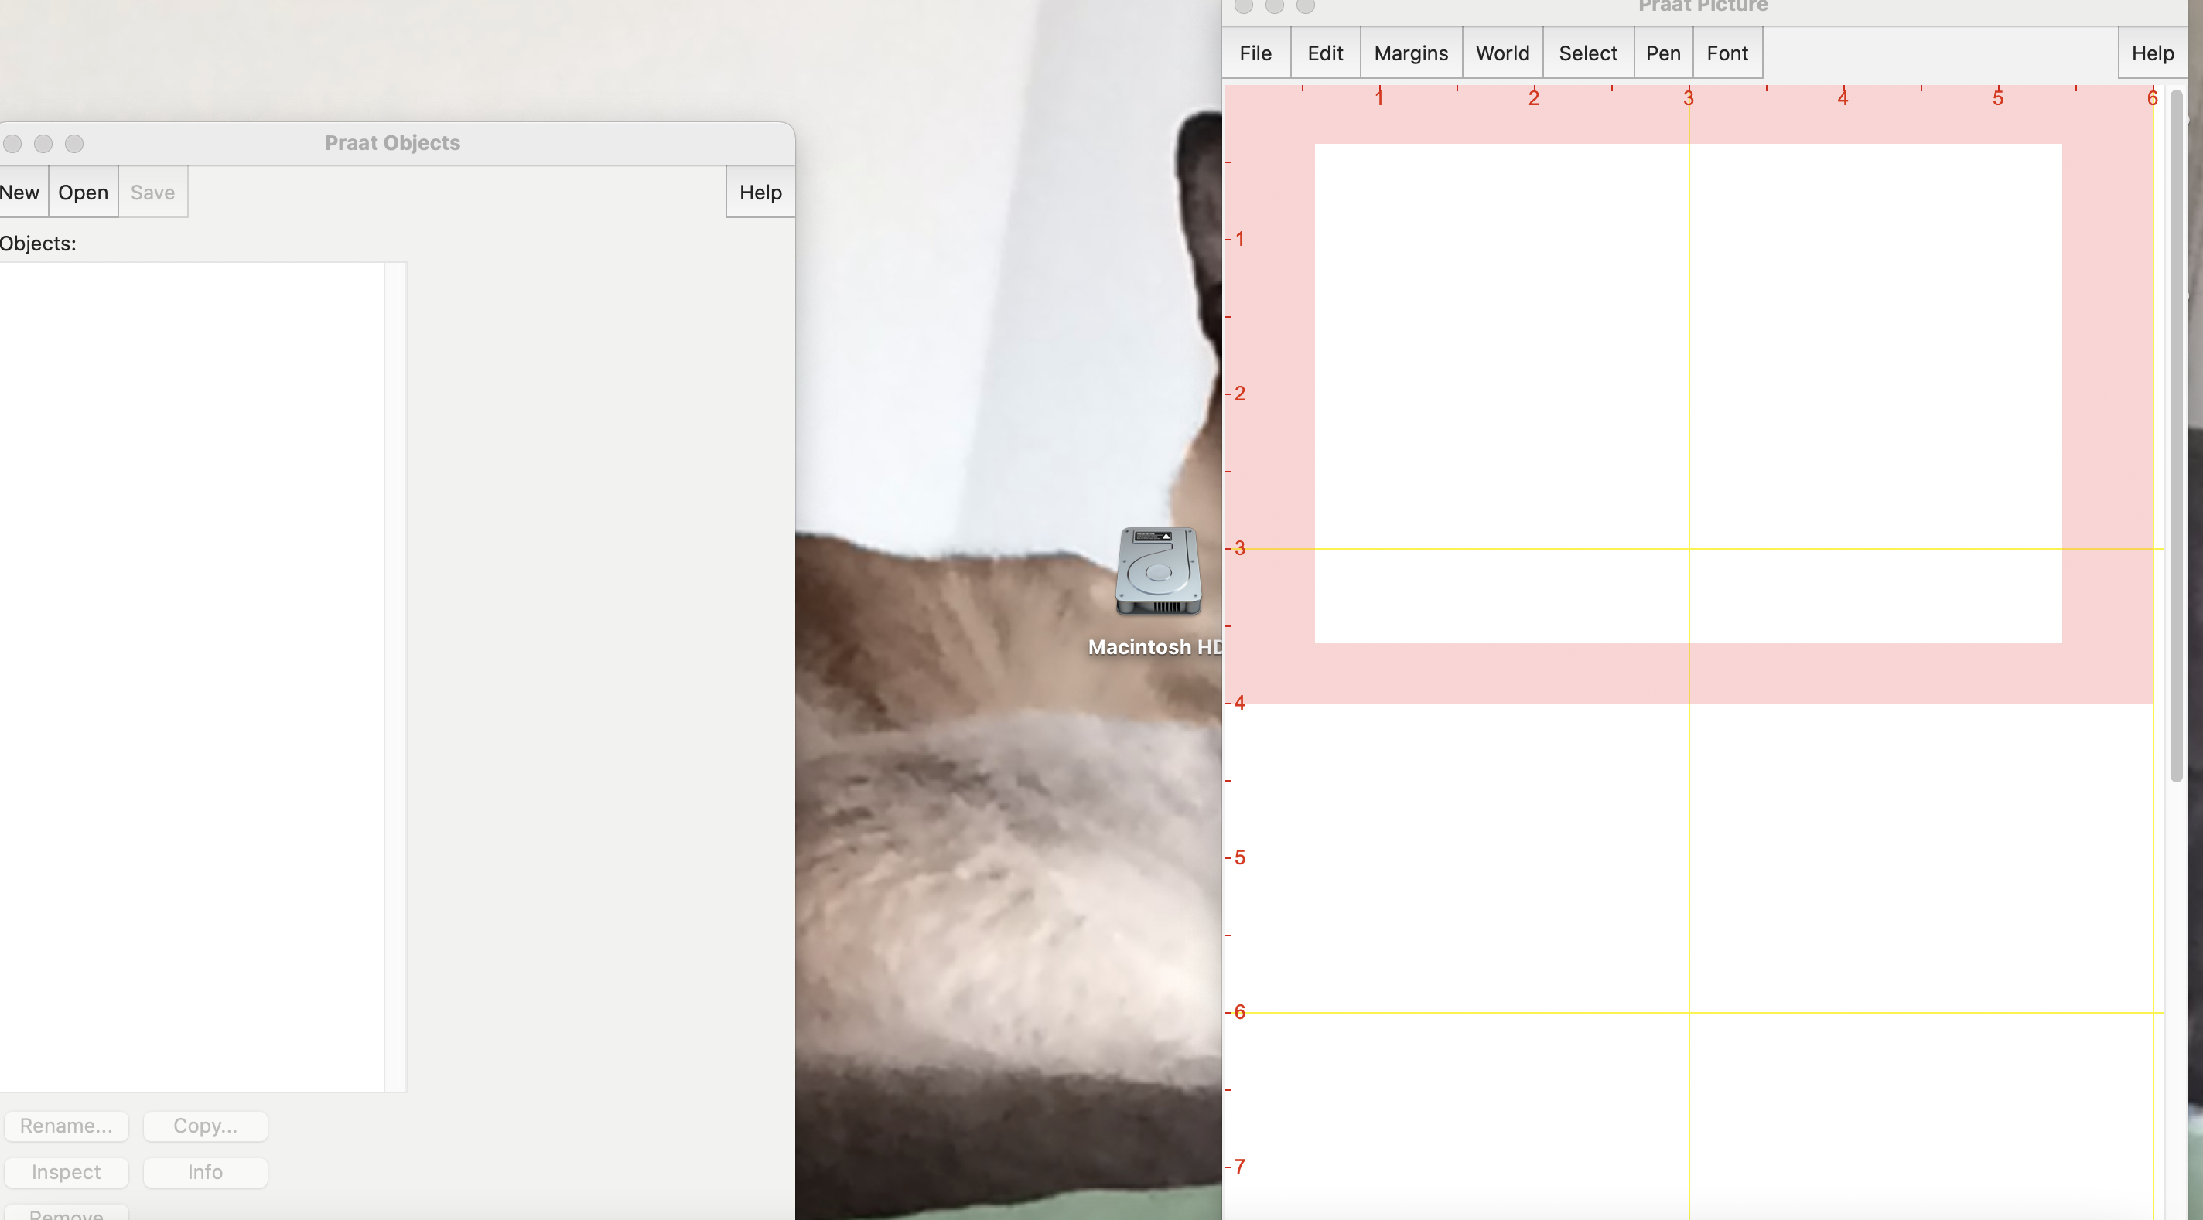
Notes:
To record your voice in Praat:
Select “New” in Praat Objects on the left
Back to previous slide

Slide 9
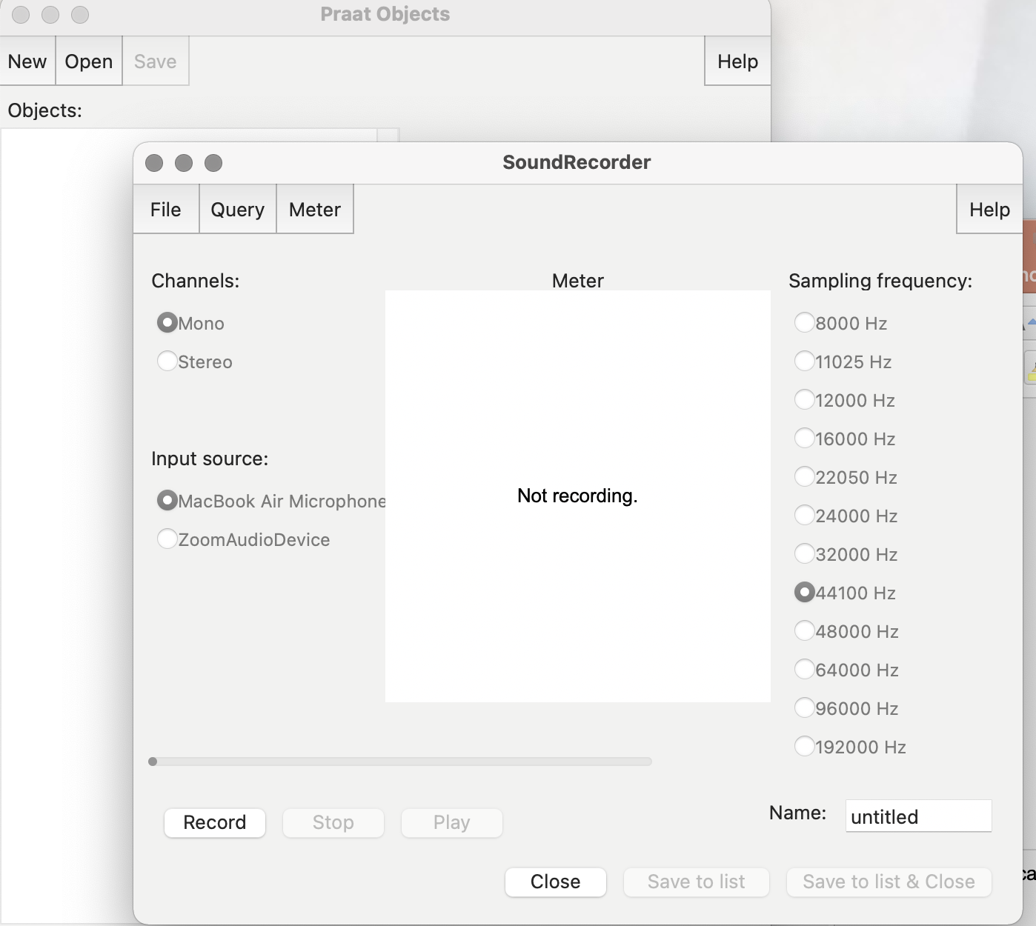
Notes:
If you need to record: This window will pop up. Use Mono as your channel, and whatever Mic you have as the input source and 44100 Hz sampling frequency. Select Record on the bottom left and hit Stop when you’re finished. Name your file on the left of the SoundRecorder Then select Save to list and close.
Back to slide 7

Slide 10
  Now select the file in the Objects window, click Save at the top left, choose Save as WAV file and place where you can find it on your machine
  Now select the file in Praat and click Remove from the bottom of the Objects window
Now we’ll see how to open files from disk
  Note: For those who have recorded a ”mama” file earlier in a quiet place open that file as below and not the one you just recorded
  Select Open from the Objects window, choose “Read from file”, find your (best) “mama” file and open in Praat
  Select this file in the Objects window to see many options on the right of the Objects window
  Select View and Edit
Notes:
Show in process in slide11
After opening files from disk and selecting View and Edit go to slide 12

Slide 11
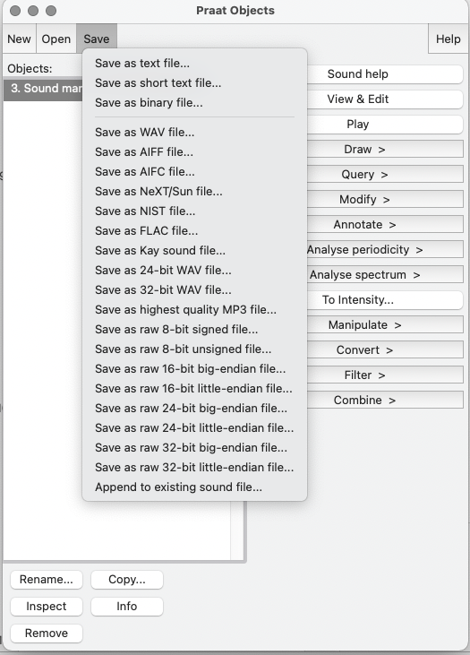
Notes:
Back to slide 10

Slide 12
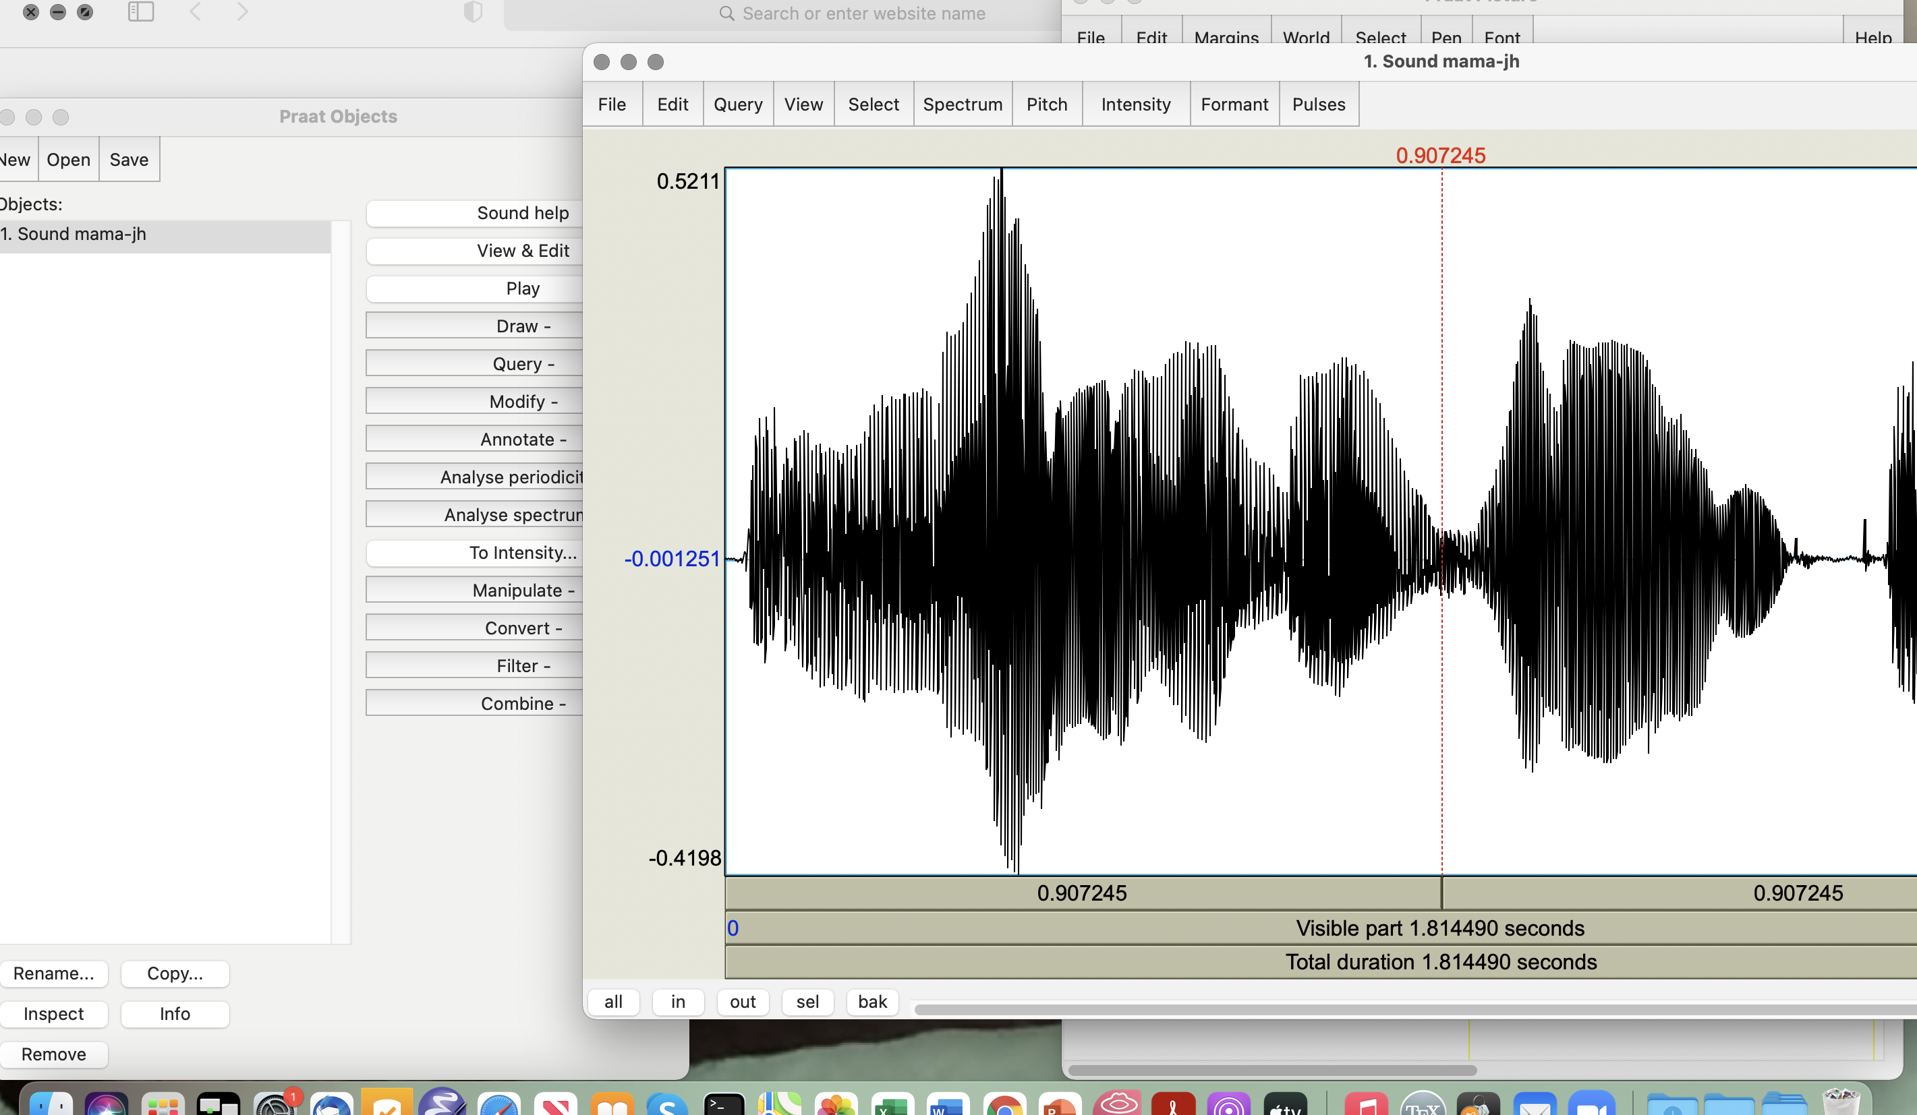
Notes:
Here’s probably what you will see: just the wav file 12
On to slide 13

Slide 13
Display Options from Objects File
In the window you see with the wavform, highlight only the speech portion of the file (not silence or noise) and click “sel” on the bottom left to select that portion
From the menus at the top of your sound file we’ll now find some Praat viewing choices
  Spectrum:
    If you do not already see your spectrogram select Spectrogram → Show spectrogram
    Select a point in your sound file and choose Spectrogram → View the spectral slice (bottom) to see the frequencies in Hz (x axis) and the sound pressure in db (y axis)
    Try to play some words one by one by selecting the correct portion of the spectrogram for each word and play by clicking on the top row at the bottom of the spectrogram
Notes:
X to the left; y to the sky
Go to next 2 slides: wav file w/spectrograph and spectral slice

Slide 14
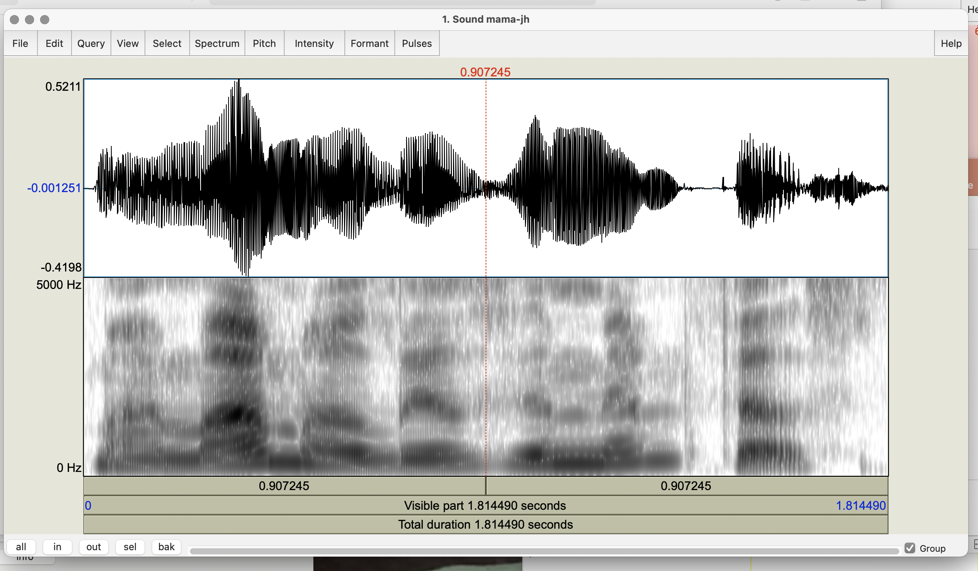
Notes:
This is the wav form and these are the harmonics of the pitch
Back to slide 13 to mention slice and then to slide 15

Slide 15
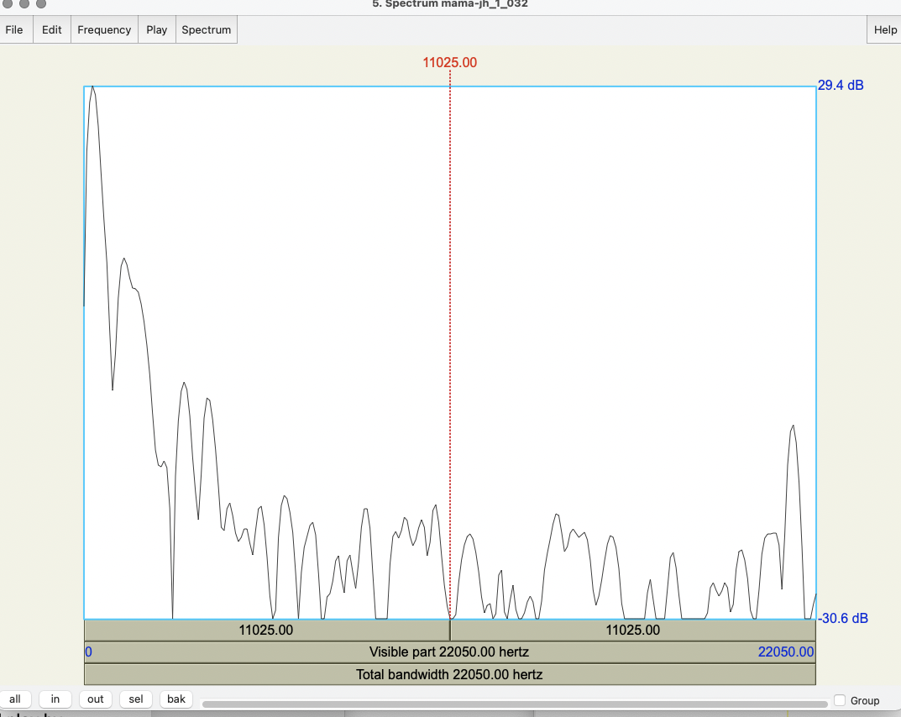
Notes:
Spectral slice
Back to slide 13

Slide 16
    At the bottom of the wav file, Row 1: is the selected portion; Row 2: is all the visible file; Row 3: the total duration of the file
    You can select a portion and hit sel at the bottom left to zoom in to it; use in and out to make visible longer or shorter, all to see the whole file and to go back to previous view
  Now look at Pitch on the top of the audio file
    Pitch → Show pitch
    Find your mean, min, and max, pitch with Pitch → Get pitch, → Get minimum pitch, → Get maximum pitch
    Can you describe the pitch contour you see?
  Intensity:
    Intensity → Show intensity
    Intensity → Get intensity, Get minimum intensity, Get maximum intensity
    Check Intensity → Intensity settings for times and intensity
Notes:
Show pitch file after Pitch
Now move to slide 19 to do intensity

Slide 17
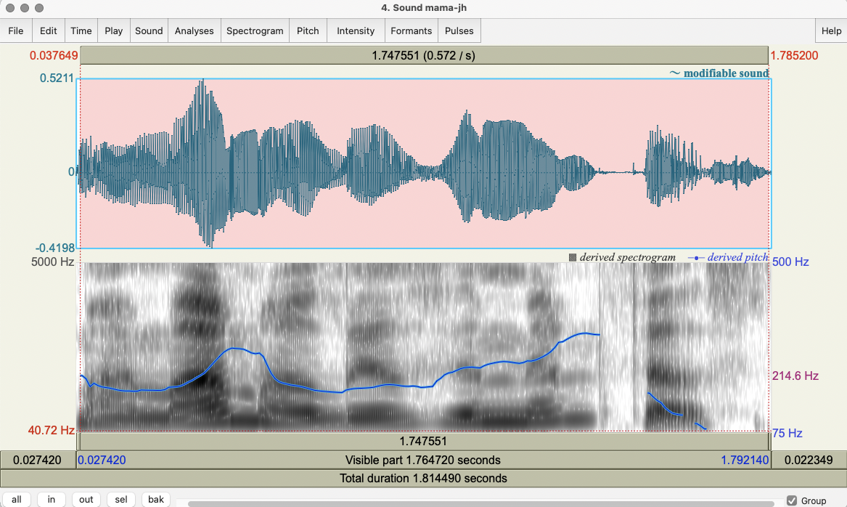
Notes:
Go to next copy of previous slide, Slide 19

Slide 18
    At the bottom, Row 1: is the selected portion; Row 2: is all the visible file; Row 3: the total duration of the file
    You can select a portion and hit sel at the bottom to zoom in to it; use in and out to make visible longer or shorter, all to see the whole file and bak to go to previous view
  Pitch
    Pitch → Show pitch
    Find your mean, min, and max, pitch with Pitch → Get pitch, → Get minimum pitch, → Get maximum pitch
    Can you describe the pitch contour you see?
  Intensity:
    Intensity → Show intensity
    Intensity → Get intensity, Get minimum intensity, Get maximum intensity
    Check Intensity → Intensity settings for times and intensity
Notes:
Show intensity file after Intensity and after Check intensity

Slide 19
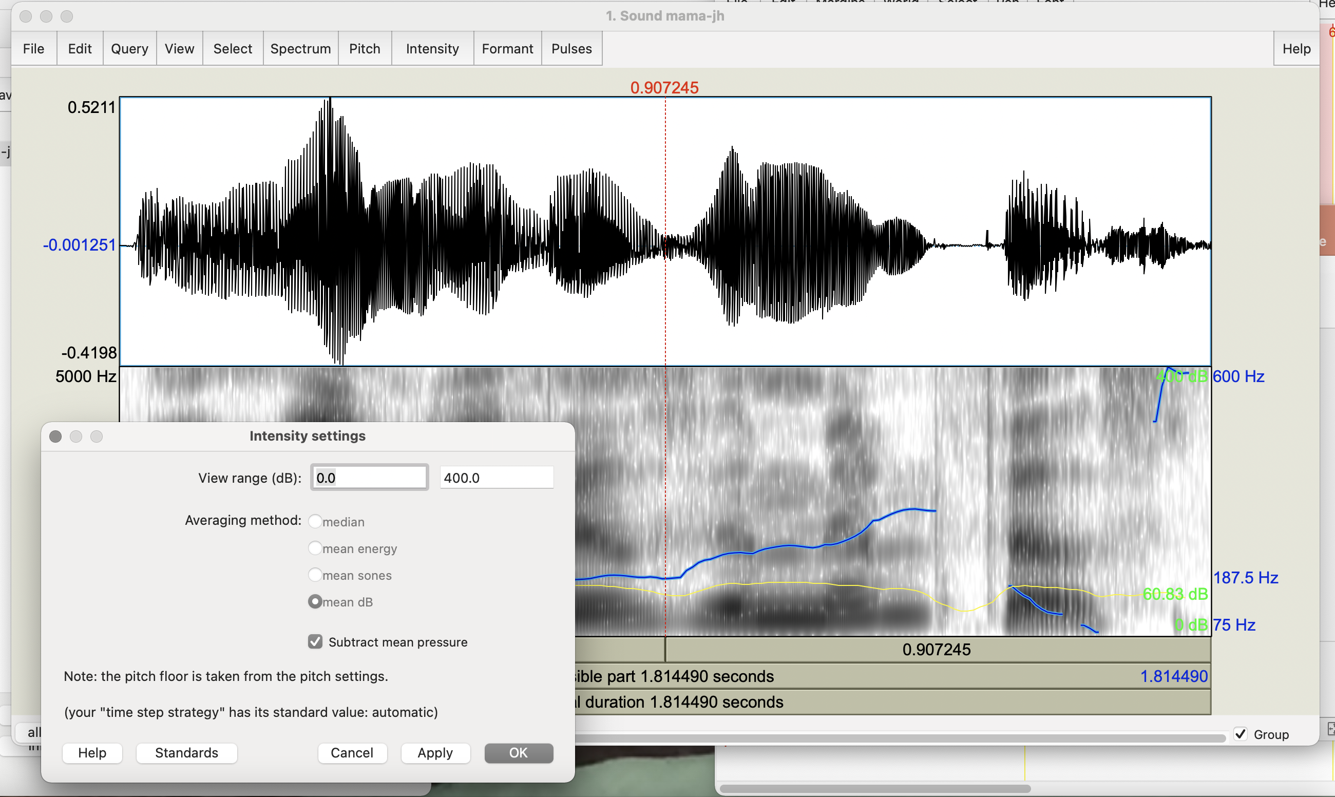
Notes:
0.0-400.0 is the usual setting for intensity

Slide 20
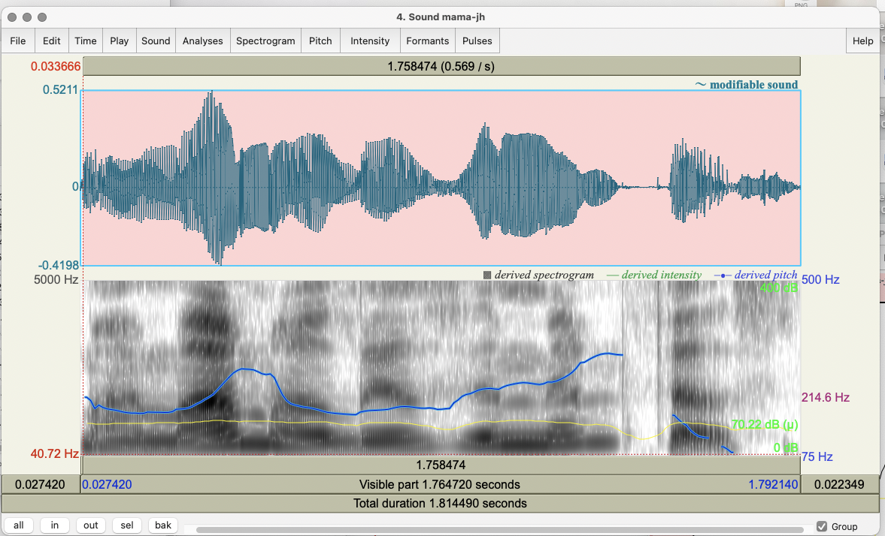
Notes:
Now we see both pitch (blue) and intensity (yello)

Slide 21
  Pulses represent the vocal fold vibrations over time:
    Pulses → Show pulses
    Select a segment in your speech file
    Pulses → Voice report – this gives you an overall summary (not always precise) of the pitch, pulses, voiced/unvoiced frames, jitter, shimmer, and HNR using many types of analysis
  Formant:
    Formant → Formant settings: Number of formants = 4.0 or 5.0; Dynamic range – 50.0
    Formant → Show formants
    Do the formant values match those you expect for vowels [aj] as in my, [ɑ] as in mama, [ɪ] as in lives, [ɛ] as in memphis?
  ,
Notes:
Show next slide (22) after Pulses – will show up on your wavfile
How to do formants
Show slide 24 after Formant

Slide 22
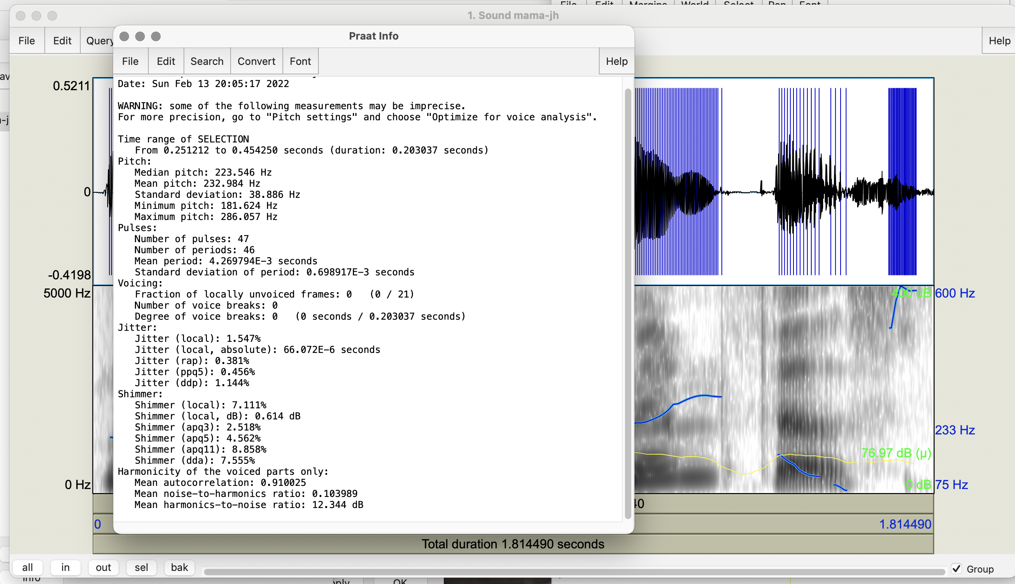
Notes:
Pulses
Back to 21

Slide 23
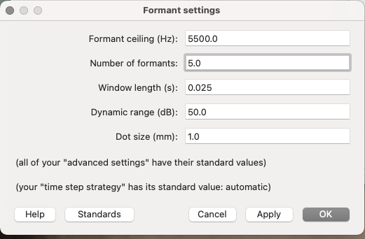
Notes:
Now select Show Formants from the Formants tab

Slide 24
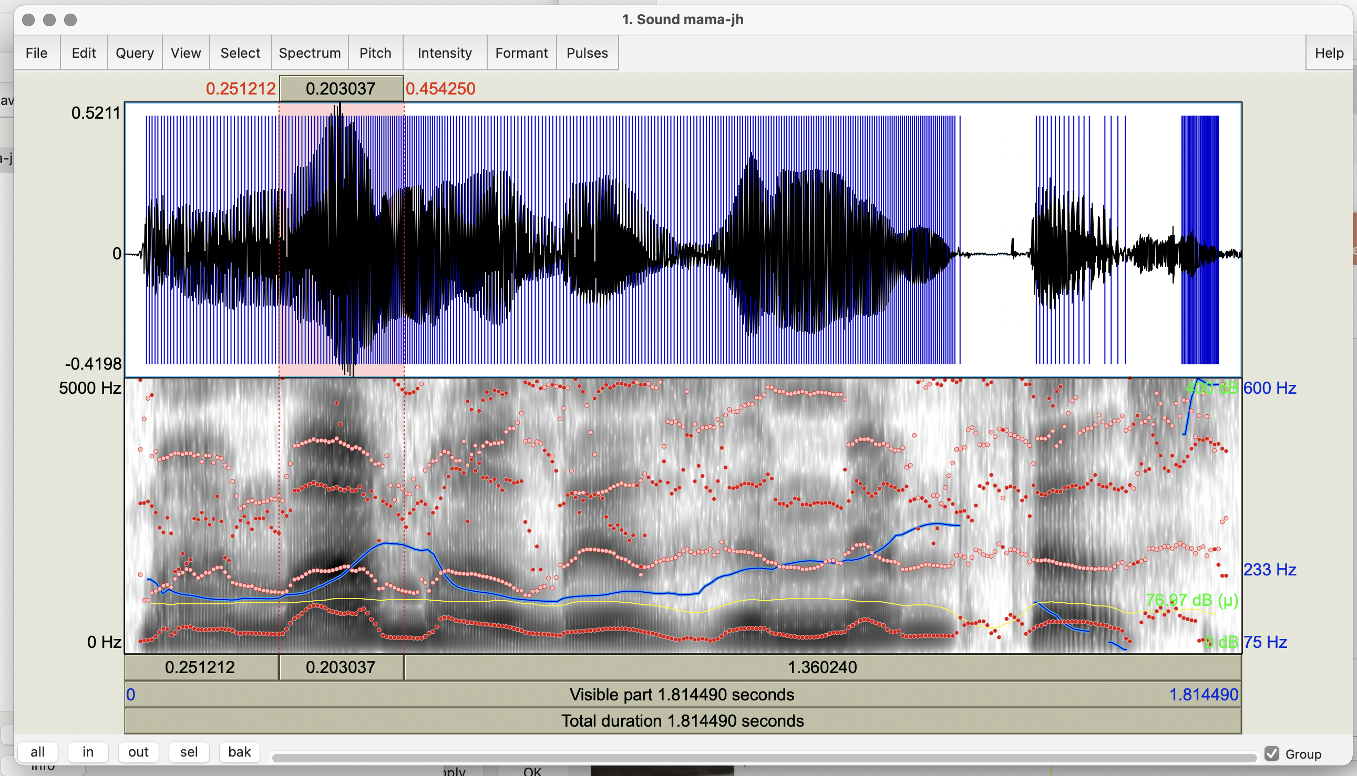
Notes:
Formants F1-5 shown – different colors (red 1, 3, 5; yellow 2, 4)

Slide 25
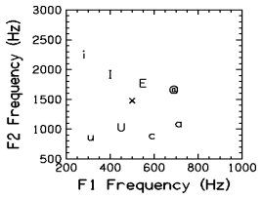
[i] - as in heed
[I] - as in hid
[E] - as in head
[@] - as in had
[a] - as in ha
[c] - as in hawed
[U] - as in hood
[u] - as in who'd
[x] - as in hud
Notes:
These are what your vowels will show in Hz frequency
Now to slide 26 to show formants

Slide 26
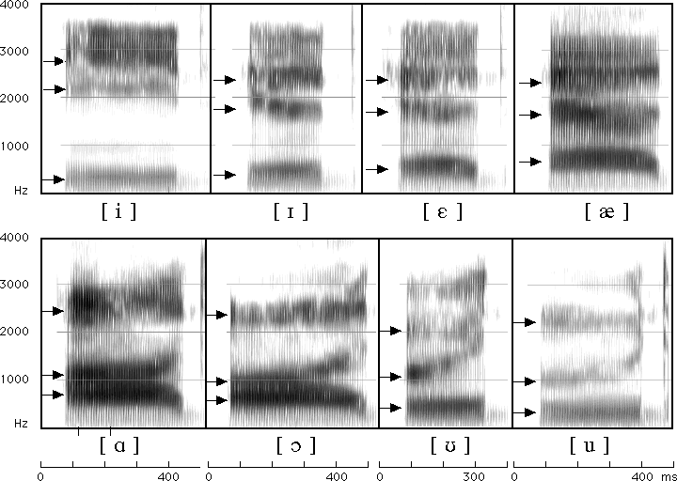
Match your Vowels in the Spectrogram to Formants for English Vowels
Notes:
My (a i/5 to 1) mama (a/5) lives in (I/2) Memphis (e/3 and i/2). How close are your vowels to these?

Slide 27
How to Set Other Praat Parameters
Select the speech segment from Sound mama
For pitch extraction:
  Open Pitch menu on Sound mama
  Select Show pitch and then Pitch settings
  Set Pitch --> Pitch settings (first) to min 75 max 500 or 600 (standard) for now but experiment with your own voice: try to find your highest and lowest pitch
For jitter (local only):
  In Objects window on left select Sound mama
  On right select Analyze periodicity
  Select To PointProcess periodic, cc
  Again set pitch max (500) and min (75) and click “OK”
Notes:
Show pitch on slide 28

Slide 28
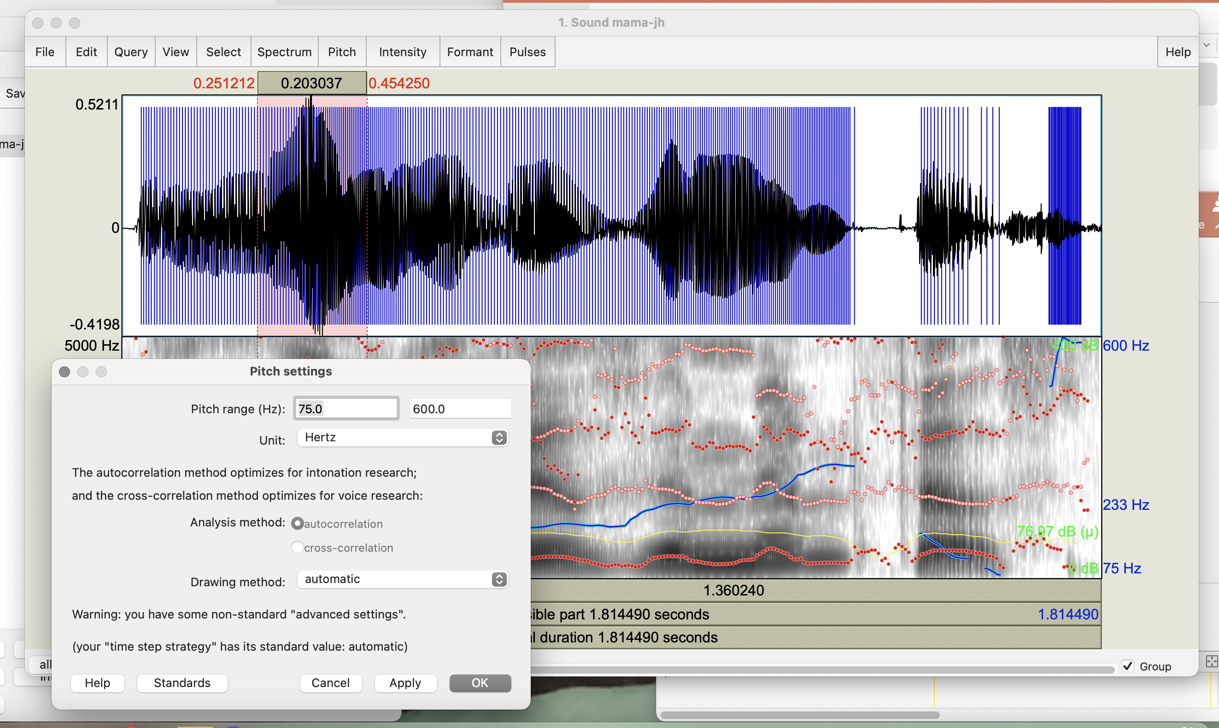
Notes:
Go to slide 29 and do jitter settings

Slide 29
How to Set Other Praat Parameters
Select the speech segment from Sound mama
For pitch extraction:
  Open Pitch menu on Sound mama
  Select Show pitch and then Pitch settings
  Set Pitch --> Pitch settings to min 75 max 500 (standard) for now but experiment with your own voice: try to find your highest and lowest pitch
For jitter (local only):
  In Objects window select Sound mama
  On right select Analyze periodicity
  Select To PointProcess periodic, cc
  Again set pitch max (500) and min (75) and click “OK”
Notes:
My high is 600
Go to Slide 30 to show jitter

Slide 30
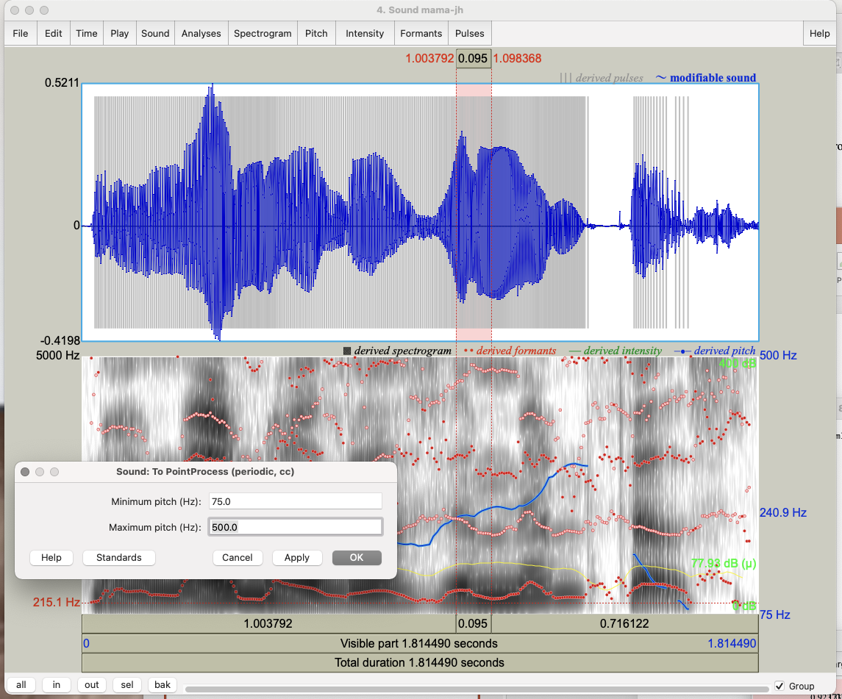
Notes:
Go to slide 31 to finish jitter

Slide 31
  In Objects window Select newly created PointProcess mama
  Choose Query → Get jitter (local) and set parameters in seconds: Shortest period = 0.0001; Longest period = 0.02, max period factor = 1.3 and click “OK”
For shimmer (local only):
  Select both Sound and PointProcess files from Objects
  Choose Query → Get shimmer (local) and set period floor to 0.0001s, period ceiling to 0.02s, max period factor to 1.3, and max amplitude 1.6 and click “OK”
Notes:
Show jitter in slide 32

Slide 32
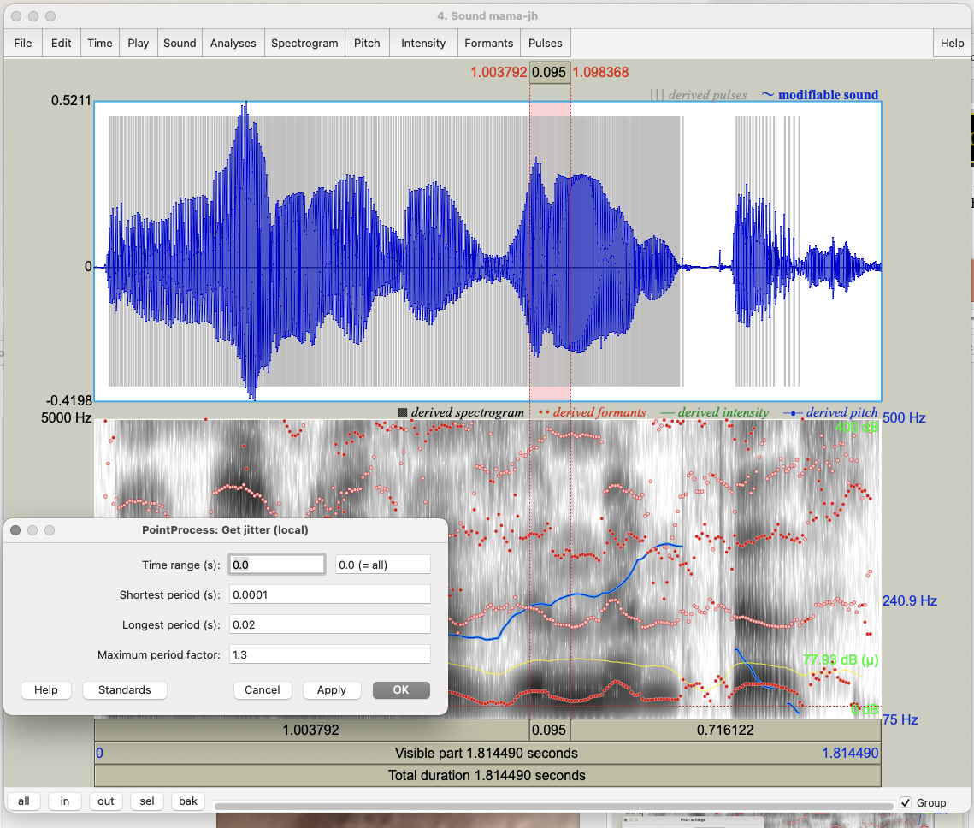
Notes:
Now go to slide 33 for shimmer

Slide 33
  In Objects window Select newly created PointProcess mama
  Choose Query → Get jitter (local) and set parameters in seconds: Shortest period = 0.0001; Longest period = 0.02, max period factor = 1.3 and click “OK”
For shimmer (local only):
  Select both Sound and PointProcess files from Objects
  Choose Query → Get shimmer (local) and set period floor to 0.0001s, period ceiling to 0.02s, max period factor to 1.3, and max amplitude factor to 1.6 and click “OK”
Notes:
Show slide 34 for shimmer

Slide 34
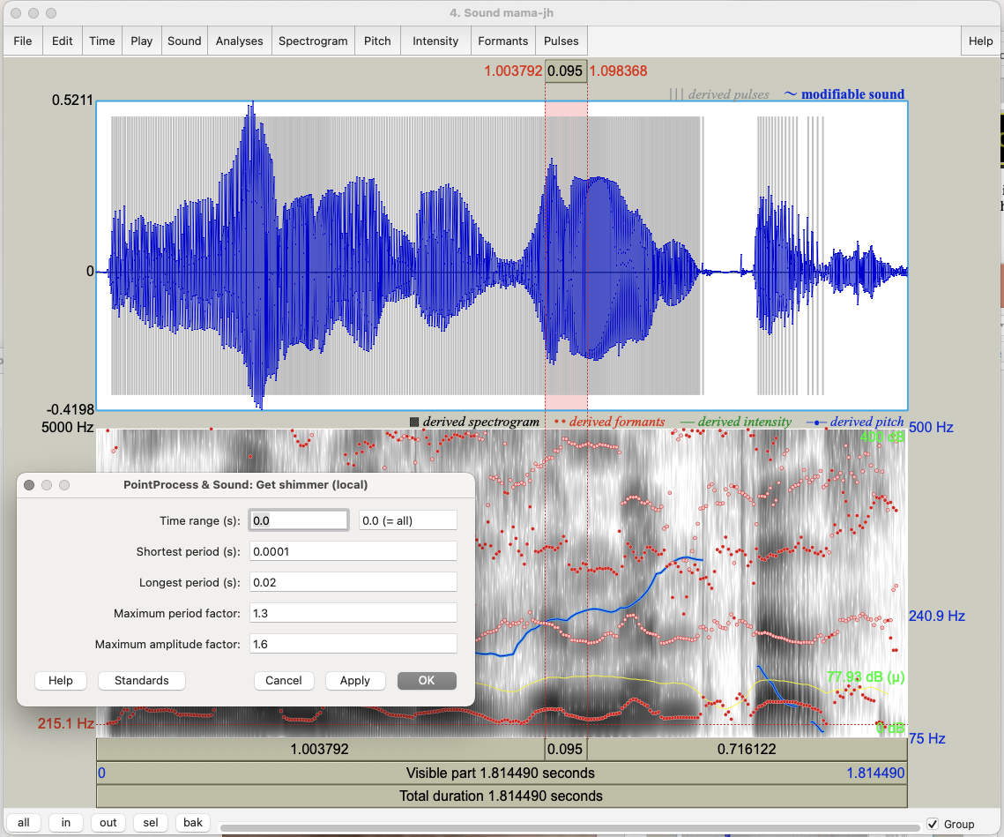
Notes:
Go to slide 35 for HNR

Slide 35
For HNR:
  In Objects window select Sound mama
  On right select Analyze periodicity
  Select To harmonicity (cc) and set time step to 0.01, min pitch to 75Hz, silence threshold to 0.1, and periods per window to 1.0
Speaking rate: Divide #words or syllables by utterance duration (or use a Praat script or parselmouth script)
To identify silences:
  Gp back to Sound mama in Objects window
  Select Annotate → To TextGrid (silences); click OK
  Select both Sound mama and TextGrid file created (using command (⌘))
  Choose View and Edit on the right
Notes:
Go to slide 36 to see HNR

Slide 36
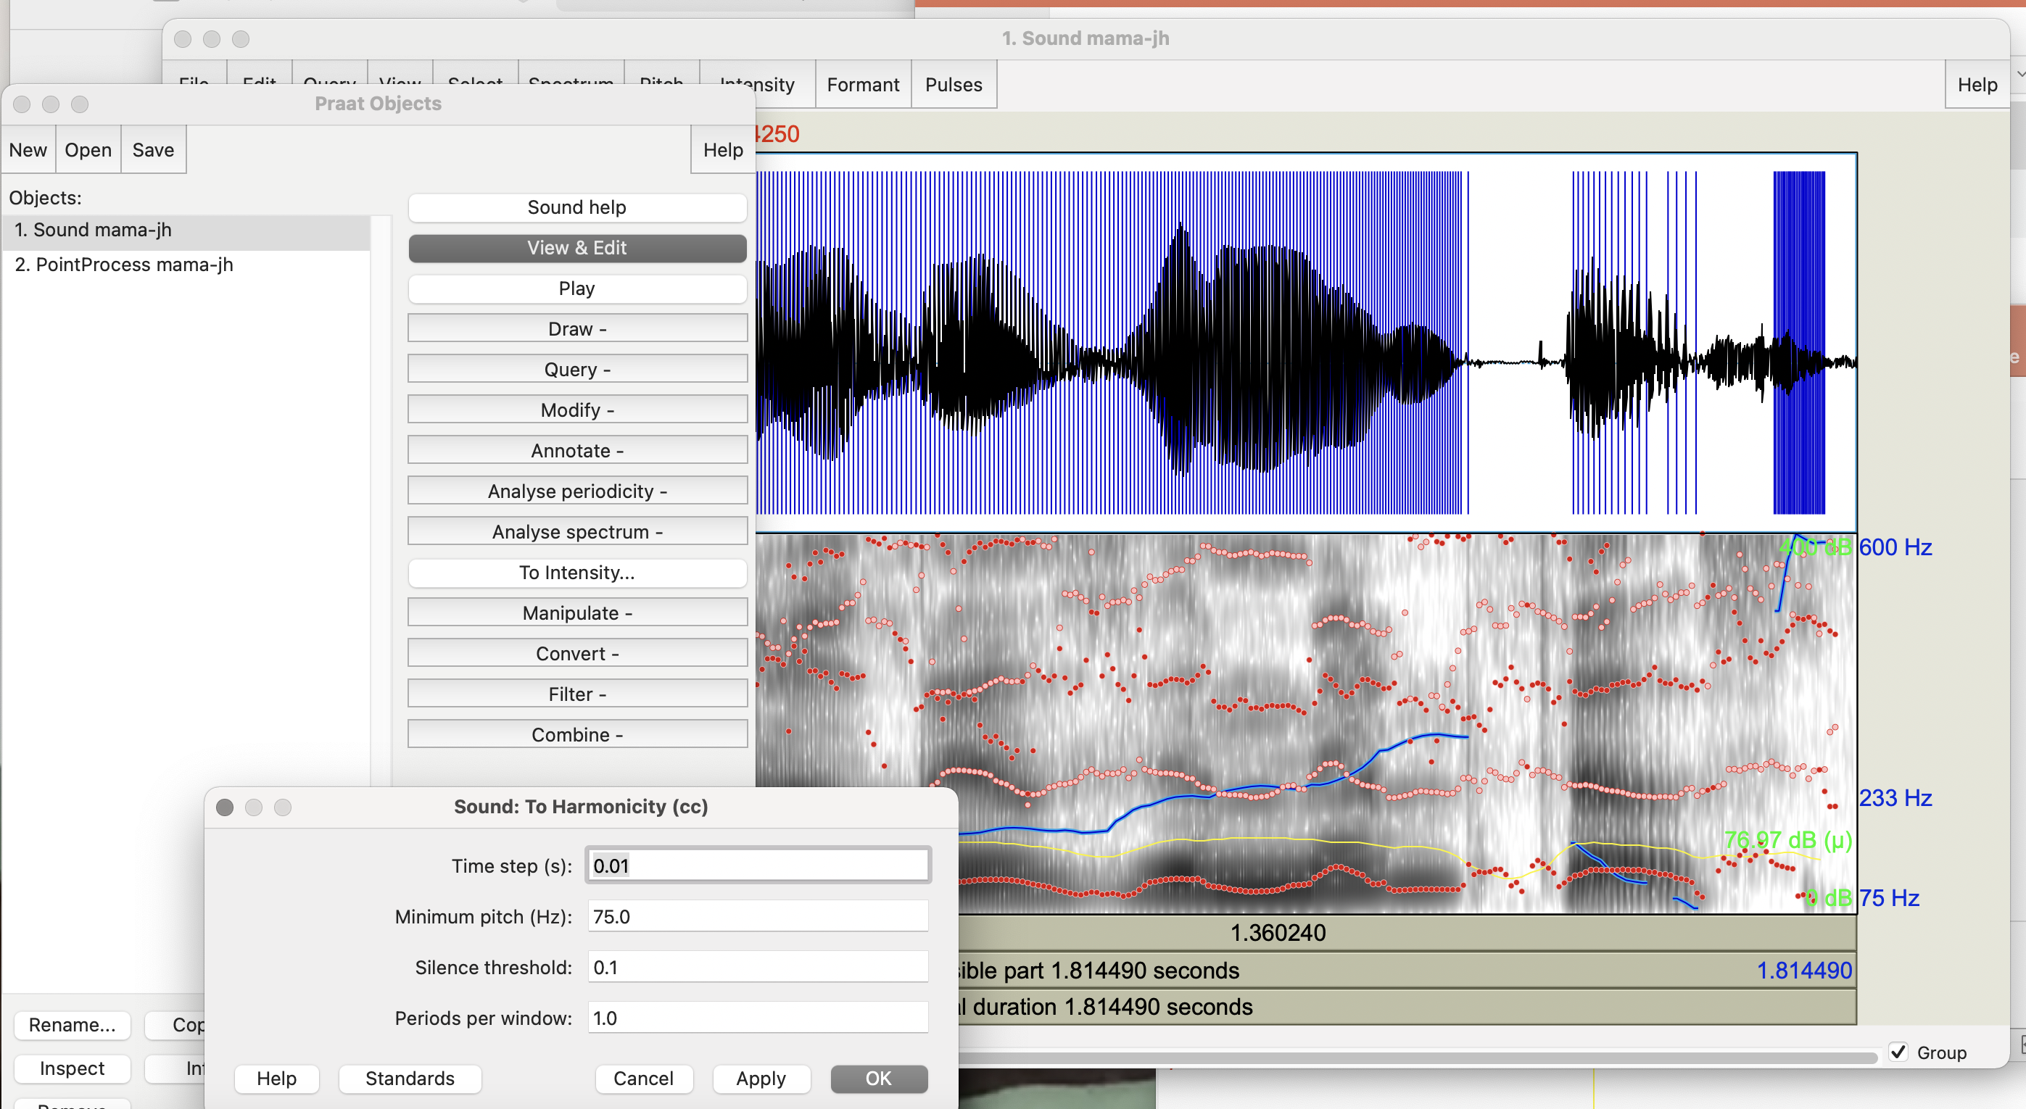
Notes:
On right select Analyze periodicity
Select To harmonicity (cc)
Go to slide 37 for rate and silences

Slide 37
For HNR:
  In Objects window select Sound mama
  On right select Analyze periodicity
  Select To harmonicity (cc) and set time step to 0.01, min pitch to 75Hz, silence threshold to 0.1, and periods per window to 1.0
Speaking rate: Divide #words or syllables by utterance duration (or use a Praat script or parselmouth script)
To identify silences:
  Select Sound mama in Objects window
  Select Annotate → To TextGrid (silences); click OK
  Select both Sound mama and TextGrid file created (using command (⌘))
  Choose View and Edit on the right
Notes:
Go to slide38 to start for silences identification

Slide 38
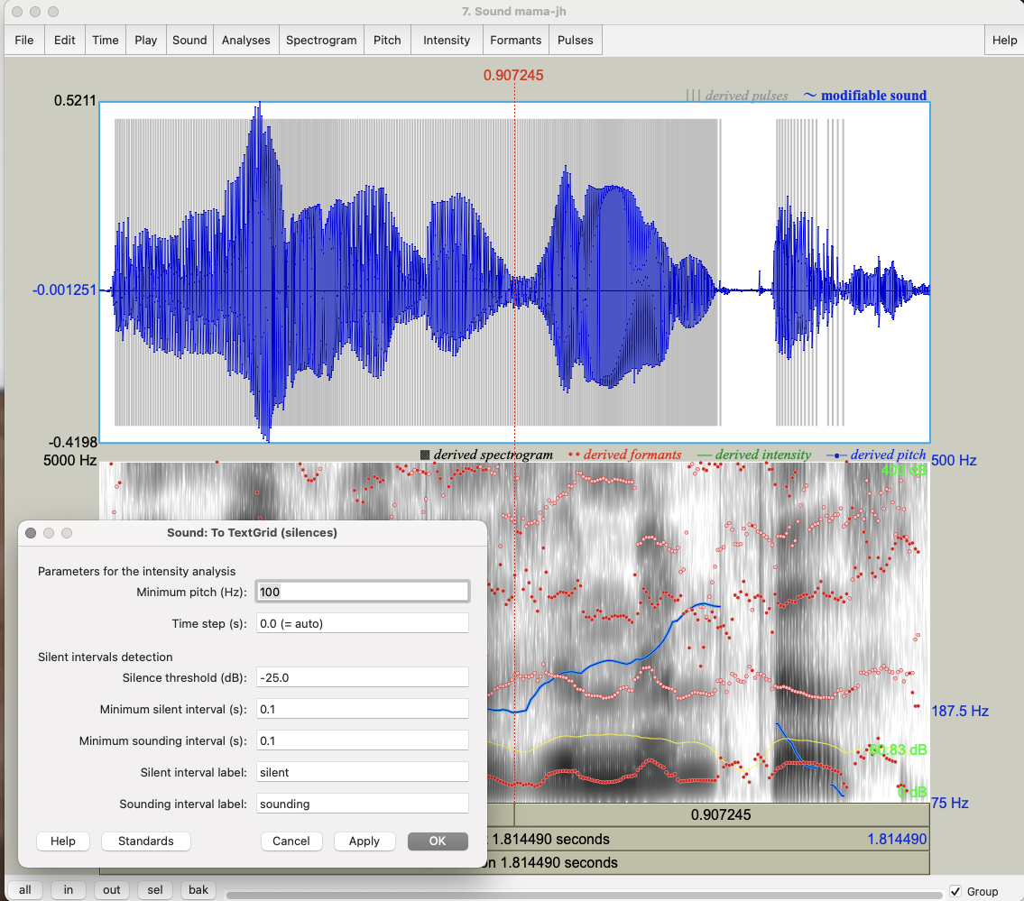
Notes:
Go to slide 39

Slide 39
For HNR:
  In Objects window select Sound mama
  On right select Analyze periodicity
  Select To harmonicity (cc) and set time step to 0.01, min pitch to 75Hz, silence threshold to 0.1, and periods per window to 1.0
Speaking rate: Divide #words or syllables by utterance duration (or use a Praat script or parselmouth script)
To identify silences:
  Select Sound mama in Objects window
  Select Annotate → To TextGrid (silences); click OK
  Select both Sound mama and TextGrid file created (using command (⌘))
  Choose View and Edit on the right
Notes:
Annotate → To TextGrid (silences); click OK;
At end go to Slide 40
Also, check mic to see if still green – otherwise change to the other

Slide 40
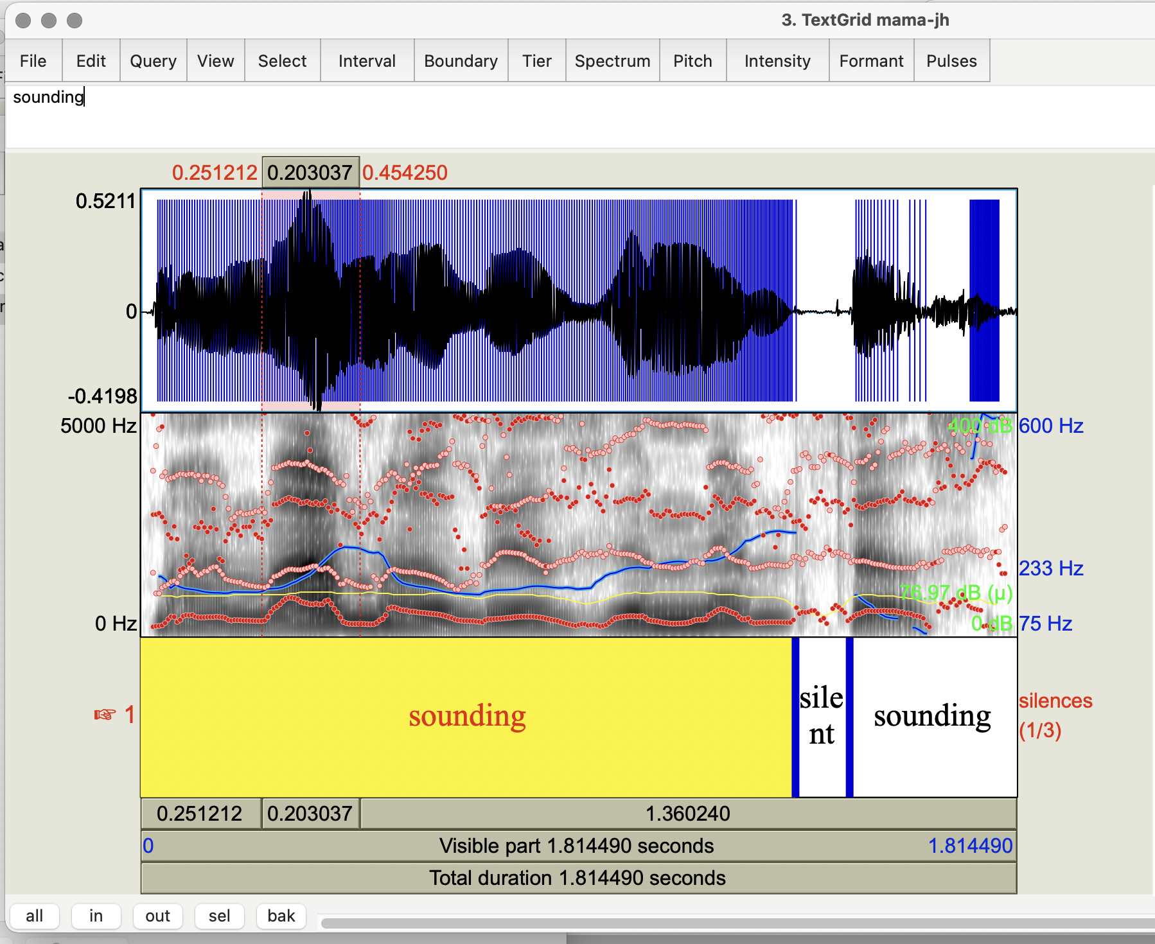
Notes:
Results

Slide 41
Task 1
Open your mama file in Praat; select View & Edit
  Show spectrogram and show pitch
  Select the most prominent word (using “sel” at the bottom)
  Look at the top -- what is the amount of time of the word identified at the top of the spectrogram?
  Look at the right side of the spectrograph where the frequency of the word is shown in Hz
Select the entire contour again using “all” at the bottom left and selecting only the waveform
  Select Pitch → Show Pitch and Intensity → Show intensity What is the minimum pitch? Maximum? Mean? the minimum intensity? Maximum? Mean?
Notes:
Show frequency in Slide 42

Slide 42
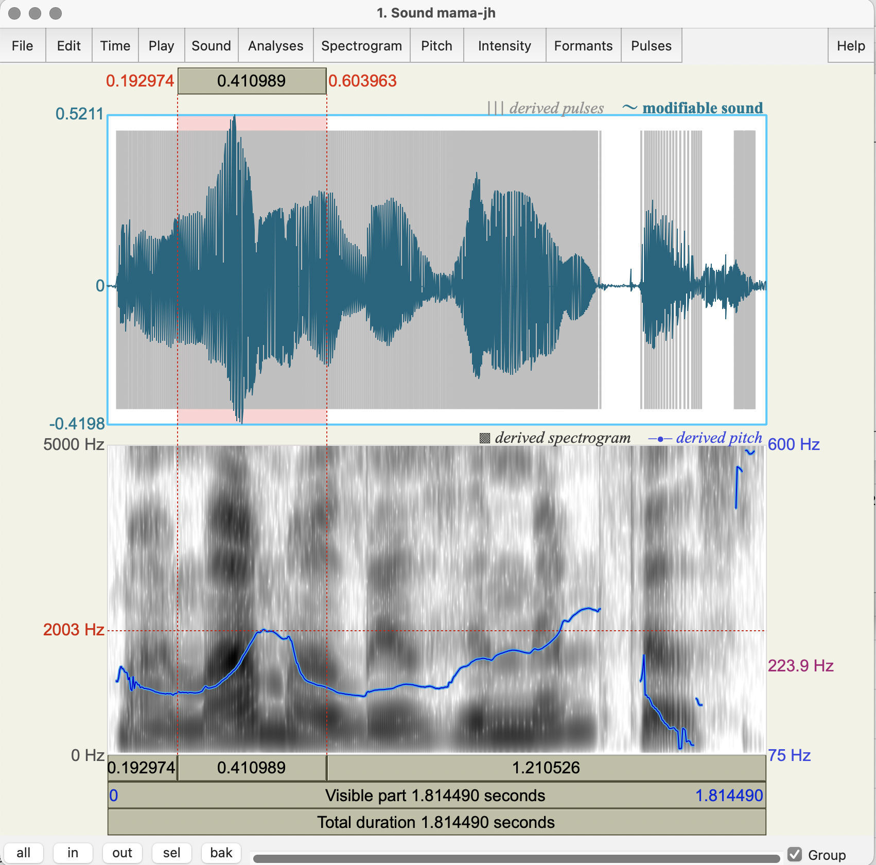

Slide 43
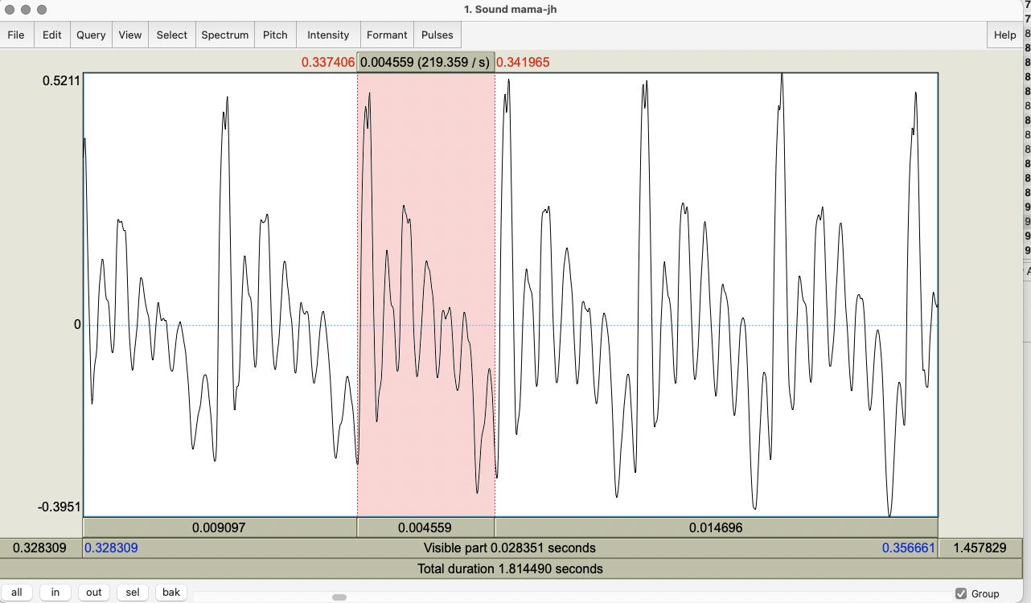
Notes:
From first syllable of Mama
Go to slide 43

Slide 44
Task 1
Open your mama file in Praat; select View & Edit
  Show spectrogram and show pitch
  Select the most prominent word (using “sel” at the bottom)
  Look at the top -- what is the frequency (cycles per second) identified at the top of the spectrogram?
  Look at the right side of the spectrograph where the pitch is shown in Hz
Select the entire contour again using “all” at the bottom left and selecting only the waveform
  Select Pitch → Show Pitch and Intensity → Show intensity What is the minimum pitch? Maximum? Mean? the minimum intensity? Maximum? Mean?
Notes:
Show frequency in Slide 42

Slide 45
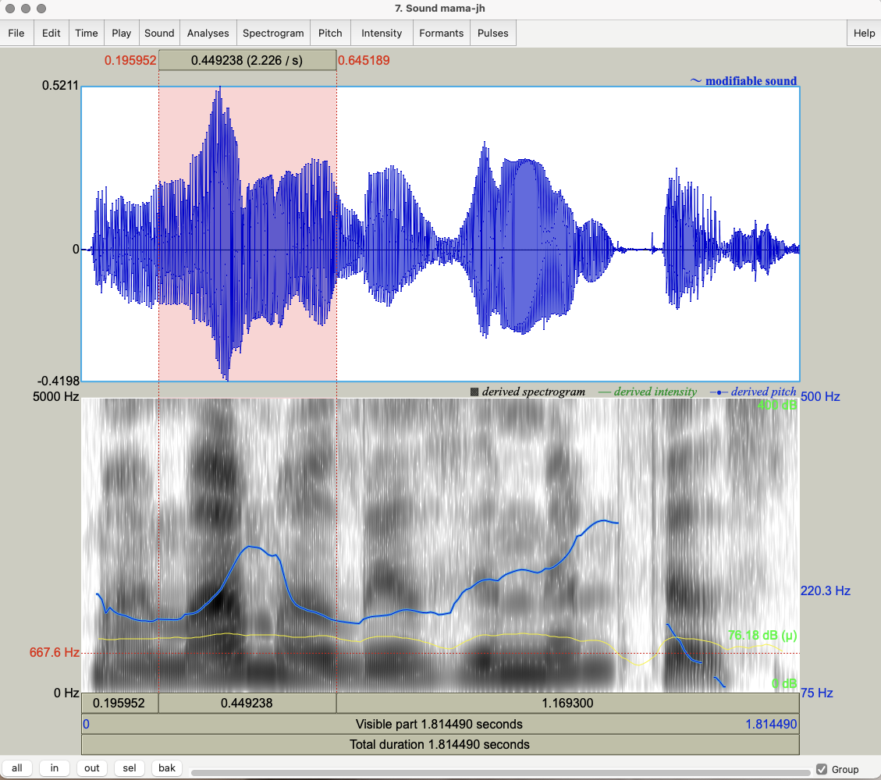

Slide 46
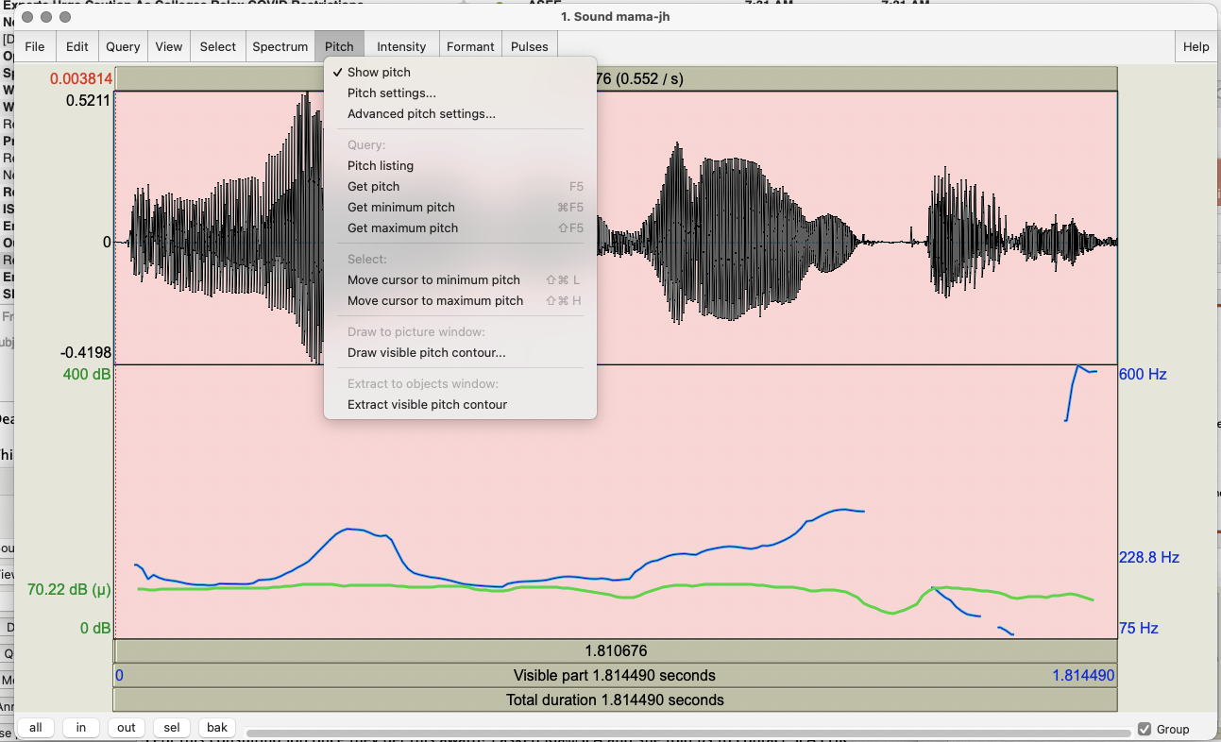
Notes:
You can remove Spectrograph → Show spectrogram if you want to see pitch and intensity more clearly
Now on to slides 46

Slide 47


Task 2: Voice Quality
Record “My mama lives in Memphis”
  in a whisper
  in a creaky voice
Add to Praat Objects and View & Edit each
  Study the pitch contours in normal vs. whisper vs. creaky. What do you notice?
  Now select Pulses -> Show pulses and select the whole waveform
  Analyze jitter, shimmer and HNR of your 3 files using Pulses → Voice report
Notes:
First play whisper.
Show next slides 48 and 49 for whisper
All slide changes must be by selecting next slide on bottom bar

Slide 48
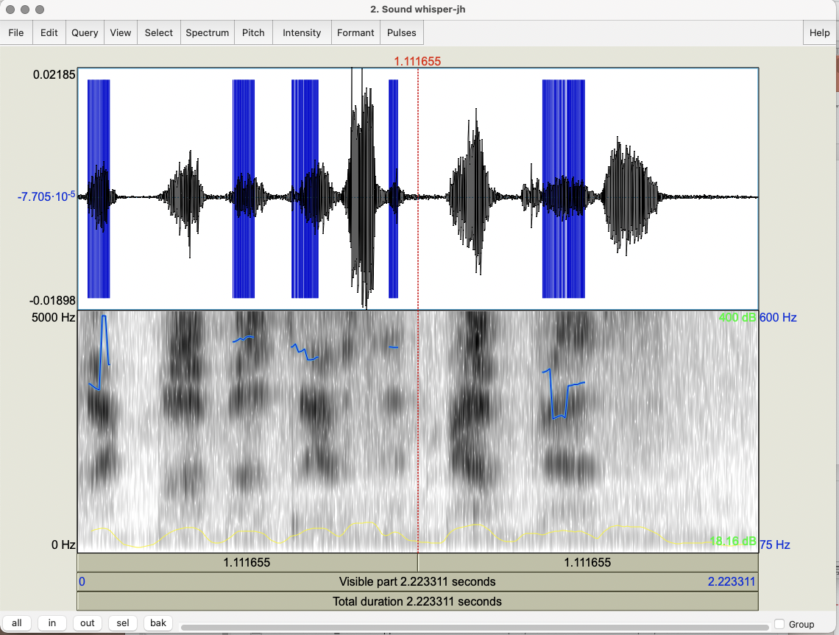
Notes:
Showing spectrogram for whisper

Slide 49
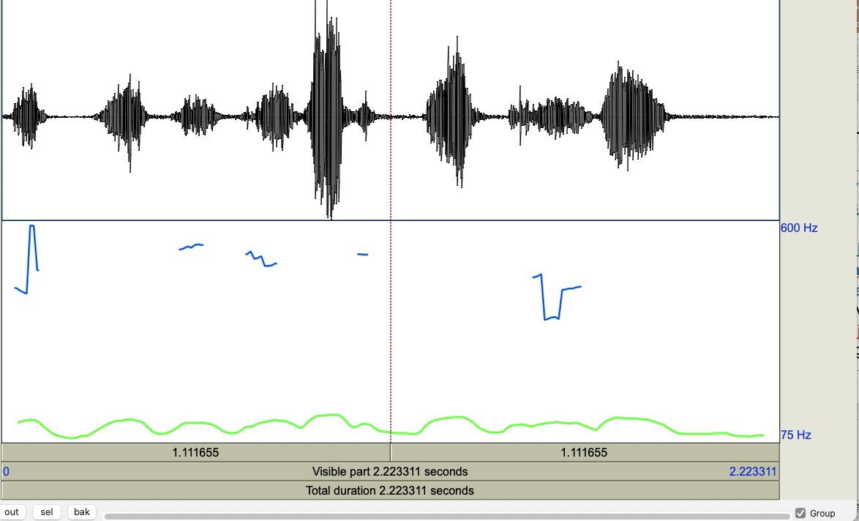
Notes:
Only pitch and intensity for whisper
Go to slide 49

Slide 50
Task 2: Voice Quality
Record “My mama lives in Memphis”
  in a whisper
  in a creaky voice
Add to Praat Objects and View & Edit each
  Study the pitch contours in normal vs. whisper vs. creaky. What do you notice?
  Now select Pulses -> Show pulses and select the whole waveform
  Analyze jitter, shimmer and HNR of your 3 files using Pulses → Voice report
Notes:
Now play creaky and Show slides 51 and 52 for creaky

Slide 51
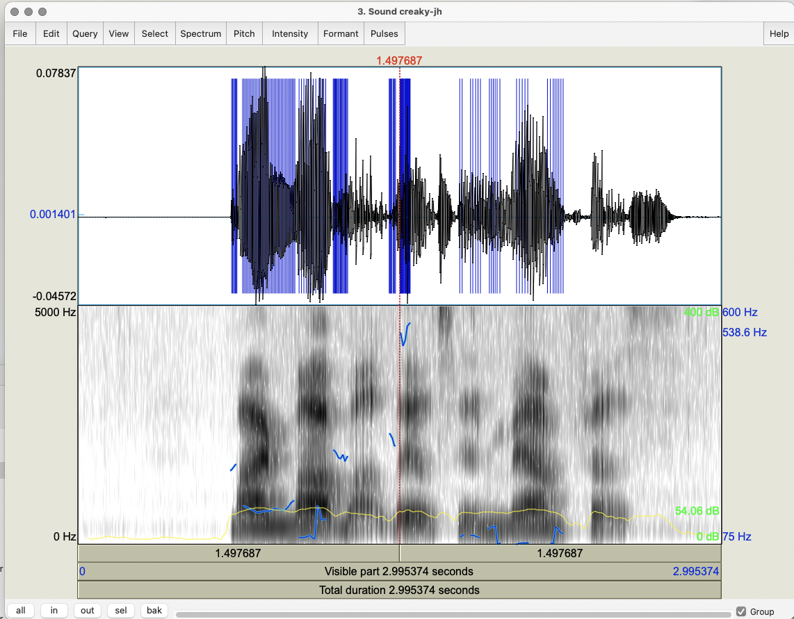
Notes:
With spectrogram for creaky

Slide 52
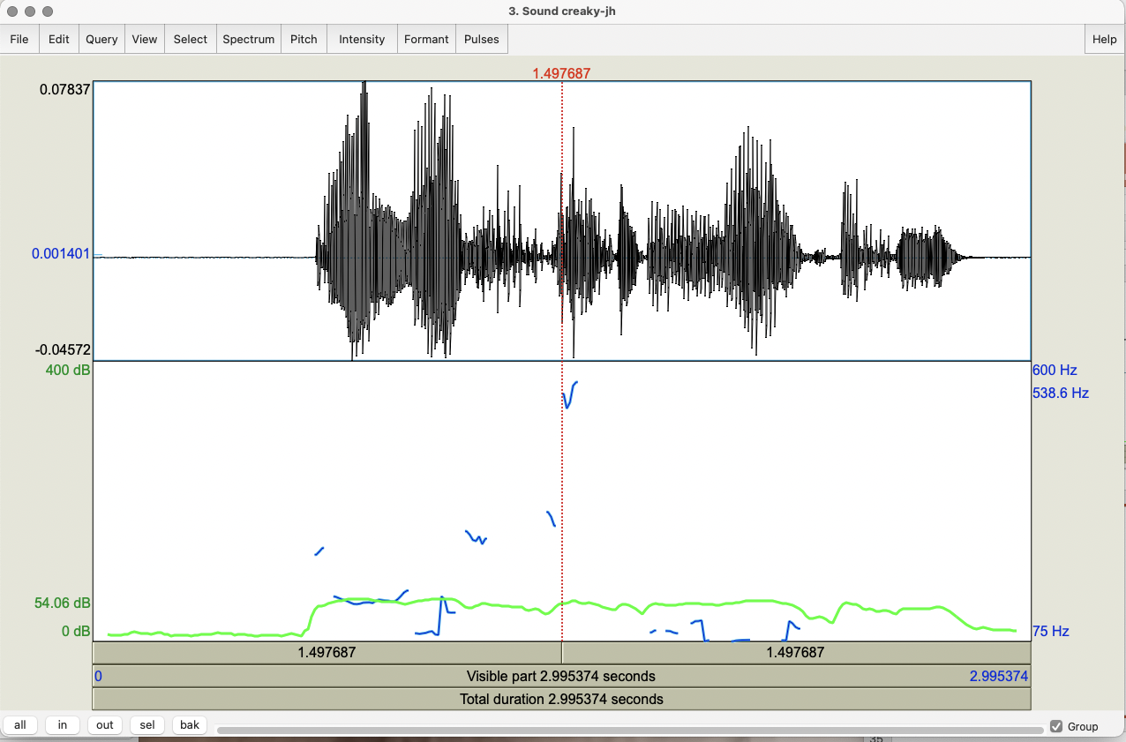
Notes:
Without spectrogram for Creaky voice
On to slide 52

Slide 53
Task 2: Voice Quality
Record “My mama lives in Memphis”
  in a whisper
  in a creaky voice
Add to Praat Objects and View & Edit each
  Study the pitch contours in normal vs. whisper vs. creaky. What do you notice?
  Now select Pulses -> Show pulses and select the whole waveform
  Analyze jitter, shimmer and HNR of your 3 files using Pulses → Voice report
Notes:
Add these to Praat and select view and edit. Compare your normal, whisper and creaky voices and check the differences in jitter, shimmer, HNR for each
Show slides 54, 55 and 56 for comparisons of normal to whisper to creaky

Slide 54
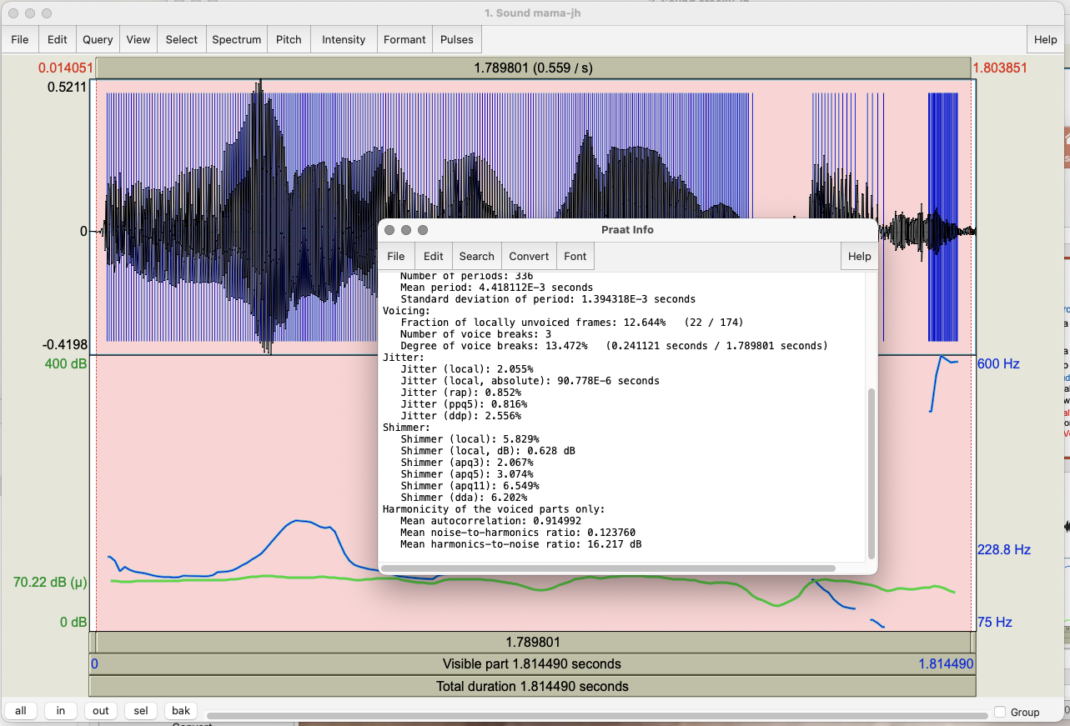
Notes:
Normal voice:
Compare to Whisper and then compare to Creaky: next 2 sides for each

Slide 55
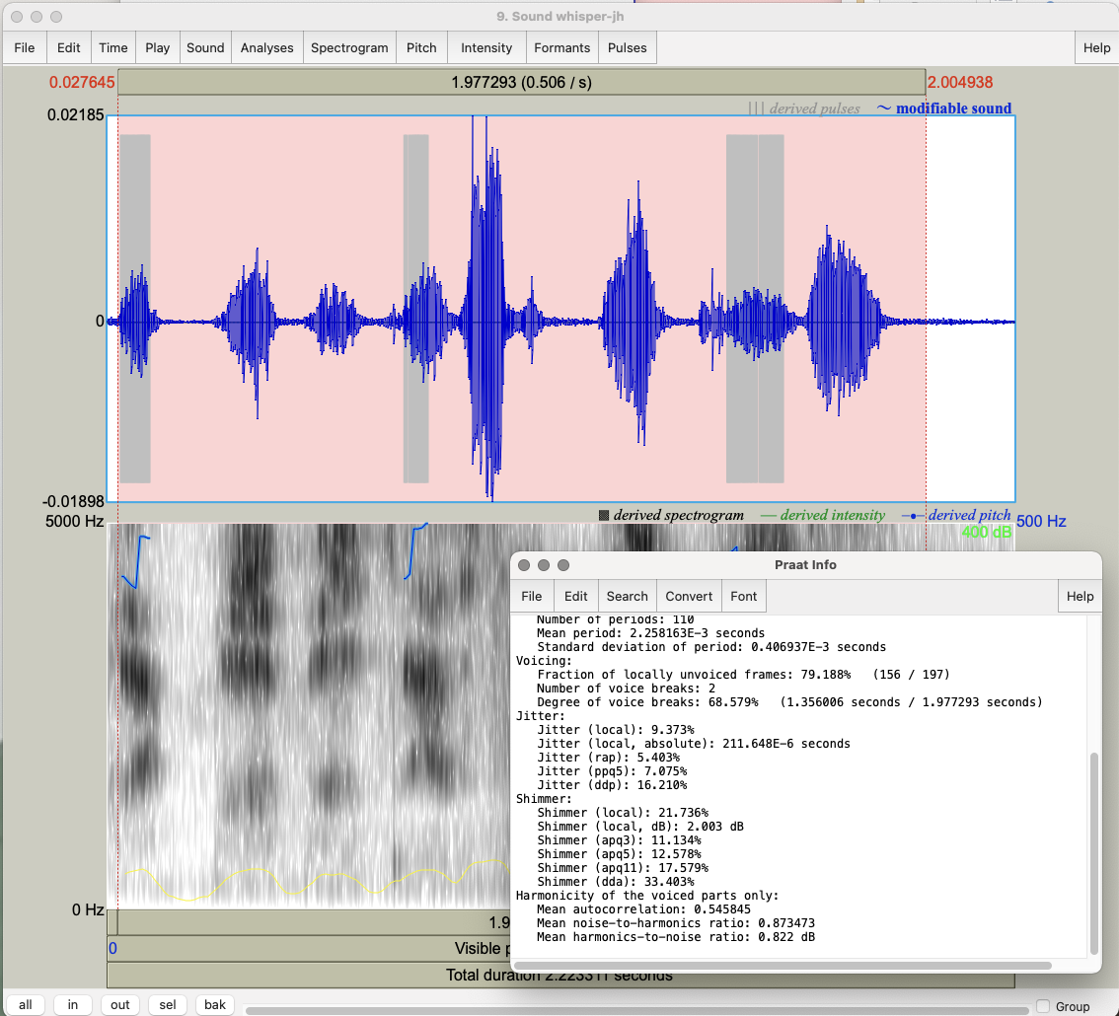
Notes:
Voice report for whisper: less voicing, less jitter, more shimmer, lower harmonicity (HNR)

Slide 56
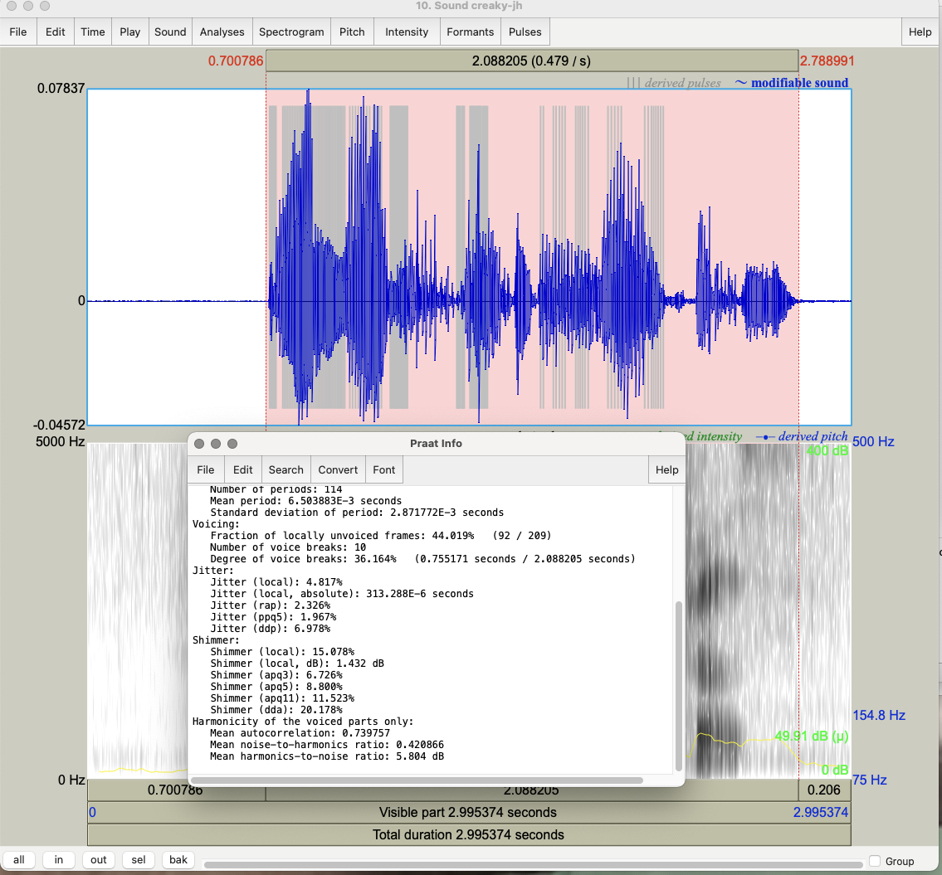
Notes:
Voice report for creaky: less voicing, more jitter, more shimmer, lower HNR ratio
On to slide 57

Slide 57
Task 3: Contours
Record “My mama lives in Memphis” as a yes-no question
  Compare to your Mama statement
  What are the similarities in F0? Differences?
Now record a wh-question: “Where does my mama live?”
Which of the other 2 contours is most similar?
Notes:
Show slide 58 for ynq

Slide 58
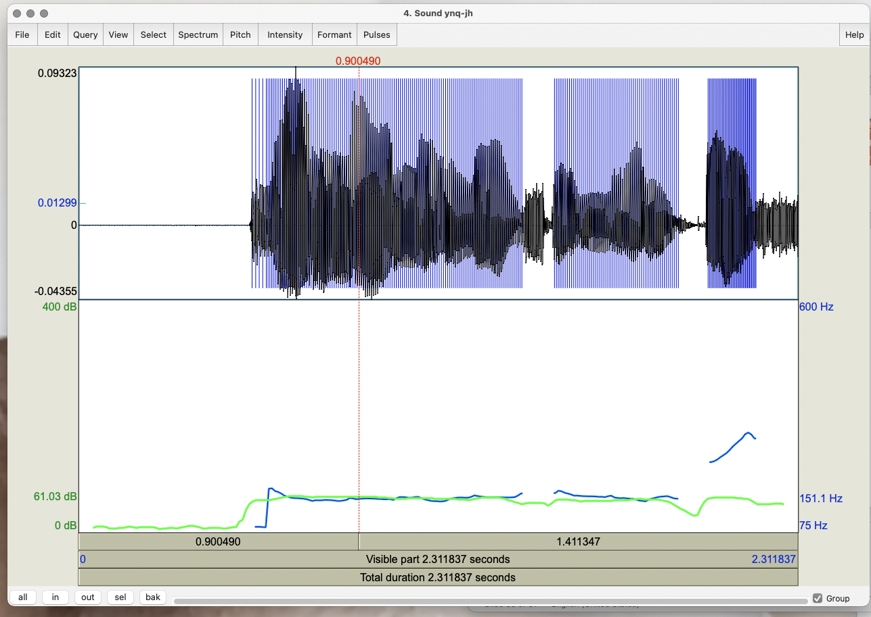
Notes:
Ynq contour goes up at the end
On to slide 58

Slide 59
Task 3: Contours
Record “My mama lives in Memphis” as a yes-no question
  Compare to your Mama statement
  What are the similarities in F0? Differences?
Now record a wh-question: “Where does my mama live?”
Which of the other 2 contours is most similar?
Notes:
Show slides 60 and 61 for wh-q’s

Slide 60
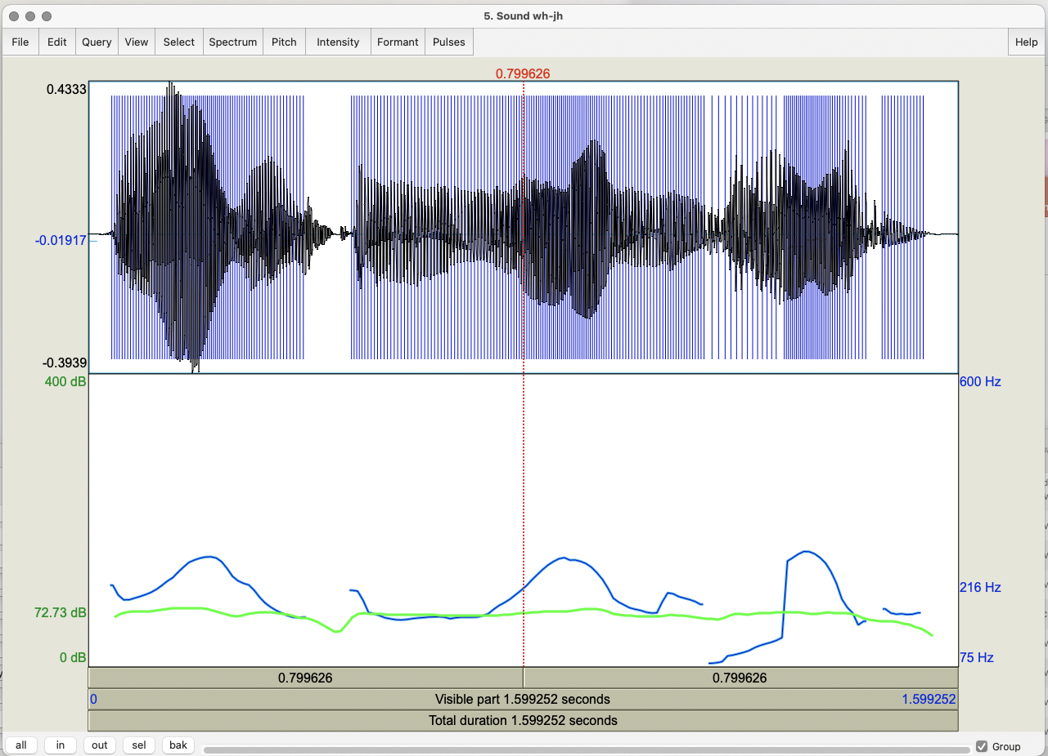
Notes:
Version 1 of whq

Slide 61
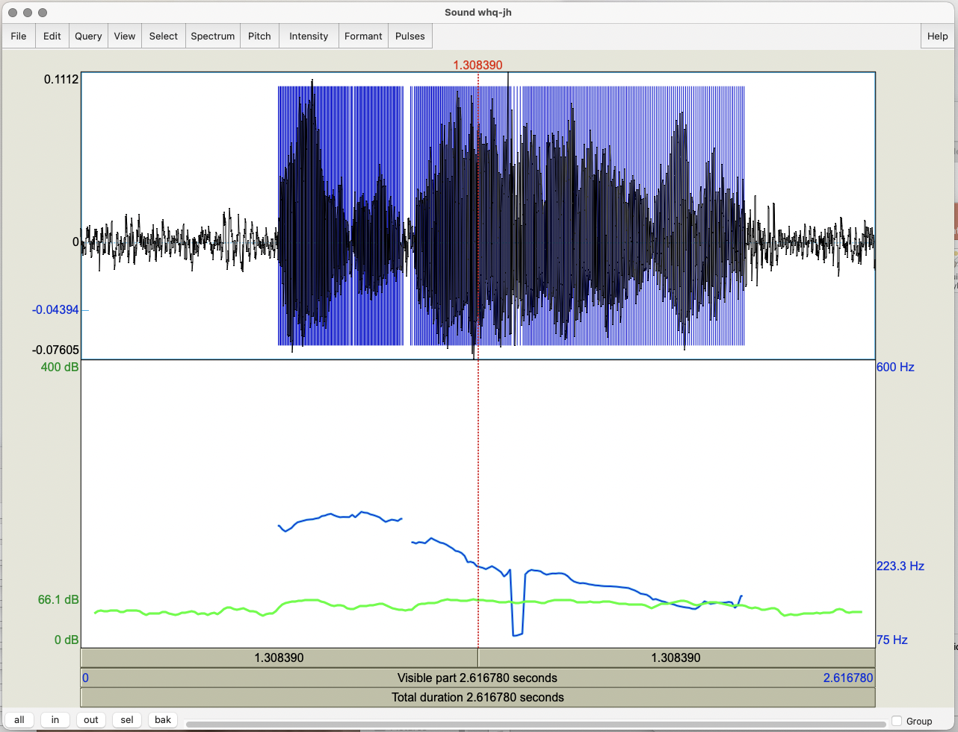
Notes:
Wh version 2 --
What difference do you see? What’s the difference in interpretation?
On to slide 62

Slide 62
Task 4: Emotional Speech
Record “My mama lives in Memphis” again
  As angry speech
  As sad speech
  As happy speech
For each token, do you see any differences in:
  Mean pitch? Maximum?
  Mean intensity? Maximum?
  Voice quality?
  Duration?
  F0 contour?
Do these differences indicate how you would be able to identify different emotions?
Notes:
Add these to Praat and select view and edit for each
Do these differences indicate how you would be able to identify different emotions?

Slide 63
Task 5: Changing the Pitch Contour
Take the initial statement version of your mama file and modify it to produce a question with a rising intonational contour
  Go to Manipulate → To manipulation – in the menu that pops up click OK
  In the Objects window select Manipulation <filename>
  Go to View & Edit
  In the Manipulation window:
    Go to Pitch → Stylize pitch (2st)
  Modify pitch by dragging points up and down
    Turn your statement into a question by lowering earlier pitch and raising final pitch

Slide 64
    Play the result
    To save go to File -> Publish resynthesis
    Compare it on Praat Objects to the yes-no question version you recorded
  Now modify the duration in the bottom section:
    Place cursor at a point in the duration manipulation band where you want to change the duration up or down
    Go to Dur → Add duration point at cursor several times
    Drag points up (slower) and down (faster) to change rate in different utterance parts
    Play the result
Notes:
File --> Publish resynthesis is at the top left of the window you see
Dur → Add duration point at cursor is at the top of the window in the middle
Show in slide 65

Slide 65
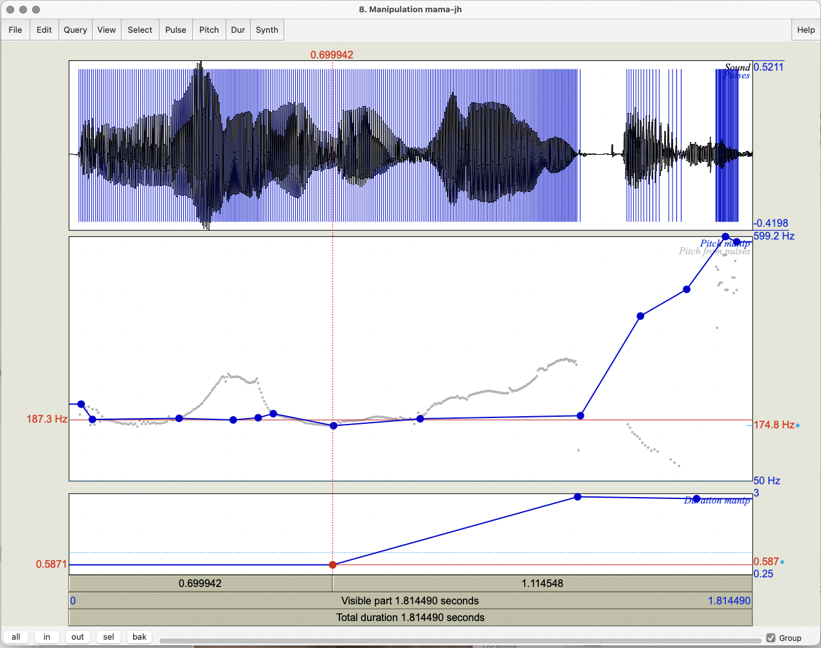

Slide 66
Task 6: Modifying Emotion
Take your very happy version of mama
  Go to Manipulate → To manipulation and click OK
  Go to View & Edit with Manipulation object
  Go to Pitch → Stylize pitch (2st)
  Modify Pitch by dragging points up and down
  Modify Dur by dragging points up and down
  Turn your happy speech into sad speech; play the result
  To save: File -> Publish resynthesis to get a new sound file “Sound from ManipulationEditor
Notes:
Show results in slide 67

Slide 67
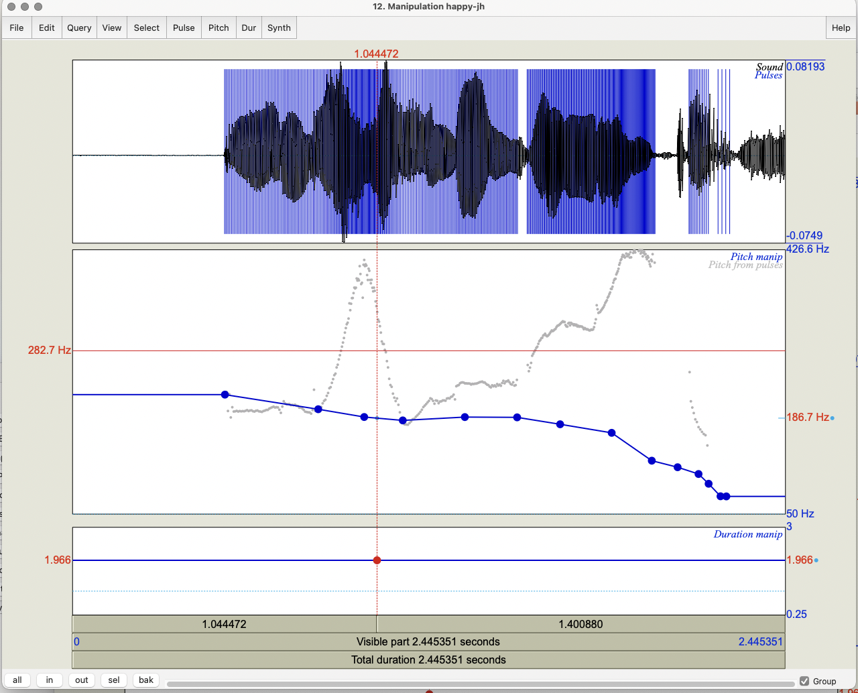
Notes:
How we changed the f0 of the happy file

Slide 68
Task 7: Pitch Contour Cloning
Record a sad version of mama and read both the happy.wav and sad.wav versions into Praat
  Create a manipulation object for happy.wav
  Select Extract pitch tier on right
  Create a manipulation object for sad.wav
  Select the pitch tier of happy.wav and the manipulation object for sad.wav and click Replace pitch tier
  Select the manipulation object for sad.wav and click Get resynthesis (LPC)
  View & Edit the new version of sad.wav
Notes:
Use Manipulate → To manipulation to create a manipulation object and click OK

Slide 69
  Compare the original sad.wav file and the new sad.wav
  Compare the new sad.wav and the original happy.wav
Notes:
Original sad to new modified sad
Original happy to new sad2happy version

Slide 70
Task 8: Clipping
Record a short phrase in a very loud voice, to produce clipping, and see what the waveform looks like
How do you identify clipping?
  Input signal amplitude is greater than the range that can be represented in
Avoid it?
    Increase the resolution (sampling rate)
    Decrease the amplitude

Slide 71
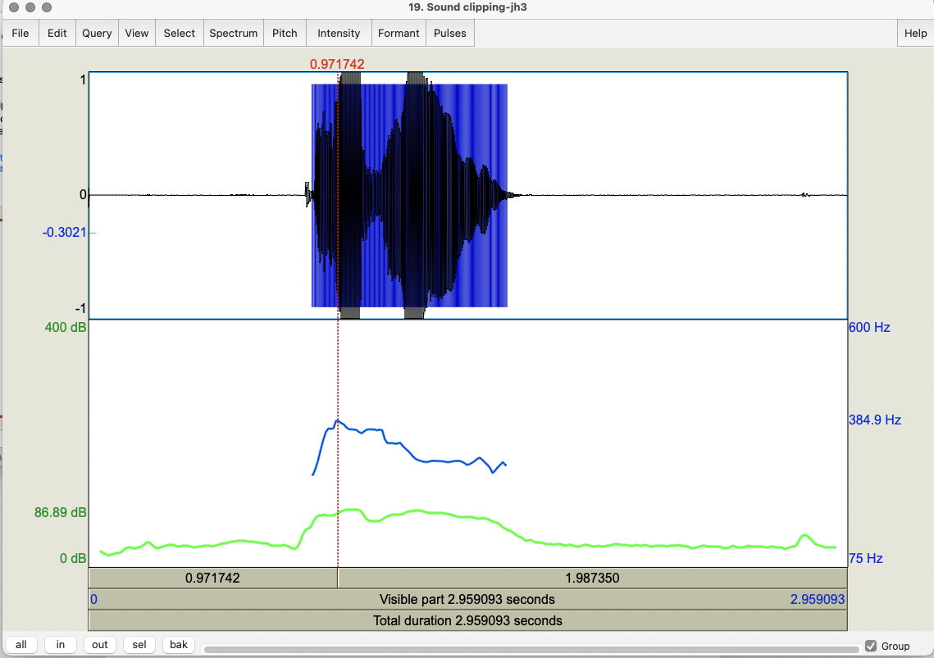

Slide 72
Task 9: Formant Analysis
Extract F1 and F2 values for the vowels in your mama file
Formant -> Show formants
  For each, select the vowel in the wavefile
    Formant → Get first formant
    Formant → Get second formant
  You can submit yours results here if you wish:
https://goo.gl/forms/ZIOvmXOP5ubIq1rS2

Slide 73
Task 8: Annotation using Textgrids
Select mama file in Objects window
  Select View & Edit
  Select Spectrogram -> Show spectrogram
  On Praat Objects: Annotate → To Textgrid
    In the box that pops up you can see a request for names of Textgrid tiers and whether these are point tiers (where you label points on the spectrogram) or interval tiers (where you label intervals)
  Select Sound mama and Textgrid mama and select View & Edit
  Point vs. interval tiers
Notes:
Will people who haven’t done this see the box??
For the point tier you click on the right location for the point in the wavfile
For the interval tier you select the beginning and ending time at the top of all textgrids by clicing at the bottom of the textgrid to form a line with circules but click on the circles at the top of the desired tier to get the segment

Slide 74
    Tier → Add a point tier and name it PartofSpeech in the box that appears on the left
      Add a point by 1) selecting a point in the waveform or spectrogram, 2) clicking on the circle that appears at the top of the PartofSpeech tier, and 3) insert the POS at this point
    Tier → Add an interval tier and name it WordsinTier In the box
      Add an interval by 1) selecting a point at the beginning of the word in the waveform or spectrogram, 2) clicking on the circle that appears at the top of the WordsinTier, 3) selecting a point at the end of the word, and 4) insert the word in the interval created

Slide 75
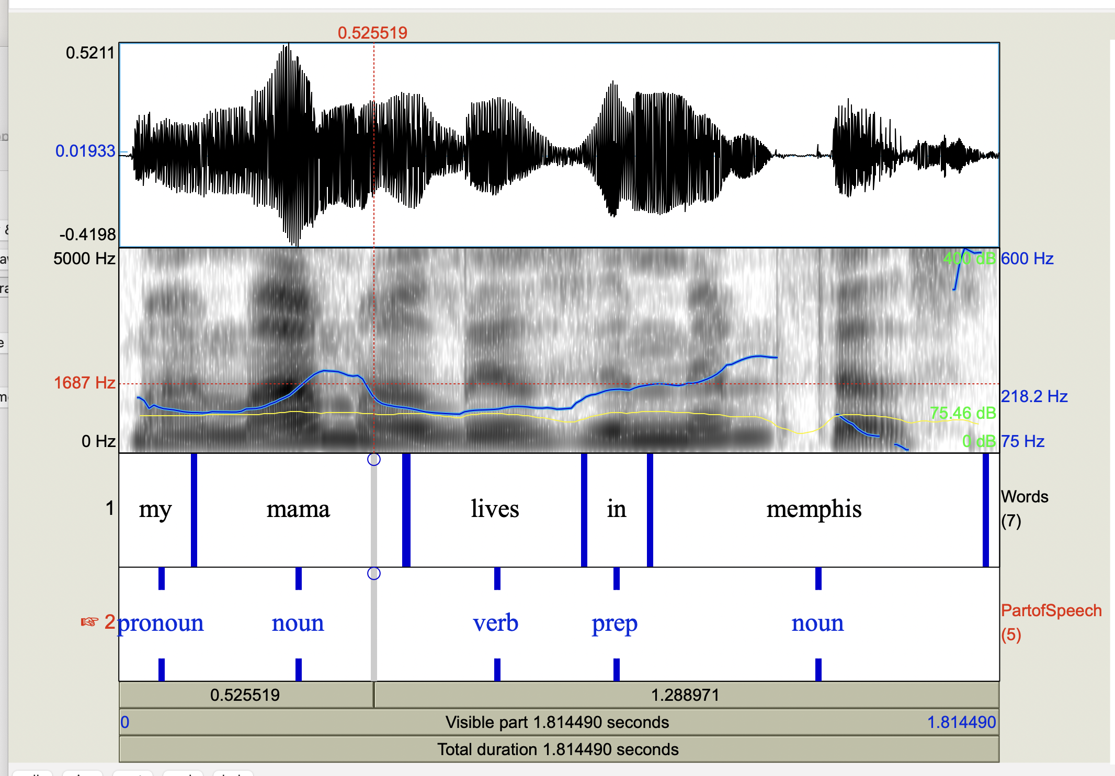

Slide 76
Task 11: Masking
Select original mama file each time
Select Convert → Change gender; OK
Select Filter →filter (pass) Hann band; OK
  Retains only a specified range through
  Find a pass band that masks the words but retains the intonation
  Find a pass band that masks the intonation but retains the words
Modify → Reverse
Notes:
Filter: keeping lower bands keeps intonation; higher bands (e.g. 500-1000) keep words
Modify Formant Shift Ratio (lower is male; 1.0 is no change; higher is female); New Pitch Median can also be reset to a lower or higher value for male vs. female
To change female to male try things like 0.8 or 0.9 for formant shift and 65 for pitch median…

Slide 77
Scripting
From what you’ve just done in Praat:
  Go to Praat (top left of screen) → New Praatscript → Edit → Paste history
  Select File → Save (or Save as) the script, which you’ll see is everything you’ve done today if you’ve kept Praat open – on your laptop
  To use again, select Praat -> Open Praat Script
  When the script opens, choose Run or Run selection on the top left of the file (you can run all or part of the script)
You can also write scripts or modify existing scripts yourself using these resources

Slide 78
Sample Praat Script
# This script will create a new text-grid for a wav file
form Make a text-grid for a .wav file
comment Source Directory?
sentence Directory C:\Documents and Settings\julila\My Documents\
comment File name?
sentence Filename
comment Tier Name?
sentence Tier
endform
Read from file... 'directory$‘ ‘filename$'
stem$ = left$(filename$,length(filename$)-4)
select Sound 'stem$'
To TextGrid... 'tier$' 'tier$‘ # tier names, which tiers are point tiers
Write to text file... 'directory$'\'stem$'.TextGrid
Remove

Slide 79
Praat Resources
Online Praat help, FAQ, manual
  Links from http://www.praat.org
  UCLA resources
  Parselmouth vs. Praat Scripting
There are more Tasks you can look at in today’s slides…
Notes:
For a quick check, you can use Praat → New Praat Script --> Edit → Paste history

Slide 80
Next Class
Readings:
  ToBI Conventions
  AuToBI
  Prosody and Meaning
  *Guidelines for ToBI Labeling
Post 5 on these is due next Monday 2/17 at 11:59 pm
HW 1 assigned: due before class 2/25 at 4:10 pm
Questions?

