Slide 1
From Sounds to Language
Julia Hirschberg
CS 6998

Slide 2
TA Information
Julia Hirschberg: W 2-4pm: CEPSR 705
Yu-Wen Chen: F 2-4pm: zoom
Riya Raj: W 4:30-6:30pm: CEPSR 7LW3
Kimiya Shahamat: M 4-6pm: zoom
Priyanka Varghese: Th 3-4pm: CEPSR 7LW3

Slide 3
Attendance
TAs will take attendance at the end of each class
For in-person classes you can line up with any of our TAs at the end of class, show your Columbia ID, and they’ll mark you as present in Courseworks → Attendance; if you cannot attend for any reason, please let us know and you’ll be able to watch from the Video Library
CVN class attendance will be taken from the on-line Video Library

Slide 4
Some Important Tasks
On Courseworks2:
  Please make sure you are enrolled in Courseworks2 and in Gradescope
If you are not, please sign up for Gradescope membership (https://www.gradescope.com/) using your Columbia email (UNI@columbia.edu) -- no other email is accepted. Add this course to your dashboard using code R7EVR
  Check out Ed Discussion on Courseworks for questions you want to ask
  Please go to You@Columbia and record your name so we can pronounce it correctly and add your photo to Photo Roster if you haven’t done already

Slide 5
  Please remember: Weekly posts are due at 11:59 pm on the Monday before class -- Posting late removes 1pt (of the 4pts possible) and is only available until the next day (Tuesday) when class begins
  For those who missed the first week of class:
    View the first class video in Courseworks: Video Library
    Submit Week 2 (late) Assignment
  Another request: if anyone does test positive for COVID-19 please do notify us confidentially for the benefit of all and do not return to class in person until your test is negative – you can view each class in Courseworks2 from the Video Library if necessary

Slide 6
Linguistic Sounds
What is the sound inventory of a language X?
How are these sounds produced?
What sounds are shared by languages X and Y? Which are different?
How do particular sounds in a given language vary in different contexts?
Why do we need to know all this to study a language?

Slide 8
A Tale of Discounts and Advertisers
(1) A burger costing $4.59 is on sale for $2.33 at Mel’s
Close your eyes and repeat the sale price to yourself 3 times
(2) A taco costing $4.53 is on sale for $2.22 at Noche Mexicana
Repeat the sale price to yourself 3 times
Can you estimate the size of the discount? Which deal is best?
Notes:
Saving 2.26 (49%) for the burger vs. saving 2.31 (51%) for the taco – taco is a better deal. but the “oo” in the sale price of the taco ($2.22) makes the sale price of the taco sound worse than the”ee” in the $2.33 sale price of the burger Please write down which deal you think is best.

Slide 9
Coulter & Coulter 2010
Notes:
Sounds produced in the back of the mouth (“uw”) (2) seem larger than sounds produced at the front (“ee”) (3)
Comparing two languages: but the opposite is true in Chinese; and Coulter and Coulter found that English speakers and Chinese speakers had opposite opinions of the two prices. Is this true? Does $2.33 sound smaller than $2.22?
So this is why we need to understand the sounds of different languages. How many Chinese speakers thought the burger deal was better?

Slide 10
Notes:
Are you going to buy these avocados? 9 is pronounced “n ah-ee n” in english – does it sound small or large? How many think smaller? How many think larger?
Sounds produced in the back of the mouth (“ah”) seem larger than sounds produced at the front (“ee”) so what about sounds that combine both?
Since it’s 2 sounds (one back “ah” and one front “ee”) which works?

Slide 11
Phonetics: Studying and Classifying Speech Sounds
Production and Perception
  Auditory phonetics: the perception of speech sounds
  Articulatory phonetics: the articulation of speech sounds
  Acoustic phonetics: the acoustic features of speech sounds

Slide 12
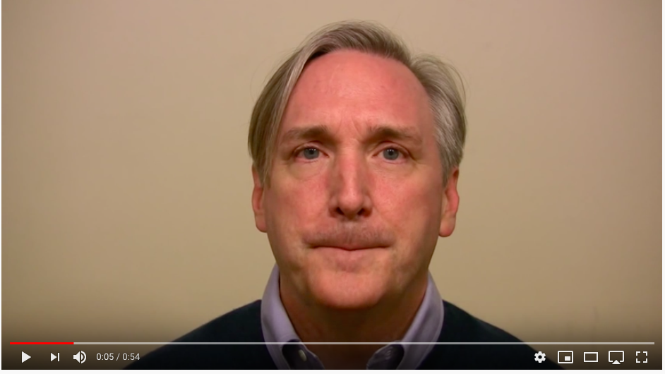
The McGurk Effect
Notes:
https://www.youtube.com/watch?v=PWGeUztTkRA (move to Slide Show, use link on title and then choose play in bottom left). Ask students to watch the first speech and then close their eyes for the second (stopping after 1 and after 2 to ask what they thought was being spoken: Va Da Ba is correct….
The McGurk effect is a perceptual phenomenon that demonstrates an interaction between hearing and vision in speech perception.
The illusion occurs when the auditory component of one sound is paired with the visual component of another sound, leading to the perception of a third sound.
Here: what consonant is the speaker producing when you watch? When you close your eyes?
So, he repeats the phonemes in three sets of two, then has a small pause.

Slide 13
Sounds in Language: Phonemes, Phones and Allophones
Phonemes: perceptually distinct units of sound in a language that distinguish one word from another
  /k/ in kitty vs. /w/ in witty
  They are our mental representation of sounds, not the sounds themselves, e.g. /kitee/ in broad phonemic transcription
Phones: the phonetic representation of the phoneme we produce when we speak
  [k] [I] [t] [i] in narrow phonemic transcription
Allophones: the different ways we can pronounce the same phoneme without changing its meaning
  E.g. kitty in 2 pronunciations [k] [I] [t] [i] vs. [k] [I] [d] [i] --
Notes:
https://linguisticsstudyguide.com/difference-between-phoneme-phone-allophone/

Slide 14
How should we Represent Speech Sounds?
Why do we need to?
  How do we translate between sounds and words (ASR, TTS, MT, dialogue systems, keyword search), learn pronunciation of new languages, compare language similarities and differences?
So…how should we represent sounds?
  Regular orthography: jump
  Special-purpose symbol sets e.g. TIMIT(usually created for one language only): /jh uh m p/
  Abstract sound classes based upon sound similarities across languages e,e, IPA: /dz ʌ m p/
Notes:
How many of you have used Duolingo?

Slide 15
Orthographic Representation?
As we know…a single letter may have many different acoustic realizations, e.g., in English
  o comb, tomb, bomb oo blood, food, good
  c court, center, cheese s reason, surreal, shy
And…a single sound may be represented differently in orthography
  [i] sea, see, scene, receive, thief; [s] cereal, same
  [u] true, few, choose, lieu, do; [ay] prime, buy, rhyme
Is orthography a good choice for English?
For Japanese? Spanish? Chinese?
Notes:
It depends on how many sounds are associated with each orthographic symbol/letter and how many symbols/letters can convey the same sound

Slide 16
Phonetic Symbol Sets
Special Purpose: ARPAbet, TIMIT, …
  Ascii characters only but must use multiple characters to represent different sounds
  English-specific, so new symbol sets are required for each new language to be represented
Abstract: International Phonetic Alphabet (IPA)
  Single character for each sound
  Represents all the sounds of the world’s languages but is quite large and requires special fonts
  Interactive IPA chart: http://www.ipachart.com
Let’s take a look at both ARPAbet and TIMIT in comparison with the IPA
Notes:
ASCII: : American Standard Code for Information Interchange: created for computer exchanges on the internet
From IPA play clicks and others
-added by Jiyoung Choi-
In 1886, a group of phoneticians from France, Germany, Britain and Denmark met to discuss the adoption of a universal system of pronunciation and formed the IPA in 1897.
The IPA is based on an alphabet written by British phonetician, Henry Sweet, represented the first successful effort for the pronunciation of speech sounds across most languages systematically in the late 19th century.
Reference: Fundamentals of Phonetics: A Practical Guide for Students (4th Edition), by Larry H. Small. Pearson, 2016. ISBN-13: 978-0133895728, ISBN-10: 0133895726.

Slide 17
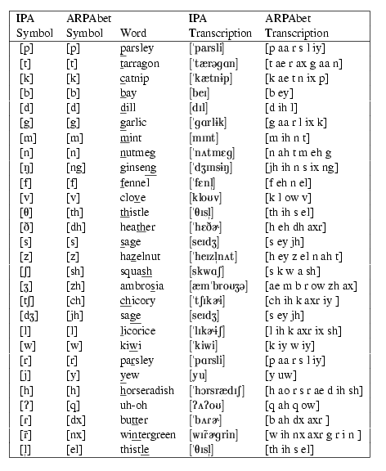
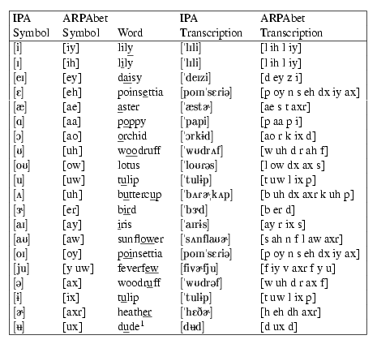
Figures 7.1 and 7.2:
Jurafsky & Martin
Exercise:
Write your first name in English
Orthography, in ARPAbet, and in IPA.
Notes:
Ix is I in tuplip – a reduced version of ih
Julia
jh uw l iy uh
ˈʤuljə
What are the differences?

Slide 18
Mine
Julia : orthography
jh uw l iy uh : ARPAbet
ˈʤuljə or ˈʤuliə: IPA
What are the differences? More or less specific
What did we learn from this?
Here’s where you can translate from English text to IPA: https://tophonetics.com
Notes:
How to convert text to more useful input for speech system-building
Use Slide Show, click on the link, leave new page, select "Use presenter view" at bottom of slide

Slide 19
Other IPA Charts
Albanian
Amharic
Bengali
Cantonese
Catalan
Farsi
Finnish
French
German
Gujarati
Hebrew
Hindi and Urdu
Japanese
Korean
Malayalam
Mandarin
Marathi
Punjabi
Portuguese
Russian
Spanish
Tamil
Thai
Notes:
Try out an IPA chart on your own language when you go home tonight

Slide 20
Articulatory Phonetics: How do we produce speech?
How speech production works for some languages:
  Air passes from our lungs – called respiration or pulmonic sounds -- then through our windpipe (trachea) – called phonation -- leaving via mouth (mostly) and nose (nasals) – called articulation -- (e.g. [m], [n])
  Air passing thru the trachea goes thru the larynx, which contains vocal folds – the space between them is the glottis
  When vocal folds vibrate, we get voiced sounds (e.g. [v]); o.w. we get voiceless sounds (e.g. [f])
Notes:
Say puff; say mama
Say vam. Fam
-subsystems added by Jiyoung Choi-
Reference: Ladefoged, P., & Johnson, K. (2014). A course in phonetics. Nelson Education.
414 language have only pulmonic consonants

Slide 21
For other languages there are non-pulmonic sounds using different airstream mechanisms
  Clicks (Khoisan, Bantu), ejectives (Amerindian, Caucasian) and implosives (Swahili, Sindhi, Hausa, Vietnamese) are stop consonants where the air direction is ingressive, going into the vocal tract
  These begin at the velum for clicks (velaric ingressive sounds) and at the glottis for implosives (glottalic ingressive sounds)
  Ejectives are glottalic egressive sounds where the air flows out from the vocal tract – they share air direction with pulmonic sounds and their airstream mechanics with implosives
Notes:
152 of 566 language have non-pulmonic consonants. The velum is at the back of the tongue. The glottis is down in your windpipe

Slide 22
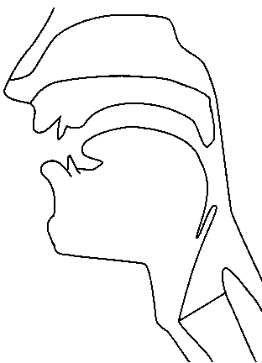
Places of Articulation
alveolar
post-alveolar/palatal
dental
velar
uvular
labial
pharyngeal
laryngeal/glottal
https://incl.pl/sammy/
Notes:
Try these out:
Labial: p, b, m, w (lips)
Dental: f, v (teeth)
Alveolar: t, d, s, z, n, l, r (front of mouth)
Palatal: sh, zh, ch, jh, y (mid top of mouth)
Velar: k, g, ng (back of mouth)
Glottal-uvular: (further back of mount)
Pharyngeal: hollow tube from nose leading down to trachea (windpipe)
Air passes from lungs –respiration- through windpipe (trachea) –as phonation-- leaving via mouth (mostly) and nose (nasals) –articulation- (e.g. [m], [n])
Air passing thru the trachea goes thru larynx, which contains vocal folds – space between them is the glottis
When vocal folds vibrate, we get voiced sounds (e.g. [v]); o.w. we get voiceless sounds (e.g. [f])

Slide 23
Consonants and Vowels
Consonants:
  Restriction/blockage of air flow
    e.g. [s] [p], sat, pat
  Voiced or voiceless
    e.g. [z] [s], zip, sip
Vowels:
  Generally voiced, less restriction
    e.g. [u], tulip
Semivowels (glides):
  Speech sounds intermediate between vowels and consonants
    e.g. [w], [y], we, ye
Notes:
Say s, z, f, g, b

Slide 24
Vowels
Mainly voiced but there are multiple differences in how they are voiced
Vowel height
  How high is the tongue? high or low vowel
  Where is its highest point? front or back vowel
How rounded are the lips? [uw] vs [iy]
  you vs. me
Monophthong [eh] vs. diphthong [ey]
  Monophthong: 1 vowel sound (con, sir, back)
  Dipthong: 2 combined (coin, sure, bake, fear)
Notes:
/aɪ/ Cry, My, Like, Bright, Lime
/eɪ/ Bake, rain, lay, eight, break
/əʊ/ Go, oh, slow, loan, though
/aʊ/ Bound, house
/eə/ Pair, lair, chai
r/ɪə/ Career, fear/ɔɪ/Boy, coy, toy
/ʊə/ Fur, sure

Slide 25
American English Vowel Space in ARPAbet
HIGH
iy
uw
ih
ix
ux
uh
oy
ey
ow
ax
FRONT
BACK
eh
ah
aw
ao
ay
ae
aa
LOW
Notes:
Touch your tongue when you say iy, uw, ae, aa
Iy: beat
Ih: bit
eh: bet
Ae: bat
Ix: tuplip
Ux:
Ao: short o
Aw: au
Ax eh?
Axr er

Slide 26
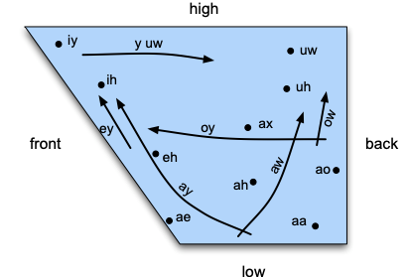
American English Vowel Space in ARPAbet
Notes:
Like consonants, vowels can be characterized by the position of the articulators as they are made. The three most relevant parameters for vowels are what is called vowel height, which correlates roughly with the height of the highest part of the tongue, vowel frontness or backness, indicating whether this high point is toward the front or back of the oral tract and whether the shape of the lips is rounded or not.
Iy: beat
Ih bit
Eh: bet
Ae:: bat
Ax: “a” in comma
Ah: butter
Uw: boot
Uh: book
Ao: caught
Aa: balm
Y uw: few
Ey: bait
Ay: bite
Aw::bout
Ow: boat
Oy: boy
Axr: er in letter
Ux: in dude
Er: in bird

Slide 27
Vowels and Places of Articulation
alveolar
post-alveolar/palatal
dental
velar
uvular
labial
pharyngeal
laryngeal/glottal
https://incl.pl/sammy/
Notes:
Like consonants, vowels can be characterized by the position of the articulators as they are made. The three most relevant parameters for vowels are what is called vowel height, which correlates roughly with the height of the highest part of the tongue, vowel frontness or backness, indicating whether this high point is toward the front or back of the oral tract and whether the shape of the lips is rounded or not.
Iy: beat
Ih bit
Eh: bet
Ae:: bat
Ax: “a” in comma
Ah: butter
Uw: boot
Uh: book
Ao: caught
Aa: balm
Y uw: few
Ey: bait
Ay: bite
Aw::bout
Ow: boat
Oy: boy
Axr: er in letter
Ux: in dude
Er: in bird

Slide 28
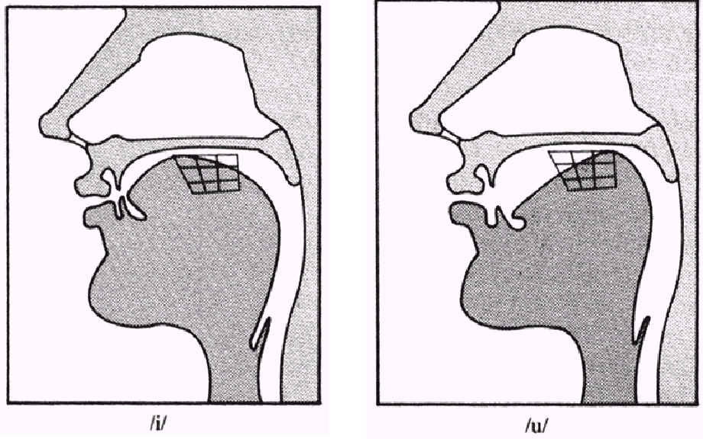
High Front or Back [iy] vs. [uw]
(From a lecture given by Rochelle Newman)
Notes:
Say iy and uw

Slide 29
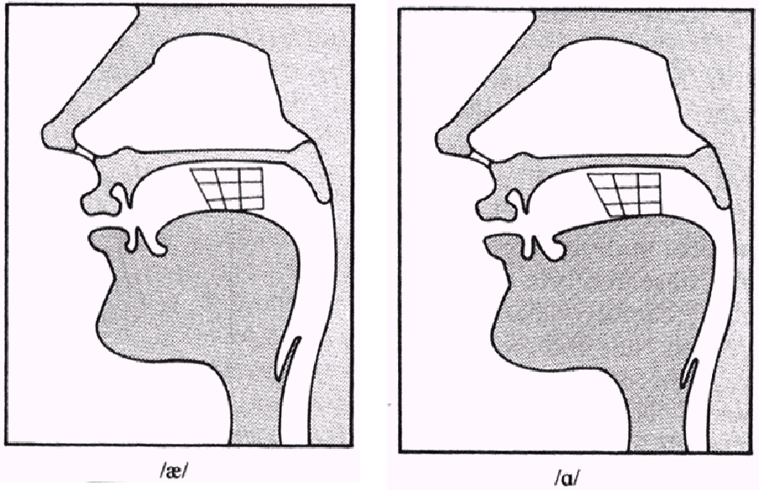
Low Front or Back [ae] vs. [aa]
(From a lecture given by Rochelle Newman)
Notes:
Say ae and aa

Slide 30
Many Differences in Vowels across Languages
Compare to British English, Indian English, Swedish, Spanish, Japanese, Mandarin …
Vowel differences make it difficult to learn to produce new languages effectively
Notes:
How many of you have noticed this?

Slide 31
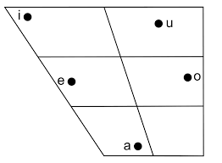
Japanese Vowel Space
Notes:
click on go to Slide Show and select Japanese Vowel, play, andd then go back to Presenter View
Much simpler than English but there are differences but there are short and long versions of each of these vowels
I : short ee
E: eh
A: ah
U: short “oo”.
O:: short “oh”

Slide 32
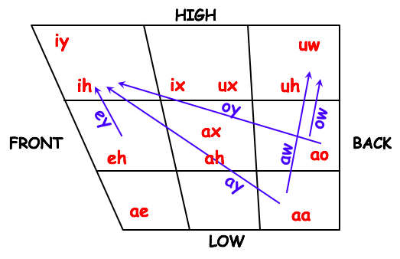
Comparing English and Japanese Vowels
Notes:
I = short ee
E = eh
A = ah
U = short uw
O = short oh

Slide 33
Consonants: A True Story about Noa
Noa’s ability to communicate is quite developed. But sometimes the fact that she can’t make 3 consonant sounds -- K, L and G -- gets in the way. Here she shares her success at Little Kickers (soccer practice for kids 3 and under) with her mother (“ima”) named Mir:
Noa - Ima, I stored a dole at YittoTitters.
Mir - What?
Noa - I stored a dole.
Mir - What sweetie? I didn’t understand you.
Noa - At YittoTitters! I stored a dole!!
Mir - Oh. You scored a goal. That’s great!
Noa - Ima, what’s a dole?
Notes:
From a colleague
Scored a goal

Slide 34
Consonants: Place of Articulation
Two things define consonant types: place of articulation and manner of articulation
Place of articulation is defined by consonants’ place of maximum air restriction
  Labial: bilabial [b], [p]; labiodental [v], [f]
  Dental: [θ], [δ] thief vs. them
  Alveolar: [t], [d], [s], [z]
  Palatal: [∫], [t∫] shrimp vs. chimp
  Velar: [k], [g]
  Glottal: [?] glottal stop (e.g. “kit’n”, “cott’n”)
Notes:
Two things are used to define consonant types: place of articulation and manner of articulation. Try each of these and see where your air is restricted in your mouth

Slide 35
Consonants: Manner of Articulation
How is the airflow restricted?
  Stop: [p],[t],[g] … aka plosive
    Airflow completely blocked (closure), then released (release)
    Glottal stop, e.g. before word-initial vowels in English after pause (extra)
  Nasal: air released thru nose [m],[ng] …
  Fricative: [s], [z], [f] air forced thru narrow channel
  Affricates [t∫] begin as stops and end as fricatives (chimp, jar)
Notes:
Putting your hand on the appropriate airflow location:
Say pat, extra, mama, sue, jar

Slide 36
  Approximant: [w],[y] e.g. we, ye
    2 articulators come close but don’t restrict much
    Between vowels and consonants
  Laterial: [l] e.g. lab
  Tap or flap: [ ] e.g. butter
  Laterial: [l] e.g. lab
Notes:
Say you, why with your hand touching your lips
Say lab
Say butter
To make a lower level dot and line use shift tab

Slide 37
 | Standard American English PLACE OF ARTICULATION
 |  | bilabial |  | labio-dental |  | inter-dental |  | alveolar |  | palatal |  | velar |  | glottal
 | stop | p | b |  |  |  |  | t | d |  |  | k | g | q
 | fric. |  |  | f | v | th | dh | s | z | sh | zh |  |  | h
 | affric. |  |  |  |  |  |  |  |  | ch | jh
 | nasal |  | m |  |  |  |  |  | n |  |  |  | ng
 | approx |  | w |  |  |  |  |  | l/r |  | y
 | flap |  |  |  |  |  |  | dx
MANNER OF ARTICULATION
VOICING:
voiceless | voiced
Notes:
My mama married Manny often used for voice analysis for medical reasons, voice improvement, hiring speakers
The words are fully voiced and sonorant.
Think of a sentence in any language which is fully voiced and sonorant.

Slide 38
Places of Articulation
alveolar
post-alveolar/palatal
dental
velar
uvular
labial
pharyngeal
laryngeal/glottal
https://incl.pl/sammy/
Notes:
Labial: p, b, m, w
Dental: f, v
Alveolar: t, d, s, z, n, l, r
Palatal: sh, zh, ch, jh, y
Velar: k, g, ng
Glottal: q, h

Slide 39
A Problem: Coarticulation
The same phone is usually produced differently depending on its phonetic context – a major issue in ASR
Occurs when articulations overlap as articulators are moving in different timing patterns to produce different adjacent sounds
  Eight vs. Eighth
    Place of articulation of /ei/ moves forward as /t/ → /th/ -- is dentalized (the tongue moves to the teeth) for eighth
  Met vs. Men
    Vowel /ɛ/ is nasalized (the tongue moves to behind the teeth) for men
Notes:
A major issue in speech recognition!!

Slide 40
Places of Articulation
alveolar
post-alveolar/palatal
dental
velar
uvular
labial
pharyngeal
laryngeal/glottal
http://smu-facweb.smu.ca/~s0949176/sammy/
Notes:
Labial: p, b, m, w (lips)
Dental: f, v (teeth)
Alveolar: t, d, s, z, n, l, r (front of mouth)
Palatal: sh, zh, ch, jh, y (mid top of mouth)
Velar: k, g, ng (back of mouth)
Glottal-uvular: q, h (vocal folds)

Slide 41
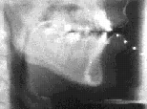
Articulators in action
Sample from the Queen’s University Speech Perception and Production Lab
More Examples
Notes:
click on go to Slide Show and select More Examples then go back to Presenter View
French Canadian subjects from the early 1970s
Play 1, 2, 3 and then end Examples
Due to ethical concerns about the high radiation dosages necessary, x-ray imaging technology using normal subjects is no longer practiced and it has become imperative to preserve those films which were originally captured on the fragile medium of 35 mm film.

Slide 42

How do we Produce Speech: Vocal Fold Vibration
[UCLA Phonetics Lab demo]
Notes:
The faster the vibration, the higher the pitch.
Usually vibrate over 100 times per second.

Slide 43
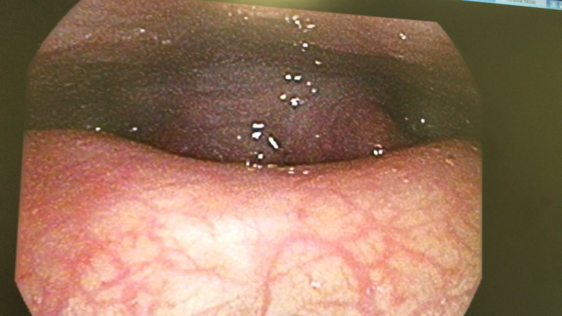
Less Than Perfect
Notes:
Dr. michael pittman (columbia doctors’ otolaryngologist – treated Hamilton star Lin-Manuel Miranda)/ Kim Duncan, my therapist

Slide 44
How do we Capture This Articulatory Data?
The X-ray Film archive we saw was created by Kevin Munhall (Queen's University) and Eric Vatikiotis-Bateson and Yoh'ichi Tohkura (ATR Human Information Processing Research Laboratories, Kyoto) in 1960s
  Cine-radiographic vocal tract footage for the speech research community to help them develop techniques for automated digital processing of speech images
  Some of the best dynamic views of entire vocal tracts provide important information about time-varying properties, especially of tongue movements
  There are Ethical concerns about the high radiation dosages necessary to collect this data, so imaging technology is no longer used on normal subjects, just for medical X-rays and CT scans
Notes:
The data we saw from Slide 41 was collected by this team
Collaborative project by Dr. Kevin Munhall of Queen's University and Drs. Eric Vatikiotis-Bateson and Yoh'ichi Tohkura of ATR Human Information Processing Research Laboratories, Kyoto, started in 1960s
Preserves cine-radiographic vocal tract footage to make the images available to the speech research community and to develop techniques for the automated digital processing of the images.
High speed x-ray films yield some of the best dynamic view of the entire vocal tract and provide important information about its time-varying properties. In particular, they accurately depict the complex movements of the tongue.
Due to ethical concerns about the high radiation dosages necessary, x-ray imaging technology using normal subjects is no longer practiced and it has become imperative to preserve those films which were originally captured on the fragile medium of 35 mm film.

Slide 45
X-Ray Microbeam Database
  Wisconsin Physical Sciences Lab
  One of only 2 machines of its type ever created
  Analyzed speech patterns by tracking small pellets placed on the subject’s tongue, teeth and nose using very narrow x-ray beam passing through the subject area and detected by a sodium iodide crystal located behind the head.
  Dense pellets block x-rays from reaching crystal
  Allowed study of speech patterns in real time

Slide 46
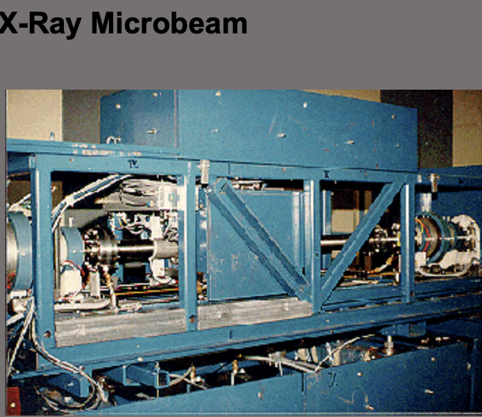
Notes:
Here’s one of the 2 machines

Slide 47
Electroglottography measures how tightly the vocal folds are touching together (tighter -> louder) from disks placed on neck
CT (Computed Tomography) and MRI (Magnetic Resonance Imaging) give us 3D pictures of vocal structures (bottom)
Videostroboscopy uses a tiny camera to record vocal fold activity (right)
Electromagnetic articulography (EMA)
    Recording of articulatory orofacial movements
    3 transmitters on helmet produce alternating magnetic fields at different frequencies, forming equilateral triangle
    Creates alternating current in 5-15 sensors to calculate sensor positions via XY coordinates
Notes:
Change to Slide Show and Play links for all for pictures or just go to pictures on the next slides
Slide 1: electroglottography (left) CT and MRI (bottom), videostroboscopy (right)
Slide 2: EMA(left)

Slide 48
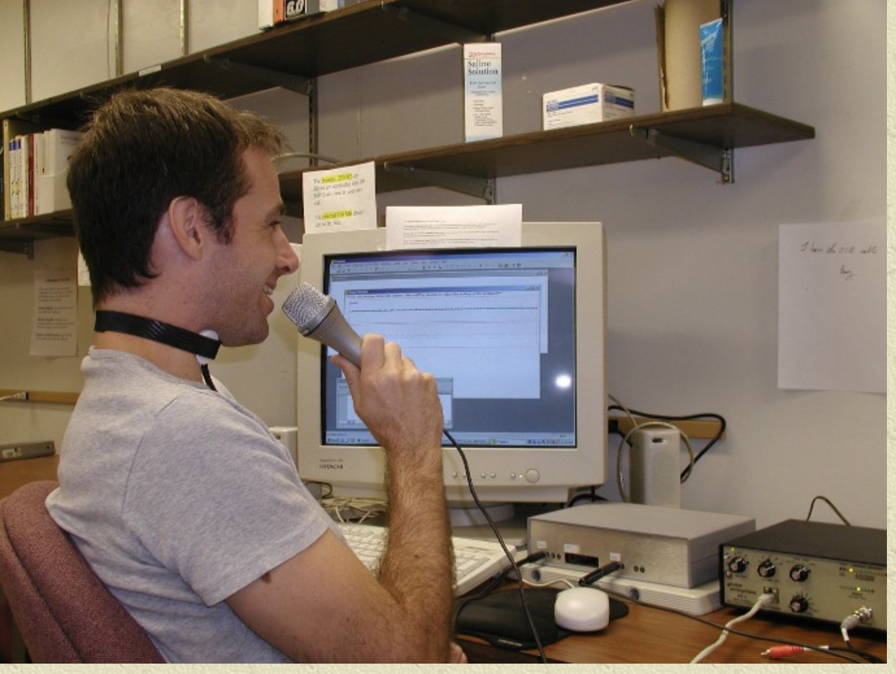
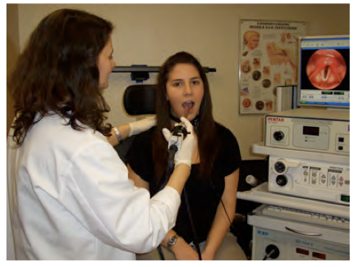
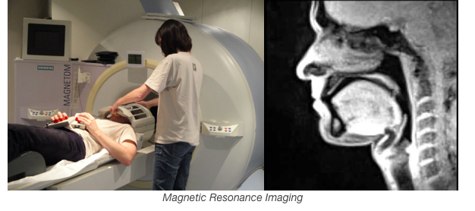
Notes:
Top:
Left: electroglottography
Right: Videostroboscopy
Bottom: Computed Tomography and MRI

Slide 49
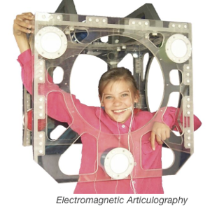
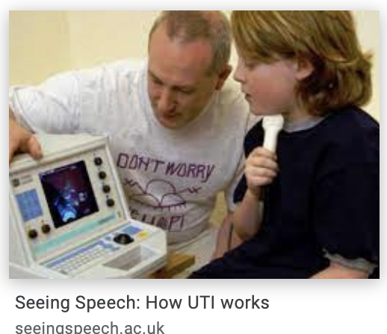
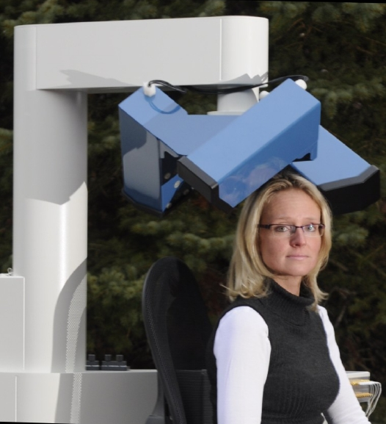
Notes:
https://seeingspeech.ac.uk/how-uti-works/
Left: EMA
Right: UTA

Slide 50
MOCHA-TIMIT corpus
  Created in Edinburgh in 1999
  460 English sentences, 1M 1F speaker
  Microphone, Laryngograph (measures vocal fold vibration) and electromagnetic articulograph (measures movement in mouth) information
Ultrasound Tongue Imaging
  Uses ultrasound (5MHz) system’s sound waves using a probe with an array of piezoelectric ceramic elements that emit an electric current when they are deformed by sound pressure when place under the chin
Notes:
Slide 2: right

Slide 51
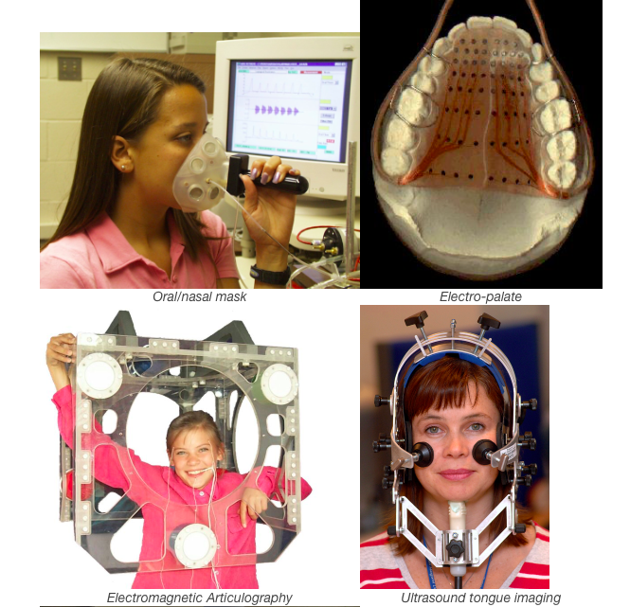
Notes:
Top:
Left: Oral/nasal mask
Right: electro-palate
Bottom:
Left: EMA

Slide 52
Representations for Sounds
Now we have ways to represent the sounds of a language (IPA, Arpabet…), to classify similar sounds and to identify and compare sounds in different languages
Why is this important?
  Automatic speech recognition (ASR)
  Speech synthesis (TTS)
  Machine translation (MT)
  Keyword search
  Speech pathology/ medical problems, language Id, speaker Id, charismatic speech, code-switching, entrainment and many more…

Slide 53
  Basic representations are critical for any speech research or application
But…how can we recognize these sounds correctly and automatically?
  What are the acoustic correlates of these differences in sound that allow us to recognize them?
  How can we use the relationship between representation and acoustics to identify speech automatically?
  Can technology help?

Slide 54
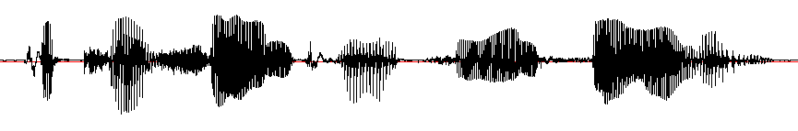

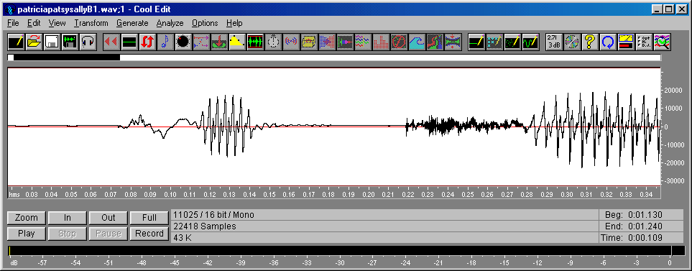
Acoustic Landmarks in a .wav File
[p]
[ix]
[t]
[r]
[ih]
[sh]
[ax]
[n]
[p]
[ae]
[t]
[s]
[iy]
[n]
[s]
[ae]
[l]
[iy]
“Patricia and Patsy and Sally”
[p]
[ae]
[t]
[r]
[ih]
Notes:
Could you recognize such patterns automatically

Slide 55
Acoustic Landmarks in a .wav File
[p]
[ix]
[t]
[r]
[ih]
[sh]
[ax]
[n]
[p]
[ae]
[t]
[s]
[iy]
[n]
[s]
[ae]
[l]
[iy]
“Patricia and Patsy and Sally”
[p]
[ae]
[t]
[r]
[ih]
Notes:
Could you recognize such patterns automatically

Slide 56
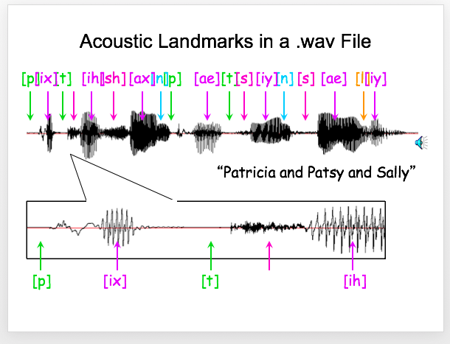
Notes:
These are the features we can identify by eye, or, much quicker if not quite so accurate by machine.

Slide 57
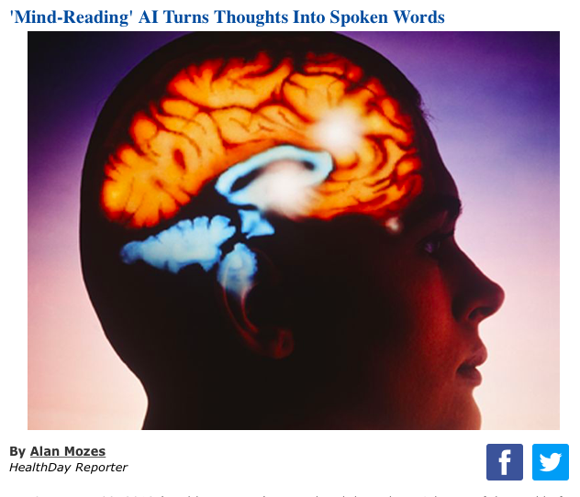
Can Our Brain (or a Ferret’s) Help?

Slide 58
Engineers translate brain signals directly into speech
Zuckerman Institute at Columbia
Advances mark critical step toward brain-computer interfaces that hold immense promise for those with limited or no ability to speak
  Nima Mesgarani: in a scientific first, neuro-engineers have created a system that translates thought into intelligible, recognizable speech. This breakthrough, which harnesses the power of speech synthesizers and artificial intelligence, could lead to new ways for computers to communicate directly with the brain.

Slide 59
For Next Week…
Readings: J&M 28 (4-6) (use syllabus link)
  Post for Week 3 in Courseworks2
  Note: if you were not able to submit Week 2 in time please just submit as Week 2 (late for students signing up late or with other issues mentioned to us)
Remember to sign up for Gradescope in Courseworks (https://www.gradescope.com/) using your Columbia email (UNI@columbia.edu) -- no other email is accepted. Add this course to your dashboard using code R7EVRJ
Notes:
In the coming week

Slide 60
Remember to enroll in Ed Discussion and record your names in You@Columbia in Courseworks2!
Now show your cards to the TAs for attendance -- Any questions?
Notes:
To end presentation: move to Slide Show and click “End show” in bottom left

