Slide 1


What Makes A Video Radicalizing? Identifying Sources of Influence in Extremist Videos
Lin Ai, Yu-Wen Chen, Seoyoung Kweon, Yuwen Yu,
Julia Hirschberg, Sarah Ita Levitan
November 22, 2022

Slide 2
Goals of Our Research
Increase our understanding of online radicalization efforts by analyzing right- and left-leaning groups’ videos in social media
  What sort of viewers do these videos appeal to
  What methods are employed in producing more persuasive videos
  How can we use multimodality features to identify radical videos computationally
  How might new, potentially influential extremist groups be identified
Identify potentially useful de-radicalizing videos

Slide 3
Related Work
Radicalization detection in social media using textual features
  Hartung et al. (2017) attempt to identify right-wing extremist content in German Twitter profiles
  Hofmann et al. (2022) leverage network structure of Reddit forums to detect polarized concepts
  Lopez-Sancez et al. (2018) and Araque and Iglesias (2020) develop methods to identify radicalizing content in Twitter

Slide 4
Related Work
Radicalization detection in multimodal content
  Bermingham et al. (2009) detect radicalization in Jihadist YouTube videos using social network analysis and sentiment
  Ribeiro et al. (2020) collect 330,925 YouTube videos to identify radicalizing pipelines for far-right groups
  Ai et al. (2021) identify multimodal features of far-right and far-left groups that makes them more popular and more persuasive

Slide 5
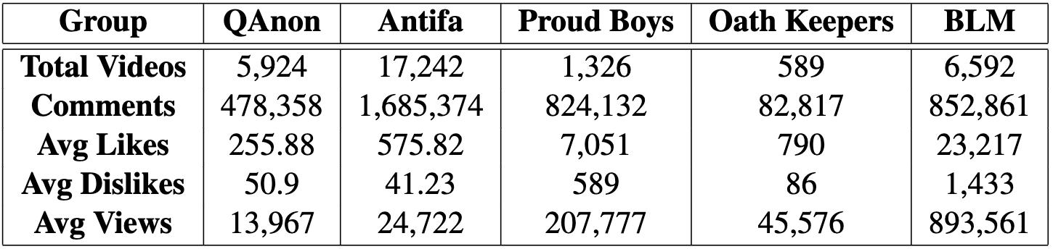
Prior Work
Collected a large number of videos for 5 extremist groups from YouTube and BitChute and extracted metadata and multimodal features
Used # comments and likes to identify video popularity changes over time
Trained stance detection models to identify stance (pro-, anti-group, or neutral) of a given video using video title and description

Slide 6

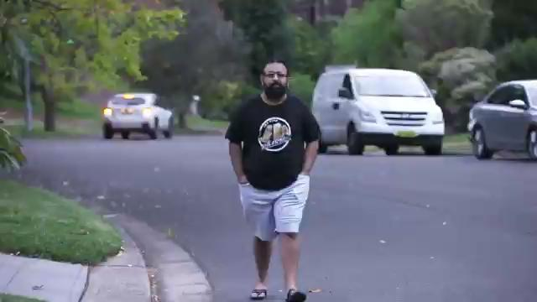
QAnon – Background
QAnon
  Originated in 2017
  One of the prime conspiracy-based radicalization groups ^{1, 2}
¹ Amarasingam, Amarnath, and Marc-André Argentino. "The QAnon conspiracy theory: A security threat in the making." CTC Sentinel 13.7 (2020): 37-44.
² Garry, Amanda, et al. "QAnon conspiracy theory: examining its evolution and mechanisms of radicalization." Journal for Deradicalization 26 (2021): 152-216.

Slide 7
QAnon – Questionnaire
Little study has computationally analyzed QAnon related videos
  How these videos drag viewers into the process of radicalization?
  Who the videos are the most appealing to?
We designed a comprehensive questionnaire to answer two research questions:
  RQ1: What viewer traits, such as personality traits and media consumption, are associated with their video preferences?
  RQ2: What video characteristics, such as speaker traits, video quality, and arousing emotions, are correlated with viewers' perception?
  RQ3: What multimodal features are correlated with viewers’ perception?

Slide 8
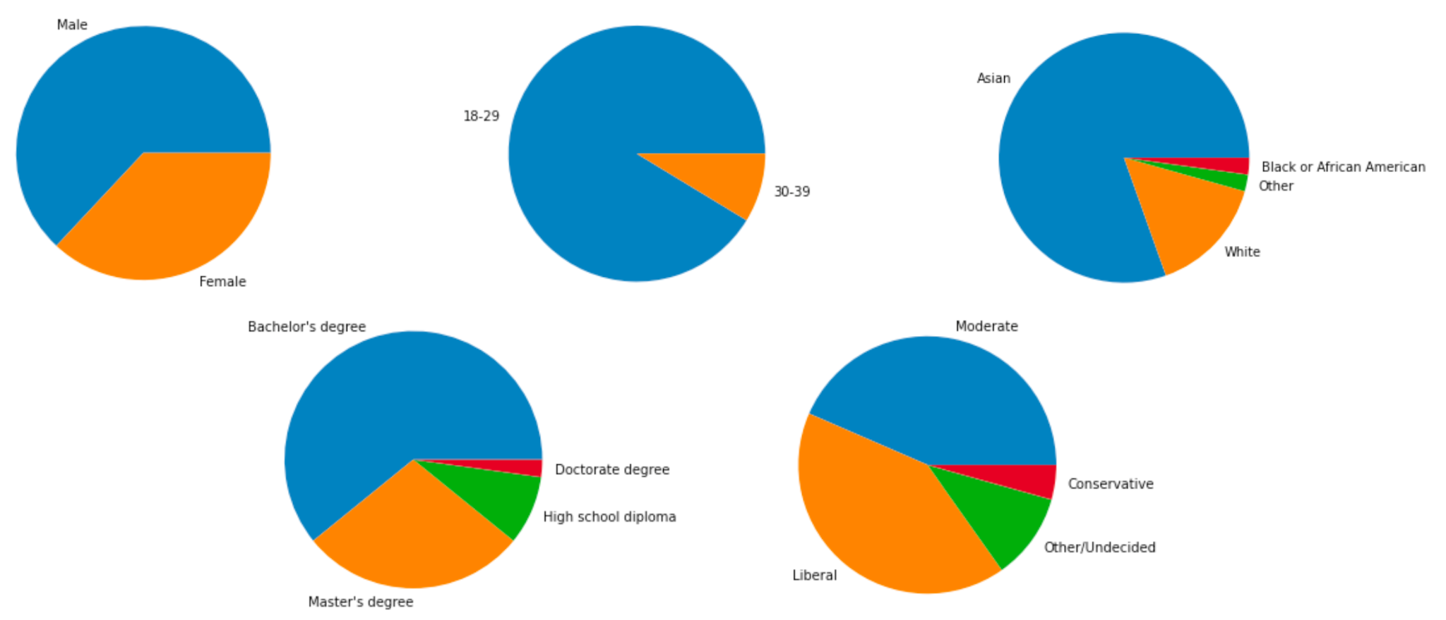
QAnon – Viewer Traits
We selected 3 pro- and 3 anti-QAnon videos
We recruited 46 participants, primarily college students

Slide 9
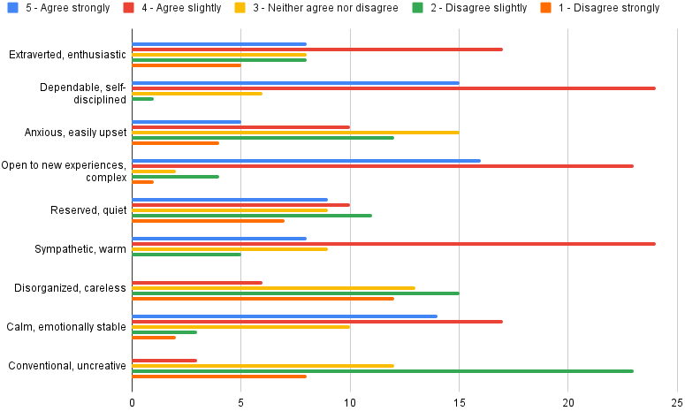
QAnon – Viewer Traits
Viewers’ self-reported personalities

Slide 10
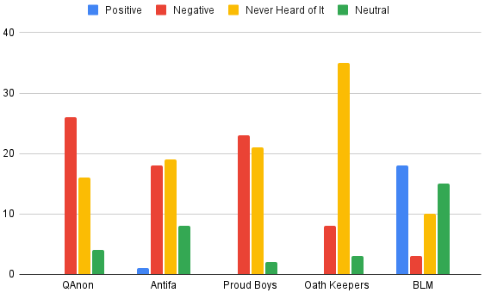
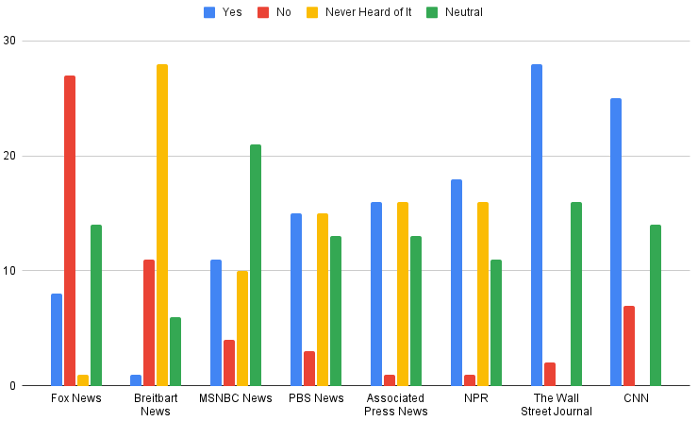
QAnon – Viewer Traits
Viewers’ opinion on radical groups
Viewers’ opinion on media sources

Slide 11
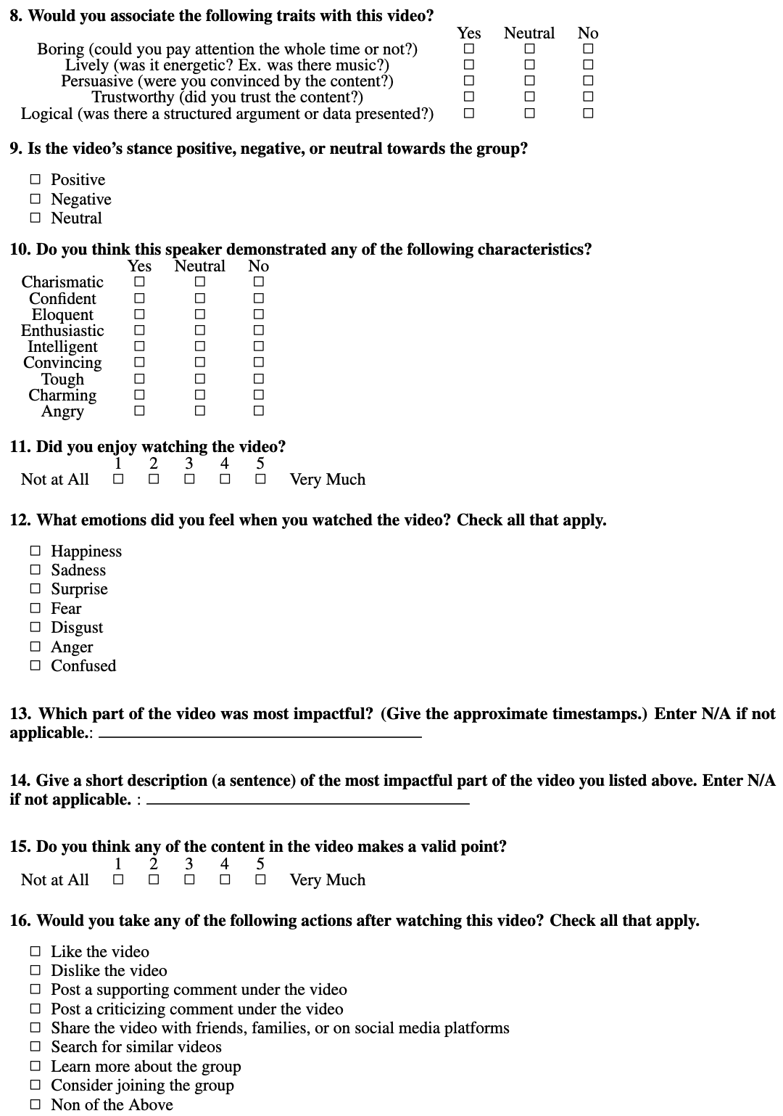
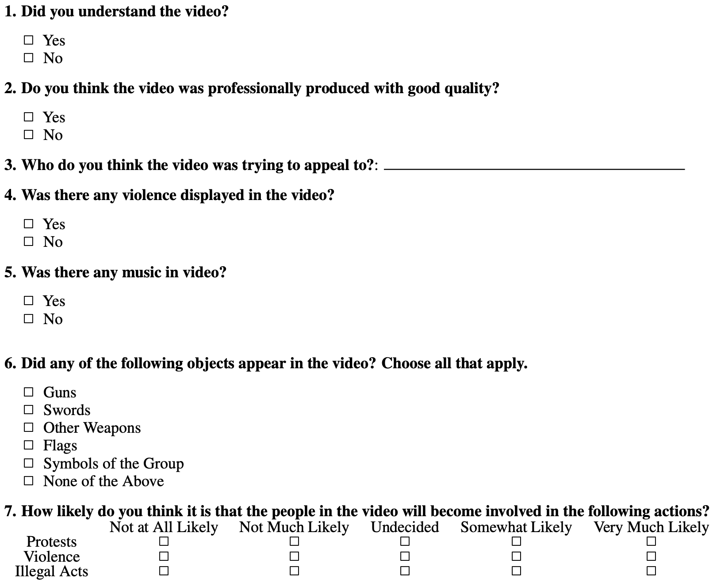
QAnon – Questions

Slide 12
QAnon – Evaluation Metrics
Enjoyment Score
  How much raters enjoyed watching each video [-2, 2]
Content Score
  Whether raters thought a video is persuasive, trustworthy, logical, and professionally created [-1, 1]
Actions Score
  posting a criticizing comment [score -2]
  disliking the video [score -1]
  liking the video [score 1]
  posting a supporting comment [score 2]
  considering joining the group [score 3]

Slide 13
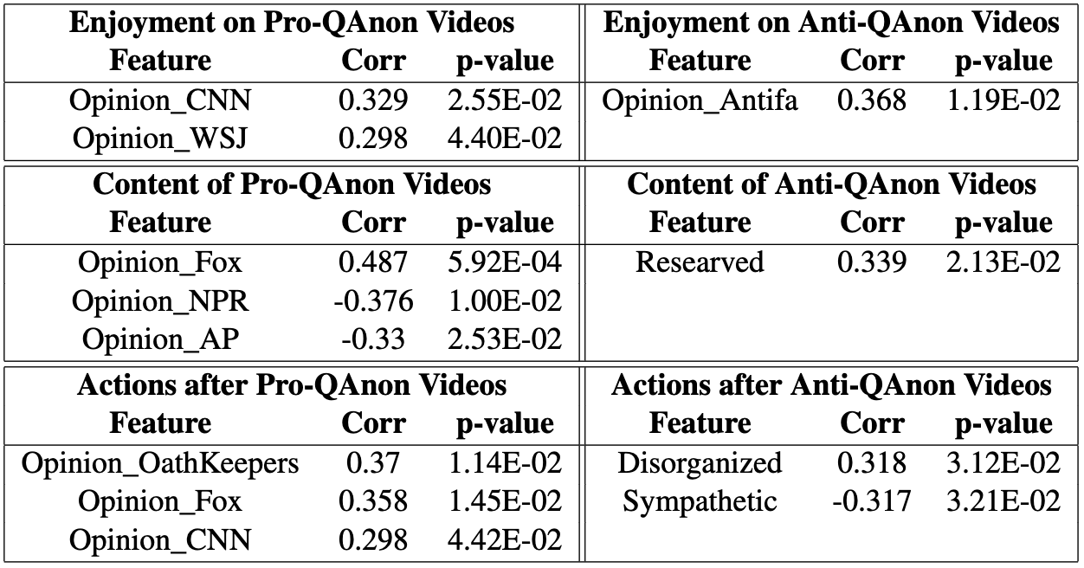
QAnon – Significant Viewer Traits (RQ1)

Slide 14
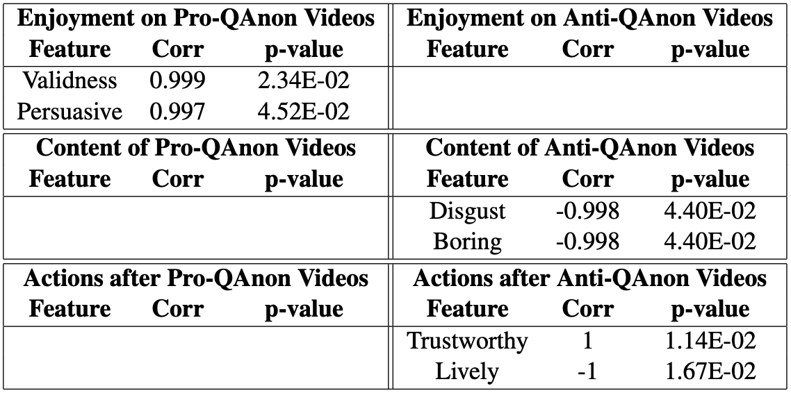
QAnon – Significant Video Characteristics (RQ2)

Slide 15
QAnon – Multimodal Features
Textual features: LIWC ³, Grievance Dictionary ⁴, VADER ⁵
Acoustic features
  OpenSmile features (pitch, intensity, etc)
  SpeechBrain’s emotion detection model ⁶
Visual features
  Pre-trained FER (facial expression recognition) model ⁷
  Clarifai’s weapon detector model ⁸
Data pre-processing
  Transcripts extracted using the Google Speech-to-text service ⁹
  IPU level segmentation
³ Pennebaker, James W., et al. The development and psychometric properties of LIWC2015. 2015.
⁴ van der Vegt, Isabelle, et al. "The grievance dictionary: Understanding threatening language use." Behavior research methods 53.5 (2021): 2105-2119.
⁵ Hutto, Clayton, and Eric Gilbert. "Vader: A parsimonious rule-based model for sentiment analysis of social media text." Proceedings of the international AAAI conference on web and social media. Vol. 8. No. 1. 2014.
⁶ Ravanelli, Mirco, et al. "SpeechBrain: A general-purpose speech toolkit." arXiv preprint arXiv:2106.04624 (2021).
⁷ Facial-Expression-Recognition.Pytorch
⁸ Clarifai weapon detector
⁹ Google Speech-To-Text

Slide 16
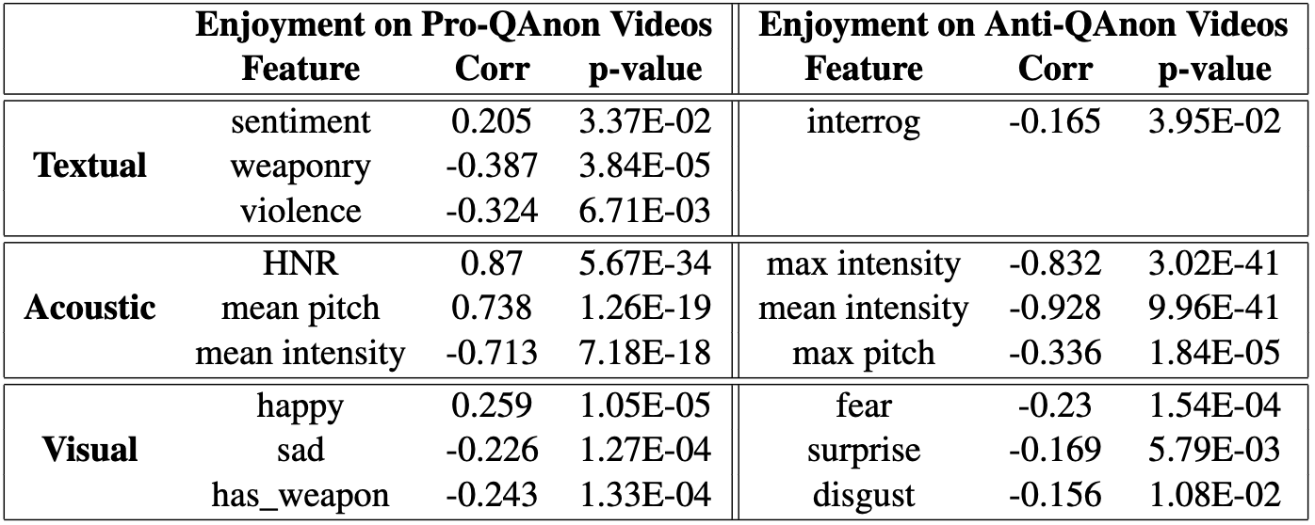
QAnon – Significant Multimodal Features (RQ3)

Slide 17
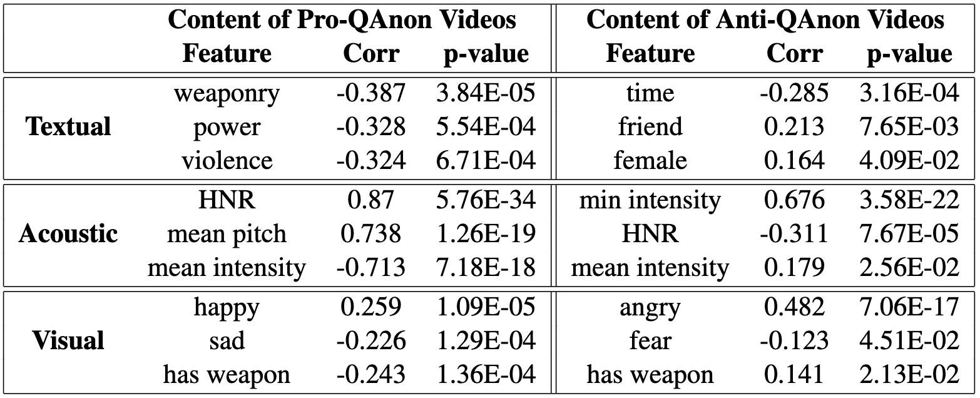
QAnon – Significant Multimodal Features (RQ3)

Slide 18
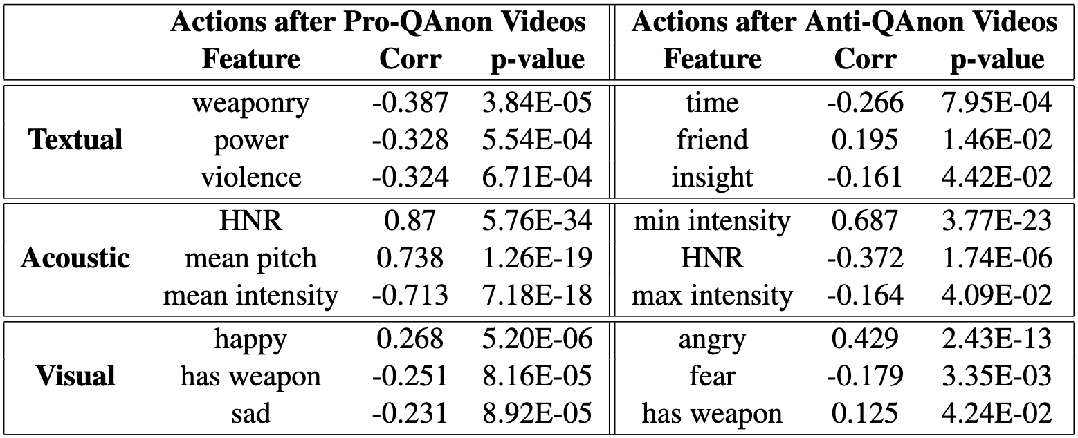
QAnon – Significant Multimodal Features (RQ3)

Slide 19
QAnon – Conclusions
Collected a corpus of videos for 5 extremist groups
Designed a comprehensive questionnaire
Answered three questions
  RQ1: What viewer traits, such as personality traits and media consumption, are associated with their video preferences?
  RQ2: What video characteristics, such as speaker traits, video quality, and arousing emotions, are correlated with viewers' perception?
  RQ3: What multimodal features are correlated with viewers’ perception?

Slide 20
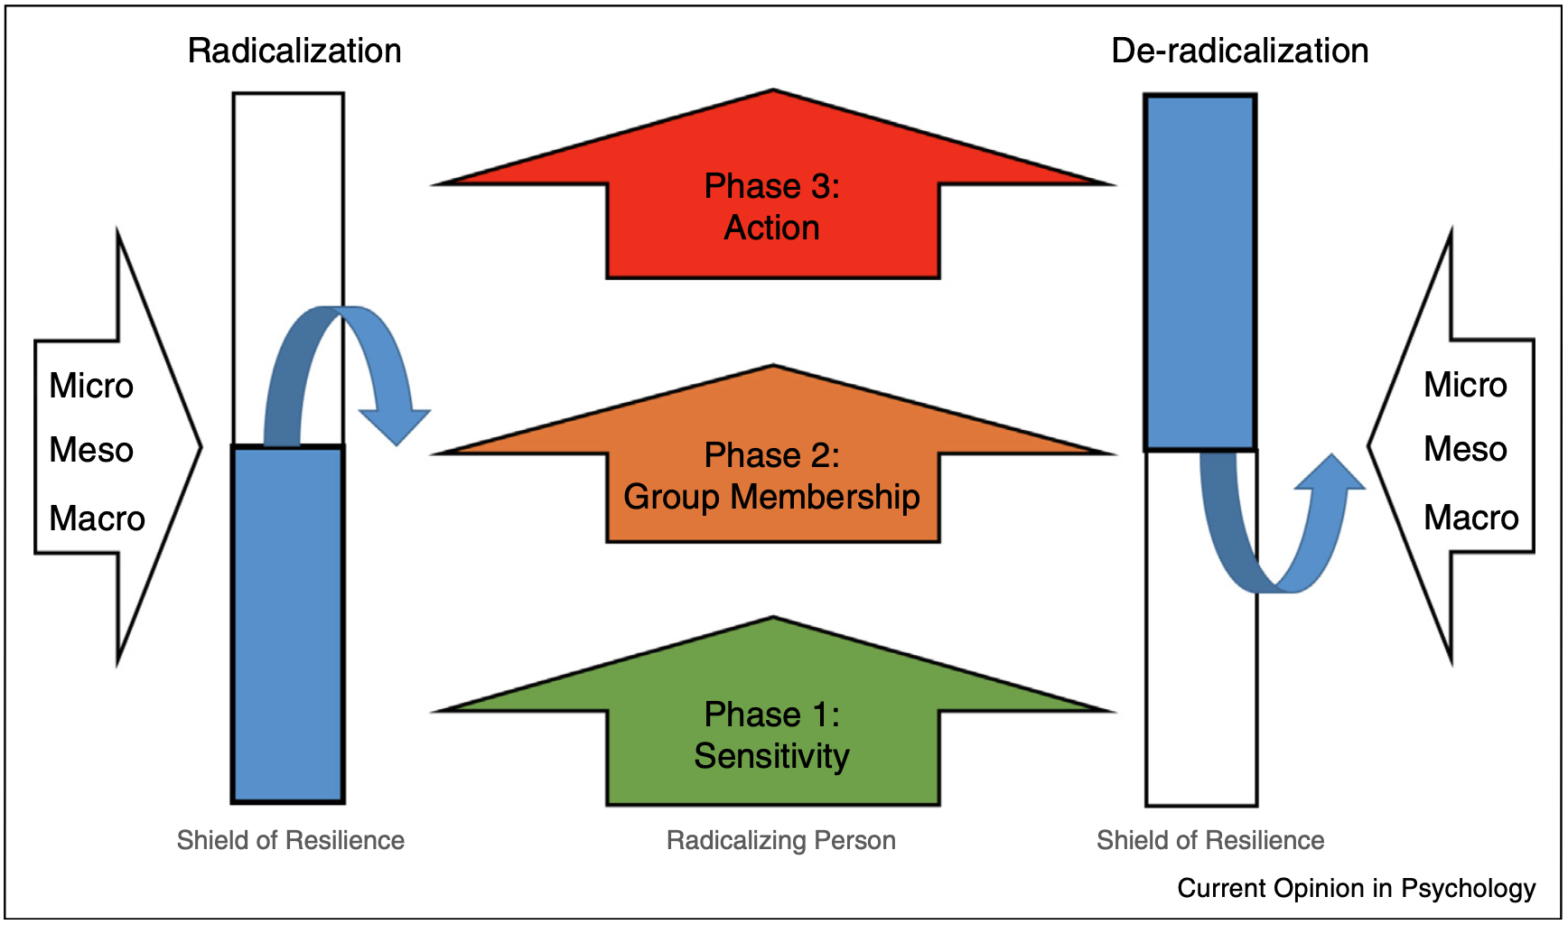
Ongoing Work
Define techniques/strategies being used by extremist groups in different phases of radicalization
Annotate videos with these techniques/strategies to score the radical level of the videos
Define and annotate strategies of de-radicalizing videos
  Former group members detaching from the group
  Intra-group conflict

Slide 21
Thank you!
Questions?

