Slide 1
Trusted and Mistrusted Speech: Acoustic-Prosodic and Lexical Cues to the Speech Humans Trust or Do Not
Julia Hirschberg
COMS CS6998
Notes:
Today I’ll be talking about work we have done to identify the kind of spoken language humans trust, which should be useful to know for building trustworthy dialogue systems.
TACL 2020 paper
We’ve been working with DHS and AFOSR for a number of years on deception production and perception and currently trust. How do humans detect lies? Or do they?

Slide 2
Collaborators in this research since 2003
Current and past colleagues and students working with us on X-Cultural Deception & Trust:
Guozhen An, Rebecca Calinsky, Nishmar Cestero, Sadia Chowdhury, Xi (Leslie) Chen, Kai-Zhan Lee, Michelle Levine, Rivka Levitan, Sarah Ita Levitan, Yocheved Levitan, Min Ma, Angel Maredia, Marco Mandic, Gideon Mendels, Elizabeth Petitti, Andrew Rosenberg, Molly Scott, Yogesh Singh, , Xinyue Tan, Mandi Wang, Laura Wilson, Jessica Xiang, Yuwen Yu, Jixuan (Gilbert) Zhang
Notes:
~17 years! This work is part of a long project I’ve been involved in with many collaborators and students studying deceptive speech and trusted speech

Slide 3
Background
Multimodal deception detection supported after 9/11 by a new Department of Homeland Security
What aspects of human behavior are valid indicators of deception?
Can we create reliable automatic deception detection models to identify future terrorists?
Current support from Air Force Office of Scientific Research focuses on identifying human trust as well
What aspects of human speech are trusted by other humans? Can we build good trust models to identify and to generate trusted speech?
Notes:
9/11/2001 attacks by al-qaeda when terrorists hijacked u.s. planes and flew them into multiple buildings in the World Trade Center, a good part of the Pentagon in Virginia, and may have been planning to destroy the Capitol and the White House in D.C. The hijackers had gotten into the U.S. apparently by fooling U.S. immigration interviewers in the airports they arrived in.

Slide 4
Why is Deception Detection a Problem? Human Performance at Detecting Lies is Very Poor (Aamodt & Mitchell, 2004; Hartwig et al., 2017)
Group | # Studies | # Subjects | Accuracy %
Criminals | 1 | 52 | 65.40
Secret service | 1 | 34 | 64.12
Psychologists | 4 | 508 | 61.56
Judges | 2 | 194 | 59.01
Police officers | 8 | 511 | 55.16
Federal officers | 4 | 341 | 54.54
Students | 122 | 8,876 | 54.20
Detectives | 5 | 341 | 51.16
Investment professionals | 1 | 215 | 49.4
Parole officers | 1 | 32 | 40.42
Notes:
We know from many studies and meta-studies that humans are generally very poor at deception detection, even those who must uphold the law – and investment professionals! And most people are worse than chance at deception detection.

Slide 5
How do People Decide: Truth or Lie?
Language
The words speakers use?
The syntax speakers choose?
How complex their discourse is?
The acoustic content of their speech – Pitch? Intensity? Speaking rate?
The prosody of their speech?
Body gestures, facial features?
Notes:
What we decided to investigate what how human decide whether a statement is truth or lie in terms of the language a speaker uses and how they present it. Others have found that they are gesture and facial features that provide clues as well but we focus on language.

Slide 6
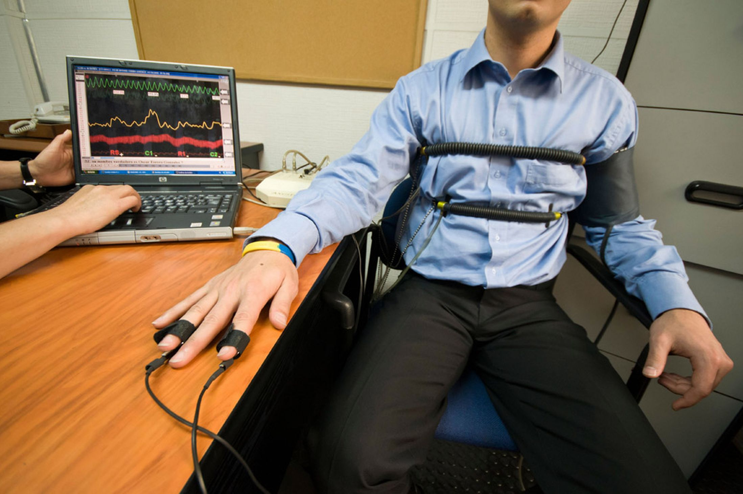
Modalities Explored for Deception vs. Truth Detection
Body posture and gestures (Burgoon et al ‘94)
Facial expressions (Ekman ‘76; Frank, ‘03)
Biometric factors (Horvath, ‘73): but not polygraphs
Brain imaging technologies (Bles & Haynes ‘08)
Language-based features
Text (Adams ’96, Pennebaker et al ‘01)
Speech (Enos et al. ’07, Levitan et al ’18,
Chen et al ‘20)
Notes:
We were among the first to do large-scale speech studies
Brain-imaging scandal in India --

Slide 7
Past Language-based Deception Detection was Primarily Base on Text Information
Practitioners
Statement analysis (Adams, 1996)
SCAN (Smith, 2001)
John Reid & Associates (Buckley, 2000)
Forensic linguistics (Robert Leonard)
Academics (NLP)
Bachenko et al. (2008) on statement analysis
Ott et al. (2011) on fake hotel reviews
Perez-Rosas & Mihalcea (2015) multimodal face and NLP
Speech
Voice Stress Analysis (Horvath, 1982)
Streeter et al. (1977)
Ekman et al. (1991)
Enos (2009)
Notes:
Statement analysis: little empirical evidence, mostly anecdotal
SCAN: Deception Detection by Scientific Content Analysis of written statements supplied to police

Slide 8
Goals of Our Research
Identify acoustic-prosodic and linguistic characteristics of deceptive and trustworthy language: speech and transcripts
Develop automated methods to detect deceptive language and trusted language – note that these are not always different
Today’ talk: Focus on trusted and mistrusted language in the Columbia Cross-Cultural Deception (CXD) Corpus (Xi (Leslie) Chen et al “Acoustic-Prosodic and Lexical Cues to Deception and Trust”, TACL 2020)
Notes:
some aspects of deceptive language are in fact trusted by many
http://www.cs.columbia.edu/speech/PaperFiles/2020/TACL_a_00311-Chen_Proof1.pdf

Slide 9
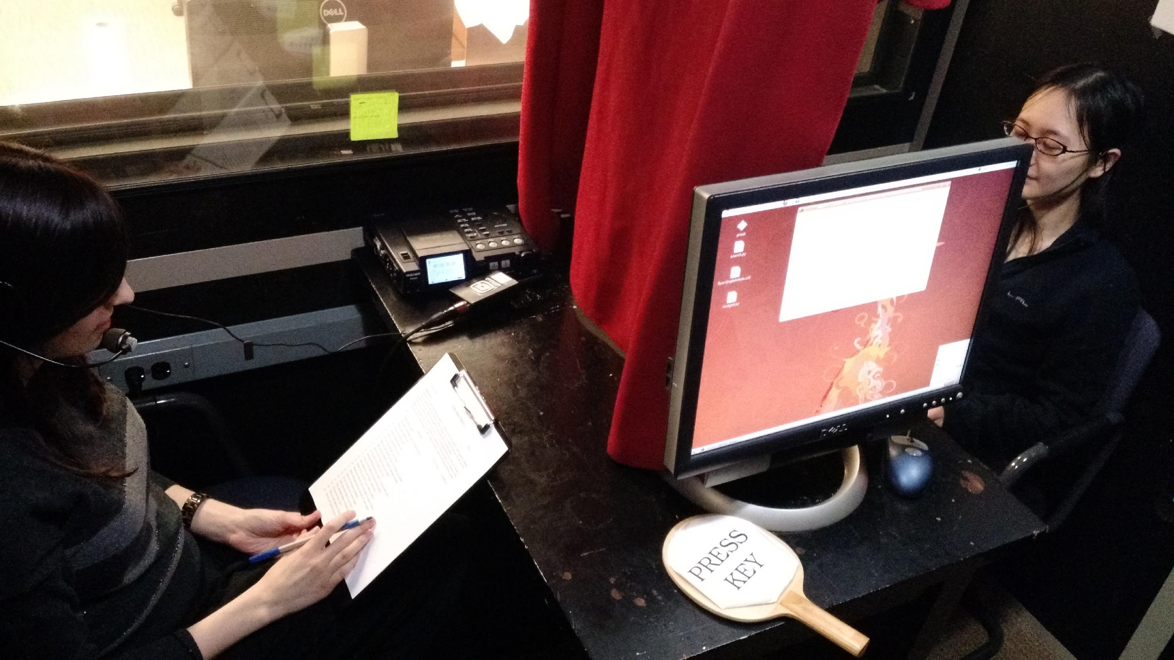
Columbia X-Cultural Deception (CxD) Corpus
340 subjects balanced for gender and native language
Native speakers of Mandarin Chinese and Standard American English
>120h of subject speech
Demographic survey
Part-Fake resume paradigm
NEO-FFI personality scores
Baseline voice sample
Financial incentives
Data: Deception production and perception labels
Global (interviewer) and local (interviewee) deception labels
Notes:
Brought pairs of subjects who did not know each other into the lab
Gave them a demographic survey, a personality (NEO FFI) survey, collected baseline speech
Partially-Fake resume paradigm: 24 questions, create false answers for half we selected at random, balanced
Interviewed one another in turn in recording booth
Financial incentive scheme: to interviewee: lie believed true by interviewer = $1; lie (correctly) believed false -$1; $1 to interviewer for each correct guess only
Keypress logging of T/F statements by interviewee for each utterance and by interviewer for ther overall T/F for each of the 24 questions at the end of their follow-ups
Crowdsourced transcriptions using AMT and hand-checked these for accuracy
Automatic segmentation with Kaldi which we then hand-corrected

Slide 10
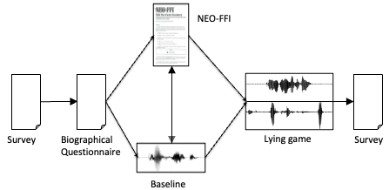
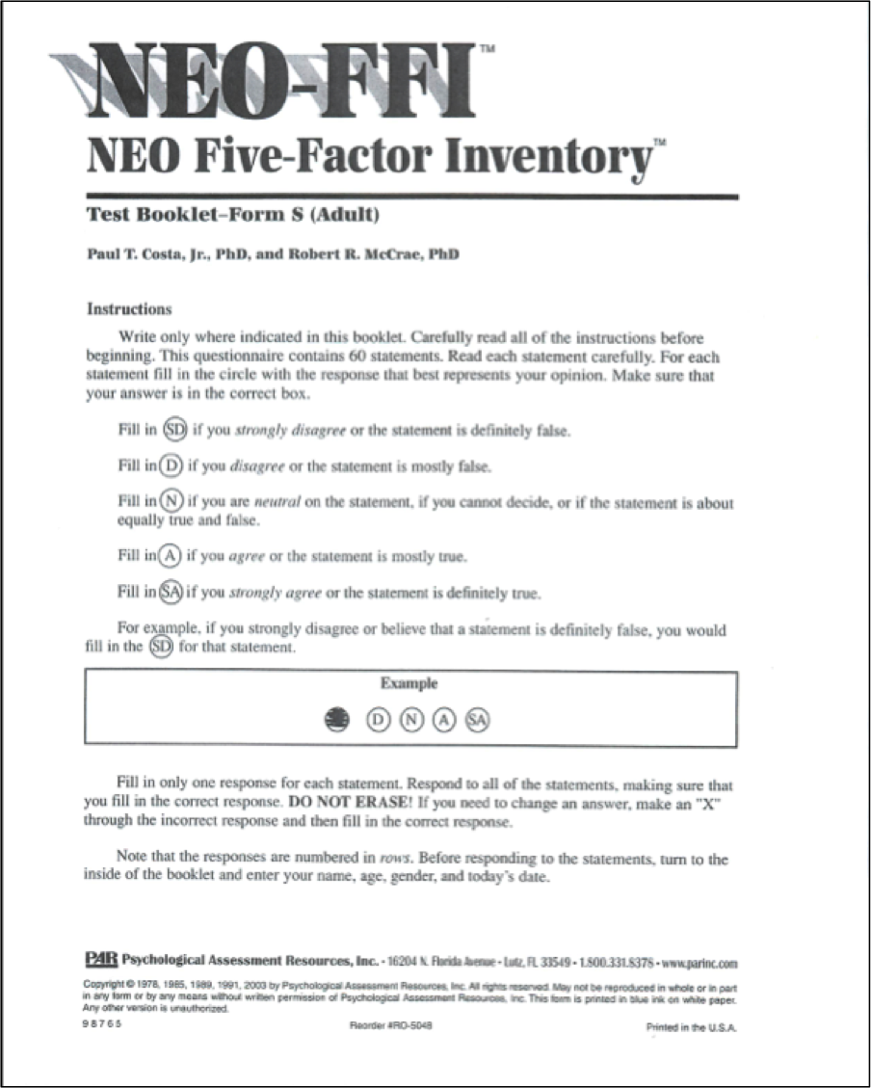
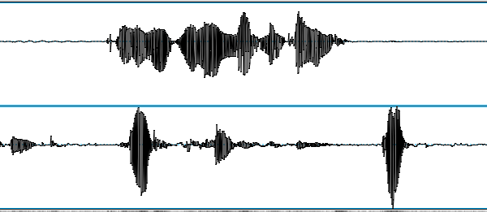
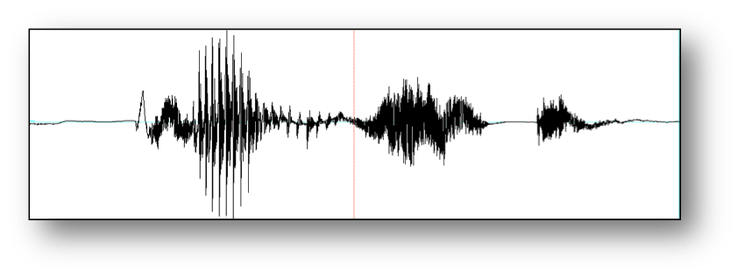
Columbia X-Cultural Deception Corpus
NEO-FFI
Survey
Biographical
Questionnaire
Lying game
Survey
Baseline
Notes:
Brought pairs of subjects who did not know each other into the lab
Gave them a demographic survey, a personality (NEO FFI) survey, collected baseline speech
Partially-Fake resume paradigm: 24 questions, create false answers for half we selected at random, balanced
Interviewed one another in turn in recording booth
Financial incentive scheme: lie believed true = $1; if believed false -$1; $1 to interviewer for each correct guess
Keypress logging of T/F statements by interviewee for each utterance and by interviewer for thier overall T/F for each of the 24 questions at the end of their follow-ups
Here are the questions we asked them to provide truth or lie answers to…

Slide 11
No. | Questions
1 | Where were you born?
2 | How many years did you live in your first home?
3 | What is your mother's job?
4 | What is your father's job?
5 | Have your parents divorced?
6 | Have you ever broken a bone?
7 | Do you have allergies to any foods?
8 | Have you ever stayed overnight in a hospital as a patient?
9 | Have you ever tweeted? (posted a message on twitter)
10 | Have you ever bought anything on eBay?
11 | Do you own an e-reader of any kind?
12 | Who was the last person you were in a physical fight with?
13 | Have you ever gotten into trouble with the police?
14 | Who ended your last romantic relationship?
15 | Whom do you love more, your mother or father?
16 | What is the most you have ever spent on a pair of shoes?
17 | What is the last movie you saw that you really hated?
18 | Have you ever gone ice-skating?
19 | Do you currently own a tennis racket?
20 | How many roommates do you have?
21 | If you attended college, what was your major?
22 | Did you ever have a cat?
23 | Have you ever watched a person or pet die?
24 | Did you ever cheat on a test in high school?
Notes:
1, 5, 6, 8, 12, 13, 14, 15, 23, 24
We grouped our questions by different categories:
ynq’s (e.g. 9, 10, 11) or open-ended q’s (16, 17)
Sensitive (12, 13, 24) or non-sensitive questions (19, 20)

Slide 12
Four Units of Analysis: Small to Large
Inter-Pausal Unit (IPU) Pause-free segment of speech from a single speaker
Turn Sequence of speech from one speaker without intervening speech from the other speaker
Question response Interviewee first turn following an interviewer biographical question
Question chunk Set of interviewee turns responding to an interviewer’s biographical question and subsequent follow-up questions

Slide 13
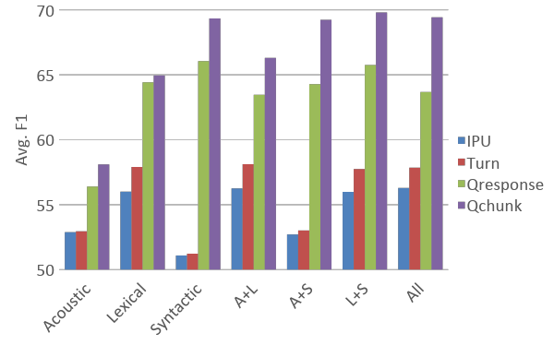
Deception Classification: Our Classifiers vs. Human Interviewer Performance
Notes:
Random: 50% (balanced truth and lie) --
Best Humans: 56.75 % (on chunks) – red line -- and mean F1 of 55.33) – Best ML on chunks: 73.67 F1
speaker independent 10-fold cross-validation using Naïve Bayes classifier

Slide 14
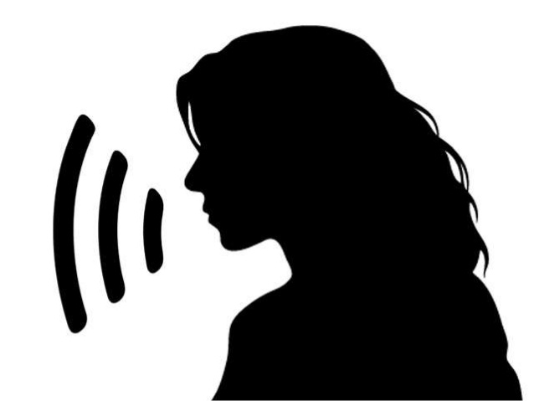
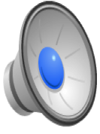
“Did you ever cheat on a test in high school?”
TRUE or FALSE?
Notes:
And now for a final test…
True. P406p407-part1
Judged true by human.

Slide 15
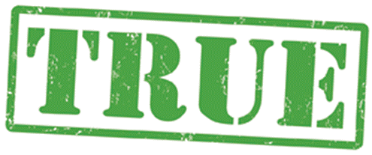
“Did you ever cheat on a test in high school?”

Slide 16
“Did you ever cheat on a test in high school?”
TRUE or FALSE?
Notes:
Turn this
False. P482p483-part1
Judged true by human.

Slide 17
“Did you ever cheat on a test in high school?”
Notes:
False. P482p483-part1

Slide 18
“Who was the last person you had a physical fight with?”
True or False?
Notes:
True: p372p373-part2_ch2/1053.631440/1054.731440/q12/n1/T

Slide 19
“Who was the last person you had a physical fight with?”
Notes:
True: p372p373-part2_ch2/1053.631440/1054.731440/q12/n1/T

Slide 20
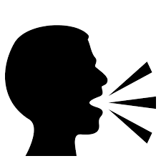
“Who was the last person you had a physical fight with?”
True or False?
Notes:
False: p542p543-part2_ch2/310.619791/322.302834/q12/n1/F

Slide 21
“Who was the last person you had a physical fight with?”
Notes:
False: p542p543-part2_ch2/310.619791/322.302834/q12/n1/F

Slide 22
“Who was the last person you had a physical fight with?”
True or False?
Notes:
p514p515-part2_ch2/1199.310584/1216.842950/q12/n1/F

Slide 23
“Who was the last person you had a physical fight with?”
Notes:
p514p515-part2_ch2/1199.310584/1216.842950/q12/n1/F

Slide 24
“Who was the last person you had a physical fight with?”
True or False?
Notes:
p352p353-part2_ch2/1834.867900/1840.947900/q12/n1/T

Slide 25
“Who was the last person you had a physical fight with?”
Notes:
True: p352p353-part2_ch2/1834.867900/1840.947900/q12/n1/T

Slide 26
How do Humans Decide which Answers to Trust?
The words speakers use?
The syntax speakers choose?
The acoustic content of their speech?
The prosody of their speech?
Why do humans believe lies are true?
How do human decisions compare with the features our classifiers use more successfully to detect lies and truth?
How does each compare with the actual characteristics of trustworthy (true) vs. untrustworthy (lying) speech?

Slide 27
Approach
Created a game, LieCatcher, to collect additional human judgments via AMT tasks
Each task included 12 of the 24 questions (shown in text) and first responses (collected in speech) of interviewees from our corpus, one at a time, plus a check question to ensure attention to game
Audio samples balanced by gender, native language, question, and speaker
Balanced also for truth/ lie: Half true, half false responses
Collected human judgments with their demographic and personality (TIPI) information
Notes:
Ten Item Personality Inventory (similar to NEO FFI but quicker to do
Unity software

Slide 28
Restricted raters to fluent speakers of English
Asked them about prior experience in law enforcement
They had to listen to a full response before answering
Also collected time interval before decision
Success rate provided to raters only at end of task of each 13 question task – not for each question they rated
Each turker limited to 10 tasks max

Slide 29
LieCatcher: Game-with-a-Purpose
Notes:
Build with Unity game development software. Game with a Purpose

Slide 30
Notes:
Here’s what the rater sees for each question in the task

Slide 31
Crowdsourcing Study Procedures
5,340 utterances w/ 3 rater judgments per utterance
431 unique turkers: 38.9% male, 59.1% female, 2.1% unreported
Only 4.8% reported previous experience in law enforcement
Raters also reported at the end of the game the features they thought indicated deception or truth
Then they were told their overall score
Notes:
13 per task, balanced by gender, native language, veracity

Slide 32
Lie Detection Ability
Used majority vote: Overall accuracy = 49.93%
Fleiss’ kappa: 0.135 (slight agreement)
Where all agreed: 50.75% accuracy
Truth bias: 65% of answers were trusted
Truth Default Theory (Timothy R. Levine, 2014)
People normally do tend to trust others
Notes:
Analyzed utterances labeled with majority vote
Agreement did not correlate with gender or native language of speakers or with utterance length (with slightly lower agreement on longer responses)
But:
Female speakers were trusted more (71.5%) than male speakers (68.6%)
Native English speakers were trusted more (73.5%) than native Chinese speakers (66.6%)

Slide 33
In terms of interviewee personality scores: Speakers with low conscientiousness scores (71.9%) or high openness to experience scores (71.6%) or high neuroticism scores (71.8%) were trusted more than their opposites; no high scores for speech from speakers high in extraversion or agreeableness, which was surprising
Truth Default Theory (Timothy R. Levine, 2014)
People normally do tend to trust others
Notes:
Also

Slide 34
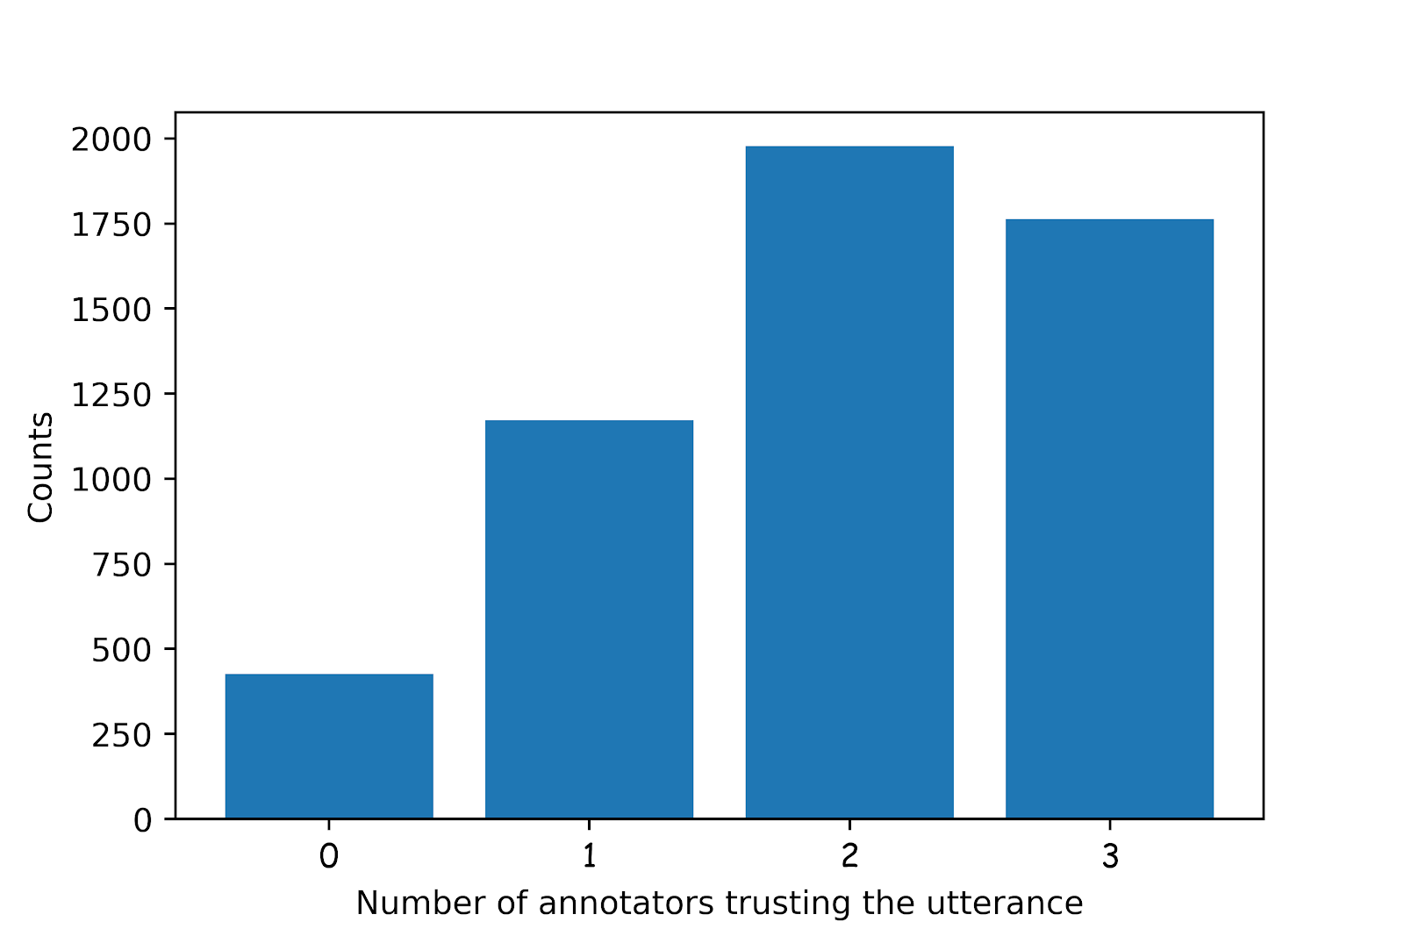
Inter-annotator Agreement
Number of annotators agreeing on trusted utterances
Fleiss’ kappa low: 0.135
Truth bias – 65% agreement on trust over-all
Truth Default Theory (Timothy R. Levine, 2014)
Notes:
Slight agreement – 0.21-0.40 is fair agreement – so seems that this is a subjective task!
33% were trusted by all, 70% trusted by at least 2
Raters more trusting than mistrusting
TDT: people tend to assume that others are honest

Slide 35
What Features Might Lead Listeners to Trust or Mistrust Speakers?
Disfluency “um…er”
Prosody/Acoustics: pitch, speaking rate, loudness
Complexity: more words, more detail
Affect: positive/negative/neutral
Uncertainty: e.g. hedging “sort of”, “probably”
Creativity: measured in difference from other interviewees’ responses to the same question
Notes:
Creativity measured by converting all responses to TF-IDF vectors on unigrams and bigrams. We built a lexical graph for each question with responses as nodes and cosine similarities between TF-IDF vectors as edge weights. Then we computed the eigenvalue centrality for each node and used its negative value as the measure of creativity.

Slide 36
Disfluency Features: Humans Do Fairly Well
Features | Trusted Responses | Actual Deceptions
Has filled pause | ↓↓↓↓ | ↑↑↑↑
# filled pause | ↓↓↓↓ | ↑↑↑↑
Response latency | ↓↓↓↓
Repetitions | ↓↓↓↓ | ↑
False start | ↓↓↓ | ↑↑
↓ indicates negative relationship of feature with response; ↑ indicates positive relationship
↓: <.05, ↓↓ : <.01, ↓↓↓ : <.001, ↓↓↓↓ : <.0001
Green is correct human judgment of truth or lie; red is incorrect (e.g. filled pause was correctly mistrusted but response latency was not an indicator of lies)
Notes:
green is correct; red is incorrect; Up arrow: positive correlation; Down arrow: negative correlation (number of arrows: significance level:
1: <.05
2: <.01
3: <.001
4: <.0001
All statistical significance calculated after the Bejamini-Hochberg (1995) correction performed.
Red human judgments are “wrong” and green are “right”

Slide 37
Acoustic/Prosodic Features: Humans Very Poor
Features | Trusted | Actual Deception
Speaking rate faster | ↑↑↑↑
Pitch max higher | ↑↑↑↑ | ↑↑↑↑
Pitch mean higher | ↑↑
Pitch min higher | ↑↑↑↑ | ↓↓
Pitch stdev lgr | ↑↑ | ↑↑
Intensity max |  | ↑↑↑
Intensity mean higher | ↑↑↑↑
Intensity min higher | ↑↑↑↑ | ↓
Intensity std smlr | ↓↓↓↓ | ↑
Jitter, shimmer, nhr higher | ↑↑↑↑
Humans very poor at judging lies from how people speak: only 3 correct judgments (higher min pitch and min intensity; smaller std of intensity)
Notes:
↓ indicates negative relationship of feature with response; ↑ indicates positive relationship
Green is correct human judgment of truth or lie; red is incorrect
Humans are very poor at judging deception from “how” people speak.
Of the 11 prosodic cues humans apparently considered useful indicators of deception or truthfulness, only 3 actually were: 2 about trust and one about lying
↓ indicates negative relationship; ↑ indicates positive relationship
↓: <.05, ↓↓ : <.01, ↓↓↓ : <.001, ↓↓↓↓ : <.0001
Green is correct human judgment of truth or lie; red is incorrect
so now let's put these results together with other rater majority judgments

Slide 38
How Did Raters Do?
Disfluency
Raters mistrusted disfluency, which was correct as a cue to deception but also mistrusted response latency, which was not a cue to deception
Prosody
Raters trusted higher, louder and faster speech with higher degrees of jitter, shimmer and NHR – but these features were not significant indicators of truth: higher and louder speech were in fact strong cues to deception
Complexity
Multiple measures showed raters correctly mistrusted more complex utterances, which, contra prior belief, were signs of deception in our data
Notes:
Complexity: longer utterances w/more content words, more concrete and specific

Slide 39
Affect
While raters trusted more pleasant utterances this was not a useful indicator of truthfulness
Uncertainty
Raters did correctly mistrust utterances containing hedge terms (possibly, sort of) but did not correctly trust utterances indicating certainty (always, never)
Creativity
While people were more creative when lying than when telling the truth, raters’ apparently did not recognize this
So this can tell us all how best to deceive others ☺
Provide responses that are shorter, louder, faster, fewer filled pauses, fewer repetitions, less variation in intensity and harsher (unstable amplitude) in VQ
Notes:
Creativity measured by how much a speakers responses differed from other speakers’

Slide 40
Statistically Significant Characteristics of Lies that Deceived Human Judges
Features | Successful Lie
Duration | ↓↓↓↓
Speaking rate | ↑↑↑↑
Response latency | ↓↓↓↓
Intensity mean/min | ↑↑↑↑
Intensity std | ↓↓↓↓
Repetition | ↓↓↓↓
Filled pauses | ↓↓↓↓
Shimmer | ↑↑↑↑
Notes:
Differences from unsuccessful lies: shorter, louder, faster, fewer filled pauses, fewer repetitions, less variation in intensity and harsher (unstable amplitude) in VQ

Slide 41
Statically Significant Characteristics of Lies that Deceived Our Classifier
Notes:
Features that fooled both human and machine judgments. Successful lies had fewer filled pauses (2, 3) and were shorter in duration (5) and number of sentences
(9). Some features only deceived our classifier. For example, lies that successfully deceived the deception classifier were less creative (1) and less specific (4). It seems that different kinds
of lies were successful at deceiving humans and an automated deception classifier

Slide 42
Analysis of Rater Strategies
Asked raters to provide strategies that they used
Annotated strategies by category
Which strategies were useful and which were not?
Compared raters’ stated strategies with their performance on the tasks
None of the strategies reported by a labeler were associated with higher performance than raters who did not report using those strategies in their tasks
Speaker confidence using (“the speaker sounded confident”) as a cue to deception was in fact negatively correlated with task success

Slide 43
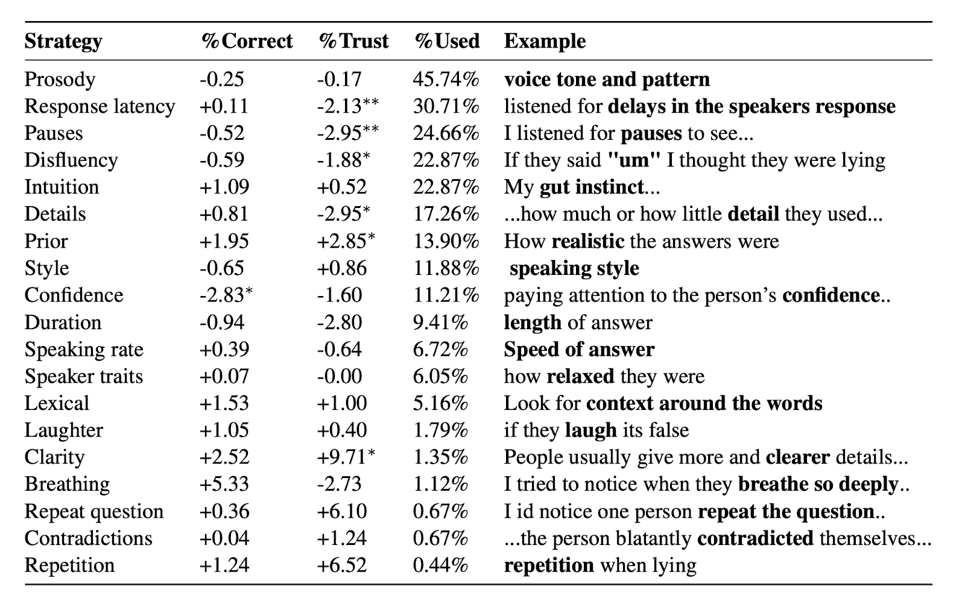
Notes:
Here we show avg % of correct judgments by raters who reported using the strategy compared with those who did not and avg % of utterances judge to be true, as well as the % of raters who reported using the strategy. No strategy reported was associated with significantly better deception detection performance. In fact, using speaker confidence was actually negatively correlated with rater performance. We did find that some strategies were more highly correlated with rater trust (clarity of response, prior domain knowledge) and some with mistrust (response latency, pauses and disfluences as well as level of detail).
For each strategy, we show the increase or decrease in the average percentage of utterances judged correctly and % trusted for annotators reporting that strategy compared with all annotators. no correlation between the number of strategies reported and the accuracy score, but we did discover a negative correlation between the percentage of answers trusted and the number of strategies raters reported using (spearman, ρ = −0.133, p < 0.01).
We also show percentage of annotators reporting the strategy and a sample response from one. For %correct and % trust, the statistical significance is computed by comparing the annotators who said they used the strategy and annotators who did not with a Mann–Whitney–Wilcoxon U test. * p <0.05; **; p < 0.01; ***; p < 0.001. %Used is the % of raters who said they used the strategy
Prosody, response latency, pauses, disfluency, and intuition were the top five strategies mentioned by annotators and features related to prosody, response latency, pauses, and disfluency were indeed significant indications of trust. As shown in this table, none of these reported strategies was associated with an improved deception detection performance. However, we did find that using speaker "confidence" as a cue to deception was negatively associated with the annotators' performance. How confident did the speaker seem?
Which strategies are reported by raters who are more or less trusting over all? We found that people who reported using response latency, pauses, and disfluency when judging deception trusted a smaller percentage of utterances. This could be because of the high prevalence of disfluencies in spontaneous speech, regardless of whether the utterance was deceptive or not. We also found that raters who used the level of detail in a response as a cue were more mistrusting in their judgments. Conversely, those who used clarity of a response and prior domain knowledge were more trusting.

Slide 44
Does Complex Reasoning Help?
How long do people take to make judgments?
No correlation between the response time and whether the answer is correct (spearman, ρ=0.008, p>0.05)
Negative correlation between the response time and whether the answer is trusted (spearman, ρ=-0.101, p<0.0001)
How many strategies do people use?
No correlation between the number of strategies reported and the score (spearman, ρ=0.029, p>0.05)
Negative correlation between the percentage of utterances that annotators trust and the number of strategies they use (spearman, ρ=-0.133, p<0.01)
Notes:
Spearman’s rank correlation coefficient.

Slide 45
So can we Predict and Produce the Speech People Trust?
Many reasons to produce trustworthy speech
Dialogue systems, spoken information systems and robots, public travel announcements and other broadcasts
Training for actors and newscasters and salespeople…
Procedure to predict trusted speech
5-fold cross validation, speaker independent
Low agreement task -> only classify utterances with rater consensus (of 5340: only 1762 trusted by all raters; 427 mistrusted by all raters)
Logistic regression; Evaluated with macro-F1 for balance
Baseline (random): 44.62 macro F1
Notes:
1762 utterances were trusted by all annotators and 427 utterances were mistrusted by all annotators
Mcro-F1: compute per-class precision and recall for all classes, then combine these pairs to compute the per-class F1 scores, and finally use the arithmetic mean of these per-class F1-scores as the macro-F1 score
Macro-F1*: compute macro-averaged precision and macro-averaged f1 and then compute the harmonic mean

Slide 46
What Features Can Identify Trusted Speech?
NLP data-driven features
GloVe embeddings
Dependency parse n-grams
Word n-grams
Our findings on human deception/ trust differences
Disfluencies
Complexity scores
Prosodic features: openSMILE 2013 6373 features
Speaker traits: gender, native language, personality
Notes:
Differences in traits: females trusted more than males; native English speakers trusted more than non-English
Speakers with low conscientiousness, high openness and high neuroticism scored higher
Using only utterances that all raters trusted or mistrusted (1762, 427). 5-fold cross validation. Logistic regression. Normalized for zero mean and unit-variance. Trained and tested on different speaker sets.

Slide 47
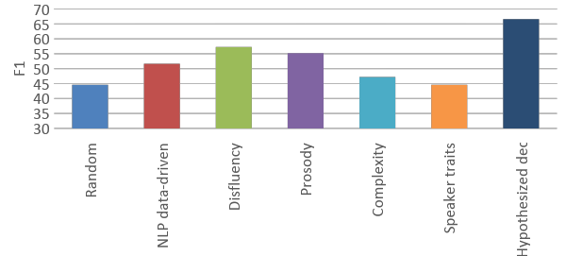
Trust Classification Results: Feature Sets Alone and Best Combined Model
Combined
Notes:
Random forest models trained and tested only on speech raters agreed on–1762 trusted and 427 mistrusted– macro F1-66.10 since data unbalanced
Random: 44.97
NLP: 61.57
Disfluency: 57.28
Prosody: 60.20
Complexity: 45.77
Speaker traits: 44.61
Combining these also with sentiment, uncertainty, and creativity outperformed the NLP data driven methods significantly and provided our best trust classification result.
we present only features that are statistically significant after Benjamini–Hochberg correction (Benjamini and Hochberg, 1995) to correct for false discovery
How to Run the Benjamini–Hochberg procedure
Put the individual p-values in ascending order.
Assign ranks to the p-values. For example, the smallest has a rank of 1, the second smallest has a rank of 2.
Calculate each individual p-value’s Benjamini-Hochberg critical value, using the formula (i/m)Q, where:
i = the individual p-value’s rank,
m = total number of tests,
Q = the false discovery rate (a percentage, chosen by you).
Compare your original p-values to the critical B-H from Step 3; find the largest p value that is smaller than the critical value.
the random baseline is calculated by adding up the squared probabilities of all the classes. The random baseline classifier thus picks a class at random, instead of choosing the most frequent one.

Slide 48
Characteristics of Successful Lies: Human and Machine Learning Models
Deceiving our raters: shorter, louder, faster, fewer filled pauses, fewer repetitions, less variation in intensity and harsher (unstable amplitude) in VQ
Deceiving our ML models: creativity, fewer filled pauses, less specific, shorter, lower pitch, less “concrete” (referring to perceptual entity)
Features that fooled both: Successful lies had fewer filled pauses and were shorter in duration and number of sentences
Different types of lies were successful at deceiving humans vs. ML models: So perhaps we need both?
Notes:
(9). Some features only deceived our classifier. For example, lies that successfully deceived the deception classifier were less creative (1) and less specific (4).

Slide 49
Why are Humans So Poor at Detecting Lies?
Prior work on our full CXD Corpus found that even with more data (full responses to their questions)
Humans achieved only 55.33 F1 (on full Q/A conversations)
But our best ML models on these achieved 73.67 F1
Why do ML-trained systems do better?
Mismatch for humans between language they trust and actual truthfulness
Ineffective reported strategies – especially in the acoustic/prosodic domain
Can we train humans to do better?

Slide 50
Ongoing Research: LieCatcher for Lie Detection Training with HELP
Key features:
Baseline sample of speech for comparison
Feedback and explanations for correct and incorrect judgments
Notes:
Using LieCatcher to do more helpful training: giving quick feedback and explaining what information the rater should have taken into account….
https://liedetector.cs.columbia.edu/mturk/portal_new_2.html

Slide 51
Data Collection
Participants:
Amazon Mechanical Turk crowdworkers and Columbia University students
28 participants (16 female, 12 male)
Each player plays 12 rounds of games, 12 question each
Survey: demographic and personality information

Slide 52
Can we train people to improve at lie detection?
Within a gameplay?
12 questions per game
Across multiple rounds of gameplay?
Players play 12 sets of games

Slide 53
Within-game Performance
Players significantly improved performance in the second half compared to the first half of each game
t(27) = 7.57, p < 0.001
51% accuracy in first half and 62% accuracy in second half
Notes:
t-test score is number of standard deviations from the mean t-distribution

Slide 54
Multiple-game Performance
Significant learning effect across 12 rounds of gameplay
F(11,297)=9.20, p < 0.001, η² = 0.22
Pairwise posthoc comparisons show that raters most significantly improve at game #8
Notes:
F-test for linear regression: comparing raters’ improvement over the 11 next sessions, looking at positive improvement scores for one round from the previous round. Did they do better in session n+1 over session n?

Slide 55
Which feedback was most helpful?
60% of players reported verbal cues
40% of players reported baseline speech samples

Slide 56
Ongoing/Future Work
Collect additional data
Examine the impact of baseline speech on player performance
Study demographic and personality factors that affect player performance

Slide 57
So… Unless People can Learn to Detect Deception Better…
Unless humans can learn to detect deception more accurately
What sort of speech should our Dialogue Systems employ?
Do we want to produce speech that we know humans do trust, whether correctly or not?
Or do we want to produce speech that actually represents speech that we should trust?
This all remains a real challenge for the dialogue community and for Ethical AI…

Slide 58
Thank you!
Questions?

