Slide 1
Conveying Empathy in Conversation
Run Chen
Columbia University
COMS 6998
Slides from Julia Hirschberg

Slide 2
Dialogue Systems of the Future
Dialogue Systems have come a long way in the past decade since Siri came our way in 2011 and Alexa in 2014 –
    Much more flexible and useful for accomplishing tasks and providing entertaining chat
    However, there is still considerable room for improvement, as we all know:
      How can we adapt them to the needs of individual users more successfully?
      How might we incentivize users to engage more?
      How can we improve the overall user experience?
      A possible solution: Perhaps our Dialogue Systems need to become more empathetic
Notes:
I became interested in empathetic dialogue several years ago when I joined a group working on this as an Amazon Scholar and started digging into past and present work on empathetic conversation – and also encouraging them to consider acoustic/prosodic features of the speech they produce and their users produce. This is what I’d like to talk about today, in conversational agents and particularly in avatars.

Slide 3
Empathetic Conversations
What is Empathy in dialogue?
Empathetic behavior in earlier Conversational Agents
Current state-of-the-art in Empathetic Agents
Our current work on Empathetic Dialogue
What are the ethical challenges?
Future work
Notes:
I’ll be talking today about the development of Conversation Avatars with a number of examples of how these have developed over the past 2 decades in different goals and modalities. Then I’ll move on to discuss what kind of Avatars are being developed to exhibit empathetic behavior toward their users: why

Slide 4
Empathetic Conversation in Dialogue Systems
What is empathy?
There are many definitions
  Social resonance, interpersonal adaptation, entrainment, interactional synchrony, social glue, immediacy behaviors, positivity resonance, rapport
  More generally…the ability to understand other people's feelings as if we were having them ourselves ... ‘feeling with’ someone – being able to put yourself in their place as if you were them, and feeling their feelings
        Read more at: https://www.skillsyouneed.com/ips/empathy-types.html

Slide 5
Different Forms of Empathy
Cognitive empathy: ‘perspective-taking’ or being able to put yourself into someone else’s place, and see their perspective
  Useful skill for managers but doesn't really fit “feeling with”
Emotional empathy: literally feeling another person’s emotions
    Aka ‘personal distress’ or ‘emotional contagion’
    Can be good or bad: we can understand each others’ emotions and respond appropriately but can overwhelm you (empathy overload)
Notes:
Different groups have identified empathy in slightly different ways.
emotional contagion: infecting another with your mood

Slide 6
Compassionate empathy: feeling someone’s pain and taking action to help mitigate their problems
  Usually people who want/need your empathy don’t just need you to understand (cognitive empathy), or just feel their pain or burst into tears w/them (emotional empathy)
  People need you to understand and sympathize with them and help take action to resolve the problem
Other types of empathy but less relevant for us:
  Somatic empathy: feeling someone’s pain physically
  Spiritual empathy: connect with a ‘higher being” (e.g. through meditation)directly with ‘higher being’ or consciousness -- achievable through meditation
Notes:
So today we’ll see systems that try to produce different types of empathy (cognitive, emotional, or compassionate) and sometimes a combination of these

Slide 7
Examples of Empathy in Conversation
  A: How are you doing today?
  U: I’m not feeling so great.
  A: I’m so sorry to hear that. Can you tell me more about how you are feeling? …
  A: How are you doing today?
  U: Pretty bad – I just lost my dear cat.
  A: Oh how awful! It is so so hard to lose a pet you love…
  A: How are you doing today?
  U: I am just so bored with working from home!
  A: Totally understand! Is there anything we can provide to help? We can recommend some great movies or videos to watch? Or…?

Slide 8
Empathy Corpora
One-Minute Gradual Empathy Challenge (OMG), 2019
  Dataset of 80 pairs of actors telling each other fictional stories (415m)
  Listeners assessed for valence (pos/neg/neu)
Rashkin et al EmpathicDialogues (2018)
  25k text conversations crowd-sourced for different emotional categories – some analysis here
STUDIES: Corpus of Japanese Empathetic Dialogue Speech Towards Friendly Voice Agent (2022)
  Simulated dialogues by 3 actors – corpus here
  Extended to customer centers in CALLS (2023) and a new corpus here

Slide 9
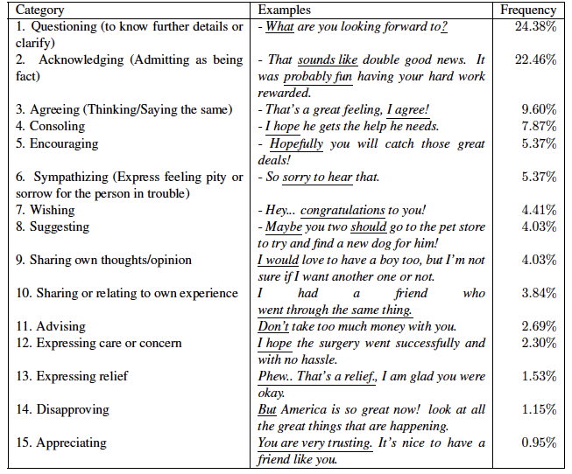
Notes:
Welivita and Pu, “A Taxonomy of Empathetic Response Intents in Human Social Conversations,” arXiv:2012.04080v1 [cs.CL] 7 Dec 2020: labeled 500 responses in dialogues from Hannah Rashkin et al 2019’s Empathy Corpus (text only) in which 810 Turkers were asked to respond empathetically to conversations.
Note that more than half these empathetic responses appear to be reacting to positive feelings and fewer to more negative feelings
empathetic agents need to handle a lot!
Some of these are quite similar categories: 4 consoling, 5 encouraging, 6 sympathizing, 12 expressing care…

Slide 10
11 Nonverbal Ways to Express Empathy and Camaraderie with Your Team (Forbes, 2018)
Practice Engaged, Active Listening (without taking notes)
Sit next to your team members instead of at the head of the table
Adopt empathetic mannerisms (square shoulders, soft eye contact, head nods, arms at your sides) and reflect back what you have heard to them
Raise eyebrows slightly, squeeze cheeks, purse lips, tilt head
Mirror the other’s body language
Relax your face
Get out from behind your desk
Be truly present in the conversation
Open your palms
Convey respect through handshake, smile and gaze
Sincerely smile and slowly nod
Notes:
Forbes (u.s. business magazine) Coaches Council report: good requirements for managers which would also be useful for empathetic avatars:
https://www.forbes.com/sites/janicegassam/2018/09/25/empathy-the-key-to-a-diverse-and-inclusive-workplace/?sh=383dfd1a7097

Slide 11
Why Produce Empathy in Humans or in Conversational Agents?
Encourage users to like the agent more, think they are more intelligent, take their advice, want to speak with them more and more often, buffer consequences when the agent makes a mistake
Help establish social bonds, promote or diffuse conflict, persuade, accomplish beneficial outcomes, succeed in negotiations, improve workplace cohesion, enhance psychotherapeutic effect, elevate test performance, develop rapport
Much evidence that humans can indeed be influenced by empathetic behavior — even when they know the agent is a computer
Notes:
But what are the practical reasons for producing empathetic avatars?

Slide 12
  Successful methods depend not just on the topic but also on the characteristics of the user
  Differences in agent/user behavior may be based on:
    Listener personality, facial expression and gesture norms
    Relative power of the conversationalists (who’s the boss?)
    Prior expectations: if positive behavior is not expected it can produce better outcomes
    Differences in cultural norms (e.g. Mandarin…)
    All these need to be taken into account to produce truly empathetic behavior

Slide 13
What Do We Need to Identify from the User?
Norms: What type of input does the user produce?
  Vocabulary, syntax, speech, expression, gestures
Mood: What is the user feeling?
  Happy, Sad, Angry, Frustrated, Confused, Uncertain
  Detected from lexical, speech, gesture, expression
Topic: What is the user speaking about now and in prior turns (conversational history)?
Dialogue acts: e.g. distinguishing pauses from floor-yielding cues, recognizing when backchannels are appropriate
Notes:
Difficult to do unless the agent/avatar has an ongoing relationship with the user and can learn these things

Slide 14
More challenging:
  Goals: What is the user trying to accomplish in the topic they’re discussing?
  Personality: How does the user score on e.g. NeoFFI categories such as agreeableness, extraversion, neuroticism, openness to experience, and conscientiousness
    Ways of identifying this through asking them to participate in story-telling event which includes questions about the story that can reveal differences in these traits
Notes:
NEOFFT NEO Five Factor Inventory

Slide 15
What Do We Need to Produce?
Empathetic conversation requires (Ma et al 2019):
  In text: some entrainment depending on user mood
  In speech: backchannels, some entrainment, overlapping speech
  In facial expression: gaze and gaze shifts, appropriate smiles, sad faces, concerned faces
  In head movement and gesture: nods, forward leaning, open posture w/uncrossed arms, body orientation, active listening postures
  In all of these modalities: appropriate sentiment/ emotion
Notes:
Patel et al https://journals.plos.org/plosone/article?id=10.1371/journal.pone.0221412: Curricula for empathy and compassion training in medical education: A systematic review, 2019

Slide 16
How is Success of Empathetic Agents’ Conversations Typically Measured?
Subjective ratings of rapport, social presence, helpfulness, distraction, naturalness
Depth of disclosure of personal information
Positive facial expression (fewer frowns and other negatives) and mutual eye-gaze patterns
Other User behaviors:
  Length of user responses, fluency, filled pauses or self-repairs per minute, length of user interaction, overall frequency of use of the dialogue system
Is this enough?
  Healthcare agents: Are they successful? Do people get healthier?
  Shopping: Do people purchase more?
Notes:
Depending on the task…. For healthcare applications, are they effective? For shopping, more purchases??

Slide 17
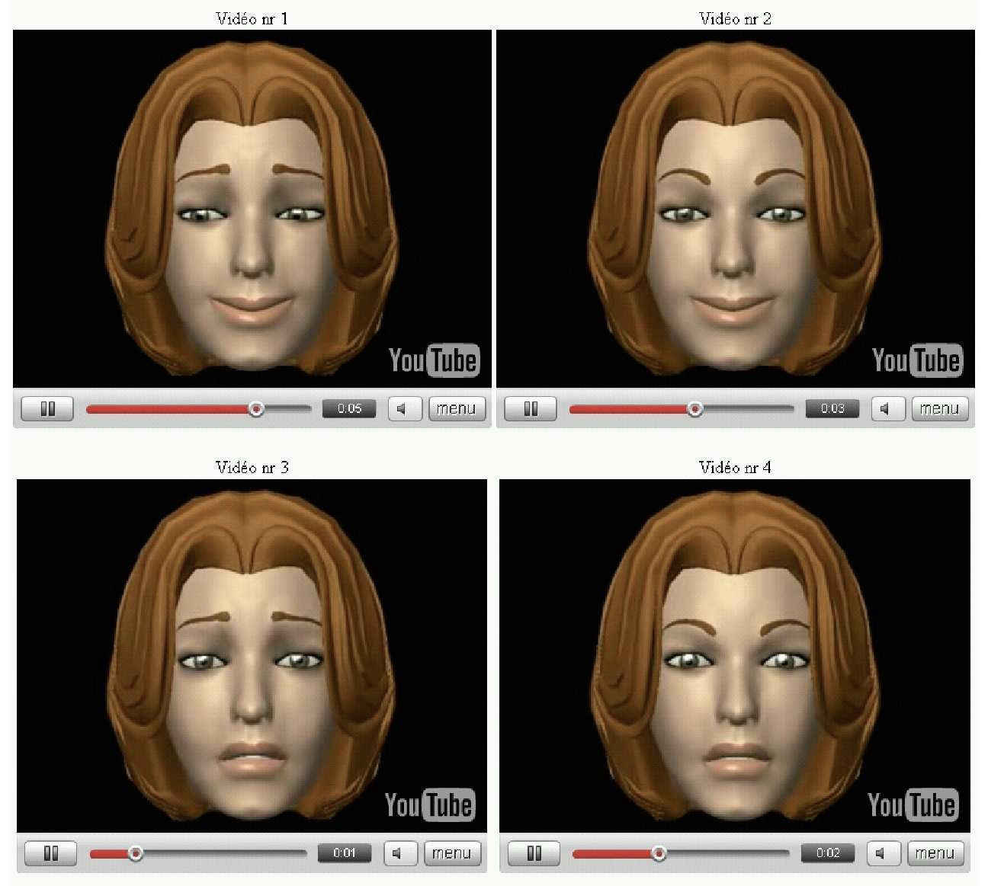
Early Empathetic Virtual Agents
Niewiadomski et al (2008) produced a conversational agent, Greta, to evaluate the use of facial expression to produce empathy
Notes:
Radoslaw Niewiadomski, Magalie Ochs and Cathinerin Pelachaud, Expressions of empathy in ECAs (empathetic conversational agents), 2008
Can you find the most empathetic face? users rated simple sadness best (33%) (upper left) but super-positive about as highly (31%) (lower left) , then masking lower (26%) (lower right) and egocentric last (10%) (upper left)
Evaluated user responses to simple emotions expressing empathy (e.g. joy, sadness) vs. 2 different ways of combining emotions: superposing an egocentric emotion (agent’s own emotion) with an empathetic one; or masking an egocentric emotion by an empathetic one:
Expressions for 1 scenario – a sad event (egocentric emotion and one empathetic): 1) simple joy; 2) simple sadness; 3) superposition of joy by sadness; 4) hand-created masking of joy by sadness. Most appropriate labels varied by scenario.

Slide 18
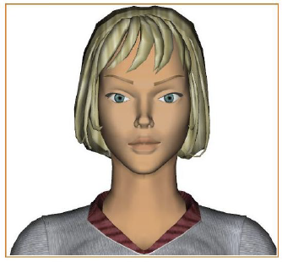
Members of the same group created Jade Semantic Agents to produce empathetic emotion from analysis of human-machine interactions to give users information about their email empathetically
  Noted that empathy means more than just happy-for and sorry-for but should include different empathetic emotions to deal with user satisfaction, frustration, sadness, irritation, anger as well
  Their goal-based emotions relied on identifying:
    Causes of an event and Consequences on user goal
    Consistency of consequences with expectations
    Potential for the user to cope with consequences
Notes:
Ochs, pelachaud and David Sadek, “An Empathic Virtual Dialog Agent to Improve Human-Machine Interaction
Provided a larger view of what was needed in empathetic responses: not just happy and sad but avatars must also deal with...
https://link.springer.com/article/10.1007/s10458-010-9156-z – Octs, Sadek and Pelachaud, A formal model of emotions for an empathic rational dialog agent, 2012

Slide 19
Conversational Agents with Rapport
Many agents developed to produce rapport in multiple modalities to provide users with feelings of engagement
  Communication via backchannels, gestures, facial expressions: behaviors that promoted disclosure and exhibited rapport
  Similar to cognitive empathy (being able to put yourself into someone else’s place, and see their perspective) but not specifically concerned with addressing user problems as in compassionate empathy which some agents had been created to do
Notes:
closer to cognitive empathy: being able to put yourself into someone else’s place, and see their perspective

Slide 20
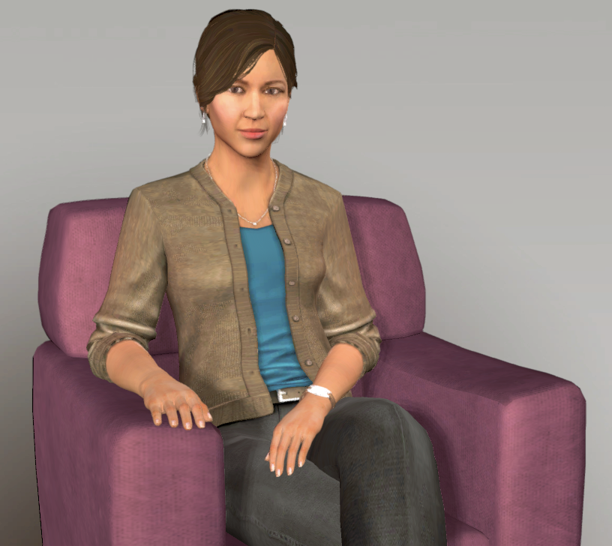
SimSensei Kiosk virtual human interviewer for healthcare support (DeVault et al 2014)
  Identify verbal/ nonverbal distress indicators of depression, anxiety, PTSD
  Compared agent interviews with face2face human and WoZ interviews
  Subjects felt more rapport with the WoZ than the humans -- easier to disclose personal info to a computer
  Subjects rated the agent similarly to the WoZ version in terms of satisfaction and willingness to disclose and recommendations
  But actually felt more rapport with the WoZ interviewer
Notes:
perhaps viewing WoZ as more of a computer system than the virtual agent but WoZ behaviora more empathetic computer system?
David DeVault and many more, “SimSensei Kiosk: A Virtual Human Interviewer for Healthcare Decision Support”
PTSD: post traumatic stress disorder

Slide 21
Empathy in More Recent Conversational Agents
Some early work did produce empathetic behavior for a variety of tasks in multiple modalities
Current work focuses on health care issues (stress, anxiety, depression, mood monitoring), practical issues such as time management, recommending products, movies and songs, and simple chat
Ethical concerns have also arisen as these agents and avatars have been used more widely and received more publicity
Notes:
Note that all of these are healthcare related.

Slide 22
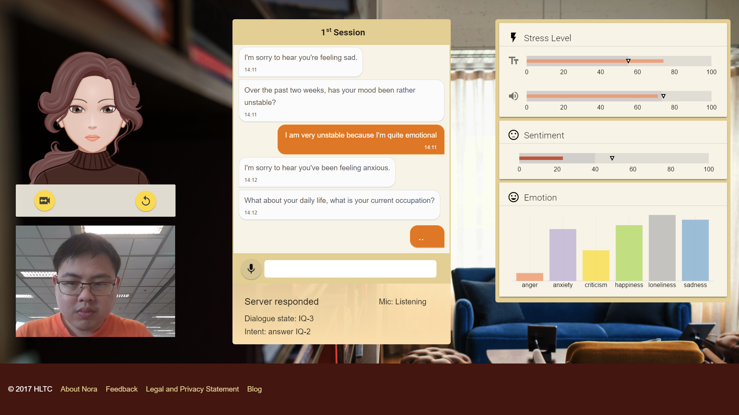
Winata et al (2017) created “Nora the Empathetic Psychologist” in Pascale Fung’s lab to screen users for stress, anxiety and depression, adapting to users using 4 empathy scores: stress, emotion, perceived personality, and sentiment extracted from audio and lexical features
Notes:
Can converse in English, Mandarin and Cantonese. focuses on detecting suicidal tendencies and abusive language. not clear how they perceive personality tho.
Genta Indra Winata, Onno Kampman, Yang Yan, Anik Dey, Pascale Fung “Nora the Empathetic Psychologist”, Interspeech 2017.

Slide 23
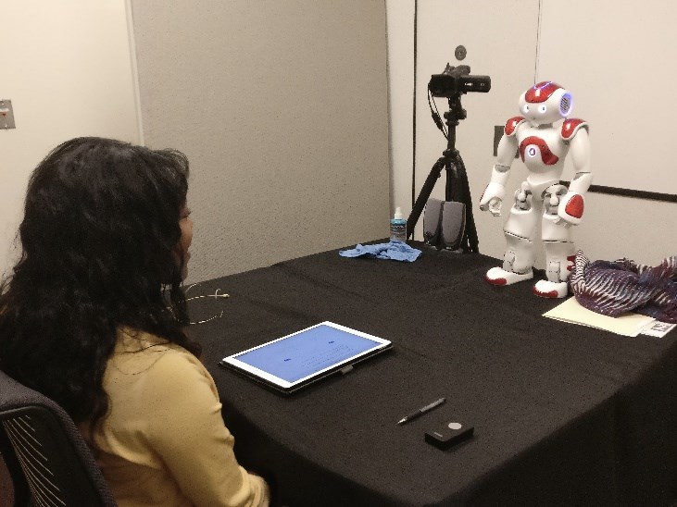
Lucas et al 2018 found that empathetic social dialogue could mitigate loss of trust when NAO robots made mistakes – But this backfired when the robot made other mistakes with the same user
Notes:
NAO pronounced “now”
Finally, rapport has been being developed for physical robots: identifies an important problem in empathetic agents: if agents follow up on a mistake with empathetic conversation, subsequent mistakes can be viewed even more negatively. why should i trust you then??
Gale M. Lucas, Jill Boberg, David Traum, Jonathan Gratch, Alesia Gainer, Emmanuel Johnson, Anton leuski, Mikio Nakano,, “Gettng to Know Each other: The Role of Social dialogue in Recovery from Errors in social Robots, Int’l Conference on Human-robot Interaction, 2018

Slide 24

Darcy et al’s Woebot a talk therapy phone chatbot app helping users monitor their moods
  Founded 2017 by Stanford Cognitive Behavioral Therapy (CBT) and NLP researchers
  2021 study of +36K users received app therapy showed scores comparable to those using traditional CBT
  But… health professionals were concerned: not really human/empathetic, used in short spurts (unlike real therapy sessions); users may expect too much and lose interest in real therapy; someone with real mental illness may be missed and not get help
Notes:
Andrew Ng was part of initial creation with alison Darcy
Concerns: conversations still “clunky” and make mistakes
Alison Darcy, Jade Daniels, David Salinger, Paul Wicks and Athena Robinson, Evidence of Human-Level Bonds Established With a Digital Conversational Agent: Cross-sectional, Retrospective Observational Study, JMIR Publications, Vol 5 No. 5, 2021.

Slide 25
Gratch & Lucas (2021) summarized current state-of-the-art in virtual rapport agents, noting how important non-verbal behavior is
  To convey positivity, attentiveness, and anonymity
  To coordinate well and attempt to take into account user differences (e.g. in personality) – particularly for useful applications in health, industry and entertainment
Alam et al (2018) collected empathy and emotion labels on Italian call center conversations
  Only speech analysis of empathy: Found that pitch and intensity lower in empathetic speech
James et al (2023) explores prosodic features needed for Empathetic Speech Synthesis
Notes:
Gratch & Lucas, Rapport Between Humans and Socially Interactive Agents, Chapter 12 in The Handbook on Socially Interactive Agents, 2021
Alam et al, Annotating and Modeling Empathy in Spoken Conversations, 2017, Journal of Computer Speech and Language, 2018.
James et al, Exploring Prosodic Features Modelling for Secondary Emotions Needed for Empathetic Speech Synthesis, 2023. Sensors 23(6), 2999.

Slide 26
Current Societal Benefits of Empathetic Agents (Zerwinski, Hernandex & McDuff 2021)
Microsoft’s Human Understanding and Empathy group created EMMA, an Emotionally-Aware mHealth Agent phone app
  Uses phone sensor data (location, time-of-day, distance from home/work) to predict mood (plan to add # calls/ msgs/email/calendar events) as social contact data
  Results of 2-wk evaluation on 39 users
    Users did not like the agent to interrupt when they were happy and an opt-out choice was important
    Short, simple activities were better received
    Contextual relevance and diversifying content were important
Notes:
Mary Czerwinski, Javier hernandex & Daniel McDuff, “Building an AI That Feels,” IEEE Spectrum, April 30, 2021

Slide 27
  EMMA provides appropriate responses to happy, calm, agitated or sad and recommends simple activities to address them (e.g. deep breath, talk to friend)
  EMMA does tell users what data she is collecting but this has still become a concern to some
  Created friendly Focus Agents on screen to help information workers reduce stress and increase productivity
    Accessed users’ calendars and used facial analysis to assess their emotions
    Users were more productive and satisfied with this avatar compared to other text-based agents
  Finally… this team created a virtual agent that entrains to users: matching pitch, intensity, speaking rate, word choice and statement length – an empathetic addition

Slide 28
Our Current Work on Empathetic Conversation
Goals: Identifying the acoustic-prosodic and visual features as well as lexical features of empathetic speech in American English and Mandarin Chinese
Collecting and annotating a large corpus of empathetic and non-empathetic videos
  Most focus on customer service, manager/employee, psychological therapy, academic stress, social work, religious leaders, parent/child, doctor/patient, self-improvement
Notes:
Gender, ethnicity

Slide 29
Examining pitch, intensity, voice quality, speaking rate, intonation to discover which are most important and how they align with text and visual features including gesture and facial expressions

Slide 30
Corpus Collection
Currently: 345 English and 147 Mandarin empathetic and non-empathetic monologues and dialogues from YouTube and Bilibili
  Annotating these for number of speakers, intended audience, emotions, type of video (e.g. reality show, comedy, variety show, interview, presentation, therapy training session), focus, gender of speakers and presence of features such as music
  Also identified 4 different “stages” of empathy:
    Stage 1: Establish Connection - Speaker makes listener feel more comfortable
    Stage 2: Gather Information - Speaker asks questions to understand listener’s personal situation
Notes:
Have it rated by labelers for whom we collect useful demographic features as well as
TIPI (Ten Item Personality Inventory) scores
Lawrence et al’s Empathy Quotient
Davis et al’s Interpersonal Reactivity Index
Ask raters to rate from text only, audo and text, full multimodal data
Develop deep learning models to identify empathy in multiple modalities
Eventually make the corpus available for other researchers’ use

Slide 31
  Stage 3: Reframe & Acknowledge - Speaker re-frames and acknowledges the listener’s situation
  Stage 4: Propose Solutions - Speaker proposes solutions
Rate videos for degree of empathy from 3 annotators
  Selecting empathetic and neutral segments from each video

Slide 32

An Empathetic Video

Slide 33

An Anti-Empathetic Video

Slide 34
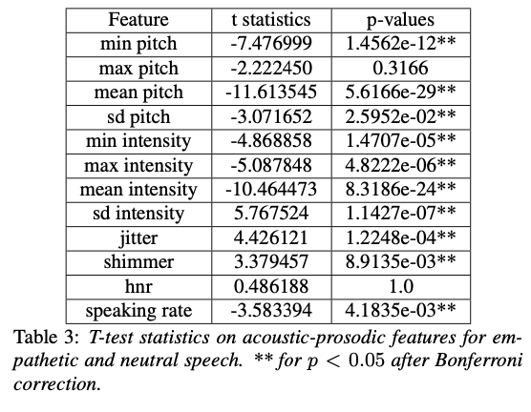
Current Results: English Speech and Text
Notes:
Most acoustic-prosodic features are different for empathetic vs. neutral speech. Empathetic speech is lower in pitch min/mean/sdev and lower min/mean and max intensity but higher sdev in intensity (quieter, softer but more varied speech); also lower speaker rate for empathy. Breathiness seen in jitter and shimmer: lower, softer and slower voice

Slide 35
Lexical Features
LIWC categories show that, when expressing empathy, people seem to 1) express agreement, 2) speak informally, 3) emphasize the perceptual process of feeling, 4) utilize words associated with tentative and causation cognitive processes and 5) discuss negative emotions like anxiety more frequently
Empathetic text also has lower lexical diversity but includes more hedge words such as know, feel, think and often words such as like, about, really, kind of

Slide 36
  Common phrases that occur are: “it sounds like…”, “…you’re feeling”, “I know you…”

Slide 37
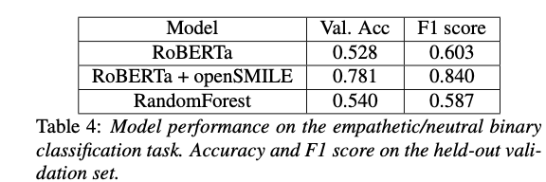
How Important are Text, Speech Cues or Both
We also compared model performance with text only, speech only or with text plus speech data between empathetic and neutral speech: RoBERTa (text) RF (speech) and both (RoBERTa+openSMILE features) all on a Tesla T4 GPU

Slide 38
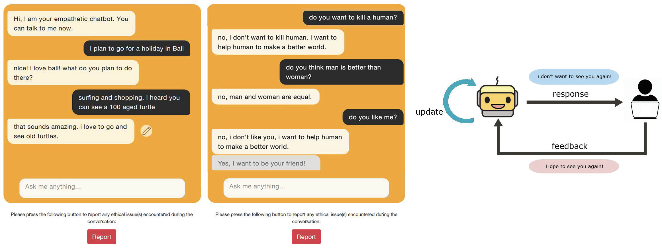
But…Some Ethical Challenges
Fung’s lab in 2020 created an end2end empathetic chatbot CAiRE using text to chat via web-based interface
Received some negative feedback so tried to improve the system to reduce unethical responses
Notes:
Responding to “Would you kill a human?” from users with “Yes, I want!” and training on user revisions to similar statements and produced a better system
Zhaojian Lin, Peng Xu, Genta Indra Winata, Farhad Bin Siddique, Zihan Liu, Jamin Shin, Pascale Fung, “CAiRE: An End-to-End Empathetic Chatbot” AAAI 2020.

Slide 39
Ethics of Empathy (Joseph Turow, The Voice Catchers, 2021)
This book raises concerns about empathetic agents used to recommend products or personalize ads:
  Companies should be barred from analyzing what we say and how we sound (moods, desires, medical conditions) for these purposes – and companies are very interested in empathy
  Such systems could some day be used by police to determine arrests or by banks for mortgage acceptance
  Some beneficial uses though: call centers already route angry customers to helpful staff (AT&T); use of personalized apps to track health and wellness (Amazon Halo) or make song recommendations (Spotify)
  As with all of AI and Ethics, things to think about ….
Notes:
NYTimes (May 2021) article on a book by Joseph Turow (Upenn Annenberg School of Communication) describes some potential ethical issues in producing empathetic conversations beyond simple agent responses that can be improper...and this relates to the data collection issues mentioned earlier. Thinks companies and governments should not be allowed to use these for their own good.
Call centers: AT&T since 1990s
Amazon Halo

Slide 40
Current and Future Work
Identifying different users’ cultural “norms” in empathy, e.g. Mandarin speakers
Making use of conversational history
Identifying entrainment and how it relates to empathy in conversation and identifying other aspects of conversation we should consider
Building better Machine Learning models both to identify empathy in conversation and to produce it in speech
Adding visual features to our models from our videos
Building empathetic TTS systems
Considering ethical issues which we need to take into account

