Slide 1


The Paralinguistics of Code-Switching in Speech
Debasmita Bhattacharya
Advanced Spoken Language Processing
April 1st, 2025
Notes:
[intro self here]

Slide 2
Why computational paralinguistics?
Paralinguistics: aspects of communication that
  convey and modify meaning
  cannot be directly or uniquely identified from the speech signal
Includes conversational dynamics, affective expression, speaker attributes, and more!
New application area for studying paralinguistics: code-switched speech
Notes:
I’ll start with the motivation for this talk. A very basic question we ask in speech processing is how and why do people speak in the ways they do? In order to answer this question completely, we often have to look beyond the speech signal alone and additionally consider the paralinguistic aspects of speech, as these can convey and modify meaning in various important ways. For instance, a sentence that is spoken with empathetic affect probably has a different meaning from the same content uttered in a neutral way. Similarly, the broader meaning of a conversation in which speakers entrain to one another is different from one which entrainment does not occur.
Applying a paralinguistic lens is helpful for understanding diverse language settings, which is especially relevant today as the fields of natural language and speech processing shift away from a traditional unique focus on monolingual contexts, and instead are moving towards the increased study of multilingual contexts. This reflects the fact that the majority of the global population speaks more than one language, and we should build technology that serves everyone. Understanding the interaction of more than one language at a time certainly hinges on understanding what is happening at the paralinguistic level in language production, and one specific area where such a perspective is useful is in the study of code-switched speech, when people alternate languages as they speak.
In this talk, I’ll be presenting some of the computational paralinguistic work I’ve done on speech as I build towards my PhD thesis - I will mainly will talk about two projects that have resulted in publications, and outline some work that is under review, as well as ongoing and upcoming research directions.

Slide 3
Measuring Entrainment in Spontaneous Code-switched Speech
Debasmita Bhattacharya, Siying Ding, Alayna Nguyen, Julia Hirschberg.
Published at NAACL 2024
Notes:
We’ll get started with a deep dive into the conversational dynamics of a code-switched context, looking at this work published last year on entrainment in spontaneous code-switched speech.

Slide 4
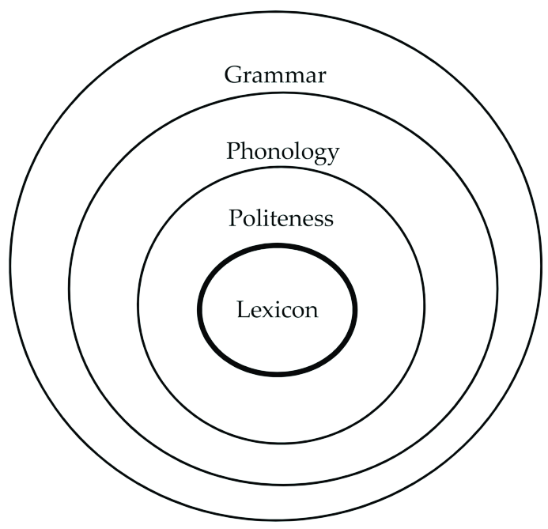
Background: what is entrainment?
Measuring Entrainment in Spontaneous Code-switched Speech
Speakers become more like their interlocutors across various dimensions
  (= alignment = accommodation = coordination)
[1] Sancho Pascual, 2019.
Notes:
Since you’ve heard about entrainment already, I’m going to skip over the definition, but I will remind you that entrainment can occur across various dimensions, from acoustic-prosodic aspects, to lexical ones, and even gestures of body language. As you’ve now learned, speakers who entrain to one another tend to have more successful conversations with more positive social outcomes.
Let’s begin with entrainment. Entrainment, which is also known as linguistic alignment, accommodation, and coordination, is what happens when speakers subconsciously adapt aspects of their communication style to match their interlocutor. This can happen across various dimensions including acoustic prosodic aspects (features like speaking rate, loudness, and variations in pitch), lexical aspects (such as specific words that are used in conversation), and even gestures of body language. We know from prior work that speakers who entrain to one another tend to have more successful conversations with more positive social outcomes.

Slide 5
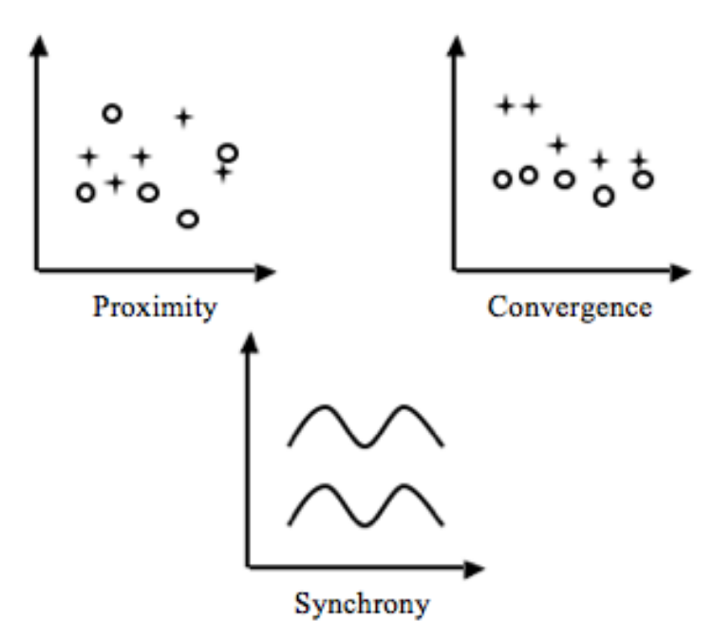
Background: types of entrainment
Measuring Entrainment in Spontaneous Code-switched Speech
[2] Levitan and Hirschberg, 2011.
Notes:
Here, I want to highlight that entrainment can be measured by different metrics – these include proximity, which involves speakers having, for example, similar pitch throughout a conversation; convergence, where speakers become more similar to one another in, say, volume, over the course of a conversation; and synchrony, where speakers vary in some aspect of their communication style in tandem.

Slide 6

Background: what is code-switching?
Measuring Entrainment in Spontaneous Code-switched Speech
puesto de interno .
Dice que le dieron ese ...
internship .
(= He said they gave him this internship.)
Notes:
Now we can turn to defining code-switching, the domain of language production in our study. Code switching happens when a speaker alternates between one language variety and another during written or spoken communication. Although we focus on code-switching between distinct languages, many speakers also code-switch between different dialects of the same language, and in general, code-switching is pretty common among bilinguals.

Slide 7
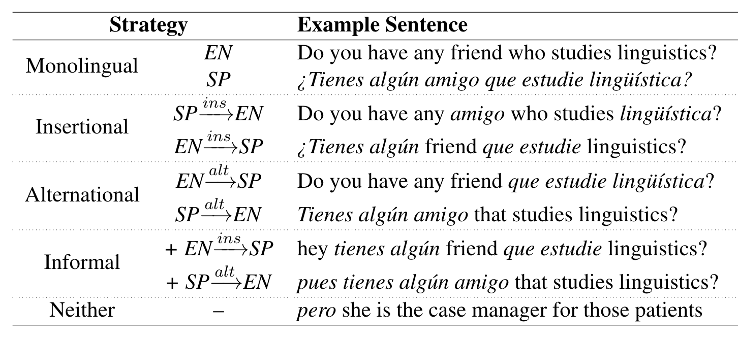
Background: strategies of code-switching
Measuring Entrainment in Spontaneous Code-switched Speech
[3] Ahn et al., 2020.
Notes:
As a final piece of background for this study, it’s important to know that there are different types or strategies of code-switching multilingual speakers produce in speech. The main ones we’ll need in this talk are insertional and alternational code-switching. Insertional code-switching involves inserting a single word or short phrase in one language into an utterance in another language. Alternational code-switching, on the other hand, involves code-switches at grammatical clause boundaries. We’ll also see some references to “other” code-switching, which involves the use of a filler word at the start or end of a sentence, and corresponds to the Neither category on this slide.

Slide 8
Motivation: entrainment in new multilingual domain
Measuring Entrainment in Spontaneous Code-switched Speech
Prior work: entrainment occurs in monolingual writing and speech
  Nenkova et al., 2008.
  Levitan and Hirschberg, 2011.
Prior work: entrainment in code-switched human-machine communication
  Ahn et al., 2020.
  Parekh et al., 2020.
What about entrainment in multilingual human speech?
Notes:
Now, the majority of prior work on entrainment has focused on monolingual written and spoken communication, and among these, many have focused on English. There have been a couple of recent studies considering entrainment in code-switched human-machine interaction, but these have been necessarily restricted to the written modality since they involve a virtual dialogue agent generating text. The combination of these findings from prior work have left open the question of how entrainment manifests itself in naturalistic, code-switched speech between real people.

Slide 9
Research Questions
Measuring Entrainment in Spontaneous Code-switched Speech
Do patterns of entrainment in monolingual settings generalize to code-switched settings?
Do patterns of entrainment on code-switching in text — some of which is produced by virtual dialogue agents — generalize to spontaneous code-switching in speech?
Notes:
This led us to our research questions.
We first asked whether the general language behaviours we expect in monolingual communication also happen in code-switched communication. Then, we wanted to know if code-switched language behaviours from generated writing also appear in speech between humans, getting at the impact of the modality of language production and the nature of the interlocutor on multilingual entrainment. And overall, do the answers to these questions combined allow us to infer anything about the language dependence or independence of entrainment as a linguistic phenomenon.
Asking and answering these questions has important implications for designing downstream multilingual speech technology that is able to produce multilingual speech in a human-like way.

Slide 10
Data: augmenting the Bangor Miami corpus
Measuring Entrainment in Spontaneous Code-switched Speech
Bangor Talk: Miami corpus
  ➕ Code-switching strategies: I, A, O
  ➖ Background noise
Features
  Lexical 🖋️
  Acoustic-prosodic 🗣️
  Code-switching 🌎
Notes:
To answer our research questions, we examined the Bangor Miami corpus of Spanish-English bilingual speech and transcripts. The entire corpus is made up of 56 conversations, but we restricted our study to the 39 dyadic conversations that contained code-switching - this involved about 20 out of a total of 35 hours of recorded conversation. We added to this corpus utterance level annotations of the strategy of code-switching used. You’ll recall that these are mainly insertional and alternational code-switching, along with an “other” category. We also denoised the audio files in the corpus, as these were mainly recorded in public spaces with babble noise in the background. From this augmented version of the Bangor Miami corpus, which we publicly share, we were interested in entrainment over a few different feature sets, namely, lexical, acoustic prosodic, and code-switching features.

Slide 11
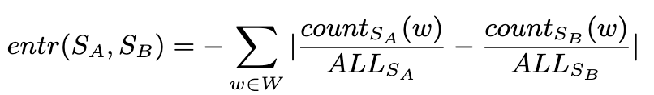
Method: statistical analyses
Measuring Entrainment in Spontaneous Code-switched Speech
Lexical features
  Count-based and probabilistic measures
Acoustic-prosodic // Code-switching features
  Turn- and conversation-level
  Proximity, convergence, synchrony
[2] Levitan and Hirschberg, 2011.
[4] Nenkova et al., 2008.
[5] Gravano et al., 2014.
Notes:
Using the various feature sets extracted from our augmented version of the Bangor Miami corpus, we performed a number of statistical analyses to determine the extent of entrainment happening across each feature set. For the lexical features, we applied the count-based metric on the slide, as well as a probabilistic technique involving using the perplexity of language models. For the acoustic-prosodic and code-switching features, we calculated turn- and conversation-level proximity, convergence, and synchrony, based on each of their definitions from prior work. If anyone is interested in the details of the method, I am happy to take questions now, or you can refer to the paper for the full explanation of each of these.

Slide 12
Research Questions
Measuring Entrainment in Spontaneous Code-switched Speech
Do patterns of entrainment in monolingual settings generalize to code-switched settings?
Do patterns of entrainment on code-switching in text — some of which is produced by virtual dialogue agents — generalize to spontaneous code-switching in speech?
Notes:
Now we can get into some of the results we found, starting with our first research question.

Slide 13
Results: interlocutors entrain on lexical features of code-switched conversations
Measuring Entrainment in Spontaneous Code-switched Speech
🖋️Overall language use
  Including OOVs: 97% of conversations
  Excluding OOVs: 74% of conversations
🖋️Word sets
  Top-100 words in corpus: 100% of conversations
  Affirmative cue words: 100% of conversations
  Top-25 words in corpus: 97% of conversations
  Filler words: 97% conversations
Notes:
For our first set of analyses, we considered overall language use, as well as a number of pre-defined word sets including high frequency words, affirmative cues that speakers use to encourage their interlocutor to keep talking, and filler words like um and uh in both English and Spanish. Across all of these features, we found statistically significant evidence of lexical entrainment in the vast majority of the code-switched conversations of the corpus. These results align with prior work on entrainment in monolingual domains, which makes ours a promising finding!

Slide 14
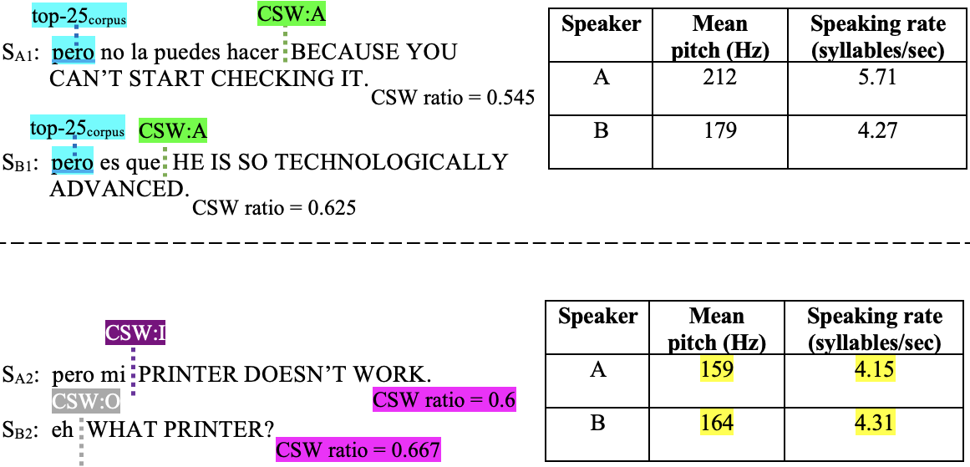
Results: interlocutors entrain on lexical features of code-switched conversations
Measuring Entrainment in Spontaneous Code-switched Speech

Slide 15
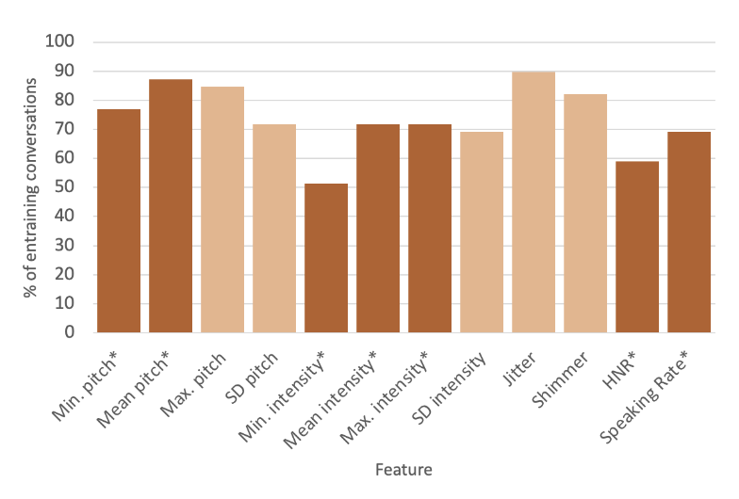
Results: interlocutors entrain on most acoustic-prosodic features of code-switched conversations
Measuring Entrainment in Spontaneous Code-switched Speech
🗣️
Figure 1: Proximity at the turn-level.
Notes:
Next, we turned to entrainment on the acoustic-prosodic features of the code-switched conversations.
We found that the majority of conversations show statistically significant evidence of turn-level proximity on the majority of acoustic-prosodic features we considered. In this figure, the significant features are indicated by the dark orange bars, and include minimum and mean pitch; minimum, mean and maximum intensity; harmonics to noise ratio; and speaking rate.

Slide 16
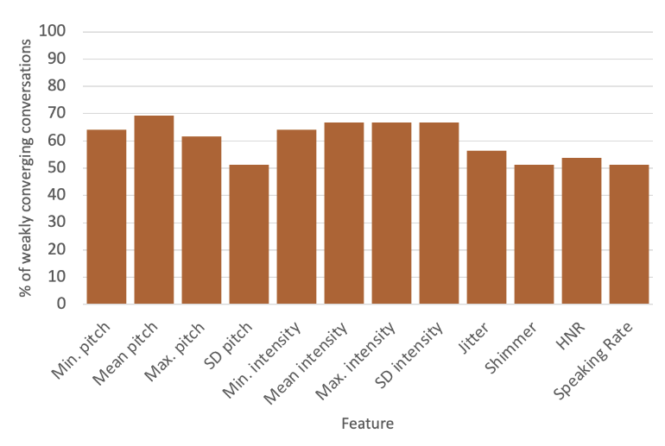
Results: interlocutors entrain on most acoustic-prosodic features of code-switched conversations
Measuring Entrainment in Spontaneous Code-switched Speech
🗣️
Figure 2: Convergence at the turn-level.
Notes:
Similarly, in terms of convergence at the turn-level, the majority of conversations show statistically significant evidence of entrainment on all of the acoustic-prosodic features under investigation.
So, again, our statistically significant evidence of entrainment on the majority of acoustic-prosodic features is in alignment with prior work on entrainment in monolingual settings. So far, it seems like the things we know about entrainment in monolingual domains generalise to code-switched language settings, with possible implications for the cross-lingual nature of entrainment as a linguistic phenomenon.

Slide 17
Results: interlocutors entrain on most acoustic-prosodic features of code-switched conversations
Measuring Entrainment in Spontaneous Code-switched Speech

Slide 18
Research Questions
Measuring Entrainment in Spontaneous Code-switched Speech
Do patterns of entrainment in monolingual settings generalize to code-switched settings?
Do patterns of entrainment on code-switching in text — some of which is produced by virtual dialogue agents — generalize to spontaneous code-switching in speech?
Notes:
Now, we turn to our analyses of the multilingual features of the corpus to address our second research question and check whether the patterns we’ve seen so far hold true when we look specifically at measures of code-switching.

Slide 19
Results: interlocutors entrain on most code-switching features of code-switched conversations
Measuring Entrainment in Spontaneous Code-switched Speech
Presence of code-switching 🌎
  Turn-level proximity: 74% of conversations
  Conversation-level proximity: 82% of conversations
  Turn-level synchrony: 54% of conversations
Quantity of code-switching 🌎
  Turn-level proximity: 85% of conversations
  Conversation-level proximity: 87% of conversations
Notes:
We generally find consistent evidence of proximity at the turn- and conversation-level on the CSW features of the Bangor Miami conversations. On the presence of CSW, we find turn- and conversation-level proximity and turn-level synchrony. This suggests that speakers are entraining to one another in a way that surfaces as one speaker's choice to code-switch in speech encouraging the other to choose the same and vary in turn.
These results are mirrored in our experiments on the amount of CSW, where we continue to observe that speakers seem to match one another's CSW behavior, specifically in terms of the quantity of code-switched utterances used within a turn, and the variation of the same across turns.

Slide 20
Results: interlocutors entrain on most code-switching features of code-switched conversations
Measuring Entrainment in Spontaneous Code-switched Speech

Slide 21
Results: interlocutors entrain on most code-switching features of code-switched conversations
Measuring Entrainment in Spontaneous Code-switched Speech
Strategy of code-switching 🌎
  Turn-level synchrony: 56% of conversations - insertional
  Conversation-level proximity: 74% of conversations - alternational
Notes:
Finally, from our experiments on CSW strategies, we find significant synchrony at the turn-level on insertional CSW, and significant proximity at the conversation-level on alternational CSW. The first of these findings mirrors the trend we see with entrainment on the presence of CSW. Since insertional CSW is a strategy lacking strict syntactic structure, when speakers mimic their interlocutors' variation in CSW in conversation, using insertional CSW is an easy way to achieve this kind of entrainment. This finding also aligns with prior work on entrainment in human-machine interaction, where this CSW strategy similarly showed the most entrainment.
The second of these findings is more interesting, however, because alternational CSW requires knowledge of both languages' syntax and is by definition the most structured strategy for speakers to employ. This likely makes it easier for interlocutors to notice and mimic in comparison to insertional or other CSW. We particularly highlight this finding because significant evidence of entrainment on alternational CSW has not been found in previous work on written CSW with dialogue agents, which suggests that there may be a key difference in how CSW and subsequent entrainment behaviors are produced in the spoken versus written modality.
Overall, in this set of experiments, we have evidence of proximity at the turn- and conversation-level. This is fairly consistent across code-switching features, and in line with previous work on entrainment in monolingual domains.

Slide 22
Results: interlocutors entrain on most code-switching features of code-switched conversations
Measuring Entrainment in Spontaneous Code-switched Speech

Slide 23
Research Questions
Measuring Entrainment in Spontaneous Code-switched Speech
Do patterns of entrainment in monolingual settings generalize to code-switched settings?
Do patterns of entrainment on code-switching in text — some of which is produced by virtual dialogue agents — generalize to spontaneous code-switching in speech?
Notes:
We finally circle back to our first research question and perform a qualitative analysis of our results in relation to the genders of the speakers in conversations that showed significant evidence of entrainment.

Slide 24
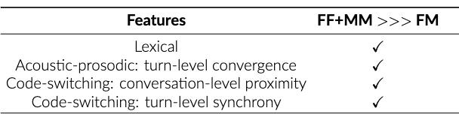
Results: same-gender interlocutors entrain more than opposite-gender interlocutors
Measuring Entrainment in Spontaneous Code-switched Speech
Notes:
We particularly distinguish between same-gender (FF or MM) conversations and mixed-gender (FM) conversations. Our comparisons are weighted to account for there being 24 same-gender conversations, but only 15 mixed-gender ones.
Among the three feature sets, we generally find that there are equal or more same-gender conversations than mixed-gender conversations among those conversations that show evidence of entrainment on: all lexical features, turn-level convergence on acoustic-prosodic features, conversation-level proximity on all CSW features, and turn-level synchrony on all CSW features. An example conversation snippet from a pair of interlocutors showing some of these entraining characteristics is the interaction here between $S_{A1}$ and $S_{B1}$, who are both female, where we see lexical entrainment on a frequent word and proximity on presence and strategy of CSW.

Slide 25
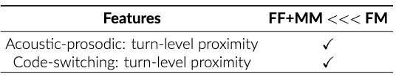
Results: same-gender interlocutors entrain more than opposite-gender interlocutors
Measuring Entrainment in Spontaneous Code-switched Speech
Notes:
However, the opposite is true for conversations that show evidence of turn-level proximity on acoustic-prosodic features, and turn-level proximity on CSW features. An example conversation snippet from a pair of interlocutors showing some of these entraining characteristics is the interaction here between $S_{A2}$, who is female, and $S_{B2}$, who is male, where we see proximity on acoustic-prosodic features and presence and amount of CSW.
So, our qualitative gender analysis shows a slight skew toward entrainment in code-switched settings taking place in same-gender conversations over mixed-gender ones. Compared to prior work that has considered the role of speaker gender in entrainment behavior, earlier studies found more entrainment in mixed-gender pairs than same-gender pairs, but these were on task-oriented monolingual conversations. Our opposing results may suggest that there are linguistic differences between task-oriented and undirected spontaneous speech, which carry through to differences in entrainment behaviors in these differing conversational settings.

Slide 26
Conclusions
Measuring Entrainment in Spontaneous Code-switched Speech
Notes:
Overall, in this work, we wanted to understand how entrainment manifests itself in naturalistic, code-switched speech between real people.
We found that, 1)...

Slide 27
Conclusions
Measuring Entrainment in Spontaneous Code-switched Speech
Do patterns of entrainment in monolingual settings generalize to code-switched settings? ✅
  🖋️
  🗣️
Notes:
Patterns of entrainment originally seen in monolingual domains are also present in a code-switched setting. This is shown in particular by our experiments on lexical and acoustic-prosodic features of a corpus of code-switched conversations. We also find evidence of entrainment on measures of CSW --- our work is the first to study entrainment in the context of spontaneous code-switched speech.
With respect to our second research question,

Slide 28
Conclusions
Measuring Entrainment in Spontaneous Code-switched Speech
Do patterns of entrainment in monolingual settings generalize to code-switched settings? ✅
  🖋️
  🗣️
Do patterns of entrainment on code-switching in text — some of which is produced by virtual dialogue agents — generalize to spontaneous code-switching in speech? ✅ ➕
  🌎
Notes:
While some patterns of entrainment previously found in code-switched written interactions are also present in spontaneous speech, we have found additional ones that suggest a fundamental difference in CSW and corresponding entraining behaviors between modalities. We particularly find differences in the dimensions over which entrainment occurs in code-switched settings depending on the aspect of language production under consideration — so, turn-level proximity and convergence on acoustic-prosodic features, versus turn- and conversation-level proximity on CSW features --- this points to the importance of examining multiple dimensions of entrainment when conducting analyses across feature sets.
Our preliminary gender analysis similarly shows possible differences in entrainment between undirected and task-oriented speech.
Overall, our results provide promising implications for a potential "universal" nature of entrainment as a paralinguistic communication phenomenon that may be independent of monolingual versus multilingual language production. We hope this work will serve as a stepping stone for informing the design of spoken language technology applications, particularly in the generation of more naturalistic and context-appropriate code-switched utterances by voice assistants.

Slide 29
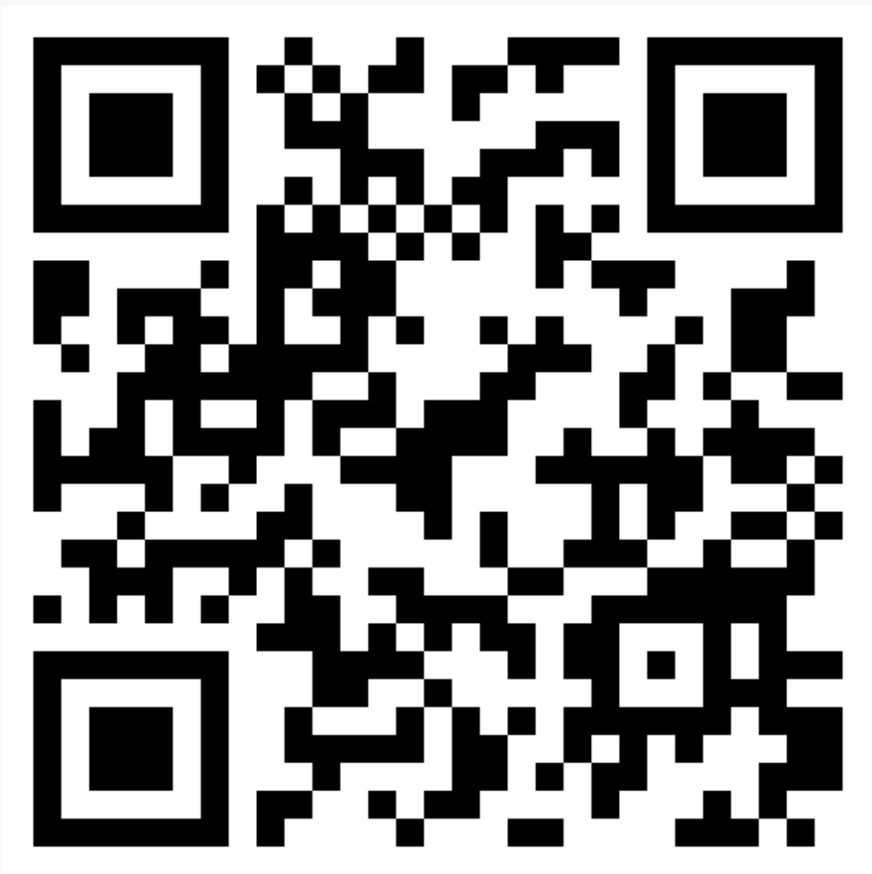
References
Paper
[1] María Sancho Pascual. 2016. Ecuatorianos de segunda generación en Madrid: percepción y actitudes lingüísticas en su proceso de integración. In Migraciones hispánicas: discurso, sociedad y cognición. Edited by Rocío Caravedo and Francisco Moreno Fernández. Special issue. Cuadernos AISPI. vol. 8, pp. 119–44.
[2] Rivka Levitan and Julia Hirschberg. 2011. Measuring acoustic-prosodic entrainment with respect to multiple levels and dimensions. In Proc. Interspeech 2011, pages 3081–3084.
[3] Emily Ahn, Cecilia Jimenez, Yulia Tsvetkov, and Alan W Black. 2020. What code-switching strategies are effective in dialog systems? In Proceedings of the Society for Computation in Linguistics 2020, pages 254–264, New York, New York. Association for Computational Linguistics.
[4] Ani Nenkova, Agustin Gravano, and Julia Hirschberg. 2008. High frequency word entrainment in spoken dialogue. In Proceedings of ACL-08: HLT, Short Papers, pages 169–172, Columbus, Ohio. Association for Computational Linguistics.
[5] Agustín Gravano, Štefan Benuš, Rivka Levitan, and Julia Hirschberg. 2014. Three ToBI-based measures of prosodic entrainment and their correlations with speaker engagement. In 2014 IEEE Spoken Language Technology Workshop (SLT), pages 578–583.
Notes:
Here are the papers I referenced during this section of the talk, and a QR code to our paper, if anyone would like to read it.
Since the publication of this work, we have performed the same analyses on a couple of other code-switched datasets, in order to check whether our results replicate in other code-switched settings. We looked at the Mandarin-English SEAME corpus of informal conversational and interview speech, and the Hindi-English MaSaC corpus of informal soap opera speech. We found that our Spanish-English results largely replicate for both of these corpora on lexical entrainment. We also found that the Spanish-English results replicate for Mandarin-English for code-switching entrainment, and for Hindi-English for acoustic-prosodic entrainment. We have some hypotheses for these last two cases, where there isn’t perfect replication across all three language pairs. [invite audience participation here?]
In the case of acoustic-prosodic entrainment where we see similarities between Spanish-English and Hindi-English, we hypothesize that this might be at least partly due to neither of these languages being tonal languages, while Mandarin in the Mandarin-English dataset most certainly is tonal. Tonality of a language can affect its prosody in particular, which would lead to differences in acoustic-prosodic entrainment.
With respect to entrainment over code-switching metrics where we see similarities between Spanish-English and Mandarin-English, we hypothesize that this might be because of the style of code-switching used. Both the Bangor Miami and SEAME corpora have a relatively low prevalence of code-switched utterances overall, and when there is code-switching, this is primarily insertional code-switching. Whereas with the Hindi-English MaSaC corpus, there is a much higher prevalence of corpus-level code-switching, and code-switched utterances are a complex mix of insertional and alternational code-switching. So, if speakers are already independently code-switching a lot, they might not be entraining to each other’s code-switching behaviour in addition in the Hindi-English corpus, compared to the other two language-pairs data. [Or, it might just be the genre difference.]
Ongoing and future work on this research direction is looking at whether the significant features from our statistical analysis are salient predictors in a machine learning context for differentiating entraining conversations from non-entraining ones.
I’ll now pause a bit for questions, if there are any.

Slide 30
Switching Tongues, Sharing Hearts: Identifying the Relationship Between Empathy and Code-Switching in Speech
Debasmita Bhattacharya*, Eleanor Lin*, Run Chen, Julia Hirschberg.
Published at INTERSPEECH 2024
Notes:
Let’s switch gears now and talk a little bit about how affect plays a role in code-switched language production. We’ll take a look at this paper that was also published last year.

Slide 31
Background: what is code-switching?
Switching Tongues, Sharing Hearts: Identifying the Relationship Between Empathy and Code-switching in Speech
puesto de interno .
Dice que le dieron ese ...
internship .
(= He said they gave him this internship.)
Notes:
We already know what code-switching is now, so I’ll skip this slide…

Slide 32
Background: why do speakers code-switch?
Switching Tongues, Sharing Hearts: Identifying the Relationship Between Empathy and Code-switching in Speech
account for speaker competence
relate to audience identity
express (in)formality
express solidarity
express group identity
adapt to linguistic context
perform affective function
reflect shared experiences
adapt to conversation topic
Notes:
Given how common code-switching is in multilingual contexts, a natural question to ask is: why do speakers code-switch at all?
Multilingual speakers are known to code-switch for a variety of reasons. For our study, a few of these reasons stood out to us in particular, and served as the starting point for our work. These were..

Slide 33
Background: why do speakers code-switch?
Switching Tongues, Sharing Hearts: Identifying the Relationship Between Empathy and Code-switching in Speech
account for speaker competence
relate to audience identity
express (in)formality
express solidarity
express group identity
adapt to linguistic context
perform affective function
reflect shared experiences
adapt to conversation topic
Notes:
Code-switching to express group identity and solidarity with one’s interlocutor, to perform affective function, and to reflect shared experiences. As a whole, this set of motivations for code-switching led us to wonder whether there might be a relationship between code-switching and the expression of empathy in speech.

Slide 34

Motivation: empathy x code-switching
Switching Tongues, Sharing Hearts: Identifying the Relationship Between Empathy and Code-switching in Speech
Empathy → the ability to…
  understand other people’s feelings as if one were having them oneself, and
  respond accordingly
Notes:
Empathy is typically defined as the ability to understand other people’s feelings as if one were having them oneself, as well as the ability to respond accordingly. Both pieces of the definition are essential, and are closely linked to the reasons for code-switching we highlighted on the previous slide.
Empathy has been previously studied in speech, and certain lexical and acoustic-prosodic features have been shown to characterize empathetic speech, such as lower pitch and pitch variations. There has also been prior work showing the influence of certain psycho- and socio-linguistic factors on code-switching, as we just saw, but, no work has yet brought these two strands of study together to examine whether the expression of empathy is a motivation for code-switching in speech.

Slide 35
Research Questions
Switching Tongues, Sharing Hearts: Identifying the Relationship Between Empathy and Code-switching in Speech
Is there a relationship between code-switching prevalence in speech and the lexical and/or acoustic-prosodic correlates of empathy?
Does the answer to 1. generalize across language pairs involving different language families?
Notes:
In our study, we wanted to take the first step toward bridging this gap by studying the extent to which empathy is manifested in code-switched speech.
We wanted to start by examining the lexical and acoustic-prosodic correlates of empathy from prior work and look for a relationship between these and the prevalence of code-switching in multilingual speech. Then, we were interested in whether any patterns we found would generalise across language pairs involving different language families with varying levels of typological distance.

Slide 36


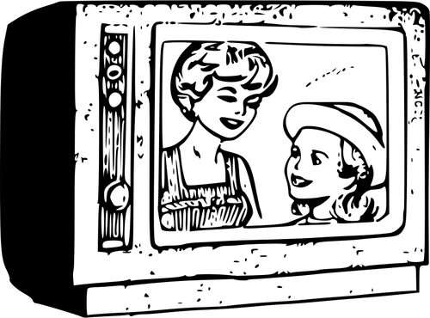
Code-switched corpora
Switching Tongues, Sharing Hearts: Identifying the Relationship Between Empathy and Code-switching in Speech
Spanish-English: conversational
  Bangor Miami
Mandarin-English: conversational and interview
  SEAME
Hindi-English: soap opera
  MaSaC
Notes:
To answer these questions, we examined three informal speech corpora: the Bangor Miami Spanish-English corpus, the SEAME Mandarin-English corpus, and the MaSaC Hindi-English corpus. Recall that the Bangor Miami corpus is mainly made up of dyadic conversations, and a few conversations between three or more speakers. And, the SEAME corpus consists of a purely conversational subset of undirected speech, as well as a slightly more directed subset of conversational but interview speech.
We tried to keep the genre of speech across all three of our data sets as consistent as possible, but we do note that while the MaSaC corpus is conversational in a sense, it does not comprise spontaneous utterances like the other two datasets do. We’ll discuss the impact of this particular data limitation later on in the presentation.

Slide 37
Method
Switching Tongues, Sharing Hearts: Identifying the Relationship Between Empathy and Code-switching in Speech
Approximate ground truth empathy labels
  RoBERTa base model (text only) & multimodal model (text +speech)
  Fine tune on English empathetic utterances
  Translate code-switched utterances to monolingual English
Compute code-switching metrics
  M-index & I-index
  Code-switched vs. monolingual
Statistical analysis
  Chi squared test
  Odds ratio
  Pearson correlation
Notes:
On all three of our corpora, we needed measures of both empathy and code-switching to look for a relationship between the two. For this, we started with approximating utterance-level ground truth empathy labels.
This was a multistep process where we applied the best performing deep learning approaches for empathy detection in English from concurrent but separate work done by our co-author Run Chen and her other collaborators in the Speech Lab. This involved using a RoBERTa base model that takes in only textual utterance transcripts, and a multimodal model that takes in both utterance transcripts and acoustic-prosodic features as extracted from OpenSmile. We fine-tuned both of these models to distinguish empathetic and non-empathetic utterances in a small English data set, also sourced from Run and her collaborators’ work. I’m leaving out some of the finer implementation details, but if you have questions about this, I can circle back at the end of the talk. Okay, so, given that the empathy detection method that we borrow was designed for English, to be able to apply these fine-tuned models to our code-switched data, we had to translate any utterance that was not monolingual English across the three data sets into monolingual English. We did so using the M2M100 translation model for Mandarin-English, and the Google Translate API for Hindi-English. The Spanish-English data already contained human translations to monolingual English, so we used these. Then, we could finally use our two empathy models for inference and get two sets of utterance level binary empathy labels for each corpus, one based on lexical features only, and another based on lexical and acoustic-prosodic features. We treat these labels as ground truth throughout the rest of the study.

Slide 38
Method
Switching Tongues, Sharing Hearts: Identifying the Relationship Between Empathy and Code-switching in Speech
Approximate ground truth empathy labels
  RoBERTa base model (text only) & multimodal model (text +speech)
  Fine tune on English empathetic utterances
  Translate code-switched utterances to monolingual English
Compute code-switching metrics
  M-index & I-index
  Code-switched vs. monolingual
Statistical analysis
  Chi squared test
  Odds ratio
  Pearson correlation
Notes:
Next, we needed to quantify code-switching at the utterance level as well.
We did this by calculating two different utterance-level code-switching metrics, the M-index and I-index. Both metrics encode the extent of multilingualism within code-switched utterances and range from 0 – corresponding to a monolingual utterance – to 1 – corresponding to a code-switched utterance that is evenly mixed between languages. The I-index additionally encodes switching frequency between languages.
Separately, we also labelled each utterance in each corpus as code-switched or monolingual in either language in the corresponding language-pair, using language ID tags. For the Spanish-English corpus, these LID tags were provided to us by the original authors of the corpus, and for Mandarin-English, these were easy to compute using script differences. For Hindi-English, we used an open source tool as both languages were written in Roman script in this data set.

Slide 39
Method
Switching Tongues, Sharing Hearts: Identifying the Relationship Between Empathy and Code-switching in Speech
Approximate ground truth empathy labels
  RoBERTa base model (text only) & multimodal model (text +speech)
  Fine tune on English empathetic utterances
  Translate code-switched utterances to monolingual English
Compute code-switching metrics
  M-index & I-index
  Code-switched vs. monolingual
Statistical analysis
  Chi squared test
  Odds ratio
  Pearson correlation
Notes:
So now, given utterance level binary labels for empathy and both binary and continuous labels for code-switching prevalence in our three corpora, we had all the necessary components for performing our statistical analyses to look for a relationship between empathy and code-switching in speech.
Our first set of statistical tests used the binary labels and involved performing chi-squared tests on each corpus to determine if CSW and empathy were related. We then calculated odds ratios on each corpus to quantify the strength of association between CSW and empathy.
Our final statistical test used the continuous labels for code-switching. We calculated Pearson correlation coefficients between values of the M- and I-indices and the continuous probability score produced by our empathy models on each utterance to determine if there is a LINEAR relationship between amount of CSW per utterance and the probability that an utterance is empathetic.

Slide 40
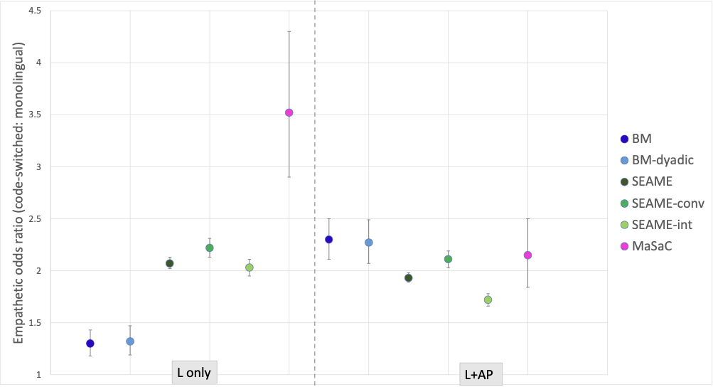
Results: spoken CSW aligns with lexical correlates of empathy
Switching Tongues, Sharing Hearts: Identifying the Relationship Between Empathy and Code-switching in Speech
Notes:
With that, we can get into the results we found, starting with our first research question and looking specifically at the lexical correlates of empathy in relation to code-switching in speech.

Slide 41
Results: spoken CSW aligns with lexical correlates of empathy
Switching Tongues, Sharing Hearts: Identifying the Relationship Between Empathy and Code-switching in Speech
Notes:
We began with the Bangor Miami corpus, where chi squared testing showed a significant positive relationship between Spanish-English code-switching and empathy. Over the entire corpus, the odds that a code-switched utterance is empathetic are 1.30 times the odds for an empathetic monolingual utterance, as shown in the dark blue dot on the figure. We also found a similar significant relationship in the dyadic subset of conversations, with the odds that a code-switched utterance is empathetic being 1.32 times those for a monolingual utterance, and this is shown in the light blue dot on the figure.
In contrast to these results, we found a very weak negative correlation between the amount of code-switching per utterance and the probability that an utterance is empathetic. So, neither the overall amount of code-switching nor the frequency with which languages alternate are correlated with the likelihood of an empathetic utterance. This pattern also holds on the dyadic subset of the corpus. Overall, we found a significant, but non-linear, association between empathetic and code-switched Spanish-English speech in the Bangor Miami corpus.

Slide 42
Results: spoken CSW aligns with lexical correlates of empathy
Switching Tongues, Sharing Hearts: Identifying the Relationship Between Empathy and Code-switching in Speech
Notes:
Next, we considered the SEAME corpus, where chi squared testing also showed a significant relationship between code-switching and empathy. This positive relationship also holds for the interview and conversation subsets of SEAME. The odds ratio for the entire corpus is 2.07, while that for the conversation subset is 2.22, and that for the interview subset is 2.03, represented by the dark green, turquoise, and light green dots. So, Mandarin-English code-switched utterances in the SEAME corpus have higher odds of being empathetic than monolingual utterances, regardless of whether these are spoken in conversational or interview settings.
However, we find only a very weak positive correlation between the amount of code-switching per utterance and the probability that an utterance is empathetic. This is true for both the M- and I-indices, and these patterns largely replicate in the conversation and interview subsets of the corpus. So, as with Spanish-English, we find a significant association between empathetic and code-switched Mandarin-English speech, but limited evidence of this association being linear.

Slide 43
Results: spoken CSW aligns with lexical correlates of empathy
Switching Tongues, Sharing Hearts: Identifying the Relationship Between Empathy and Code-switching in Speech
Notes:
We finally turned to the MaSaC corpus, and again found a significant positive relationship between code-switching and empathy. The odds that a Hindi-English code-switched utterance is empathetic are 3.52 times the odds for monolingual utterances, as shown in the pink dot on the figure. Similar to SEAME, we find a weak positive correlation between the probability of an empathetic utterance and both M- and I-indices.

Slide 44
Results: spoken CSW aligns with lexical correlates of empathy
Switching Tongues, Sharing Hearts: Identifying the Relationship Between Empathy and Code-switching in Speech
 | Odds CSW:ML | CSW∝empathy
Bangor Miami | ~1.3 | weak -
SEAME | ~2.1 | weak +
MaSaC | ~3.5 | weak +
Notes:
So, to recap, in all three language pairs, we see a significant, positive, non-linear association between code-switching and empathy as encoded by
its lexical correlates in speech. With respect to our second research question, so far it seems like our results generalize across language pairs. Let’s now briefly look more closely at an example of code-switched empathetic speech.

Slide 45

Results: spoken CSW aligns with lexical correlates of empathy
Switching Tongues, Sharing Hearts: Identifying the Relationship Between Empathy and Code-switching in Speech
Pero ahora mismo tú me estabas diciendo que te gustaba y te parecía nice
= But right now you were telling me that you like it and you think it’s nice
Notes:
Here we have a code-switched utterance from the Bangor Miami corpus, with Spanish in italicized font and English in purple font. This was labelled as empathetic by our lexical model, and displays similar lexical features as those shown to characterize empathy in concurrent work done in our lab. This example in particular references the addressee’s cognitive processes and feelings, which Run’s group also found to be referenced more frequently in empathetic speech.

Slide 46
Results: spoken CSW aligns (somewhat) with acoustic-prosodic correlates of empathy
Switching Tongues, Sharing Hearts: Identifying the Relationship Between Empathy and Code-switching in Speech
Notes:
Now, we can circle back to our first research question, with respect to the acoustic-prosodic correlates of empathy in relation to code-switching in speech.

Slide 47
Results: spoken CSW aligns (somewhat) with acoustic-prosodic correlates of empathy
Switching Tongues, Sharing Hearts: Identifying the Relationship Between Empathy and Code-switching in Speech
Notes:
Recall that in this set of statistical analyses, we applied our multimodal model to detect empathetic utterances from speech transcripts AND openSMILE features. As before, we found a significant positive relationship between code-switching and empathy in the Bangor Miami corpus, for both the entire corpus and the dyadic subset. The odds that a Spanish-English utterance is empathetic are 2.30 and 2.27 times the odds for monolingual utterances, as shown by the dark blue and light blue dots on the figure.
In contrast, though, we found a very weak positive correlation between the amount of code-switching and the probability that an utterance is empathetic. This was true for both the M- and I-indices, for the entire corpus and the dyadic subset.
Overall, the inclusion of acoustic-prosodic features here seems to show an even stronger association between empathy and CSW than we found in our lexical-only experiments, as the odds that a code-switched utterance is empathetic are higher when we add acoustic-prosodic features. This suggests there may be a similarly non-linear relationship between the acoustic-prosodic correlates and code-switching compared to what we already saw with the lexical ones.

Slide 48
Results: spoken CSW aligns (somewhat) with acoustic-prosodic correlates of empathy
Switching Tongues, Sharing Hearts: Identifying the Relationship Between Empathy and Code-switching in Speech
Notes:
However… this finding doesn’t seem to hold up for Mandarin-English. On one hand, we did find a significant positive relationship between empathy and code-switching across all subsets of the SEAME corpus, and, we again found a very weak positive correlation between the amount of code-switching and the probability measure for both M- and I-indices. But, on the other hand, the inclusion of acoustic-prosodic features slightly decreased the strength of the non-linear association, as shown by the decrease in odds ratios across all subsets of the SEAME corpus. So, compared to the results we just saw for Spanish-English, this set of findings suggests that, while there may still be a relationship between the acoustic-prosodic correlates of empathy and Mandarin-English code-switching, this relationship may be less strongly positive than that between the lexical correlates and code-switching.

Slide 49
Results: spoken CSW aligns (somewhat) with acoustic-prosodic correlates of empathy
Switching Tongues, Sharing Hearts: Identifying the Relationship Between Empathy and Code-switching in Speech
Notes:
We finally looked again at the the MaSaC corpus and found, as before, a significant positive relationship between code-switching and empathy, with the odds of a code-switched utterance being empathetic about 2.15 times the odds for monolingual utterances. However, unlike the other corpora, we found no correlation between the amount of code-switching in an utterance and the probability of an utterance being empathetic. As with SEAME, these results indicate that the relationship between acoustic-prosodic correlates of empathy and Hindi-English code-switching may not be as strongly positive as that between the lexical correlates and code-switching, as this odds ratio is lower than that from the previous lexical-only experiments.

Slide 50
Results: spoken CSW aligns (somewhat) with acoustic-prosodic correlates of empathy
Switching Tongues, Sharing Hearts: Identifying the Relationship Between Empathy and Code-switching in Speech
 | Odds CSW:ML | CSW∝empathy | Odds CSW:ML | CSW∝empathy
Bangor Miami | ~1.3 | weak - | ~2.3 | weak +
SEAME | ~2.1 | weak + | ~1.9 | weak +
MaSaC | ~3.5 | weak + | ~2.1 | none
Notes:
To recap, our results confirm a non-linear relationship between empathy and amount of code-switching across the three language pairs. There seems to be a positive relationship between the acoustic-prosodic correlates of empathy and code-switching, but this is weaker than that with the lexical correlates for Mandarin- and Hindi-English code-switching in particular. So, with respect to our second research question, we have less conclusive evidence for the relationship between empathy and code-switching in speech generalizing across language pairs. We hypothesize that differences in strength of association may reflect differences in relative contributions of lexical and acoustic-prosodic features to expressing empathy in the three language pairs.
While the association between the lexical correlates of empathy and CSW is strongest in Hindi-English, then Mandarin-English, and finally Spanish-
English, this ranking is somewhat reversed for the strength of association with the acoustic-prosodic correlates.
To finish up, let’s look more closely at another example of code-switched empathetic speech, before discussing the main takeaways of our work.

Slide 51
Results: spoken CSW aligns (somewhat) with acoustic-prosodic correlates of empathy
Switching Tongues, Sharing Hearts: Identifying the Relationship Between Empathy and Code-switching in Speech
Of course mujhe pata hai, lekin ek baar tum kaho na you know 24th February ke baare mein, jab tum kehti ho na, to aur accha lagta hai
= Of course I know, but once you say that you know about the 24th of February, when you say it, it feels better
Notes:
Here we have a code-switched utterance from the MaSaC corpus, with Romanized Hindi in italicized font and English in purple font. This was labelled as empathetic by our multimodal model. As with the previous example we saw, this utterance references cognitive processes, AND has a jitter of 2.1%, which is lower than average for the corpus and is thus likely to characterize empathy, according to concurrent work done by Run’s group.

Slide 52
Conclusions
Switching Tongues, Sharing Hearts: Identifying the Relationship Between Empathy and Code-switching in Speech
Notes:
So, having seen all of our analyses, we can wrap up with the main takeaways from our study. In our work we examined the relationship between empathy and code-switching in speech.

Slide 53
Conclusions
Switching Tongues, Sharing Hearts: Identifying the Relationship Between Empathy and Code-switching in Speech
Is there a relationship between code-switching prevalence in speech and the lexical and/or acoustic-prosodic correlates of empathy? ✅
Notes:
We found a positive non-linear association between code-switching and the lexical correlates of empathy, and a weaker but still positive non-linear association between code-switching and the acoustic-prosodic correlates of empathy.

Slide 54
Conclusions
Switching Tongues, Sharing Hearts: Identifying the Relationship Between Empathy and Code-switching in Speech
Is there a relationship between code-switching prevalence in speech and the lexical and/or acoustic-prosodic correlates of empathy? ✅
Does the answer to 1. generalize across language pairs involving different language families? 🤔
Notes:
We also found that patterns from lexical features hold across language pairs while those from acoustic-prosodic features are less consistent.

Slide 55
Conclusions
Switching Tongues, Sharing Hearts: Identifying the Relationship Between Empathy and Code-switching in Speech
Current metrics of empathy in speech generally align with the incidence of code-switching.
Notes:
We conclude that current metrics of empathy in speech generally align with the incidence of code-switching, with the odds that code-switched speech is empathetic about twice the odds for monolingual speech.

Slide 56

Conclusions
Switching Tongues, Sharing Hearts: Identifying the Relationship Between Empathy and Code-switching in Speech
Current metrics of empathy in speech generally align with the incidence of code-switching.
Notes:
But, this conclusion does come with a caveat.

Slide 57
Conclusions
Switching Tongues, Sharing Hearts: Identifying the Relationship Between Empathy and Code-switching in Speech
The relationship between acoustic-prosodic empathetic features and code-switching may be more subtle than expected.
Notes:
We acknowledge that while on the lexical side, the relationship between empathy and code-switching generalizes across language pairs and corpus subsets, this is less clear on the acoustic-prosodic side.

Slide 58
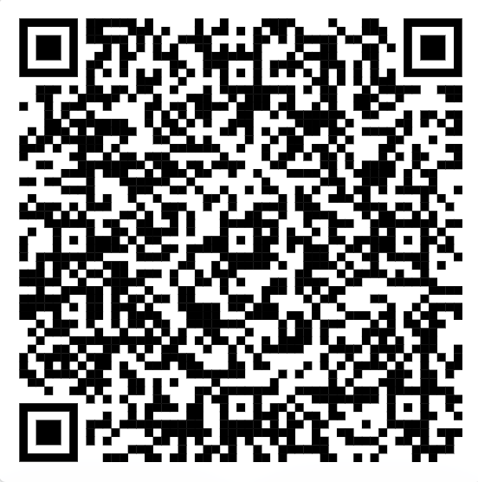
Conclusions
Switching Tongues, Sharing Hearts: Identifying the Relationship Between Empathy and Code-switching in Speech
The relationship between acoustic-prosodic empathetic features and code-switching may be more subtle than expected.
Next steps
  Further exploration of acoustic-prosodic features
  Multilingual (≠ English) empathy models
  Determining causal relationship between empathy and code-switching
Paper
Notes:
We think that fruitful future work will determine a set of acoustic-prosodic features that more clearly encodes a positive relationship between empathy and code-switching. We expect this challenging task to become more tractable with improvements in the measurement and modeling of both monolingual and multilingual empathetic speech.
In terms of limitations, we assumed that our multimodal model was language-independent with respect to acoustic-prosodic features, and so could provide reliable gold labels of empathy across the code-switched corpora. Based on work on monolingual empathy in languages other than English, we believed this was a fair assumption, as many of the acoustic-prosodic correlates of empathy found in English have also been found in other languages. And, we believe that this is still the best available current option, given the low-resource setting and lack of alternative models for this task. BUT, We also recognise that using an English-trained model and translation to detect empathy in other languages is not ideal and it would be better to use multilingual models.
Finally, our findings serve as a first step toward answering the question of whether the expression of empathy is a motivation for code-switching in speech. We hope to motivate future work on finding a possible causal relationship between the two.
As before, here is a QR code link to the paper if anyone is interested. I’ll now pause for questions again.

Slide 59
From Context to Code-switching: Examining the Interplay of Language Proficiency and Multilingualism in Speech
Debasmita Bhattacharya, Aanya Tolat, Julia Hirschberg.
Under review at INTERSPEECH 2025
Notes:
At the beginning of this talk, I mentioned a few examples of paralinguistic aspects that we can apply to the study of multilingual speech. I’ve already presented work on the first two of them since we’ve talked about how conversational dynamics and affective expression interact with code-switching. The final study that I’ll present is currently under review and will cover the third paralinguistic example of speaker attributes. Specifically, we’ll look into speaker language proficiency and how it shapes code-switching.

Slide 60

Motivation: language proficiency x code-switching
From Context to Code-switching: Examining the Interplay Between Language Proficiency and Multilingualism in Speech
Language proficiency
  A speaker’s competence and capability to use oral and/or written language accurately and appropriately in a variety of settings.
  Individual linguistic characteristics → years of experience
  Language exposure aspects → medium of schooling
Notes:
So what is language proficiency? We usually define this in terms of a speaker’s ability to write or speak accurately and appropriately in a variety of contexts. This is often measured in the wild via proxy measures like standardized tests, or in research via proxy measures that span an individual’s personal linguistic characteristics and demographic aspects of language exposure throughout their life.
Given our understanding of language proficiency, it seems almost obvious that it must play some role in modulating how speakers code-switch in speech, but no work has explicitly accounted for speakers’ linguistic ability when studying multilingual speech, and so we do not know exactly how proficiency influences specific code-switching behaviours.

Slide 61
Research Question
From Context to Code-switching: Examining the Interplay Between Language Proficiency and Multilingualism in Speech
How is language proficiency, as encoded by demographic and linguistic factors, related to the quantity, language distribution, and syntactic complexity of code-switching in a conversational domain?
Notes:
In this study, we wanted to address the general lack of empirical investigation into this fundamental aspect of multilingual language production by asking: how is language proficiency related to the quantity, language distribution, and syntactic complexity of code-switching in a conversational domain?

Slide 62
Data: Bangor Miami corpus 2.0
From Context to Code-switching: Examining the Interplay Between Language Proficiency and Multilingualism in Speech
Conversational data
  CSW quantity and frequency: CSW ratio, M-index, I-index
  CSW language distribution: relative token counts
  CSW syntactic complexity: CSW strategy
Questionnaire data
  Linguistic: age, years of experience, self-reported ability
  Demographic: parents’ primary language, medium of schooling
Notes:
To answer this question, we again used the Bangor Miami corpus, but this time made use of a new addition to the data set that we discovered only last summer: the responses to a sociolinguistic questionnaire given to each speaker to solicit demographic and linguistic background information on the primary languages spoken by each of their parents, the languages of instruction at their primary and secondary schools, years of language experience in both Spanish and English, age, and self-reported ability in each language.
From the original subset of the corpus, we computed some metrics of code-switching quantity and frequency that should be familiar to you by now, and determined speaker-level code-switching richness. We also calculated speaker-level predominant language during code-switching by comparing token counts in each language, and we measured the syntactic complexity of utterances based on the code-switching strategy used: insertional or alternational.

Slide 63

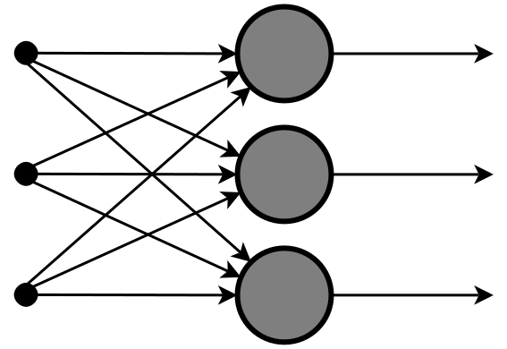
Method
From Context to Code-switching: Examining the Interplay Between Language Proficiency and Multilingualism in Speech
Statistical analysis
  Chi squared tests
  ANOVA tests
  Pearson correlation
  Logistic regression
Predictive modeling
  Logistic regression and SVM
    3-fold CV
    80-20 train-test split
Notes:
With all those features, we used a suite of statistical tests to determine the relationship between factors of language proficiency and code-switching behaviour. We needed to use a variety of tests to account for both categorical and continuous independent and dependent variables. We complemented this statistical testing through analysis of simple predictive models of CSW behaviour over the combined continuous and categorical language proficiency data.

Slide 64
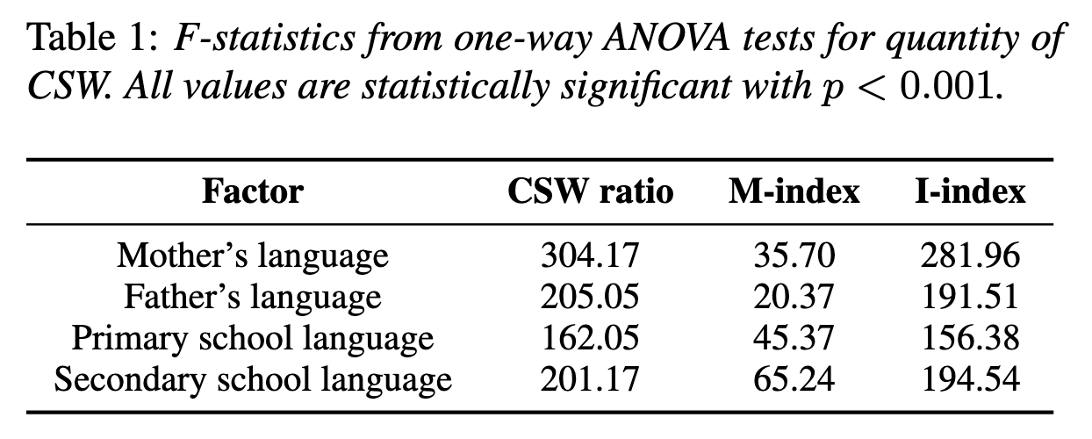
Results: language proficiency is significantly related to CSW quantity
From Context to Code-switching: Examining the Interplay Between Language Proficiency and Multilingualism in Speech
Notes:
We began by examining the relationship between categorical features of language proficiency and the continuous quantity of CSW in speakers' utterances. One-way ANOVA tests showed a strong and statistically significant association between all the categorical variables and CSW quantity, as encoded by CSW ratio and I-index in particular. This suggests that variations in these linguistic environment factors can distinguish speaker CSW behavior related to both the raw quantity of code-switches in an individual's speech, and the frequency with which a speaker alternates between languages in that speech. So, there are significant differences in quantity and frequency of code-switches produced between speaker groups with differing backgrounds of language exposure, which go on to shape language proficiency.
We also examined the continuous features of language proficiency – age, years of experience, and self-reported ability – in relation to the continuous metrics of CSW richness using Pearson correlation tests, but didn’t find evidence of any significant linear correlations between any of the pairings.

Slide 65
Results: language proficiency is significantly related to predominant language in CSW
From Context to Code-switching: Examining the Interplay Between Language Proficiency and Multilingualism in Speech
Factor | Odds Ratio
Primary school language | 4.97
Secondary school language | 7.32
Notes:
Next, we examined the categorical language proficiency factors in association with the dominant language used within a speaker's code-switched utterances. Chi-squared tests showed that the language of schooling is significantly related to dominant language use in code-switched utterances. Both primary and secondary school media are associated with the same language being the dominant one in a speaker's code-switched productions.
The odds that a speaker is Spanish-dominant in CSW, given that their primary school medium was Spanish, are 4.97 (95\% CI: 1.34-20.32) times those for a speaker with an English-medium primary school. Similarly, the odds that a speaker is Spanish-dominant in CSW, given that their secondary school medium was Spanish, are 7.32 times greater than those for an English-medium school (95\% CI: 1.63-39.93). These results are especially significant given that there is an overall skew towards English in the corpus. So, there appears to be a meaningful relationship between the medium of a speaker's education, particularly at the secondary level, and the dominant language used in their code-switched utterances.

Slide 66
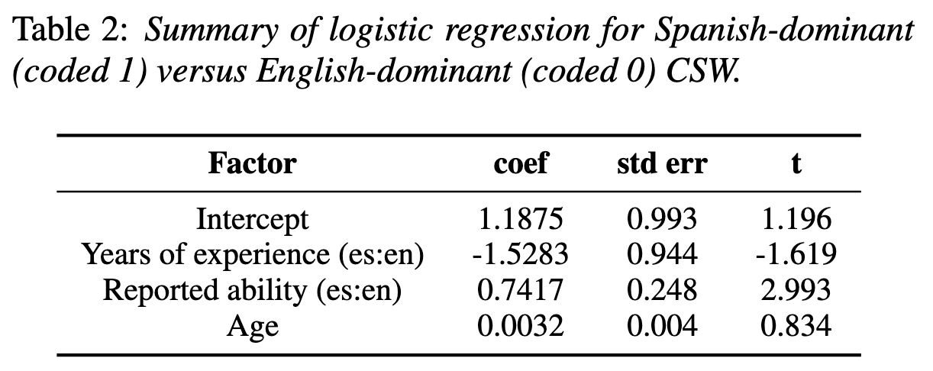
Results: language proficiency is significantly related to predominant language in CSW
From Context to Code-switching: Examining the Interplay Between Language Proficiency and Multilingualism in Speech
Notes:
Turning to the continuous language proficiency factors and their relationship with language dominance in CSW, we implement a binary logistic regression distinguishing Spanish-dominant CSW from English-dominant CSW.
Most notably, we find that higher self-reported ability in Spanish relative to English is associated with Spanish-dominant CSW, as you can tell from the positive-valued coefficient in the table. This finding is statistically significant and aligns with expectations. We also find that older speakers in this corpus are slightly more likely to use Spanish as the dominant language in their code-switches, which could reflect increasing comfort in one language over time, but more information is needed to assess whether this interpretation is reasonable given a speaker's context. Overall, there appears to be an association between one continuous measure of speaker language proficiency -- self-reported ability -- and the dominant language used in code-switched utterances.

Slide 67
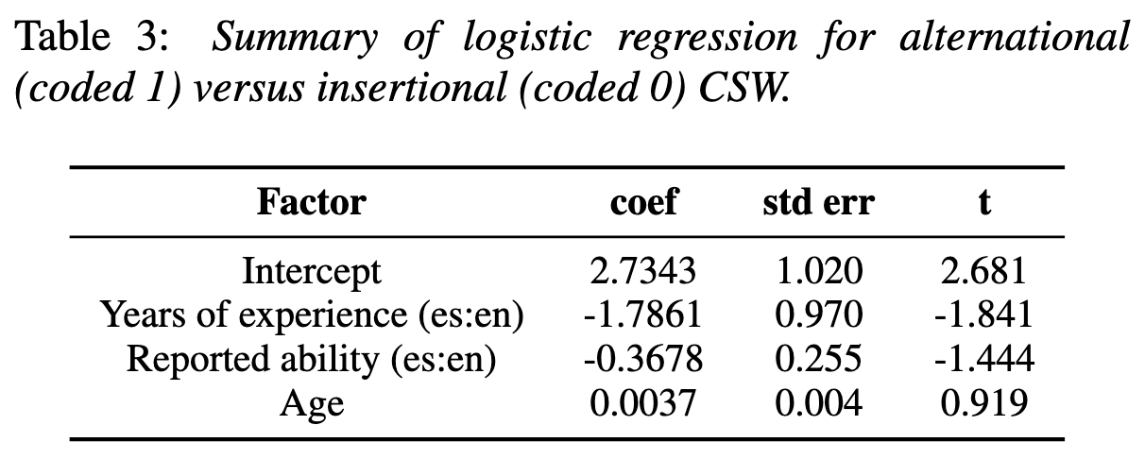
Results: language proficiency is not directly related to CSW strategy
From Context to Code-switching: Examining the Interplay Between Language Proficiency and Multilingualism in Speech
Notes:
We finally considered the language proficiency factors associated with the CSW strategy most used in conversation. We didn’t find any significant relationships between the categorical proficiency features from chi-squared tests, which initially suggests that the syntactic complexity of code-switching, as encoded by code-switching strategy, may be too fine-grained an aspect of code-switching behaviour to be directly impacted by language proficiency, especially when measured via influential but indirect aspects of the linguistic environment.
We turned instead to the continuous language proficiency variables using another logistic regression that distinguishes speakers’ use of insertional and alternational code-switching. Here, we find the most notable result that approaches statistical significance is that greater years of experience in Spanish relative to English are more associated with the use of insertional code-switching than alternational code-switching. But, this might just be a reflection of the majority of English insertions into Spanish utterances in the corpus (about 58\% of insertional code-switched utterances fall into this category); and does not provide much insight into a relationship between language proficiency and CSW strategy choice.
We also note that greater self-reported ability in Spanish relative to English is more associated with the use of insertional than alternational CSW. This is somewhat counter-intuitive, though, as alternational CSW is more syntactically complex, and we expected its use to be aided by greater proficiency in relatively grammatically complex Spanish, and thus preferred by such proficient speakers. But, this result is not statistically significant, and so we may discount it. Finally, we find that older speakers are slightly more likely to use alternational code-switches in this corpus.
Overall, it is difficult to conclude that any of the language proficiency factors are directly related to CSW behavior as encoded by the CSW strategy used in conversation. However, we do note that alternational CSW tends to have higher M-index values than insertional CSW (median: 0.83 v.s. 0.6), while insertional CSW tends to have higher CSW ratio and I-index values (median: 0.2 v.s. 0.1), indicating a potential indirect relationship via CSW quantity, since we found that CSW quantity is significantly associated with language proficiency.

Slide 68
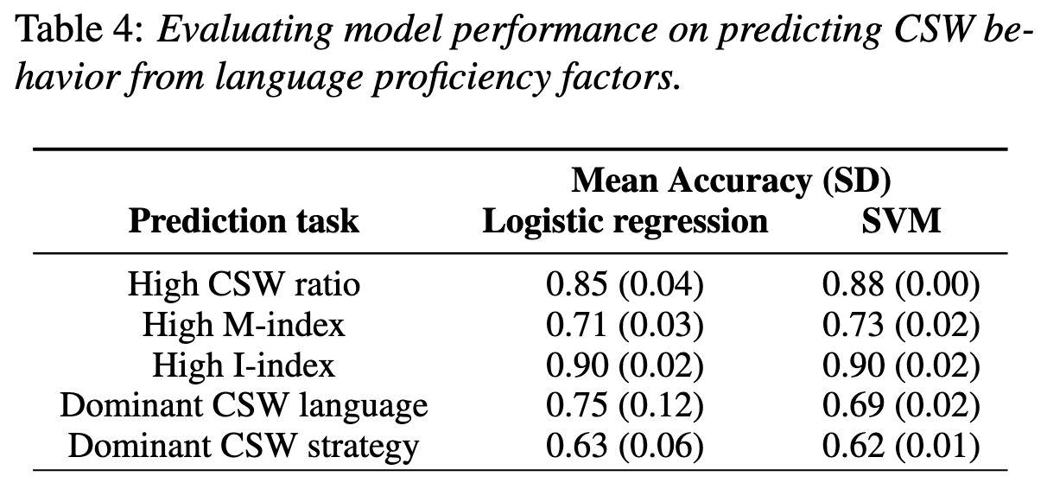
Results: language proficiency can predict CSW behaviour
From Context to Code-switching: Examining the Interplay Between Language Proficiency and Multilingualism in Speech
Notes:
We completed our study by assessing whether predictive models can leverage the relationships we found between language proficiency and aspects of CSW behavior to accurately predict CSW from a speaker's linguistic profile. To make CSW quantity prediction a binary task, we define a speaker with a ``high" value for a given metric as one whose CSW quantity surpasses the midpoint of values for that metric across all speakers. Predicting CSW dominant language and strategy are already binary tasks.
Both models perform similarly and reasonably well on all CSW prediction tasks, beating a random baseline of 0.5 in each case. Stronger results for CSW quantity and dominant language prediction reflect the relative statistical significance of associations we found above. These results overall provide further evidence for the role of language proficiency in CSW.

Slide 69
Conclusions
From Context to Code-switching: Examining the Interplay Between Language Proficiency and Multilingualism in Speech
How is language proficiency, as encoded by demographic and linguistic factors, related to the quantity, language distribution, and syntactic complexity of code-switching in a conversational domain?
Notes:
So, having seen all of our analyses, we can wrap up with the main takeaways from the study.

Slide 70
Conclusions
From Context to Code-switching: Examining the Interplay Between Language Proficiency and Multilingualism in Speech
Parents’ primary language → code-switching quantity and frequency
Notes:
We found that (1) the language spoken by a speaker's parents is strongly associated with the quantity and frequency of CSW in that speaker's productions

Slide 71
Conclusions
From Context to Code-switching: Examining the Interplay Between Language Proficiency and Multilingualism in Speech
Parents’ primary language → code-switching quantity and frequency
Medium of instruction + self-reported ability → dominant code-switching language
Notes:
(2) the medium of instruction during a speaker's education and a speaker's self-reported higher-ability language are strongly related to the dominant language used in their CSW;

Slide 72
Conclusions
From Context to Code-switching: Examining the Interplay Between Language Proficiency and Multilingualism in Speech
Parents’ primary language → code-switching quantity and frequency
Medium of instruction + self-reported ability → dominant code-switching language
Language proficiency →? code-switching strategy
Notes:
and (3) a potential indirect relationship between language proficiency and the strategy of CSW used in conversation.

Slide 73
Conclusions
From Context to Code-switching: Examining the Interplay Between Language Proficiency and Multilingualism in Speech
Language proficiency has notable relationships with several aspects of code-switching.
  These relationships can even be learned and applied by simple predictive models of code-switching behaviour.
Notes:
Overall, we showed that language proficiency, measured via aspects of speakers' linguistic environment and individual linguistic characteristics, has notable relationships with several aspects of CSW. These relationships can even be learned and applied by simple predictive models of CSW behavior, lending validity to our statistical findings.
We conclude that certain aspects of language proficiency may well have a downstream impact on code-switched language production, and should be accounted for in any study of CSW. We recommend that future work on modeling and predicting CSW, or assessing the effect of other paralinguistic factors on CSW, incorporate language proficiency features in their analysis, wherever possible.
Are there any questions about this study?
Having shown you what kind of work we’ve already done on code-switching, I’m going to finish this talk by briefly mentioning ongoing and future research directions.

Slide 74
Ongoing research directions
Which dialogue acts and discourse topics tend to be produced most often in code-switching?
  Understanding motivation for code-switching
  Generating appropriate and naturalistic code-switched responses in text
Notes:
We are currently working on a discourse-level analysis of code-switching centered around dialogue acts and discourse topics, to understand people’s discursive motivations for code-switching. This could be useful for both predicting code-switches, and for generating human-like code-switched responses.

Slide 75
Ongoing research directions
How does the presence of named entities influence code-switching?
  Improving code-switching prediction
Notes:
We are performing similar analysis of the influence of named entities in code-switched contexts too.

Slide 76
Future research directions
How do bilingual speakers produce prosody when code-switching? Matching one language, both, neither?
  Generating naturalistic code-switched responses in speech
Notes:
Finally, we plan to investigate the prosodic aspects of code-switching, which would also be useful for generating human-like code-switched responses. We know from some of our prior work that is also under review that prosody changes depending on the monolingual or multilingual context of the conversation, so this research direction intends to build on that finding.
This planned project is a good example of the transition in my work from understanding how code-switching happens, to applying that knowledge towards generating authentic code-switched speech.

Slide 77
CSW research opportunities in the Speech Lab
If you are interested in collaborating on a code-switching project, please reach out to me at debasmita.b@cs.columbia.edu!
I will be recruiting one or two students for the fall semester.
  Preference for: strong background in machine learning, experience with LLMs or other generative AI.
Notes:
If any of the research directions I presented sounded interesting to you – whether it was a past, ongoing, or upcoming project – and if you think you might be interested in collaborating on code-switching with me, you can let me know over email, as I will be looking to recruit one or two research assistants for the fall, with the possibility of starting over the summer.
This is the end of my talk, so thanks for your attention, and I’d be happy to take any questions.

