Slide 1
Spoken Dialogue System in Healthcare
Yu-Wen Chen

Slide 2
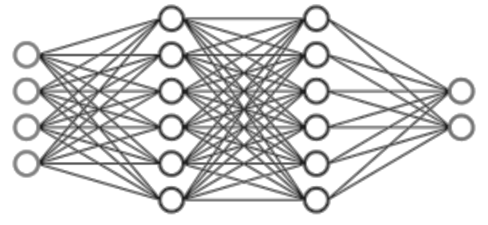
/
Help healthcare providers review and validate the information
Spoken dialogue system
Provide healthcare professionals with data-driven insights

Slide 3
hi. how are you ?
good.
good good.
your blood pressure seems to be under control.
great.
your depression , you know , it sounds like you're doing well with that, but again, I'm happy to start on a medical regiment or ...
mm-hmm
refer you to psychotherapy , if you think that that would be helpful.
mm-hmm
would you like that ?
u- u- um , maybe not necessarily.

Slide 4
hi. how are you ?
good.
good good.
your blood pressure seems to be under control.
great.
Summarize the conversation
your depression , you know , it sounds like you're doing well with that, but again, I'm happy to start on a medical regiment or ...
mm-hmm
refer you to psychotherapy , if you think that that would be helpful.
mm-hmm
would you like that ?
u- u- um , maybe not necessarily

Slide 5
Model for medical note generation
Overview of the MEDIQA-Chat 2023 Shared Tasks on the Summarization & Generation of Doctor-Patient Conversations
(Ben Abacha et al., ClinicalNLP @ ACL 2023 )
Fine-tuning LM-based method.
LED: Longformer: The Long-Document Transformer
WangLab at MEDIQA-Chat 2023: Clinical Note Generation from Doctor-Patient Conversations using Large Language Models

Slide 6
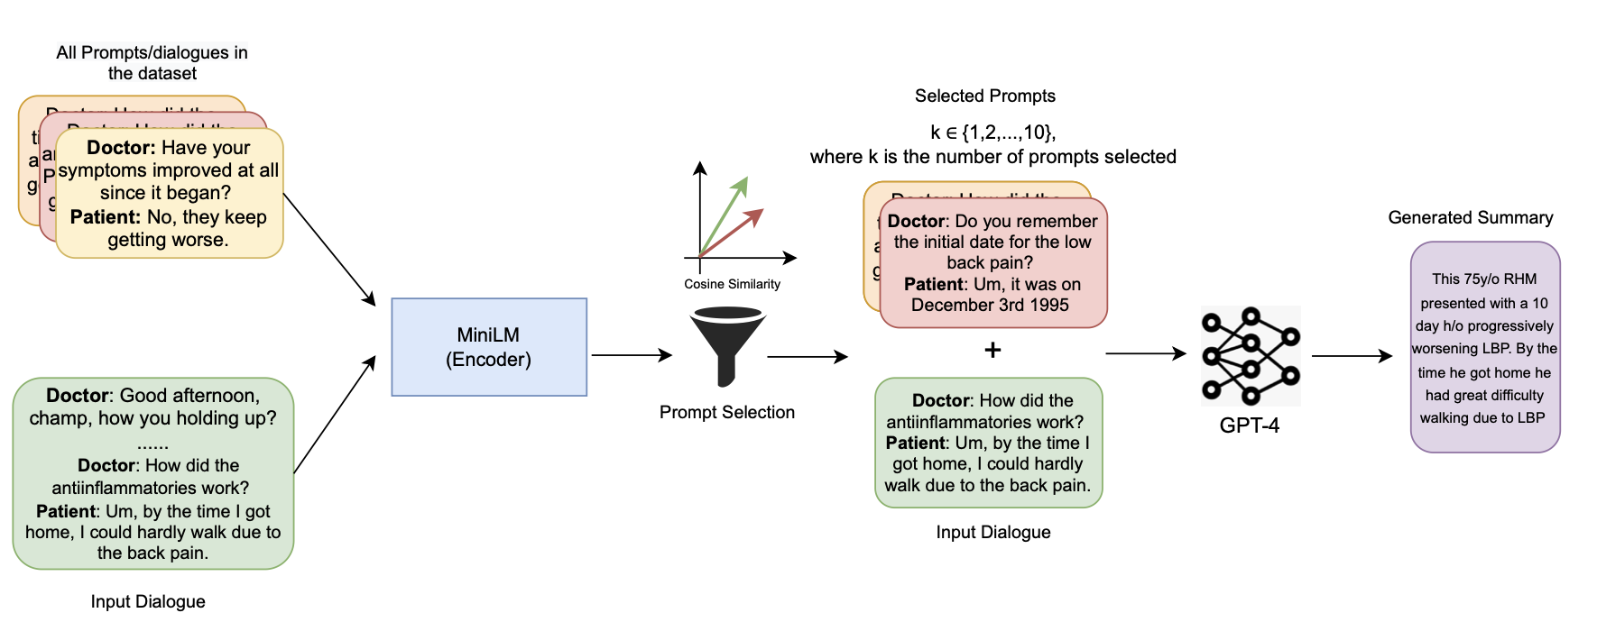
Model for medical note generation (Cont.)
GPT-based methods
Learn the format
SummQA at MEDIQA-Chat 2023: In-Context Learning with GPT-4 for Medical Summarization

Slide 7
https://huggingface.co/wanglab/ task-a-flan-t5-large-run-2
Doctor: Hello, how are you today?
Patient: I am doing well.
Doctor: Great. What would you like to bring up today?
Patient: I have some questions about my liver.
Doctor: Alright. Let's start with the basics. Do you drink? Excessive drinking can cause issues with the liver.
Patient: No, I do not. I take a lot of Tylenol for pain and I am worried it is effecting my liver.
Doctor: Okay, that is a common concern. We can address that today. Do you happen to smoke?
Patient: No, I do not smoke.
The patient is a nonsmoker. No history of alcohol abuse. Tylenol use is noted to be problematic.

Slide 8
https://huggingface.co/wanglab/ task-a-flan-t5-large-run-2
Doctor: Hello, how are you today?
Patient: I am doing well.
Doctor: Great. What would you like to bring up today?
Patient: I have some questions about my liver.
Doctor: Alright. Let's start with the basics. Do you drink? Excessive drinking can cause issues with the liver.
Patient: No, I do not. I take a lot of Tylenol for pain and I am worried it is effecting my liver.
Doctor: Okay, that is a common concern. We can address that today. Do you happen to smoke?
Patient: No, I do not smoke.
The patient is a nonsmoker. No history of alcohol abuse. Tylenol use is noted to be problematic.

Slide 9
https://huggingface.co/wanglab/ task-a-flan-t5-large-run-2
Doctor: Hello, how are you today?
Patient: I am doing well.
Doctor: Great. What would you like to bring up today?
Patient: I have some questions about my liver.
Doctor: Alright. Let's start with the basics. Do you drink? Excessive drinking can cause issues with the liver.
Patient: No, I do not. I take a lot of Tylenol for pain and I am worried it is effecting my liver.
Doctor: Okay, that is a common concern. We can address that today. Do you happen to smoke?
Patient: No, I do not smoke.
The patient is a nonsmoker. No history of alcohol abuse. Tylenol use is noted to be problematic.
Look ok? Include all important information?
How well will the model perform on out-of-domain data?

Slide 10
Important information in medical dialogue
SOAP notes
Subjective: information reported by the patient
e.g., History of illness
Objective: objective observations
e.g., Exam, lab results
Assessment: doctor’s evaluation
Plan: future care plan
SOAP is widely utilized by healthcare providers to document a patient’s progress
Notes:
An organized framework that reduces communication confusion among healthcare professionals.

Slide 11
Open-sourced dataset
MTS-Dialog
ACI-BENCH
Doctor: Good afternoon, sir. My chart here says that you are a fifty one year old white male, is that correct? Patient: Good afternoon, doctor. Yes, all of that is correct.
...
Doctor: Finally, your ECOG score is one according to the nurse, is that correct? Patient: Yes, doctor. That's correct.
Doctor: hi. how are you? Patient: hey, good to see you. Doctor: i'm doing well, i'm doing well.
…
Doctor: let me know if your symptoms worsen and we can talk more about it, okay? Patient: you got it. Doctor: all right. hey, dragon. finalize the note.
~1800 tokens
~150 tokens
(Subjective)
CHIEF COMPLAINT Upper respiratory infection. HISTORY OF PRESENT ILLNESS The patient is a 59-year-old male with a past medical history significant for depression, …
RESULTS
ASSESSMENT AND PLAN ..
(Subjective)
Section header: HISTORY of PRESENT ILLNESS
Section text: A 51-year-old white male diagnosed with PTLD in latter half of 2007. He presented with symptoms of increasing adenopathy, abdominal pain, weight loss, and anorexia. ….
(Subjective)
(Objective)
(Assessment and Plan)
Notes:
Here are examples of the datasets used in this study. mts dialog and aci-bench. Both of them have the corresponding SOAP category of the summary.

Slide 12
Mapping between original note categories and SOAP
Dataset | Original section | # of samples
Subjective
MTS-Dialog | GENHX, FAM/SOCHX, PASTMEDICALHX, CC, PASTSURGICAL, ALLERGY, ROS, MEDICATIONS, IMMUNIZATIONS, GYNHX, PROCEDURES, OTHER_HISTORY, | 175
ACI-BENCH | Subjective: CHIEF COMPLAINT, HISTORY OF PRESENT ILLNESS, and REVIEW OF SYSTEMS. | 40
Objective
MTS-Dialog | EXAM, IMAGING, LABS | 7
ACI-BENCH | Objective exam and objective result: RESULTS, PHYSICAL EXAMINATION, and VITALS REVIEWED. | 40
Assessment and plan
MTS-Dialog | ASSESSMENT, DIAGNOSIS, DISPOSITION, PLAN, EDCOURSE | 18
ACI-BENCH | Assessment and plan: ASSESSMENT AND PLAN | 40
Is SOAP written in a similar way?

Slide 13
Introduction of LIWC
Linguistic Inquiry and Word Count
A text analysis software that provides insights into the emotional, cognitive, and structural components of written or spoken language.
LIWC analyzes text based on a predefined set of linguistic categories and calculates the percentage of words in a given text to uncover patterns and meanings in the text.
Input text
LIWC features
“Past medical history is unremarkable.”
[ 0, 0, 0 , 0.166, …, ]
I
we
you
health
https://www.liwc.app/

Slide 14
LIWC features related to healthcare
LIWC feature | Examples
pronoun | I, you, that, it
number | one, two, first, once
posemo (positive emotion) | good, love, happy, hope
negemo (negative emotion) | bad, hate, hurt, tired
anx (anxiety) | worry, fear, afraid, nervous
anger | hate, mad, angry, frustr*
sad | sad, disappoint*, cry
hear | heard, listen, sound
feel | touch, hold, felt
bio | eat, blood, pain
body | ache, heart, cough
health | medic*, patients, health
ingest (food) | food*, drink*, eat, dinner*
risk | secur*, protect*, pain, risk*
time | when, now, then, day
Hypothesis:
LIWC features should be similar across different dataset SOAP categories.

Slide 15
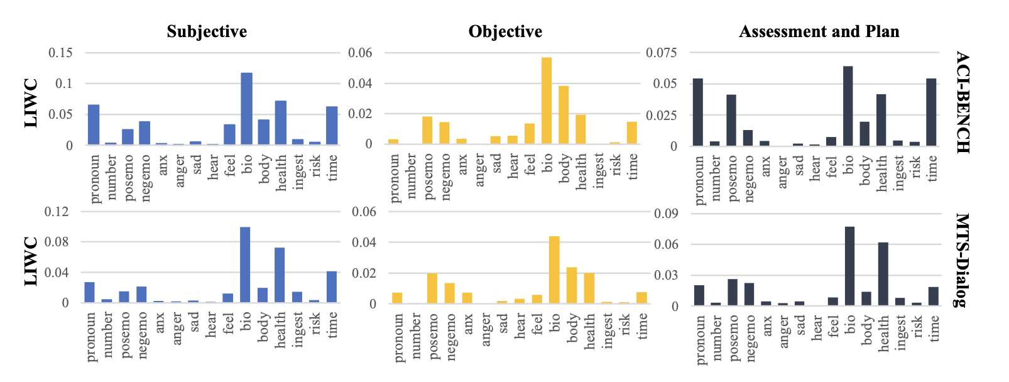

Slide 16
Correlation: 0.93
Correlation: 0.95
Correlation: 0.77

Slide 17
Subjective (subjective information from the patient)
is similar to
Assessment and plan (subjective information from the doctor)

Slide 18
LIWC features have characteristics that resonate with SOAP notes in real-world scenarios

Slide 19
Case study
Have you had your flu or Pneumonia vaccination this year?
I got my flu shot this year, but I did not get the one for Pneumonia.
Reference: Immunizations were up to date for influenza, negative for Pneumovax.
Model | Section | Generated note
LED | S | (CHIEF COMPLAINT) Pneumonia. (MEDICAL HISTORY) Patient reports history of pneumonia in the past. (SOCIAL HISTORY) patient reports that she has a family history of pneumonia. (MEDICATIONS) Patient reports she received a flu shot this year. (REVIEW OF SYSTEMS) Constitutional: Reports pneumonia. Respiratory: Denies pneumonia. Gastrointestinal: Reports abdominal pain. Genitourinary: Reportsuria. Musculoskeletal: Reports right lower extremity pain.
 | O | (PHYSICAL EXAM) Itegumentary. Examination: Normal gait. Examination of Abdomen: No enlarged lymph nodes. Palpation: Normal perfusion. Auscultation of Lungs: No evidence of lymphadenopathy. Cardiovascular Examination; normal perfusion, bilaterally. - Musculosity: Normal pulmonary function. gastrointestinal: Normal vaginal bleeding.
 | AP | 1. Pneumonias. - Medical Reasoning: Based on the patient's examination and radiographic findings, we believe this is a case of Pneumona. - Patient Education and Counseling: We discussed the diagnosis and treatment options with the patient. We also discussed the importance of maintaining a high index of suspicion when treating patients with suspected pneumonia. - Additional Testing: We recommended that all patients be referred to a thoracic/GI/Lymphatic surgeon for further evaluation and possible treatment. - medical Treatment: Initiate antiviral treatment. Patient Agreements: The patient understands and agrees with the recommended medical treatment plan. (INSTRUCTIONS) The patient will follow-up as needed.

Slide 20
Case study
Have you had your flu or Pneumonia vaccination this year? I got my flu shot this year, but I did not get the one for Pneumonia.
Model | Section | Generated note
gpt3.5 | S | N/A
 | O | The patient has received a flu vaccination this year, but they have not received a pneumonia vaccination
 | AP | The patient has not received a pneumonia vaccination. Recommend the patient to get their pneumonia vaccination.
gpt4 | S | The patient reported having received their annual flu vaccination, but they have not been vaccinated for pneumonia this year.
 | O | N/A
 | AP | The patient is up to date with their flu vaccination but lacks their pneumonia shot for the current year. The plan is likely to facilitate the pneumonia vaccination for the patient.

Slide 21
Challenges
Long conversation
Domain: medical terms (new medical term, abbreviation)
Data: hard to collect or share data due to privacy concerns
Retrieval-augmented generation (RAG)
Retrieve
(Private / new data)

Slide 22
Challenges
Have you had your flu or Pneumonia vaccination this year? I got my flu shot this year, but I did not get the one for Pneumonia.
Evaluation
Reference: Immunizations were up to date for influenza, negative for Pneumovax
GPT: The patient has received a flu vaccination this year, but they have not received a pneumonia vaccination
Adapted large language models can outperform medical experts in clinical text summarization
Van Veen, D., Van Uden, C., Blankemeier, L., Delbrouck, J. B., Aali, A., Bluethgen, C., ... & Chaudhari, A. S. (2024). Nature medicine, 30(4), 1134-1142.

