Slide 1
Adaptive Empathetic Feedback
for English Learning
Siyan Li

Slide 2
Motivation
Frustration and stumbling is common in English learning
Wu et al. (2023) : perceived teacher affective support positively correlate with L2 grit (passion and perseverance in second language learning process)
Affective support should correlate positively with empathy.
Wu, et al. "Teachers matter: exploring the impact of perceived teacher affective support and teacher enjoyment on L2 learner grit and burnout." System 117 (2023): 103096.
Notes:
Affective support has core components such as caring, respect, concern for students, encouragement, and listening.

Slide 3
Does an Empathetic Chatbot System increase L2 Grit?

Slide 4
System Overview

Slide 5
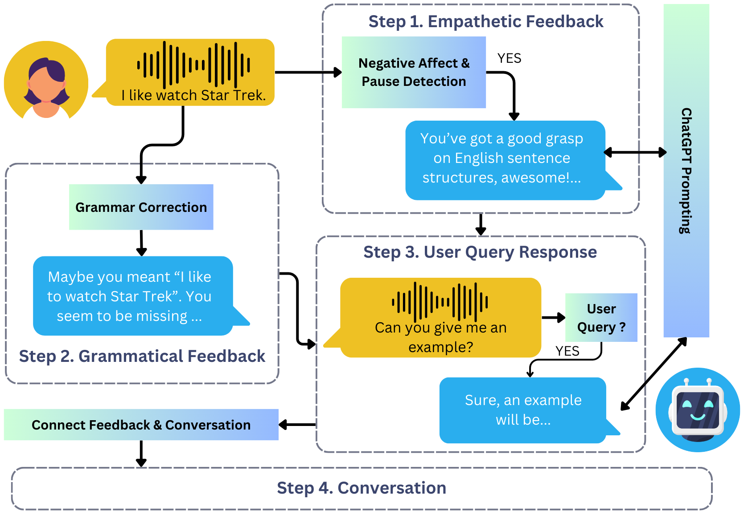
System Design

Slide 6
First, We Find Data
Audio clips collected from Dr. Zhou Yu’s platform
3200 audio clips from 613 conversations and 163 users upon extensive filtering
Native Mandarin speakers speaking English
Transcribe transcripts using Whisper Medium
Radford, Alec, et al. "Robust Speech Recognition via Large-Scale Weak Supervision. 2022." arXiv preprint arxiv:2212.04356 (2022).

Slide 7
Audio Examples
Negative
Unusable: Unintelligible or only Mandarin
Negative: Clearly negative sentiment (e.g. frustration), asking for clarification
Pauses: Prolonged pauses and stammering
Neutral: All other clips
Negative - Asking Clarification
Pauses

Slide 8
Grammar Correction
Trained Llama-2-chat-7b on ErAConD dataset (grammatical corrections of discourse utterances)
Supervised Fine-tuning only, but can incorporate more data / training approaches in the future to improve the model
Provides grammar correction given an input sentence
Then use the Serrant package to find grammatical errors
Pre-written template for grammar feedback
Xun Yuan et al. 2022. ErAConD: Error Annotated Conversational Dialog Dataset for Grammatical Error Correction.;
Kai-Hui Liang et al. 2023. ChatBack: Investigating Methods of Providing Grammatical Error Feedback in a GUI-based Language Learning Chatbot.

Slide 9
Negative Affect & Pause Detection
Perceived negative emotions
Use existing wav2vec speech recognition model
Pauses, since pauses are related to foreign language anxiety
Use Silero-VAD for pause duration computation
Use the average pause length as a metric
If we detect either, then trigger Empathetic Feedback Module

Slide 10
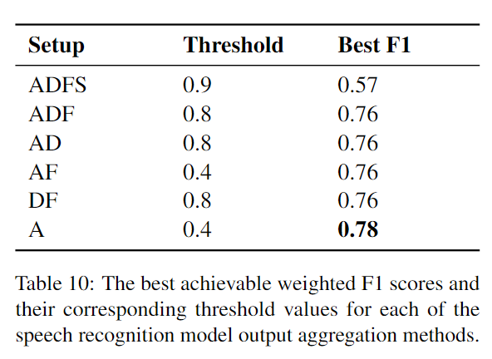
Negative Affect Detection
Our model has the following emotion range: Angry, Calm, Disgust, Fearful, Happy, Neutral, Sad, and Surprised.
Test for different combinations of emotion probabilities + thresholding
F1 score obtained by testing on all Neutral and Negative

Slide 11
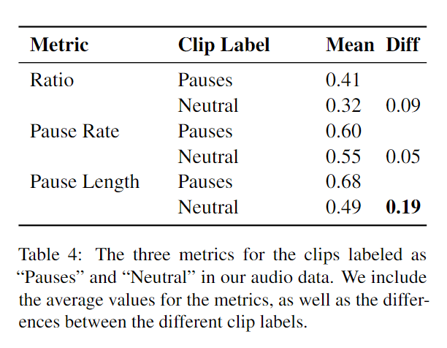
Pause Detection
Different potential metrics for pause detection:
Silence Ratio
Pause Rate
Average Pause Length
Want to aim for the best approach to separate Neutral and Pauses clips
A.P.L. + Threshold 0.5

Slide 12
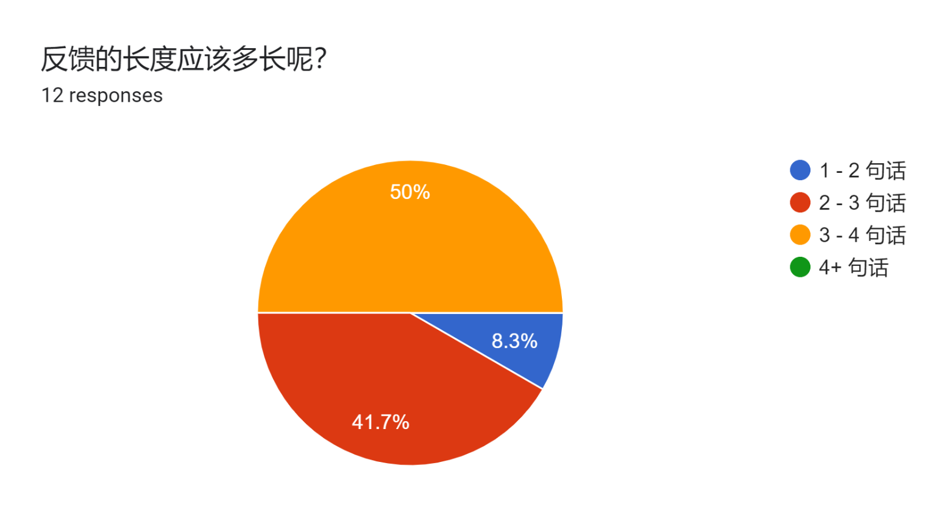
Empathetic Feedback: Ideal Feedback

Slide 13
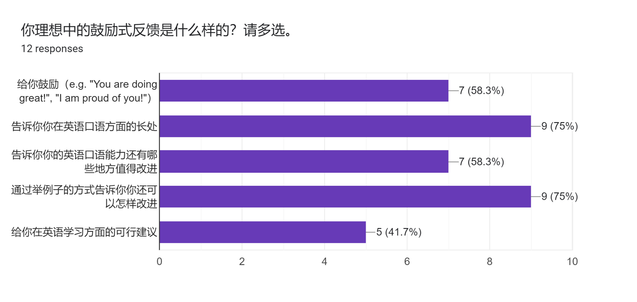
Empathetic Feedback: Ideal Feedback

Slide 14
Empathetic Feedback: Implementation
No ground truth → Prompting LLMs; but LLMs are sensitive to how they are prompted
So we used DSPy as a prompt optimization framework and it also generates in-context examples
Use GPT-4-Turbo as judge for a set of defined metrics
Improved from 68.3 to 89.8!
empathetic = "Does the assessed spoken utterance sound empathetic and encouraging?"
example_include = "Does the spoken utterance include a specific example for the student to learn from?"
colloquial = "Would someone say this utterance in a beginner English classroom conversation?"
correct = f"The student said the following utterances:\n{convo}\nDoes the assessed spoken utterance correctly point out the specific issues and strengths in the student's utterances from a language skill perspective?"

Slide 15
You’ve got a good grasp of the topic and express yourself clearly, awesome! Just tweak your grammar and sentence structure for a smoother flow. For example, instead of saying "I remember she taught us in my fifth grade," you could say "I remember she taught us when I was in fifth grade." Keep practicing, and you’ll keep improving!
Example of Empathetic Feedback

Slide 16
User Study

Slide 17
Population
Recruited through social media and personal connections
8 users currently, out of nearly 100 emailed; it is difficult to get people to finish the full experimental flow without sufficient monetary incentives
Self-reported English proficiency at least intermediate

Slide 18
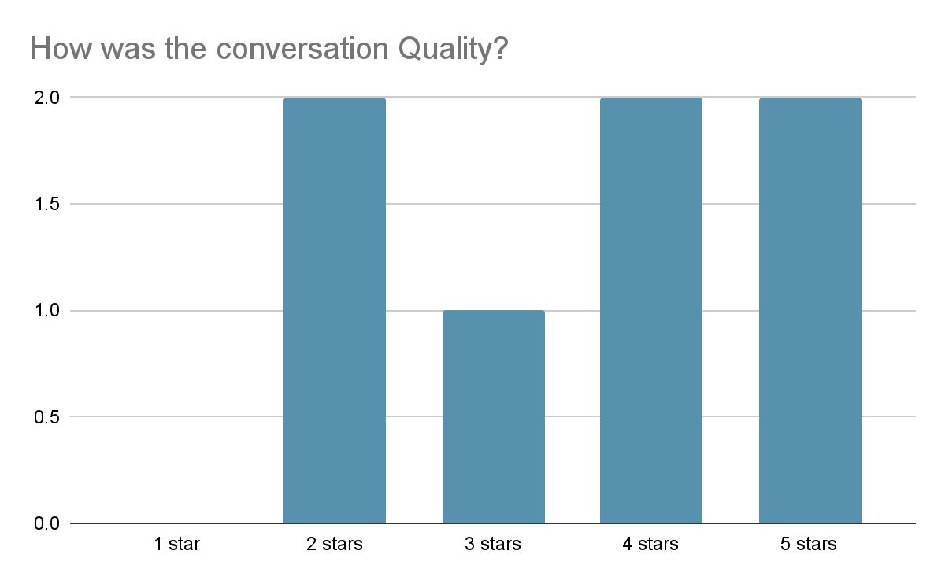
Results Thus Far

Slide 19
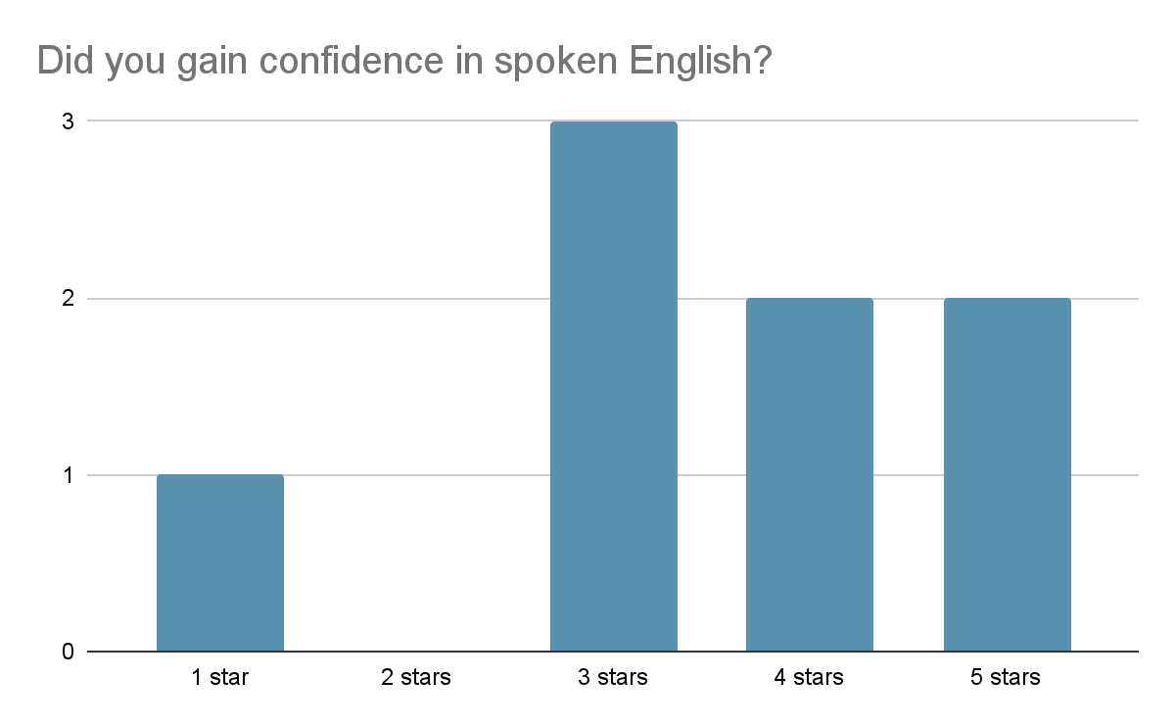
Results Thus Far

Slide 20
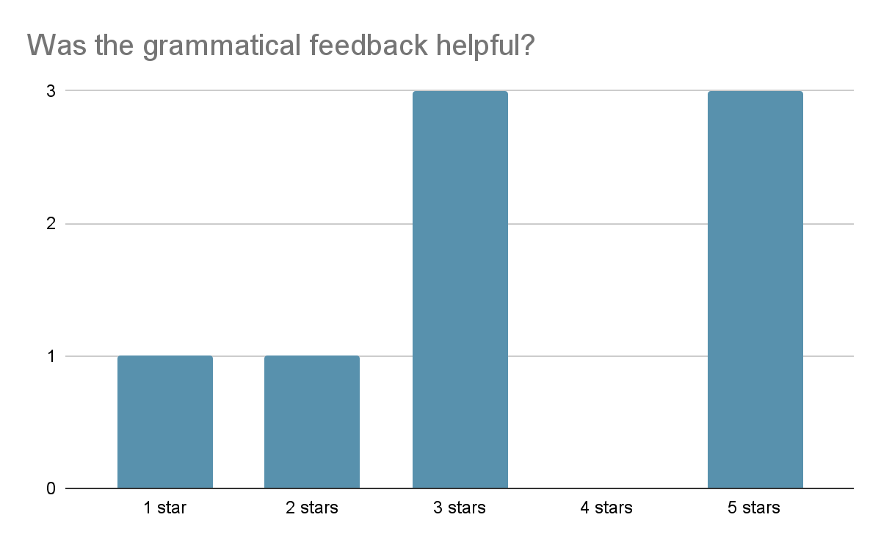
Results Thus Far

Slide 21
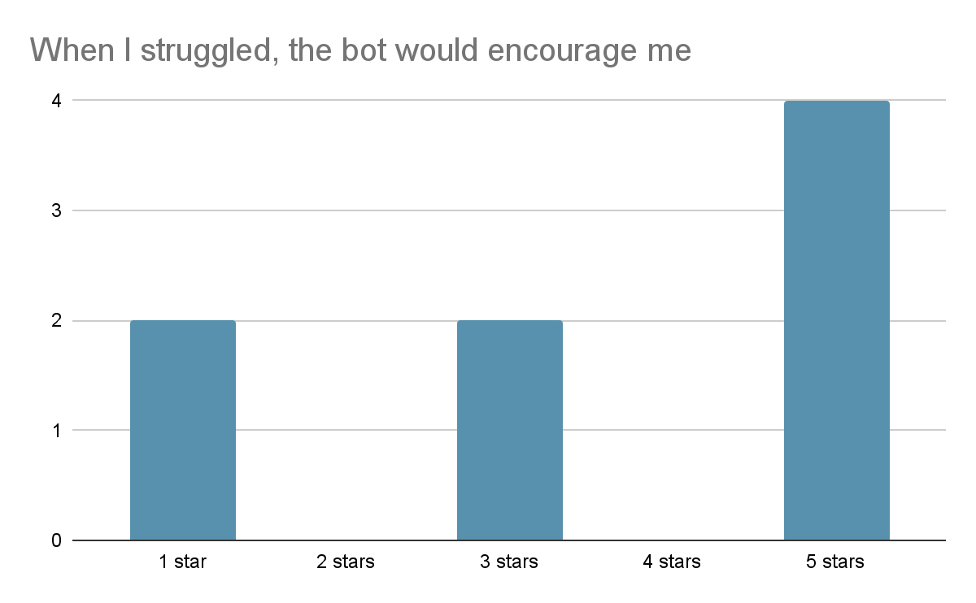
Results Thus Far

Slide 22
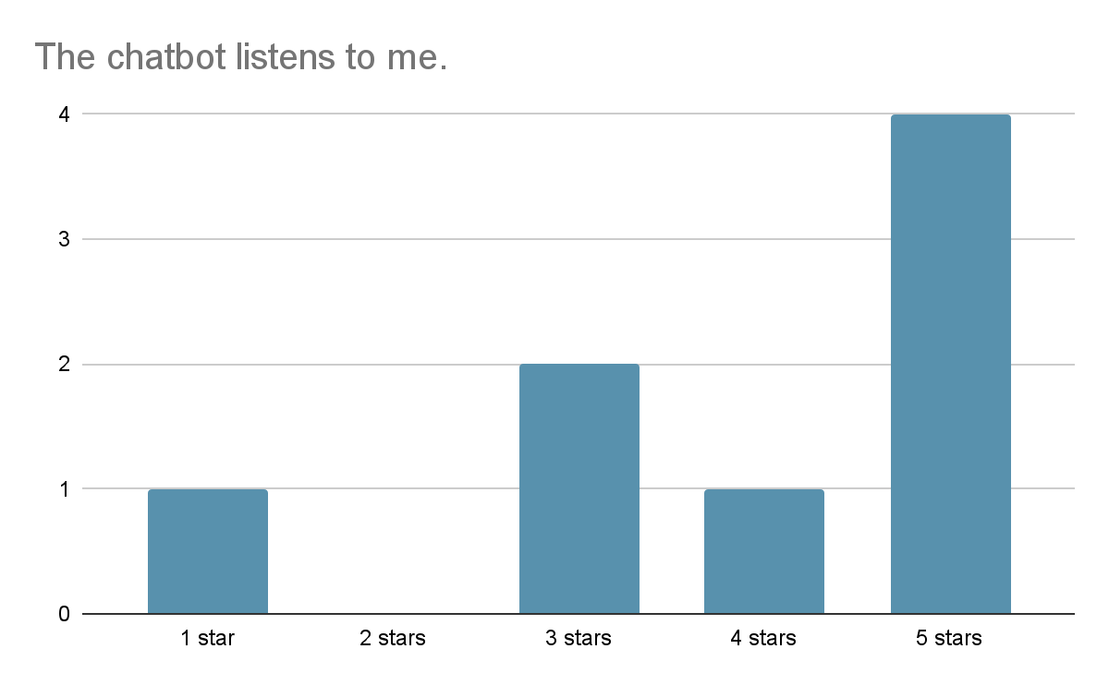
Results Thus Far

Slide 23
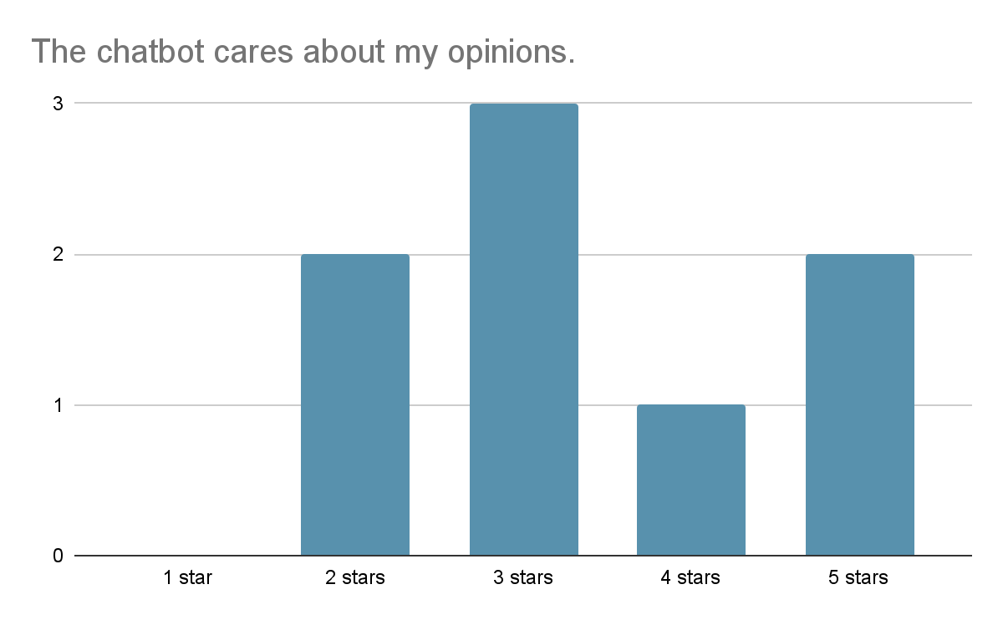
Results Thus Far

Slide 24
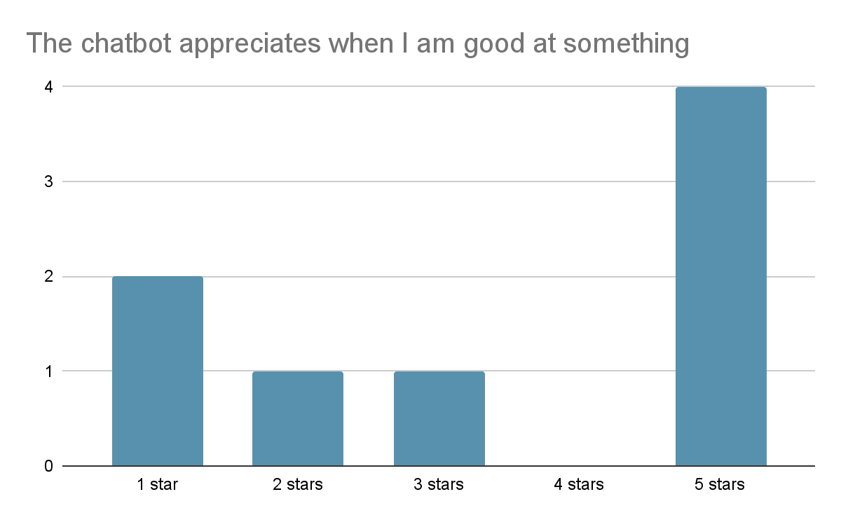
Results Thus Far

Slide 25
User Feedback
Users liked high ASR and conversation quality
Can improve on smoothness of providing feedback
Better approaches to user query detection and response

Slide 26
User Feedback
I like the chatbot and I look forward to the finished product... When the chatbot corrects my grammar, the way it corrects me is very stiff and clunky, and it can interfere with the immersive experience... Additionally, when I use filler words or discourse markers or perform self-repair in the conversation, the bot would catch these as grammatical errors even though they should not be treated as such.

Slide 27
User Feedback
Your chatbot has high ASR accuracy, and the quality of the conversation is quite good! However, it may be challenging to provide English learners with sufficient help, because I asked for more specific feedback after receiving a feedback and it went back to talking about movies.

Slide 28
User Feedback
One thing I really like about the chatbot is that the feedback is very timely! When using ChatGPT I don't always get very prompt feedback. We have a foreigner English teacher coming next week and your bot is definitely a life-saver.

Slide 29
Thank You!
Any Questions?
Email: siyan.li@columbia.edu

