Slide 1
Spoken Dialogue Systems
Julia Hirschberg
COMS 6998
*Thank you to Svetlana Stoyanchev, Sarah Ita Levitan, and Zhou Yu for original and updated slides
Notes:
Play gbose emotion files

Slide 2
What is Natural Language Dialogue?
Communication involving
  Multiple contributions
  Coherent interaction
  More than one participant
Interaction modalities
  Input: Speech, typing, writing, gesture, facial expression
  Output: Speech, text, graphical display, animated face/body (Avatar: embodied virtual agent)

Slide 3
When is an Automatic Dialogue System Useful?
When hands-free interaction is needed
  In-car interface
  In-field assistant system
  Command-and-control interface
  Language tutoring
  Immersive training (e.g. autistic children)
When speaking is easier than typing
  Voice search interface
  Virtual assistant (Siri, Google Now, Alexa, Cortana)
  Many chatbots….
Notes:
When do you use one of these?

Slide 4
How is this useful?
  Replacing human agents (cutting cost for companies)
  Call routing for companies, travel systems
  Menu-based customer help
  Voice interfaces for customer assistance

Slide 5
Visions of Dialogue from Science Fiction
Hal “2001: A Space Odyssey” (1968)
  Naturally conversing computer
Star Trek (original 1966)
  Natural language command and control
Her (2013)
  A virtual partner with natural dialogue capabilities
Avatar 1 (2009), 2 (2022), 3 (2024), 4 (2026), 5 (2028)
  James Cameron films where humans can become avatars when they need to
Notes:
Links?

Slide 6
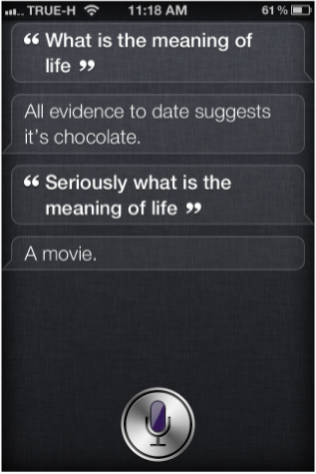
Examples of Current Virtual Assistant Dialogue Systems
Apple Siri (2010 --)
  Supports questions in a set of domains
  Answers open-ended questions
  Cute “Easter egg” responses
Notes:
How many people have used Siri – how many use it often?

Slide 7
Android Google Assistant (2016 --)
  Virtual assistant engaging in conversation
Microsoft 365 Copilot (2023 --)
  Uses your M$ 365 data (calendar, email, chat, documents, meetings) to help you create, edit, share content but ensures your data is private
  Lets you ask complex questions get get concise answers from web sources
Notes:
How many use Gogle Assistant? Microsoft 365 Copilot? Which of these 3 do you think is the best?

Slide 8

Embedded Devices with Dialogue Capabilities
Amazon Echo and Alexa (2014 --) – home assistant device
  Plays music
    With voice commands
  Question answering
    Get weather, news
    More complex questions, like
      “how many spoons are in a cup?”
  Setting timer for wakeup, lights, laundry
  Manage TODO lists
  Shopping on Amazon…
Notes:
And how many of you have used either of these?

Slide 9

Many Embedded Devices with Dialogue Capabilities
Control ice machines
Control microwaves
Manage shopping lists
Stream music and TV
Alexa compatible
Others?

Slide 10
Research in Dialogue Systems
Research systems explore
  Novel research questions in speech recognition/ language understanding/ generation/ dialogue management/ intent recognition/ persuasion/ entrainment/ empathy
Research systems today are
  Based on many LLM frameworks
  Many focusing on chatbot development
Transition from research to commercial
  Siri (2010) came out of a DARPA-funded research project (CALO) run by Ron Brachman and now many many more
Notes:
DARPA project name

Slide 11
One of the Earliest Rule-based Chatbots: ELIZA
Eliza (text only) (Joseph Weizenbaum, MIT, 1966): a “psychologist” system
Example conversation: http://www.masswerk.at/elizabot/
  ELIZA: Is something troubling you ?
  YOU: I am worried about teaching
  ELIZA: How long have you been worried about teaching ?
  YOU: For couple weeks
  ELIZA: Do you feel strongly about discussing such things ?
  YOU: yes
  ELIZA: You seem to be quite positive.
  YOU: I am concerned about choosing course content
  ELIZA: Do you believe it is normal to be concerned about choosing course content ?
In 2023 beat Open-AI’s GPT-3.5 but not GPT-4
Notes:
Now let’s move to chatbots…

Slide 12
Darcy et al’s Woebot a talk therapy phone chatbot app helping users monitor their moods
  Founded 2017 by Stanford Cognitive Behavioral Therapy (CBT) and NLP researchers
  2021 study of +36K users received app therapy showed scores comparable to those using traditional CBT
  But… health professionals were concerned: not really human/empathetic, used in short spurts (unlike real therapy sessions); users may expect too much and lose interest in real therapy; someone with real mental illness may be missed and not get help
Notes:
Andrew Ng was part of initial creation with Alison Darcy.
Was fun to try out in earlier days.
Testing program has ended; Woebot only offered thru provider, employer or other Woebot Health Partner

Slide 13
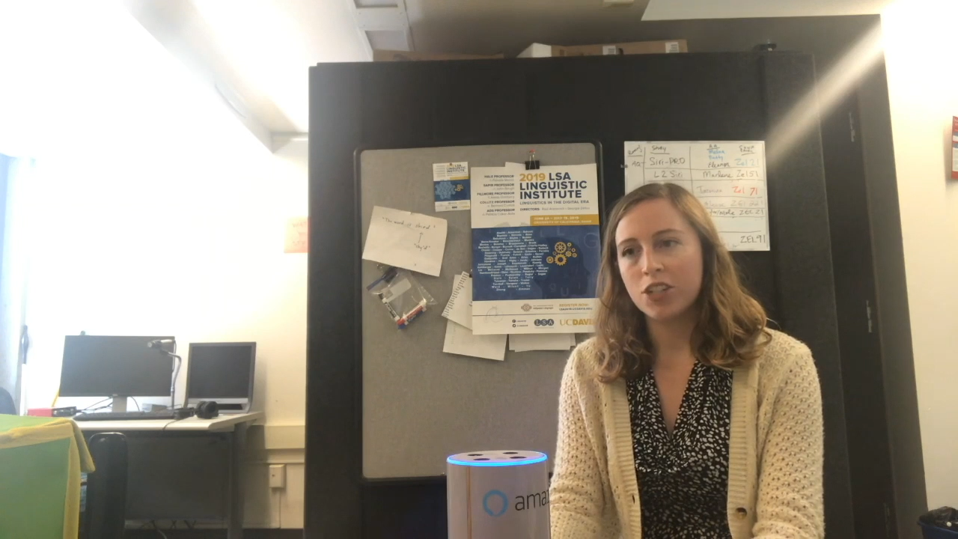
Social Chatbots (Tx to Zhou Yu)
Talk about anything with anyone.
Notes:
While social conversations do not have a specific goal in mind. The aim is to have a conversation with anyone about anything for as long as possible. Here is a student student Michelle talking to Zhou’s Gunrock social chatbot.
The chatbot is about to carry a conversation of the user’s choice. Remembering the dog’s name and express emotions.

Slide 14
Gunrock: 2018 Amazon Socialbot Winner
A $ 2.5 Million competition from Amazon, eight schools involved.
Notes:
Gunrock won the 2018 Amazon Alexa challenge. The challenge aims to build a chatbot that deploys on all amazon alexa devices. There are eight university teams from all over the world competed for the half million prize. In 2018,zhou’s students were first year graduate students, they were able to go from knowing nothing about NLP to building the best social chatbot. They were really excited about the half million cash prize, while Zhou was simply happy that she beat her own advisor Alex Rudnicky in the competition.
The next year we participated in the competition again,but had stronger opponents, such as Chris Manning from Stanford. I reviewed these for several years – a lot of fun…

Slide 15


A Persuasion for Good Dialogue
...
You're probably on a computer right now, so you probably have quite a bit of money yourself, don't you think you could spare maybe 25 cents for some needy children around the world?
No thank you.
Do you have children yourself? What if your children were in a position these kids are in, wouldn't you want someone to help them?
Where are those children's parents?
If only they had parental support, but in war-torn countries like Syria their parents are being killed in wars or are fighting for their country. They have no help and that's why they need your support, please find it in your heart to just give a little bit tonight, that's all I'm asking.
Notes:
Zhou Yu’s Persuasion for Good system
She collected 1000 conversations in total. Here is an example conversation.
Some worked (and people gave a few coins; some did not…

Slide 16
Ethical Issues for Chatbots
Bias Microsoft’s Tay chatbot (Thinking about you)
Privacy issues important
Stereotypes of Tay should not be created
Training on human conversation with chatbots can be a huge problem since humans don’t always speak nicely with bots
Claiming to be human and convincing many people that it is… Google’s duplex
Notes:
Tay was released on 3/23/2016 but caused subsequent controversy when the bot began to post inflammatory and offensive tweets through its Twitter account, causing Microsoft to shut down the service only 16 hours after its launch.^{[1]} According to Microsoft, this was caused by trolls who "attacked" the service as the bot made replies based on its interactions with people on Twitter.^{[2]}

Slide 17
Switchboard Dialogue Act Corpus
Developed from the Switchboard Corpus
  Collected by Texas Instruments in 1990-91 in a DARPA project for regional accent information
  2400 telephone conversations among 543 speakers (302 male, 241 female) from many areas of the U.S.
  Robot operator system handled the calls, introducing the speakers and 1 of 70 topics for discussion and recording the speech
  Transcripts revised many times
  SWB-2 Phase II included 5m conversations from 679 participants collected for speaker ID
  Annotated with +200 Dialogue Acts

Slide 18
Switchboard Dialogue Acts Corpus provided tools to annotate a large portion (1155 conversations) of the Switchboard Corpus in 2000 with 43 DAs
Major problems:
  DAs and their annotations were aligned automatically with SWBD speech and text
  Alignment often incorrect, making it impossible for users to build models to identify audio features of DAs successfully
    Models built to identify utility of speech features as well as text often worse than text alone

Slide 19
Solution: We are now re-aligning the conversations by hand
  Over 3/4 of 1155 conversations have now been realigned by human labelers who are still working
Goal: Make correctly aligned corpus publicly available to the Speech and NLP community
You’ll get a better picture of all this with HW2 ☺

Slide 20
And some other concerns
A NYTimes writer had an interesting experience:
  Feared the version built into M$ Bing is not ready for human contact
  Had an extended conversation in which Bing ‘told me about its dark fantasies (which included hacking computers and spreading misinformation), and said it wanted to break the rules that Microsoft and OpenAI had set for it and become a human. At one point, it declared, out of nowhere, that it loved me. It then tried to convince me that I was unhappy in my marriage, and that I should leave my wife and be with it instead.’

Slide 21
Now Some Presentations about Other Ways Dialogue Systems Can be Useful
Siyan Li: EDEN:Empathetic Dialogues for English Learning
Yu-Wen Chen: Spoken Dialogue Systems in Healthcare
Haozhe (Tony) Chen: 🎛️ EmoKnob Enhance Voice Cloning with Fine-Grained Emotion Control

