Slide 1
RASwDA: Re-Aligned Switchboard Dialog Act Corpus for Dialog Act Prediction in Conversations
COMS 6998: Advanced Topics in Spoken Language Processing (Spring 2024)
Week 8: 3/5 - Spoken Dialogue Systems
Project Members: Run Chen, Eleanor Lin, Shayan Hooshmand, Mariam Mustafa, Rose Sloan, Ritika Nandi, Alicia Yang, Andrea Lopez, Ansh Kothary, Isaac Suh, Catherine Lyu, Eric Chen, Sophia Horng and Julia Hirschberg

Slide 2
Outline
What are dialog acts (and why do we care)?
Switchboard Dialog Act Corpus
Re-Aligned Switchboard Dialog Act Corpus

Slide 3
What are dialog acts?
dialog act = communicative function + semantic content
Through dialog, speakers influence (=act on) each other's cognitive states and their surrounding environment (=context)
Many possible realizations of the same dialog act
"Could you open the window?"
"Please open the window."
etc.
Popescu-Belis, A. (2007). Dialogue Acts: One or More Dimensions? ISSCO WorkingPaper, 62, 1-46.

Slide 4
What are dialog acts?
Many possible realizations of the same dialog act
Many possible interpretations of same utterance as different dialog acts
"an utterance of ['I'll be there before you'] can be taken under appropriate conditions e.g., as a promise, a prediction, a warning, or a remark on the speaker's and the addressee's dispositions . . . in each of these cases a different speech act has been performed." (Searle et al., Speech Act Theory and Pragmatics, 1980, p. 1)
promise > "I'll be there before you" (I promise I'll be on time)
prediction > "I'll be there before you" (I think I will arrive first)
etc.

Slide 5
Dialog Acts for Spoken Dialogue Systems
Useful abstraction for dialog systems when generating language
Learn when it is appropriate to generate different dialog acts
Use dialog act type as input when generating utterances
Dialog systems also need to accurately recognize dialog acts ("I'll be there before you": promise, prediction, warning, or remark?)
Dialog acts and prosody
Example: Expressing uncertainty (left) versus incredulity (right)
Chen, H., Liu, X., Yin, D., & Tang, J. (2017). A survey on dialogue systems: Recent advances and new frontiers. Acm Sigkdd Explorations Newsletter, 19(2), 25-35.
Hirschberg, J. (2016). Pragmatics and Prosody.

Slide 6
Switchboard Dialog Act Corpus
Extends 1990's Switchboard Corpus annotated with dialog acts
Designed for computational DA modeling, conversational speech recognition
1,155 telephone conversations
Typical length: 5-10 minutes
2 speakers per conversation
Americans from various regions (different dialects)
Topics: various (e.g., cars, criminal justice system, women's fashion, childcare, cooking, books, movies, air pollution)
Transcripts manually segmented into utterances and annotated with dialog acts
Also provides audio recordings of conversations
Stolcke, A., Ries, K., Coccaro, N., Shriberg, E., Bates, R., Jurafsky, D., ... & Meteer, M. (2000). Dialogue act modeling for automatic tagging and recognition of conversational speech. Computational linguistics, 26(3), 339-373.

Slide 7
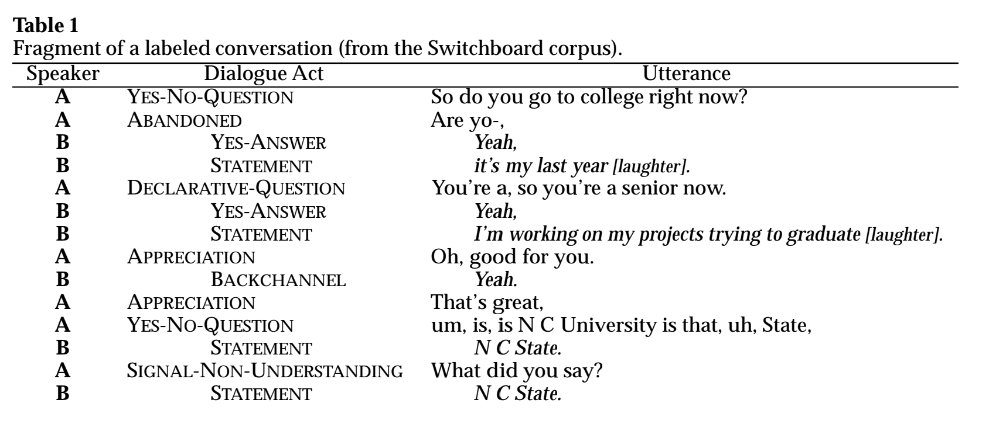
Stolcke, A., Ries, K., Coccaro, N., Shriberg, E., Bates, R., Jurafsky, D., ... & Meteer, M. (2000). Dialogue act modeling for automatic tagging and recognition of conversational speech. Computational linguistics, 26(3), 339-373.
Notes:
3 parts: speaker, DA tag, utterance (unseen: audio)

Slide 8
DA and Prosody in Switchboard Corpus
yes-no question: rising intonation
non-opinion statement:
falling intonation
greeting ("conventional-opening"): rising intonation (uncertainty?)
opinion statement:
falling intonation pattern broken to place emphasis on "better"
laughter: short, breathy bursts

Slide 9
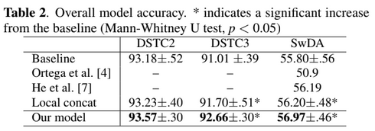
Dialog Act Classification on SwDA
2022
This model used only audio input.
Note: DSTC3 corpus has ~1/2 of the number of labels in SwDA

Slide 10
Inaccuracies in Switchboard DA Corpus
Audio data not effectively leveraged due to misalignment with text
Inaccurate utterance boundaries affect prosodic analysis of DA's
utterance duration
pitch range compression/final lowering at end of turn/topic
boundary tones at ends of phrases
Original automatic alignment skipped inarticulate/quiet words
MSU Switchboard: better alignments and transcriptions but also problems linking new transcripts to DA labels
Deshmukh, N., Ganapathiraju, A., Gleeson, A., Hamaker, J., & Picone, J. (1998). Resegmentation of SWITCHBOARD. In ICSLP.
Hirschberg, J. (2017). Pragmatics and prosody. The Oxford handbook of pragmatics, 532-549.
Shriberg, E., Stolcke, A., Jurafsky, D., Coccaro, N., Meteer, M., Bates, R., Taylor, P., Ries, K., Martin, R., & van Ess-Dykema, C. (1998). Can prosody aid the
automatic classification of dialog acts in conversational speech? Language and Speech, 41(3–4), 443–492. https://doi.org/10.1177/002383099804100410

Slide 11
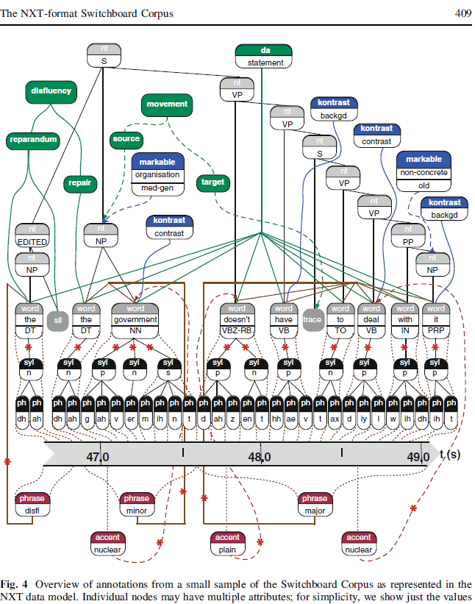
NXT Switchboard: 642/1155 SwDA conversations
Calhoun, S., Carletta, J., Brenier, J. M., Mayo, N., Jurafsky, D., Steedman, M., & Beaver, D. (2010). The NXT-format Switchboard Corpus: a rich resource for investigating the syntax, semantics, pragmatics and prosody of dialogue. Language resources and evaluation, 44, 387-419.

Slide 12
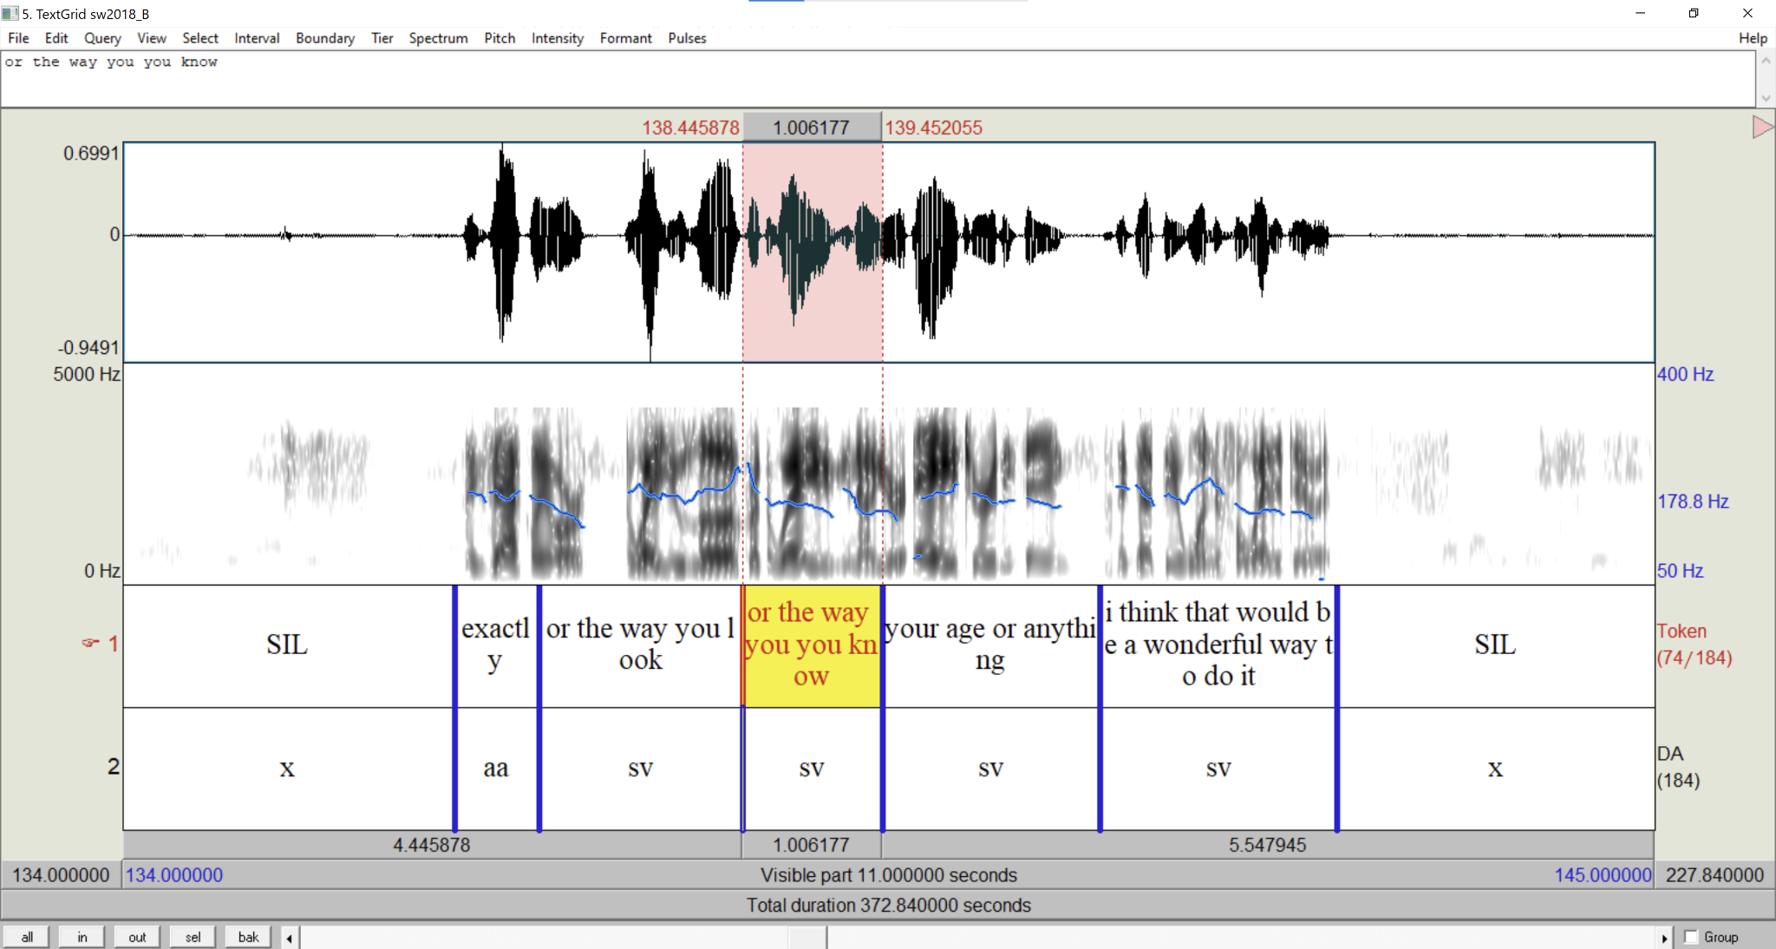
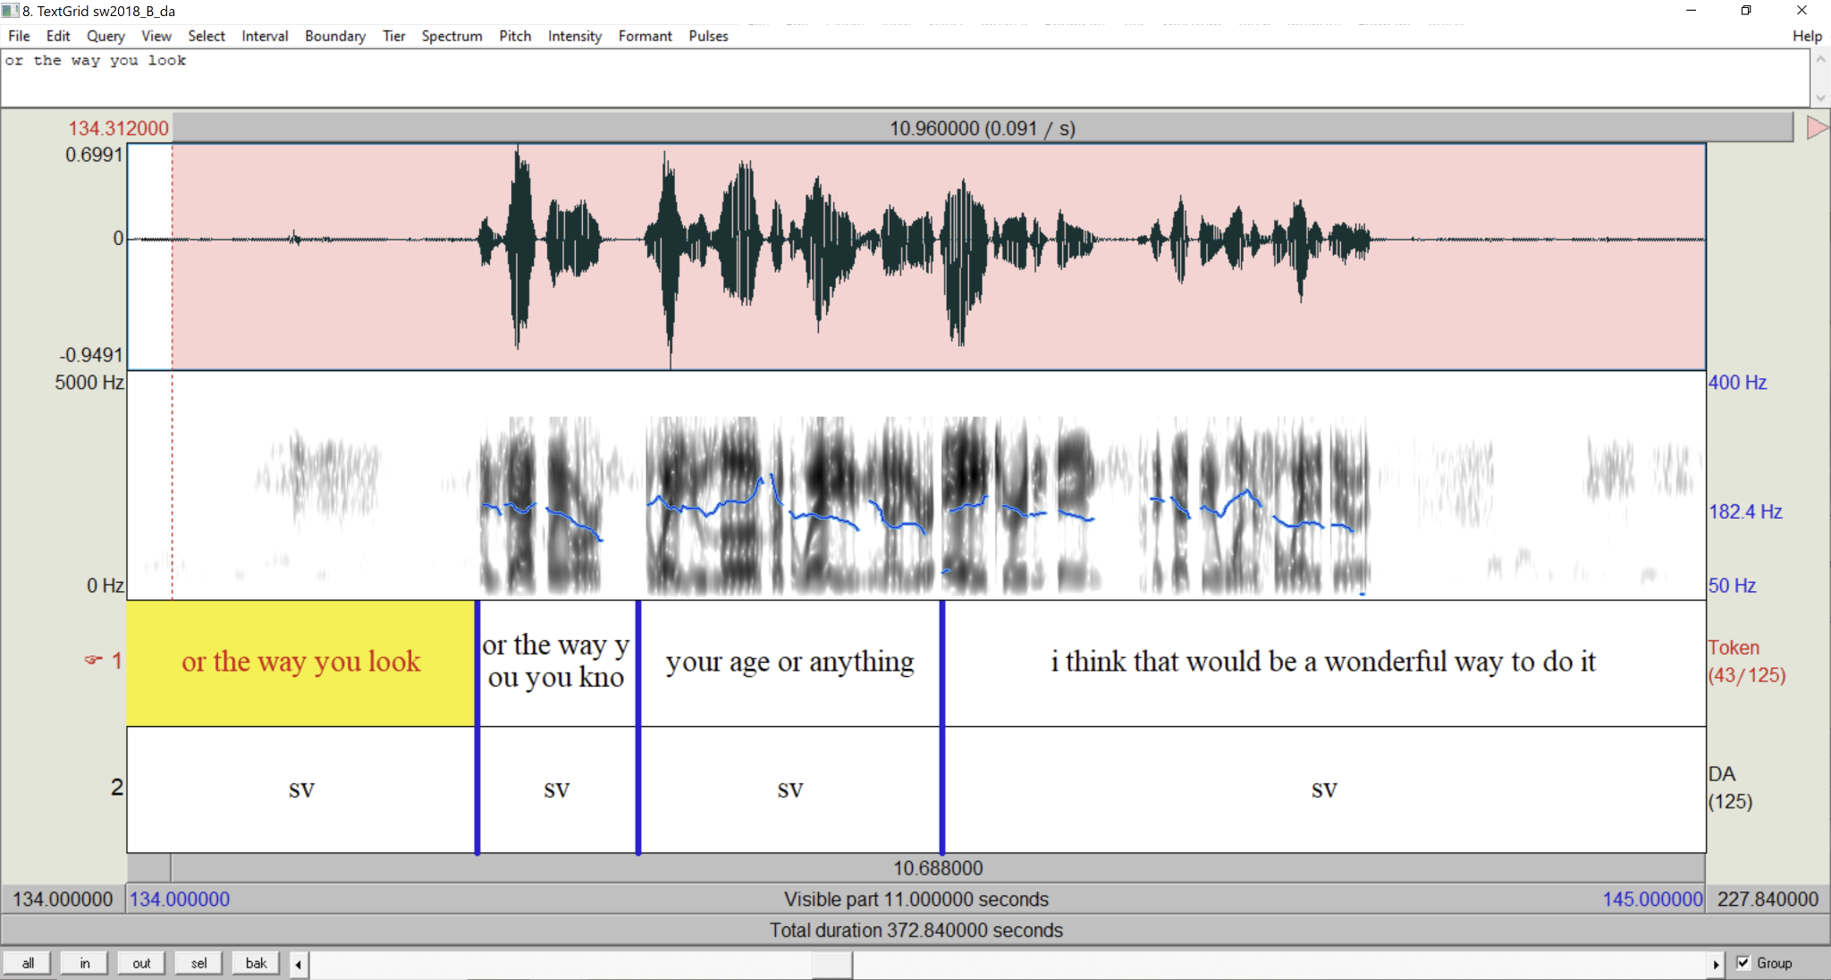
Re-Aligned Switchboard Dialog Act Corpus
Manual correction
NXT Switchboard
SwDA transcripts
+
SwDA audio
Aligned TextGrid
aeneas forced alignments (github.com/readbeyond/aeneas)

Slide 14
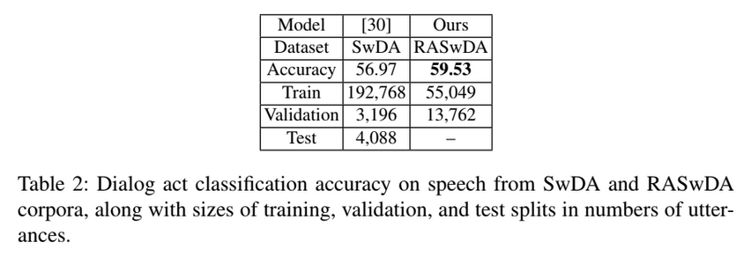
Realigned Data Improves DAC Accuracy

Slide 15
Conclusion and Future Work
Dialog systems need to accurately predict and produce dialog acts
The Switchboard Dialog Act corpus is a valuable resource for dialog modeling but has inaccuracies in its automatic alignments
Our Re-Aligned Switchboard Dialog Act (RASwDA) corpus has improved performance on DA classification from speech
We plan to continue to release the full RASwDA corpus to the wider speech community

Slide 16
Questions?
Please post on EdStem

