Slide 1
Speech Synthesis: Then and Now
Rose Sloan
CS 6998

Slide 2
Today
Early speech synthesis
What information do we need?
Now: Today’s TTS Systems
How do we evaluate a TTS System?
What problems remain for TTS?

Slide 3
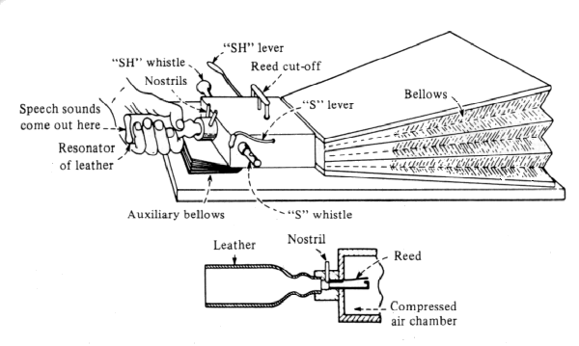
The First ‘Speaking Machine’
    Wolfgang von Kempelen, Mechanismus der menschlichen Sprache nebst Beschreibung einer sprechenden Maschine, 1791 (in Deutsches Museum still and playable)
    First to produce whole words, phrases – in many languages
Notes:
First experimental phonetician: therapeutic applications: how do humans produce speech?
First machine which could produce whole words
3 weeks to learn to ‘play’ in latin, french or italian – german was harder due to consonant clusters, closed syllables
Bellows: lungs (operated with right forearm; counterweight for inhale; aux. bellows to simulate stop release
World’s largest science museum, munich
Wind box, mouth (cover for unvoiced sounds), nostrils (cover except for nasal)
Thumb in mouth → [l]
Hissing whistlea to make sibilants
Vocal cords (ivory reed): can’t change length on the fly, so monotone only
Wire dropped on read simulated [r]

Slide 4
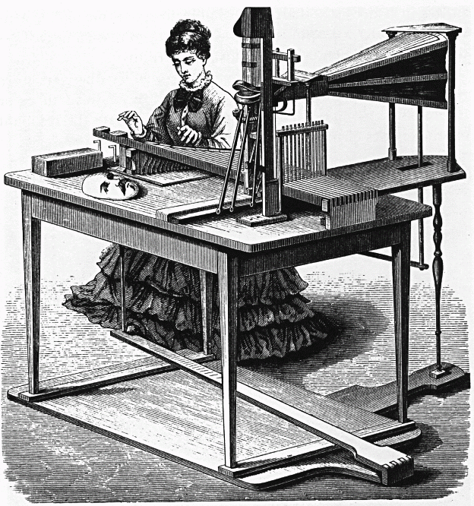
Joseph Faber’s Euphonia, 1846
Notes:
Built in 1835
Modeled tongue and pharyngeal cavity, with manual control of shape
Very good for singing
Pedal and keyboard control
Sang ‘God Save the Queen’ at public exhibition

Slide 5

Constructed 1835 w/pedal and keyboard control
  Whispered and ordinary speech
  Model of tongue, pharyngeal cavity with manipulable shape
  Singing too: “God Save the Queen”
Riesz’s 1937 synthesizer with almost natural vocal tract shape
Forerunners of Modern Articulatory Synthesis: George Rosen’s DAVO synthesizer (1958) at MIT

Slide 6
Notes:
First notable EE synthesizer, presented at World’s Fair in 1939
Requires lots of training to use

Slide 7
World’s Fair in NY, 1939
Requires much training to ‘play’
Purpose: coding/compression
  Reduce bandwidth needed to transmit speech, so many phone calls can be sent over single line

Slide 8
Notes:
First attempt to synthesise speech by breaking it down into component sounds and reproducing sound patterns electronically
Produced two sounds: a tone generated by a radio valve to produce the vocal sounds and a hissing noise produced by a gas discharge tube to create the sibilants.
These basic sounds passed through a set of filters and an amplifier that mixed and modulated them

Slide 9
Notes:
Goal: investigating speech perception
Inverse of spectrograph: from spectral information to speech
Lamp produces light ray directed against rotating disk with 50 concentric tracks whose transparence varies systematically to produce 50 partials (pure tones) w/f0 of 120 hz – transparences rep sound pressures
Light also projected against spectrogram whose reflectance corresponds to sound pressure level of each partial
Variation in light converted into variation in sound pressure
Spectrogram passed thru light on rollers to reproduce the speech of the spectrogram
Can create ‘fake’ spectrograms to produce new speech
How are different spectral features perceived?
Last used for an experimental study by Robert Remez in 1976!

Slide 10
Answers:
  These days a chicken leg is a rare dish.
  It’s easy to tell the depth of a well.
  Four hours of steady work faced us.
‘Automatic’ synthesis from spectrogram – but can also use hand-painted spectrograms as input
Purpose: understand perceptual effect of spectral details

Slide 11
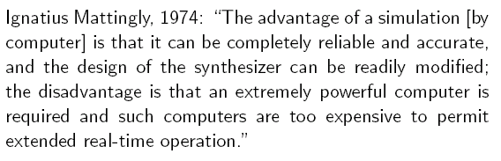
Synthesis by Computer
Beginnings ~1960; dominant from 1970—

Slide 12
Requirements for a TTS System
Knowledge
Task
World Knowledge
Syntax, semantics, lexicon
Phonetics/phonology
Acoustics/signal processing
Text Normalization
Pronunciation, intonation assignment
Duration, f0, spectral features
Waveform production
Notes:
The children read to Dr. Smith.

Slide 13
Overview: Synthesizer I/O
Front End: From input to control parameters
  Acoustic/phonetic representations, naturally occurring text, constrained mark-up language, semantic/conceptual representations
Back End: From control parameters to waveform
  Articulatory, formant/acoustic, concatenative, (diphone, unit-selection/corpus, HMM, DNN) synthesis

Slide 14
Requirements for a TTS System
Front End:
  Pronunciation Modeling
  Text Normalization
  Intonation, Duration, F0 Assignment
Back End:
  Waveform Production

Slide 15
Front End and Back End
2/19/24
Speech and Language Processing Jurafsky and Martin
15
PG&E will file schedules on April 20.
TEXT ANALYSIS: Text to intermediate representation:
WAVEFORM SYNTHESIS: From intermediate representation to waveform
Notes:
15

Slide 16
Pronunciation Issues
Rules for disambiguation in context: bass, desert
Lexicon: comb, tomb, Punxsutawney Phil
  Letter-to-Sound Rules
    Hand built
    Learned from data (pronunciation dictionary)
    Hard to get good accuracy and coverage – many exceptions
  Pronunciation Dictionary
    More accurate but…
    Out-of-Vocabulary words a problem (e.g. proper names)

Slide 17
Text Normalization Issues
Homographs, numbers, abbreviations
  Reading is what he hates most.
  Reading is the place he hated most.
  The NAACP just elected a new president.
  NASA is the U.S. space agency.
  In 1996 she sold 2010 shares and deposited $42 in her 401(k).
  The duck dove supply.
  How to pronounce emojis? (ASR yes but TTS??)

Slide 18
Intonation Assignment Issues: Phrasing
Traditional: hand-built rules
  Use punctuation: 234-5682; New York, NY
  Context/function word: no breaks after function word: He went to dinner. He came to and stayed to dinner.
  Syntax: She favors the nuts and bolts approach. She went home and Dave stayed.
Current: machine learning on large labeled corpus

Slide 19
Intonation Assignment Issues: Accent
Hand-built rules
  Function/content distinction:
    They called in (particle) the doctor/They called in (preposition) the afternoon.
  Complex nominals:
    Main Street/Park Avenue
    City hall – parking lot -- city hall parking lot (stress shift)
Statistical procedures trained on large corpora
  Need lots of data – but why learn what you already know?

Slide 20
Intonation Assignment Issues: Contours
Simple rules
  ‘.’ = declarative contour, wh-question
  ‘?’ = yes-no-question contour unless wh-word present at/near front of sentence
    Is your name Caroline? What’s your name.
Pretty monotonous in long stretches of speech
Problem: no one knows how to assign other contours from text… yet

Slide 21
How do we get from Text to Speech?
TTS Back End takes segments+f0+duration information derived from Front End and creates a waveform
A full system needs to go all the way from random text to sound in real time
2/19/24
21
Notes:
21

Slide 22
Waveform Generation
Articulatory Synthesis: Model movements of articulators and acoustics of vocal tract
Formant Synthesis: Start with acoustics, create rules/filters to create each formant
Concatenative Synthesis: Diphone or Unit Selection using databases to store speech segments
Parametric Synthesis: ML-based learning methods
End2End Models
2/19/24
Text from Richard Sproat slides
22
Speech and Language Processing Jurafsky and Martin
Notes:
22

Slide 23
Formant/Resonance/Acoustic Synthesis
Parametric or resonance synthesis
  Specify minimal parameters, e.g. f0 and first 3 formants
  Pass electronic source signal thru filter
    Harmonic tone for voiced sounds
    Aperiodic noise for unvoiced
    Filter simulates the different resonances of the vocal tract
  Walter Lawrence’s Parametric Artificial Talker (1953) for vowels and consonants
  Gunnar Fant’s Orator Verbis Electris (1953) for vowels
  Formant synthesis download (M$demo)
Notes:
Demo if you have a windows machine

Slide 24

Later Formant Synthesizers
Most common commercial systems were formant synthesizers in early days (while computers relatively underpowered)
1979 MIT MITalk (Allen, Hunnicut, Klatt)
1983 DECtalk system
  Voice of Stephen Hawking
2/19/24
Speech and Language Processing Jurafsky and Martin
24
Notes:
24
Theoretical physicist who lost his voice due to Amyotrophic lateral sclerosis (ALS) or Lou Gerig’s disease – DecTalk’s perfect paul voice (Dennis Klatt)

Slide 25
Concatenative/Unit Selection Synthesis
Most common commercial TTS until recently
First practical application in 1936: British Phone company’s Talking Clock
  Optical storage for words, part-words, phrases
  Concatenated to tell time
And a ‘similar’ example from Radio Free Vestibule (1994)
Bell Labs TTS (1977) (1985)
Notes:
RFV comedy troup: tape and editing are phone concatenations. Is it a fake?

Slide 26
Variants of Concatenative Synthesis
Inventory units
  Diphone synthesis (e.g. Bell Labs, Festival)
  Microsegment synthesis
  “Unit Selection” – large, variable units
Issues
  How well do units fit together?
  What is the perceived acoustic quality of the concatenated units?
  Is post-processing on the output possible, to improve quality?

Slide 27

Concatenative Synthesis
Diphone Synthesis
  Units are diphones; middle of one phone to middle of next.
  Why? Middle of phone is steady state.
  Record 1 speaker saying each diphone in different contexts
Unit Selection Synthesis
  Larger units
  Record 10 hours or more, so have multiple copies of each unit
  Use search to find best sequence of units
2/19/24
Speech and Language Processing Jurafsky and Martin
27
Notes:
27
accuvoice

Slide 28
Voice
Speaker
  Must have all needed audio recorded by a single professional speaker
  Called voice talent
  How to choose?
Diphone database
  Called a voice
  Modern TTS systems have multiple voices
2/19/24
Speech and Language Processing Jurafsky and Martin
28
Notes:
28

Slide 29
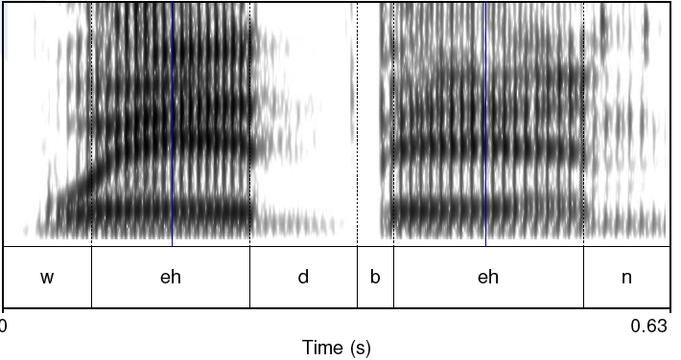
Diphones
2/19/24
Speech and Language Processing Jurafsky and Martin
29
Where is the stable region?
Notes:
29

Slide 30
Unit Selection Synthesis
Generalization of the diphone intuition
  Larger units
    From diphones to phrases to …. sentences
  Record many copies of each unit
    E.g., 10 hours of speech instead of 1500 diphones (a few minutes of speech)
  Label diphones and their midpoints
2/19/24
30
Notes:
30

Slide 31
Unit Selection Intuition
Given a large labeled database, find the unit that best matches the desired synthesis specification
What does “best” mean?
  Target cost: Find closest match in terms of
    Phonetic context
    F0, stress, phrase position
  Join cost: Find best join with neighboring units
    Matching formants + other spectral characteristics
    Matching energy
    Matching F0
2/19/24
Speech and Language Processing Jurafsky and Martin
31
Notes:
31

Slide 32
Unit Selection Summary
Advantages
  Quality far superior to diphones: fewer joins, more choices of units
  Natural prosody selection sounds better
Disadvantages:
  Quality very bad when no good match in database
    HCI issue: mix of very good and very bad quite annoying
  Synthesis is computationally expensive
  Hard to control prosody
    Diphone technique can vary emphasis
    Unit selection can give result that conveys wrong meaning
2/19/24
32
Notes:
32

Slide 33
TTS Demos (all Unit-Selection)
2/19/24
33
Festival
  Festival early voice
Cepstral
  https://www.cepstral.com/en/demos
AT&T
  http://www.wizzardsoftware.com/text-to-voice.php
Notes:
33
http://research.spa.aalto.fi/publications/theses/lemmetty_mst/appa.html

Slide 34
Parametric Synthesis
Uses ML to predict acoustic features based on statistics learned from data
Can change voice quality by updating model parameters
Can train on mixed data from many speakers
Model takes up a very small amount of space
Speaker adaptation possible

Slide 35
Types of Parametric Synthesis
Hidden Markov Model Synthesis
  Sounds less natural to researchers but naïve subjects preferred
  Best non-neural parametric system
Neural Net Synthesis
  Can capture more complex relationships
  Began to overcome naturalness issues
2/19/24
Speech and Language Processing Jurafsky and Martin
35
Notes:
35

Slide 36
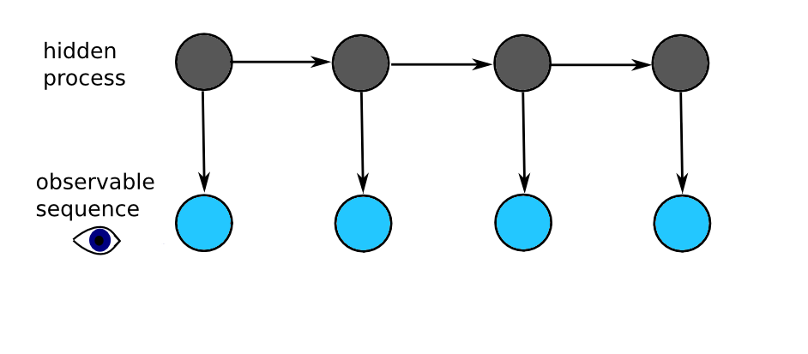
Idea Behind HMMs
There is some hidden process that has generated some audible observation – learn that process from observed audio

Slide 37
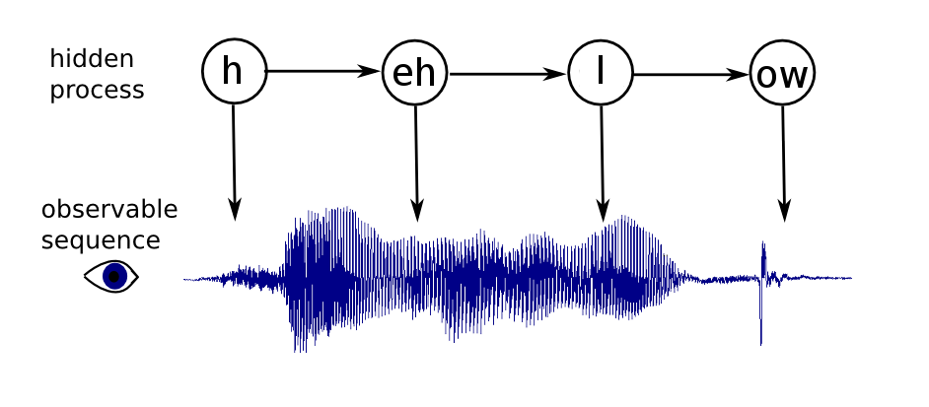
Learning from Data
Some hidden process has generated some audible observation.

Slide 38
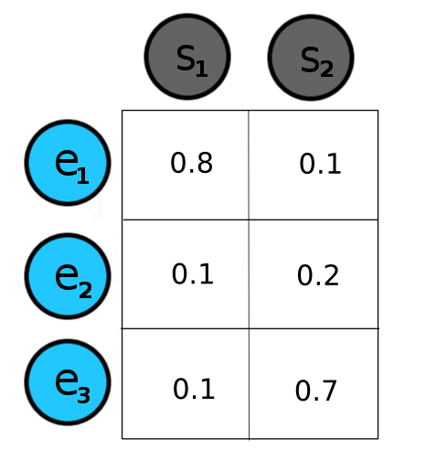
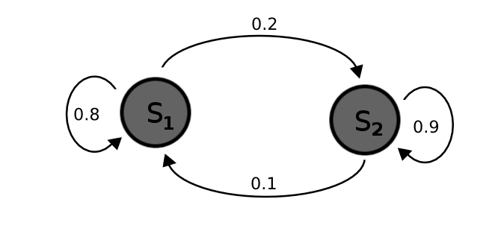
HMMs
Hidden states have transition probabilities and emission probabilities.

Slide 39
HMM Synthesis
Every phoneme+context is represented by an HMM
  The cat is on the mat.
  The cat is near the door.
Sample < phone=/th/, next_phone=/ax/, word='the', next_word='cat', num_syllables=6, .... >
Acoustic features extracted that are aligned with this: f0, spectrum, duration
Train full HMM with examples like these
Notes:
Every phoneme+context is represented by an HMM.
The cat is on the mat.
The cat is near the door.
< phone=/th/, next_phone=/ax/, word='the',
next_word='cat', num_syllables=6, .... >
Acoustic features extracted: f0, spectrum, duration
Train HMM with these examples.

Slide 40
HMM Synthesis Issues
Many contextual features = data sparsity
So…. cluster similar-sounding phones
  e.g: 'bog' and 'dog’
  the /aa/ in both have similar acoustic features, even though their context is a bit different
Make one HMM that produces both, and is trained on examples of both
Notes:
Many contextual features = data sparsity
Cluster similar-sounding phones
e.g: 'bog' and 'dog'
the /aa/ in both have similar acoustic features, even though their context is a bit different
Make one HMM that produces both, and was trained on examples of both.

Slide 41

HMM Synthesis
Unit selection (Roger)
HMM (Roger)
Unit selection (Nina)
HMM (Nina)
2/19/24
Speech and Language Processing Jurafsky and Martin
41
Notes:
41

Slide 42
Towards a Better System
Naturalness is lacking in HMM-based systems
Data sparsity/clustering leads to a lot of “averaging” effects
Is there a better way to represent the complex non-linear relationship between input text features and output acoustic features?

Slide 43
Neural nets
Notes:
Describing neural nets in detail is far outside the scope of this class, but the basic concept is that we transform an input vector through a series of nonlinear transformations into an output vector.
Neural nets are very good at learning patterns from large amounts of data – very commonly used in speech these days
Merlin uses an LSTM-based model

Slide 44
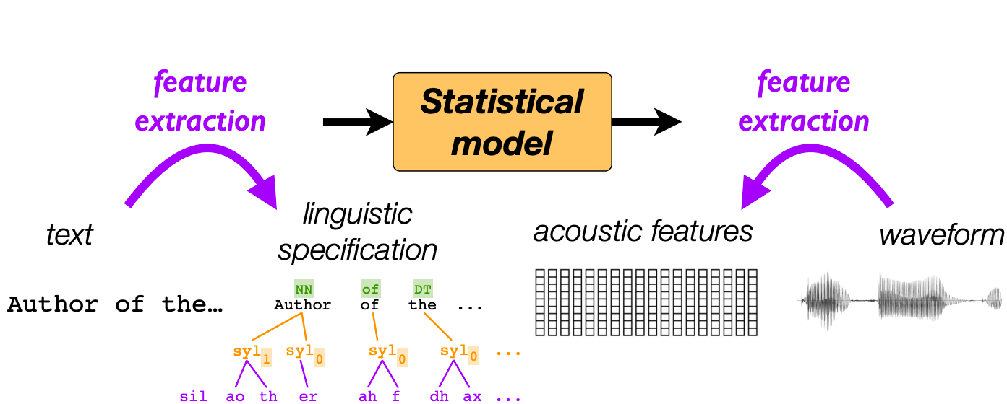
Merlin and Neural Net Synthesis
An open source toolkit for TTS synthesis from Edinburgh University
Map linguistic features to acoustic features using a neural net

Slide 45
Input Vectors
Each phone has a number of features:
  Current phone
  Surrounding phones
  Position in syllable/word/sentence
  Stress
  Etc.
We can add any linguistic features we wish to incorporate
Notes:
Output vectors are the same acoustic features as HMM-based synthesis, but what are the input vectors?

Slide 46
The model
phone vectors
duration model
linguistic frames
acoustic model
acoustic frames
Notes:
Two steps (each a NN): duration model determines length of phone and duplicates it into the correct number of frames, acoustic model converts phone vector + position into same acoustic features as HMM

Slide 47

Some Merlin Samples
Trained on a few hours of news data
Official demos: https://cstr-edinburgh.github.io/merlin/demo.html

Slide 48
Towards End-to-End
HMM systems and Merlin both have a lot of separate components (front end processing, acoustic model, vocoding)
Errors can propagate throughout, leading to drops in quality
Can we eliminate some (or all) of these separate steps?

Slide 49
WaveNet
Replaces the vocoder by using CNNs to predict waveforms directly
Requires massive data and processing power: 16,000 samples per second
Much better performance than previous parametric or concatenative systems
parametric
concatenative
WaveNet

Slide 50
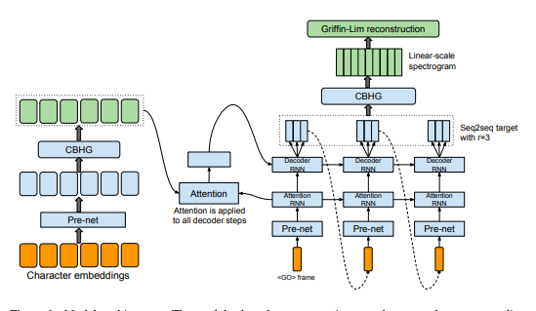
Tacotron: Truly End-to-End

Slide 51
Tacotron
Seq2seq model: Map input sequence of characters or phones to output sequence (spectrogram)
Basic architecture
  Encoder: various layers to model n-grams and get high-level features
  Attention: alignment between input and output
  Decoder: attention results to output
  Spectrogram to waveform: reconstruction or WaveNet
Notes:
CBHG (part of other things): convolution (models n-grams), highway network (get high level features), GRU RNN (get sequential features from context)

Slide 52
Tacotron Results
Tacotron 2 with WaveNet is nearly as good as human speech

Slide 53
Why is Tacotron so good?
Autoregression
  Audio at each time step is directly conditioned on the audio from the previous time step
Front end
  Neural nets are mostly better at learning contextual features
Attention
  Use attention to do alignment vs. HMMs
  Only minor improvements: attention is actually probably too powerful

Slide 54
TTS Evaluation
Intelligibility Tests
Mean Opinion Scores
Preference Tests
2/19/24
Speech and Language Processing Jurafsky and Martin
54
Notes:
54

Slide 55
Intelligibility Tests
Diagnostic Rhyme Test (DRT)
  Listening test
  Listeners choose between two words differing by a single phonetic feature (voicing, nasality, sustenation, sibilation)
  DRT: 96 rhyming pairs
    Dense/tense, bond/pond, …
      Subject hears dense, chooses either dense or tense
      % of correct answers is intelligibility score
  Problem: Only tests single word synthesis

Slide 56
Intelligibility Tests (cont.)
Modified DRT:
  300 words, 50 sets of 6 words (went, sent, bent, tent, dent, rent)
  Embedded in carrier phrases:
    Now we will say dense again
Semantically Unpredictable Sentences
  Can listeners transcribe grammatical but nonsensical sentences?
    “The medium blackbird froze the delicate candidate”

Slide 57
Naturalness tests
Mean Opinion Score
  Have listeners rate output on a scale from 1 (bad) to 5 (excellent)
Preference tests:
  Reading addresses out loud, reading news text, using two different systems or systems against human voice
  Do a preference test (prefer A, prefer B)

Slide 58
TTS Today
End-to-end systems have led to very good neutral synthesis, but we have a ways to go
Mostly RNN-based—very slow to train
Low-level control for prosody and other features has become difficult—can we fix this?
Current methods require large amounts of data
What about low-resource languages?

Slide 59
TTS for Low-Resource Languages
Speech technology has become ubiquitous
~6,500 languages spoken in the world
Conventional TTS data is expensive and time-consuming to collect
Can we make use of data which was created or collected for another purpose?
Which language-specific traits are important for TTS?
Case study: Amharic gemination

Slide 60


A Case Study: Amharic አማርኛ
የዜግነት ክብር በ ኢትዮጵያችን ጸንቶ
ታየ ሕዝባዊነት ዳር እስከዳር በርቶ
ለሰላም ለፍትህ ለሕዝቦች ነጻነት
በእኩልነት በፍቅር ቆመናል ባንድነት
መሠረተ ፅኑ ሰብዕናን ያልሻርን
ሕዝቦች ነን ለሥራ በሥራ የኖርን
ድንቅ የባህል መድረክ ያኩሪ ቅርስ ባለቤት
የተፈጥሮ ጸጋ የጀግና ሕዝብ እናት
እንጠብቅሻለን አለብን አደራ
ኢትዮጵያችን ኑሪ እኛም ባንቺ እንኩራ።
The second most widely spoken of
90 languages of Ethiopia
21.6 million native speakers
Official language
Semitic language family
Ge’ez script (abugida)
Gemination: long consonants are
contrastive

Slide 61
Datasets
IARPA BABEL 307b- v1.0b full language pack
  40 hours of conversational speech from 300 different speakers
  10 hours of scripted speech from 230 different speakers
  Telephone
AudioBible
  55 hours of read speech from one male speaker
Amharic Read Speech corpus (ARS)
  University of Hamburg collected for ASR
  20 hours of read speech, 44 female speakers, 56 male speakers

Slide 62
Gemination in Amharic
Long consonants are contrastive
Long consonants are not indicated in the orthography
~15% of consonants are geminates
Lexical gemination:
  Can only be distinguished by context
  ገና /gəna/ = ‘still/yet’; /gənna/ = ‘Christmas’
  Infrequent
Morphological gemination:
  Can be inferred from morphology
  ስበረው /s11bǝrǝw/, ‘break (masc.sing.) it’
  ይሰበራሉ /y1ssǝbbǝrallu/, ‘they are broken’
Notes:
https://www.jstor.org/stable/44324700?read-now=1&seq=6#metadata_info_tab_contents

Slide 63
Gemination Experiments
Gemination (consonant length variation) is an essential component of natural Amharic speech
Extracted consonant length variation from training voices to add gemination to labels
Trained models using updated labels
New voices preferred by native speakers (76%)
Next: prosodic variation….

Slide 64
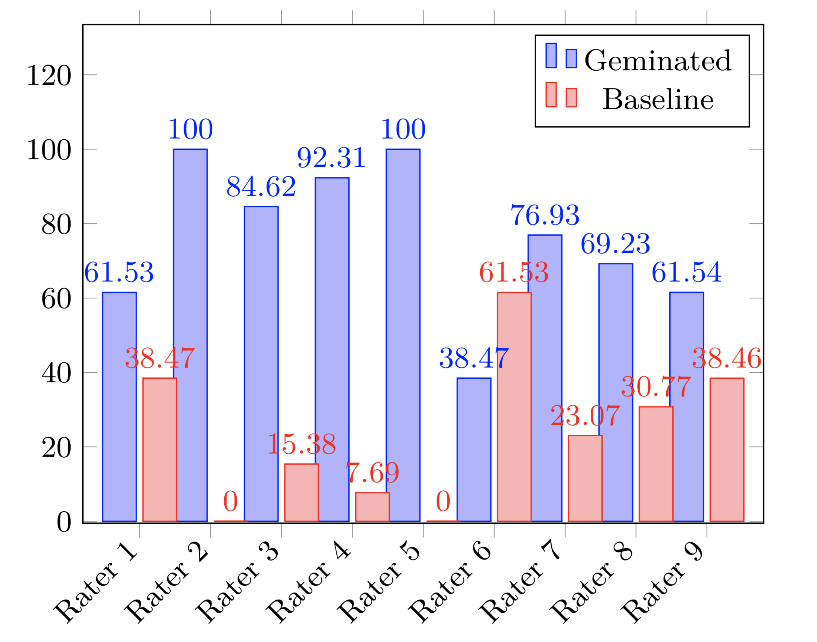
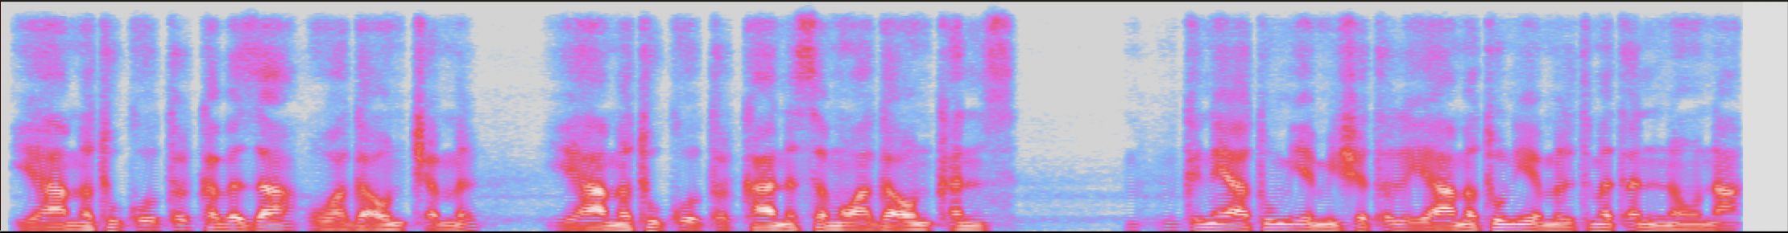
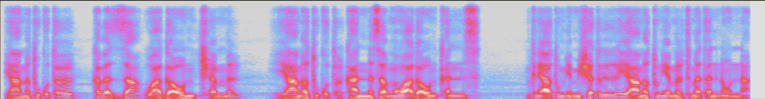
Gemination Helps Naturalness
77.7% (p=2.7 × 10⁻¹⁰) preference for the voice with gemination over the voice without gemination.
Non-geminated
Geminated

Slide 65
Prosody Modeling for TTS
End-to-end TTS is a lot more natural than previous approaches!
However, it can make explicitly modeling prosody very difficult, since prosody modeling is hard to disentangle
Fine-grained control especially difficult
Several approaches exist

Slide 66
Prosodic Event Modeling
One approach: explicitly model ToBI features (phrase break and pitch accent) in the TTS pipeline
Can predict these features from text using linguistic features (syntax, word embeddings, coreference, etc.)
Can add ToBI events into a TTS front end
Alternate approaches instead include linguistic features in front end (can include more subtle prosodic variations but gives less direct control)

Slide 67
Style Embeddings and Sentence-Level Prosody
End-to-end makes it easy to condition speech on “style embeddings”
Makes it easy to transfer prosody from one utterance to another
Flexible uses
Can also use similar approaches on the back end to provide prosodic variation

Slide 68
Takeaways
TTS is a field with a rich history
Today, neural net based end-to-end systems can produce really high quality output
Challenges still remain for low-resource languages and for prosody modeling (and much more!)

