Slide 1
Acoustics of Speech
Julia Hirschberg
CS 6998

Slide 2
Assignments
If you were unable to do the Week 2 assignment last week for any reason, please do the Week 2 (late for students signing up late) asap -- how many of you does this include?
Please do remember to provide 100 words each for positive and also for each negative responses for each assigned Chapter/subchapter or paper
If you have any questions about an Assignment or a Homework or anything else involving this course, please first look at the threads on Ed Discussion.
  If you don’t see an answer to your question then do post on Ed Discussion and we’ll respond promptly

Slide 3
Reminder: Sample Assignment from an earlier course for Jurafsky & Martin on Dialogue
Positive aspects:
I found this chapter interesting and enjoyed learning about the various
approaches of building dialogues systems: rule based, corpus-based, sequence to sequence Chatbot and more. One of the things I appreciated the author including were ethical issues concerned with building dialog systems. They were very important issues raised such as the tendency for agents to have female names, biases in the training data and even more fascinating how users can corrupt an agents’ knowledge as in the case of Microsoft Tau making reinforcement learning a double edge-sword. In other words, while reinforcement learning can help chat-bots better personalize to a user it can also be trained to reflect discriminative opinions of the user.

Slide 4
Negative aspects:
One of the things that I felt was incomplete was in understanding turn-taking. How can the system know when the user is done speaking? Are there prosodic cues such as the F0 contour that can help the system to avoid overlapping speech with the user, causing the agent to miss out on important information? On the note of prosody, in most conversations the emotional state and the intent of a speaker can inform the type of response that is desired. How can a system deal with a situation when a user is sarcastic of frustrated in a conversation? How can it detect this and how should it respond?
Challenge Question: Are there cues besides F0 contour that can help the system avoid overlapping speech with the user, which might cause the agent to miss out on important information?
Please do present your assignments in this form for each reading assigned, although the Challenge Question is assigned only for some

Slide 5

Goal 1: Distinguishing One Phoneme from Another, Automatically
ASR: Did the caller say ‘I want to fly to Newark’ or ‘I want to fly to New York’?
Forensic Linguistics: Did the accused say ‘Kill him’ or ‘Bill him’?
What evidence is there in the speech signal?
  How accurately and reliably can we extract it?
  Let’s look at the waveform and spectrogram
Notes:
ATIS corpus for ASR: dialogue system for travel arrangements: record something not so clear about N*
Record bill and kill?

Slide 6
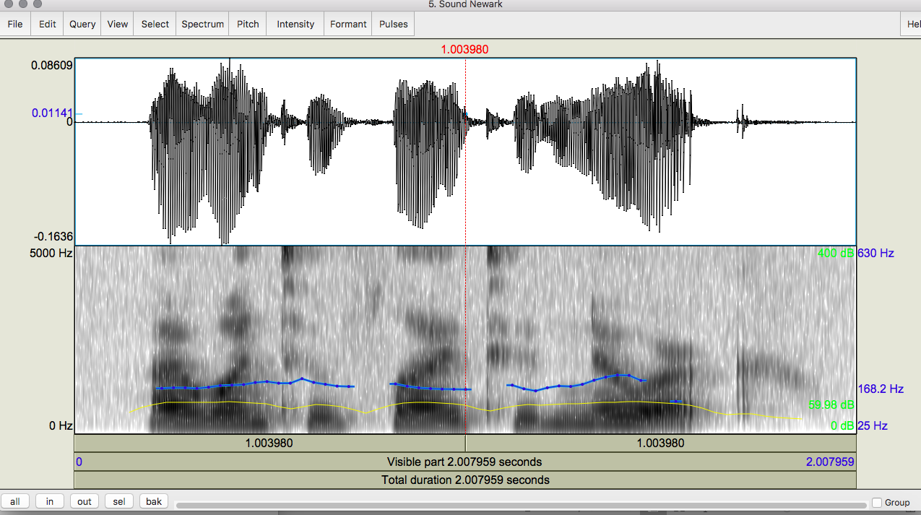
Notes:
I want to fly to Newark: waveform at the top and spectrogram at the bottom. The spectrogram also has information here on pitch (blue) and intensity (yellow)

Slide 7
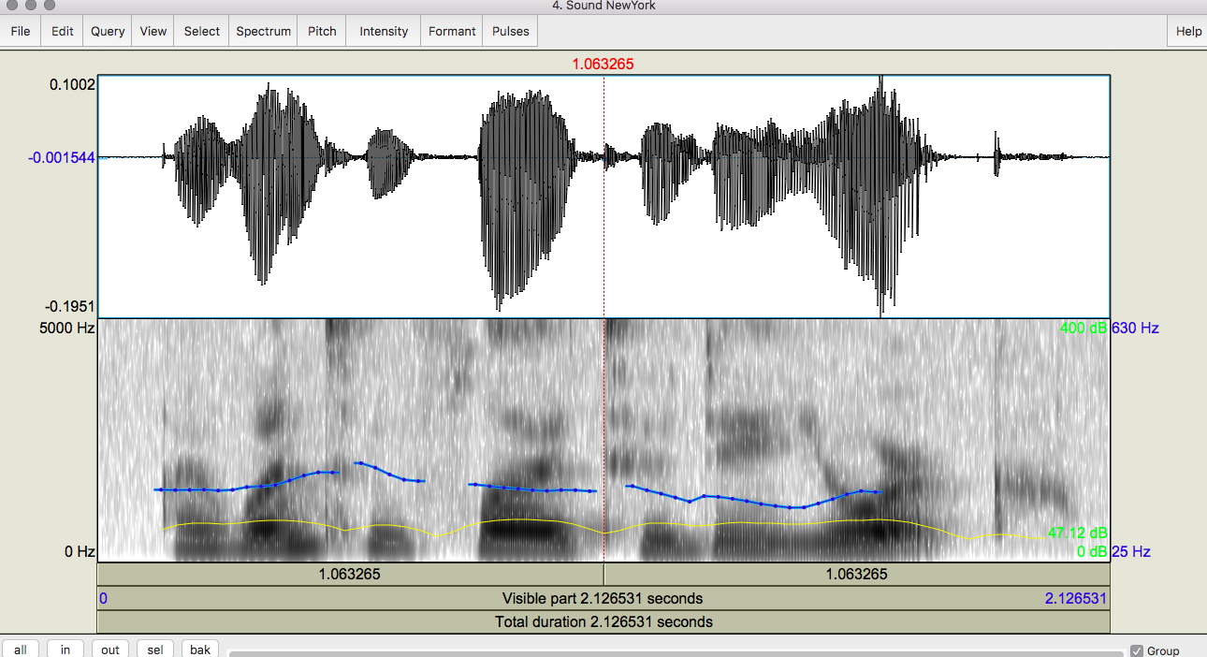
Notes:
I want to fly to New York

Slide 8
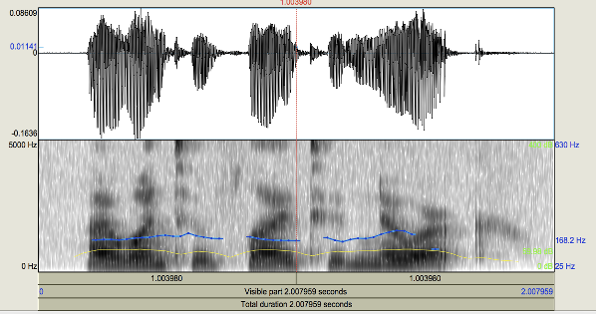
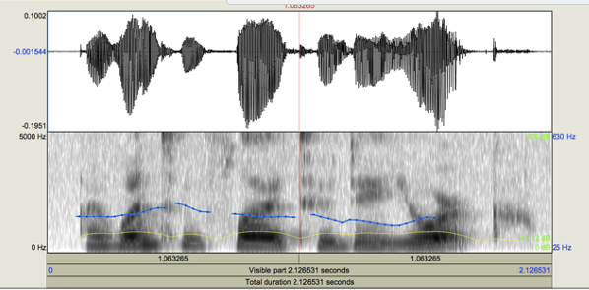
Notes:
Let’s compare the 2: where do you see the differences? I want to fly to Newark/New York.

Slide 9
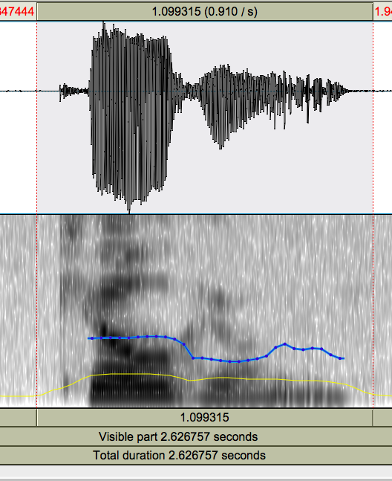
Notes:
Here’s another wav form and spectrogram. Kill – voiceless stop with VOT (voice onset time) from the beginning of “k”

Slide 10
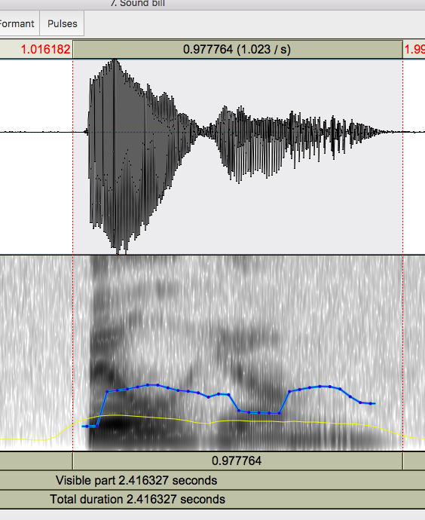
Notes:
Bill him – voiced consonant, no VOT (voice onset time)

Slide 11
Goal 2: Determining How things are said is sometimes critical to understanding what is intended by the speaker
Intonation
  Forensic Linguistics: ‘Kill him!’ or ‘Kill him?’
  TTS: ‘Are you leaving tomorrow./?’
  What information do we need to extract from or generate in the speech signal?
  What tools do we have to do this?
Notes:
What are the differences? For kill: “I’m telling you what to do” “I’m asking if you want to do it” “I’m surprised that you want to kill this particular person”
For leaving: ”I’m pretty sure you are leaving tomorrow” “I don’t know if you’re leaving tomorrow”

Slide 12
Today and Next Class
How do we define cues to segments and intonation?
  Fundamental frequency (pitch)
  Amplitude/energy (loudness/intensity)
  Spectral features (formant frequencies)
  Timing (pausing, speaking rate)
  Voice Quality (jitter, shimmer, HNR)
How do we extract them?
  Praat (or parselmouth)
  openSMILE
  libROSA…
Notes:
Formant frequencies correspond to resonances in the vocal tract

Slide 13
Today
Sound production
Capturing speech for analysis
Feature extraction
Spectrograms

Slide 14
Sound Production
Pressure fluctuations in the air can be caused by a musical instrument, a car horn, a voice…
  Sound waves propagate thru the air like marbles thrown in a lake: slow, stone-in-lake ripples
  Cause our eardrums (tympanum) to vibrate
  Our auditory system translates these into neural impulses
  Our brain then interprets these as sounds
  We can plot these sounds as changes in air pressure over time
From a speech-centric point of view, sound not produced by the human voice is noise
  Ratio of speech-generated sounds to other simultaneous sounds: Signal-to-Noise Ratio (SNR)
Notes:
SNR: compares signal power to background noise, expressed in decibels – ratio higher that 1:1 indicates more signal than noise
HNR: measures ratio between periodic and non-periodic speech, important in measuring pathologic voices

Slide 15
    For example, when people are speaking while music is playing or cars are running by or a tea kettle is brewing or a dog is barking or any sort of non-speech noise is in the background of a phone call we examine the SNR
    If this ratio is high then there is a stronger speech signal and the speech itself can be analyzed more accurately
  Harmonic to Noise Ratio (HNR) measures the ratio between periodic and a-periodic speech components (speech waveforms that show repeating patterns over time vs. those that do not) in distorted or unnatural speech
    For example, when people with dysarthria, apraxia, aphasia, autism, stuttering try to speak but have trouble speaking clearly
  What do we do to measure speech?

Slide 16
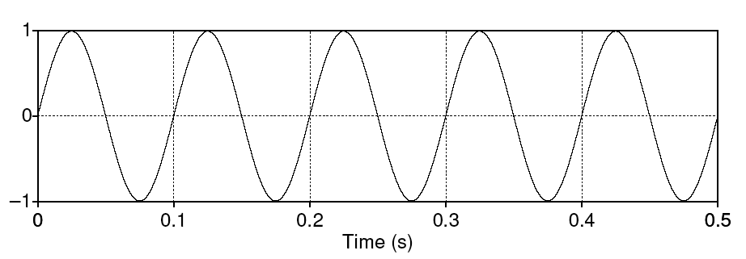
Simple Periodic Speech Waves
Characterized by their frequency (x-axis) and amplitude (y-axis)
Frequency (f) – # of cycles per second
Amplitude – maximum value in y axis
Period (T) – time it takes for one cycle to complete (.1)
Notes:
Frequency = 5 cyles /.5 sec = 10 Hz
Amplitude = 1
Period (T) = .1 sec

Slide 17
One Period
Characterized by both frequency and amplitude
Frequency (f) – cycles per second
Amplitude – maximum value in y axis
Period (T) – time it takes for one cycle to complete
Notes:
The x axis provides the length of a period and the number of periods in time
The y axis provides the amplitude of the sound
How high is our voice (frequency) and how loud is it (amplitude)

Slide 18
Speech is Composed of Complex Periodic Waves
Cyclic but composed of multiple sine waves
  Fundamental frequency (F0): rate at which largest sine wave pattern repeats (also called Hertz or Hz)
  Harmonics: waves with a frequency that is a positive integer multiple of the frequency of the F0, which is typically called the first harmonic
Any complex waveform can be analyzed into its component sine waves with their frequencies, amplitudes, and phases using the Fourier Transform
  Fourier analysis allows us to evaluate amplitude, phases, and frequencies of data
Notes:
Heinrich Hertz, a German physicist who studied electromagnetic waves in the 1880s

Slide 19
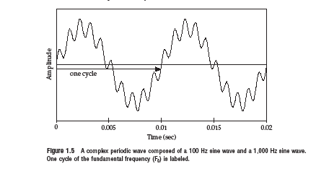
2 Sine Waves Combining to Form 1 Complex Periodic Wave
Notes:
Here’s an example of a very simple complex periodic wave form. We can see the F0 or first harmonic by tracing over one repetition of the form with fewest repetitions and the second harmonic by tracing over a repetition of the one with more repetitions

Slide 20
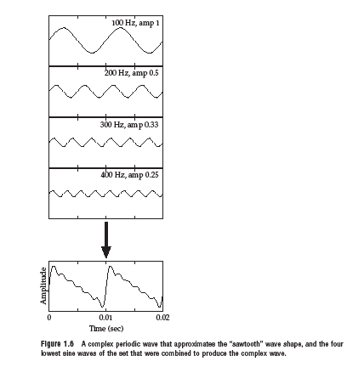
4 Sine Waves→ 1 Complex Periodic Wave
Notes:
Here’s an example of a more “normal” complex periodic wave showing each of the sine waves separately and together. Note from their y axes that each does have different amplitudes too from the top (highest, 1) to the bottom (.25)

Slide 21
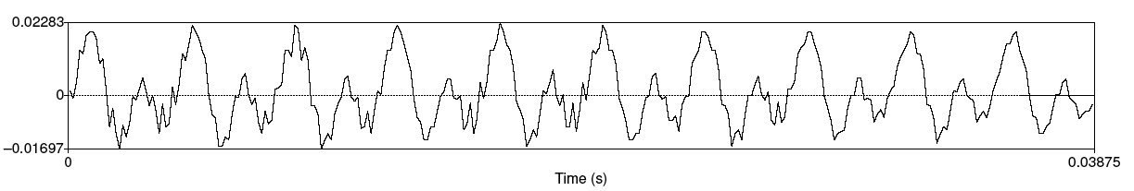
Speech Sound Waves: /iy/
X-axis: time
Y-axis: air pressure above (+ Compression), at (0 Normal air pressure) and below (- Rarefaction (decompression)) normal air pressure
Combined sound waves of different frequencies
Notes:
Here you can see that it’s easiest to identify the F0 (first harmonic) but you can also see that there are other sine waves which continue throughout.

Slide 22
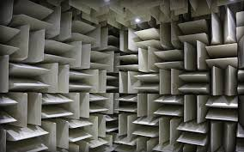
How do we Capture Speech for Analysis?
Recording conditions: Quiet office, head-mounted mic, sound booth, or anechoic chamber

Slide 23
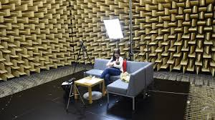
Notes:
We had one larger than this at Bell Labs but typically used smaller ones to record speech we needed to train our TTS systems.

Slide 24
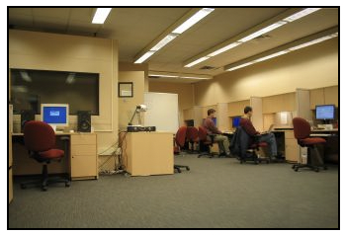
A Smaller Sound Booth in our Speech Lab
Notes:
8” x 8.51 and 8.4’ high
This is one we used at Bell Labs which I was given when I came to Columbia and they created my Speech Lab, CEPSR 7LW3 now.

Slide 25
What do we need to Capture Speech Well?
Good recording conditions (quiet space, close-talking microphone): please remember this when recording your own voice!
Microphones convert sounds into electrical current: oscillations of air pressure become oscillations of voltage in an electric circuit
  Analog devices (e.g. tape recorders) store these as a continuous signal
  Digital devices (e.g. computers, Digital Audio Tape (DAT) systems) first convert continuous signals into discrete signals (digitizing)
    Now … cell phones and head-mounted microphones… as well
Notes:
DAT systems were developed by Sony in 1980s. There was much pushback in the U.S. by the Recording Industry Association of America (RIAA) because of their ability to copy LPs, CDs, and pre-recorded cassettes. Sony released its last DAT in 1995 and continued to produce these until 2005.

Slide 26
Speech Sampling
Sampling rate: how often do we need to sample?
  At least 2 samples per cycle to capture periodicity of a waveform component at a given frequency – why?
    Need to identify positive and negative wav components
    So a 100 Hz waveform needs 200 samples per sec
  Nyquist frequency:
    highest-frequency component that can be captured for a given sampling rate (half the sampling rate) – e.g. an 8K Hz sampling rate (the speech that most phones use) captures frequencies only up to 4K Hz – which then is the highest frequency rate that allows a signal to be reconstructed
Notes:
We need the positive and negative wav components – the up and the down – most phones do not record all your voice correctly because of their 8K sampling rate.

Slide 27
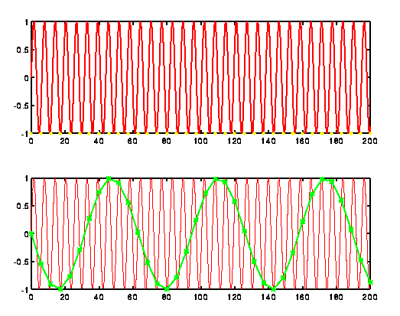
Ideal Sampling
Notes:
Take the speech signal shown at the top and sample the min and max of the sound wave over a longer segment to get a reasonable estimation of the signal.
F = 32 cycles / 1 sec

Slide 28
Sampling/Storage Tradeoff
Human hearing: ~20K Hz top frequency
  Do we really need to store 40K samples per second of speech?
Telephone speech: 300-4K Hz (8K sampling)
  But some speech sounds (e.g. fricatives, stops) have energy above 4K…so these may be hard to hear
44K (CD quality audio) vs.16-22K (usually good enough to study pitch, amplitude, duration, …)
Golden Ears…an experience of a Bell Labs colleague, Steve Crandall, at Oberlin College
Notes:
Golden Ears: Steve crandall: It was at Oberlin College, The Cleveland Orchestra (we learned a lot from the concertmaster) and Telarc Records in Cleveland. TCO and Telarc had certified Tone Masters. What we learned was hearing is much better if you’re under 30 and you can train students in a few hours to be as good as a tone master. We used students from the music conservatory and tried some from other departments. The best two or three (out of the dozen we trained for the tests) weren’t in music:) One was an art major — I can’t remember the others. A very strange finding was asking people to list music genres. Most people can do six to eight. Music students up to 20 with a few outliers. Niki Fallen was the statistical sport with over 150… that’s where I first learned about Calgary (Canada) Sugar Pop. The mind wobbles.

Slide 29
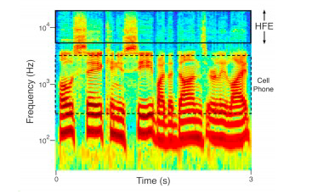
What your Phone is not Telling You
High frequency samples
Notes:
Listen to only the high frequencies and report what you hear. We can do this using conventional signal processing methods: cut out everything below 6,000 Hz thereby only transmitting sounds above 6,000 Hz to the ear of the listener. When we do this, some listeners only hear chirps and whistles, but most normal-hearing listeners report hearing voices in the high frequencies. Strangely, some voices are very easy to hear out in the high frequencies, while others are quite difficult. The reason for this difference is not yet clear. You might experience this phenomenon if you listen to the following clips of high frequencies from several different voices. You’ll need a good set of high-fidelity headphones or speakers to ensure you’re getting the high frequencies. The closes to intelligible is the last one in the list. Cell phones now trying to include high frequency transmission…

Slide 30
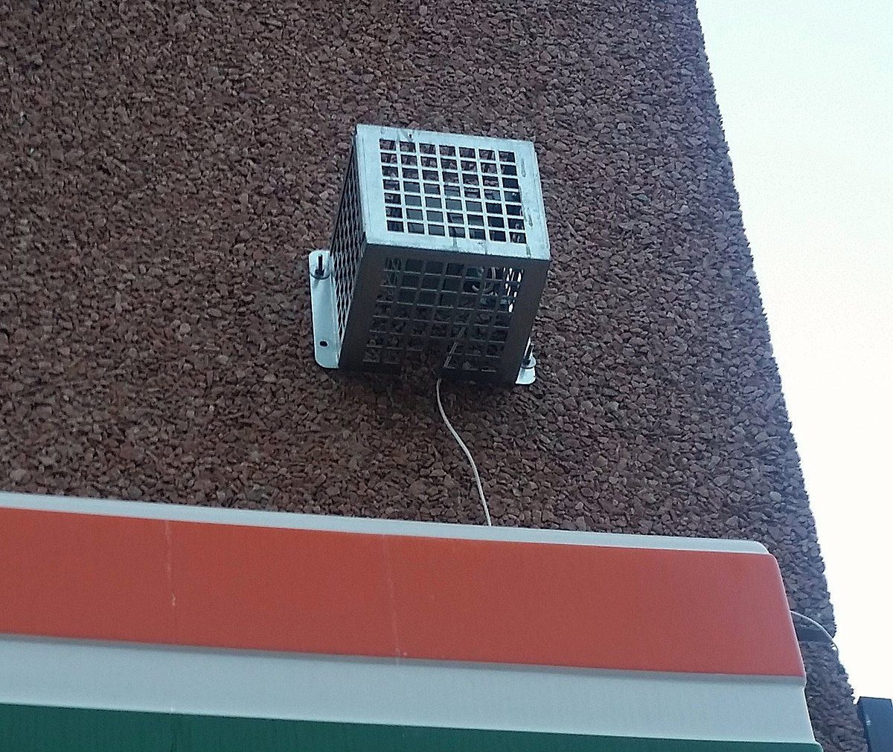
The Mosquito Alarm
Listen (at your own risk)
Teen Buzz ringtone (for class ☺)
Notes:
Play from Listen (title goes to Mosquito company)
The newest version of the device, launched late in 2008, has two frequency settings, one of approximately 17.4 kHz^{[4]} that can generally be heard only by young people, and another at 8 kHz that can be heard by most people. The maximum potential output sound pressure level is stated by the manufacturer to be 108 dB decibels (dB), and the manufacturer's product specification furthermore states that the sound can typically be heard by people below 25 years of age.^{[1]} The ability to hear high frequencies deteriorates in most humans with age (a condition known as presbycusis), typically observable by the age of 18.^{[5]}
Can you hear this?
Teen Buzz ringtone: The sound was made into a mobile phone ringtone, which could not be heard by teachers if the phone rang during a class.^{[14]} Mobile phone speakers are capable of producing frequencies above 20 kHz.^{[15]} This ringtone became informally known as "Teen Buzz"^{[16]} or "the Mosquito ringtone" and has since been sold commercially.
machine used to deter loitering by young people by emitting sound at high frequency so that it can be heard mostly by young people -- human rights concerns

Slide 31
Sampling Errors
Aliasing:
  Different signals can become indistinguishable (aliases) from one another when they are sampled
  E.g. Signals with frequency higher than the Nyquist frequency
  Solutions for analysis:
    Increase the sampling rate
    Filter out frequencies above half the sampling rate (anti-aliasing filter)
Notes:
Aliasing causes different signals to become indistinguishable (or aliases of one another) when sampled. It also often refers to the distortion or artifact that results when a signal reconstructed from samples is different from the original continuous signal.
Aliasing is the effect of new frequencies appearing in the sampled signal after reconstruction, that were not present in the original signal. It is caused by too low sample rate for sampling a particular signal or too high frequencies present in the signal for a particular sample rate.

Slide 32
Quantization Issues: Representing the Signal in Digital Form
How do we measure the amplitude (sound pressure) of speech?
  Choose sampling points: what resolution should you choose?
  Integer representation: 8, 12 or 16 bits per sample
Noise due to less useful quantization steps can be avoided by higher resolution -- but requires more storage
  How many different amplitude levels do we need to distinguish?
  Choice depends on data and application (44K 16bit stereo requires ~10Mb storage): music vs. speech

Slide 33
  But clipping occurs when the input volume (i.e. the amplitude of a signal) is greater than the range that can be represented
  Watch for this when you are recording…
  Most recorders (including Praat) will give you a signal when you are above the sound range
  Solutions
    Increase the resolution (sampling rate)
    Decrease the amplitude of the recording
    Important to check the right amplitude before you start recording
Notes:
Recording devices will usually show you if clipping is likely

Slide 34
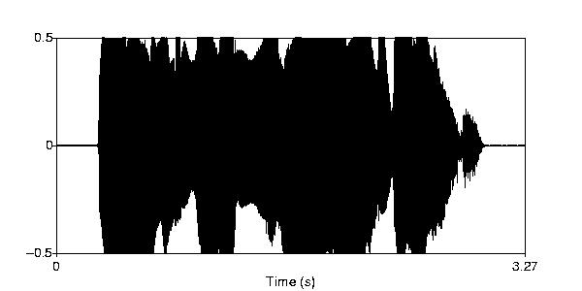

An Example of Clipping

Slide 35
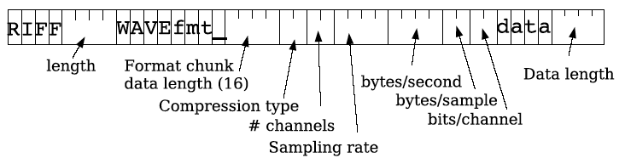
Speech File Formats: WAV and Many More
Many formats, trade-offs in compression, quality
SoX (Sound eXchange) can be used to convert speech formats from one to another:
  .WAV, AIFF, HTK, MP2/MP3/MP4, MPEG, SPHERE, Ogg Vorbis, u-law, .VOX, .VOC, RIFF
Notes:
Resource Interchange File Format: RIFF file: M$ wave file format with header and data.

Slide 36
Frequency
How fast are the vocal folds vibrating?
  Vocal folds vibrate for voiced sounds, causing regular peaks in amplitude
As discussed earlier: F₀ – is the Fundamental Frequency of the periodic waveform
  Lowest frequency of the waveform
Pitch track – plot of F₀ over time

Slide 37
Estimating Pitch
Frequency = cycles per second
  Simple approach to calculating cycles: count the zero crossings in a time range -- changes in signal from pos2neg and neg2pos -- and divide by 2
Notes:
Or just count pos2neg or neg2pos

Slide 38
F0 Measure: Autocorrelation Process
Idea: Identify the period between successive cycles of the wave
  F₀ = 1/period length
Where does one cycle end and another begin?
  Find the similarity between one piece of the signal and the next -- a shifted version of itself
  The period is the chunk of the segment that matches best with the next chunk
  Systems were developed to do just this, e.g. Praat
Notes:
Return to previous slide to show how to do

Slide 39
  Parameters considered
    Window size (chunk size)
    Step size (how quickly the next chunk appears)
    Frequency range

Slide 40
Common Problems in Pitch Tracking
Microprosody effects of consonants (e.g. /v/, /m/) on following vowels’ f0
Creaky voice → no pitch track
System errors to watch for in reading pitch tracks:
  Halving: shortest lag calculated is too long → estimated cycle too long, too few cycles per sec (under-estimate pitch)
  Doubling: shortest lag too short and second half of cycle similar to first → cycle too short, too many cycles per sec (over-estimate pitch)
Notes:
Play the link for microprosody

Slide 41
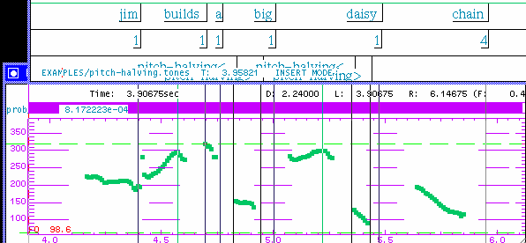

Pitch Halving
Pitch is halved
Notes:
If you double the pitch, you’ll see if is a better match for the preceding pitch

Slide 42
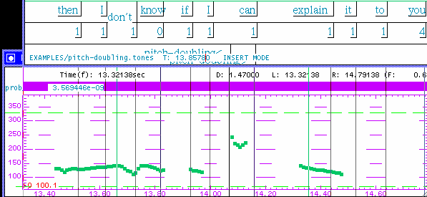
Pitch Doubling
Pitch is doubled
Notes:
Now halve the pitch and you’ll see a better match. When you see and listen to pitch in the pitch track (e.g. in Praat) which seems not to be coordinated with the previous and following pitch, check by looking at half that pitch (does that coordinate better) or twice that pitch

Slide 43
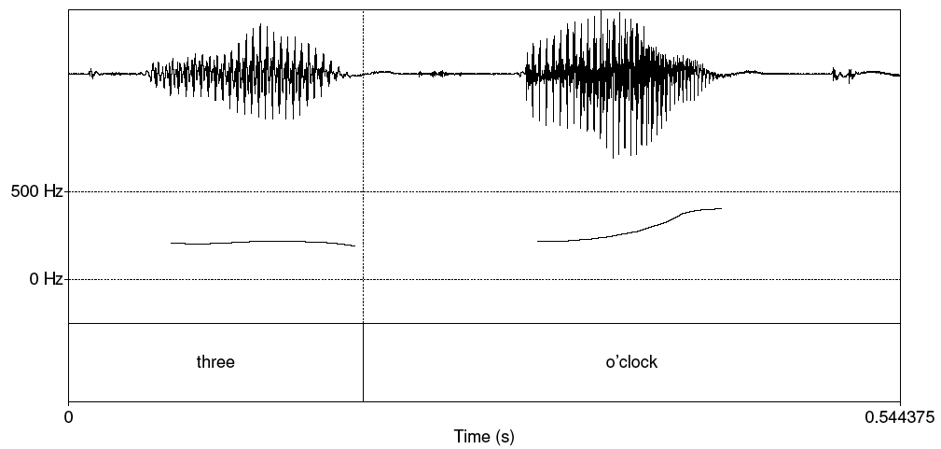
Better Pitch Track
Notes:
Smooth

Slide 44
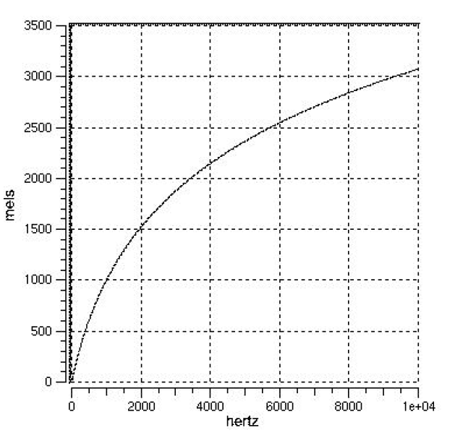
Pitch vs. f0
Pitch is the perceptual correlate of f0
  Human hearing is not equally sensitive to all frequency bands;
    Most accurate between 100Hz and 1000Hz
    Less sensitive at higher frequencies, roughly > 1000 Hz

Slide 45
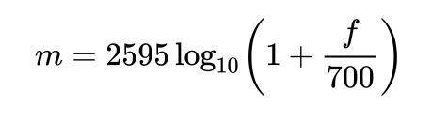
Mel scale
  Mel: A perceptual scale of pitches judged by listeners to be equal in distance from one another: above 500 Hz though, increasingly large intervals are judged to produce equal pitch increments
  Psycho-acoustic model of pitch
  Can convert f0 Hz into Mel scale to understand typical listener identification of pitch using this equation:
Notes:
Natural log to the base e (~2.718281828459)
The reference point between this scale and normal frequency measurement is defined by assigning a perceptual pitch of 1000 mels to a 1000 Hz tone, 40 db above the listener's threshold. Above about 500 Hz, increasingly large intervals are judged by listeners to produce equal pitch increments.

Slide 46
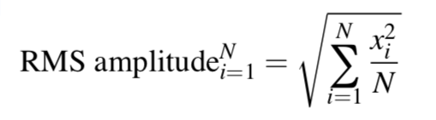
Amplitude
Measuring amplitude over a speech segment
  Root Mean Squared (RMS): Square each peak value of speech units x on the y axis over a speech segment and take the average

Slide 47
Intensity
Human-perceived loudness is measured in decibels (dB) on a logarithmic scale comparing 2 sounds to one another
10 log₁₀ (P₂/P₁), where P₁ represents the human threshold of hearing and P₂ represents the loudness to be measured to identify speech intensity or amplitude: the power of 10 of the sound intensity, expressed as a multiple of the threshold of hearing intensity
Notes:
Pa = Pascal = unit of pressure named after Blais Pascal – used to measure pressure of sound on an object (like an eardrum)
https://en.wikipedia.org/wiki/Decibel

Slide 48
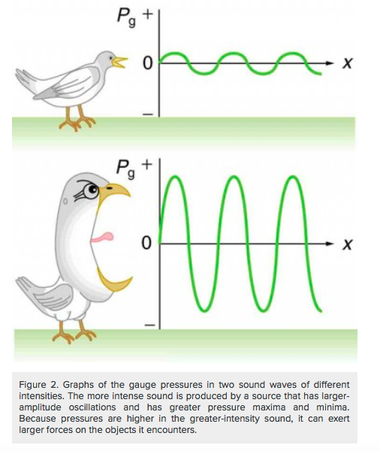
Notes:
The larger the pressure max and min, the more intense the sound

Slide 49
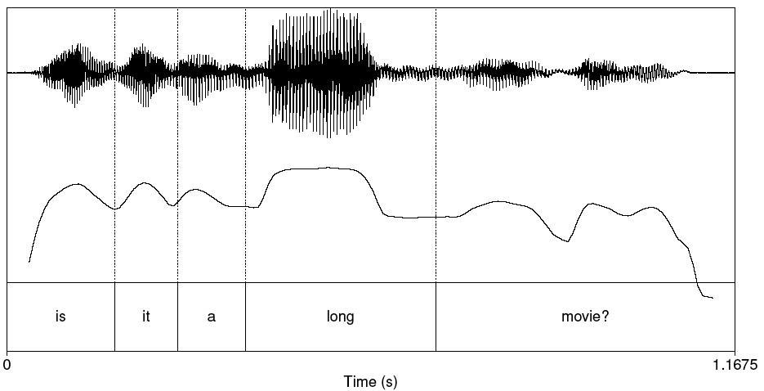
Plot of Intensity
Notes:
The speaker emphasizes long, which gives it more sound pressure or amplitude

Slide 50
How Loud are Common Sounds – How Much Pressure is Generated?
Event Pressure (Pa) Db
Absolute 20 0
Whisper 200 20
Quiet office 2K 40
Conversation 20K 60
Bus 200K 80
Subway 2M 100
Thunder 20M 120
*DAMAGE* 200M 140
Best decibel meters
Notes:
Pa = Pascal pressure metric
Db = Decibel
You can measure dbs on your phone: Decibel X et al

Slide 51
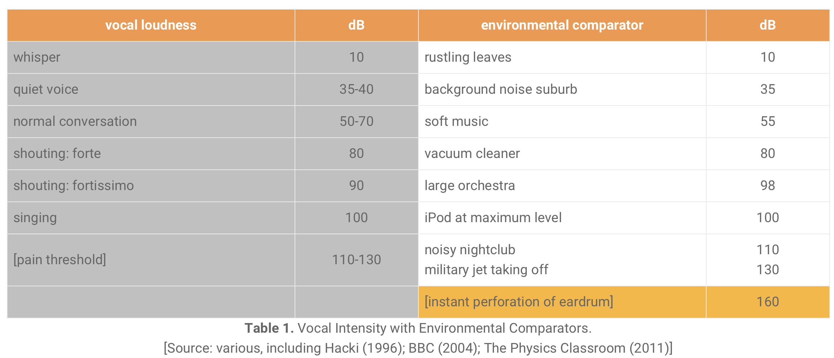

Slide 52
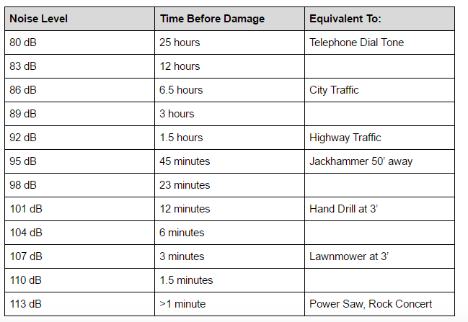

Slide 53
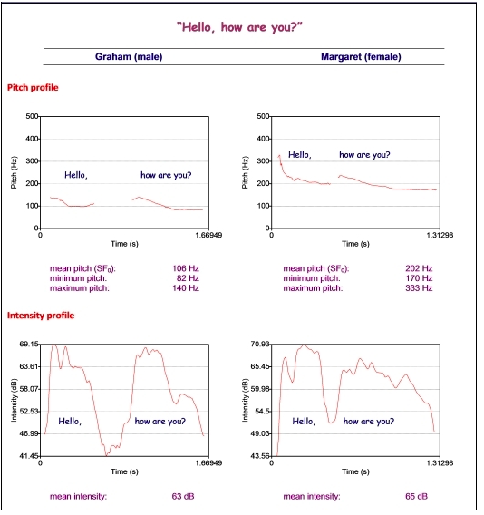

Slide 54
Voice quality
Jitter
Shimmer
Harmonics to Noise Ratio (HNR)

Slide 55
Voice quality
Jitter
  Random cycle-to-cycle variability in F₀
  Pitch perturbation/irregularity
Shimmer
  Random cycle-to-cycle variability in amplitude
  Amplitude perturbation/irregularity

Slide 56
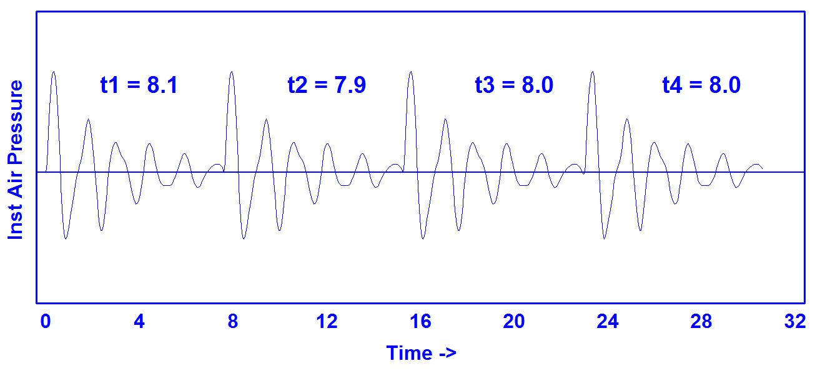
Jitter (Pitch Irregularity)
https://homepages.wmich.edu/~hillenbr/501.html
Notes:
Pitch irregularity

Slide 57
Synthetic Continuum Varying in Jitter (Pitch)
0.0% 2.0%
0.2% 2.5%
0.4% 3.0%
0.6% 4.0%
0.8% 5.0%
1.0% 6.0%
1.5%
https://homepages.wmich.edu/~hillenbr/501.html

Slide 58
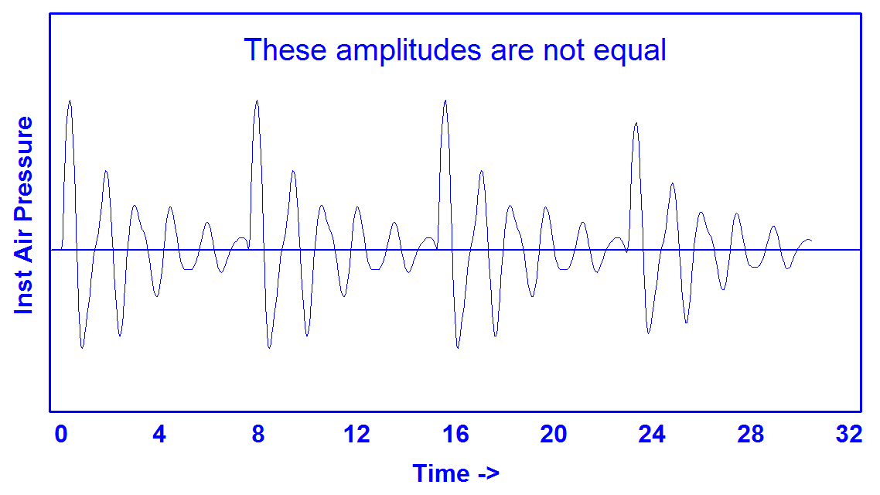
Shimmer (Amplitude Irregularity)
https://homepages.wmich.edu/~hillenbr/501.html
Notes:
Amplitude irregularity

Slide 59
Synthetic Continuum Varying in Shimmer (Amplitude)
0.00 dB 1.60 dB
0.20 dB 1.80 dB
0.40 dB 2.00 dB
0.60 dB 2.25 dB
0.80 dB 2.50 dB
1.00 dB 2.75 dB
1.20 dB 3.00 dB
1.40 dB
https://homepages.wmich.edu/~hillenbr/501.html

Slide 60
HNR
Harmonics to Noise Ratio
  Ratio between periodic and aperiodic components of a voiced speech segment
Periodic: vocal fold vibration
Non-periodic: glottal noise
Lower HNR -> more noise in signal, perceived as hoarseness, breathiness, roughness
Pathologic voice disorders
  Vocal fatigue, muscle tension, dysphonia (nerve causes vocal cords to spasm), diplophonia, (voice perceived as having 2 concurrent pitches), ventricular phonation (false vocal folds squeeze true folds), laryngitis (vocal cord swelling), vocal cord paralysis
Notes:
Harmonics: good; Noise: not

Slide 61
Speaking Rate (Jason Kottke)
Different languages are spoken at varying speeds but thanks to correlated differences in data-density, the same amount of information is conveyed within a given time period.
For all of the other languages, the researchers discovered, the more data-dense the average syllable is, the fewer of those syllables had to be spoken per second — and the slower the speech thus was. English, with a high information density of .91, is spoken at an average rate of 6.19 syllables per second. Mandarin, which topped the density list at .94, was the spoken slowpoke at 5.18 syllables per second. Spanish, with a low-density .63, rips along at a syllable-per-second velocity of 7.82. The true speed demon of the group, however, was Japanese, which edges past Spanish at 7.84, thanks to its low density of .49. Despite those differences, at the end of, say, a minute of speech, all of the languages would have conveyed more or less identical amounts of information.
Notes:
https://kottke.org/11/09/the-speed-and-density-of-language

Slide 62
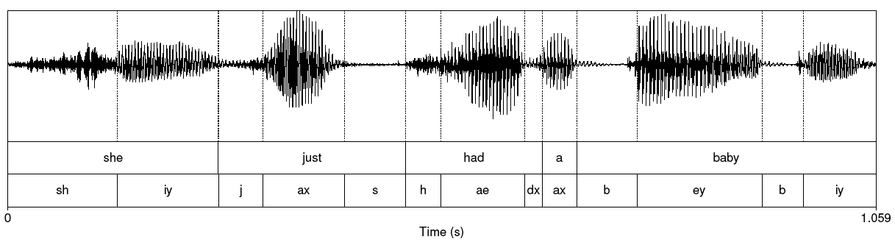
Reading Waveforms

Slide 63
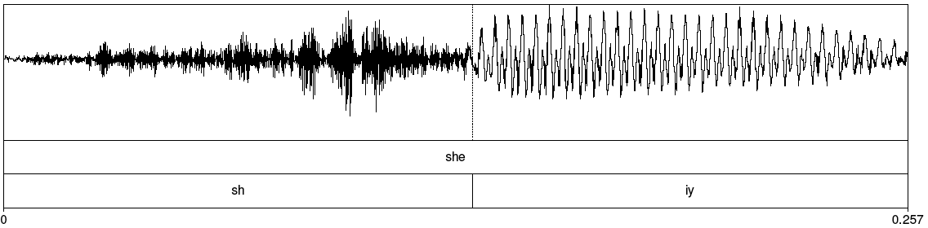
Fricative vs. Vowel
Notes:
Sh in she

Slide 64
Spectrum
Representation of the different frequency components of a waveform: amount of power (dbs) as a function of frequency (Hz)
  Computed by a Fourier Transform
    FTs can take a complex waveform and decompose it into its constituent frequencies
    Here are some useful tools for computing spectra and also spectrograms using LibROSA
  Linear Predictive Coding (LPC) spectrum – smoothed version
    Here are more python tools for LPC
Notes:
Change loudness, the amplitude gets bigger
Change the pich, the frequency of all components increases

Slide 65
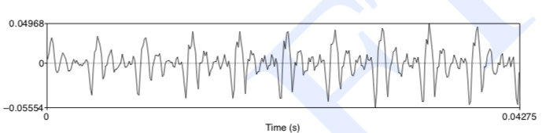
Part of [ae] Waveform from “had”
Complex wave repeated 10 times (~234 Hz)
Smaller waves repeated 4 times per large (~936 Hz)
Two tiny waves on the peak of 936 Hz waves (~1872 Hz)

Slide 66
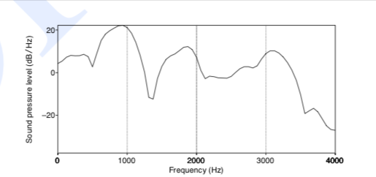
Spectrum “Slice”
Represents frequency components: Sound pressure at different frequencies
  Computed by the Fourier Transform
  Peaks at 930 Hz, 1860 Hz, and 3020 Hz
Notes:
[ae] from had in “She had a baby.”

Slide 67
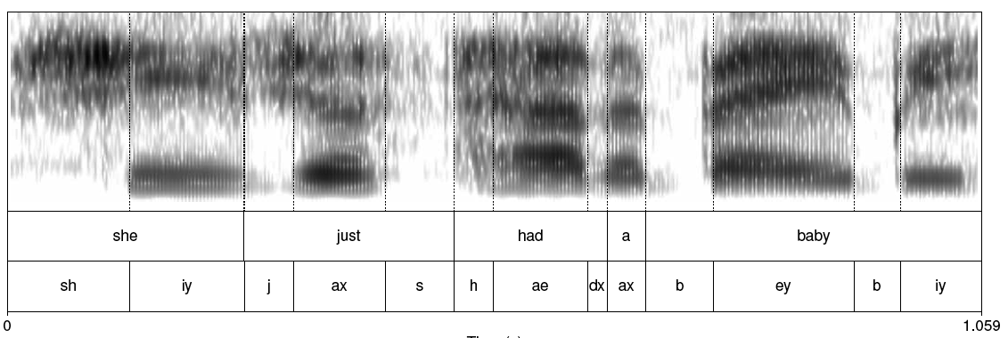
Spectrogram: Many Spectra “Slices”
Notes:
Spectrogram shows frequencies over time with intensity identifying amplitude – what you can see in Praat
For vowels in particular you can see spectral formants which relate to the different positions of the articulators discussed last week.
Note that iy is a high front vowel, ax is a middle vowel, ae is low front, and ey is mid and front
Iy for she and baby look fairly similar although different lengths because of pitch accent

Slide 68
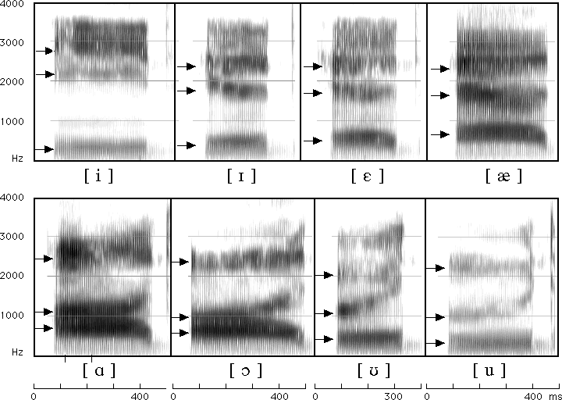
Formants for English Vowels
Notes:
i ee
I ih
e eh
ae ae
a ah
c ao
u oo (wood)
u oo (tulip)

Slide 69
Source-filter Model
Why do different vowels have different spectral signatures?
  Source = glottis
  Filter = vocal tract
When we produce vowels, we change the shape of the vocal tract cavity by placing articulators in particular positions

Slide 70
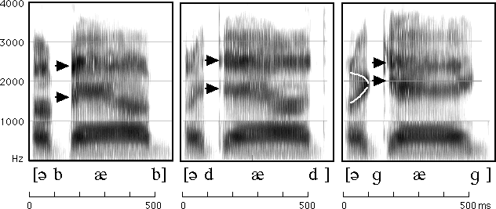
Reading Spectrograms: Changes in Vowels Based on Different Consonant Contexts
Notes:
uhbab, uhdad, uhgag…”uh” before “b”, “d”, “g”

Slide 71
Other Useful Features for Analysis: MFCCs
Sounds that we generate are filtered by the shape of the vocal tract (tongue, teeth etc.)
If we can determine the shape, we can identify the phoneme being produced
Mel Frequency Cepstral Coefficients are widely used features in speech recognition to approximate these shapes
Can be calculated using this python library

Slide 72
MFCC Calculation
Frame the signal into short frames
Take the Fourier transform of the signal
Apply mel filterbank to power spectra, sum up energy in each filter
Take the log of all filterbank energies
Take the Discrete Cosine Transform (DCT) of the log filterbank energies
Keep DCT coefficients 2-13
Or… use this python library ☺

Slide 73
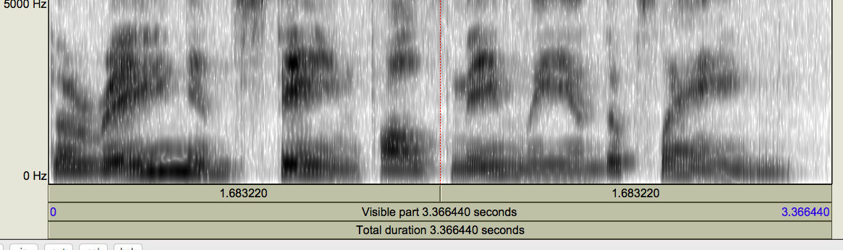
Mystery Spectrogram
Notes:
See if you can figure this out on your own after class without listening to the speech wav file ☺
Then you can listen and see how well you did!

Slide 74
Next Class
Download the latest version of Praat from the link on the course syllabus page
View all the Praat video tutorials also linked from the syllabus
Record yourself in a quiet room saying the utterances requested here (link also provided in the syllabus)
Bring a laptop and headphones with a close-talking mic to class if possible
Any questions?

