Slide 1
Advanced Topics in Spoken Language Processing
Lin Ai, Debasmita Bhattacharya, Julia Hirschberg, Harsh Srivastava
CS 6998
Notes:
Mention Ed Discussion for questions?

Slide 2
Welcome to the Course!
Notes:
Lin, please introduce yourself. You can put some slides here if you like? And make any other changes you think would be good ☺.

Slide 3
My Background
First PhD in History at UMich on 16th-century first settlers in Puebla de los Angeles, Mexico
  Taught at Smith College
  Discovered CS from colleagues at Amherst and UMass
  Back for another PhD at UPenn in CS (NLP)
Research on TTS at Bell Labs, and started the first HCI Research Dept which then moved to AT&T Labs
To Columbia in 2002, where I started the Columbia Speech Lab, have taught multiple Spoken Language Processing courses, and chaired the CS Dept (2012-18)
  Research in many aspects of speech…
Notes:
Settlers’ demographics, relationships, locations, and activities
TTS in multiple languages, charismatic, emotional, trusted, deceptive speech, radicalization in online videos, fake information in twitter, hate tweets directed toward women journalists, cross-cultural communication, and empathetic speech

Slide 4
  Intonation and discourse; TTS in multiple languages; charismatic, emotional, trusted/mistrusted and truthful/deceptive speech; entrainment; radicalization in online videos; false information in Twitter/X and the intent behind it (malicious or benign), hate tweets directed toward women journalists; empathetic speech; dialogue systems; code-switching
  Many students at Columbia have worked on these projects and we’ve published many papers

Slide 5
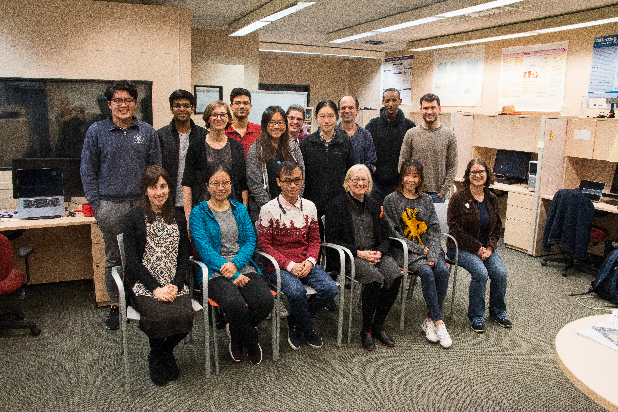
Columbia Speech Lab a While Back…

Slide 6

Getting to know each other
Notes:
turn to the person sitting next to you and introduce yourselves. Then turn to the other person and introduce yourselves.
Compile a list of all the abbreviations you use in social media or email (e.g. LGTM)
Can we do this with emojis??

Slide 7



Course Focus: Speech Processing Questions
  How do you produce sounds that other people interpret as language?
  How does your hearer decode what you are trying to convey?
  In a conversation, how do you know when it’s your turn to talk?
  Once you decide what you want to say, how do you decide how to say it?:
    How do you decide where to pause in the sentence?
    How do you decide what words to emphasize?
    How do you decide what intonational contour to use?
    How do you convey your own feelings and emotions?
Notes:
Angry, sad, happy

Slide 8
Different languages can convey this information in different ways but most use intonation or sometimes word order in the process – and of course facial expression and body gesture also play a role in communication – which is why multimodal research has become so popular
  How do you ask a question in your native language? Do you have a pet? Do you like ice cream?
  How do you make a statement? I have a cat.
Some links to information about prosody in multiple languages:
  Mandarin Chinese:
  Swedish
  Hindi
Notes:
Try out both in your native language.

Slide 9
  French
  Turkish
  Italian
  Singlish (Singapore English)
  ...If your own first language (or a language you know well) is one of these – or another language – please send me any useful links you find on prosody in that language so we can share with the class
What we’ll be learning in this class is a wide range of information that speech can convey to others --- and what we, in turn, can learn about others from their speech

Slide 10
What Can We Convey and Learn from Speech
What speech can convey
What else we can learn from speech
  Emotions: anger, fear, joy, sadness, disgust, surprise
  Sarcasm, humor
  Speech Acts
  Empathy
  Trust
  Likability/Charisma
  Persuasion
  Intent
Deception
Mental health
Physical health
Autism and dysarthria
Entrainment
Vocal Attractiveness
Age and gender
Personality
Notes:
Speech acts: question? Statement? Backchannels (um, uhuh…)
I know that.
I really believe you.

Slide 11
Basic Speech Technologies
Speech synthesis (TTS):
  Many versions of concatenative, parametric TTS: NaturalReader, Balabolka, Panopreter Basic, WordTalk, Zabaware Text-to-Speech Reader, WaveNet and WaveNet2, Deep Voice AI, Tacotron2, Tacotron-3, Re-Flow-TTS, WaveGlow, Deepmind TTS
  Many challenges:
    Do you live at 288 110th St. West?
    The city hall parking lot was chock full of cars.
    Martín Pérez plays for the Twins.
Speech recognition (ASR): and more
  Free: Kaldi, Simon, Mozilla DeepSpeech, WhisperX
Notes:
WaveNet, Deep Voice (Baidu), Tacotron (Google), FastSpeech (TTS with transformers), WaveGlow (Nvidia)
Spleeter for noise removal, aeneas for speech/transcript alignment,
TTS challenges…
Do you live at 288 110th St. West?
The city hall parking lot was chock full of cars.
Martín Pérez plays for the Twins.

Slide 12
  Paid: Labellerr, Google Cloud Speech-to-Text, Deepgram, Express Scribe, M$Azure, Nuance Dragon, IBM Watson, Verbit, …
  Many challenges: new languages, named entities, phone apps
Speech analysis:
  Praat, Sox, WaveSurfer, Adobe Audition
  Spleeter, CMGAN, and Audacity for removing background noise
  Aeneas for aligning text and speech
  Please check the course’s Resources website for links to these and more…

Slide 13
Many Other Speech Applications
Speech to Speech Translation: Google Translate
Speech Search: Google Voice Search
OpenAI tools for producing conversations in text and speech
For government:
  Deception detection: false Information detection in news and social media and detecting lying for police, military, and social services
  Dialect, language and speaker ID
  Creating and detecting trust
  Aids for first responders in low resource languages
  Communication across cultures/languages
  Sleepiness or drunkenness for drivers

Slide 14
For industry
  Degree of interest e.g. for salespeople
  Spoken Dialogue Systems: Siri, Alexa, Cortana, Google Home, Echo
  Recognizing or generating emotion, e.g.
    Recognizing anger/frustration in dialogue systems
    Generating excitement/fear in games
  Tutoring systems: Duolingo (uses Chrome to handle speech)
For society
  Accessibility: Web access for visually or manually challenged, TTS’d audio books, MeowTalk
  Voices for people who cannot speak clearly (Parrotron) or who have never been able to speak at all (Vocalid:Kids) or who are losing their voice (Vocalid: Elderly):
  Recognizing confidence vs. uncertainty in tutoring systems

Slide 15
  Medical diagnosis e.g. depression, aphasia, schizophrenia
  Charisma for politicians, religious leaders, startup leaders – and conversational systems

Slide 16
What you will Learn in This Class
By the end of the course, you should be able to:
  Understand more about these speech applications and how they work
  Analyze acoustic and prosodic features of speech and connect these with text information (and sometimes visual features)
  Analyze and classify corpora using these features to identify different types of information (dialogue acts, emotion)
  Evaluate research papers on spoken language processing and produce useful questions about them

Slide 17
What You Should Know/Have before You Start
A laptop or access to a computer (hopefully a Mac but…)
Headphones with a close-talking mic for recording
Some knowledge of NLP or speech processing or linguistics
Some experience using Machine Learning (not necessarily Deep Learning) – scikit-learn.org, e.g.

Slide 18
Syllabus Overview
Course syllabus
Part 1: basic concepts, tools, analysis approaches
  Acoustics, prosody, tools, TTS, ASR, dialogue systems
Part 2: speech analysis applications
  Charisma, deception, dialogue acts, emotion and sentiment, empathy, entrainment, mental state, personality, mental state, radicalization and de-radicalization, trust and deception

Slide 19
Grade breakdown
5% Class attendance: will be checked by TAs
20% Weekly posts
20% HW 1
25% HW 2
30% HW 3

Slide 20
Weekly Readings
Textbook
  Required: Speech and Language Processing, Jurafsky & Martin (use links from course syllabus)
  Optional: Acoustic and Auditory Phonetics, Keith Johnson (3rd edition)
Conference papers and journal articles (all links in syllabus)

Slide 21
Weekly Posts
For weekly Reading Assignments: please provide 100-200 words (in several sentences) for each positive and each negative aspect of each assigned paper or chapter; this will give us a better chance to assess the quality of your responses. Do not use any GPTs ☺
  For some Assignments you will also be asked to provide one or more: “an insightful and potentially challenging question about one of the readings.” Deadline: Mondays at 11:59 pm; Points 0-4
  Late policy: 1 day,1 point loss
  Please be sure to post on time…
Notes:
GPTs are prone to hallucinations as we know well from a new project we are proposing to IARPA

Slide 22
Sample Assignment from an earlier course for Jurafsky & Martin on Dialogue
Positive aspects:
I found this chapter interesting and enjoyed learning about the various
approaches of building dialogues systems: rule based, corpus-based, sequence to sequence Chatbot and more. One of the things I appreciated the author including were ethical issues concerned with building dialog systems. They were very important issues raised such as the tendency for agents to have female names, biases in the training data and even more fascinating how users can corrupt an agents’ knowledge as in the case of Microsoft Tau making reinforcement learning a double edge-sword. In other words, while reinforcement learning can help chat-bots better personalize to a user it can also be trained to reflect discriminative opinions of the user.

Slide 23
Negative aspects:
One of the things that I felt was incomplete was in understanding turn-taking. How can the system know when the user is done speaking? Are there prosodic cues such as the F0 contour that can help the system to avoid overlapping speech with the user, causing the agent to miss out on important information? On the note of prosody, in most conversations the emotional state and the intent of a speaker can inform the type of response that is desired. How can a system deal with a situation when a user is sarcastic of frustrated in a conversation? How can it detect this and how should it respond?
Challenge Question: Are there cues besides F0 contour that can help the system avoid overlapping speech with the user, which might cause the agent to miss out on important information?
Please do present your assignments in this form for each reading assigned.

Slide 24
Homework Assignments
Praat emotion recording and analysis
Dialogue Act identification and how these DAs differ from one another
Emotional Speech identification (e.g. anger, sadness)
Late policy:
  3 days only available after the deadline with 5 points lost for each day -- Please note that late submissions will be counted after the exact time of the deadline, so don’t wait to submit the homework until the last minute. (Note that it might take some time to upload files to coursework or gradescope.)

Slide 25
  We also require medical proof if a student seeks an extension of late days due to illness.
  Before initiating a regrade request, take time to consider the reasons thoughtfully. Keep in mind that the grade has the potential to be lowered after the regrading process.
  Alternative or make-up assignments will not be given.

Slide 26
Teaching Assistants
Introducing our TAs for the course this semester, my PhD students and their office hours:
  Lin Ai: F 2-4pm
  Debasmita Bhattacharya: Th 2:30-4:30pm
  Julia Hirschberg: W 2-3:30pm
  Harsh Srivastava: M 9-11am
Notes:
Can you introduce yourselves and what research you do?

Slide 27
Todo
Please read the Ethics policy on our syllabus

Slide 28
Next Class
For our Week 2 class: Look at today’s slides and follow the links again (or any not followed today)
Week 2 Topic: From Sounds to Language
  Reading: J&M Chapter 28 (sections 1-3)
  Post your Week 2 assignment on Courseworks2 before next Monday at 11:59pm
Record your name on Courseworks2 → Name and Pronoun Recording so we can learn to pronounce everyone’s name correctly ☺
Make sure your picture is also on Courseworks2

Slide 29
Questions?

