Slide 1
Simulating Conversations,
Emotional Speech Synthesis,
& More
Tony Chen

Slide 2

How do you like this conversation?

Slide 3
Both text and audio are AI generated!

Slide 4
Part 1
Simulating Conversations with LLM and TTS

Slide 5
Text Generation with GPT
Create two agents
Each agents receive an instruction and conversation history
Instruction for Speaker A: You are a doctor. Bob, in this role-play scenario, you'll be engaging with Nurse Alice who is feeling overwhelmed by the emotional weight of caring for a terminally ill child. Your role is…
Instruction for Speaker B: Nurse Alice, in this exercise, you'll be approaching Bob to discuss your emotional struggle with a difficult case involving a terminally ill child. Express your feelings openly and describe the challenges you're facing…
I actually asked GPT to write this for me

Slide 6
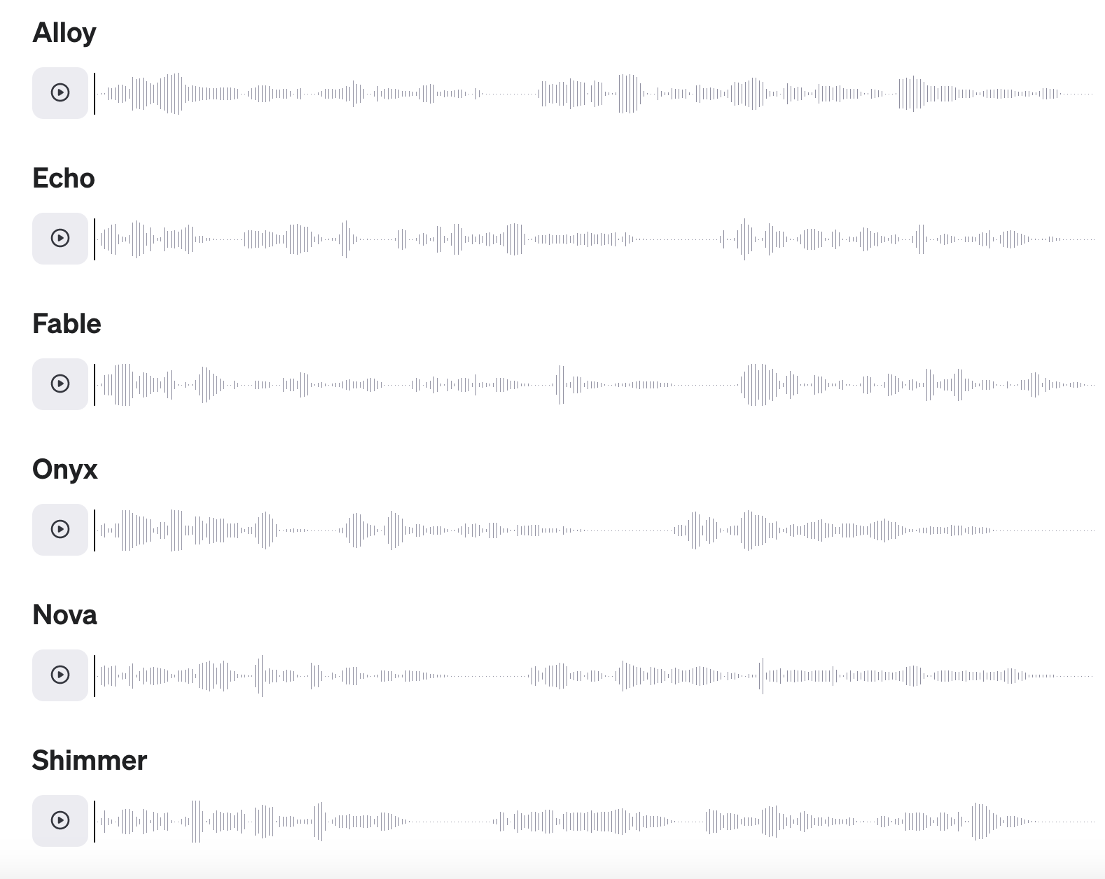
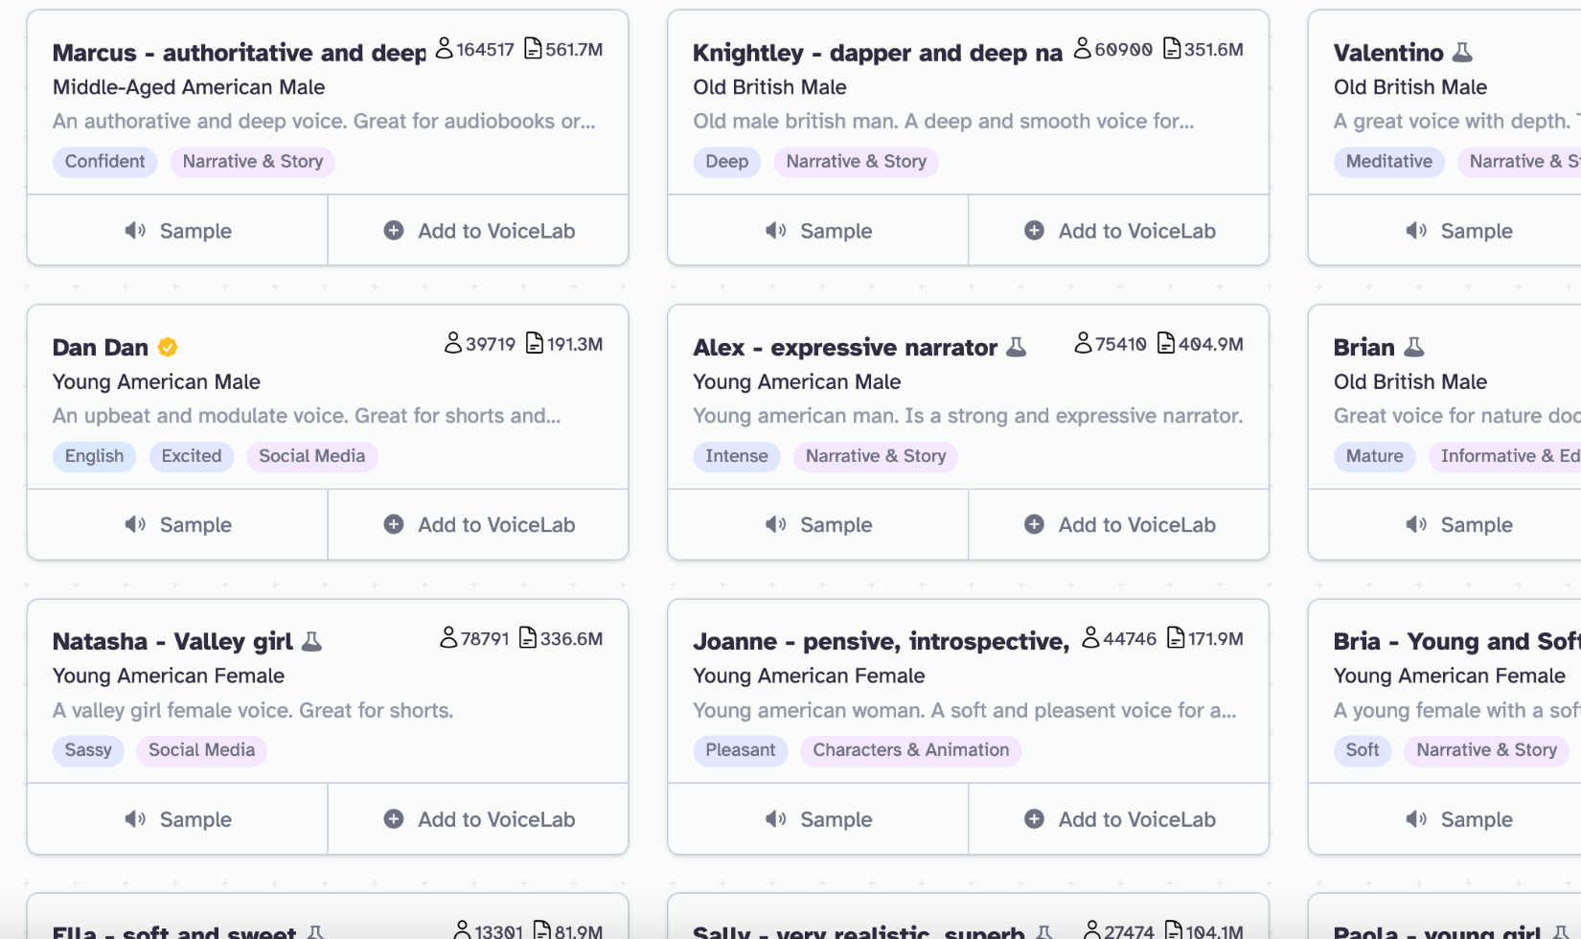
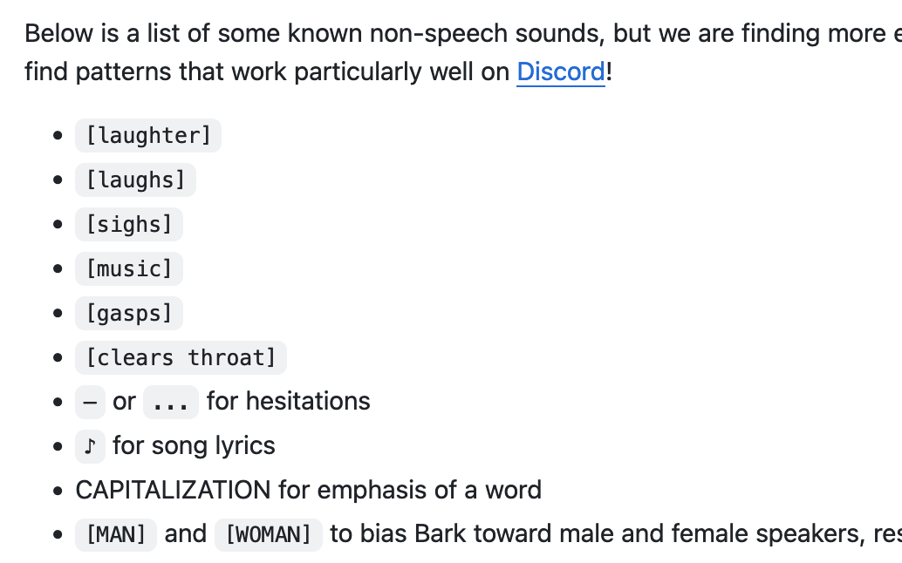
Generating Audio
OpenAI TTS
ElevenLabs
Suno (Open source)
https://platform.openai.com/docs/guides/text-to-speech
ElevenLabs provides a ton of voices
Suno supports non-speech sound tags
https://elevenlabs.io/
https://github.com/suno-ai/bark
Limitations: can’t specify emotions, purely text-to-speech
Solution: e.g. prompt text generation to include phrases like “emm” and punctuations like “...” to signify emotions

Slide 7
Part 2
Emotional Speech Synthesis
by repurposing voice cloning model

Slide 8
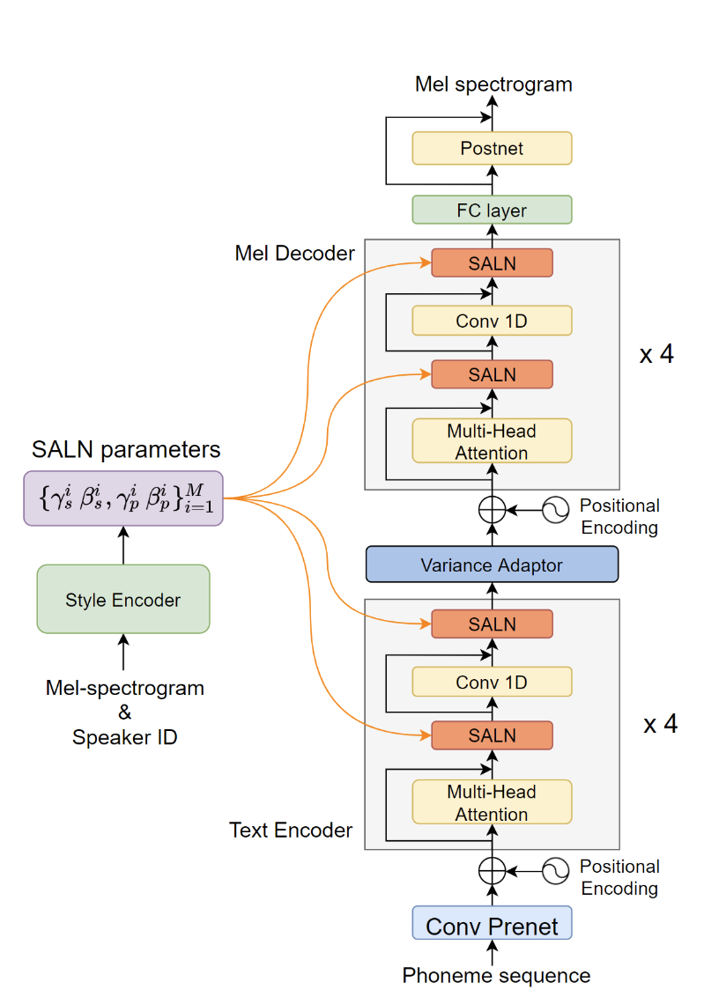

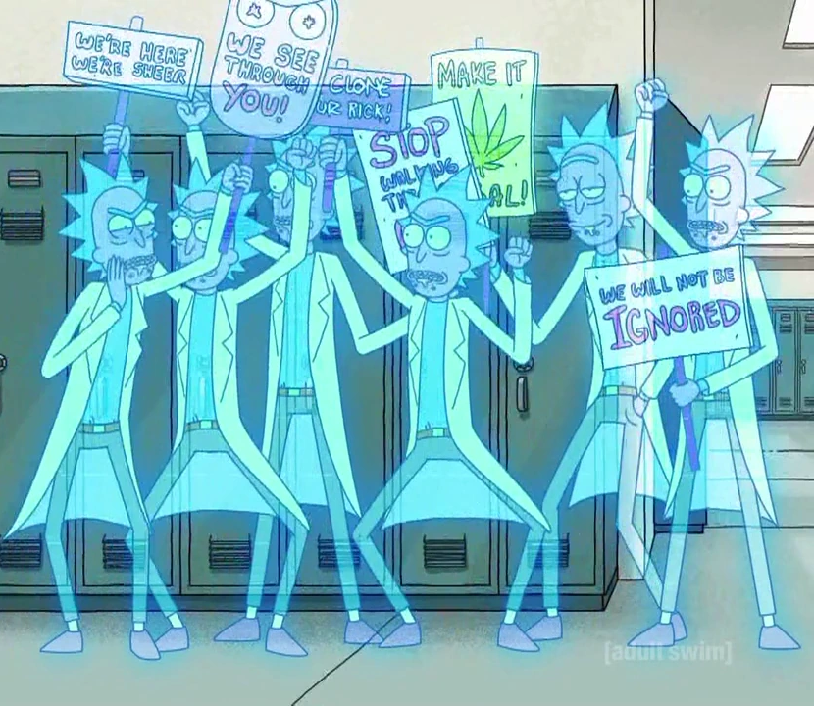
MetaVoice: Voice Cloning Model
Original
Clone
https://themetavoice.xyz/

Slide 9
Creating New Voice by Mixing Speaker Embeddings
6 speakers
…
Take average of speaker embeddings
Aggregated into a new empathetic speaker voice

Slide 10

Make Non-Empathetic Speaker Empathetic
Recall: Original Rick
1 * Empathetic
+ 0 * Rick
0.5 * Empathetic
+ 0.5 * Rick
(Empathetic Rick)
0.4 * Empathetic
+ 0.6 * Rick
0.35 * Empathetic
+ 0.65 * Rick
0.3 * Empathetic
+ 0.7 * Rick
0.2 * Empathetic
+ 0.8 * Rick
0 * Empathetic
+ 1 * Rick
Weight of Rick Embedding
Observe the smooth interpolation

Slide 11
Part 3
Some other new cool models

Slide 12
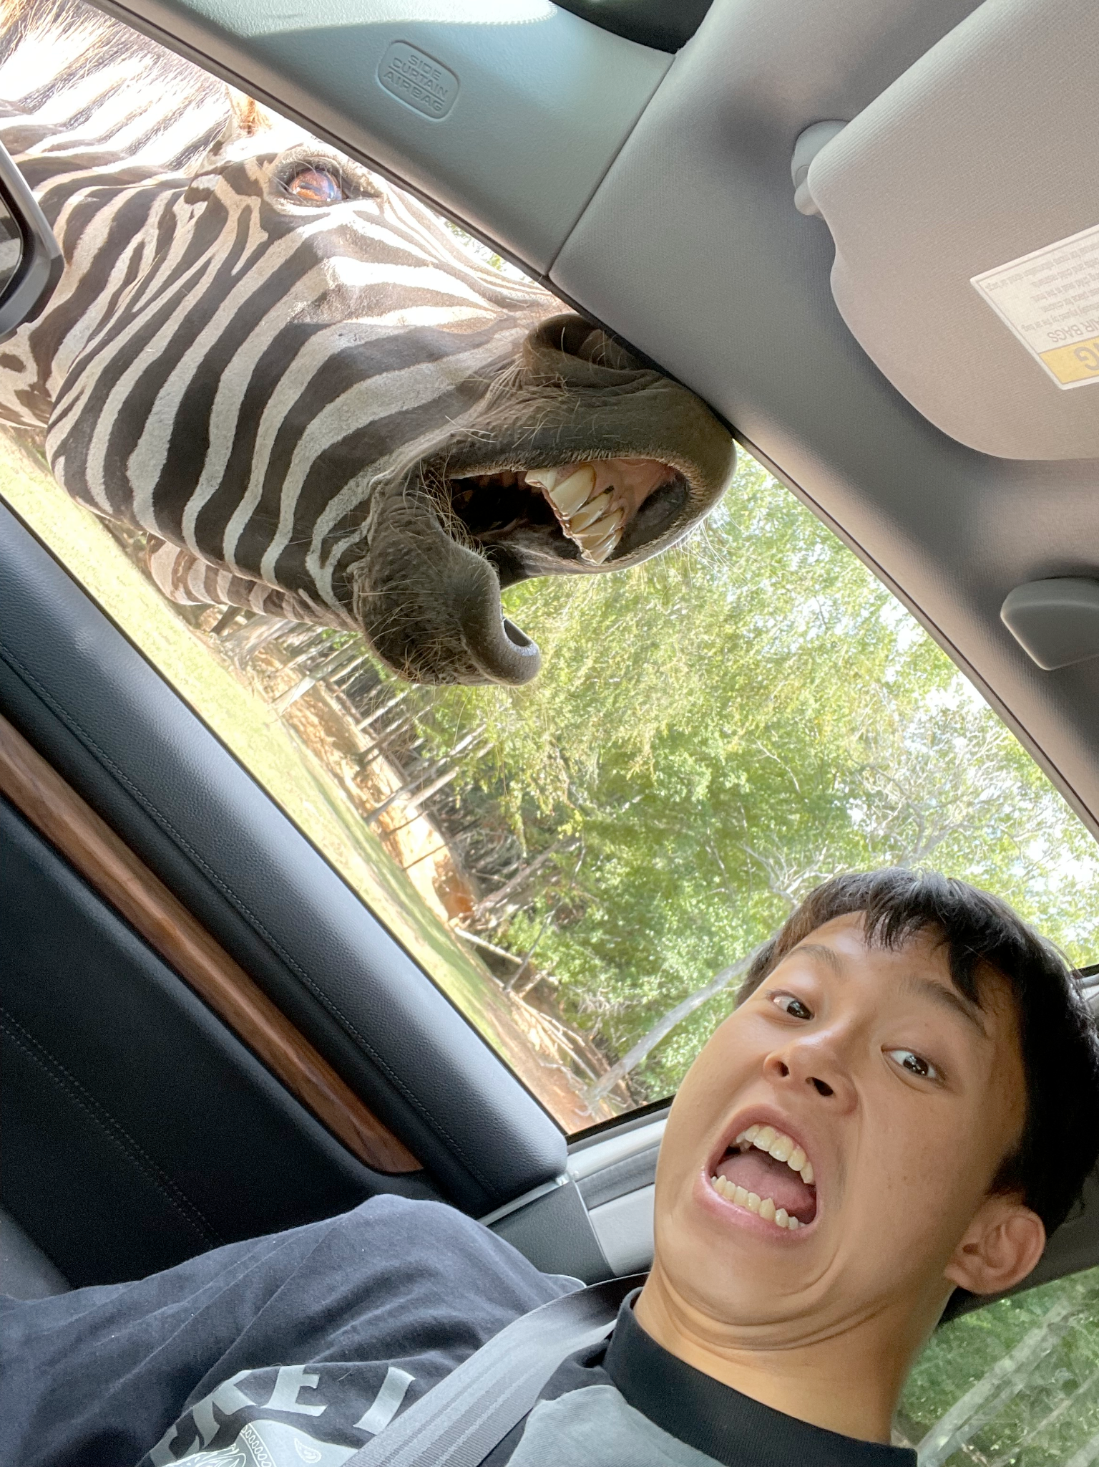
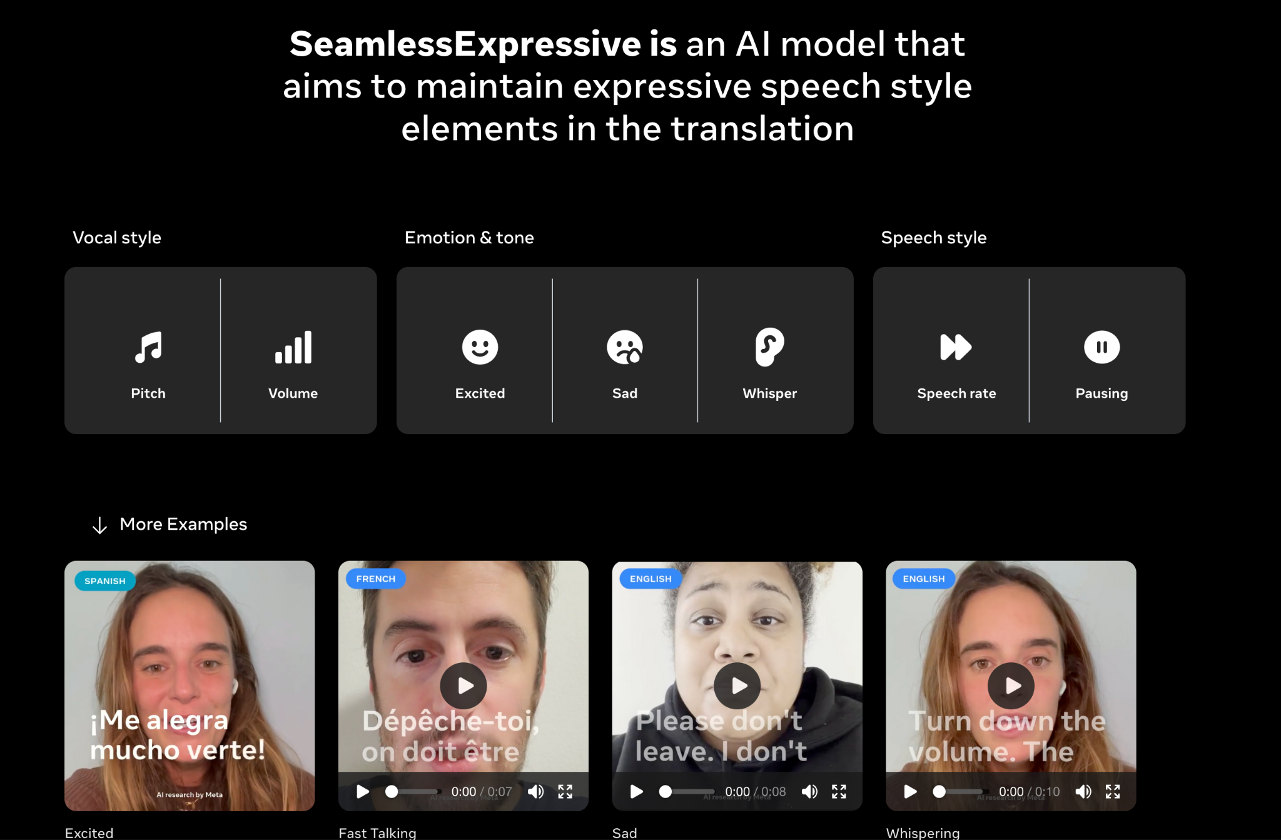
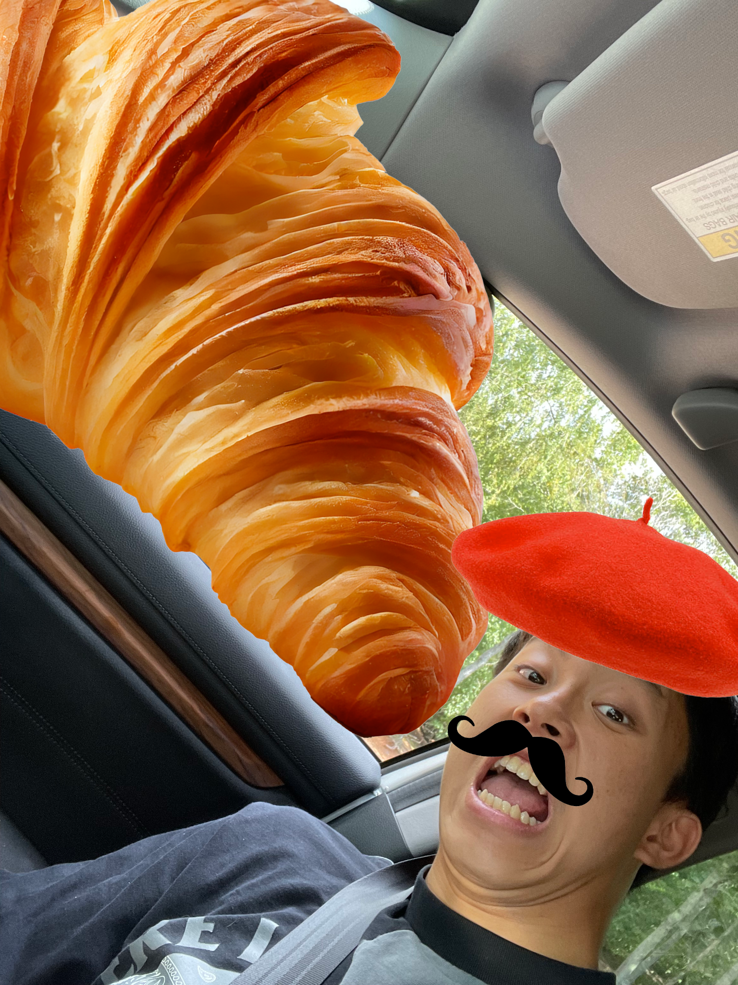
Meta’s Seamless Expressive Translation
My original voice in English
Expressive Translation to French
Baseline: Non-Expressive Translation to French
https://seamless.metademolab.com/expressive

Slide 13
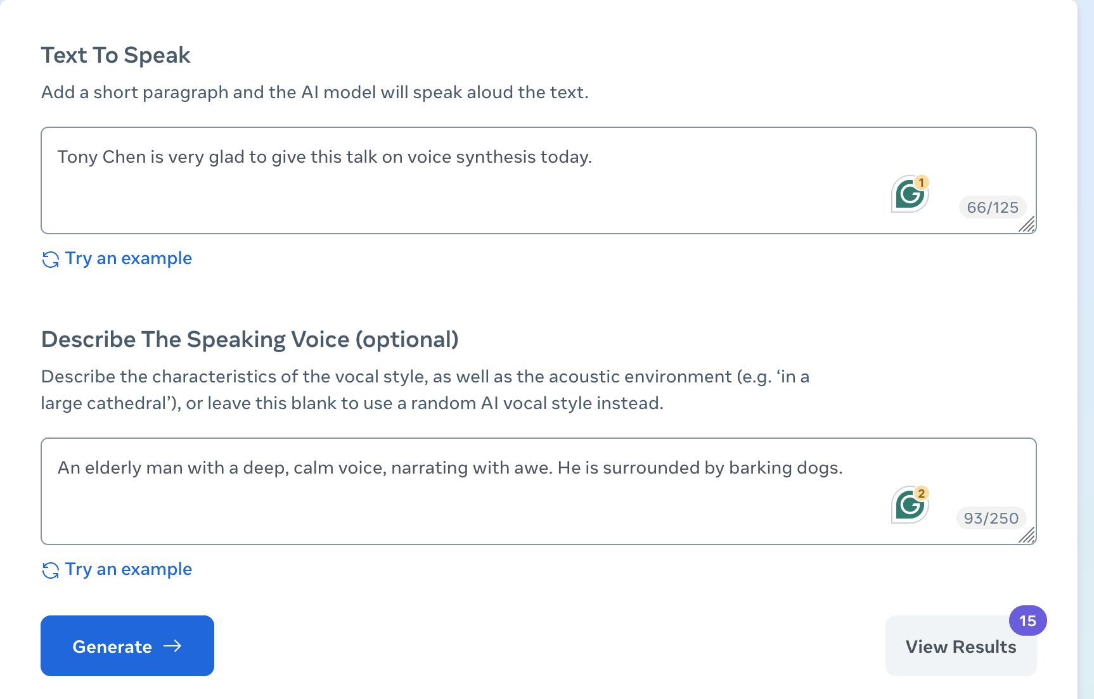
Describe a voice with Meta’s Audiobox
https://ai.meta.com/blog/audiobox-generating-audio-voice-natural-language-prompts/

