Slide 1
Speech Synthesis
CS 6998
Andrew Rosenberg
heavily based on slides from Rose Sloan

Slide 2
A little history
Major Components
Evaluation
Lightning round of Interesting New Models

Slide 3
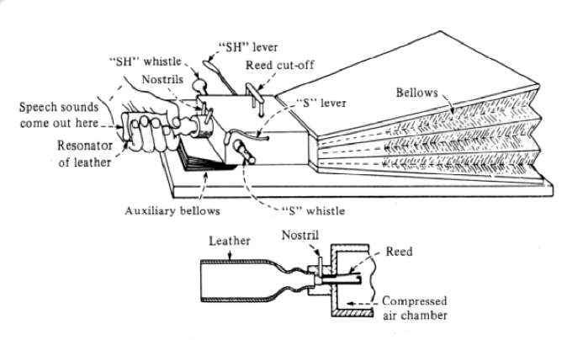
Wolfgang von Kempelen, Mechanismus der menschlichen Sprache nebst Beschreibung einer sprechenden Maschine, 1791 (in Deutsches Museum still and playable)
First to produce whole words, phrases – in many languages

Slide 4
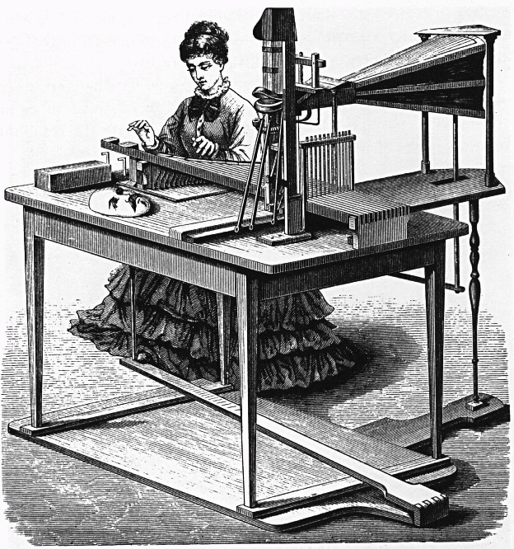
Joseph Faber’s Euphonia, 1846
Constructed 1835 w/pedal and keyboard control
  Whispered and ordinary speech
  Model of tongue, pharyngeal cavity with manipulable shape
  Singing too: “God Save the Queen”
Riesz’s 1937 synthesizer with almost natural vocal tract shape
Forerunners of Modern Articulatory Synthesis: George Rosen’s DAVO synthesizer (1958) at MIT

Slide 5
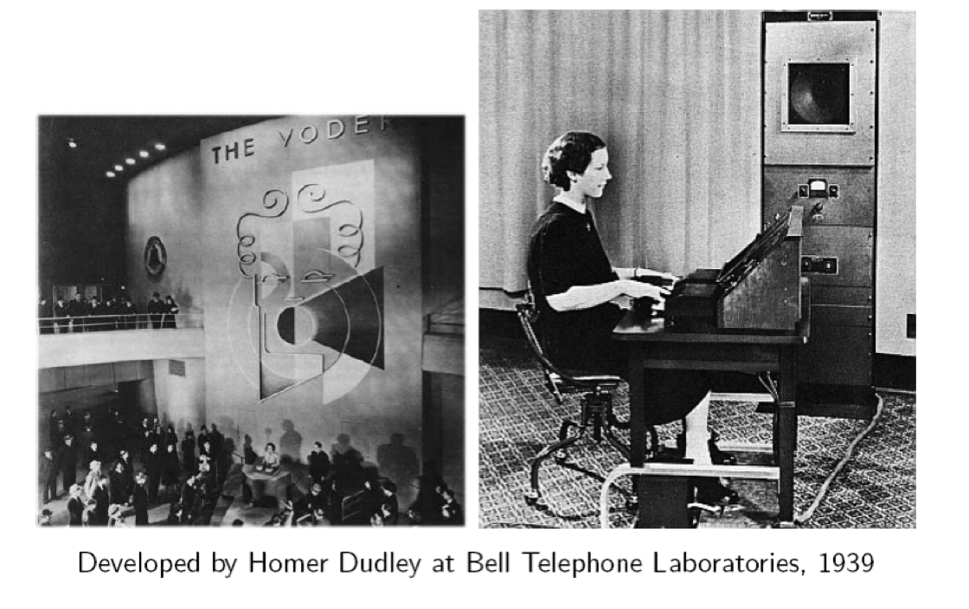
The Voder
World’s Fair in NY, 1939
Requires much training to ‘play’
Purpose: coding/compression
  Reduce bandwidth needed to transmit speech, so many phone calls can be sent over single line

Slide 6
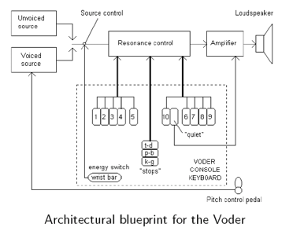
The Voder synthesizer

Slide 7
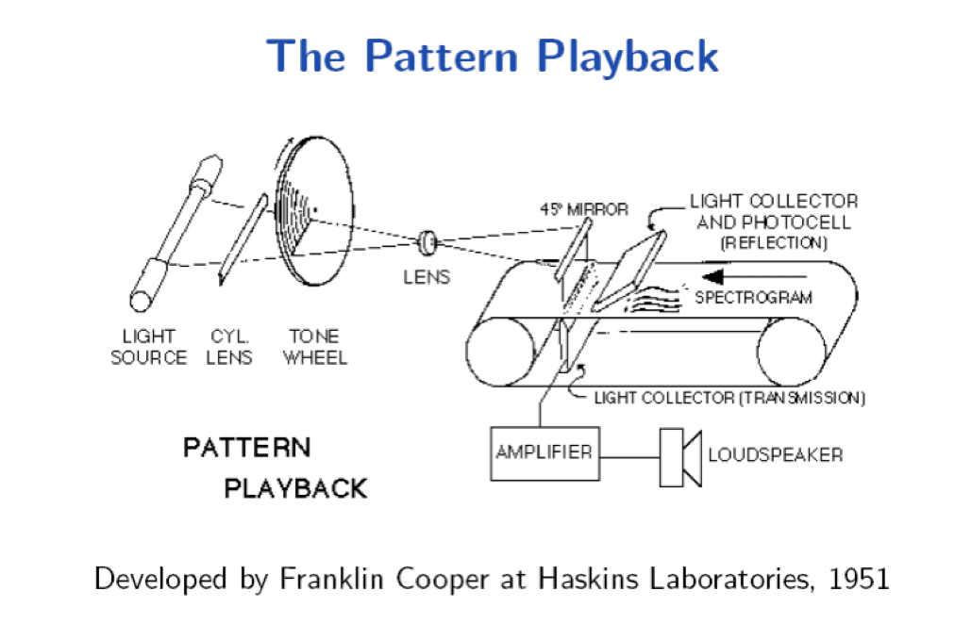
Pattern Playback
‘Automatic’ synthesis from spectrogram – but can also use hand-painted spectrograms as input
Purpose: understand perceptual effect of spectral details

Slide 8
Major Components of a TTS System
[brainstorm time]

Slide 9
Major Components of a TTS System
Frontend:
  Text Normalization
  Pronunciation (grapheme-to-phoneme; G2P)
  Prosodic assignment
Acoustic Model: Prediction of Output features
Backend/Vocoder: Mapping of Output features to Waveform
Data

Slide 10
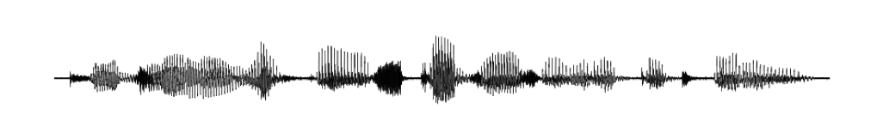
Frontend and Backend
PG&E will file schedules on April 20.
TEXT ANALYSIS: Text to intermediate representation:
WAVEFORM SYNTHESIS: From intermediate representation to waveform

Slide 11
Pronunciation
Rules for disambiguation in context: bass, desert
Lexicon: comb, tomb, Punxsutawney Phil
  Letter-to-Sound Rules
    Hand built
    Learned from data (pronunciation dictionary)
    Hard to get good accuracy and coverage – many exceptions
  Pronunciation Dictionary
    More accurate but…
    Out-of-Vocabulary words a problem (e.g. proper names)

Slide 12
Text Normalization Issues
Homographs, numbers, abbreviations
  Reading is what he hates most.
  Reading is the place he hated most.
  The NAACP just elected a new president.
  NASA is the U.S. space agency.
  In 1996 she sold 2010 shares and deposited $42 in her 401(k).
  The duck dove supply.
  How to pronounce emojis? Covid-19?
RNN Approaches to Text Normalization: A Challenge
  https://arxiv.org/pdf/1611.00068

Slide 13
Prosodic Assignment: Phrasing
Traditional: hand-built rules
  Use punctuation: 234-5682; New York, NY
  Context/function word: no breaks after function word: He went to dinner. He came to and stayed for dinner.
  Syntax: She favors the nuts and bolts approach. She went home and Dave stayed.
Modern: machine learning on large labeled corpus
Current: machine learning on large unlabeled corpus

Slide 14
Prosodic Assignment: Accent
Hand-built rules
  Function/content distinction:
    They called in (particle) the doctor/They called in (preposition) the afternoon.
  Complex nominals:
    Main Street/Park Avenue
    City hall – parking lot -- city hall parking lot (stress shift)

Slide 15
Prosodic Assignment Issues: Contours
Simple rules
  ‘.’ = declarative contour, wh-question
  ‘?’ = yes-no-question contour unless wh-word present at/near front of sentence
    Is your name Caroline? What’s your name.
Pretty monotonous in long stretches of speech

Slide 16
Prosody Modeling for TTS
End-to-end TTS is a lot more natural than previous approaches!
However, it can make explicitly modeling prosody very difficult, since prosody modeling is hard to disentangle
Fine-grained control especially difficult
Several approaches exist

Slide 17
Prosodic Event Modeling
One approach: explicitly model ToBI features (phrase break and pitch accent) in the TTS pipeline
Can predict these features from text using linguistic features (syntax, word embeddings, coreference, etc.)
Can add ToBI events into a TTS front end
Alternate approaches instead include linguistic features in front end (can include more subtle prosodic variations but gives less direct control)

Slide 18
Acoustic Model & Backend/Vocoder types
Recall:
Acoustic Model: Prediction of Output features from Text-based features
Backend/Vocoder: Mapping of Output features to Waveform
Per Richard Sproat
Articulatory Synthesis: Model movements of articulators and acoustics of vocal tract
Formant Synthesis: Start with acoustics, create rules/filters to create each formant
Concatenative Synthesis: Diphone or Unit Selection using databases to store speech segments
Parametric Synthesis: ML-based learning methods
End2End Models
  Attention-based Encoder Decoder Models
  Non-autoregressive Modeling
  Decoder only “LM” modeling

Slide 19
Formant/Resonance/Acoustic Synthesis
Parametric or resonance synthesis
  Specify minimal parameters, e.g. f0 and first 3 formants
  Pass electronic source signal thru filter
    Harmonic tone for voiced sounds
    Aperiodic noise for unvoiced
    Filter simulates the different resonances of the vocal tract
  Walter Lawrence’s Parametric Artificial Talker (1953) for vowels and consonants
  Gunnar Fant’s Orator Verbis Electris (1953) for vowels

Slide 20
Later Formant Synthesizers
Most common commercial systems were formant synthesizers in early days (while computers relatively underpowered)
1979 MIT MITalk (Allen, Hunnicut, Klatt)
1983 DECtalk system
  Voice of Stephen Hawking

Slide 21
Concatenative/Unit Selection Synthesis
First broadly applied commercial TTS
First practical application in 1936: British Phone company’s Talking Clock
  Optical storage for words, part-words, phrases
  Concatenated to tell time
And a ‘similar’ example from Radio Free Vestibule (1994)
Bell Labs TTS (1977) (1985)

Slide 22
Variants of Concatenative Synthesis
Inventory units
  Diphone synthesis (e.g. Bell Labs, Festival)
  Microsegment synthesis
  “Unit Selection” – large, variable units
Issues
  How well do units fit together?
  What is the perceived acoustic quality of the concatenated units?
  Is post-processing on the output possible, to improve quality?

Slide 23
Concatenative Synthesis
Diphone Synthesis
  Units are diphones; middle of one phone to middle of next.
  Why? Middle of phone is steady state.
  Record 1 speaker saying each diphone in different contexts
Unit Selection Synthesis
  Larger units
  Record 10 hours or more, so have multiple copies of each unit
  Use search to find best sequence of units

Slide 24
Voice
Speaker
  Must have all needed audio recorded by a single professional speaker
  Called voice talent
  How to choose?
Diphone database
  Called a voice
  Modern TTS systems have multiple voices

Slide 25
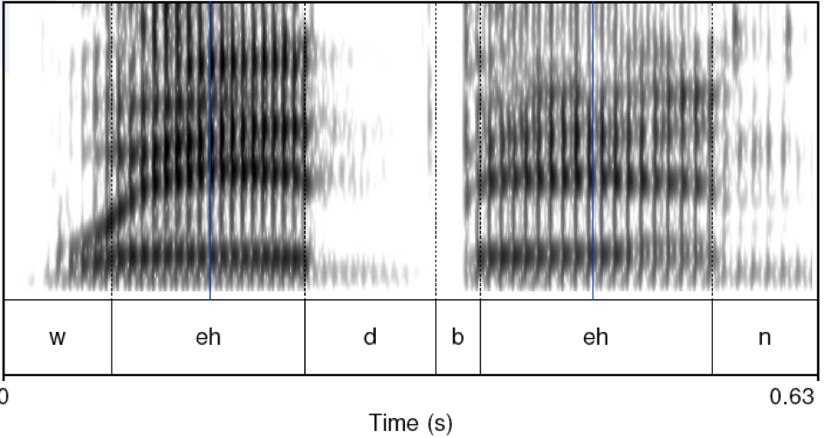
Diphones
Where is the stable region? Where is the phone boundary?

Slide 26
Unit Selection Synthesis
Generalization of the diphone intuition
  Larger units
    From diphones to phrases to …. sentences
  Record many copies of each unit
    E.g., 10 hours of speech instead of 1500 diphones (a few minutes of speech)
  Label diphones and their midpoints

Slide 27
Unit Selection Intuition
Given a large labeled database, find the unit that best matches the desired synthesis specification
What does “best” mean?
  Target cost: Find closest match in terms of
    Phonetic context
    F0, stress, phrase position
  Join cost: Find best join with neighboring units
    Matching formants + other spectral characteristics
    Matching energy
    Matching F0

Slide 28
Unit Selection Summary
Advantages
  Quality far superior to diphones: fewer joins, more choices of units
  Natural prosody selection sounds better
Disadvantages:
  Quality very bad when no good match in database
    HCI issue: mix of very good and very bad quite annoying
  Synthesis is computationally expensive
  Hard to control prosody
    Diphone technique can vary emphasis
    Unit selection can give result that conveys wrong meaning

Slide 29
TTS Demos and Examples (all Unit-Selection)
Festival
  Festival early voice
Cepstral
  https://www.cepstral.com/en/demos
AT&T
  http://www.wizzardsoftware.com/text-to-voice.php
Watson Jeopardy Challenge
  e.g. https://www.youtube.com/watch?v=P18EdAKuC1U

Slide 30
Parametric Synthesis
Uses ML to predict acoustic features based on statistics learned from data
Can change voice quality by updating model parameters
Can train on mixed data from many speakers
Model takes up a very small amount of space
Speaker adaptation possible

Slide 31
Types of Parametric Synthesis
Hidden Markov Model Synthesis
  Sounds less natural to researchers but naïve subjects preferred
  Best non-neural parametric system
Neural Net Synthesis
  Can capture more complex relationships
  Began to overcome naturalness issues

Slide 32
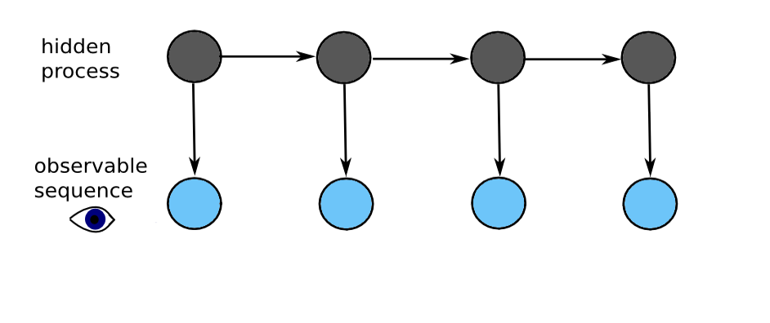
Idea Behind HMMs
Markov Assumption:
The future is conditionally independent of the past given the present.
There is some hidden process that has generated some audible observation – learn that process from observed audio

Slide 33
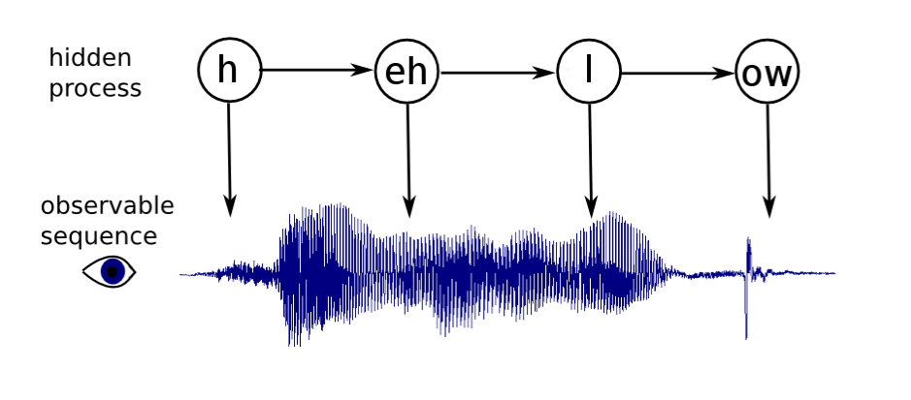
Learning from Data
Some hidden process has generated some audible observation.

Slide 34
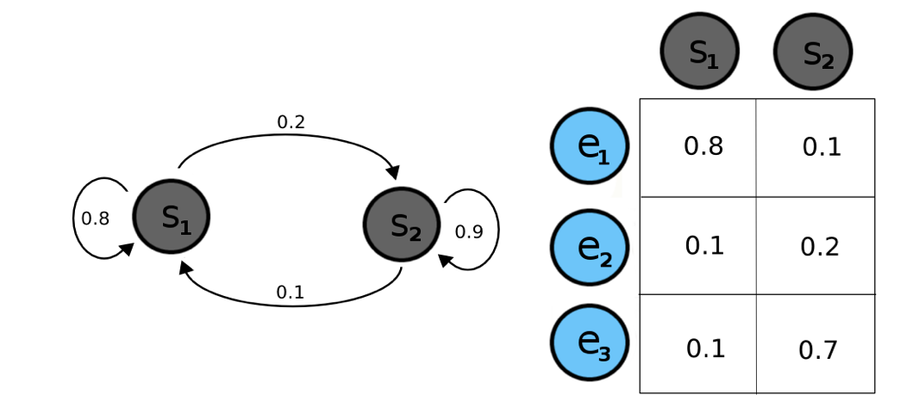
HMMs
Hidden states have transition probabilities and emission probabilities.

Slide 35
HMM Synthesis
Every phoneme+context is represented by an HMM
  The cat is on the mat.
  The cat is near the door.
Sample < phone=/th/, next_phone=/ax/, word='the', next_word='cat', num_syllables=6, .... >
Acoustic features extracted that are aligned with this: f0, spectrum, duration
Train full HMM with examples like these

Slide 36
HMM Synthesis Issues
Many contextual features = data sparsity
So…. cluster similar-sounding phones
  e.g: 'bog' and 'dog’
  the /aa/ in both have similar acoustic features, even though their context is a bit different
Make one HMM that produces both, and is trained on examples of both

Slide 37
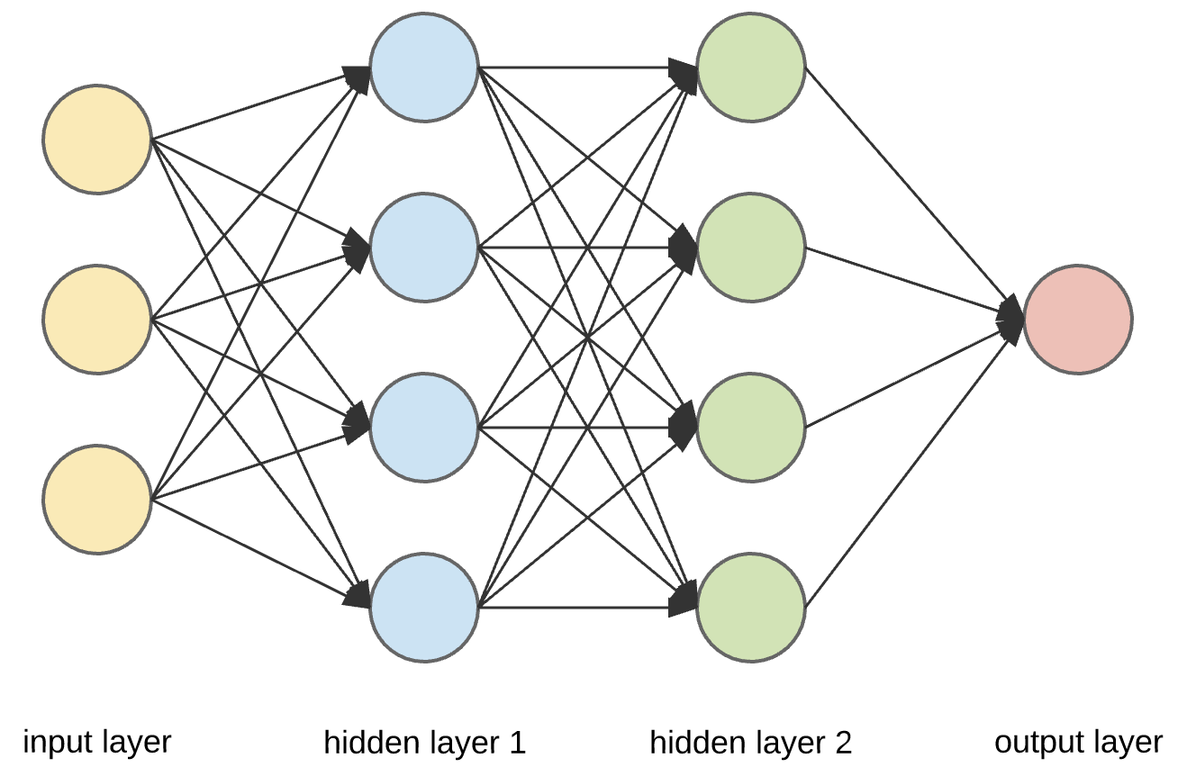
Enter Deep Learning

Slide 38
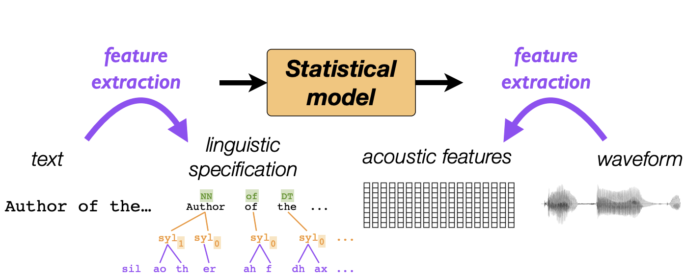
Merlin and Neural Net Synthesis
An open source toolkit for TTS synthesis from Edinburgh University
Map linguistic features to acoustic features using a neural net

Slide 39
Input Features
Each phone has a number of features:
  Current phone
  Surrounding phones
  Position in syllable/word/sentence
  Stress
  Etc.
We can add any linguistic features we wish to incorporate

Slide 40
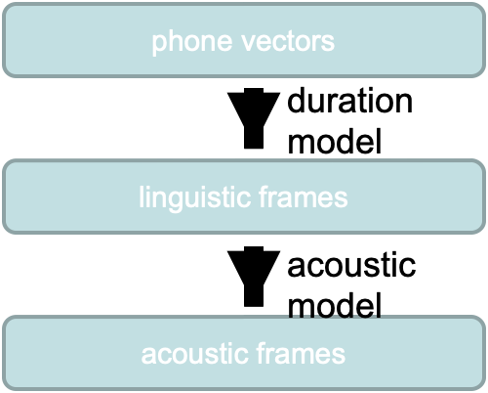
The Merlin Model
Official demos: https://cstr-edinburgh.github.io/merlin/demo.html

Slide 41
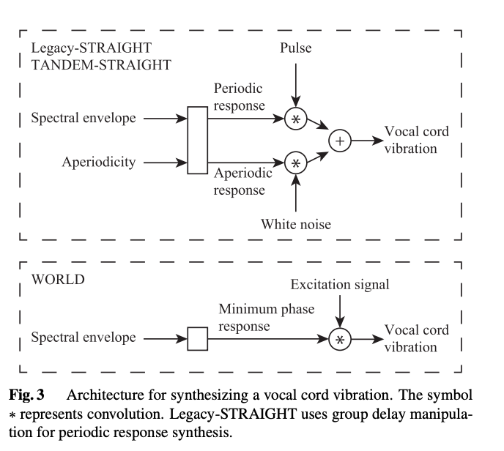
Vocoders
Griffin Lim
  spectrogram to waveform
STRAIGHT & WORLD
  F0, Spectral Envelope and Aperiodicity.
WaveNet
  Dilated convolution Neural waveform prediction
WaveRNN & WaveGRU
  Faster Neural waveform generation
WaveFIT
  Diffusion-based prediction
Soundstream & Encodec
  Residual Vector Quantization

Slide 42
End-to-End
HMM systems and Merlin both have a lot of separate components (front end processing, acoustic model, vocoding)
Errors can propagate throughout, leading to drops in quality
Can we eliminate some (or all) of these separate steps?
Aim: Model text input, and waveform output.

Slide 43
WaveNet
Replaces the vocoder by using CNNs to predict waveforms directly
Requires massive data and processing power: 16,000 samples per second
Much better performance than previous parametric or concatenative systems

Slide 44
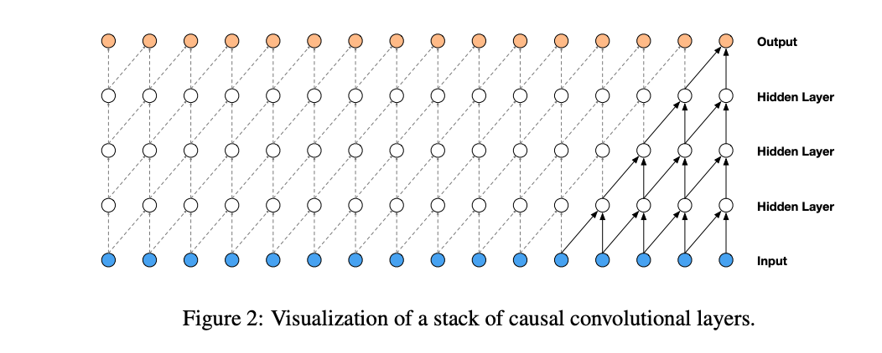
WaveNet
https://arxiv.org/abs/1609.03499
Convolutions to autoregressively generate a waveform

Slide 45
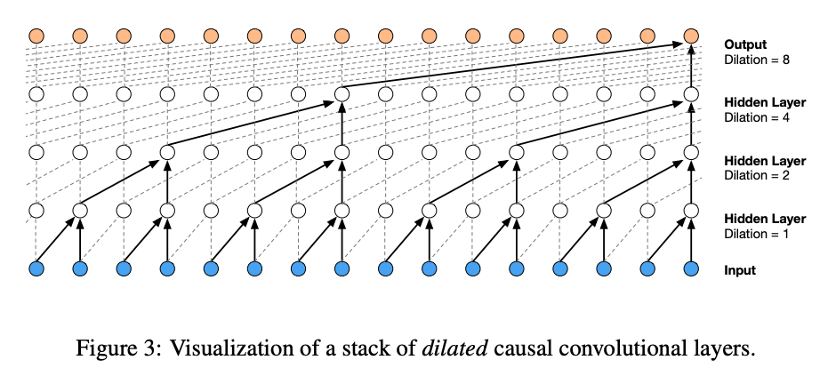
WaveNet
https://arxiv.org/abs/1609.03499
Dilated Convolutions to autoregressively generate a waveform

Slide 46
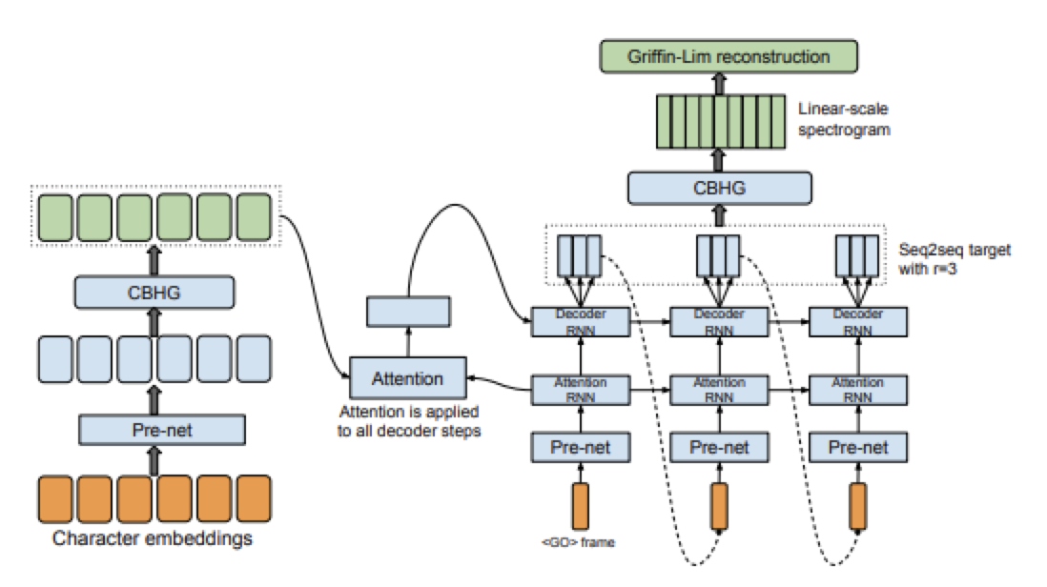
Tacotron – Encoder Decoder Attention model

Slide 47
Tacotron
Seq2seq model: Map input sequence of characters or phones to output sequence (spectrogram)
Basic architecture
  Encoder: various layers to model n-grams and get high-level features
  Attention: alignment between input and output
  Decoder: attention results to output
  Spectrogram to waveform: reconstruction or WaveNet
Notes:
CBHG (part of other things): convolution (models n-grams), highway network (get high level features), GRU RNN (get sequential features from context)

Slide 48
Why is Tacotron so good?
Autoregression
  Audio at each time step is directly conditioned on the audio from the previous time step
Front end
  Neural nets are mostly better at learning contextual features
Attention
  Use attention to do alignment vs. HMMs
  Only minor improvements: attention is actually probably too powerful

Slide 49
TTS Evaluation
Intelligibility
Mean Opinion Scores
Preference Tests
What else?
  Speaker Similarity?
  Accent?
Notes:
‹#›

Slide 50
Intelligibility Tests
Diagnostic Rhyme Test (DRT)
  Listening test
  Listeners choose between two words differing by a single phonetic feature (voicing, nasality, sustenation, sibilation)
  DRT: 96 rhyming pairs
    Dense/tense, bond/pond, …
      Subject hears dense, chooses either dense or tense
      % of correct answers is intelligibility score
  Problem: Only tests single word synthesis

Slide 51
Intelligibility Tests (cont.)
Modified DRT:
  300 words, 50 sets of 6 words (went, sent, bent, tent, dent, rent)
  Embedded in carrier phrases:
    Now we will say dense again
Semantically Unpredictable Sentences
  Can listeners transcribe grammatical but nonsensical sentences?
    “The medium blackbird froze the delicate candidate”

Slide 52
Naturalness and Preference Tests
Mean Opinion Score
  Have listeners rate output on a scale from 1 (bad) to 5 (excellent)
Preference tests or Side-by-Side
  Reading addresses out loud, reading news text, using two different systems or systems against human voice
  Do a preference test (prefer A, prefer B)
Statistical Significance please!
  t-test (paired preferably) for MOS
  Sign-test for sxs

Slide 53
Other Tests
Speaker Similarity
  does the voice sound like the intended voice?
Style
  Is the style appropriate in this context?
  Does the style of two clips match each other
Nativeness
  Does the speech sound like a native speaker of the language?

Slide 54
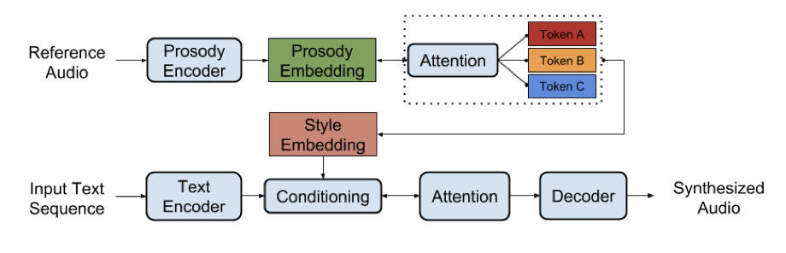
Style Embeddings and Sentence-Level Prosody
End-to-end makes it easy to condition speech on “style embeddings”
Makes it easy to transfer prosody from one utterance to another
Flexible uses
Can also use similar approaches on the back end to provide prosodic variation

Slide 55
Lightning round of Interesting New Models
Generative Adversarial Networks
  HiFi GAN
Non-Autoregressive Modeling
  Parallel Tacotron
Joint Spech-Text Modeling
  Maestro, Virtuoso
Language Model All the Things
  AudioLM
  VALL-E
Joint Language Modeling
  Moshi

Slide 56
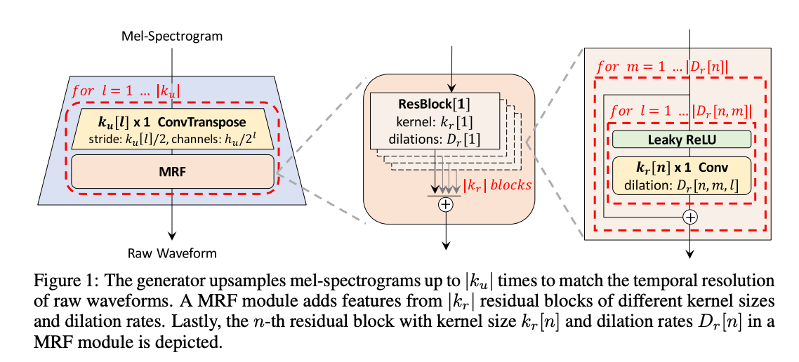
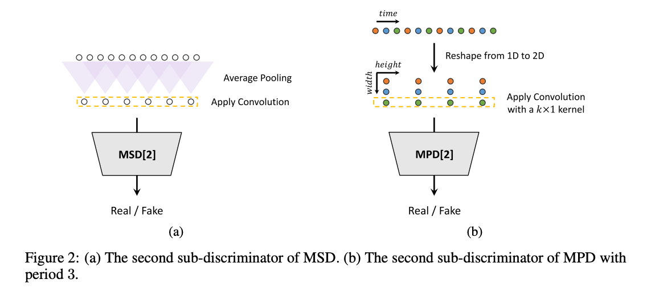
HiFi GAN
https://arxiv.org/pdf/2010.05646
Generative Adversarial Network (GAN) for vocoding (mel spectrogram to waveform)
Convolutional Generator
  different dilation rates
Multi Scale Discriminators
HiFi-GAN: Generative Adversarial Networks for Efficient and High Fidelity Speech Synthesis

Slide 57
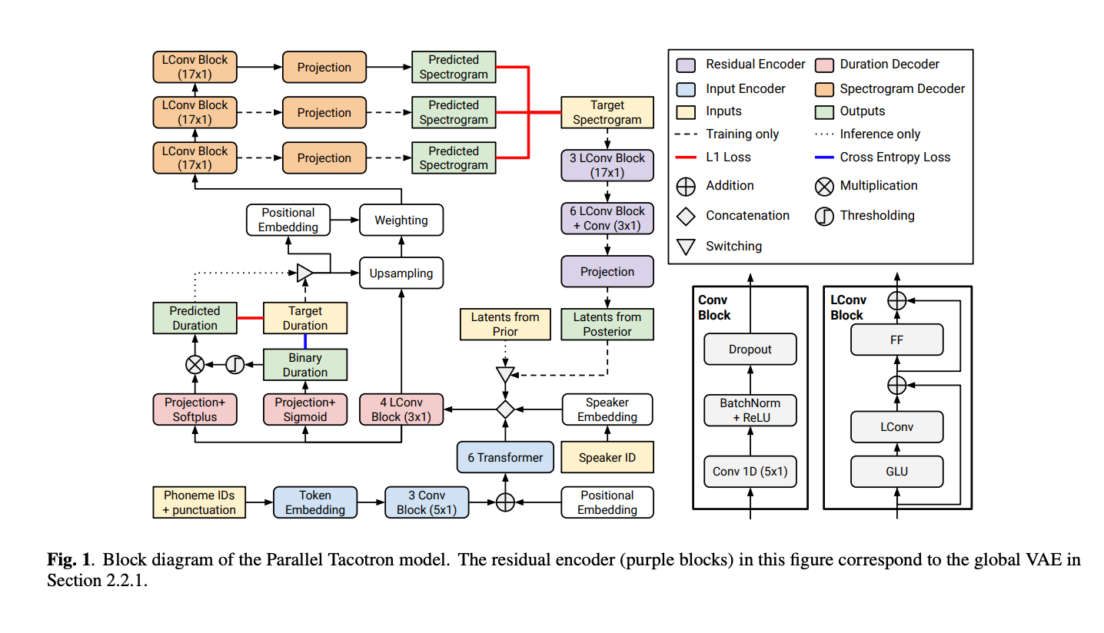
Parallel Tacotron
https://arxiv.org/pdf/2010.11439
Non-Autoregressive Tacotron Variant
Learned Duration model
VAE Latents
Residual Reconstruction
Parallel Tacotron: Non-Autoregressive and Controllable TTS

Slide 58
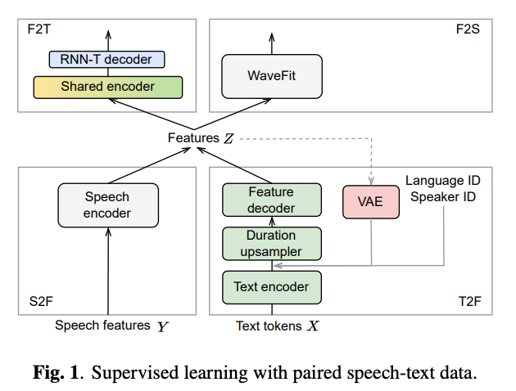
Virtuoso, Maestro and Extensions
https://arxiv.org/pdf/2402.18932
Joint modeling of speech and text
Designed for large multilingual modeling with found data and unlabeled data
Works fairly well on +100 languages
Especially effective for decomposition of language and speaker
MAESTRO: Matched Speech Text Representations through Modality Matching
Virtuoso: Massive Multilingual Speech-Text Joint Semi-Supervised Learning for Text-To-Speech
Extending Multilingual Speech Synthesis to 100+ Languages without Transcribed Data

Slide 59
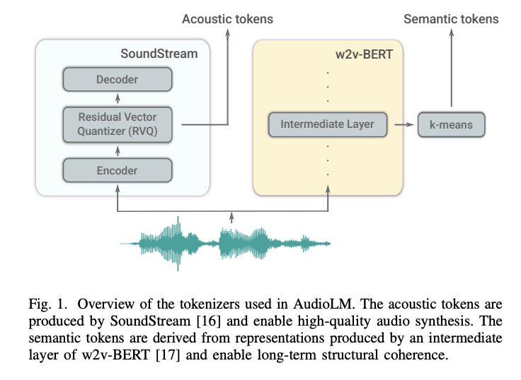
AudioLM
Acoustic tokenization at multiple levels
“Language Model” style training of discrete tokens
Coherence from prefix prompt into continuation
AudioLM: a Language Modeling Approach to Audio Generation https://arxiv.org/pdf/2209.03143

Slide 60
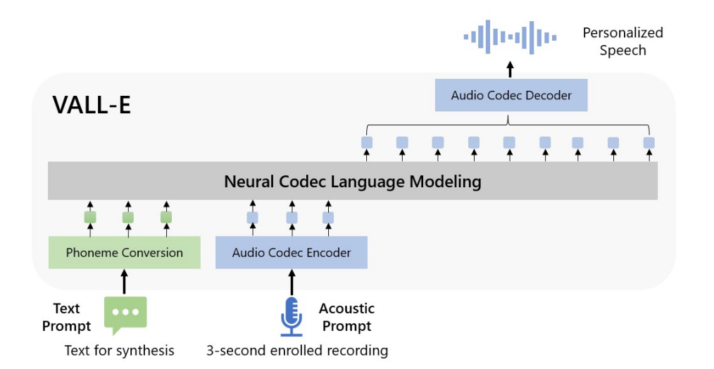
VALL-E
Language model over neural codec discrete codes.
Phone prompt
Acoustic prompt
Decoder-only Transformer based LM
Detail: encodec (and soundstream) have layers of codes. The first code is predicted autoregressively. 2-N use a non-AR model
Neural Codec Language Models are Zero-Shot Text to Speech Synthesizers https://arxiv.org/pdf/2301.02111

Slide 61
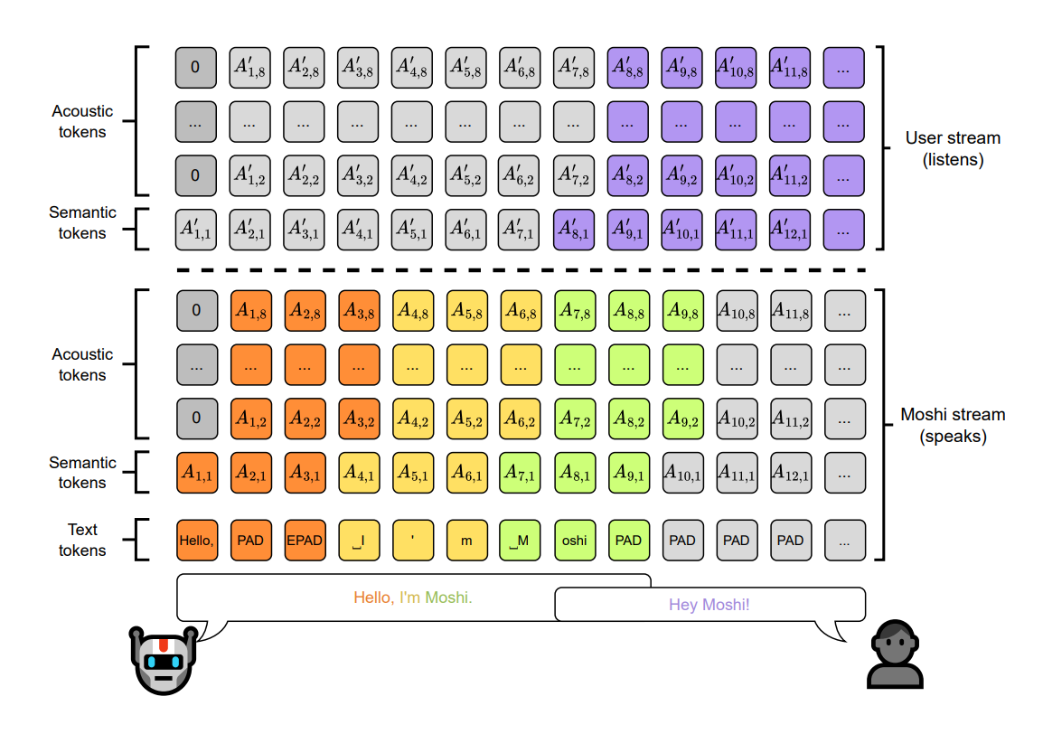
Moshi
Speech-text foundation model, designed around dialog
Transformer based Language Model
Acoustic Encoder (similar to soundstream and encodec)
RQ-transformer to predict hierarchical encoder codes
Moshi: a speech-text foundation model for real-time dialogue https://arxiv.org/pdf/2410.00037

