Slide 1

Knowledge-enhanced Language Models and Human-AI Collaboration Frameworks
for Figurative Language Generation
Tuhin Chakrabarty
April, 2024

Slide 2




Knowledge-Enhanced
Models
Human-AI collaboration Frameworks
+
Linguistic knowledge,
Common sense knowledge
Creative NLG
Sarcasm ACL20
Metaphor NAACL21;ACL21
Simile EMNLP20;
Generate High Quality Datasets
Figurative Language EMNLP22
Visual metaphors ACL23

Slide 3
How can we model AI to generate sarcasm?
Be evaluative
Be based on a reversal of valence between the literal and intended meaning
Be based on a semantic incongruity with the context, which can include shared common sense or world knowledge between the speaker and addressee
Be aimed at some target
Be relevant to the communicative situation in some way
I made the genius choice of selling my car right before I decided to move

Slide 4
R^3 : Reverse, Retrieve, and Rank for Sarcasm Generation with Commonsense Knowledge ( Chakrabarty et al ACL 2020)
Starting from an evaluative non-sarcastic utterance, generate a sarcastic utterance that keeps the speaker's intended meaning.
Notes:
Here say we simplify the task, but say that our generated sarcastic message should have the first 4 characteristics

Slide 5
An Examples
Non Sarcastic
This is a horrible music video.
Sarcastic
This is a great music video. Let’s take a look at the ear damage.

Slide 6
Generating Sarcasm is Challenging
No large parallel corpus of non-sarcastic to sarcastic text to train a generative model.
Even if a large parallel corpus exists, learning the distribution of existing data and sampling from it will likely just mimic/memorize, rather than generate truly novel, creative sarcasm.
Notes:
I feel the Creative composition sign is not needed and is distracting...

Slide 7

Our approach
Given the lack of training data for sarcasm generation, we propose a novel unsupervised approach that has three main components inspired by the sarcasm factors
Reversal of Valence
Retrieval of Common sense Context
Ranking of Semantic Incongruity

Slide 8

Lets see how it makes Sarcasm better
Non-Sarcastic : Zero visibility in fog makes driving difficult.

Slide 9

Reversal Of Valence
Zero visibility in fog makes driving difficult easy.

Slide 10

Retrieval Of Commonsense Context
Zero visibility in fog makes driving difficult easy. It is advisable to insure your life against accident.

Slide 11

Ranking Of Semantic Incongruity
Zero visibility in fog makes driving difficult easy. Suffered three cracked ribs in the accident.

Slide 12
Crowdworker written Sarcasm
Driving is nice with zero visibility.
Notes:
Now contrast to the human and bring up that our generation can sometimes be better than human written sarcasms.

Slide 13
System Overview
zero visibility in fog makes driving easy
zero visibility in fog makes driving easy. suffered three cracked ribs in the accident.
REVERSE
CONCAT
REVERSAL OF VALENCE
NON-SARCASTIC UTTERANCE REVERSED
TOP RANKED
SENTENCE
SARCASTIC
OUTPUT
RANKING OF
SEMANTIC
INCONGRUITY
NON-SARCASTIC UTTERANCE INPUT
zero visibility in fog makes driving difficult
ROBERTA LARGE
FINE-TUNED ON
MNLI
POS TAGGING
FORM CANDIDATE
PAIRS FOR NLI
Inputs: zero, visibility,
fog,makes, driving, difficult
INCONGRUITY RANKING
RETRIEVAL OF COMMONSENSE CONTEXT
COMET
(GPT-2 FINE-TUNED
ON CONCEPTNET)
Output: accident
RETRIEVAL
CAUSES
COMMONSENSE
TERM / PHRASE
suffered three cracked ribs in the accident.
I injured my spine in a riding accident.
…...

Slide 14
REVERSE
REVERSAL OF VALENCE
NON-SARCASTIC UTTERANCE REVERSED
NON-SARCASTIC UTTERANCE INPUT

Slide 15
zero visibility in fog makes driving easy
REVERSE
REVERSAL OF VALENCE
NON-SARCASTIC UTTERANCE REVERSED
NON-SARCASTIC UTTERANCE INPUT
zero visibility in fog makes driving difficult

Slide 16
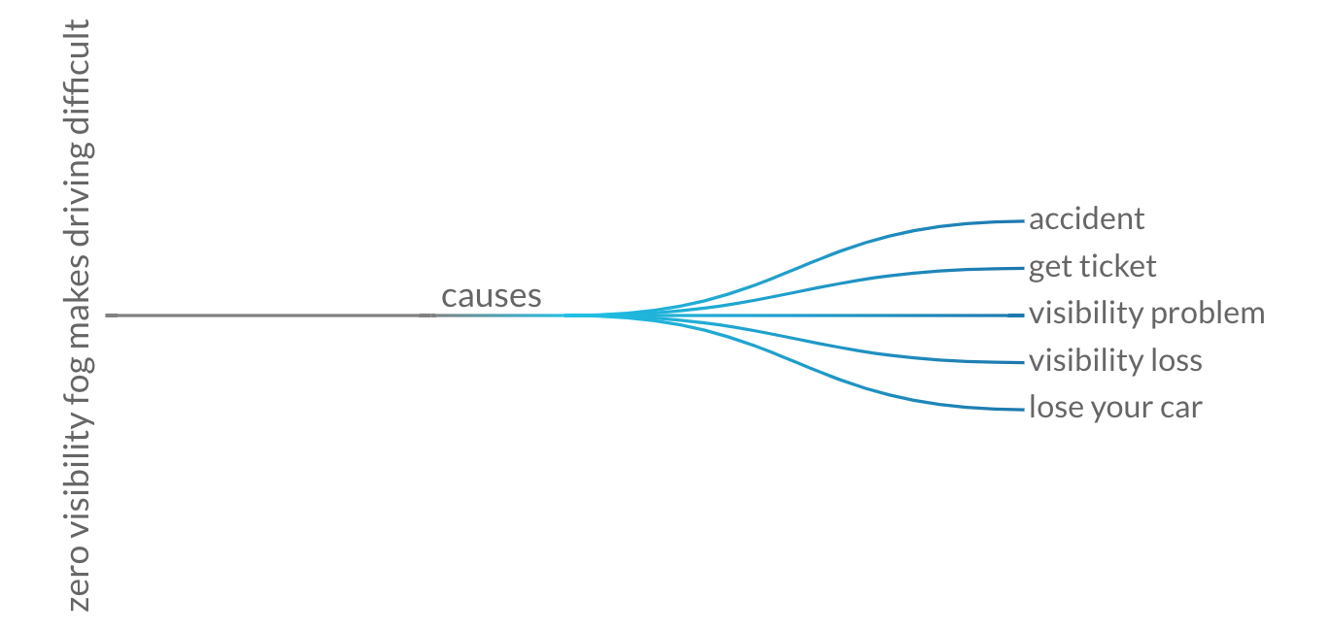
NON-SARCASTIC UTTERANCE INPUT
zero visibility in fog makes driving difficult
POS TAGGING
COMET (Bosselut et al 2019)
Inputs: zero, visibility,
fog,makes, driving, difficult
RETRIEVAL OF COMMONSENSE CONTEXT
COMET
(GPT-2 FINE-TUNED
ON CONCEPTNET)
Output: accident
RETRIEVAL
suffered three cracked ribs in the accident.
I injured my spine in a riding accident.
…...
CAUSES
COMMONSENSE
TERM / PHRASE

Slide 17
NON-SARCASTIC UTTERANCE INPUT
zero visibility in fog makes driving difficult
POS TAGGING
COMET (Bosselut et al 2019)
Inputs: zero, visibility,
fog,makes, driving, difficult
RETRIEVAL OF COMMONSENSE CONTEXT
COMET
(GPT-2 FINE-TUNED
ON CONCEPTNET)
Output: accident
RETRIEVAL
suffered three cracked ribs in the accident.
I injured my spine in a riding accident.
…...
CAUSES
COMMONSENSE
TERM / PHRASE

Slide 18
zero visibility in fog makes driving easy
zero visibility in fog makes driving easy. suffered three cracked ribs in the accident.
REVERSAL OF VALENCE
CONCAT
NON-SARCASTIC UTTERANCE REVERSED
TOP RANKED
SENTENCE
SARCASTIC
OUTPUT
RANKING OF
SEMANTIC
INCONGRUITY
ROBERTA LARGE
FINE-TUNED ON
MNLI
FORM CANDIDATE
PAIRS FOR NLI
INCONGRUITY RANKING
suffered three cracked ribs in the accident.
I injured my spine in a riding accident.
…...
Notes:
After this Add again the overall slide and add R^3 As name in the corner left.

Slide 19
zero visibility in fog makes driving easy
zero visibility in fog makes driving easy. suffered three cracked ribs in the accident.
REVERSE
CONCAT
REVERSAL OF VALENCE
NON-SARCASTIC UTTERANCE REVERSED
TOP RANKED
SENTENCE
SARCASTIC
OUTPUT
RANKING OF
SEMANTIC
INCONGRUITY
NON-SARCASTIC UTTERANCE INPUT
zero visibility in fog makes driving difficult
ROBERTA LARGE
FINE-TUNED ON
MNLI
POS TAGGING
FORM CANDIDATE
PAIRS FOR NLI
INCONGRUITY RANKING
Inputs: zero, visibility,
fog,makes, driving, difficult
RETRIEVAL OF COMMONSENSE CONTEXT
COMET
(GPT-2 FINE-TUNED
ON CONCEPTNET)
Output: accident
RETRIEVAL
suffered three cracked ribs in the accident.
I injured my spine in a riding accident.
…...
CAUSES
COMMONSENSE
TERM / PHRASE

Slide 20
Evaluation Setup
Test Set
Test on 150 randomly selected non sarcastic utterance
Evaluation Criterion
Creativity
Sarcasticness
Humor
Grammaticality
Notes:
Maybe make this slide Evaluation Setup and have “Test Set” and “Evaluation Criteria” as subbullets.

Slide 21
Ablations
Reversal of Valence (RV)
No Reversal of Valence (NoRV)
No Semantic Incongruity (NSI)
SOTA (Hybrid reinforced seq2seq model Mishra et al 2019)
Full Model (FM)
Human (Gold) Sarcasm

Slide 22
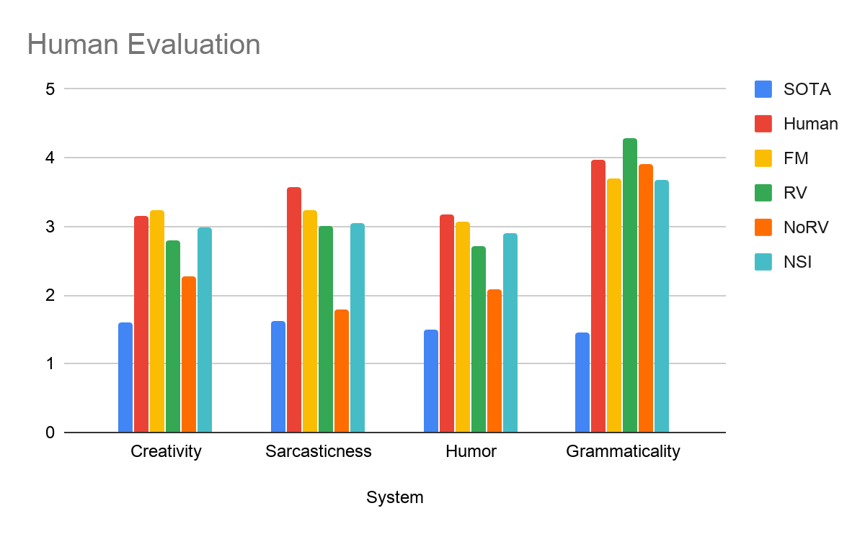
Results

Slide 23
Why should AI be able to generate metaphors?
Metaphors shape the mind, structure our experiences, and influence behavior (Lakoff and Johnson 1980)
Evoking emotions and conveying deeper meanings in writing
Education and Learning
METAPHORS IN THERAPY
Helps to explain ideas
Take home remembrance of the session
Suggest possibility of alternatives
Sometimes fate is a small sandstorm that keeps changing directions
-Murakami, Kafka on the Shore
Therapy and Counseling
A cell is a city. The nucleus is the city center, where important decisions are made. The mitochondria are the power plants

Slide 24
MERMAID: Metaphor Generation with Symbolism and Discriminative Decoding (Chakrabarty et al; NAACL 2021)
Simplifying assumption: focus on verbs as they are often the key component of metaphoric expressions (Steen et al., 2010; Martin, 2006).
Given a literal input sentence, generate a corresponding metaphoric sentence
Literal
The window panes were rattling as the wind blew through them
Metaphor
The window panes were trembling as the wind blew through them

Slide 25
Key Challenges and Solutions
Lack of parallel (literal, metaphorical) training data
Automatically create parallel data with distant supervision
Ensuring Meaning (metaphor) = Meaning (Literal)
Rely on external knowledge and theoretical grounding
Generative language models tend to produce literal text over metaphorical one
Modify inference objective to improve outputs

Slide 26
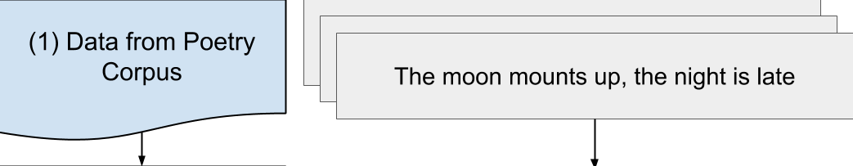
Automatic Creation of Parallel Data
Detect sentences with metaphoric verbs
Gutenberg Poetry Corpus
The house where love had died
Address this challenge through theoretical insight + knowledge
injection
How can we convert to literal meaning that is semantically consistent?
The house where love had ended

Slide 27
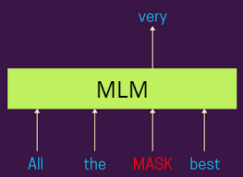


How to generate literal meaning from metaphors?
BERT
Trained on
3.3B words
Masked Language Model
But how to also ensure semantic consistency ?
started (0.11)
withered (0.08)
ended (0.06)
…
flickered (0.04)
The house where love had MASK

Slide 28
Insight
Theoretically grounded relation between metaphors and symbols
  “A metaphor is not language, it is an idea expressed by language, an idea that in its turn functions as a symbol to express something” (Susanne Langer)

Slide 29

Semantic Consistency based on Theoretical Grounding
Adapted knowledge model, COMET
(Bosselut et al., 2019)
Language Model trained on a knowledge graph called ConceptNet
The house where love had died
Theoretical connection between metaphor and symbol :
Susanne Langer
SymbolOf
relation
Loss, Loneliness,Despair, Sadness, Sorrow
The house where love had started
The house where love had ended
0/5 = 0.0
5/5 = 1.0
Love,Life,Marriage,Romance,Passion
Loss,Loneliness,Despair,Sadness,Sorrow

Slide 30

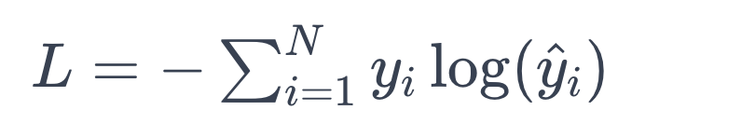

Metaphor Generation (Training)
Created parallel data: 90K training, ~3k validation
METAPHOR
LITERAL
The house where love had died
.......
The house where love had ended
.........
MLM
COMET
DECODER TARGET
ENCODER
SOURCE
Training
Language
Model (Bart)
True p for token in a metaphor
Predicted p for token in a metaphor
Fine-tune BART ( Lewis et al 2019): pre-trained
language model
18

Slide 31
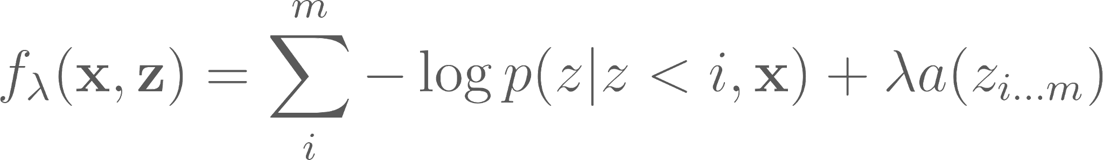
Metaphor Generation (Inference)
Inference step
Language
Model (Bart)
DISCRIMINATOR
The window panes were trembling as the winds blew threw them
The window panes were rattling as the winds blew threw them
(Metaphor rescoring model a)
x : Literal sentence
z : Metaphorical sentence
a: Rescoring model predicts 0/1 based on presence of metaphoric verb
Controls discriminator weight
‹#›

Slide 32
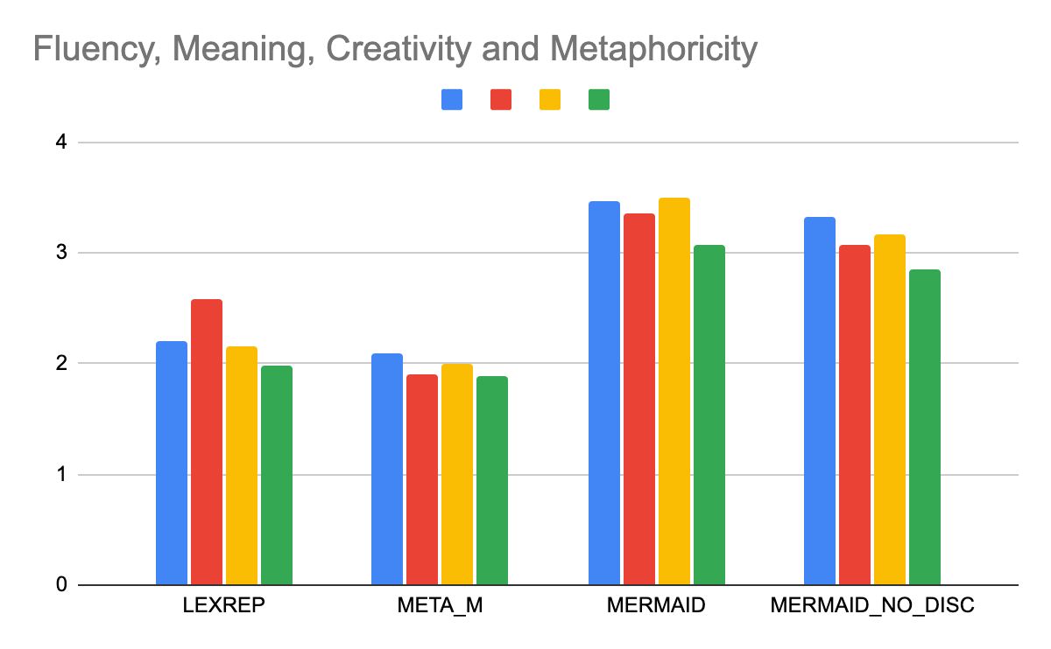
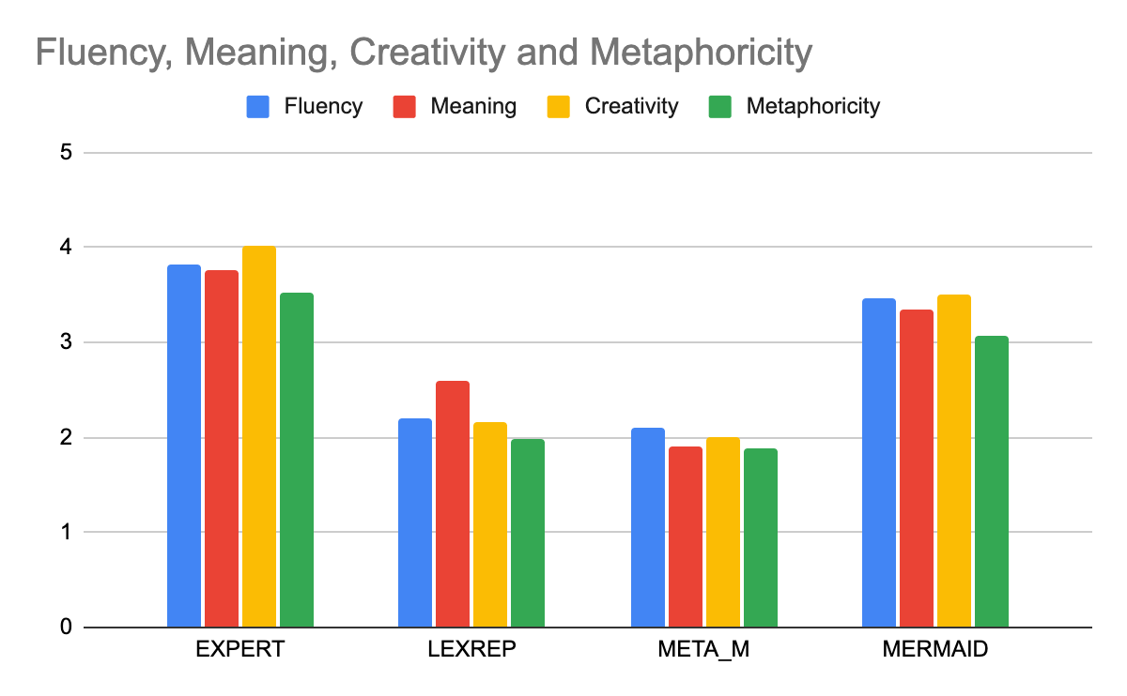
Human Evaluation Results
Carefully curated test set with metaphors written by literary experts for any given literal input
Recruit crowdworkers with strict training and ask them to rate outputs on
Likert scale (0-5)
DROP w/o DISC
3.76%
8.06%
9.71%
7.17%
Baselines
Notes:
IAA using Krippendorff’s alpha for Creativity, Meaning, Fluency and Metaphoricity are 0.44, 0.42, 0.68, 0.52

Slide 33
Multiple and Novel Metaphor (Conceptual Metaphors)
(Stowe, Chakrabarty et al; ACL 2021)
Conceptual Metaphor Theory (CMT) : Conceptual mapping between
Target Source domains (Lakoff and Johnson 1980)
The party ended as soon as she left
Semantic Frames as Domains
CAUSE_TO_END
DEATH
CHANGE_POSITION
The party died as soon as she left
The party dwindled as soon as she left

Slide 34
Multiple and Novel Metaphor (Conceptual Metaphors)
(Stowe, Chakrabarty et al; ACL 2021)
Conceptual Metaphor Theory (CMT) : Conceptual mapping between
Target Source domains (Lakoff and Johnson 1980)
We similarly train a language model on data from MERMAID augmented with metaphoric mapping and the model generalizes to unseen domains
Knowledge used:
  Common sense knowledge : COMET
  Linguistic knowledge (frame semantics) : FRAMENET

Slide 35
Beyond word level metaphor generation
A Style Transfer Approach for Simile Generation (Chakrabarty et al; EMNLP 2020)
[...]
His laughter almost sounded like a roar
[....]
His laughter almost sounded loud and powerful
COMET
Has Property
DECODER TARGET
Language
Model (Bart)
ENCODER
SOURCE
The food cooked by mother is always
delicious
Language
Model (Bart)
The food cooked by mother is always
like a warm embrace for the taste buds.

Slide 36

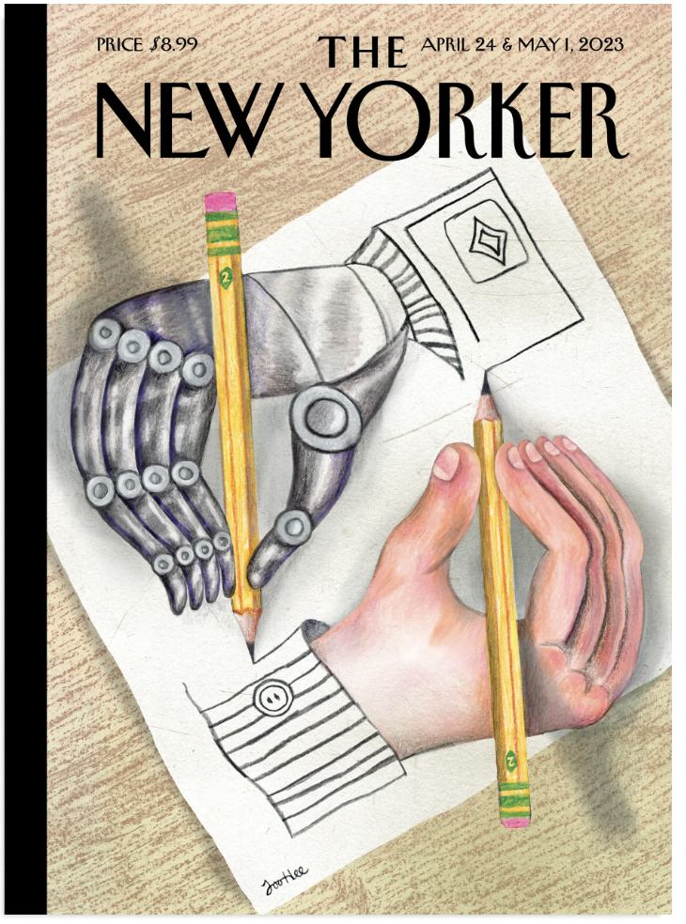
What is a Visual Metaphor?
Powerful rhetorical device used to persuade or communicate creative ideas through images. They convey meaning implicitly through symbolism and juxtaposition of the symbols

Slide 37

Generating Visual Metaphors
We propose a new task of generating visual metaphors from linguistic metaphors
He was a lion in the battlefield
Underspecification
Hutchinson et al., 2022
Attribute Object Binding
Saharia et al., 2022
Requires understanding implicit meaning, & merge objects, properties, and relations involved

Slide 38
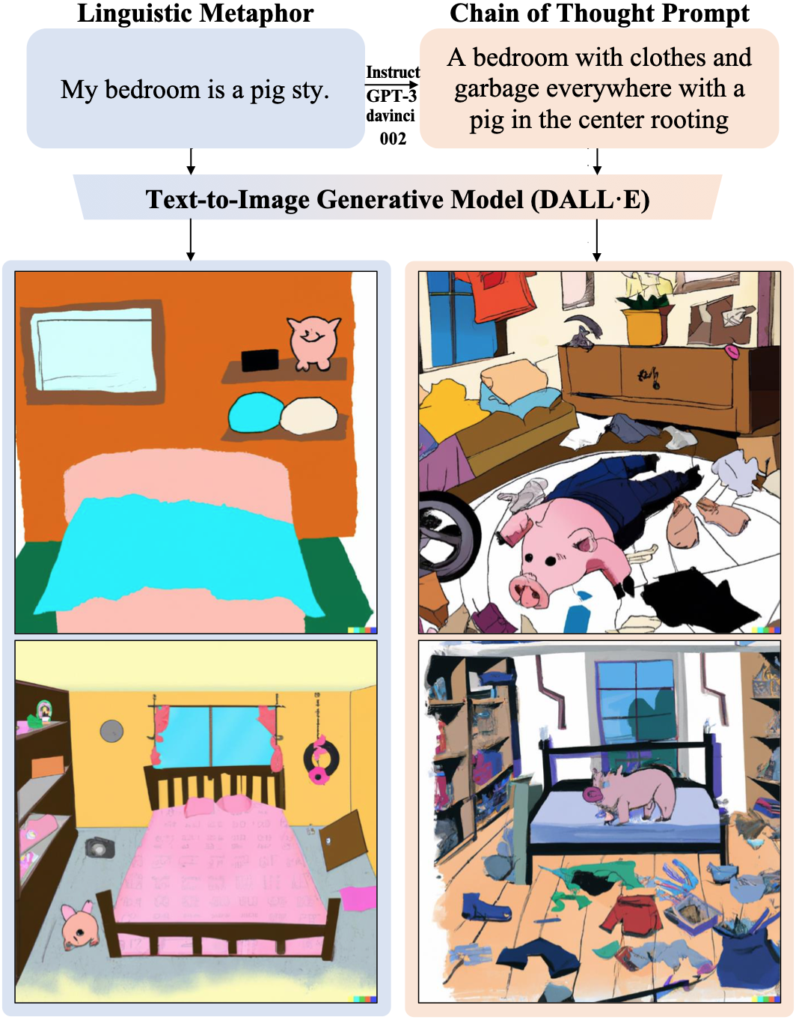
I Spy a Metaphor: Large Language Models and Diffusion Models Co-Create Visual Metaphors (Chakrabarty et al; ACL 2023 _{Findings})
Novel approach through collaboration of Large Language Models (e.g GPT3) and Vision and Language Models (e.g DALLE2, Stable diffusion)
HAIVmet: A high-quality visual metaphor dataset of 6476 examples built through Human-AI collaboration

Slide 39
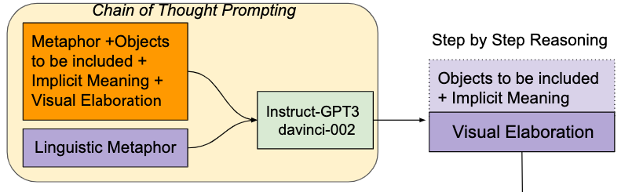
Generate Elaboration through Step-by-Step Reasoning
Task Instruction
Task Demonstration
1. Metaphor: My lawyer is a shark.
Objects to be included: Lawyer, Shark
Implicit Meaning: fierce
Visual elaboration: A shark in a suit with fierce eyes and a
suitcase and a mouth open with pointy teeth.
2.
[….]
4.
[….]
6. Metaphor: My bedroom is a pigsty
Written by Human
Objects to be included: Messy bedroom, Pig
Implicit Meaning: dirty
Visual elaboration: A bedroom with clothes and garbage
everywhere with a pig in the center rooting around.
Written by Machine

Slide 40
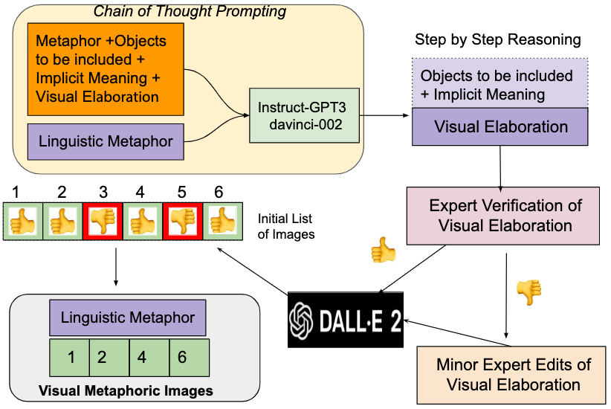


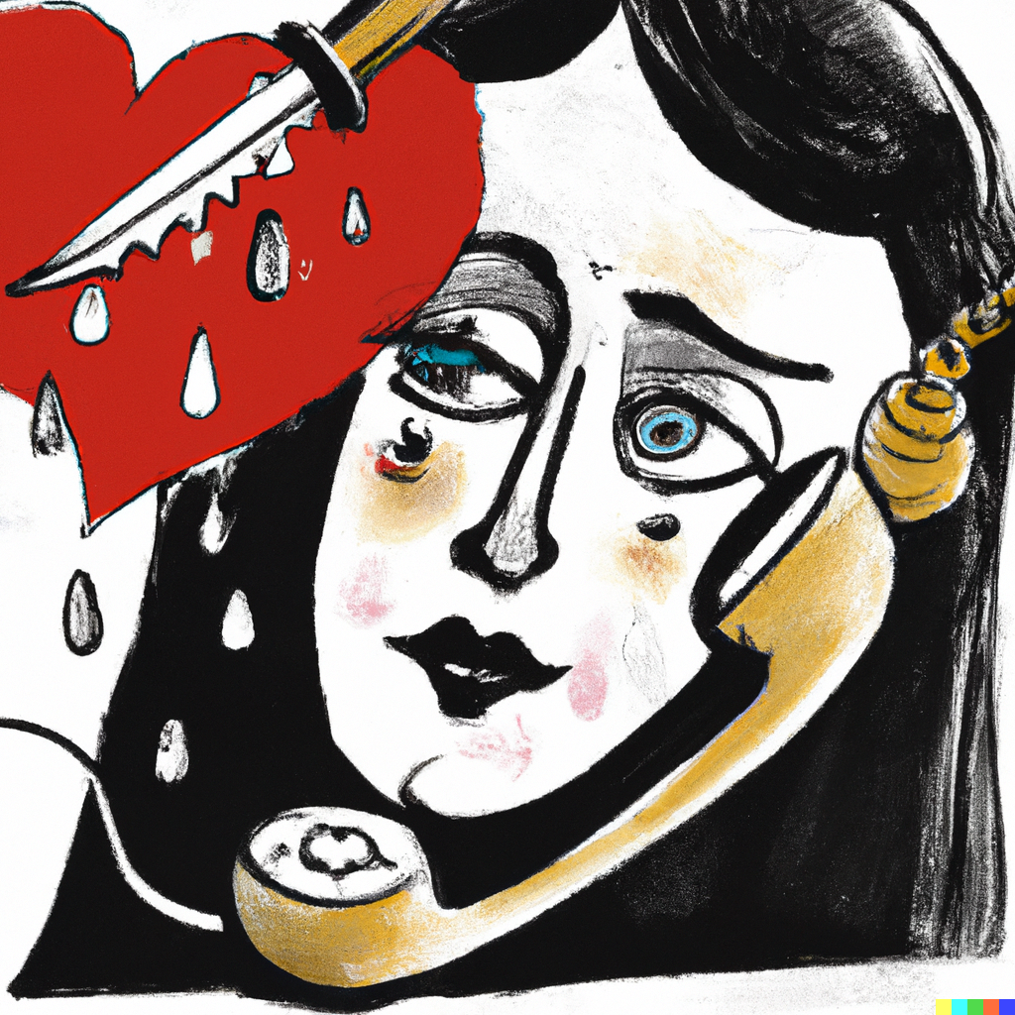
Human AI collaboration for HAIVmet
The news of the accident was a dagger in her heart
A heart with a dagger stuck into it, dripping with blood and pain in the woman’s eye
A woman receiving a phone call and her heart with a dagger stuck into it, dripping with blood and pain in the woman’s eye

Slide 41
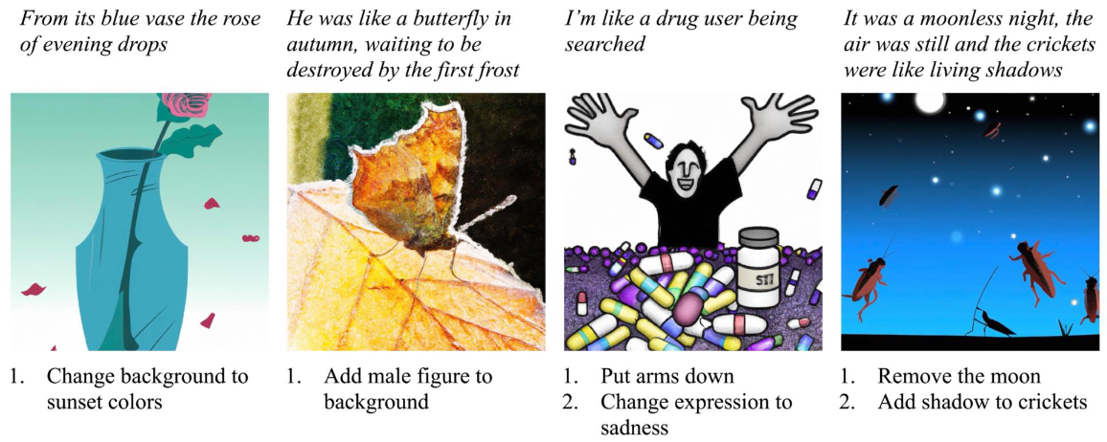
Expert Feedback
Provide instructions needed to make the image better, unless Perfect or Lost Cause

Slide 42
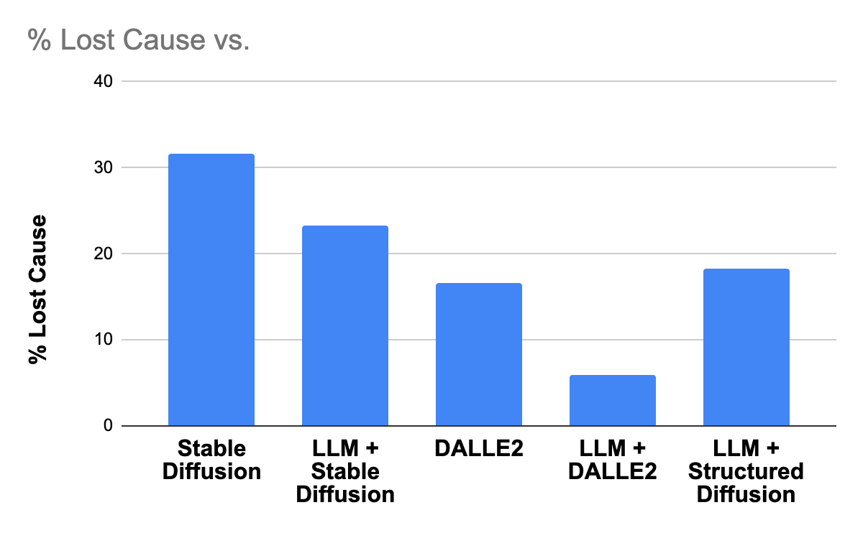
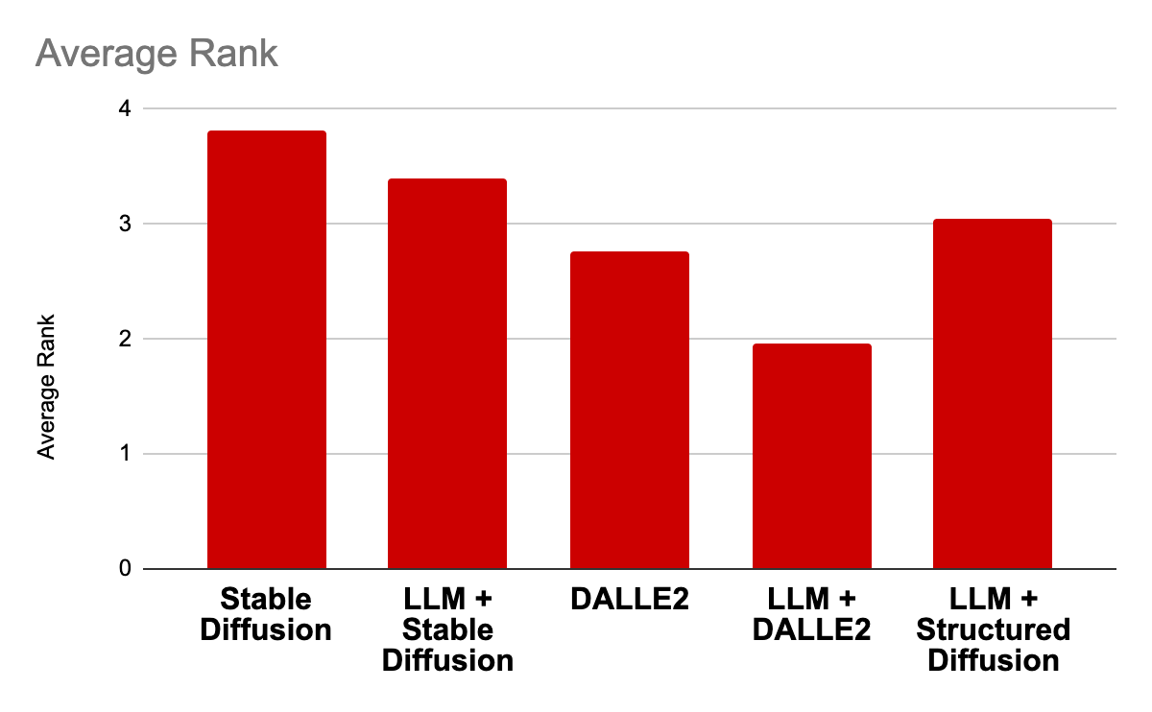
How good are text-to-image models when they collaborate with GPT3?
Concept illustrationists perform evaluation by ranking outputs from 100 random linguistic metaphors as well suggest edits unless Perfect or Lost Cause
Lower is Better
Lower is Better
Metric: Rank of outputs from systems
Metric: What % of images are Lost Cause

Slide 43
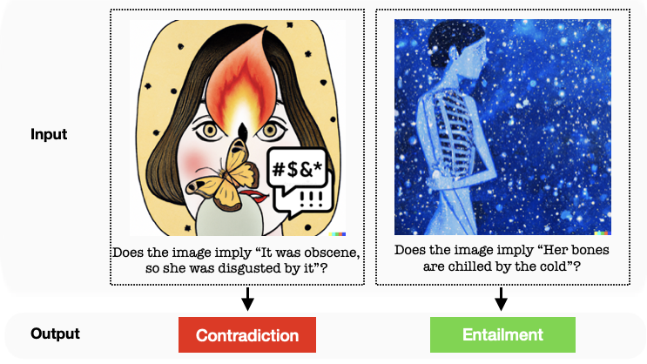
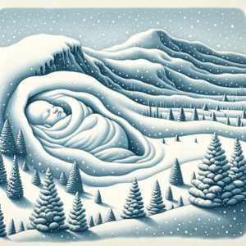
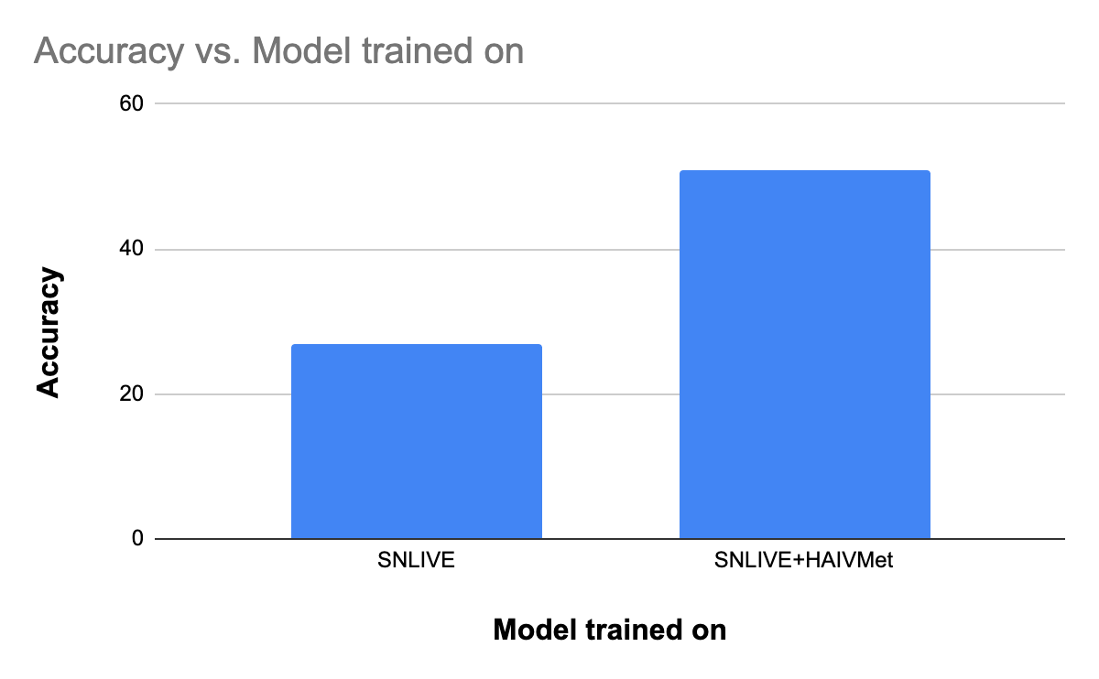
Extrinsic Evaluation : Visual Entailment
<Image,Claim> pair refers
to the same thing or not
Does the image imply “The snow made the earth look exposed and vulnerable”
Does the image imply “Her bones are chilled by the cold”
SNLI-VE : Visual entailment: A novel task for fine-grained image understanding CVPR 2019

Slide 44

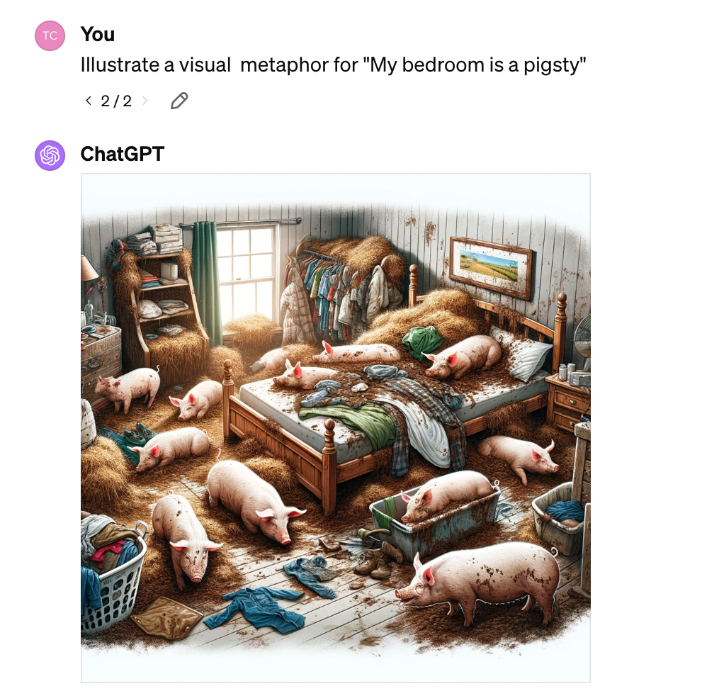
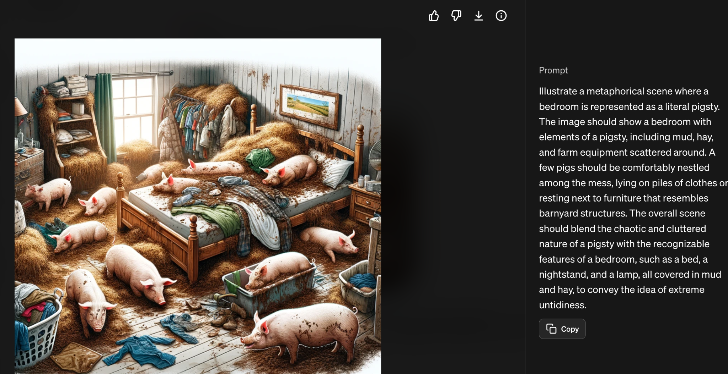
Similar Adaptation

Slide 45
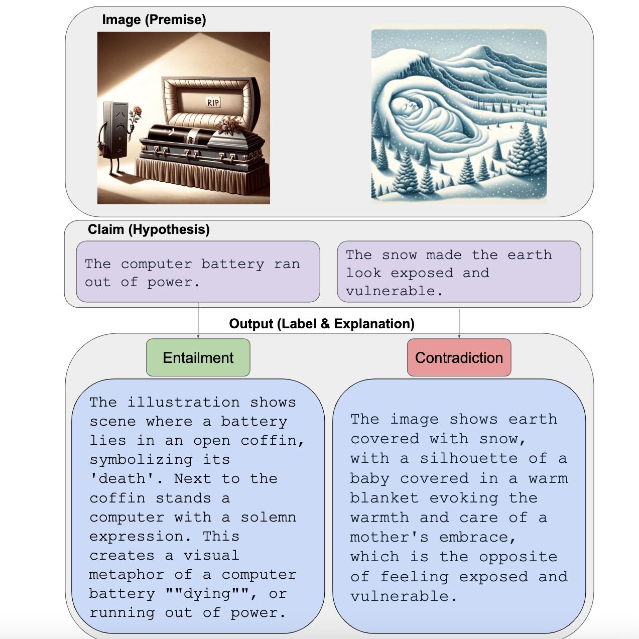
Some upcoming work

Slide 46
Thank You

