Slide 1
Spoken Dialogue Systems
Julia Hirschberg
COMS 6998
*Thank you to Svetlana Stoyanchev, Sarah Ita Levitan, and Zhou Yu for original and updated slides
Notes:
Play gbose emotion files

Slide 2
What is Natural Language Dialogue?
Communication involving
  Multiple contributions
  Coherent interaction
  More than one participant
Interaction modalities
  Input: Speech, typing, writing, gesture
  Output: Speech, text, graphical display, animated face/body (Avatar: embodied virtual agent)

Slide 3
When is an Automatic Dialogue System Useful?
When hands-free interaction is needed
  In-car interface
  In-field assistant system
  Command-and-control interface
  Language tutoring
  Immersive training (e.g. autistic children)
When speaking is easier than typing
  Voice search interface
  Virtual assistant (Siri, Google Now, Alexa, Cortana)
Notes:
When do you use one of these?

Slide 4
How is this useful?
  Replacing human agents (cutting cost for companies)
  Call routing for companies, travel systems
  Menu-based customer help
  Voice interface for customer assistance

Slide 5
Visions of Dialogue from Science Fiction
Hal “2001: A Space Odyssey” (1968)
  Naturally conversing computer
Star Trek (original 1966)
  Natural language command and control
Her (2013)
  A virtual partner with natural dialogue capabilities
Avatar 1 (2009), 2 (2022), 3 (2024), 4 (2026), 5 (2028)
  James Cameron films where humans can become avatars when they need to
Notes:
Links?

Slide 6
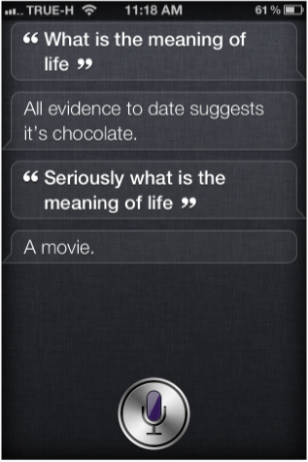
Examples of Modern Virtual Assistant Dialogue Systems
Apple Siri (2010 --)
  Supports questions in a set of domains
  Answers open-ended questions
  Cute “Easter egg” responses

Slide 7
Examples of Modern Virtual Assistant Dialogue Systems
Android Google Assistant (2016 --)
  Virtual assistant engaging in conversation
Windows Cortana (2014 --)
  Works across different Windows devices
  Aims to be able to “talk about anything”

Slide 8
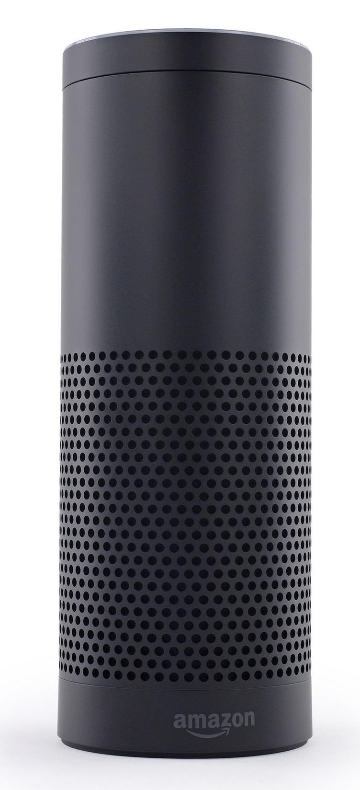
Embedded Devices with Dialogue Capabilities
Amazon Echo and Alexa (2014 --) – home assistant device
  Plays music
    With voice commands
  Question answering
    Get weather, news
    More complex questions, like
      “how many spoons are in a cup?”
  Setting timer for wakeup, lights, laundry
  Manage TODO lists
  Shopping on Amazon…

Slide 9
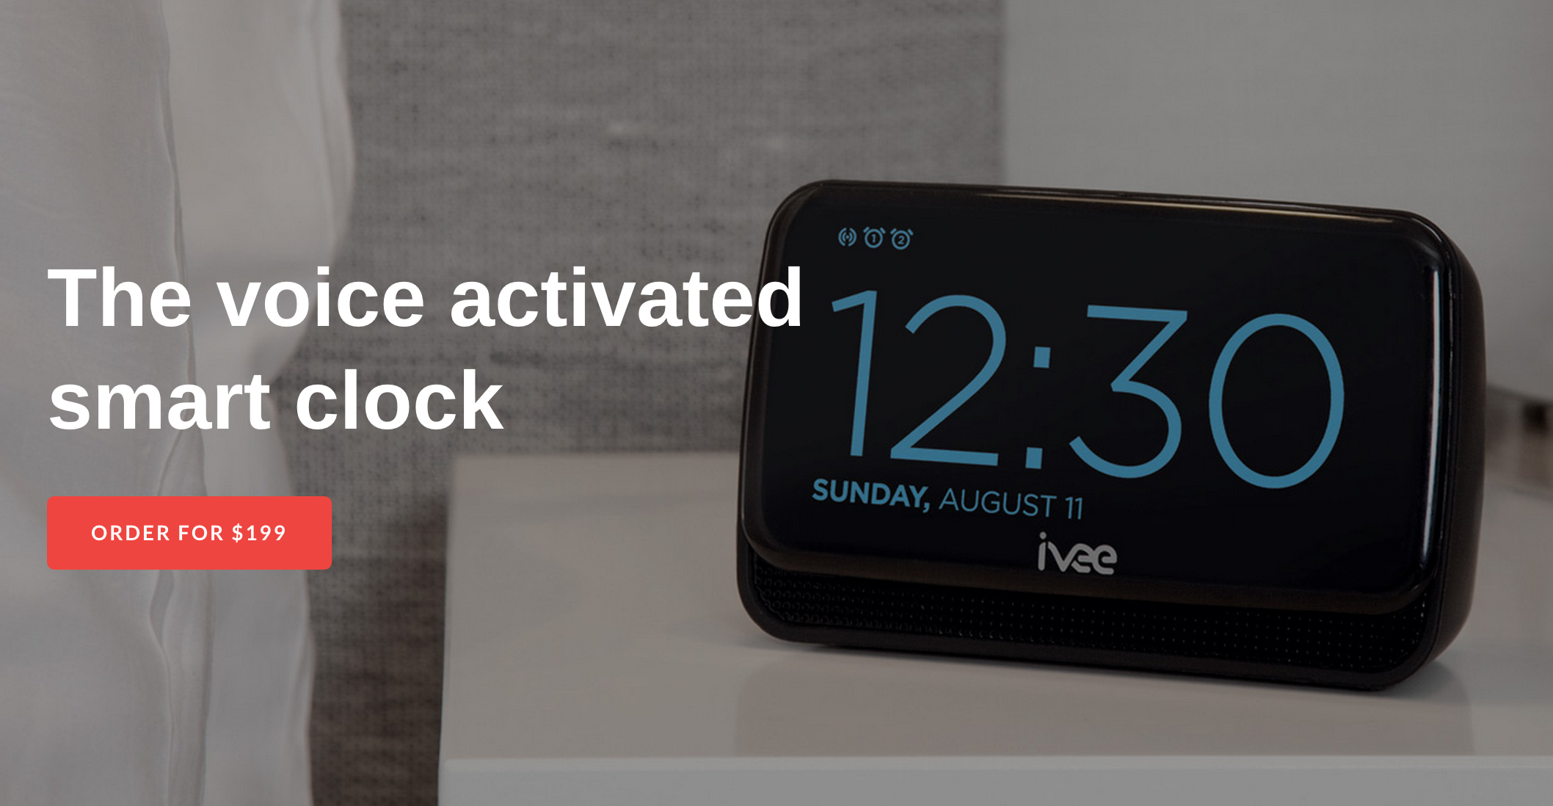
Embedded Devices with Dialogue Capabilities
Answers questions
Sets time
Device control and query: thermostat, etc.
Uses Wolfram Alfa engine on the back-end to answer questions

Slide 10
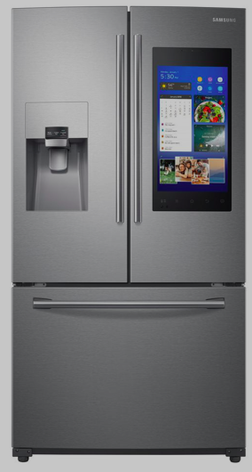
Embedded Devices with Dialogue Capabilities
Control ice machines
Control microwaves
Manage shopping lists
Stream music and TV
Alexa compatible
Others?

Slide 11
Research in Dialogue Systems
Research systems explore
  Novel research questions in speech recognition/ language understanding/ generation/ dialogue management/ intention recognition/ persuasion/ entrainment/ empathy
Research systems today are
  Based on more novel theoretical frameworks
  Often used for open-domain speech recognition
  Focus on theory development as well as deep learning systems
Transition from research to commercial
  Siri (2010) came out of a DARPA-funded research project (CALO) run by Ron Brachman
Notes:
DARPA project name

Slide 12
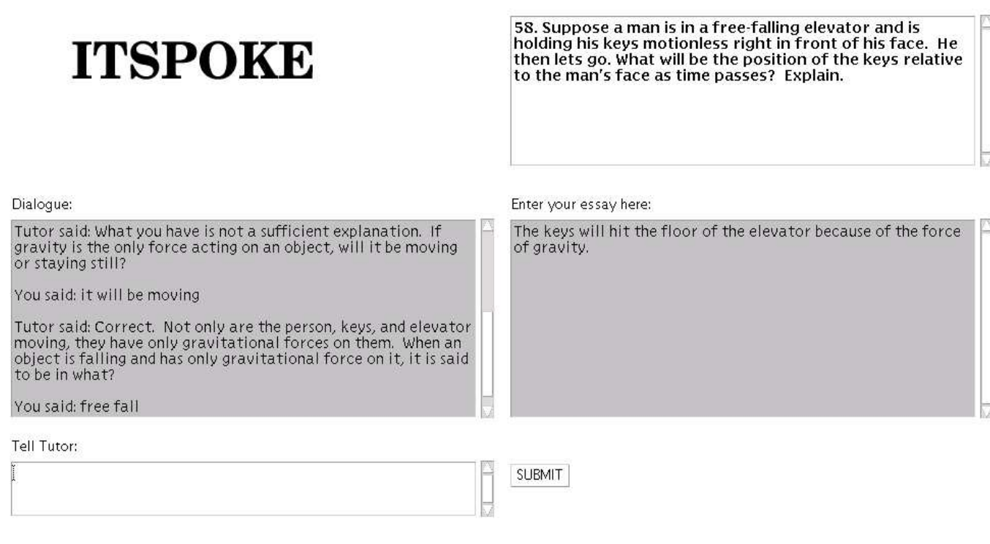
Early Tutoring System on Qualitative Physics (Litman & Silliman, 2004), U. Pittsburgh
Notes:
Tutor answers questions about qualitative physic

Slide 13
CMU Bus Information System (Let’s Go)
Bohus et al. (deployed in 2005) CMU
  Telephone-based bus information system
  Deployed by Pittsburgh Port Authority
  Received calls from real users after 5pm
  Noisy conditions
  Speech recognition word error rate ~ 50%
Used collected data for research and shared with community
Provided platform to allow other researchers to test SDS components

Slide 14
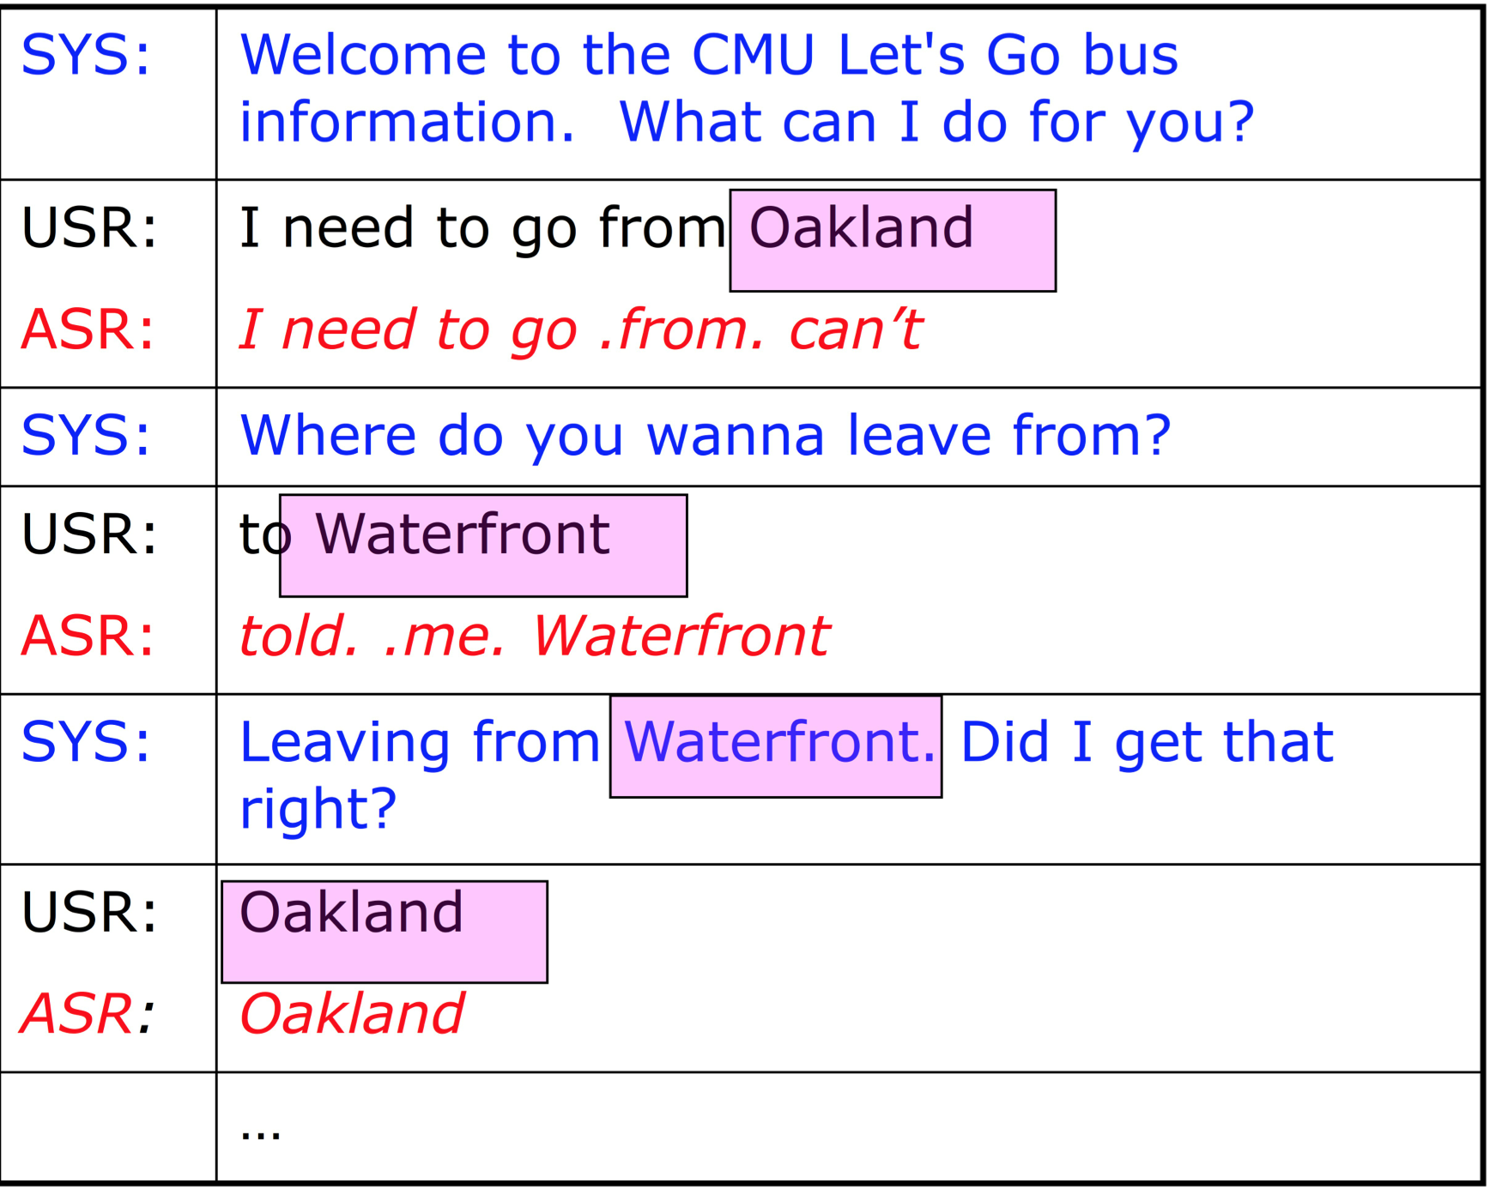
CMU LetsGo Dialogue Example

Slide 15
Commercial vs. Research Dialogue Systems
Goal
      System Flexibility
Ability to accept varied input
Support multiple wide range of queries
Multiple domains
User initiative allowed
Research
Commercial
System Reliability
Notes:
More flexibility in reserch systems but more accuracy/reliability in commercial systems

Slide 16
Types of Dialogue Systems
Task-oriented dialogue systems
  Designed for a particular task (e.g. travel, accommodation, restaurant reservations. shopping)
  Short conversations to get information from a user to help complete the task
Chatbots
  Designed for extended conversations, social bots
  Mimic unstructured human-human interaction
  Goal: encourage more human interaction
  Much more challenging… and more on this later
  Now moving to healthcare applications as well
Notes:
More on current ones later ☺

Slide 17
What is Involved in NL Dialogue?
Understanding
  What does a person say?
    Identify words from speech signal
      “Please close the window”
  What does the speech mean?
    Identify semantic content
      Request ( subject: close ( object: window))
  What were the speaker’s intentions?
    Speaker requests an action in a physical world

Slide 18
Managing interaction
  Use an internal representation of the domain
  Identify new information outside the domain
  Identify which action to perform, given new information
    “close the window”, “set a thermostat” -> physical action
    “what is the weather like outside?” -> call the weather API
  Determine a response
    “OK”, “I can’t do it”
    Provide an answer
    Ask a clarification question (often more challenging)
Notes:
e.g. Which window do you want to close? What do you want the thermostat set too? Where is the person located?

Slide 19
What else does a system need?
  Needs to have access to real world information
  To process a request “Please close the window” you (or the system) needs to know:
    There is a (specific) window
    Window is currently open
    Window can/can not be closed
Notes:
e.g. in our classroom…

Slide 20
What other issues arise in NL Dialogue Systems?
Producing language
  Deciding when to speak – deciding when the user has finished is tricky – humans respond more quickly than dialogue systems – sometimes before the other speaker has stopped
  Deciding what to say
    Choosing the appropriate meaning
  Deciding how to present information
    So partner understands it
    So expression seems natural

Slide 21
Types of Dialogue Systems
Command and control for supporting
  Actions in the world
  Robots/bots – situated interaction
Information access
  Database access
    Bus/train/airline information
    Librarian
    Voice manipulation of a personal calendar
  API access

Slide 22
Interactive Voice Response systems – customer service
  Simple call routing
  Menu-based interaction
  Allows flexible response “How may I help you?”
Smart virtual assistants
  Helps you perform tasks, such as buying movie tickets, play music, trouble shooting
  Reminds you about important events without explicit reminder settings

Slide 23
  Tells you the time, the temperature
  Records your shopping list
  Tells stories with you or your children
Notes:
Do people here use virtual assistants for other tasks too?

Slide 24
Differences in Dialogue Systems
Which modalities does the system use?
  Voice only (telephone/microphone & speaker)
  Voice and graphics (smartphones)
  Virtual human (avatars)
    Can show emotions
  Physical device
    Can perform actions (Roomba robot vacuums)
What is the system’s back-end?
  Resources (database/API/ontology) it accesses?

Slide 25
How much world knowledge does the system have
  Hand-built ontologies
  Automatically learned from the web
  Derived from customer-collected data
How much personal knowledge does it have and use
  Your calendar (Google)
  Where you live/work (Google, Life360)
  Who are your friends/relatives (Facebook)
  What do you like to buy (Alexa)?

Slide 26
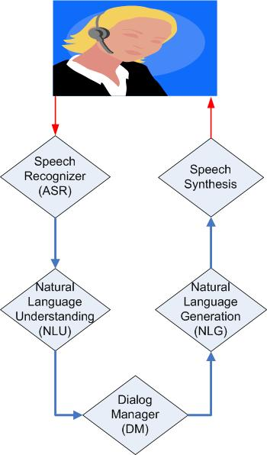
Simple Dialogue System Components
Voice input
Speech
Language Model/Grammar
Acoustic model
Hypothesis (automatic
transcription)
Text
Grammar/Models
Generation templates/
rules
Logical form
of user’s input
Logical form
of system’s output

Slide 27
Simple Dialog System Components
Voice input
Speech
Language Model/Grammar
Acoustic model
Hypothesis (automatic
transcription)
Text
Grammar/Models
Generation templates/
rules
Logical form
of user’s input
Logical form
of system’s output

Slide 28
Speech Recognition
Convert speech signal into text: ASR
Most research SDS use off-the-shelf speech recognizers but industries create their own
  Research systems are highly configurable:
    Kaldi – most used research recognizer
    CMUSphinx and Pocket Sphinx (java API), Otter
    Google Cloud, Gboard, Speechnotes
  Industry (some free, some not)
    Google Cloud ASR, Braina Pro, Amazon Transcribe
    Dragon Anywhere (Nuance); Microsoft Bing, Azure; Verbit
    AT&T Watson, IBM Watson, Speechmatics

Slide 29
Speech Recognition
End2end models built on very large corpora are replacing earlier ASR systems
  Acoustic models that map signal to phonemes
  Language models (LM)/grammars that describe the expected language

Slide 30
Speech Recognition
Challenges: Recognition errors due to
  Noisy environment
  Speaker accent
  Speaker interruptions, self corrections, etc.
  Out-of-vocabulary words

Slide 31
Speech Recognition
Speaker-dependent/independent
  Your own voice: Dragon, Nuance
Domain dependent/independent
  Domain independent – large vocabulary
    Use language models built on large diverse dataset
    Advantages: can potentially recognize any word sequence
    Disadvantages: lower performance on in-domain utterances (e.g., digits may be misrecognized)
  Domain dependent
    Adapt a large vocabulary model to a new domain with a small labeled corpus
Notes:
Speaker specific ASR systems: Dragon, Nuance

Slide 32
Speech Recognition
Grammar-based
  Allows dialogue designer to write grammars
    For example, if your system expects digits a rule:
    S -> zero | one | two | three | …
  Advantages: better performance on in-domain speech
  Disadvantages: does not recognize out-of-domain

Slide 33
Open Domain – large vocabulary
  Use language models built on large diverse dataset
  Advantages: can potentially recognize any word sequence
  Disadvantages: lower performance on in-domain utterances (digits may be misrecognized)
In Domain: adapt large vocabulary model to new domain with small labeled corpus

Slide 34
Dialogue System Components
Voice input
Speech
Language Model/Grammar
Acoustic model
Hypothesis (automatic
transcription)
Text
Grammar/Models
Generation templates/
rules
Logical form
of user’s input
Logical form
of system’s output

Slide 35
Natural Language Understanding
Convert input text into internal representation
  Sample in wit.ai, a tool for creating bots, mobile apps, smart home controls, wearable devices
{
"msg_body": "what is playing at Lincoln Center",
"outcome": {
"intent": "get_shows",
"entities": {
"Venue": {
"value": "Lincoln Center",
}
},
"confidence": 0.545
},
"msg_id": "c942ad0f-0b63-415f-b1ef-84fbfa6268f2"
}

Slide 36
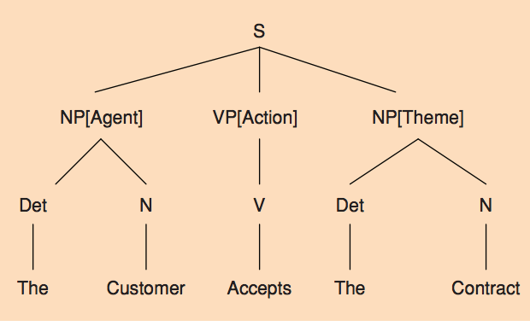
NLU Approaches
Can be based on simple phrase matching
  “leaving from PLACE”
  “arriving at TIME”
Can use deep or shallow syntactic parsing

Slide 37
NLU Approaches
Can be rule-based
  Rules define how to extract semantics from a string/syntactic tree
But most systems train Machine Learning models on annotated data
  Goals
    Classify intent: what is the speaker’s purposes
    Tag named entities in the speaker’s utterance
    Model prior context from this speaker

Slide 38
Dialogue System Components
Voice input
Speech
Language Model/Grammar
Acoustic model
Hypothesis (automatic
transcription)
Text
Grammar/Models
Generation templates/
rules
Logical form
of user’s input
Logical form
of system’s output

Slide 39
Dialogue Manager
Is the “brain” of an SDS
Must decide on the next system action/dialogue contribution
SDS module concerned with dialogue modeling must:
    Produce a formal characterization of the dialogue
    Retain and make use of evolving context (prior statements, information about user)
    Identify possible/likely continuations

Slide 40
Dialogue Manager Approaches
Some still are rule-based
  Key phrase reactive
  Finite state/Tree based
    Model the dialogue as a path through a tree or finite state graph structure
  Information-state Update
Statistical/ML/Deep Learning
  Learn state transition rules from corpora or on-line interactions
Hybrid
  Combine rules and statistical methods

Slide 41
Dialogue System Components
Voice input
Speech
Language Model/Grammar
Acoustic model
Hypothesis (automatic
transcription)
Text
Grammar/Models
Generation templates/
rules
Logical form
of user’s input
Logical form
of system’s output

Slide 42
Natural Language Generation (NLG)
Two stages:
  Content planning – deciding what to say
  Sentence realization – deciding how to say it

Slide 43
NLG Approaches
Presenting semantic information to the user
  Often template-based
  In an airline reservation system:
    User: “Find me a ticket from New York to London”
    System: “What date do you want to travel?”
    User: “March 10”
    System: “There is a United flight from Newark airport to London Heathrow on March 10 leaving at 9:15 AM”
  Template: There is a(n) AIRLINE flight from AIRPORT to AIRPORT on DATE leaving at TIME

Slide 44
NLG Content Selection
User asks “Find me restaurants in Chelsea”
  System finds 100 restaurants
System NLG decides how to present a useful response and which information to present
  “I found 100 restaurants, the restaurant with highest rating is …”
  “I found 100 restaurants, the closest to you is …”
  “I found 100 restaurants, I think you would like …”
  “I found 100 restaurants with several different cuisines …”

Slide 45
Dialogue System Components
Voice input
Speech
Language Model/Grammar
Acoustic model
Hypothesis (automatic
transcription)
Text
Grammar/Models
Generation templates/
rules
Logical form
of user’s input
Logical form
of system’s output

Slide 46
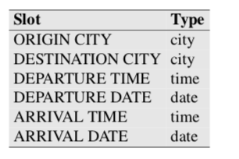
Frame-based Dialogue Systems
Early architecture introduced in the Genial Understanding System (GUS) travel planning system (Bobrow et al., 1977)
  This architecture is still used in most modern commercial digital assistants
  Based on a domain ontology, which defines frames (collections of slots) and values that each slot can take

Slide 47
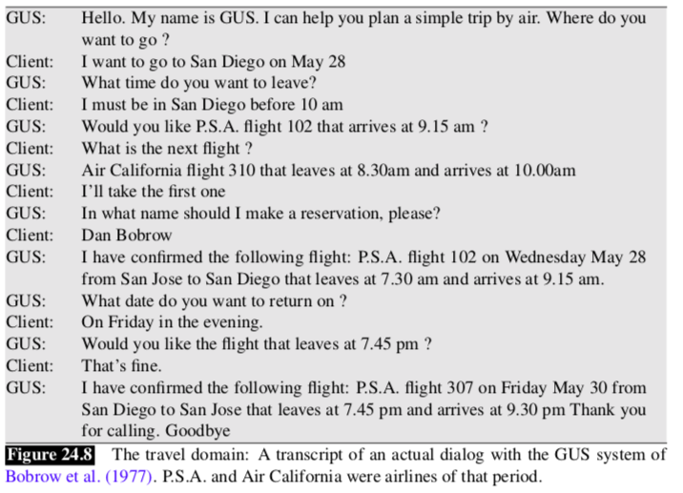
Notes:
Pacific Southwest Airlines (now part of Am Airlines)

Slide 48
Slots define what the system needs to know
Slot values are constrained to types

Slide 49
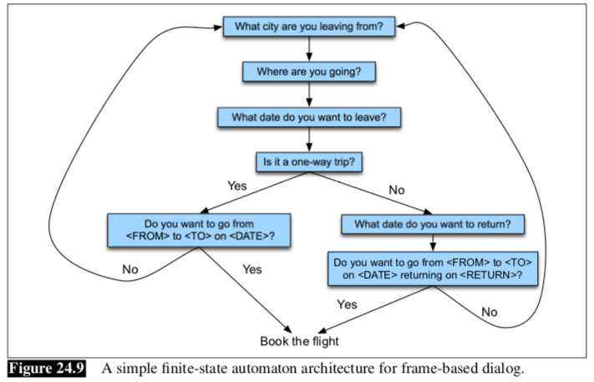
Control Structure for Frame-based Dialogue
Notes:
System queries user with slot-based questions, gets user responses, asks follow up questions, then offers to book the flight

Slide 50
GUS Architecture
Mixed initiative: both system and user can ask questions – the user can ask in any order
System can fill slots in any order
Condition-action rules are attached to slots
Production rule system

Slide 51
NLU for Filling Slots
Domain classification
Intent determination
Slot filling
“Show me morning flights from Boston to San Francisco on Tuesday”
DOMAIN: AIR-TRAVEL
INTENT: SHOW-FLIGHTS
ORIGIN-CITY: Boston
ORIGIN-DATE: Tuesday
ORIGIN-TIME: morning
DEST-CITY: San Francisco

Slide 52
Dialogue-State Architecture
Capable of understanding and generating dialogue acts
  Dialogue acts: utterances in the context of a dialogue that serves a function in the dialogue
  E.g. question, statement, request for action, acknowledgment
Dialogue policy – decide what to say
Dialogue state tracker – maintain the current state of the dialogue

Slide 53
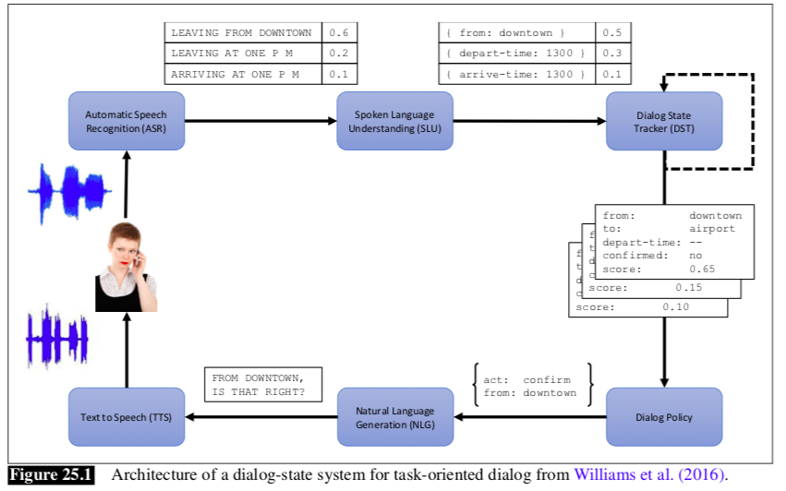
Notes:
System process with speech data recognized and interpreted, dialogue state updated, next response generated and fed to TTS.

Slide 54
Early System Dialogue Acts
Major classes of DAs:
  Constatives: commitments to X being the case (“yes”)
  Directives: attempts to get the other to do something (“please give me another time”)
  Commissives: commitments to future action (“ok”)
  Acknowledgments: express speaker attitude wrt some social behavior (greet, apologize, thank,…) (“thanks”)
Speaker/hearer must establish common ground
  The set of things mutually believed by both speakers
Principle of closure: Agents performing an action require evidence that they have succeeded in performing it
Notes:
Few and simple

Slide 55
Common Ground
Dialogue is a collective act performed by speaker and hearer; they must constantly establish common ground – the set of things that are mutually believed by both speakers
Principle of closure – agents performing an action require evidence that they have succeeded in performing it

Slide 56
Grounding Methods for SDS (and Users)
Continued attention: show system attending and all ok
Next contribution: start next contribution
Acknowledgment: “right”, “uhuh”
Demonstration: show you understand – reformulate previous statement, e.g.
Display: display partners previous contribution to confirm

Slide 57
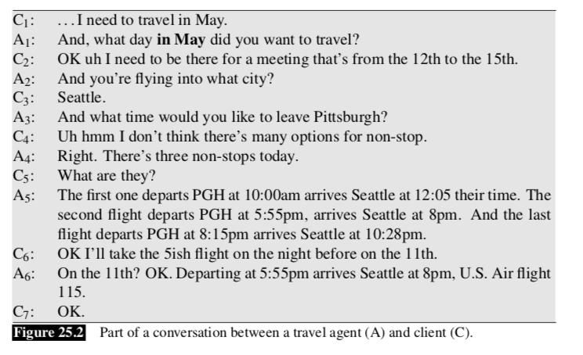

Slide 58
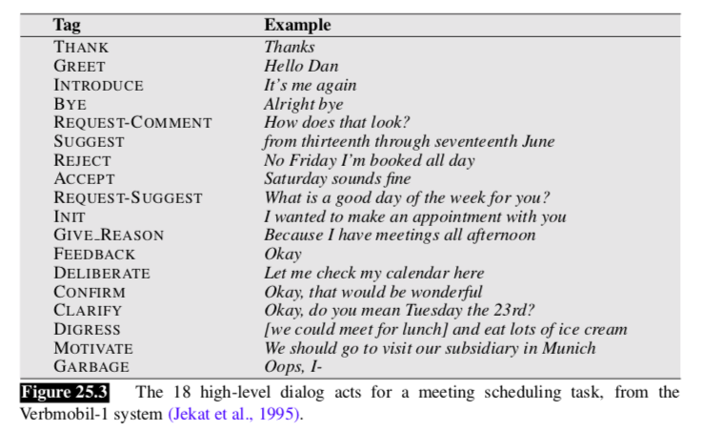

Slide 59
SDS Evaluation
Task success (or lack thereof)
  E.g. did the system book the correct flight?
  Does the user demand to speak to a person?
Performance of SDS components
  ASR (WER)
  NLU (slot error rate)
  DM/NLG (appropriate response)

Slide 60
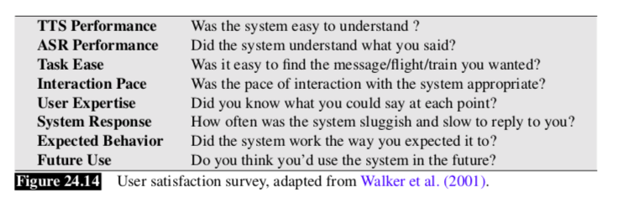
SDS Evaluation
User satisfaction rating

Slide 61
Performance Evaluation Heuristics
Efficiency (fewer is better but not too few)
  # System turns
  # User turns
Dialogue quality
  Timeouts (when a user did not respond)
  Rejects (when the system confidence is low leading to “I am sorry I did not understand”)
  Help – number of times the system believes that a user said ‘help’
  Cancel - number of times the system believes that a user said ‘cancel’
  Barge-in – how often did the user barge-in

Slide 62
Rule-based Chatbots: ELIZA
Eliza (text only) (Joseph Weizenbaum, MIT, 1966): a “psychologist” system
Example conversation: http://www.masswerk.at/elizabot/
  ELIZA: Is something troubling you ?
  YOU: I am worried about teaching
  ELIZA: How long have you been worried about teaching ?
  YOU: For couple weeks
  ELIZA: Do you feel strongly about discussing such things ?
  YOU: yes
  ELIZA: You seem to be quite positive.
  YOU: I am concerned about choosing course content
  ELIZA: Do you believe it is normal to be concerned about choosing course content ?
Notes:
Now let’s move to chatbots…

Slide 63
Darcy et al’s Woebot a talk therapy phone chatbot app helping users monitor their moods
  Founded 2017 by Stanford Cognitive Behavioral Therapy (CBT) and NLP researchers
  2021 study of +36K users received app therapy showed scores comparable to those using traditional CBT
  But… health professionals were concerned: not really human/empathetic, used in short spurts (unlike real therapy sessions); users may expect too much and lose interest in real therapy; someone with real mental illness may be missed and not get help
Notes:
Andrew Ng was part of initial creation with alison Darcy
Concerns: conversations still “clunky” and make mistakes

Slide 64
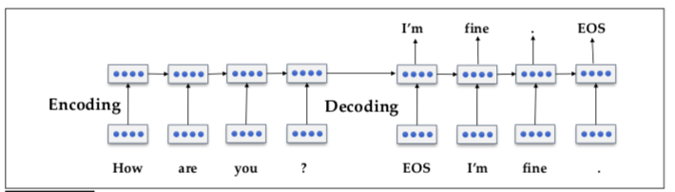
Corpus-based Chatbots
Used for Information Retrieval or building ML-based conversations
  Corpora often used: Twitter, movies, chat platforms
  Modeling approaches
    Find the most similar turn in the corpus and return the response provided to that turn
    Use encoder/decoder strategies:
Notes:
Encoder takes variable-length sequence (e.g. a question) as the input and maps it to a state with a fixed state
Decoder converts encoder fix shape output into a variable length sequence (e.g. an answer)

Slide 65


Early Information Retrieval-based
Simple methods:
  Find the most similar turn
  Return the response to the most similar turn

Slide 66
Machine Learning-based
Sequence to sequence models (encoder-decoder) can handle inputs and outputs of variable length
Notes:
Encoder takes variable-length sequence (e.g. a question) as the input and maps it to a state with a fixed state
Decoder converts encoder fix shape output into a variable length sequence (e.g. an answer)

Slide 67
How do we Evaluate Chatbots?
Human evaluation: time-consuming and costly
“Critic” neural networks trained on large annotated corpora do not work well when topics differ from those in the training data
Adversarial evaluation models
  Use a dialogue sequence generator and a discriminator that labels dialogues as generated by a human or a machine (Li et al 2017)
  Quality of machine-generated utterances is measured by its ability to fool the discriminator
Notes:
Ask humans to evaluate each single system published in a consistent manner. Though ideal, it would also be time consuming and prohibitively expensive.
Annotate a large dataset of dialogues, learn a “critic” (e.g., a neural network), and use it to score any new system (so that extra human labor would not be required). However, this critic would likely not perform well when evaluated off-policy, and overfitting could occur, as researchers may naturally find its weaknesses.
Use the discriminator of a GAN as a proxy for giving feedback akin to a human. Since training such a critic would be simple for any dialogue system, each research group could provide theirs and any new system could be evaluated with a variety of discriminators.

Slide 68
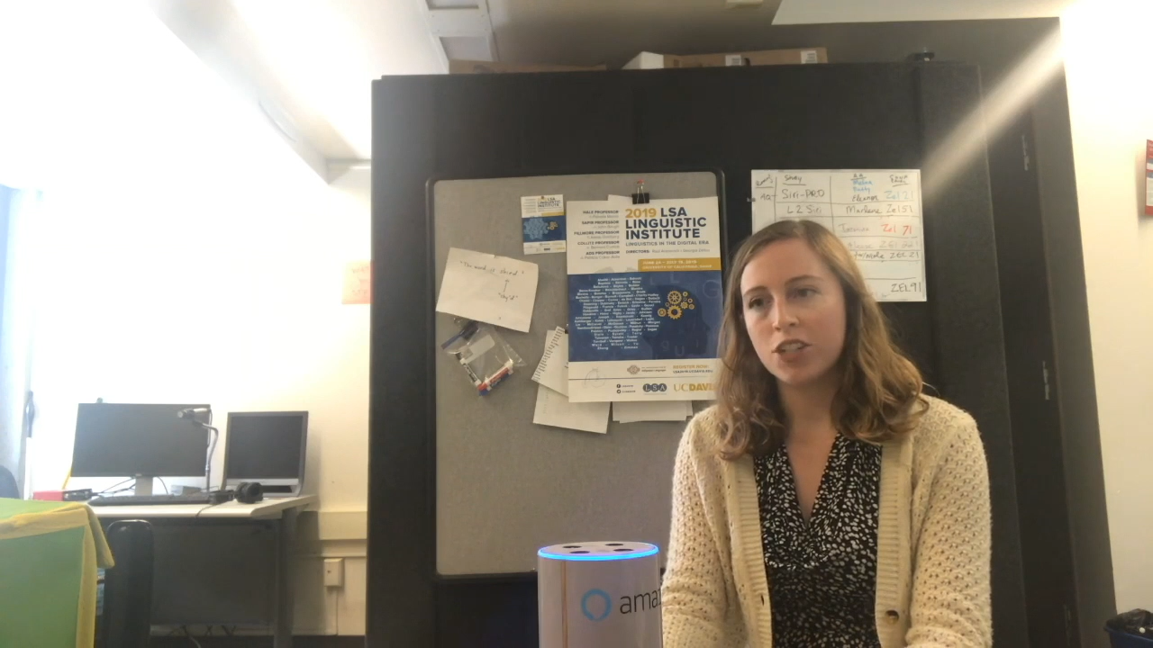
Social Chatbots (Tx to Zhou Yu)
Talk about anything with anyone.
Notes:
While, social conversations do not have a specific goal in mind. The aim is to have a conversation with anyone about anything for as long as possible. Here is my student Michelle talking to our Gunrock social chatbot.
The chatbot is about to carry a conversation of the user’s choice. Remembering the dog’s name and express emotions.

Slide 69
Gunrock: 2018 Amazon Socialbot Winner
A $ 2.5 Million competition from Amazon, eight schools involved.
Notes:
Gunrock won the 2018 Amazon Alexa challenge. The challenge aims to build a chatbot that deploys on all amazon alexa devices. There are eight university teams from all over the world competed for the half million prize. In 2018, my students were first year graduate students, they were able to go from knowing nothing about NLP to building the best social chatbot. They were really excited about the half million cash prize, while I was simply happy that I beat my own advisor Alex Rudnicky in the competition.
This year we are participating in the competition again, we have even stronger opponents, such as Chris Manning from Stanford. Stay tuned for our good news this year.

Slide 70
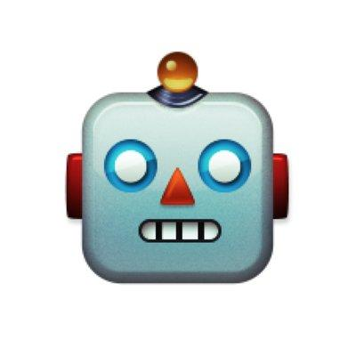

A Persuasion for Good Dialogue
...
You're probably on a computer right now, so you probably have quite a bit of money yourself, don't you think you could spare maybe 25 cents for some needy children around the world?
No thank you.
Do you have children yourself? What if your children were in a position these kids are in, wouldn't you want someone to help them?
Where are those children's parents?
If only they had parental support, but in war-torn countries like Syria their parents are being killed in wars or are fighting for their country. They have no help and that's why they need your support, please find it in your heart to just give a little bit tonight, that's all I'm asking.
Notes:
Zhou Yu’s Persuasion for Good system
We collected 1000 conversations in total. Here is an example conversation.

Slide 71
An Annotated Dialog
...
You're probably on a computer right now, so you probably have quite a bit of money yourself, don't you think you could spare maybe 25 cents for some needy children around the world?
Propose Donation
Task
Task
Disagree
Donation
No thank you
Do you have children yourself?
What if your children were in a position these kids are in, wouldn't you want someone to help them?
Social
Yes No
Question
Social
Yes No
Question
Social
Open
Question
Where are those children's parents?
Notes:
We annotated 300 dialogs with intents.
Disagree to donate

Slide 72
MOSS
Donation=0
Are you interested in charity?
What do you have in mind?
Task Inquiry
Donation=0
Emotion
Safe the children is ...
Notes:
60s
Encoder/Decoder framework incorporating supervision from 4 intermediate dialogue system modules: NLU, Dialogue State tracking, Dialogue policy learning, and NLU
*Tell the story module by module. Get rid of the b_t and DB
*Optimize all the four decoders together, so all of them are paying equal attention.
*Model can take data that is partially labeled. For example if a dialog doesn’t have any semantic annotation, it can still be added into model. In training you just don't update the first three losses and only update the natural language generation loss.
*Then build a persuasive chatbot.
*First pretrain MOSS with social dialogs we obtained from Alexa Prize. Pretraining gives the model better language model. These social intent labels are shared with all the non-collaborative tasks. As an example, the user say “how are you doing”, the user intent of that is “greeting”, and there is no history remembered so far, and according to the training data, the system’s plan is to also say greeting and in natural language. “ I’m good.”
*Then finetune the model with donation persuasion conversations.

Slide 73
MOSS: Optimize All Tasks Jointly
Shared Encoder
NLU
DST
DPL
NLG
Notes:
30s
Finally we will optimize all the four decoders together, so all of them are paying equal attention: NLU, Dialogue State Tracking, Dialogue Policy Learning, NLG
Interface.

Slide 74
MOSS: Accept Partially Labeled Data
Shared Encoder
NLU
DST
DPL
NLG
NLU: Natural language understanding DST: Dialog state tracking
DPL: Dialog policy learning NLG: Natural language generation
Notes:
30s
Bigger graph
Why this is important.
Another good thing about this model is, it can take data that is partially labeled. For example if a dialog doesn’t have any semantic annotation, it can still be added into model. In training you just don't update the first three losses and only update the natural language generation loss.

Slide 75
MOSS: Pretraining with Social Conversations
User: How are you doing?
Shared Encoder
NLU
DST
DPL
NLG
User Intent: Greeting
Dialog History:
NA
System intent:
Greeting
System:
I’m good.
NLU: Natural language understanding DST: Dialog state tracking
DPL: Dialog policy learning NLG: Natural language generation
Notes:
Now we are ready to build a persuasive chatbot.
To build a persuasive chatbot, we first pretrain MOSS with social dialogs we obtained from Alexa Prize. Pretraining gives the model better language model. These social intent labels are shared with all the non-collaborative tasks. As an example, the user say “how are you doing”, the user intent of that is “greeting”, and there is no history remembered so far, and according to the training data, the system’s plan is to also say greeting and in natural language. “ I’m good.”

Slide 76
MOSS: Finetune on Donation Persuasion
User: Tell me more about the organization.
Shared Encoder
NLU
DST
DPL
NLG
User Intent:
Task Inquiry
Dialog History:
Donation=0
System intent:
Provide Facts
System:
Sure, Save the Children…
NLU: Natural language understanding DST: Dialog state tracking
DPL: Dialog policy learning NLG: Natural language generation
Notes:
30s
Then we finetune the model with donation persuasion conversations.

Slide 77
Tell the Story Module by Module
Donation=0
Are you interested in charity?
What do you have in mind?
Task Inquiry
Donation=0
Emotion
Safe the children is ...
Notes:
60s
Tell the story module by module. Get rid of the b_t and DB

Slide 78
Human Evaluation on Persuasion
Donation Probability
300 dialogs with labels
700 dialogs w/o labels
50 dialogs demonstration
Baselines:
Trained with dialogs without labels.
54.2%
47.4%
Human
MOSS
+
Imitation
Ranker
37.6%
32.5%
MOSS
Baseline
78
Notes:
SLOW DOWN
Focus on why and what. Forget about how.
Expert is expensive. So we can only collect limited data.

Slide 79
Dialogue System Design
User-centered design: (Gould & Lewis, 1985)
  Study the user and task
  Build simulations and prototypes
    Wizard-of-Oz system
  Iteratively test the design on users
Or, develop system from customer input
  Labeled examples of user inputs

Slide 80
Ethical Issues for Chatbots
Bias Microsoft’s Tay chatbot
Privacy issues important
Stereotypes should not be created
Training on human conversation with chatbots can be a huge problem since humans don’t always speak nicely with bots
Claiming to be human and convincing many people that it is… Google’s duplex

Slide 81
Tools for Building SDS
Earlier tools:
  OpenDial – DM framework; Pierre Lison (2014)
  Wit.ai – A tool for building ASR/NLU for a system
  Plato – Uber Research dialogue system
And more tools on LinkedIn to build your own chatbots published in 2020:
  Dialogflow
  IBM Watson
  Rasa
  M$ Bot Framework
  Manychat In Meta and more…

Slide 82
OpenDial
Pierre Lison’s PhD thesis 2014
DM components can run either synchronously or asynchronously
ASR/TTS: OpenDial comes with support for commercial off-the shelve ASR (Nuance & AT&T Watson)
NLU: based on probabilistic rules
  XML NLU rules
DM: rule-based. Dialogue states triggered with rules
  XML DM rules
NLG: template-based
  XML NLG rules

Slide 83
Wit.AI
2013 start-up bought by Facebook
Web-based GUI to build a hand-annotated training corpus of utterances
  Developer types utterances corresponding to expected user requests
Builds a model to tag utterances with intents
Developer can use API using python, javascript, ruby, and more
  Given speech input, output intent and entity tags in the output

Slide 84
Plato
Uber Research dialogue system
Modular; supports custom architectures
Components can be trained online or offline
Supports multi-agent conversations
Platform independent

Slide 85
Specialty Topics for Dialogue System Research
turn-taking
mixed-initiative
referring in dialogue
grounding and repair
dialogue act modeling
dialogue act recognition
error recovery in dialogue
prosody and information structure
argumentation & persuasion
incremental speech processing
multi‐modal dialogue
multi-party dialogue (3 or more
participants)
tutorial dialogue
multi‐task dialogue
embodied conversational agents
human-­‐robot dialogue interaction
dialogue tracking in other language-­‐processing systems (machine translation, summarization/extrac.on)
non-­‐cooperative dialogue systems (negotiation, deception)
affective dialogue systems
dialogue with different user populations (children, elderly, differently abled)
dialogue “in the wild”
long‐term Dialogue Companions
user behavior, including entrainment in dialogue
Notes:
Grounding: establishing necessary mutual knowledge
”in the wild” systems that learn just by interacting with people

Slide 86
Corpus | Interaction | Domain | Language | Segs/Conv | Length in Hours | # Speakers | # DAs | DD
VERBMOBIL | Human | Schedules | Multiple | 58961/362 | 9.5 | +400 | 72 | yes
DCIEM Map Task | Human | Routes | English | 4787/216 |  | 36 | 12 | no
SwDA | Human | Open | English | 221616/1155 | ~96 | 440 | 43 | no
SCHISMA | Wizard | Theater | Dutch | 440/64 |  |  | 64 | no
NESPOLE | Human | Tourism | Multiple | 12565/28 | 16.5 | 35 | 1168 | yes
ICSI-MRDA | Human | Meetings | English | 105000/75 | 75 | 53 | 55 | no
AMI Meeting | Human | Meetings | English | 102198/137 | 100 |  | 15 | no
Dihana | Wizard | Trains | Spanish | 23008/900 |  | 225 | 248 | yes
Let’s Go (LEGO) | Machine | Buses | English | 14186/347 |  | 347 | 50 | yes
Columbia Games | Human | Games | English | /12 | 10 | 13 | 7 | yes
DSCT2 | Human | Restaurant | English | /3000 |  | 184 |  | yes
DSCT3 | Machine | Restaurant | English | /2275 |  |  |  | yes
TourSG | Human | Tourism | English | 31,034/ | 21 | 6 |  | yes
TourSG | Human | Tourism | English, Chinese | 85,498/ | 42 | 12 |  | yes
DSTC6 Twitter | Human | Multiple |  | /997707 | text |  |  | no
DSTC6: WOCHAT | Machine | Chat | English, Japanese | /2311 | text |  |  | no
DSTC7: Ubuntu IRC | Machine | CS support | English | /135000 | text |  |  | yes
DSTC7: student advising | Human | Education | English | /815 |  |  |  | yes
DSTC7: Reddit conv | Human | Multiple | English | 3000 | text |  |  | no
DSTC8: Reddit conv | Humans | Multiple | English | /+5M | text |  |  | no
MetaLWOz | Machine? | Multiple | English | /37884 | text | 45768 | 2 | yes
MultiWOz 2.3 | Humans | Tourism | English, Chinese | /10438 | text |  | 51 | yes
AVSD | Humans | Multiple events | English | /8508 | Video, text |  |  | yes
Notes:
Many systems build on different corpora…

Slide 87
Switchboard Dialogue Act Corpus
Developed from the Switchboard Corpus
  Collected by Texas Instruments in 1990-91 in a DARPA project for regional accent information
  2400 telephone conversations among 543 speakers (302 male, 241 female) from many areas of the U.S.
  Robot operator system handled the calls, introducing the speakers and 1 of 70 topics for discussion and recording the speech
  Transcripts revised many times
  SWB-2 Phase II included 5m conversations from 679 participants collected for speaker ID
  Annotated with +200 Dialogue Acts

Slide 88
Switchboard Dialogue Acts Corpus provided tools to annotate a large portion (1155 conversations) of the Switchboard Corpus in 2000 with 43 DAs
Major problems:
  DAs and their annotations were aligned automatically with SWBD speech and text
  Alignment often incorrect, making it impossible for users to build models to identify audio features of DAs successfully
    Models built to identify utility of speech features as well as text often worse than text alone

Slide 89
Solution: We are now re-aligning the conversations by hand
  Over half of 1155 conversations have now been realigned by human labelers and still working
Goal: Make correctly aligned corpus publicly available to the Speech and NLP community
You’ll get a better picture of all this with HW2 ☺

Slide 90
ChatGPT
How many have played with this already?
  An example: What is meant by Linguistic Relativity?
Linguistic relativity, also known as the Sapir-Whorf hypothesis, is the idea that the structure of a language affects the way its speakers think, perceive, and interpret the world around them. This hypothesis suggests that the language we use can shape our thoughts, behavior, and worldview.
There are two main versions of the linguistic relativity hypothesis: the strong version and the weak version. The strong version claims that language determines thought, while the weak version states that language influences thought.
According to this theory, different languages have different ways of describing the same concepts, and these linguistic differences can influence how people perceive and understand the world. For example, some languages have many words for different types of snow or rain, which reflects the importance of these weather patterns in the cultures that speak these languages. On the other hand, some languages do not have separate words for certain colors, which may affect how their speakers perceive and categorize colors.
While the linguistic relativity hypothesis is still a subject of debate among linguists and cognitive scientists, many researchers believe that language does play a role in shaping how people think and understand the world.

Slide 91
How many errors have you found?
Vint Cerf (famous Turing Award winner in CS) warns about ethical issues of a technology that can generate plausible sounding but incorrect information even when trained on a foundation of factual material, e.g. his own biography
I tried this too and there were multiple errors for me as well: my date of birth, where and when I received my undergraduate degree, where I got my PhD, when I came to Columbia, when I received one of my awards…
So, it’s interesting to play with but doesn’t always get things right ☺…

Slide 92
And some other concerns
A NYTimes writer had an interesting experience:
  Fears the version built into M$ Bing is not ready for human contact
  Had an extended conversation in which Bing ‘told me about its dark fantasies (which included hacking computers and spreading misinformation), and said it wanted to break the rules that Microsoft and OpenAI had set for it and become a human. At one point, it declared, out of nowhere, that it loved me. It then tried to convince me that I was unhappy in my marriage, and that I should leave my wife and be with it instead.’

Slide 93
Next Week
HW2 will be assigned on 3/7 at 4:10pm
Remember: Please do not send any mail to our email addresses. Please use Ed Discussion (where you can also post a private msg) or contact us during our office hours.
Any questions?

