Slide 1
Analyzing Speech Prosody
Julia Hirschberg
CS 6998

Slide 2
Notes for today
Thanks for all the useful suggestions for the Praat tutorials, and thanks to all of you who overcame some challenges doing your own voice recordings!

Slide 3
Today
How can we represent differences in how people produce speech that influence and we interpret their speech?
  Expanded vs. compressed pitch range?
  Louder vs. softer speech?
  Faster vs. slower speech?
  Differences in intonational prominence?
  Differences in intonational phrasing?
  Differences in pitch contours?

Slide 4
Why are Prosodic Models Important?
Improve Text-to-Speech Synthesis: build TTS systems that sound more like humans
Improve speech recognition and understanding: what people convey is more than just the words they say
Dialogue modeling on both sides, understanding and production
Machine translation: translate what the speaker means to convey, not just the words they produce

Slide 5
Joshua Steele’s Prosodia Rationalis (1779)
Notes:
Figure 1. Transcription of Alexander Pope’s Happiness poem (Steele, 1775, p. 13)
Since speech is composed of slides, and not stable, discrete pitches, he developed note heads which were lines, curves, and circumflex notes that could cover several pitches. To these curved heads (“accents”), he then added a tail (“phrase boundaries”) which marked the duration of the syllable in a number of beats within a musical bar.
Looks sort of like an intonational contour..

Slide 6

Limitations of Music Representations
Difficult to represent similarities between contours
  E.g. these contours are the same
  but in a different pitch range
Too tied to particular instances – hard to generalize

Slide 7
Language Training Approaches
A simpler approach with arrows and capital letters
  / IS it INteresting /
  / d’you feel ANGry? /
  / WHAT’S the PROBlem? / (McCarthy, 1991:106)
Too general
  Doesn’t capture full contours or type of pitch accents or phrase boundaries
Notes:
https://www.birmingham.ac.uk/documents/college-artslaw/cels/essays/matefltesldissertations/kumakidiss.pdf

Slide 8
What Do We Really Need?
Capture sufficient variation to
  Explain both similarities and differences in prosodic meaning in a language
  Compare prosody across languages
How much detail do we need to capture?

Slide 9

Prosodic Prominence
Terms: Prominence, emphasis, [pitch] accent, stress
  Prominence is an acoustic excursion use to make a word or syllable “stand out” from the rest
  Used to draw a listeners attention to some quality of an utterance: Topic, Contrast, Focus, Information Status
there’s ALSO some SHOPPING
BDC h1s9

Slide 10
Prosodic Prominence
Terms: Prominence, emphasis, [pitch] accent, stress
Prominence is an acoustic excursion use to make a word or syllable “stand out” from the rest
Used to draw a listeners attention to some quality of an utterance: Topic, Contrast, Focus, Information Status
there’s ALSO some SHOPPING
BDC h1s9

Slide 11
Prosodic Phrasing
An acoustic “perceived disjuncture” between words
  Physiologically necessary – a speaker cannot produce sound indefinitely
  Used to structure information in an utterance, grouping words into regions
    Phrasing structure may be related to syntactic structure – or it may not…
finally we will get off - - at Park Street - and get on the Red Line - -
BDC h1s9
Notes:
Again, we will return to acoustic correlates of phrasing later. Now let’s just get a sense of what’s going on.
Examples

Slide 12
Prosodic Phrasing
An acoustic “perceived disjuncture” between words.
Physiologically necessary – a speaker cannot produce sound indefinitely.
Used to structure the information in an utterance, grouping words into regions.
  Phrasing structure may be related to syntactic structure.
finally we will get off - - at Park Street - and get on the Red Line - -
BDC h1s9
Notes:
Again, we will return to acoustic correlates of phrasing later. Now let’s just get a sense of what’s going on.
Examples

Slide 13
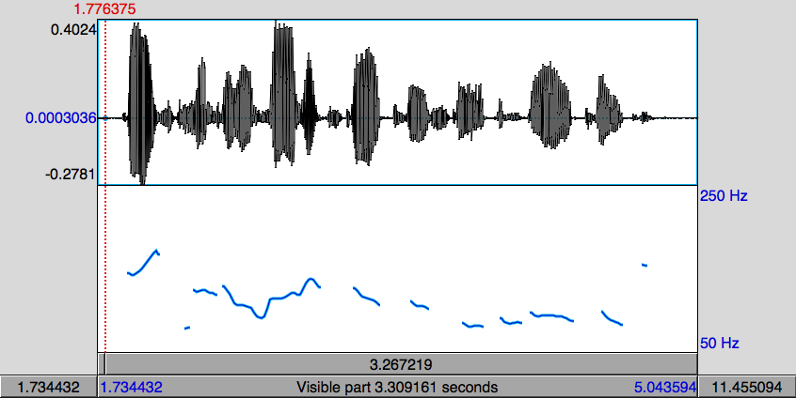
Pitch Contour Example
DoublingError
Halving Error
Pitch (fundamental frequency) is estimated by finding the length of the period of the speech signal.
  If a cycle is missed, the period appears to be twice as long (pitch halving)
  If an extra cycle is found, the period appears to be half as long (pitch doubling)
Notes:
As you know from previous classes

Slide 14
Tone Sequence Models
Intonation generated from sequences of categorically different, phonologically distinctive tones
Basic unit of intonational description: intonation phrase (tone unit, breath group)
  Delimited by pauses, phrase-final lengthening, pitch
Syllables may be stressed or accented
  Accent aligned with primary stress -- telephone
  Indicated by F0, duration, intensity, voice quality
Notes:
O’Connor and Arnold 1972:
Earliest textbook for English instruction that tells user which contour appropriate in which context

Slide 15
Types of Tone-sequence Models
Type 1: based on pitch movements
a
t
r
g
Type 2: based on pitch levels
e
t
H
The British School The Dutch School
a
t
r
g
L
e
t
The American School

Slide 16

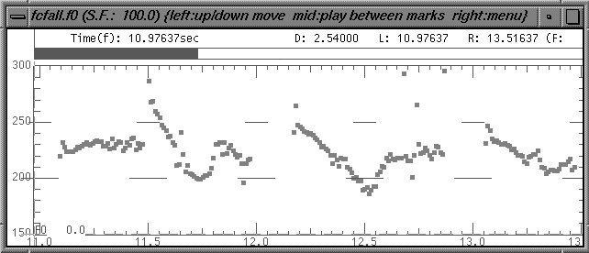
Note the Pitch Accent Location
and I think it’s HOrriblerrible
...a POINT where
you have to CLEAN it
There’s a point where you have to clean it and I think it’s horrible...

Slide 17
British School
Each accent defines the beginning of a prosodic constituent
Prenuclear accent unit
Nuclear accent unit
Prehead
‘Head’
‘Nucleus’
Stressed syllable
But
JOHN’s never BEEN to Jamaica
Received Pronunciation (RP)
Notes:
Two types of accent unit in the British School:
Prenuclear accent units; also called the Head
Nuclear accent units; also called the Nucleus
The nuclear accent unit is the last accent unit in the IP
The head comprises all prenuclear accent units

Slide 18
Six nuclear choices in English
m
a
a
a
i
c
J
c
i
a
a
a
J
m
falling
rising
m
a
a
a
i
i
J
c
a
a
c
J
m
a
rising-falling
falling-rising
i
a
i
m
a
c
a
c
a
a
a
J
J
m
a
Rising-falling-rising
level

Slide 19
The American School
American school-type models make a distinction between accents (what makes a particular word prominent) and boundary tones (how a phrase ends)
Auto-segmental metrical or two-tone models
Only two tones, which may be combined
  H = high target
  L = low target

Slide 20
Price, Ostendorf et al
Defined different types of prosodic phrases by the degree of juncture between words
Break indices from 0 to 8
  0 no word boundary
  1 word boundary
  2 strong juncture with no tonal markings
  3 intermediate phrase boundary
  4 intonational phrase boundary
  5,6,7 increasing length of phrase boundary
Notes:
Patty Price and Mari Ostendorf

Slide 21
Pierrehumbert 1980 Put Phrases and Accents Together
Contours = pitch accents, phrase accents, boundary tones
Pitch Accents*
Phrase Accents*
Boundary Tone
H* L*
L*+H L+H*
H*+L H+L*
L- H-
L% H%
Notes:
Jd

Slide 22
To(nes and)B(reak)I(ndices)
ToBI: Developed by prosody researchers in four meetings over 1991-94 plus several more to refine the system and address problem issues
Putting Pierrehumbert ‘80 and Price, Ostendorf, et al together
Goals:
  Devise common labeling scheme for Standard American English that is robust and reliable
  Promote collection of large, prosodically labeled, shareable corpora

Slide 23
Prosody is described by high (H) and low (L) tones that are associated with prosodic events (pitch accents, phrase accents, and boundary tones) and break indices which describe the degree of disjuncture between words.
ToBI is inherently categorical in its description of prosody

Slide 24
Minimal ToBI Transcription
Recording of speech
F0 contour
ToBI tiers:
  Orthographic Tier: words
  Break-index Tier: degrees of junction (Price et al ‘89)
  Tonal Tier: pitch accents, phrase accents, boundary tones (Pierrehumbert ‘80)
  Miscellaneous Tier: disfluencies, laughter and other non-speech sounds, etc.

Slide 25
ToBI Pitch Accent Types in Standard American English
Words are accented or deaccented
5 pitch accent types (in SAE) defined by target level
  H* simple high (declarative)
  L* simple low (ynq)
  L*+H scooped, late rise (uncertainty/ incredulity)
  L+H* early rise to stress (contrastive focus)
H*
L*
L*+H
L+H*
H+!H*
Notes:
Examples!!!!

Slide 26
  L+H* early rise to stress (contrastive focus)
  H+!H* fall onto stress (implied familiarity)
High tones can be produced in an increasingly compressed pitch range – catathesis, or “downstepping”

Slide 27
Downstepped accents:
  !H*,
  L+!H*,
  L*+!H
Degree of prominence:
  within a phrase: HiF0 (~nuclear accent)
  across phrases ??

Slide 28
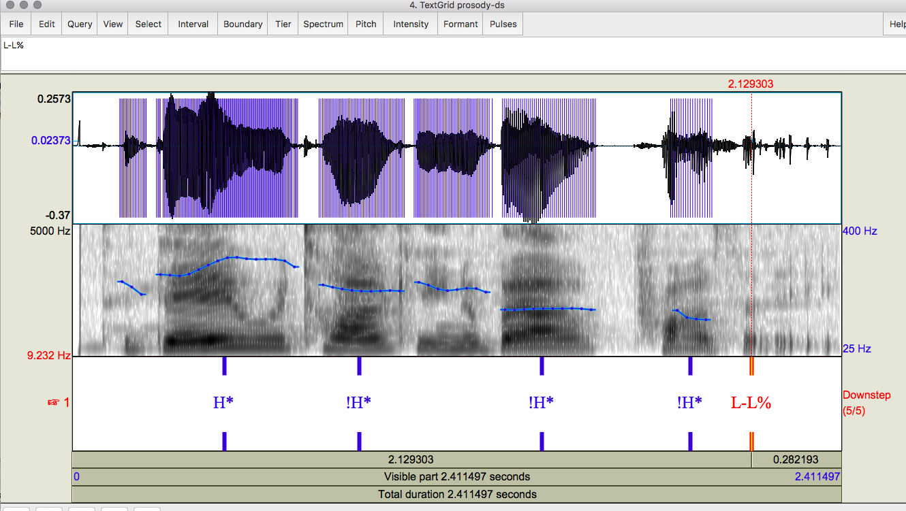
Today….

Slide 29
Prosodic Phrasing in ToBI
‘Levels’ of phrasing:
  Intermediate phrase: one or more pitch accents plus a phrase accent, H- or L-
    “marmalade H-”
    “I” L-
  Intonational phrase: 1 or more intermediate phrases + boundary tone, H% or L%
    Amelia H-H%
    Amelia L-L%
Notes:
Marmelade H-

Slide 30
Word boundaries are marked with a degree of disjuncture, or break index
  Break indices range from 0-4
  0 is no boundary (it’s a)
  1 is a word boundary
  2 is between a word and a phrase boundary
  3 intermediate phrase boundary
  4 intonational phrase boundary

Slide 31
ToBI Phrase Endings in Natural Speech
Intermediate Phrase boundaries have associated Phrase Accents describing the pitch movement from the last accent to the phrase boundary
  Phrase Accents: H-, !H- or L-
Intonational phrase boundaries have Boundary Tones describing the pitch movement immediately before the boundary
  Boundary Tones: H% or L%
L-L%
L-H%
H-H%
H-L%
!H-L%
Notes:
Examples!!!!

Slide 32
L-L%
L-H%
H-L%
H-H%
H*
L*
L*+H
Notes:
Try producing some of these as we play them

Slide 33
L-L%
L-H%
H-L%
H-H%
L+H*
H+!H*
H* !H*

Slide 34
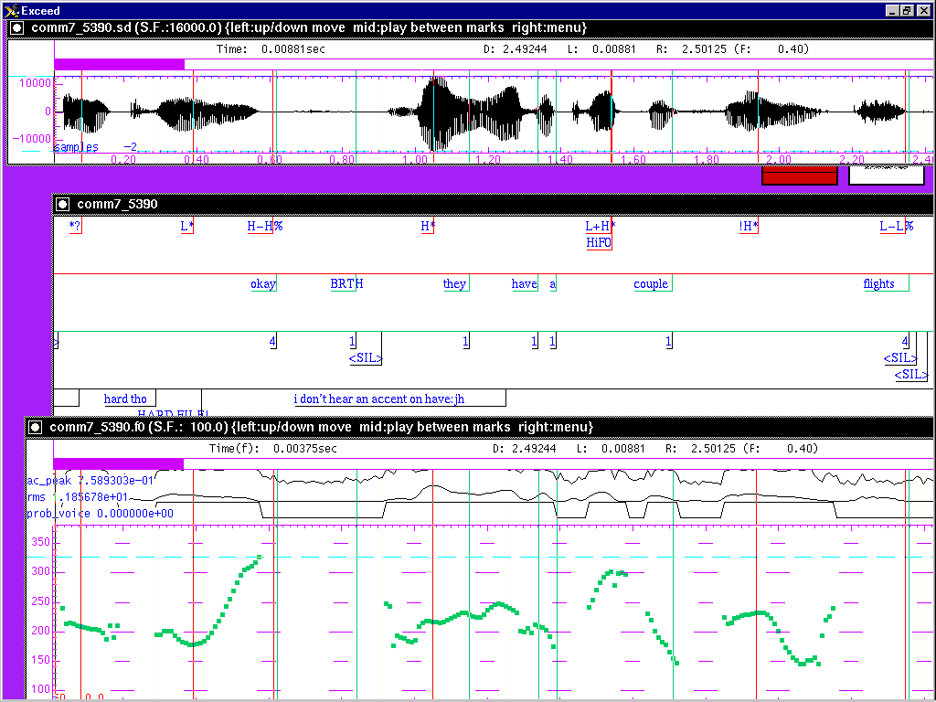
Sample ToBI Labeling
Notes:
Word boundaries and break indices with notes tier

Slide 35
Sample ToBI Labeling
Notes:
Adding the Tonal tier

Slide 36
ToBI Example (in Praat)
Notes:
Include audio example

Slide 37
ToBI Conventions for English
  http://www.cs.columbia.edu/~julia/papers/conv.pdf
More guidelines here:
  https://web.archive.org/web/20200220084533/http:/www.speech.cs.cmu.edu/tobi/ToBI.1.html
  https://www.ling.ohio-state.edu/research/phonetics/E_ToBI/
Guidelines for ToBI labeling in Spanish and other languages
  http://prosodia.upf.edu/sp_tobi/en/references/Sp_ToBI_references.html (not all links work)
Notes:
Select each. For the last also select “Other ToBI Systems” link

Slide 38
ToBI Evaluation
Good inter-labeler reliability for expert and naive labelers
  88% agreement on presence/absence of tonal category, 81% agreement on category label, 91% agreement on break indices to within 1 level (Silverman et al. ‘92,Pitrelli et al ‘94) but…
ToBI Lite and other simpler schemes created for English (e.g. Yoon et al 2004)
  E.g. Binary classification of 2 pitch accents (L*, H*) phrase accents (H-, L-) and boundary tones (H%, L%)
  Agreement on presence or absence and choice of
    pitch accents, 86.57%, phrase accents 85.63%, boundary tones 89.33%

Slide 39
ToBI Conventions in Many Languages
Mandarin, Taiwanese, Cantonese
Korean
Japanese
Spanish (many)
Catalan
Basque
Portuguese
Greek
Australian, British, Glasgow English
Serbian
Slovak
Italian (many)
Chicasaw
Bengali
Dutch
German (many)

Slide 40
AuToBI (Rosenberg 2010)
Automatic ToBI labels for multiple languages:
  https://github.com/AndrewRosenberg/AuToBI
  Rosenberg video on “talking”
Identifies pitch accents and boundaries with high accuracy using many acoustic-prosodic features
Input:
  Time-aligned word boundaries (human or automatic)
    TextGrid, CPROM, BURNC forced alignment (.ala) for text
  Wav file
  Previously trained AuToBI models (available from AuToBI website)
Notes:
Use the video for this class – 15m long
Written in Java

Slide 41
Output:
  Hypothesized ToBI tones (with confidence scores) and break indices
  Praat TextGrid format
Languages employed to date
  Developed for English and adapted for Mandarin, German, Italian, Portuguese and French, with small amounts of labeled data

Slide 42
AuToBI Command Line Example
java –jar AuToBI.jar \
-text_grid_file=in.TextGrid \
-wav_file=in.wav \
-out_file=out.TextGrid \
-pitch_accent_detector=accent.model \
-pitch_accent_classifier=pa_type.model \
-intonational_phrase_detector=ip.model \
-intermediate_phrase_detector=interp.model \
-phrase_accent_classifier=phraseac.model \
-boundary_tone_classifier=bt.model
Notes:
TODO fix command line example

Slide 43
AuToBI Schematic
Audio (wav)
Normalization Parameters
Segmentation
(TextGrid)
ToBI Annotation Specific Feature Extraction
ToBI Annotation Specific Classifier
Hypothesized Prosodic Events
Evaluation
Notes:
Normalization parameters are for speaker normalization based on set of wav files from given speaker
Feeds these with wav file and segmentation textgrid to feature extraction module which feed these to the pre-trained model to
Identify ToBI features for the new data
Textgrids from previously trained models provide textgrid information for identification and evaluation

Slide 44
AuToBI Performance
Cross-Corpus Performance: BURNC → Columbia Games
Available models
  Boston Directions Corpus
    Read, Spontaneous, Combined
  Boston Radio News Corpus
Also models for French, Italian, European and Brazilian Portuguese
Task | Accuracy
Pitch Accent Detection | 73.5%
Pitch Accent Classification | 69.78%
Intonational Phrase Boundary Detection | 90.8% (0.812 F1)
Phrase Accent/Boundary Tones Classif. | 35.34%
Intermediate Phrase Boundary Detection | 86.33% (0.181 F1)
Phrase Accent Classification | 62.21%
Notes:
Detection: is this an X or not?
Classification: what type of X is it
BURNC: Boston University Radio News Corpus
CGC: Columbia Games Corpus
Detection is comparable to human labeling and much better than classification

Slide 45
Available ToBI Labeled Corpora
Boston University Radio News Corpus
  Available from LDC
  6 speakers (3M, 3F)
  Professional News Readers (Broadcast News)
  Reading the same news stories
Boston Directions Corpus
  Available from the Speech Lab
  Read and Spontaneous Speech
  4 non-professional speakers (3M, 1F)
  Speakers perform a direction giving task (spontaneous)
  ~2 weeks later, speakers read a transcript of their speech with disfluencies removed.
Notes:
https://groups.inf.ed.ac.uk/switchboard/prosody_annotation.pdf
https://groups.inf.ed.ac.uk/switchboard/ostendorfetal01.pdf
BDC link is to the 2007 “Intonational overload: Uses of the Downstepped (H* !H* L- L%) contour in read and spontaneous speech
Julia Hirschberg, Agustín Gravano, Ani Nenkova, Elisa Sneed and Gregory Ward

Slide 46
Columbia Games Corpus
  13 subjects (6 female, 7 male) each doing 2 conversations with different partners
  10h of speech, averaging 45m per dialogue
  Manually transcribed and aligned
  Annotated also for affirmative cue words, turn-taking
Switchboard Corpus (SWBD-1 Release 2 of many)
  Available from LDC
  Spontaneous phone conversations on different topics
  543 U. S. speakers from different regions (302 male, 241 female) recorded in early 1990s
  2400 conversations in 70 topics
  Subset annotated with ToBI labels and other NXT features
Notes:
Link to information on the CGC
Link to LDC info on SWBD corpus

Slide 47
Current Work on SWDA Corpus
Switchboard Dialog Act Corpus is a portion (1155 conversations) of the original Switchboard Corpus
  Transcribed
  Aligned using old ASR methods which did not work well
  43 DAs annotated
  Much other work on annotation but no alignment correction which is what we are doing now to see if acoustic-prosodic features help with DA identification
  About half re-aligned, building ML models on them

Slide 48
ASCCD-Annotated Speech Corpus of Chinese Discourse
http://shachi.org/resources/9
  Created by the Institute of Linguistics Chinese Academy of Social Sciences
  ASCCD includes
    A text corpus
    wav data
    Labeling information
  Suited for research in speech and language, the development of speech software and the foundational teaching of Mandarin

Slide 49
C-ToBI Labels for Mandarin
Pinyin tier with tones
Syllable initial labels tier
Tone and intonation tier
Break index tier (0-4)
Stress index tier (1-4): @ indicates contrastive stress
Sentence function tier: interrogative, imperative, declarative, exclamation
Regional accent tier for dialect/accent
Turn-taking tier: start and end of each tier
Miscellaneous tier: paralinguistics (e.g. laughter)

Slide 50
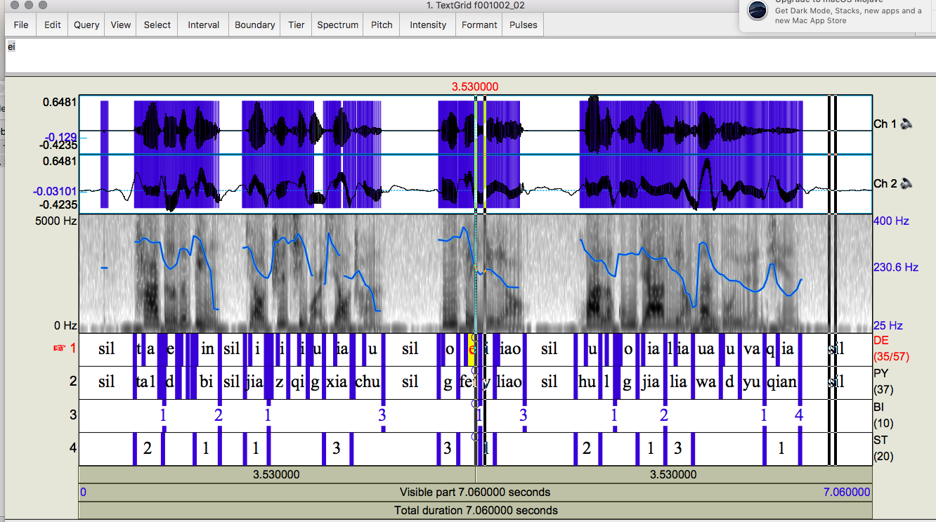
C-ToBI Corpora
Notes:
From the ASCCD (Annotated Speech Corpus of Chinese Discourse): label tiers seem to include phones on tier DE
We’ve just acquired another corpus, the COSPRO corpus of Taiwanese Chinese

Slide 51
Weizmann Institute Prosody Quantification Project (Tirza Biron et al)
An integrative theory for prosody analysis combining:
  Para-syntactic Prototype: Dialogue Act
  Discourse functions: e.g. rhetorical question, item in a list, parenthetical phrase
  Information structure: e.g. marking focus
  Attitude/sentiment: identifying both
Here’s an example

Slide 52

[If you’re poorly educated,] Why shouldn’t you steal/shoot/go to prison
Three segments
Para-syntactic Prototype: Wh-question
Discourse function I: Rhetorical question
Discourse function II: Item in a list
Discourse function III: Apodosis (main clause in conditional sentence) to an implied protasis (conditional) as above
Information structure: marked focus on shouldn’t
Attitude/sentiment: Insistent reprimand

Slide 53
“[If you’re poorly educated,] Why shouldn’t you steal?”
Para-syntactic prototype
WH question
Discourse functions
Rhetorical; list; apodosis
Information structure
Contrastive shouldn’t
Sentiment/Attitude
Insistent reprimand

Slide 54
Other Prosodic Models
Developed for database retrieval, phonological analysis and text-to-speech synthesis
  How can we extract information from large speech corpora that go beyond pitch, intensity, speaking rate?
  How can we analyze the way subjects convey different kinds of information?
  How can we generate synthetic speech that sounds like a human being?

Slide 55
F0 Modeling for Research and for TTS
Generation or Event Detection
  ToBI: event detection and TTS
  Fujisaki model: Japanese TTS
  TILT: developed for Festvox TTS
  Tonal Center of Gravity: developed for linguistic analysis
  Quantized Contour Modeling: Pitch Accent Detection (Rosenberg)
Notes:
We’ve looked much at ToBI. Now we’ll go over some other models

Slide 56
Fujisaki’s Superpositional Models for Speech Generation
Pitch pattern of intonation modeled with two components: phrase component and accent component.
Phrase has basic shape, and pitch movements for individual accents are superimposed over basic shape:
plus
=
Apples, oranges and tomatoes
Notes:
Hiroshi Fujisaki and TTS

Slide 57
Fujisaki Model
Superpositional view of intonation Fujisaki & Hirose 1982
Prosody is described by a phrase command which is modified by accent commands.
In the Fujisaki model, this is an additive process in log Hz space.

Slide 58
Fujisaki model

Slide 59
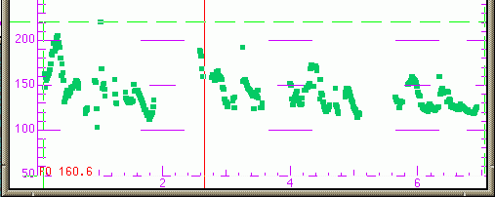
Useful for Modeling Utterance-level Trends
Declination: downtrend in f0 over the course of an utterance
Successful in speech synthesis for languages like Japanese (little variation in accent type, e.g.)
Lily and Rosa thought this was divine.
Prince William was gorgeous
and he was looking for a bride.
They dreamed of wedding bells.

Slide 60
Superpositional vs. Sequential
Superpositional models require identification of an overall phrase signal
Sequential models describe one prosodic event – phrasing or prominence – at a time
Similarities
  Both describe phrasing and accenting
  If the phrasal context can be accommodated by a sequential model, there are no analytical reasons to do otherwise
Differences
  Categorical vs. continuous accent types
  Superpositional model is tightly coupled with pitch

Slide 61
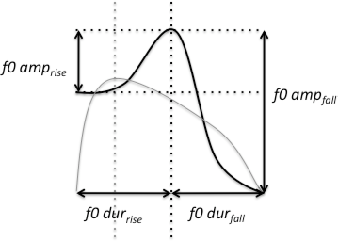
FestTILT Model
Describes an F0 excursion based as a single parameter (Taylor 1998)
Compact representation: TILT parameters allow generation/db retrieval
Notes:
Tilt=+1 all rise
Tilt= -1 all fall
In betw, some of each

Slide 62
Festvox TILT Model
Basic unit: the intonational event which changes TTS over time
  Types are pitch accents and boundary tones which provide continuously varying shapes in terms of pitch, amplitude and duration
  Useful for modeling:
    Questions
    Statements
    Even moods
Notes:
Tilt=+1 all rise
Tilt= -1 all fall
In betw, some of each
The basic unit in the tilt model is the intonational event. Events occur as instants with nothing between them, as opposed to segmental based phenomena where units occur in a contiguous sequence. The basic types of intonational event are pitch accents and (following the popular terminology) boundary tones. Pitch accents (denoted by the letter a) are F0 excursions associated with syllables which are used by the speaker to give some degree of emphasis to a particular word or syllable. In the tilt model, boundary tones (b) are rising F0 excursions which occur at the edges of intonational phrases and as well as giving the hearer a cue as to the end of the phrase, can also signal effects such as continuation and questioning. A combination event ab occurs when a pitch accent and boundary tone occur so close to one another that only a single pitch movement is observed. There are different kinds of pitch accents and boundary tones: the choice of pitch accent and boundary tone allows the speaker to produce different global intonational tunes which can indicate questions, statements, moods etc to the hearer.

Slide 63
Tonal Center of Gravity (ToG)
Measures the distribution of the area under the F0 curve within a region
  Perceptually robust
  Better classification of pitch accent types than peak timing measures (Veilleux et al. 2009, Barnes et al. 2010)
Notes:
X is F0, t is time

Slide 64
Quantized Contour Modeling
A Bayesian approach to simultaneously modeling contour shape and classifying prosodic events
(Rosenberg 2010)
  Specify a number of time (M) and value (N) bins
  Represent a contour as an M dimensional vector where each entry can take one of N values.
  For extension to higher dimensions, allow values to be multidimensional vectors

Slide 65
Variety of Methods for Modeling Intonation
All these models can be used to identify or produce some forms of intonational variation in speech
  Improve Text-to-Speech Synthesis
  Improve speech understanding and interpretation
  Dialogue modeling understanding and production
  Machine translation
However, the ToBI model has been used most widely for many languages and is often modified to represent that language more correctly
  Also a useful way to learn about intonation

Slide 66
Sample ToBI Labeling

Slide 67
Next Class
Topic: Text-to-Speech Synthesis (zoom on Courseworks → Zoom Class Sessions: Week 6: Text-to-Speech Synthesis)
HW1 due by 4:10pm on 2/21/23
Any questions?

