Slide 1
Whom Do We Trust in Dialogue Systems?
Julia Hirschberg
Columbia University
COMS 6998
Spring 2022
Notes:
Today I’ll be talking about work we have done to identify the kind of spoken language humans trust, which should be useful to know when you are building trustworthy dialogue systems.
TACL 2020 paper
We’ve been working with DHS and AFOSR for a number of years on deception production and perception and currently trust. How do humans detect lies? Or do they?

Slide 2
Collaborators in this research since 2003
Current CxD Deception & Trust:
  Sarah Ita Levitan, Michelle Levine, Laura Willson, Nishmar Cestero, Guozhen An, Angel Maredia, Elizabeth Petitti, Molly Scott, Yogesh Singh, Jessica Xiang, Jixuan (Gilbert) Zhang, Rivka Levitan, Andrew Rosenberg, Xi (Leslie) Chen, Rebecca Calinsky, Marko Mandic, Xinyue Tan
Earlier CDC Deception Project:
  Frank Enos, Stefan Benus, Jennifer Venditti-Ramprashad, Sarah Friedman, Sarah Gilman, Jared Kennedy, Max Shevyakov, Wayne Thorsen, Alan Yeung, and collaborators from SRI/ICSI and from the University of Colorado at Boulder
Notes:
~17 years! This work is part of a long project I’ve been involved in with many collaborators and students studying deceptive speech and trusted speech

Slide 3
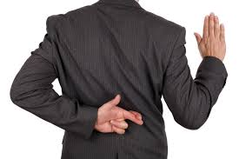
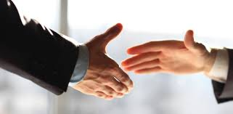
Deception
Trust

Slide 4
Deception
Trust
What are the characteristics of deceptive and truthful speech?
What makes humans perceive speech as truthful, or trust speech?
Can we automatically detect deceptive and trustworthy speech?

Slide 5


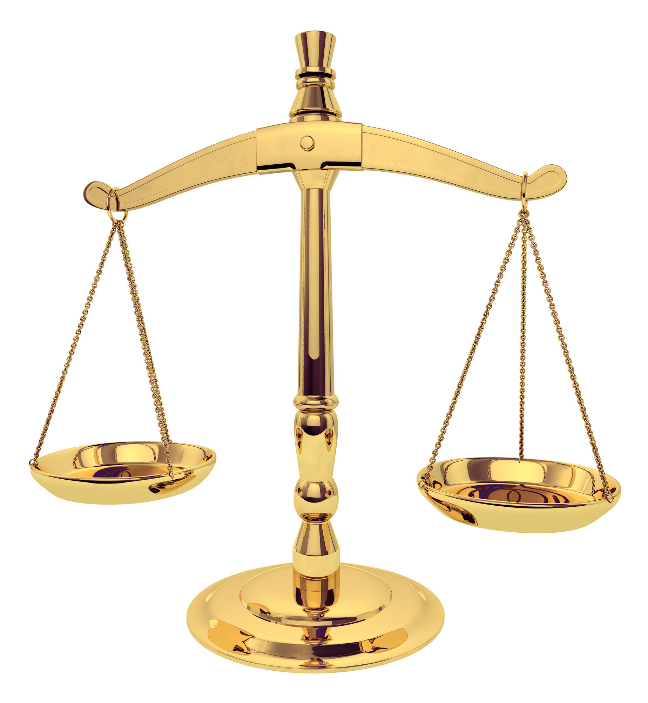
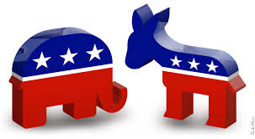

Notes:
Who would be interested? Law enforcement, military, intelligence agencies, social services, political and financial organizations, insurance companies, department stores

Slide 6
Human performance at deception detection is about 50% -> random chance.

Slide 7
Why is Deception Detection a Problem? Human Performance at Detecting Lies is Very Poor (Aamodt & Mitchell, 2004; Hartwig et al., 2017)
Group | # Studies | # Subjects | Accuracy %
Criminals | 1 | 52 | 65.40
Secret service | 1 | 34 | 64.12
Psychologists | 4 | 508 | 61.56
Judges | 2 | 194 | 59.01
Police officers | 8 | 511 | 55.16
Federal officers | 4 | 341 | 54.54
Students | 122 | 8,876 | 54.20
Detectives | 5 | 341 | 51.16
Investment professionals | 1 | 215 | 49.4
Parole officers | 1 | 32 | 40.42
Notes:
We know from many studies and meta-studies that humans are generally very poor at deception detection, even those who must uphold the law – and investment professionals! And most people are worse than chance at deception detection.

Slide 8
Background
Multimodal deception detection supported after 9/11 by a new Department of Homeland Security
  What aspects of human behavior are valid indicators of deception?
  Can we create reliable automatic deception detection models to identify future terrorists?
Current support from Air Force Office of Scientific Research focuses on identifying human trust as well
  What aspects of human speech are trusted by other humans? Can we build good trust models to identify and, for better purposes, to generate trusted speech?
Notes:
9/11/2001 attacks by al-qaeda when terrorists hijacked u.s. planes and flew them into multiple buildings in the World Trade Center, a good part of the Pentagon in Virginia, and may have been planning to destroy the Capitol and the White House in D.C. The hijackers had gotten into the U.S. apparently by fooling U.S. immigration interviewers in the airports they arrived in.

Slide 9
How do People Decide: Truth or Lie?
Language
  The words people say?
  The syntax people choose?
  How complex their discourse is?
  The acoustic content of their speech – Pitch? Intensity? Speaking rate?
  The prosody of their speech?
Body gestures, facial features?
Notes:
What we decided to investigate what how human decide whether a statement is truth or lie in terms of the language a speaker uses and how they present it. Others have found that they are gesture and facial features that provide clues as well but we focus on language.

Slide 10
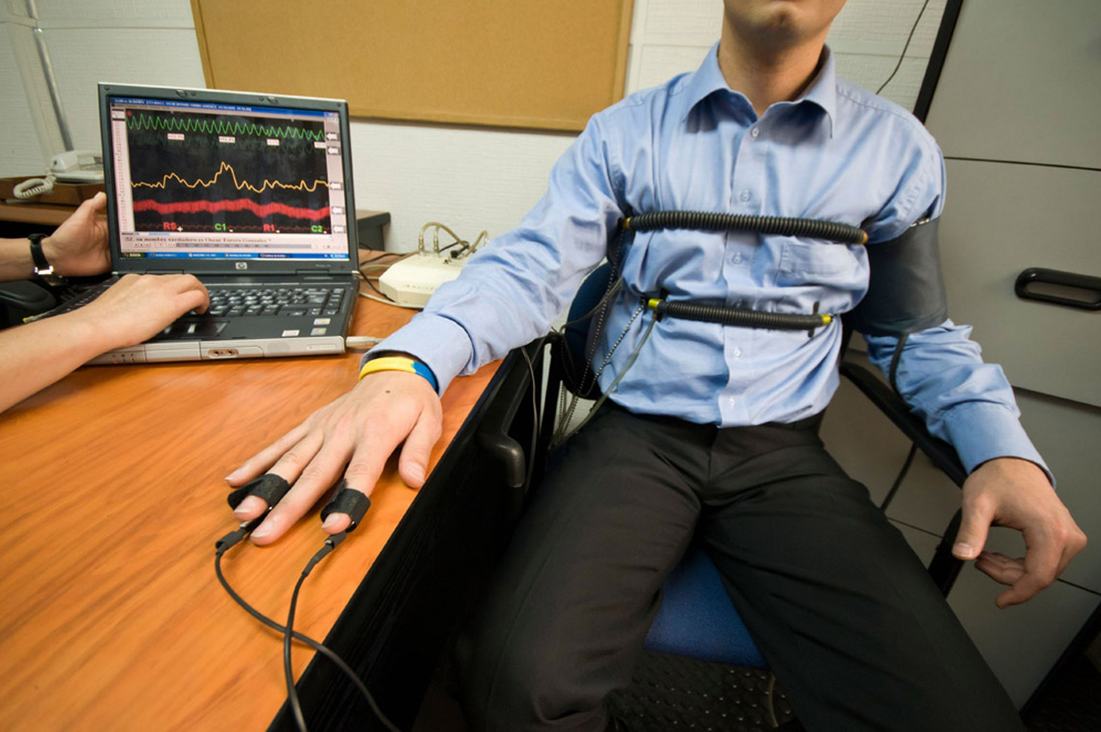
Modalities Explored for Automatic Deception vs. Truth Detection
Body posture and gestures (Burgoon et al ‘94)
Facial expressions (Ekman ‘76; Frank, ‘03)
Biometric factors (Horvath, ‘73): but not polygraphs
Brain imaging technologies (Bles & Haynes ‘08)
Language-based features
  Text (Adams ’96, Pennebaker et al ‘01)
  Speech (Enos et al. ’07, Levitan et al ’18,
  Chen et al ‘20)
Notes:
We were among the first to do large-scale speech studies
Brain-imaging scandal in India --

Slide 11
Past Language-based Deception Detection was Primarily Based on Text Alone
Practitioners
  Statement analysis (Adams, 1996)
  SCAN (Smith, 2001)
  John Reid & Associates (Buckley, 2000)
  Forensic linguistics (Robert Leonard)
Academics (NLP)
  Bachenko et al. (2008) on statement analysis
  Ott et al. (2011) on fake hotel reviews
  Perez-Rosas & Mihalcea (2015) multimodal face and NLP
Speech
Voice Stress Analysis (Horvath, 1982)
Streeter et al. (1977)
Ekman et al. (1991)
Enos (2009)
Notes:
Statement analysis: little empirical evidence, mostly anecdotal
SCAN: Deception Detection by Scientific Content Analysis of written statements supplied to police

Slide 12
Goals of Our Research
Identify acoustic-prosodic as well as linguistic characteristics of deceptive and trustworthy language: speech, transcripts and other modalities
Develop automated methods to detect deceptive language and trusted language – note that these are not always different
Identify the characteristics of speech as well as language that humans: trust or mistrust

Slide 13
Columbia Cross-Cultural Deception Corpus (CXD)
Pair native speakers of SAE with native speakers of Mandarin Chinese, all speaking English, interviewing being interviewed by each other
Collect
  Gender and personality information for all subjects
  Survey questions about themselves and families: half true and half false answers
  Baseline sample of their normal voices
Provide monetary incentive to lie successfully (interviewee) or detect lies correctly (interviewer)

Slide 14
The Big Five NEO-FFI (Costa & McCrae, 1992)
Openness to Experience: “I have a lot of intellectual curiosity.”
Conscientiousness: “I strive for excellence in everything I do.”
Extraversion: “I like to have a lot of people around me.”
Neuroticism: “I often feel inferior to others.”
Agreeableness: “I would rather cooperate with others than compete with them.”
Notes:
Costa & McCrae (1992) NEO-FFI Personality Measures and sample questions
Openness to Experience: intellect/imagination, originality, curiosity, ingenuity, imaginative, insightful “I have a lot of intellectual curiosity.”
Conscientiousness: orderliness, responsibility, dependability, organized, thorough, planful
“I strive for excellence in everything I do.”
Extraversion: talkativeness, assertiveness, energy “I like to have a lot of people around me.”
Neuroticism: anxiety, emotional instability, intense, moody, “I often feel inferior to others.”
Agreeableness: good-naturedness, cooperativeness, sympathetic, kind, affectionate, trust “I would rather cooperate with others than compete with them.”

Slide 15
No. | Questions
1 | Where were you born?
2 | How many years did you live in your first home?
3 | What is your mother's job?
4 | What is your father's job?
5 | Have your parents divorced?
6 | Have you ever broken a bone?
7 | Do you have allergies to any foods?
8 | Have you ever stayed overnight in a hospital as a patient?
9 | Have you ever tweeted? (posted a message on twitter)
10 | Have you ever bought anything on eBay?
11 | Do you own an e-reader of any kind?
12 | Who was the last person you were in a physical fight with?
13 | Have you ever gotten into trouble with the police?
14 | Who ended your last romantic relationship?
15 | Whom do you love more, your mother or father?
16 | What is the most you have ever spent on a pair of shoes?
17 | What is the last movie you saw that you really hated?
18 | Have you ever gone ice-skating?
19 | Do you currently own a tennis racket?
20 | How many roommates do you have?
21 | If you attended college, what was your major?
22 | Did you ever have a cat?
23 | Have you ever watched a person or pet die?
24 | Did you ever cheat on a test in high school?
Notes:
1, 5, 6, 8, 12, 13, 14, 15, 23, 24
We grouped our questions by different categories:
ynq’s (e.g. 9, 10, 11) or open-ended q’s (16, 17)
Sensitive (12, 13, 24) or non-sensitive questions (19, 20)

Slide 16
Motivation and Scoring
Monetary motivation
  Success for interviewer:
    Add $1 for every correct judgment, truth or lie
    Lose $1 for every incorrect judgement
  Success for interviewee:
    Add $1 for every lie interviewer thinks is true
    Lose $1 for every lie interviewers thinks is a lie
Good liars tell the truth as much as possible when lying, so how do we know what’s true or false for follow-up questions?
  Interviewees press T/F keys after every phrase
Notes:
Interviewer motivation: We didn’t want interviewees to try to sound like they were lying, only to sound truthful.

Slide 17
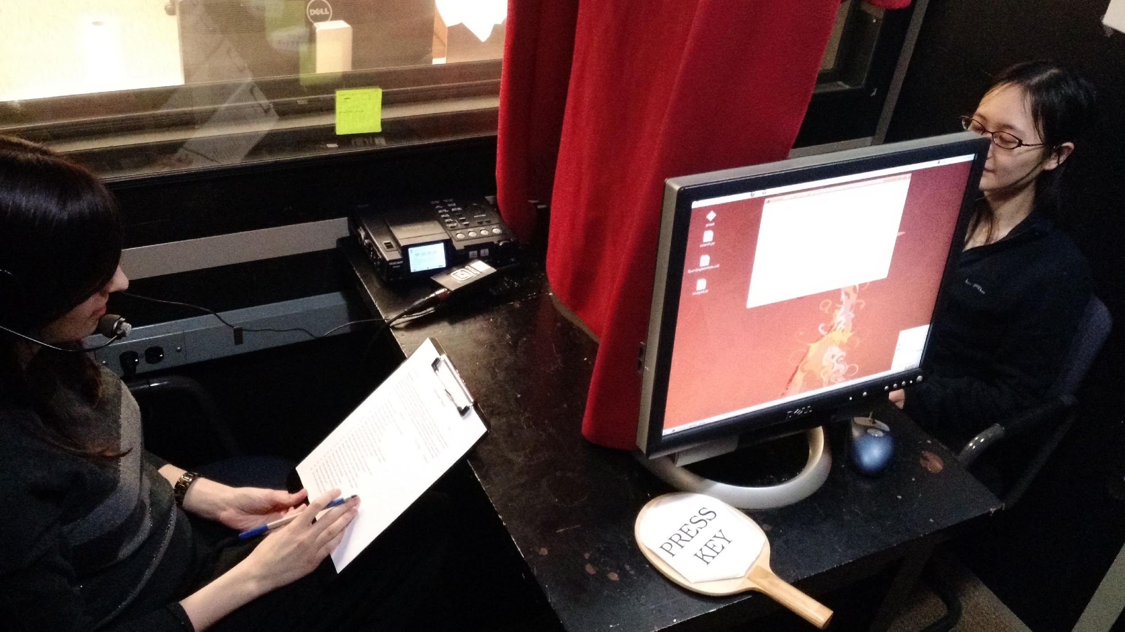
Columbia X-Cultural Deception (CxD) Corpus
340 subjects balanced for gender and native language
  Native speakers of Mandarin Chinese and Standard American English
  122h of subject speech
Demographic survey
Part-Fake resume paradigm
NEO-FFI personality scores
Baseline voice sample
Financial incentives
Data: Deception production and perception labels
  Global (interviewer) and local (interviewee) deception labels
Notes:
Brought pairs of subjects who did not know each other into the lab
Gave them a demographic survey, a personality (NEO FFI) survey, collected baseline speech
Partially-Fake resume paradigm: 24 questions, create false answers for half we selected at random, balanced
Interviewed one another in turn in recording booth
Financial incentive scheme: lie believed true = $1; if believed false -$1; $1 to interviewer for each correct guess
Keypress logging of T/F statements by interviewee for each utterance and by interviewer for thier overall T/F for each of the 24 questions at the end of their follow-ups
Crowdsourced transcriptions using AMT and hand-checked these for accuracy
Automatic segmentation with Kaldi which we also hand-corrected

Slide 18
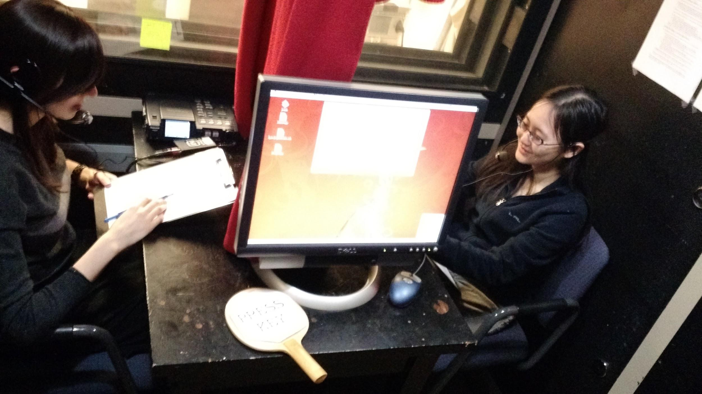
Our CXD Experiment
Notes:
One subject interviews the other on the 24 questions, scoring truth or lie for every answer. Interviewee tries to convince the interviewer they are telling the truth on every question. Then they change places and start again.

Slide 19
Columbia X-Cultural Deception Corpus
  340 subjects, balanced by gender and native language (American English, Mandarin Chinese): 122 hours of speech
Crowdsourced transcription, automatic speech alignment (hand-corrected)
Interviewee speech segmented into
  Inter-pausal units (IPUs): 111,479
  Speaker turns: 43,706
  Question/answer sequences (Q/1st Response and Q/Resp+follow-up): 7,418
Notes:
Largest corpus of cleanly-recorded deceptive/non-deceptive speech
IPU: phrases separated by 50ms or more
Turns: consecutive speech from one speaker with only backchannels from the other
Q/A: first answer to one of the 24 questions
Q/A+follow-up: interviewee responses to first Q and follow-up Qs

Slide 20
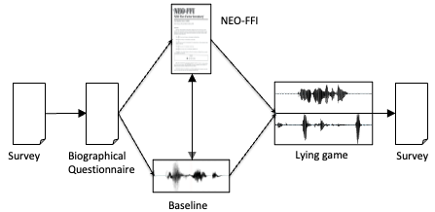
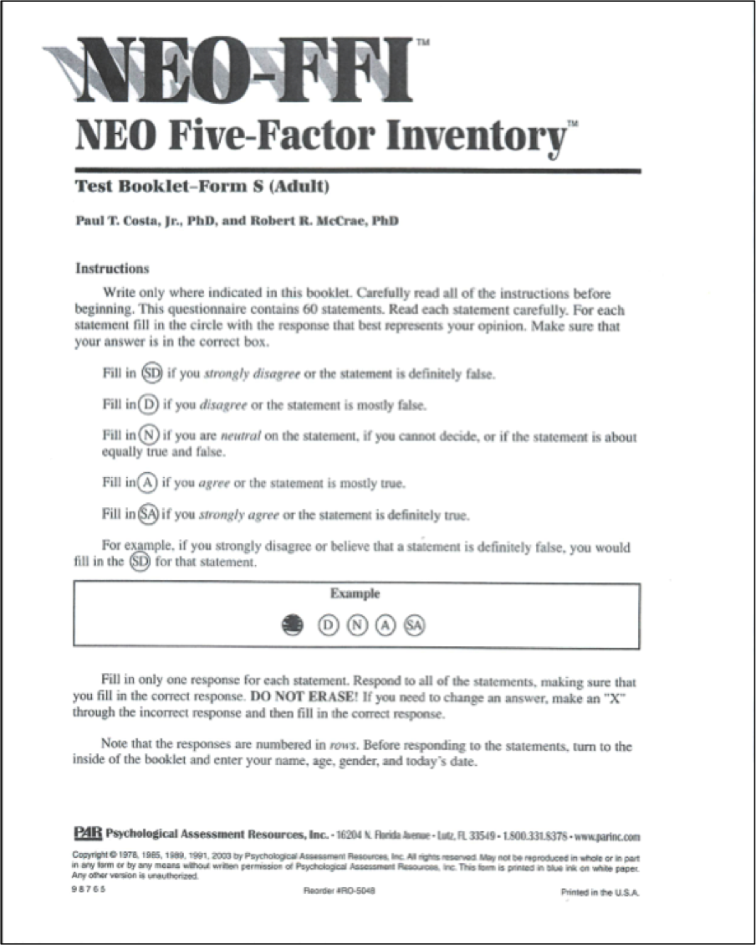
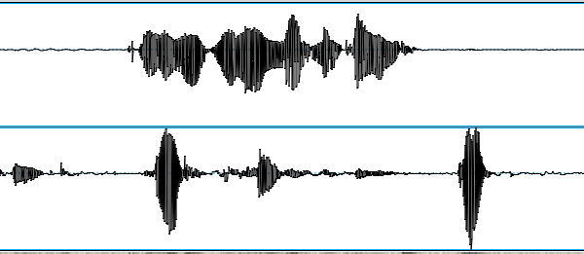
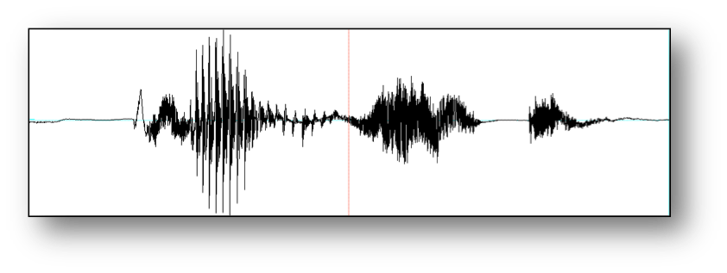
Columbia X-Cultural Deception Corpus
NEO-FFI
Survey
Biographical
Questionnaire
Lying game
Survey
Baseline
Notes:
Brought pairs of subjects who did not know each other into the lab
Gave them a demographic survey, a personality (NEO FFI) survey, collected baseline speech
Partially-Fake resume paradigm: 24 questions, create false answers for half we selected at random, balanced
Interviewed one another in turn in recording booth
Financial incentive scheme: lie believed true = $1; if believed false -$1; $1 to interviewer for each correct guess
Keypress logging of T/F statements by interviewee for each utterance and by interviewer for thier overall T/F for each of the 24 questions at the end of their follow-ups
Here are the questions we asked them to provide truth or lie answers to…

Slide 21
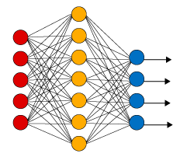
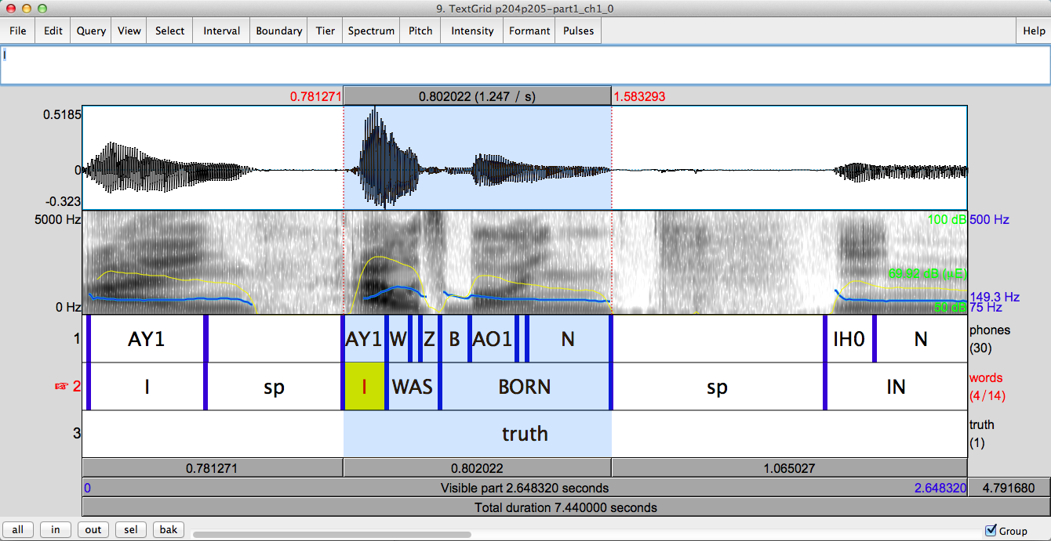
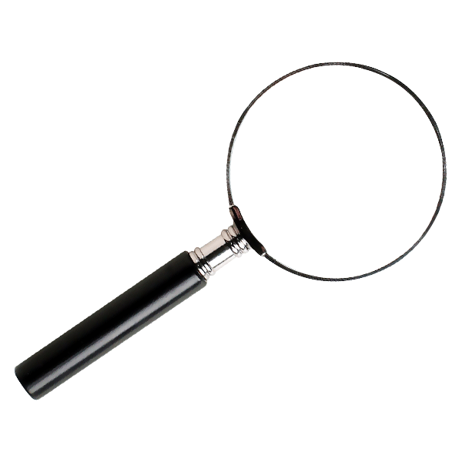
Deception Detection from Spoken Language
Corpus collection
Annotation,
feature extraction
Classification
Analysis
Notes:
Here’s an outline of our process and my talk.

Slide 22
Four Units of Analysis: Small to Large
Inter-Pausal Unit (IPU) Pause-free segment of speech from a single speaker
Turn Sequence of speech from one speaker without intervening speech from the other speaker
Question response Interviewee first turn following an interviewer biographical question
Question chunk Set of interviewee turns responding to an interviewer’s biographical question and subsequent follow-up questions

Slide 23
Features Extracted
Text-based: n-grams, psycholinguistic, Linguistic Inquiry and Word Count (LIWC) (Pennybaker et al), word embeddings (GloVe trained on 2B tweets)
Speech-based: openSMILE IS09 (e.g. f0, intensity, speaking rate, voice quality)(386)
Gender, native language, NEO-FFIs personality scores and clusters
Syntactic features (complexity), entrainment, regional origin
Notes:
Psycholinguistic features from practitioner literature
Word embeddings: capture semantic similarity of use by context

Slide 24
Acoustic-prosodic and Linguistic Characteristics of Human Deception and Truth
Deception
Increased pitch & intensity
Poor speech planning
Descriptive, detailed
Complex
Uses hedge terms
Entrainment
Truth
Negation
Cue phrases
Cognitive processes
Function words

Slide 25
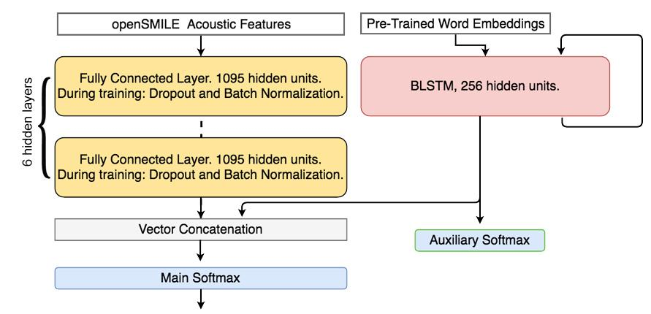
Deep Learning on Word Embeddings and openSmile Acoustic Features (Mendels et al 2017)
BLSTM-word embeddings
DNN-openSMILE
Hybrid: BLSTM-lexical + DNN-openSMILE
Notes:
Mendels, Levitan et al. 2017, “Hybrid acoustic lexical deep learning approach for deception detection,” Interspeech, Stockholm.
Built some deep learning models to compare with other classifier. Used only acoustic and lexical features on IPUs (smallest unit and largest number of inputs): a DNN using openSMILE acoustic features with 6 fully connected layers, BLSTMs using pretrained (GloVe) word embeddings; another using low level acoustic features (MFCCs). Acoustic BLSTM performed poorly. A hybrid model combining the DNN with the best BLSTM (lexical) obtained the best performance.
NOTE: As the hybrid model is used on more data it improves exponentially.
DNN:384 openSmile features; 6 fully connected layers with 1095 hidden units each, followed by ReLU activation. A softmax layer with 2 outputs. Loss function: categorical cross-entropy. During training output normalized using Batch Normalization and passed thru Dropout layer with .497 prob (due to having many parameters). Used stochastic gradient descent with learning rate of .00134 that reduces by 50% every 10 epochs w/no improvement on training loss. Hyperparameters obtained using Bayesian Optimization.

Slide 26
Neural network models
Notes:
F1= 2 * (P * R)/ (P + R) – harmonic mean, or weighted avg of P and R – good when classes are not balanced
Prediction is how many correct positives you have predicted out of all the positives you predict
Recall is how many true positives you have predicted from all the true positives there are

Slide 27
What Next Can We Learn from Gender and Native Language?
Extract simple acoustic/prosodic features from question responses
Compare distributions of features over all and by gender and native language
  When interviewees lie vs. tell the truth
  When interviewees are trusted (believed) or are not
  When interviewers trust (believe) an interviewee or do not
Perform paired t-tests to compare feature means
  Tests for significance correct for family-wise Type I error by controlling the false discovery rate at α=0.05. (Parentheses indicate an uncorrected p <=0.05.)
Notes:
So adding personality helps significantly with deception prediction: it appears that speakers with different personality traits lie or tell the truth somewhat differently.
So not we want to know, do speakers differ by gender or by native language as well?
As a start, we compare distributions of features characterizing lies and truth over the whole corpus and then over different gender and language groups.
We also examine whether interviewer belief that a response is true or not varies both by the gender and native language of the speaker and of the hearer.
Correcting for family-wise Type 1 error: incorrect rejection of the true null hypothesis (aka false positive results often due to running many statistical tests on the same corpus). To correct you use the following formula to get the corrected p value:
The formula to estimate the familywise error rate is:
FWE ≤ 1 – (1 – α_{IT})^{c}
Where:
α_{IT} = alpha level for an individual test (e.g. .05),
c = Number of comparisons.

Slide 28
Differences Gender and Native Language in Deceptive vs. Truthful Interviewee Speech
Feature | Male | Female | English | Chinese | All
Pitch Max | F |  |  | F | F
Pitch Mean
Intensity Max | F | (F) | F |  | F
Intensity Mean |  |  | (F)
Speaking Rate |  |  |  | T
Jitter |  | (T)
Shimmer
NHR
Deceptive True
Notes:
Putting these together we do see evidence that gender and native language may be useful cues to unraveling individual differences in deceptive and truthful behavior –

Slide 29
Differences in Gender and Native Language for Trusted vs. Mistrusted Interviewee Speech
Feature | Male | Female | English | Chinese | All
Pitch Max | (F) |  |  | (F) | (F)
Pitch Mean |  |  |  | F
Intensity Max |  |  |  | F | F
Intensity Mean
Speaking Rate | (T) | (T) |  | T | T
Jitter |  | (T) | (T)
Shimmer |  | (T) | T
NHR |  |  |  | F
Mistrusted Trusted
Notes:
Here are the results for group-specific cues to trusted and mistrusted speech, analyzing differences across interviewee traits
Highlight some findings:
Some features were consistent across groups – for example speaking rate was faster in trusted speech for all groups except native English speakers
There was also considerable variation across groups – for example, pitch mean and NHR were increased in mistrusted speech for native Chinese speakers only.
Overall, we observed greater differences in native language than gender when considering interviewee traits.
Next, we studied the role of interviewer traits in the perception of deception

Slide 30
Individual differences between Interviewers’ Judgments by Interviewer Gender and Native Language
Feature | Male | Female | English | Chinese | All
Pitch Max |  |  | F |  | (F)
Pitch Mean | (F)
Intensity Max | (F) |  | (F) | (F) | F
Intensity Mean
Speaking Rate | T |  | T | (T) | T
Jitter |  | F
Shimmer |  | (F)
NHR
Mistrusted Trusted
Notes:
Here are the results for group-specific cues to trusted and mistrusted speech, analyzing differences across interviewer traits
Highlight some findings:
Increased speaking rate was a cue to trust for all groups except for female interviewers
Jitter and shimmer were increased in mistrusted speech only for female interviewers
Overall, we observed greater differences in gender than native language when considering interviewer traits.
It seems that gender and native language play a role in how people produce and perceive deception
-> having identified significant acoustic-prosodic differences between truthful and deceptive speech, we trained machine learning classifiers to classify deceptive speech using acoustic-prosodic features. And since we observed individual differences in cues to deception, we incorporated individual traits in classification.

Slide 31
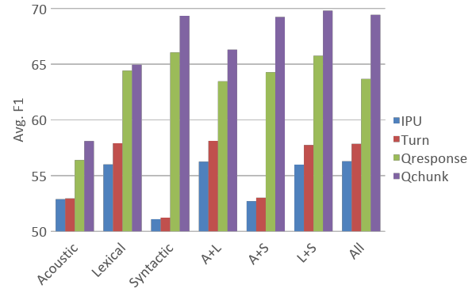
Deception Classification: Our Classifiers vs. Human Interviewer Performance
Notes:
Random: 50% (balanced truth and lie) --
Best Humans: 56.75 % (on chunks) – red line -- and mean F1 of 55.33) – Best ML on chunks: 73.67 F1
speaker independent 10-fold cross-validation using Naïve Bayes classifier

Slide 32
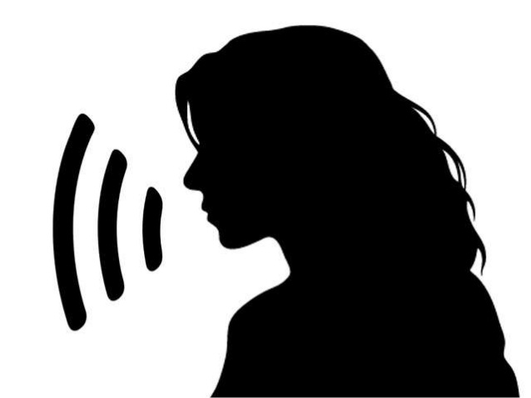
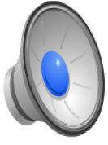
“Did you ever cheat on a test in high school?”
TRUE or FALSE?
Notes:
And now for a final test…
True. P406p407-part1
Judged true by human.

Slide 33

“Did you ever cheat on a test in high school?”

Slide 34
“Did you ever cheat on a test in high school?”
TRUE or FALSE?
Notes:
Turn this
False. P482p483-part1
Judged true by human.

Slide 35

“Did you ever cheat on a test in high school?”
Notes:
False. P482p483-part1

Slide 36

“Who was the last person you had a physical fight with?”
True or False?
Notes:
True: p372p373-part2_ch2/1053.631440/1054.731440/q12/n1/T

Slide 37
“Who was the last person you had a physical fight with?”
Notes:
True: p372p373-part2_ch2/1053.631440/1054.731440/q12/n1/T

Slide 38
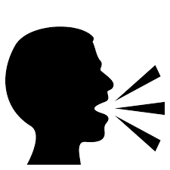
“Who was the last person you had a physical fight with?”
True or False?
Notes:
False: p542p543-part2_ch2/310.619791/322.302834/q12/n1/F

Slide 39
“Who was the last person you had a physical fight with?”
Notes:
False: p542p543-part2_ch2/310.619791/322.302834/q12/n1/F

Slide 40
“Who was the last person you had a physical fight with?”
True or False?
Notes:
p514p515-part2_ch2/1199.310584/1216.842950/q12/n1/F

Slide 41
“Who was the last person you had a physical fight with?”
Notes:
p514p515-part2_ch2/1199.310584/1216.842950/q12/n1/F

Slide 42
“Who was the last person you had a physical fight with?”
True or False?
Notes:
p352p353-part2_ch2/1834.867900/1840.947900/q12/n1/T

Slide 43
“Who was the last person you had a physical fight with?”
Notes:
True: p352p353-part2_ch2/1834.867900/1840.947900/q12/n1/T

Slide 44

“Have you ever tweeted?”
TRUE or FALSE?

Slide 45
“Have you ever tweeted?”
Notes:
false

Slide 46

What Other Modalities are Useful in Deception Detection?
Applications: Law enforcement, military, intelligence agencies, social services, political and financial organizations
Linguistic Cues: Fake hotel reviews, controversial persuasive essays, interview dialogues
Visual Cues: Emotional facial expression
Multimodal dataset with manual annotations
Notes:
As you read this week we also tried multimodal features with some good results:
Jiaxuan Zhang, Sarah Ita Levitan, Julia Hirschberg, “Multimodal Deception Detection using Automatically Extracted Acoustic, Visual, and Lexical Features,” Interspeech 2020.
The main problem we are trying to solve in this work is deception detection.
It has been increasingly studied by researchers in speech and Natural Language Processing.
It has applications in law enforcement, military, intelligence agencies, social services, political and financial organizations
Researchers has been trying to solve this problem by examining different modalities.
For instance, linguistic cues have proven to to be useful to identify fake hotel reviews, controversial persuasive essays, as well as conversations in the interviews.
visual cues have also been studied by various researchers and
emotional facial expression is shown to be correlated with deceptions.
In our work, we are aiming to combine the fully automatically extracted features from different modalities and combine them for better performance.

Slide 47
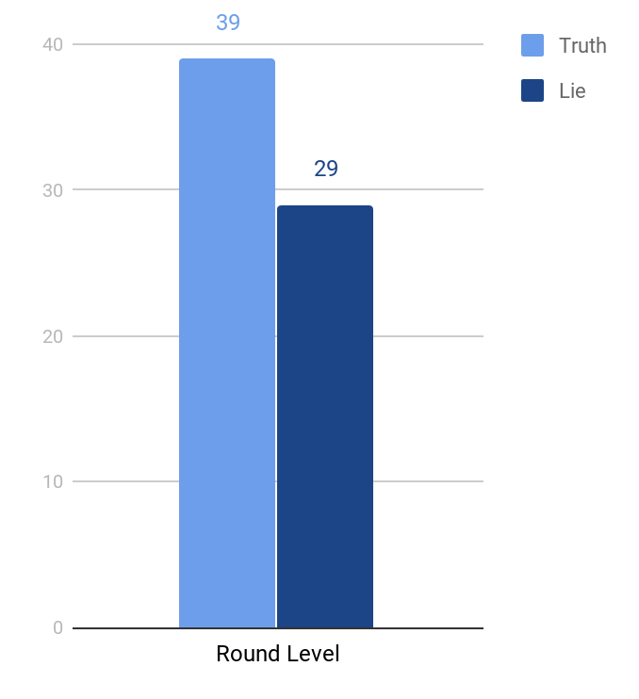
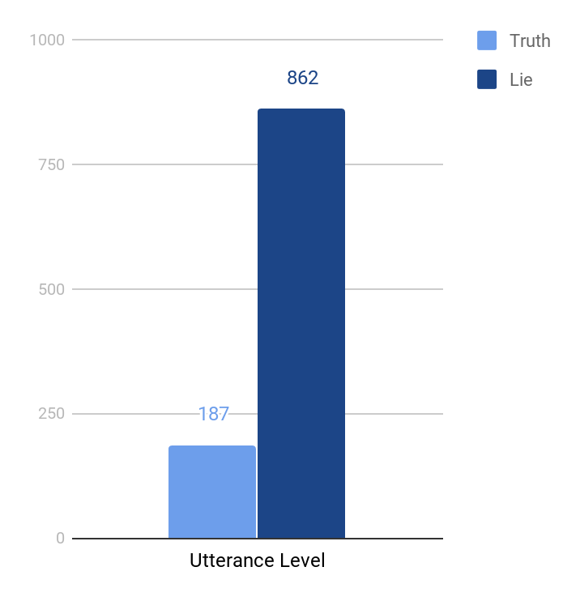
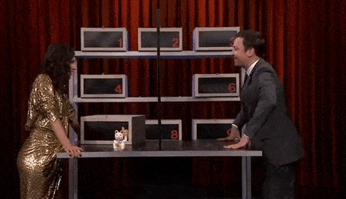
Box of Lies Dataset
Game played on Jimmy Fallon’s Tonight Show
Each round introduces a new box with a new object
Notes:
The dataset we use in our work is called the Box of Lies Corpus, introduced in 2019.
it contains video-recorded conversations between the host of the Tonight Show, Jimmy Fallon, and 28 guests who play a game called “Box of Lies.”
as shown in the gif at the bottom, each round, One player gives a truthful description of an object which they see inside a box or a deceptive description of some fictional object that is not in the box. The other player guesses whether the description is truthful or not.
As you can see, this conversational setting greatly increases the difficulty of predicting truth or lie, since the interaction between participants can be difficult to capture.
There are 68 recorded rounds of the game and a total of 1049 utterances
Most of our experiments were conducted at the utterance level simply because there are more data points.
However the downside of using utterance level data is the data imbalance problem .

Slide 48
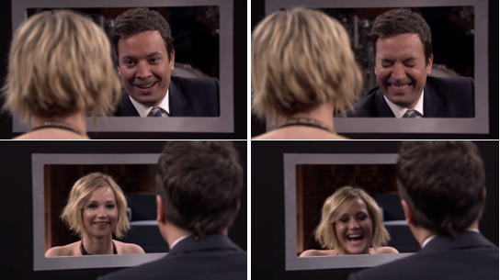
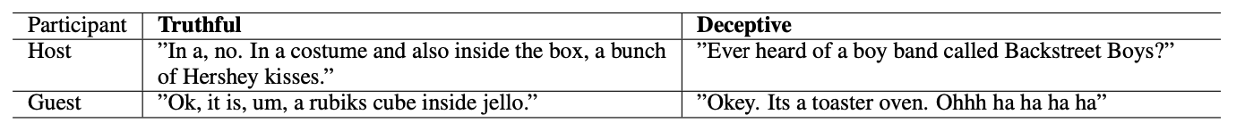
Box of Lies Dataset and Prior Results (Soldner et al 2019)
Manual annotations for facial expression
Manual transcripts of speech
Includes round level context but no acoustic features
65% Accuracy: Proof of difficulty
Notes:
Our baseline model is derived from the paper that introduces this dataset.
Features were extracted from three modalities.
both visual feature, lexical features and round level context features are annotated manually
In the end, 65% accuracy is achieved, which proves the difficulty of this work.
to further develop on top of the baseline model, we decided to explore the potential of using fully automated feature extraction techniques, without relying on any human annotated features,

Slide 49
Our Multimodal Approach (Zhang et al 2020)
How can speech, text, and facial expression be used to identify deception automatically, without manual labeling?

Slide 50
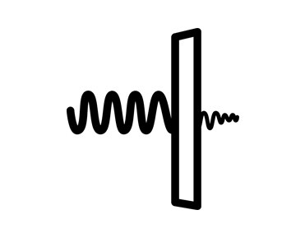


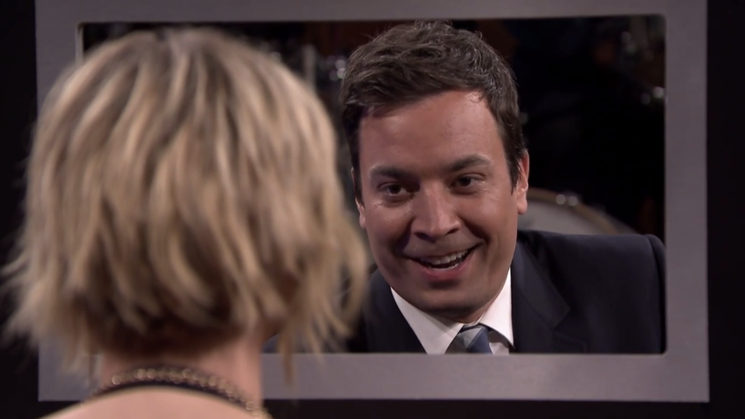
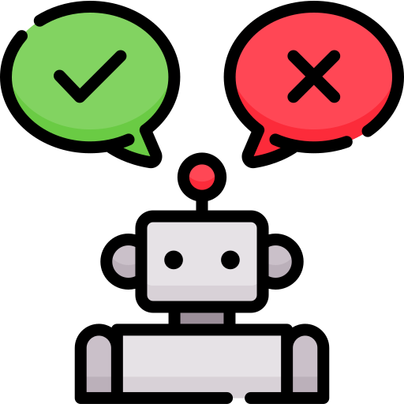
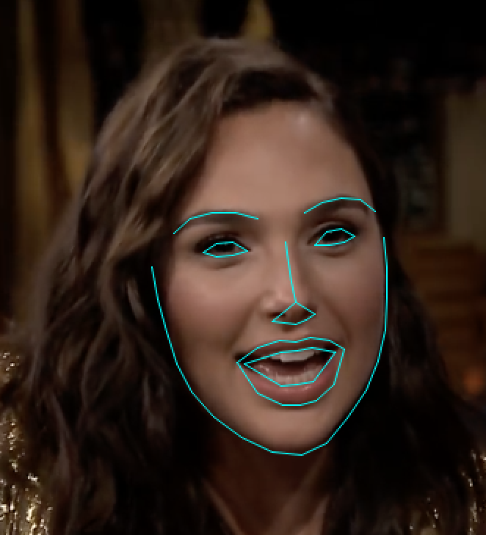
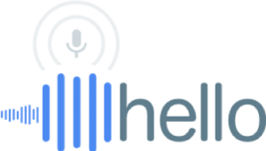
Acoustic Features
+
Noise Reduction
OpenSMILE Toolkit
RF Model 1
Visual Features
+
Fisher Vector
Box of Lies Game Video Clips
Facial Landmarks
RF Model 2
Aggregate to get final truth/lie prediction
Linguistic Features
Word2Vec
+
LIWC
Unigram
Google Cloud ASR
POS tagging
RF Model 3
Notes:
Several methods for noise reduction
openSMILE 2009 384 features

Slide 51
Acoustic Features
Noise Reduction Effort
Mitigate the effect of laughters, applause, background noise, etc.
Techniques
  Calculating Spectral Centroids
  MFCCs
  Median filtering
OpenSMILE Feature Extraction
Interspeech 2009 (IS09) ComParE Challenge OpenSMILE baseline feature set
384 features
Acoustic features (e.g. pitch, energy, voicing probability, MFCCs)
Functions (e.g. min, max, range, stddev, slope of linear approximation)
Notes:
Our first feature set is acoustic; which were not explored in the previous work on this corpus.
we first explored different options of reducing noise in the acoustic signals.
The main reason is because there is a great deal of background noise in the recordings, such as laughter, applause and background music.
We have experimented with three different ways to reduce noise:
Calculating Spectral Centroids
MFCCs
Median filtering
Since these are all existing well-known methods for noise reduction, we won’t go into too much detail here.
For the actual feature extraction, we adopt the opensmile toolkit.
There are 384 features, which contains acoustic features like pitch, energy…
as well as common functions like min/max, range etc of these acoustic features.

Slide 52

Acoustic Features
+
Noise Reduction
OpenSMILE Toolkit
RF Model 1
Visual Features
+
Fisher Vector
Box of Lies Game Video Clips
Facial Landmarks
RF Model 2
Aggregate to get final truth/lie prediction
Linguistic Features
Word2Vec
+
LIWC
Unigram
Google Cloud ASR
POS tagging
RF Model 3
Notes:
Facial landmark features on each frame
Fisher Vector Encoding (Gaussian Mixture Model) creating fixed vector representations on the distribution of visual features
Tried other methods but this seemed to work best

Slide 53
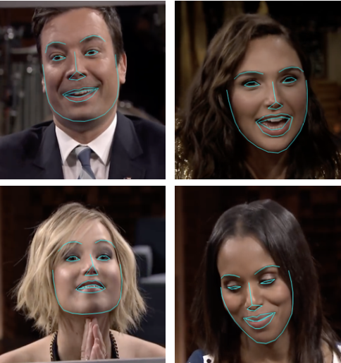
Extract Facial Landmark Features on Each Frame
Extract Facial Landmark features on each frame
68 (x, y) pairs of coordinates
128D vector representation of the face to extract only the face of speakers
Apply vector normalization to eliminate the effect of different angles
Varying length of facial landmarks on each utterance (N x 68 x 2)
Notes:
We extracted the facial landmarks from video frames containing the face of the describer, by using a pre-trained neural network.
Facial landmark is a useful feature representation is because it encodes a person’s facial expression
Each extracted face is represented as 68 coordinates.
On the right hand side, you can see the visualization of the facial landmarks.
To match faces of the same speaker and exclude the partner’s face in the same video clip from our analysis, we computed face embeddings, which is a 128-D vector, and measure the distance between two faces using cosine similarity.
To eliminate the effect of faces being located at different positions with different angles, we normalized the coordinates of each distinct face detected.
As a result, for a single video clip on the utterance level, we will detect a series of facial landmarks. The number of faces in different series will be different
therefore, we explored the following two ways to map the feature to same dimensionality.

Slide 54
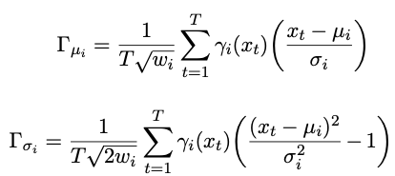
Fisher Vector Encoding
A Gaussian Mixture Model (GMM) models the distribution of visual features
Create fixed-length vector representations
FVs have been shown to outperform traditional Bag-of-Visual representations for image classification tasks
Notes:
The first option is called fisher vector encoding
Essentially A Gaussian Mixture Model (GMM) estimates the distribution of visual features extracted from an image, which in our case are the facial landmarks.
The FV encodes the gradients of the log-likelihood of the features under the GMM, with respect to the GMM parameters, creating fixed-length vector representations.
Suppose that a GMM using facial landmarks as the training data is built as shown on the first line of the equation
The final fisher vector is simply the concatenation of the second and third expression, for a total dimension 2 x (number of cluster) x (length of single facial landmark = 68x2)
FVs have been shown to outperform traditional Bag-of-Visual representations for image classification tasks and it fits into our use case perfectly

Slide 55
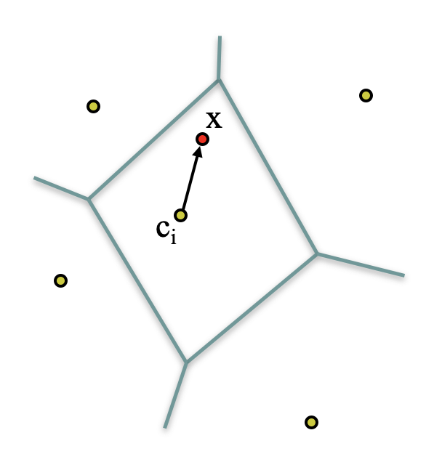
VLAD Encoding
Vector of Locally Aggregated Descriptors
Similar to FV features mapping with various lengths to the same latent space
Uses K-Means clustering instead of a GMM and stores only first order information
Notes:
The second approach we considered is VALD encoding, which stands for
Vector of Locally Aggregated Descriptors
Similar to FV encoding, it also maps feature with various lengths to the same latent space
The main difference between two of them is that
VLAD Uses K-Means clustering instead of a GMM to generate the feature,
and it does not store second-order information about the features

Slide 56
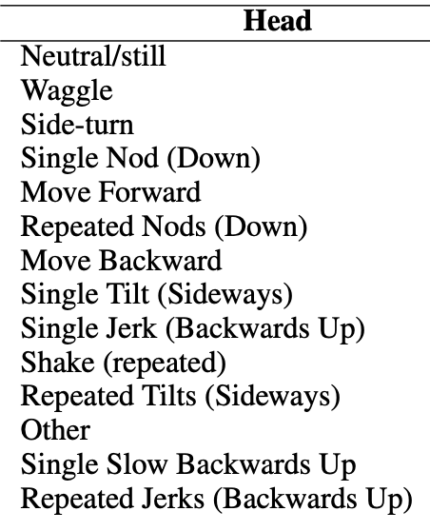
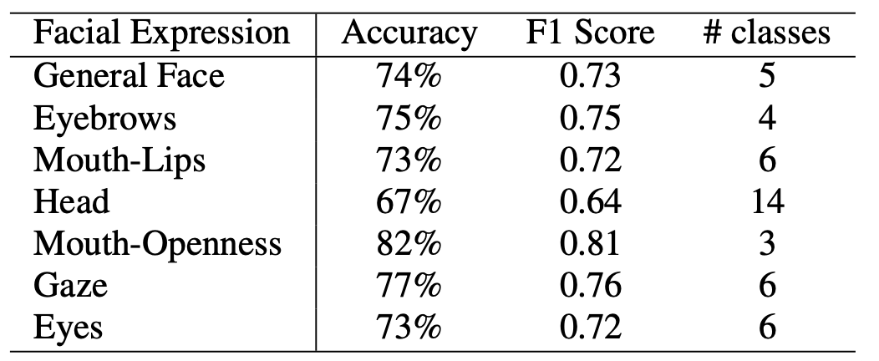
Facial Expression Detection
MUMIN multimodal coding scheme
Facial landmark coordinates as input feature
Random forest classifier for each type of facial expression
Compare against unsupervised method(FV/VLAD)
Most challenging one: 14 classes (Head movements)
Notes:
In addition to these two unsupervised image representations, we also explored a supervised approach for extracting facial expression detection.
There are 7 categories of facial expressions annotated in the corpus.
These expressions were carefully annotated in the original corpus by trained annotators.
We wanted to leverage these existing gold annotations and explore whether it would be more useful for deception detection than our unsupervised methods.
We trained individual facial expression detectors with the facial landmark coordinates as input features.
These classification results are quite promising, especially given the challenge that the camera angle changes constantly and thus the face of the describer is captured from quite different angles.

Slide 57
Acoustic Features
+
Noise Reduction
OpenSMILE Toolkit
RF Model 1
Visual Features
+
Fisher Vector
Box of Lies Game Video Clips
Facial Landmarks
RF Model 2
Aggregate to get final truth/lie prediction
Linguistic Features
Word2Vec
+
LIWC
Unigram
Google Cloud ASR
POS tagging
RF Model 3

Slide 58
Lexical Features
Unigram: frequency of each word in the utterance
LIWC: word counts for semantic classes – linguistic, markers of psychological processes, punctuation, formality
Word Embeddings: word2vec model + FV Encoding to get unified feature length
PoS Tags: frequency of each type of PoS tag in the utterance
WER 47.43%
Notes:
Since manually transcribing the words from the audios could be tedious,
which also defeats our purpose of having a fully automated system,
we decided to use a asr model to automatically generate the transcripts from the audios
Our Word-Error-Rate was fairly high at 47.43%, so we were interested to discover how it would affect our final result
We have four different types of lexical features, which are unigram, LIWC, word embedding and pos tags.
In case you are not familiar with LIWC, it stands for Linguistic Inquiry and Word Count,
which groups words into 80 psychologically-motivated categories and has been successful in many deception detection experiments;

Slide 59
Random Forest Model
Score 1
+
Downsampling vs Upsampling
Modal aggregation & Majority Vote
RF Model 1: Acoustic Features
Score 2
RF Model 2: Visual Features
+
Aggregate to get final truth/lie prediction
Score 3
RF Model 3: Lexical Features
Notes:
To mitigate the data imbalance problem, we considered using both Downsampling and Upsampling in our strategy.
Interestingly, our experiments shows that applying upsampling to the dataset will easily make the model overfit,
therefore, we chose to use downsampling across all our experiments.
Instead of concatenating all features and build a single random forest model, we decided to build a model for each modality we mentioned before.
Our experiments show that this greatly increases the stability of the result and boost our performance.

Slide 60
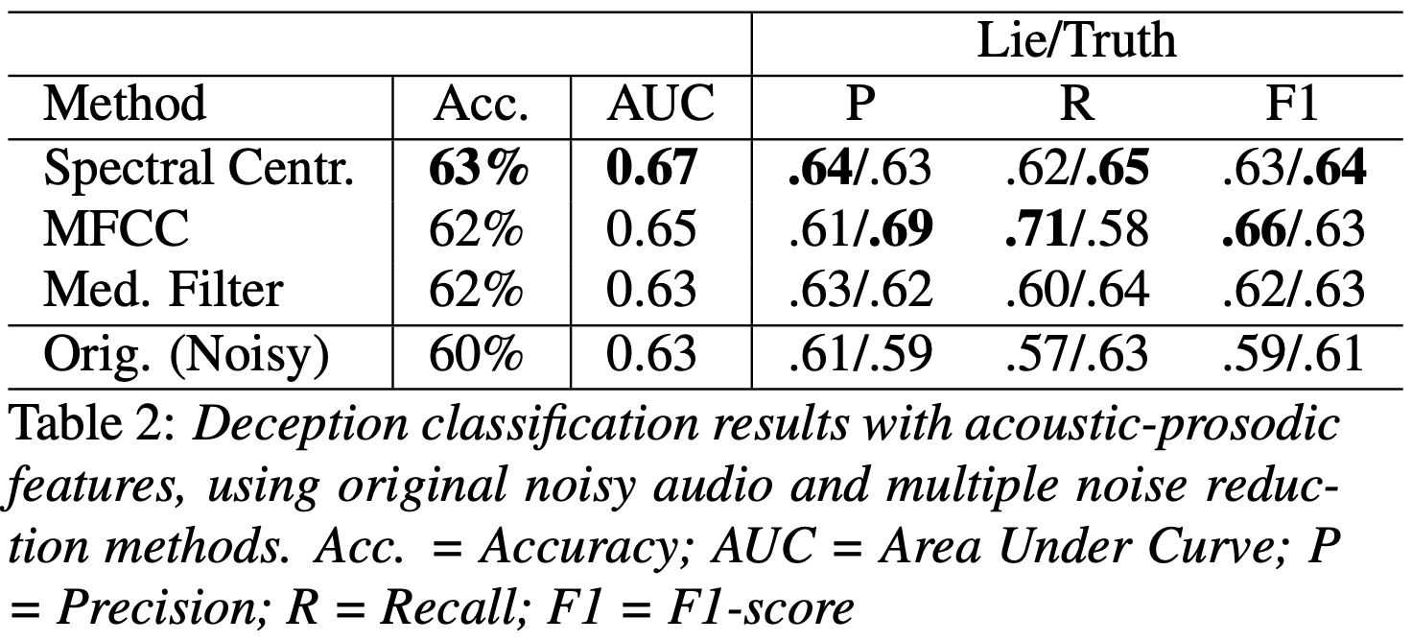
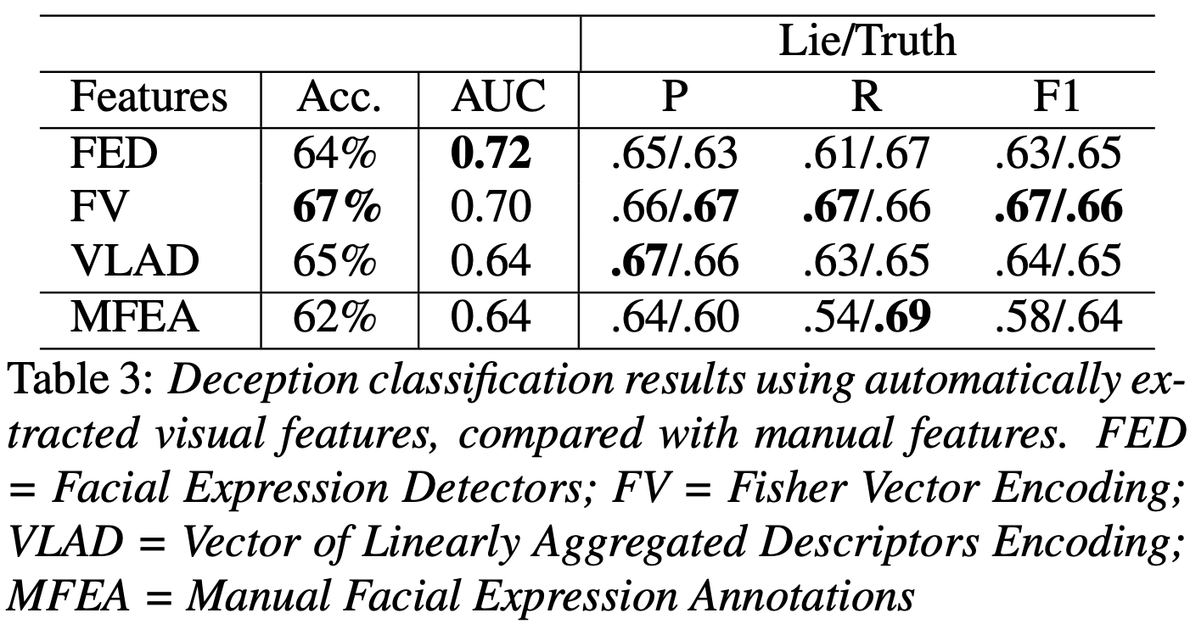
Results
Acoustic Features
Visual Features
Notes:
for acoustic-prosodic features, we compare the performance of models with both unfiltered noisy audio and from noise-reduced audio.
As shown in the left table, noise reduction was an important for deception classification, achieving 63% accuracy using the spectral centroid method, as opposed to 60% using the unfiltered data.
for results using visual features,
we compared classification results between our automated features and these manually extracted features.
features generated by our trained facial expression detectors achieved an accuracy of 64%, performing slightly better than manually annotated facial expressions
However, the best visual deception classification performance (67% accuracy) was achieved using FV encoding.
it is quite impressive and useful for future research because FV encoding and VLAD encoding does not rely on human annotated features.,

Slide 61
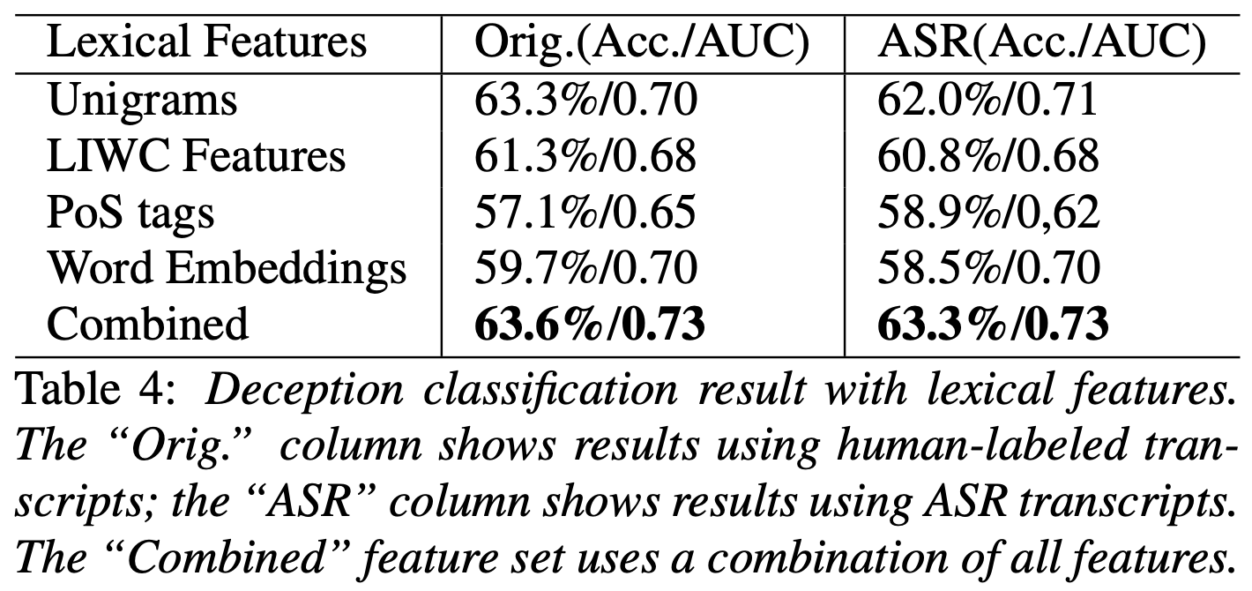
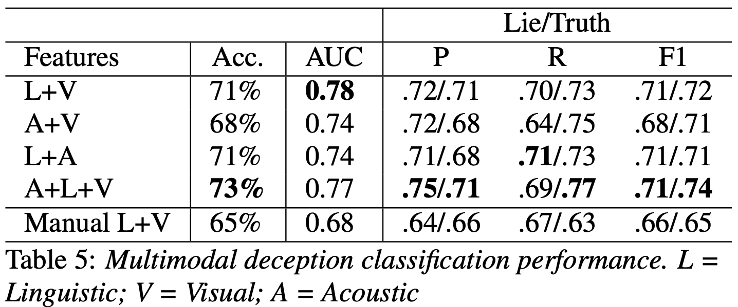
Overall Better Results than Prior Work
Lexical Features
All Features
Notes:
The best deception detection performance obtained with the ASR transcriptions was similar the the one with manual transcripts,
which are both around 63%
A manual inspection of ASR errors showed that several errors occurred around filler words.
clearly, ASR transcription allowed us to capture important lexical information for deception detection, despite high Word error rate.
Lastly, we trained multimodal classifiers combining the best performing features for each modality.
For acoustic features, we used the features extracted from the spectral centroid noise-reduced audio.
For visual features, we used FV encoding.
For linguistic features, we used a combination of all features extracted from ASR transcripts.
We compared our multimodal deception models with the previous manual feature results in our baseline model.
As we can see, it achieves the best deception classification performance of 73% accuracy.
This is an 8% absolute improvement over the best multimodal performance using manual features.

Slide 62
Game Level Classification
Directly comparable to human performance
Results generated by our majority vote on utterance level prediction
15% better than human performance (as reported in Soldner et al. 2019)
72%
Notes:
In addition to classifying utterances as deceptive or truthful, we also evaluated our proposed method on entire rounds of games.
An advantage of evaluating performance at the round level is that it allows us to directly compare our system performance with human performance
We trained a classifier on the utterance-level data and then generated the round-level predictions by taking the majority vote.
Using this approach, our classifier achieved an accuracy of 72% on entire rounds of the game.
This is a 15% absolute improvement over human performance, which was 57%.

Slide 63
Future Directions
Evaluate model against real-world multimodal deception data
  court testimonies
  political speeches
With the increase in magnitude of data, more complex models
  RNN for conversational context
  time-dependent features
  ……
Trust analysis
  Does the opponent of the game believe what you said?
Notes:
In future work we will evaluate our models on real-world multimodal deception data, such as videos of court testimonies and political speeches, where deception has higher stakes.
In addition, future work can explore more complex classifiers such as recurrent neural networks to model conversational context and time-dependent features to improve automatic deception detection.
Trust analysis is also another interesting topic inspired by the intrinsic property of this dataset, we could potentially analyze whether the opponent of the game will believe what the describer says about the object in front of her/him.

Slide 64
So…How do Humans Decide which Speech to Trust? (Xi (Leslie) Chen et al “Acoustic-Prosodic and Lexical Cues to Deception and Trust”, TACL 2020)
The words people say?
The syntax people choose?
The acoustic content of their speech?
The prosody of their speech?
Why do humans believe lies are true?
  How do human decisions compare with the features our classifiers use more successfully to detect lies and truth?
  How does each compare with the actual characteristics of trustworthy (true) vs. untrustworthy (lying) speech?
Notes:
Which you have already read for today

Slide 65
Approach
Created a game, LieCatcher, to collect additional human judgments via AMT tasks
  Each task included 12 of the 24 questions (text) and first responses (speech) of interviewees from our corpus, one at a time, plus a check question to ensure attention to game
  Audio samples balanced by gender, native language, question, and speaker
  Balanced also for truth/ lie: Half true, half false responses
Collected human judgments with their demographic and personality (TIPI) information
Notes:
Ten Item Personality Inventory (similar to NEO FFI but quicker to do
Unity software

Slide 66
  Restricted raters to fluent speakers of English
  Asked them about prior experience in law enforcement
  Must listen to full response before answering
  Also collected time interval before decision
  Success rate provided to raters only at end of task of each 13 question task – not for each question they rated
  Each turker limited to 10 tasks max

Slide 67
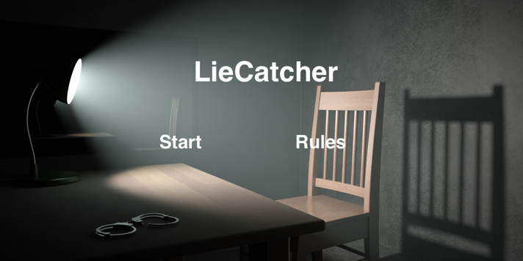
LieCatcher: Game-with-a-Purpose
Notes:
Build with Unity game development software. Game with a Purpose

Slide 68
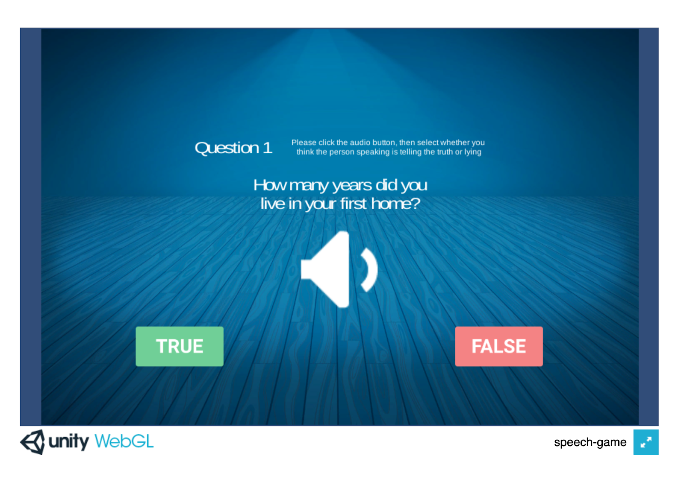
Notes:
Here’s what the rater sees for each question in the task

Slide 69

Crowdsourcing Study Procedures
5,340 utterances w/ 3 rater judgments per utterance
  431 unique turkers: 38.9% male, 59.1% female, 2.1% unreported
  Only 4.8% reported previous experience in law enforcement
  Raters also reported at the end of the game the features they thought indicated deception or truth
  Then they were told their overall score
Notes:
13 per task, balanced by gender, native language, veracity

Slide 70
Lie Detection Ability
Used majority vote: Overall accuracy = 49.93%
  Fleiss’ kappa: 0.135 (slight agreement)
Where all agreed: 50.75% accuracy
  Agreement did not correlate with gender or native language of speakers or with utterance length (with slightly lower agreement on longer responses)
But:
  Female speakers were trusted more (71.5%) than male speakers (68.6%)
  Native English speakers were trusted more (73.5%) than native Chinese speakers (66.6%)
Notes:
Analyzed utterances labeled with majority vote

Slide 71
  In terms of interviewee personality scores: Speakers with low conscientiousness scores (71.9%) or high openness to experience scores (71.6%) or high neuroticism scores (71.8%) were trusted more than their opposites; no high scores for speech from speakers high in extraversion or agreeableness, which was surprising
Notes:
Also

Slide 72
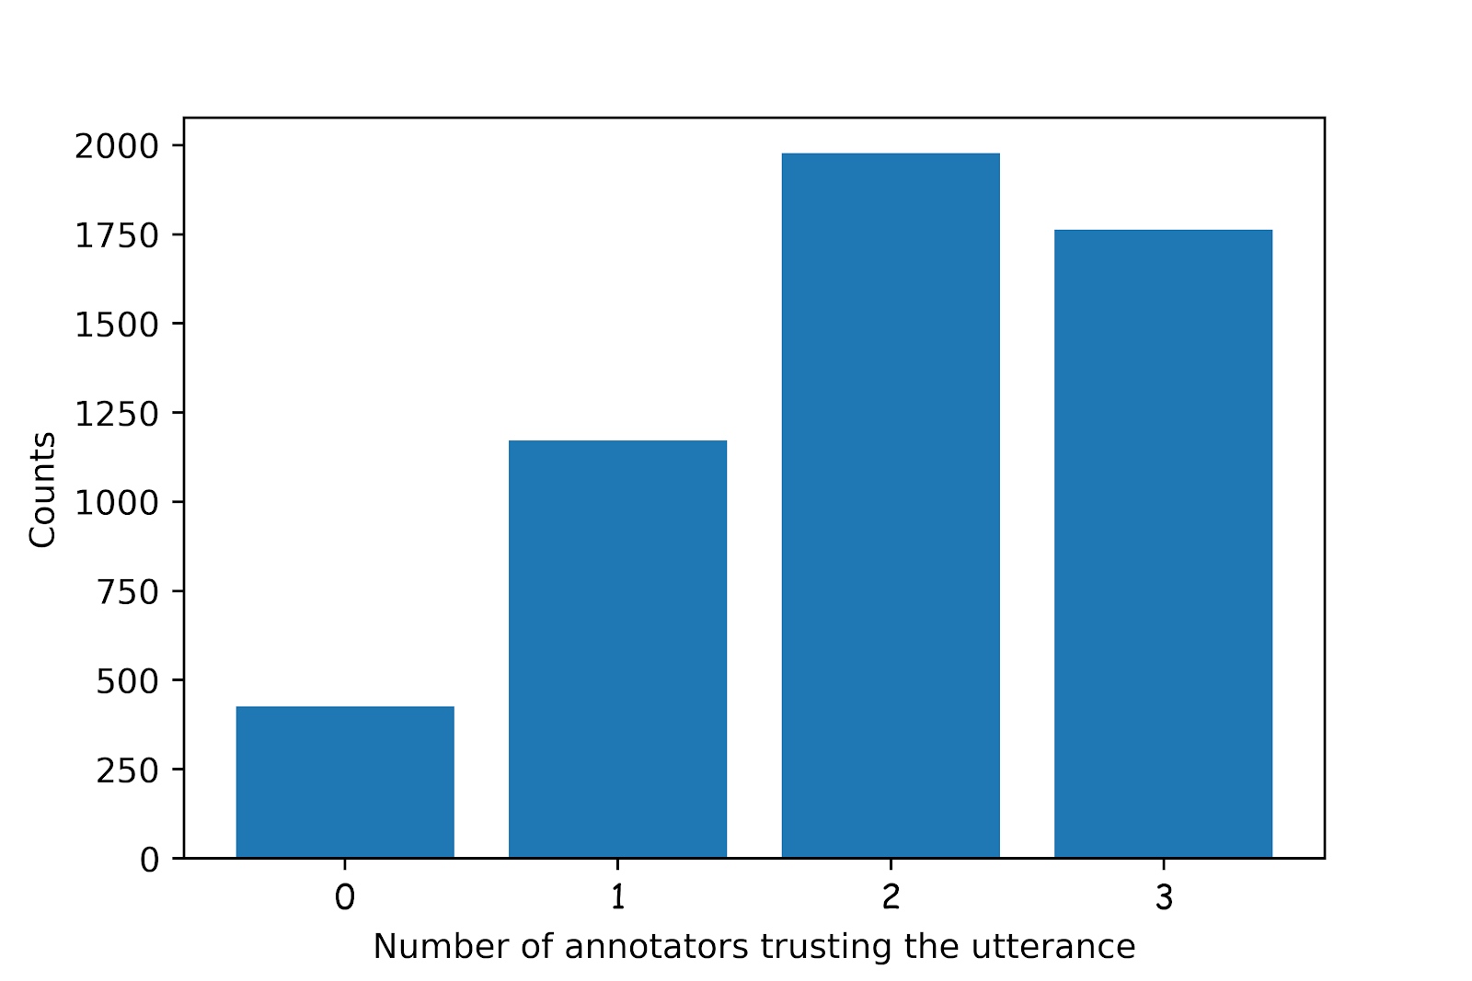
Inter-annotator Agreement
Number of annotators agreeing on trusted utterances
Fleiss’ kappa low: 0.135
Truth bias – 65% agreement on trust over-all
Truth Default Theory (Timothy R. Levine, 2014)
Notes:
Slight agreement – 0.21-0.40 is fair agreement – so seems that this is a subjective task!
33% were trusted by all, 70% trusted by at least 2
Raters more trusting than mistrusting
TDT: people tend to assume that others are honest

Slide 73
Features of Responses Examined
Disfluency “um…er”
Prosody/Acoustics: pitch, speaking rate, loudness
Complexity: more words, more detail
Affect: positive/negative/neutral
Uncertainty: e.g. hedging “sort of”, “probably”
Creativity: measured in difference from other interviewees’ responses to the same question
Notes:
Creativity measured by converting all responses to TF-IDF vectors on unigrams and bigrams. We built a lexical graph for each question with responses as nodes and cosine similarities between TF-IDF vectors as edge weights. Then we computed the eigenvalue centrality for each node and used its negative value as the measure of creativity.

Slide 74
Disfluency Features: Humans Do Fairly Well
Features | Trusted Responses | Actual Deceptions
Has filled pause | ↓↓↓↓ | ↑↑↑↑
# filled pause | ↓↓↓↓ | ↑↑↑↑
Response latency | ↓↓↓↓
Repetitions | ↓↓↓↓ | ↑
False start | ↓↓↓ | ↑↑
↓ indicates negative relationship of feature with response; ↑ indicates positive relationship
↓: <.05, ↓↓ : <.01, ↓↓↓ : <.001, ↓↓↓↓ : <.0001
Green is correct human judgment of truth or lie; red is incorrect (e.g. filled pause was correctly mistrusted but response latency was not an indicator of lies)
Notes:
green is correct; red is incorrect; Up arrow: positive correlation; Down arrow: negative correlation (number of arrows: significance level:
1: <.05
2: <.01
3: <.001
4: <.0001
All statistical significance calculated after the Bejamini-Hochberg (1995) correction performed.
Red human judgments are “wrong” and green are “right”

Slide 75
Acoustic/Prosodic Features: Humans Very Poor
Features | Trusted | Actual Deception
Speaking rate faster | ↑↑↑↑
Pitch max higher | ↑↑↑↑ | ↑↑↑↑
Pitch mean higher | ↑↑
Pitch min higher | ↑↑↑↑ | ↓↓
Pitch stdev lgr | ↑↑ | ↑↑
Intensity max |  | ↑↑↑
Intensity mean higher | ↑↑↑↑
Intensity min higher | ↑↑↑↑ | ↓
Intensity std smlr | ↓↓↓↓ | ↑
Jitter, shimmer, nhr higher | ↑↑↑↑
Humans very poor at judging lies from how people speak: only 3 correct judgments (higher min pitch and min intensity; smaller std of intensity)
Notes:
Humans are very poor at judging deception from “how” people speak.
Of the 11 prosodic cues humans apparently considered useful indicators of deception or truthfulness, only 3 actually were: 2 about trust and one about lying
↓ indicates negative relationship; ↑ indicates positive relationship
↓: <.05, ↓↓ : <.01, ↓↓↓ : <.001, ↓↓↓↓ : <.0001
Green is correct human judgment of truth or lie; red is incorrect
so now let's put these results together with other rater majority judgments

Slide 76
How Did Humans Do?
Disfluency
  Raters mistrusted disfluency, which was correct but also mistrusted response latency, which was not a cue to deception
Prosody
  Raters trusted higher, louder and faster speech with higher degrees of jitter, shimmer and NHR – but these features were not significant indicators of truth: higher and louder speech were in fact strong cues to deception
Complexity
  Multiple measures showed raters correctly mistrusted more complex utterances, which, contra prior belief, were signs of deception in our data
Notes:
Complexity: longer utterances w/more content words, more concrete and specific

Slide 77
Affect
  While raters trusted more pleasant utterances this was not a useful indicator of truthfulness
Uncertainty
  Raters did correctly mistrust utterances containing hedge terms (possibly, sort of) but did not correctly trust utterances indicating certainty (always, never)
Creativity
  While people were more creative when lying than when telling the truth, raters’ apparently did not recognize this
Notes:
Creativity measured by how much a speakers responses differed from other speakers’

Slide 78
Statistically Significant Characteristics of Lies that Deceived Human Judges
Features | Successful Lie
Duration | ↓↓↓↓
Speaking rate | ↑↑↑↑
Response latency | ↓↓↓↓
Intensity mean/min | ↑↑↑↑
Intensity std | ↓↓↓↓
Repetition | ↓↓↓↓
Filled pauses | ↓↓↓↓
Shimmer | ↑↑↑↑
Notes:
Differences from unsuccessful lies: shorter, louder, faster, fewer filled pauses, fewer repetitions, less variation in intensity and harsher (unstable amplitude) in VQ

Slide 79
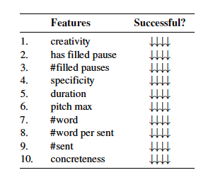
Statically Significant Characteristics of Lies that Deceived Our Classifier
Notes:
Features that fooled both human and machine judgments. Successful lies had fewer filled pauses (2, 3) and were shorter in duration (5) and number of sentences
(9). Some features only deceived our classifier. For example, lies that successfully deceived the deception classifier were less creative (1) and less specific (4). It seems that different kinds
of lies were successful at deceiving humans and an automated deception classifier

Slide 80
Analysis of Rater Strategies
Asked raters to provide strategies that they used
Annotated strategies by category
Which strategies were useful and which were not?
  Compared raters’ stated strategies with their performance on the tasks
  None of the strategies reported by a labeler were associated with higher performance than raters who did not report using those strategies in their tasks
  Speaker confidence using (“the speaker sounded confident”) as a cue to deception was in fact negatively correlated with task success

Slide 81
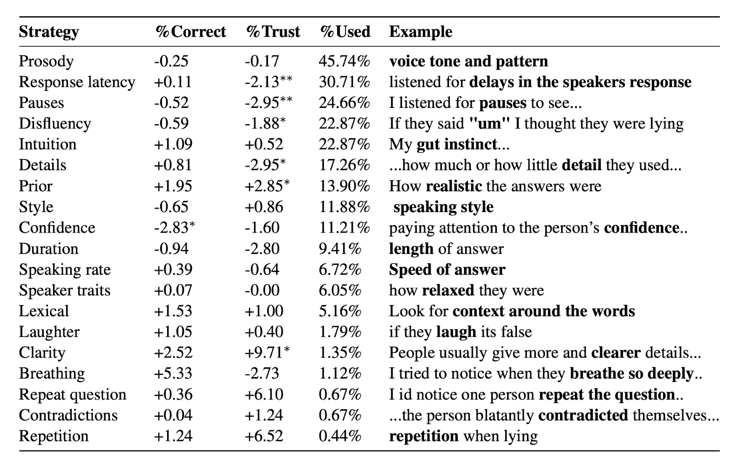
Notes:
Here we show avg % of correct judgments by raters who reported using the strategy compared with those who did not and avg % of utterances judge to be true, as well as the % of raters who reported using the strategy. No strategy reported was associated with significantly better deception detection performance. In fact, using speaker confidence was actually negatively correlated with rater performance. We did find that some strategies were more highly correlated with rater trust (clarity of response, prior domain knowledge) and some with mistrust (response latency, pauses and disfluences as well as level of detail).
For each strategy, we show the increase or decrease in the average percentage of utterances judged correctly and % trusted for annotators reporting that strategy compared with all annotators. no correlation between the number of strategies reported and the accuracy score, but we did discover a negative correlation between the percentage of answers trusted and the number of strategies raters reported using (spearman, ρ = −0.133, p < 0.01).
We also show percentage of annotators reporting the strategy and a sample response from one. For %correct and % trust, the statistical significance is computed by comparing the annotators who said they used the strategy and annotators who did not with a Mann–Whitney–Wilcoxon U test. * p <0.05; **; p < 0.01; ***; p < 0.001. %Used is the % of raters who said they used the strategy
Prosody, response latency, pauses, disfluency, and intuition were the top five strategies mentioned by annotators and features related to prosody, response latency, pauses, and disfluency were indeed significant indications of trust. As shown in this table, none of these reported strategies was associated with an improved deception detection performance. However, we did find that using speaker "confidence" as a cue to deception was negatively associated with the annotators' performance. How confident did the speaker seem?
Which strategies are reported by raters who are more or less trusting over all? We found that people who reported using response latency, pauses, and disfluency when judging deception trusted a smaller percentage of utterances. This could be because of the high prevalence of disfluencies in spontaneous speech, regardless of whether the utterance was deceptive or not. We also found that raters who used the level of detail in a response as a cue were more mistrusting in their judgments. Conversely, those who used clarity of a response and prior domain knowledge were more trusting.

Slide 82
Does Complex Reasoning Help?
How long do people take to make judgments?
  No correlation between the response time and whether the answer is correct (spearman, ρ=0.008, p>0.05)
  Negative correlation between the response time and whether the answer is trusted (spearman, ρ=-0.101, p<0.0001)
How many strategies do people use?
  No correlation between the number of strategies reported and the score (spearman, ρ=0.029, p>0.05)
  Negative correlation between the percentage of utterances that annotators trust and the number of strategies they use (spearman, ρ=-0.133, p<0.01)
Notes:
Spearman’s rank correlation coefficient.

Slide 83
So can we Predict and Produce the Speech People Trust?
Many reasons to produce trustworthy speech
  Dialogue systems, spoken information systems and robots, public travel announcements and other broadcasts
  Training for actors and newscasters and salespeople…
Procedure to predict trusted speech
  5-fold cross validation, speaker independent
  Low agreement task -> only classify utterances with rater consensus (of 5340: only 1762 trusted by all raters; 427 mistrusted by all raters)
  Logistic regression; Evaluated with macro-F1 for balance
  Baseline (random): 44.97 macro F1
Notes:
1762 utterances were trusted by all annotators and 427 utterances were mistrusted by all annotators
Mcro-F1: compute per-class precision and recall for all classes, then combine these pairs to compute the per-class F1 scores, and finally use the arithmetic mean of these per-class F1-scores as the macro-F1 score
Macro-F1*: compute macro-averaged precision and macro-averaged f1 and then compute the harmonic mean

Slide 84
What Features Can Identify Trusted Speech?
NLP data-driven features
  GloVe embeddings
  Dependency parse n-grams
  Word n-grams
Our findings on human deception/ trust differences
  Disfluencies
  Complexity scores
  Prosodic features: openSMILE 2013 6373 features
  Speaker traits: gender, native language, personality
Notes:
Differences in traits: females trusted more than males; native English speakers trusted more than non-English
Speakers with low conscientiousness, high openness and high neuroticism scored higher
Using only utterances that all raters trusted or mistrusted (1762, 427). 5-fold cross validation. Logistic regression. Normalized for zero mean and unit-variance. Trained and tested on different speaker sets.

Slide 85
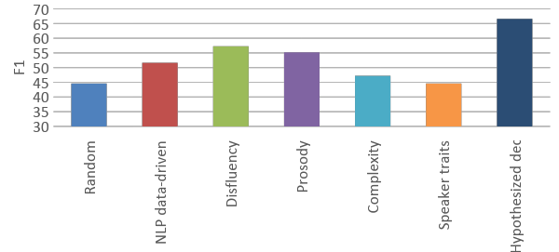
Trust Classification Results: Feature Sets Alone and Best Combined Model
Combined
Notes:
Random forest models trained and tested only on speech raters agreed on–1762 trusted and 427 mistrusted– macro F1-66.10 since data unbalanced (takes mean of the scores of each class)
Random: 44.97
NLP: 61.57
Disfluency: 57.28
Prosody: 60.20
Complexity: 45.77
Speaker traits: 44.61
Combining these with sentiment, uncertainty, and creativity outperformed the NLP data driven methods significantly and provided our best trust classification result.
we present only features that are statistically significant after Benjamini–Hochberg correction (Benjamini and Hochberg, 1995) to correct for false discovery
How to Run the Benjamini–Hochberg procedure
Put the individual p-values in ascending order.
Assign ranks to the p-values. For example, the smallest has a rank of 1, the second smallest has a rank of 2.
Calculate each individual p-value’s Benjamini-Hochberg critical value, using the formula (i/m)Q, where:
i = the individual p-value’s rank,
m = total number of tests,
Q = the false discovery rate (a percentage, chosen by you).
Compare your original p-values to the critical B-H from Step 3; find the largest p value that is smaller than the critical value.

Slide 86
Characteristics of Successful Lies: Human and Machine Learning Models
Deceiving our raters: shorter, louder, faster, fewer filled pauses, fewer repetitions, less variation in intensity and harsher (unstable amplitude) in VQ
Deceiving our ML models: creativity, fewer filled pauses, less specific, shorter, lower pitch, less “concrete” (referring to perceptual entity)
Features that fooled both: Successful lies had fewer filled pauses and were shorter in duration and number of sentences
  Different types of lies were successful at deceiving humans vs. ML models: So perhaps we need both?
Notes:
(9). Some features only deceived our classifier. For example, lies that successfully deceived the deception classifier were less creative (1) and less specific (4).

Slide 87
Why are Humans So Poor at Detecting Lies?
Prior work on our full CXD Corpus found that even with more data (full responses to their questions)
  Humans achieved only 55.33 F1 (on full Q/A conversations)
  But our best ML models on these achieved 73.67 F1
Why do ML-trained systems do better?
  Mismatch for humans between language they trust and actual truthfulness
  Ineffective reported strategies – especially in the acoustic/prosodic domain
  Can we train humans to do better?

Slide 88
Current Research: LieCatcher for Lie Detection Training on Our Data with Help
Notes:
Previously used to collect more user labels. Now using LieCatcher to do helpful training on our corpus: provide a “normal” utterance from the user and give quick feedback for mistakes of either truth of lie, explaining what information the rater should have taken into account when they make a mistake or reinforcing a correct answer by explaining what useful cues were present
If you want to learn how to spot a lie, let us know!

Slide 89
Ongoing Research: LieCatcher for Lie Detection Training with HELP
Key features:
  Baseline sample of speech for comparison
  Feedback and explanations for correct and incorrect judgments
Notes:
Using LieCatcher to do more helpful training: giving quick feedback and explaining what information the rater should have taken into account….
https://liedetector.cs.columbia.edu/mturk/portal_new_2.html

Slide 90
Data Collection
Participants:
  Amazon Mechanical Turk crowdworkers and Columbia University students
28 participants (16 female, 12 male)
Each player plays 12 rounds of games, 12 question each
Survey: demographic and personality information

Slide 91
Can we train people to improve at lie detection?
Within a gameplay?
  12 questions per game
Across multiple rounds of gameplay?
  Players play 12 sets of games

Slide 92
Findings: Within-game Performance
Players significantly improved performance in the second half compared to the first half of each game
  t(27) = 7.57, p < 0.001
  51% accuracy in first half and 62% accuracy in second half

Slide 93
Findings: Multiple-game Performance
Significant learning effect across 12 rounds of gameplay
  F(11,297)=9.20, p < 0.001, η² = 0.22
Pairwise posthoc comparisons show that raters most significantly improve at game #8

Slide 94
Ongoing/Future Work
Collect additional data
Examine the impact of baseline speech on player performance
Study demographic and personality factors that affect player performance

Slide 95
Which feedback was most helpful?
60% of players reported verbal cues
40% of players reported baseline speech samples

Slide 96
Some Preliminary Results
Results from our pilot study:
  Raters did improve over time on the 12 tasks of 12 Q/As
More questions to look at:
  Who do people trust more than others? (Regardless of whether they are actually speaking a truth or lie!) grouping by player.
    Do speaker traits, question types and/or topic type impact this?
  Who is more trusting than others?
    Do speakers’ traits, question type and topic type impact this?

Slide 97
  Do the number of baselines played on each question impact accuracy? Did it impact trustworthiness?
  How accurate were raters on different types of questions?
    Similar to our previous deception detection experiments)
  Did the specific cues of a lie impact judgment more than others?
    Also similar to previous work but can also look at from lens of trustworthiness

Slide 98
And for other speech and language applications…
Unless humans can Learn to detect deception more accurately
  What sort of speech should our Dialogue Systems employ?
  Do we want to produce speech that we know humans do trust, whether correctly or not?
  Or do we want to produce speech that actually represents speech that we should trust?
This all remains a real challenge for the dialogue community and for Ethical AI…

Slide 99
Other Current Related Activities
Requests for collaboration on financial or insurance fraud detection, on deception in other languages, for licensing CxD corpus
LDC sharing of the CSC corpus and eventually also the CxD corpus
Sharing CxD corpus for work on identifying human trust and mistrust of AI systems potentially created by the military for use by their groups
Notes:
CSC Columbia/SRI/Colorado corpus

Slide 100
Other Columbia Speech Lab Research
Identifying misinformation and intent in social media
  Covid19 tweets, humor and sarcasm
Hate speech targeting female journalists
Radicalization in Alt-Right and Alt-Left videos
Cross-lingual detection of sentiment from Bible data
Charisma in U. S. politicians
TTS

Slide 101
Research Outputs, Engagements, Future Directions
Talks on this work at Bloomberg, Facebook, Schonfeld Quant Conference, ACL 2020 (from TACL paper), HDIAC Webinar, Interspeech 2020, journalists and researchers
Requests for collaboration on financial or insurance fraud detection, in other languages, licensing CDC corpus, LDC
Future directions
  Using the Lie Detector game to train humans
  Extending our language work to multimodal and to understanding how people can be influenced and potentially radicalized in social media
Notes:
HDIAC: Homeland Defense and Security Information Analysis Center; students this year: xi chen, mark mandic, yogesh singh, jiaxuan, xinyue tan, becky calinksi

Slide 102

Thank you!
Questions?

