Slide 1
Sarcasm
Julia Hirschberg
CS 6998
Spring 2020
Many thanks to Smaranda Muresan for some slides
Notes:
thanks to everyone for getting their HW2 in
catching up on grading
covid19 tip

Slide 2
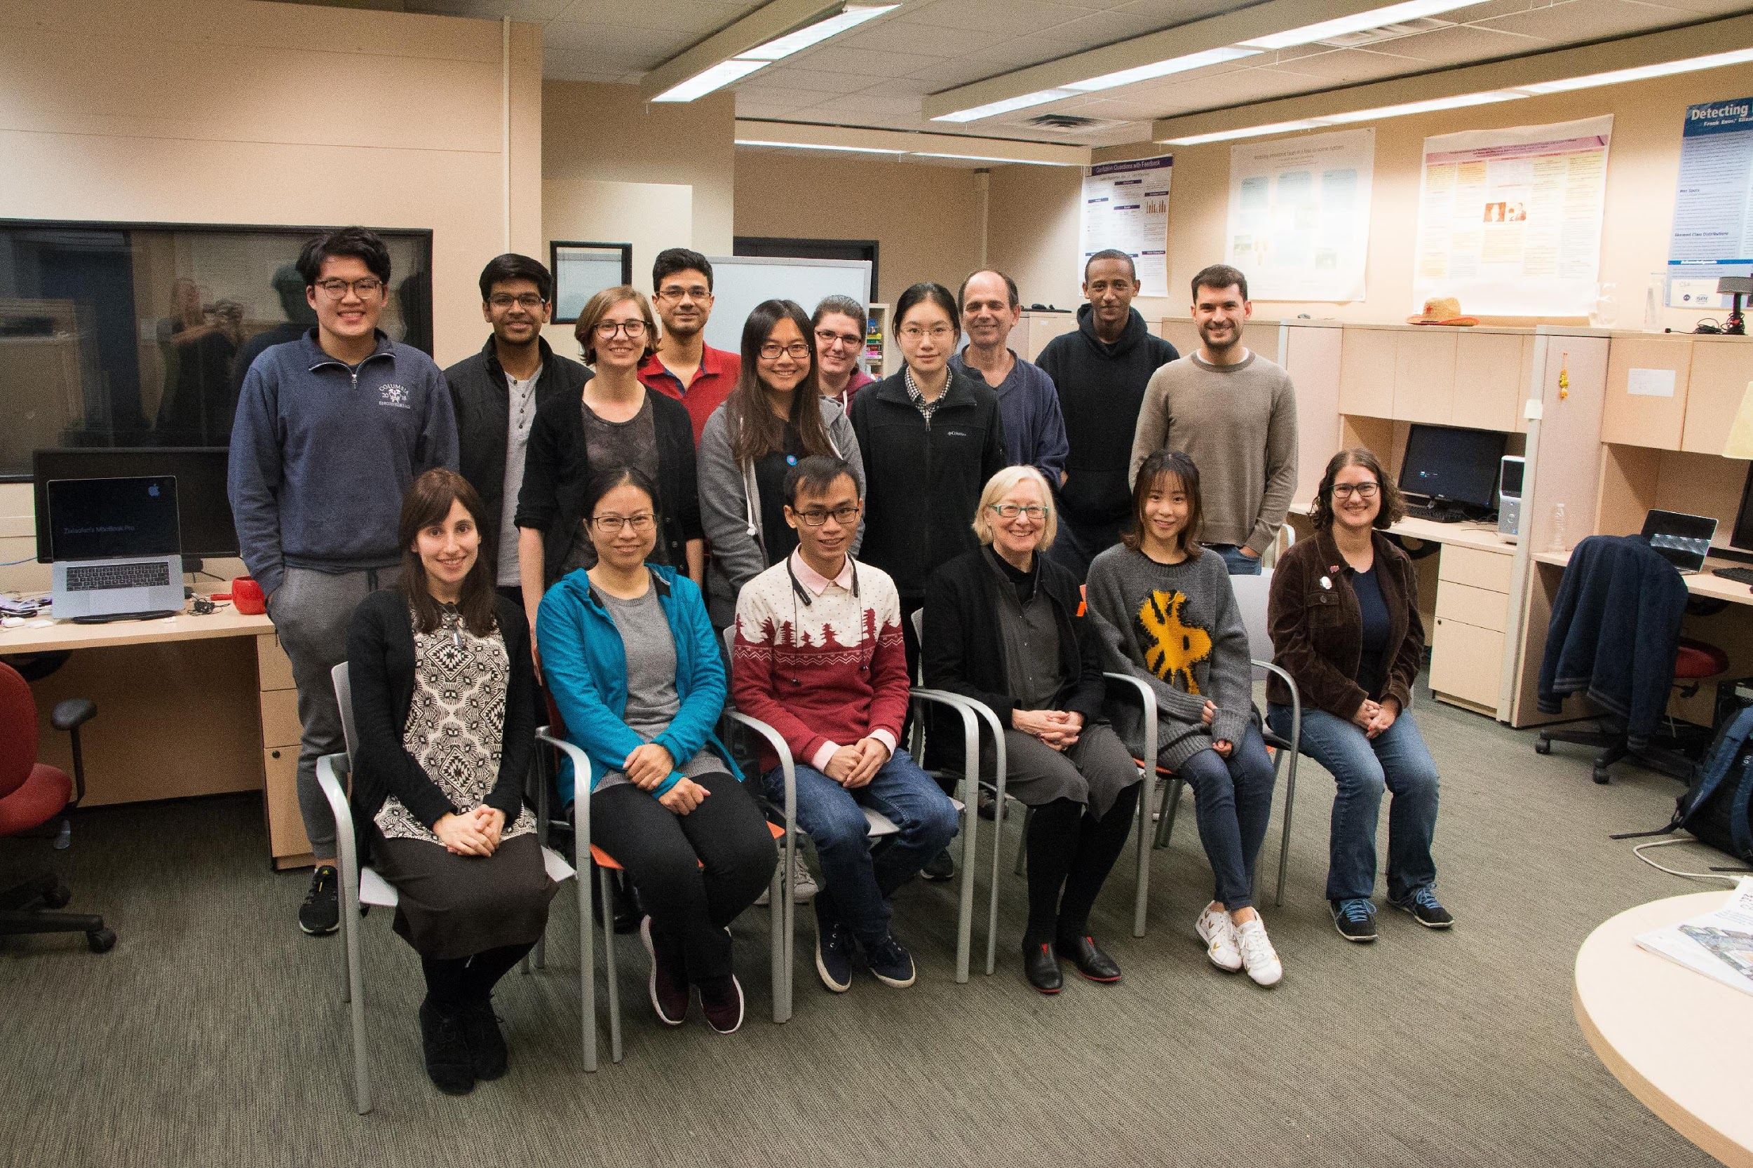
Notes:
Just to remind you of what the Speech Lab looks like!

Slide 3
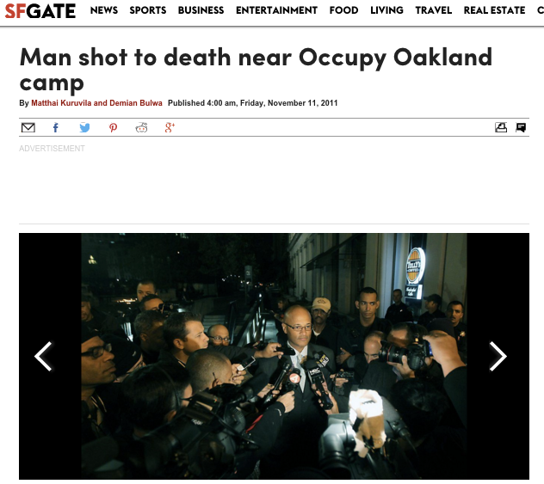

Understanding People’s Attitudes is Important
News Item
Discussion Forum
User1: A shooting in Oakland? That NEVER happens.
User2: Shootings happen in Oakland all the time and it had nothing to do with the Occupy movement. […]
User3: This shooting does have something to do with the Occupy movement because many of the witnesses are the Occupiers and it happened only a few yards away from the encampment.
Very sad news, regardless of if this young man was w/ #OO or not URL… via @sfgate
Oh yay. Another shooting #sarcasm
Unrecognized Sarcasm will lead to erroneous belief and sentiment detection
Notes:
We need to identify a speaker’s sentiment and beliefs in order to properly interpret what they say….
Occupy Oakland began as a protest encampment at Frank H. Ogawa Plaza on October 10, 2011. Protestors renamed it Oscar Grant Plaza after a young man who was fatally shot by Bay Area Rapid Transit Police in 2009. The encampment was cleared out by multiple law enforcement agencies on October 25, 2011.^{[4]} The movement also helped spur the November 2, 2011 Oakland General Strike that shut down the Port of Oakland. Police again cleared the protest encampment at Frank Ogawa Plaza on November 14, 2011. Other protest encampments were created and subsequently dismantled by law enforcement. The last encampment at Snow Park was cleared on November 21, 2011. Occupy Oakland then had no physical presence in any public space overnight in the city.^{[5]}
Occupy Oakland has often centered on complaints about alleged police misconduct,

Slide 4
Verbal Irony/Sarcasm
Figurative language
Verbal Irony: the use of words to express something other than and especially the opposite of the literal meaning (Mirriam-Webster dictionary)
Sarcasm: the use of words that mean the opposite of what you really want to say especially in order to insult someone, to show irritation, or to be funny” (Mirriam-Webster dictionary)
The market index is falling greatly. What a happy Christmas #sarcasm
Sarcastic
Literal
happy christmas eve ... new haircut ready for new year !!! #christmaseve #enjoy
Notes:
Sarcasm is one form of what we call “verbal irony”. To identify sarcasm we need to decide if people are using a word like ‘happy’ in a sarcastic of a literal sense.

Slide 5


Verbal Irony/Sarcasm
2. Characteristics:
Irony Markers: “A shooting in Oakland? That NEVER happens”
- typographics, punctuation, hyperbole, interjection
Irony Factors: Incongruence
The market index is falling greatly. What a happy Christmas #sarcasm
prior turn
Plane window shades are open so that people can see fire
@ one more reason to feel really great about flying #sarcasm
current turn
Notes:
An important indicator of sarcasm is a word or phrases incongruence in its context.

Slide 6
Sarcasm as Figurative Language
Reframe the problem as a word-sense disambiguation problem: Literal vs Sarcastic Sense
The market index is falling greatly. What a happy Christmas #sarcasm
Sarcastic
Literal
happy christmas eve ... new haircut ready for new year !!! #christmaseve #enjoy
(Ghosh, Guo and Muresan, 2015) - EMNLP 2015
3rd prize awarded at the NYC Media Lab Annual Summit, 2015
Notes:
What smara and her students did was to reframe this problem into a word-sense disambiguation problem. But how do we tell when ’happy’ is meant in its literal sense – or as the opposite of ‘happy’

Slide 7
Key Issues to be Addressed
How to collect a set of target words that can have either literal or sarcastic meaning, depending on context?
Given an utterance and a target word, how to detect whether the target word is used in the literal or the sarcastic sense?

Slide 8

Crowdsourcing Experiments
I'm so happy I'm going back to the emergency
room
AMT
SM
IM1: I don't like that I have to go to the emergency room again.
IM2: I'm so unhappy that I am going back to the emergency room.
IM3: I am so upset that I have to return to the emergency room.
IM4: …
IM5: ….
  Use the SM – IM dataset as parallel corpus to identify Semantically Opposite (SO) words (happy <-> upset, …) via monolingual alignment (Barzilay&McKeown, 2001) – the rest of the phrases are mostly the same words
  Use the semantically opposite pairs to extract target words (`happy’, `love’, `yeah’) in original utterance.
Notes:
SM: sarcastic msg
IM: intended msg which turkers asked to identify in multiple examples, which gives us antonyms of the word used in sarcasm
Unsupervised alignment of sarcastic words with opposite meanings in phrases

Slide 9
Target and Data Collection
Extracted 70 targets via alignment
Using Twitter APIs, collected training data for each target
  Sarcastic (#sarcasm, #sarcastic)
  Literal (labeled with sentiment hashtags: e.g., #enjoy, #sad)
Size of training data varies per target word from 427 (`mature’) to 26,802 (`love’)
The market index is falling greatly. What a happy Christmas #sarcasm
happy christmas eve ... new haircut ready for new year !!! #christmaseve #enjoy
Notes:
Pairing sarcastic uses of happy with literal ones

Slide 10
Classify Sarcastic vs. Literal Uses
love(26802), like(14995), great(14495), good(11624), really(9825), right(6771), fun(6603), best(6182), better(5960), glad(5748), yeah(5504), nice(4443), awesome(4196), excited(4027), always(3807), happy(3098), cool(2705), amazing(1952), favorite(1883), perfect(1792), wonderful(1749), wonder(1476), lovely(1424), super(1390), fantastic(1369), joy(1176), cute(1007), beautiful(981), sweet(800), hot(729), proud(703), shocked(645), interested(624), brilliant(576), genius(481), attractive(449), mature(427)
Consider only target with at least 400 training instances
Train-Test split: 80%(Training), 10% (Dev.) and 10% (Test)

Slide 11
Classification Approach
For each target, separate training/testing done using Support Vector Machines (SVM)
Baseline (BL_SVM):
  SVM with Lexical features (unigrams, sentiment lexicons such as LIWC, as well as sarcasm markers such as interjections, All Caps, emoticons)
New Approach:
  SVM with new kernel using Word Embeddings
  Alignment to find similarity between two short texts

Slide 12
Details on Word Embedding
Approaches to building embeddings used
  Weighted Textual Matrix Factorization [Guo and Diab, 2012] used to weight similarity of definitions
  GloVe [Pennigton et al., 2014]
  Word2Vec [Mikolov et al., 2013]
    Skip-gram: use current word to predict neighbors
    CBOW (continuous-bag-of-words): use context to predict current word
Use 2.5 Million tweets to build each model
Context window of ± 10 words
100-dimension vector for each word
Notes:
WTMF: weights word similarities by TF-IDF of words appearing in same definitions of the 2 words compared

Slide 13
Accuracy Results
Various word embedding models
For some targets (`brilliant’, `mature’, `joy’) the accuracy is higher than other targets (`genius’, `sweet’)
Unlike the Lexical baseline, word embeddings can achieve high accuracy for small training data.
Notes:
CBOW and Skip-gram perform the best

Slide 14
Sarcasm: Modeling Conversation Context
Characteristics:
  Irony Factors: Incongruence (out of place)
prior turn
Plane window shades are open so that people can see fire
current turn
@ one more reason to feel really great about flying #sarcasm
(Ghosh, Fabrri and Muresan, 2017;2018)
best paper award at SIGDIAL 2017
Notes:
incongruent means not the same, not compatible or out of place. When you take one position on something and then a second later you take a contrary position, this is an example of a situation where your statements would be described as incongruent

Slide 15
Sarcasm Analysis
Vast majority of research on sarcasm/verbal irony detection relies on the content of an utterance in isolation
  Incongruity between positive sentiment and negative situation [Riloff et al. 2013]
  Sarcasm as a word sense disambiguation problem [Ghosh, Guo, Muresan; 2015]
  Cognitive features for sarcasm [Mishra et al. 2016]
The market index is falling greatly. What a happy Christmas #sarcasm
Sarcastic
Literal
happy christmas eve ... new haircut ready for new year !!! #christmaseve #enjoy

Slide 16
Sarcasm Analysis
But a speaker’s intent is often unclear without additional context:
  Conversation context [Bamman and Smith 2015; Oraby et al. 2017]
  Multimodal information [Schifanella et al. 2016]
  Author’s context/behaviors [Rajadesingan et al.2015; Khattri et al. 2015; Moreira et al. 2016]
  Background knowledge
Notes:
Author context, e.g. rajadesingan: leveraging behavioral traits intrinsic to users expressing sarcasm. We identify such traits using the user's past tweets. We employ theories from behavioral and psychological studies to construct a behavioral modeling framework tuned for detecting sarcasm

Slide 17
Modeling Conversation Context
[Ghosh, Fabbri, Muresan 2017; 2018]
Data needed: prior turn? Authors’ prior tweets?
RQ1: Can conversational context help in sarcasm detection
RQ2: Can we identify what part of the context triggers the sarcastic reply?

Slide 18
Twitter Example
Plane window shades are open so that people can see fire
prior turn
current turn
@ one more reason to feel really great about flying #sarcasm

Slide 19

Discussion Forum Example
It is entirely premature to be discussing this matter for the purpose of promoting political positions and beliefs. It is also disrespectful to those that died and their families to try and capitalize on their pain for a political agenda. No relevant details have been discovered or released yet meaning all that can be had is pure speculation and hyperbole. The simple fact that authorities were able to apprehend the individual before he could commit suicide places us as a whole in a unique situation.
prior turn
the law abiding responsible gun owner who gunned them down did so respectfully, right? You
current turn
Notes:
discussion of killings as a political act…1) don’t disrespect the families by using this act for political reasons; 2) the gunman was respecting them

Slide 20
Discussion Forum Example
In his early life, X had a reputation for drinking too much. Whether or not this affected his thinking is a question which should to be considered when asking questions about mormon theology ….. emoticonXBanghead.
prior turn
Wow, that must be some good stuff he was drinking to keep him 'under the influence' for THAT long!! :p
current turn
Perhaps he was stoned on other drugs like the early writers of the bible.
succeeding turn
Notes:
Banging head on wall: frustration
:p : sticking out tongue

Slide 21
Data and Annotations
Twitter Corpus
  ``reply_to(@user)’’ to detect reply; collect the full thread
  Self-labeled corpus (provided by the tweet authors using hashtags)
    S: #sarcasm, #sarcastic
    NS: #love, #hate, … [González-Ibáñez et al. 2011]
  25K instances (12K S/13K NS; 30% with > 1 context utterance)
Context (prior turn(s))
…
Current turn (S or NS)
Notes:
Data used for experiments

Slide 22
  Data aInternet Argument Corpus_{v2} ([Oraby et al, 2016], Discussion forum
……………………………….
  Annotated by crowdsourcing at comment level: perceived sarcasm! (4950 Instances)
    Balanced between S/NS
    Comments between 3-7 sentences long
    3 types of sarcasm: General, Rhetorical Question, Hyperbole
Prior turn
.
Current turn (S or NS)
Notes:
Creating and Characterizing a Diverse Corpus of Sarcasm in Dialogue
Shereen Oraby, Vrindavan Harrison, Lena Reed, Ernesto Hernandez, Ellen Riloff, Marilyn Walker
Rhetorical: Q not wanting an answer
Hyperbole: exaggerated comment

Slide 23
  IAC_{v2} and IAC+_{v2} (Discussion forum)
  Built a subset that includes succeeding turns (2900 Instances)
    Balanced between Sarcastic/Non-Sarcastic
    Comments between 3-7 sentences long
    3 types of sarcasm: General, Rhetorical Question, Hyperbole
……………………………….
Prior turn
………………………...
Current turn (S or NS)
……………………………….
Succeeding turn

Slide 24
  Data anReddit Corpus ([Khodak et al. 2017], Discussion forum)d Annotations
  Self-labeled corpus, annotated at comment level (``\s marker added by speaker)
  Collected subset of 50K instances
    Balanced between Sarcastic/Non-Sarcastic
    Comments between 3-7 sentences long
……………………………….
Prior turn
………………………...
Current turn (S or NS)
Notes:
A Large Self-Annotated Corpus for Sarcasm
Mikhail Khodak, Nikunj Saunshi, Kiran Vodrahalli

Slide 25
RQ1: Can Conversational Context Help in Sarcasm Detection?
Baseline (SVM with discrete features)
  ngrams
  Sentiment and pragmatic features
    Linguistic Inquiry and Word Count (LIWC) lexicon
    MPQA Subjectivity lexicon
    Change of sentiment [Joshi et al. 2015]
  Sarcasm Markers [Burgers et al. 2012]
    Morpho-syntactic
      (interjections: ``yeah’’; ``uh’’), Tag questions (``isn’t it?”), Exclamations
    Typographic
      Capitalization (``NEVER’’), quotation marks, emoticons
    Tropes: figurative or metaphorical uses
      Intensifiers (``greatest’’, ``best’’…)
Notes:
The Subjectivity Lexicon (list of subjectivity clues) that is part of OpinionFinder is also available for separate download. These clues were compiled from several sources (see the enclosed README). This is the version of the lexicon used in:
Theresa Wilson, Janyce Wiebe, and Paul Hoffmann (2005). Recognizing Contextual Polarity in Phrase-Level Sentiment Analysis. Proc. of HLT-EMNLP-2005.

Slide 26
Computational Models
Long Short-Term Memory (LSTM) Networks [Hochreiter & Schmidhuber 1997]
  Type of RNN; able to learn long-distance dependencies
  One LSTM reads the context and another LSTM reads the response
Attention-based LSTM Networks allow focus
  Word and sentence level attention (hierarchical model; Yang et al. 2016) or only sentence level (avg. word embeddings)
Notes:
Context: prior turns; Response: sarcastic or not.

Slide 27
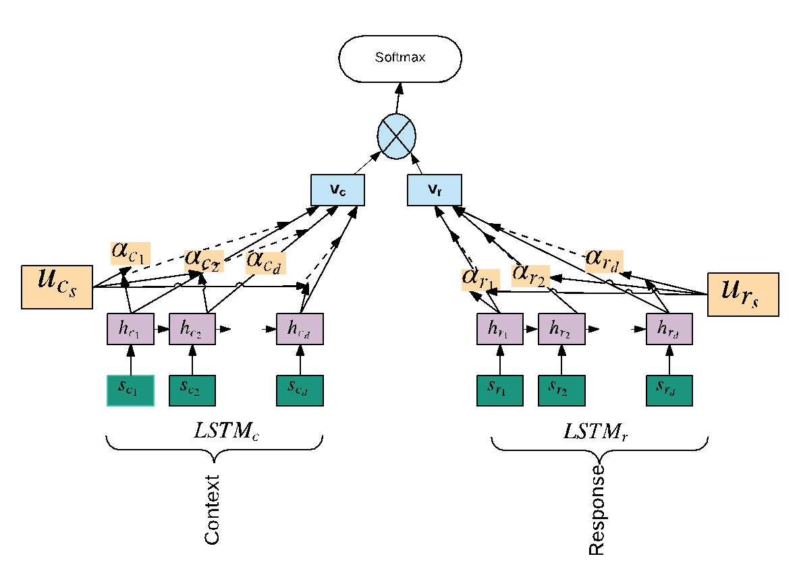
Final Vector Rep.
Attention
Hidden layers
Sentence Embedding
Fig. inspired by Yang et al. 2016
Notes:
The context c contains d sentences and each sentence sci contain Tci words. we first feed the sentence annotation hci through a one layer Multi-layer perceptron to get uci as a hidden representation of hci , then we weight the sentence uci by measuring similarity with a sentence level context vector ucs . This gives a normalized importance weight αci through a softmax function. vc is the vector that summarizes all the information of sentences in the context.
Likewise we compute vr for the response r via LSTMr (similar to eq. 1 and 2; also shown in Figure 1). Finally, we concatenate the vector vc and vr from the two LSTMs for the final softmax decision (i.e., predicting the S or N S class).

Slide 28
Computational Models
Conditional LSTM
  Introduced for textual entailment [Rocktäschel et al. 2015]
  LSTM that reads response is conditioned on representation of the first LSTM built for context
Word embeddings
  Discussion forum: Google’s pre-trained Word2Vec model
  Twitter: model trained on tweets [Ghosh et al. 2015]
Notes:
\

Slide 29
Data Split: 80/10/10
    Dev data is used for parameter tuning

Slide 30
Results: Prior Turn
Model | Twitter F1 | IAC_{v2} F1 | Reddit F1
SVM^{ct} | 66.5 | 65.8 | 72.54
SVM^{ct+pt} | 67.9 | 63.1 | 67.00
LSTM^{ct} | 67.2 | 67.5 | 68.5
LSTM^{ct+pt} | 68.0 | 69.9 | 74.22
LSTM^{conditional} | 74.5 | 71.8 | 73.03
LSTM_{a}^{ct} | 73.4 | 69.8 | 74.68
LSTM_{a}^{ct+pt} | 75.1 | 71.3 | 75.42
Notes:
Pt==rt (response)

Slide 31
Results: Prior Turn
Model | Twitter F1 | IAC_{v2} F1 | Reddit F1
SVM^{ct} | 66.5 | 65.8 | 72.54
SVM^{ct+pt} | 67.9 | 63.1 | 67.00
LSTM^{ct} | 67.2 | 67.5 | 68.5
LSTM^{ct+pt} | 68.0 | 69.9 | 74.22
LSTM^{conditional} | 74.5 | 71.8 | 73.03
LSTM_{a}^{ct} | 73.4 | 69.8 | 74.68
LSTM_{a}^{ct+pt} | 75.1 | 71.3 | 75.42
Notes:
Stat significant

Slide 32
Results: Prior Turn
Model | Twitter F1 | IAC_{v2} F1 | Reddit F1
SVM^{ct} | 66.5 | 65.8 | 72.54
SVM^{ct+pt} | 67.9 | 63.1 | 67.00
LSTM^{ct} | 67.2 | 67.5 | 68.5
LSTM^{ct+pt} | 68.0 | 69.9 | 74.22
LSTM^{conditional} | 74.5 | 71.8 | 73.03
LSTM_{a}^{ct} | 73.4 | 69.8 | 74.68
LSTM_{a}^{ct+pt} | 75.1 | 71.3 | 75.42
Twitter: using only immediate prior turn: LSMT_{a}^{ct+pt_last}: 73.71
Notes:
Statistically significant differences for the final model– best model for S and NS classes is LSTM(conditional); the LSTM with attention for c and prior turn gives best F1 for S but for NS the LSTM with attention only on prior turn is best

Slide 33
Results: Cross-Corpora Training
Reddit data is self labeled and is larger
Train on Reddit and Test on IAC_{v2}
Model | F1
LSTM_{a}^{ct} | 65.11
LSTM_{a}^{ct+pt} | 63.23

Slide 34
Results: Cross-corpora training
Reddit data is self labeled and is larger
Train on Reddit and Test on IAC_{v2}
Model | F1
LSTM_{a}^{ct} | 65.11
LSTM_{a}^{ct+pt} | 63.23
Possible issues:
- self-labeled vs. crowdsourced labeled
- topics

Slide 35
Results: Prior + Succeeding Turn
Model | IAC⁺_{v2} (F1)
SVM^{ct} | 77.89
SVM^{ct+pt} | 76.43
SVM^{ct+st} | 68.83
SVM^{ct+ps+st} | 72.77
LSTM^{ct} | 79.25
LSTM^{ct+pt} | 83.32
LSTM^{ct+st} | 82.60
LSTM^{ct+pt+st} | 83.33
LSTM_{a}^{ct} | 80.05
LSTM_{a}^{ct+pt} | 81.52
LSTM_{a}^{ct+st} | 80.67
LSTM_{a}^{ct+pt+st} | 81.08

Slide 36
Results: Prior + Succeeding Turn
Model | IAC⁺_{v2} (F1)
SVM^{ct} | 77.89
SVM^{ct+pt} | 76.43
SVM^{ct+st} | 68.83
SVM^{ct+ps+st} | 72.77
LSTM^{ct} | 79.25
LSTM^{ct+pt} | 83.32
LSTM^{ct+st} | 82.60
LSTM^{ct+pt+st} | 83.33
LSTM_{a}^{ct} | 80.05
LSTM_{a}^{ct+pt} | 81.52
LSTM_{a}^{ct+st} | 80.67
LSTM_{a}^{ct+pt+st} | 81.08
Even if dataset is smaller the results are higher….
Possible answer: IAC⁺_{v2} contains mostly Generic type of Sarcasm (95%) while IAC_{v2} contains an equal distribution of Generic, Rhetorical Questions and Hyperbole
Notes:
Stat significant

Slide 37
Train and Test on (larger) IAC⁺_{v2}
Model | IAC⁺_{v2} (F1)
SVM^{ct} | 77.89
SVM^{ct+pt} | 76.43
SVM^{ct+st} | 68.83
SVM^{ct+ps+st} | 72.77
LSTM^{ct} | 79.25
LSTM^{ct+pt} | 83.32
LSTM^{ct+st} | 82.60
LSTM^{ct+pt+st} | 83.33
LSTM_{a}^{ct} | 80.05
LSTM_{a}^{ct+pt} | 81.52
LSTM_{a}^{ct+st} | 80.67
LSTM_{a}^{ct+pt+st} | 81.08
Even if dataset is smaller the results are higher….
Possible answer: IAC⁺_{v2} contains mostly Generic type of Sarcasm (95%) while IAC_{v2} contains an equal distribution of Generic, Rhetorical Questions and Hyperbole
Notes:
Larger than IACvs corpus but smaller than Reddit;; using context, prior turn and succeeding turn; Stat significant

Slide 38
Error Analysis
Can capture cases of context incongruity
Misses:
  Use of contextual information outside the text (shared common ground)
  Sarcastic turns with more than 5 sentences
  User of profanity and slang
  Use of rhetorical questions

Slide 39
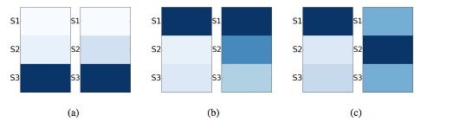
RQ2: Can we Identify What Part of the Context Triggers the Sarcastic Reply?Experiment
  Crowd-sourcing: Given a context and sarcastic reply, identify one or more sentences from the context that you think triggered the sarcastic reply
    Use IAC_{v2} data
    85 HITs (context length between 3-7 sentences)
  Ratings compared to attention weights (41% matches for the top-ranked sentence)
LHS: attention weights; RHS: Turkers’ selections
39
Notes:
Triggerng sentence location differs for different samples but for 41% the attention weights agree with humans

Slide 40
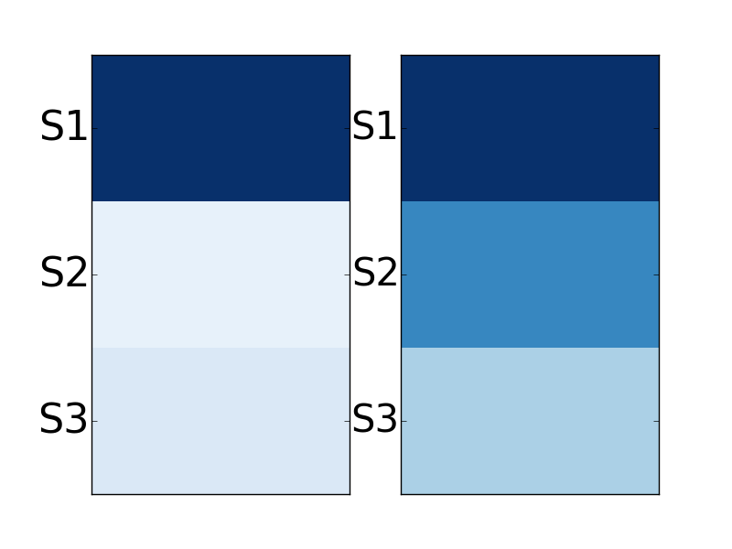
S1. how do we rationally explain these creatures existence so recently in our human history if they were extinct for millions of years?
S2. and if they were the imaginings of bronze age sheep herders as your atheists/evolutionists would have you believe, then how did these ignorant people describe creatures we can now recognize from fossil evidence?
S3. and while your at it, ask yourself if it's reasonable that the bones of dead creatures have survived from 60 million years to some estimated to be more than 200 million years without becoming dust?
LHS: attention weights
RHS: Turkers’ selection
how about this explanation - you're reading waaaaay too much into your precious bible

Slide 41
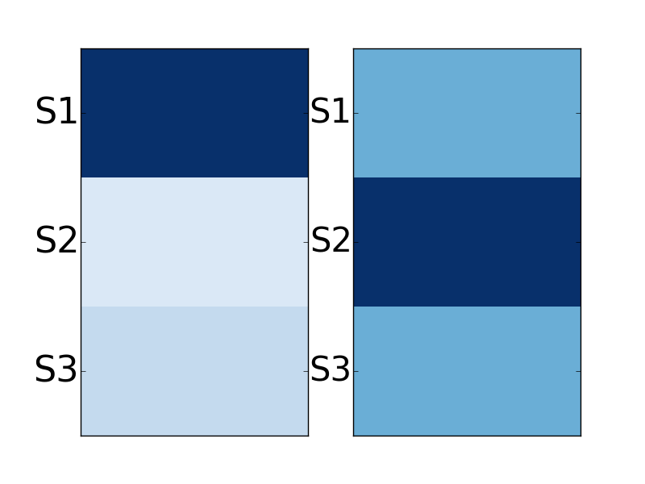
S1. you disgusting sickening woman!
S2. how can you tell a man that about his mum??!!!
S3. evil twisted filthy...
LHS: attention weights
RHS: Turkers’ selection
you think im evil , how would your mum have felt reading half the %$#%# that comes out of your mouth. oh and i love you.
41
Notes:
Here the attention weight is on S1 but the turkers believed it was S2

Slide 42
Crowd-sourcing 2
Given a pair of sarcastic turn and its previous post
  Indicate what sentence inside the sarcastic turn expresses sarcasm
  Identify what triggered that sarcastic sentence
60 examples from IACv2 and 100 from Reddit
  Ratings were compared to attention weights
    For task 2:
      51% matches the top-ranked (attention-rated) sentence for IACv2 data
      30% matches the top-ranked sentence for Reddit data
    For task 1: ~25% matches for both IAC and Reddit

Slide 43
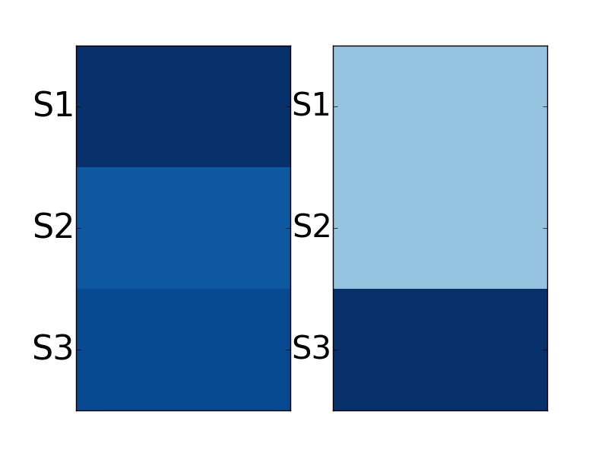
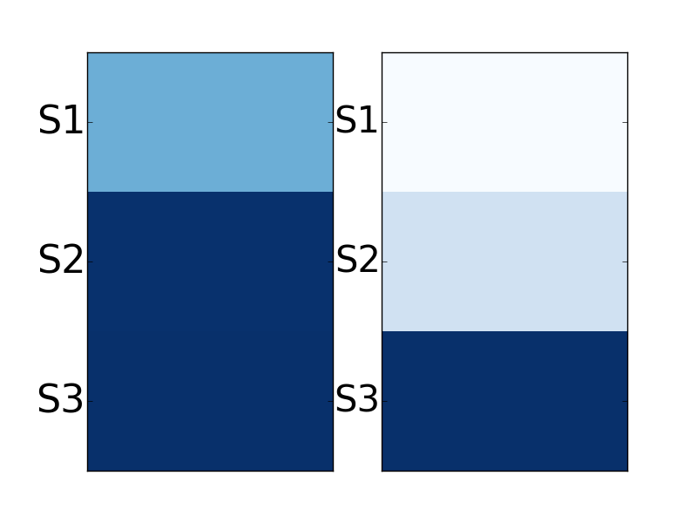
S1. nothing will happen, this is going to die a quiet death like 99.99 \% of other private member motions.
S2. this whole thing is being made into a big ordeal by those that either don't know how our parliament works, or are trying to push an agenda.
S3. feel free to let your mp know how you feel though but i doubt this motion gets more than a few minutes of discussion before it is send to the trashcan.
LHS: attention weights
RHS: Turkers’ selection
S1. the usual ``nothing to see here'' response.
S2. whew!
S3. we can sleep at night and ignore this.
Notes:
Identify what triggered that sarcastic sentence in the previous turn
Indicate what sentence inside the sarcastic turn expresses sarcasm

Slide 44
Attention Weights
Sarcasm markers
  Explicit indicators of sarcasm
  Attention put more weights on markers, such as emoticons (``:p’’) and interjections (``yeah’’, ``hmm’’)
However,
  Interpretations based on attention weights have to be taken with care: classification should not rely solely on attention weights [Rocktäschel et al. 2015]

Slide 45
Conclusion
Conversation context helps, particularly prior context
Preliminary study to understand what part of the prior turn triggers the sarcastic reply
Results might differ depending on corpora
  Twitter vs. Discussion Forums
  Self-labeled vs. Crowdsourcing labeled
  Topics could have an influence
  Size of data

Slide 46
Current/Future Work
Investigate more closely self-labeled vs. crowd-labeled data
Look at unbalanced datasets (old experiments in twitter data show similar results to balanced conditions) and also the topic of conversation
Consider the entire thread of the discussion as context
Look at the role of sarcasm in the unfolding conversation (e.g., agreement/disagreement space; shift in topics, etc.)

Slide 47
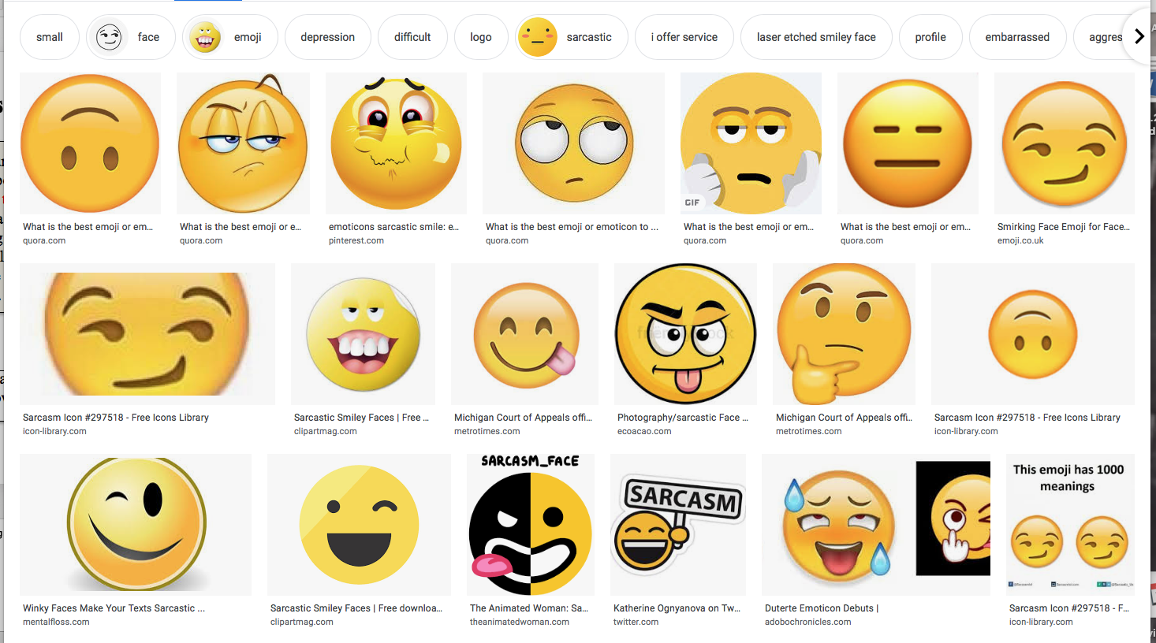
Twitter Emojis

Slide 48
Use other types of context
  Multimedia (speech & videos)
  Social network (social relations)
  World knowledge
  And….

Slide 49
Sarcasm in Spoken Language
Is sarcasm detection easier in text or in speech?
In speech there are additional cues
  Prosody, timing, laughter
But do people compensate in text with more cues?
  Hashtags
  Emojis
  More explicit language
And where are corpora for spoken sarcasm?

Slide 50
Spoken Sarcasm Corpora
Acted
  Movies
  TV shows
Natural speech: dialogues between strangers
  Switchboard
  Fisher
Similar issues with acted vs. natural emotion corpora: more exaggeration?
Notes:
Same debate as with emotion – acted vs. natural speech
Rakov & Rosenberg argue that TV show is sort of “natural” – do you agree?
Problem with natural – between strangers

Slide 51
Definition
“Speech bearing a semantic interpretation exactly opposite to its literal meaning…[with] no intent to deceive on the speaker’s part”
  Importantly: We are not trying to detect deception – next week!☺
Sarcasm as verbal irony violates a Gricean Maxim of Cooperative Conversation
  “Do not say what you believe to be false”
  But it occurs often in conversation
Very important for spoken dialogue systems and any attempt to transcribe and interpret speech
Notes:
What other cases can you think of in which it would be important to recognize sarcasm in speech: poitical debates?

Slide 52
Yeah right: Sarcasm Recognition for Spoken Dialogue Systems (Tepperman, Traum, & Narayanan (2006))
Goal: Discover reliable cues to sarcasm
Corpora: 131 “yeah right” occurrences in 2 corpora of strangers speaking on assigned topics
  Switchboard, Fisher
  Selected data with and without surrounding context
4 types of cues examined
  Contextual
  Objective
  Prosodic
  Spectral
Notes:
Both corpora collected to elicit data for ASR training

Slide 53
Contextual Cues
Contextual: annotated four kinds of ‘yeah right’ speech acts
  Acknowledgement (sincere): (perhaps a back channel)
    A: that’s right near Piedmont
    B: Yeah right, right…
  Agreement/Disagreement: not used to ground understanding
    A: a thorn in my side: bureaucratics
    B: yeah right, I agree
Notes:
Second could be sarcastic if said in disagreement of course

Slide 54
Indirect Interpretation: anecdotal; not directed at interlocutor
  “…We have too many pets!” I thought, “Yeah right, come tell me about it…”
Phrase internal: When ‘yeah right’ is really ‘yeah, right’ -- not functioning as a phrasal unit
  A: Park Plaza, Park Suites?
  B: Park Suites, yeah right across the street…

Slide 55
Objective Cues
Was there laughter?
Was it a response to a question?
Where did it occur in a speaker’s turn – beginning or end? Was it an entire turn?
Were there surrounding pauses?
Gender: Do men use sarcasm more than women?

Slide 56
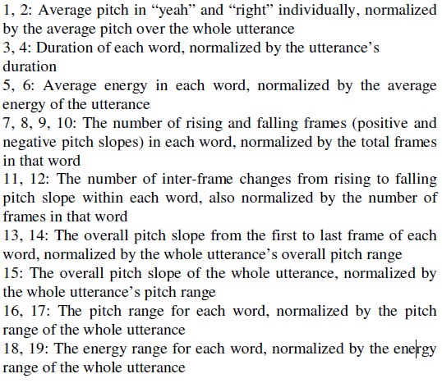
Prosodic Cues
Pitch mean, range, F0 slope
Word duration
Energy

Slide 57
Spectral Features
Mel-frequency cepstral coefficients- Short term power spectrum of a sound
  Used the first 12 MFCCs and their delta and acceleration coefficients
Used to train Hidden Markov Models which were utilized for sarcasm detection

Slide 58
Methods
Collected 2 versions of “yeah rights”, one with and one without surrounding context
  Hand annotated version without context to serve as a human baseline (low agreement)
  Hand annotated the version with context (fair agreement)
Trained the Weka C4.5 decision trees using leave-one-out cross-validation
Compared classification results to human performance on “without context” data

Slide 59
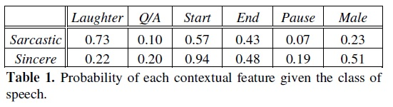
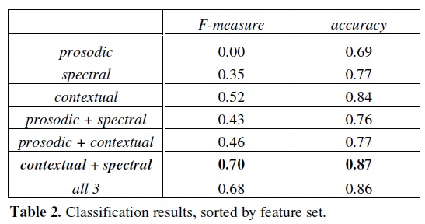
Results
Notes:
Laughter, answer to question, at beginning of speaker turn, at end, were there surroucing pauses?
Interesting that the prosodic features do not help…

Slide 60
Conclusions
Using contextual and spectral features provides best accuracy and F1
  Prosodic cues alone are not useful
  Prosodic cues do not improve
Laughter seems to be good cue for sarcasm
Initial position seemed to be a good cue for sincerity
Gender was not a good cue

Slide 61
Problems and Possibilities
What problems do you see in this work?
  Small dataset
  Requested conversation between strangers
    Prosodic cues may not be used?
What might be done to improve?
What uses could successful identification of sarcasm provide?
  Train computer-human dialogue systems to recognize sarcasm? To respond to it?? To generate it??

Slide 62
Do you Agree?
“As for handling the sarcasm once it’s detected, a dialogue agent ought to do what real humans do and acknowledge it. Either generate some synthetic laughter or, for more advanced agents, somehow point out that it “ gets” the joke.”
Notes:
What do you do with sarcasm classifier?
Do you agree/disagree with this?
Future work: go beyond “yeah right”, more data…
Rakov and Rosenberg build directly on this paper

Slide 63
“Sure, I did the Right Thing”: A System for Sarcasm Detection in Speech (Rakov and Rosenberg, 2013)
Used an acted speech corpus annotated for sarcastic vs. sincere speech
Daria Sarcasm Corpus
  Created from Daria, an animated television show that ran on MTV from 1997-2001
  Acted speech but should ‘lead to a more natural expression of sarcasm than traditional acted speech’ since these are real actors..
  75 sarcastic sentences and 75 sincere sentences plus context
Notes:
Differences: acted speech, good results even without context
Where "acted speech" implies that a speaker read an utterance with a prescribed emotion, the pragmatic and paralinguistic content of the Daria material is dictated by the character's state and narrative context. We believe this should lead to a more natural expression of sarcasm than traditional "acted speech.” Additionally, since the television show uses a stylized animation style, it is difficult to determine sarcasm from facial expression alone. We predicted that this would result in even more exaggerated acted speech than a live-action sitcom could have yielded. Furthermore, as a scripted sitcom, Daria leans heavily on sarcasm as a comedic device. This causes the source material to be rich in examples that can be used for investigation
Question: included non-native speakers for perception studies (3 years of English) – is that a problem?

Slide 64
Perceptions of Sarcastic Speech Survey
165 speakers listen to the 150 sentences and label them as sarcastic or sincere (forced-choice)
  Anything labeled as sarcastic with 30% agreement or less was labeled as sincere
  Anything labeled as sarcastic with 72% agreement or higher was labeled as sarcastic
  Only 112 sentences effectively labeled

Slide 65
Features
Baseline acoustic features:
  Mean pitch
  Pitch range
  Standard deviation of pitch
  Mean intensity
  Intensity range
  Speaking rate
Sequences of pitch and intensity contours over words in utterances were modeled using k-means clustering and used as additional features

Slide 66
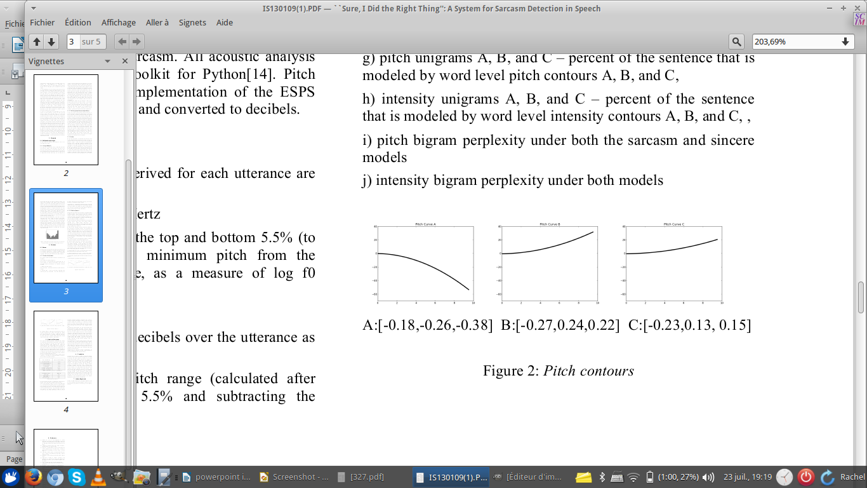
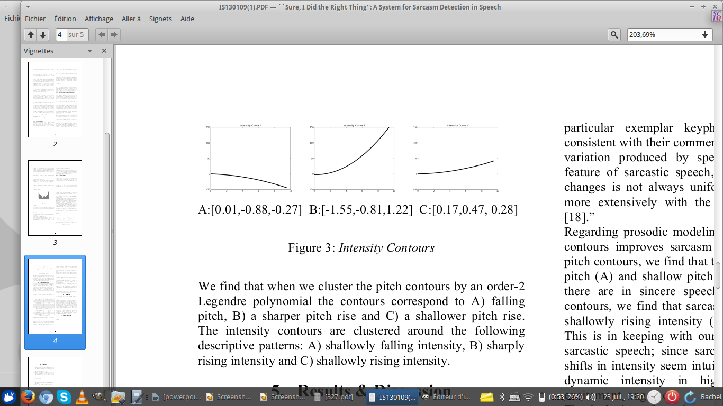

Slide 67
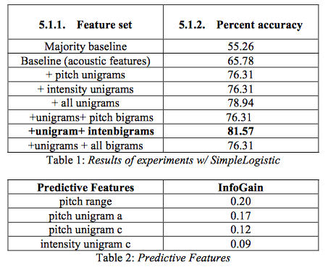
Results
Notes:
Simple Logistic Regression modeling
Pitch range was most predictive
They argue that prosody is important!
Difference from “Yeah Right”: they use intonational contours and intensity contours

Slide 68
How would you Improve Sarcasm Detection in Speech?
Acted vs. natural corpora?
Single speaker vs. multiple speakers?
How to improve human annotation?
Additional features?
Notes:
Humor next or next week

