Slide 1

Sarcasm: Detection, Pragmatic Goal, Generation
Smaranda Muresan (smara@columbia.edu)

Slide 2
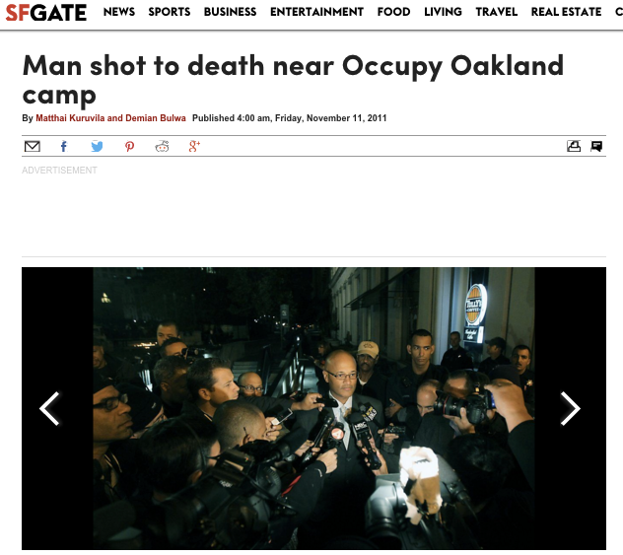

Understanding People’s Attitudes is Important
News Item
Discussion Forum
User1: A shooting in Oakland? That NEVER happens.
User2: Shootings happen in Oakland all the time and it had nothing to do with the Occupy movement. […]
User3: This shooting does have something to do with the Occupy movement because many of the witnesses are the Occupiers and it happened only a few yards away from the encampment.
Very sad news, regardless of if this young man was w/ #OO or not URL… via @sfgate
Oh yay. Another shooting #sarcasm
Unrecognized Sarcasm will lead to erroneous belief and sentiment detection
Notes:
We need to identify a speaker’s sentiment and beliefs in order to properly interpret what they say….
Occupy Oakland began as a protest encampment at Frank H. Ogawa Plaza on October 10, 2011. Protestors renamed it Oscar Grant Plaza after a young man who was fatally shot by Bay Area Rapid Transit Police in 2009. The encampment was cleared out by multiple law enforcement agencies on October 25, 2011.^{[4]} The movement also helped spur the November 2, 2011 Oakland General Strike that shut down the Port of Oakland. Police again cleared the protest encampment at Frank Ogawa Plaza on November 14, 2011. Other protest encampments were created and subsequently dismantled by law enforcement. The last encampment at Snow Park was cleared on November 21, 2011. Occupy Oakland then had no physical presence in any public space overnight in the city.^{[5]}
Occupy Oakland has often centered on complaints about alleged police misconduct,

Slide 3
Verbal Irony/Sarcasm
Type of Figurative Language
Verbal Irony: the use of words to express something other than and especially the opposite of the literal meaning (Mirriam-Webster dictionary)
Sarcasm: the use of words that mean the opposite of what you really want to say especially in order to insult someone, to show irritation, or to be funny” (Mirriam-Webster dictionary)
The market index is falling greatly. What a happy Christmas #sarcasm
Sarcastic
Literal
happy christmas eve ... new haircut ready for new year !!! #christmaseve #enjoy
Notes:
Sarcasm is one form of what we call “verbal irony”. To identify sarcasm we need to decide if people are using a word like ‘happy’ in a sarcastic of a literal sense.

Slide 4


Verbal Irony/Sarcasm
Characteristics:
Irony Markers: “A shooting in Oakland? That NEVER happens”
- typographics, punctuation, hyperbole, interjection
Irony Factors: Evaluative, Reversal of Valence, Semantic Incongruity with context
The market index is falling greatly. What a happy Christmas #sarcasm
prior turn
Plane window shades are open so that people can see fire
@ one more reason to feel really great about flying #sarcasm
current turn
Notes:
An important indicator of sarcasm is a word or phrases incongruence in its context.

Slide 5
Overview
Sarcasm Detection: Modeling the conversation context
Pragmatic Role of Sarcasm: Modeling Disagreement Space
Sarcasm Generation

Slide 6
Sarcasm: Modeling Conversation Context
Characteristics:
  Irony Factors: Incongruency with context
prior turn
Plane window shades are open so that people can see fire
current turn
@ one more reason to feel really great about flying #sarcasm
(Ghosh, Fabrri and Muresan, 2017;2018)
best paper award at SIGDIAL 2017
Notes:
incongruent means not the same, not compatible or out of place. When you take one position on something and then a second later you take a contrary position, this is an example of a situation where your statements would be described as incongruent

Slide 7
Modeling Conversation Context
[Ghosh, Fabbri, Muresan 2017; 2018]
RQ1: Can conversational context help in sarcasm detection
RQ2: Can we identify what part of the context triggers the sarcastic reply?

Slide 8
Data and Annotations
Twitter Corpus
  ``reply_to(@user)’’ to detect reply; collect the full thread
  Self-labeled corpus (provided by the tweet authors using hashtags)
    S: #sarcasm, #sarcastic
    NS: #love, #hate, … [González-Ibáñez et al. 2011]
  25K instances (12K S/13K NS; 30% with > 1 context utterance)
Context (prior turn(s))
…
Current turn (S or NS)
Notes:
Data used for experiments

Slide 9
  Data aInternet Argument Corpus_{v2} ([Oraby et al, 2016], Discussion forum
……………………………….
  Annotated by crowdsourcing at comment level: perceived sarcasm! (4950 Instances)
    Balanced between S/NS
    Comments between 3-7 sentences long
    3 types of sarcasm: General, Rhetorical Question, Hyperbole
Prior turn
.
Current turn (S or NS)
Notes:
Creating and Characterizing a Diverse Corpus of Sarcasm in Dialogue
Shereen Oraby, Vrindavan Harrison, Lena Reed, Ernesto Hernandez, Ellen Riloff, Marilyn Walker
Rhetorical: Q not wanting an answer
Hyperbole: exaggerated comment

Slide 10
  IAC_{v2} and IAC+_{v2} (Discussion forum)
  Built a subset that includes succeeding turns (2900 Instances)
    Balanced between Sarcastic/Non-Sarcastic
    Comments between 3-7 sentences long
    3 types of sarcasm: General, Rhetorical Question, Hyperbole
……………………………….
Prior turn
………………………...
Current turn (S or NS)
……………………………….
Succeeding turn

Slide 11
  Data anReddit Corpus ([Khodak et al. 2017], Discussion forum)d Annotations
  Self-labeled corpus, annotated at comment level (``\s marker added by speaker)
  Collected subset of 50K instances
    Balanced between Sarcastic/Non-Sarcastic
    Comments between 3-7 sentences long
……………………………….
Prior turn
………………………...
Current turn (S or NS)
Notes:
A Large Self-Annotated Corpus for Sarcasm
Mikhail Khodak, Nikunj Saunshi, Kiran Vodrahalli

Slide 12
RQ1: Can Conversational Context Help in Sarcasm Detection?
Baseline (SVM with discrete features)
  ngrams
  Sentiment and pragmatic features
    Linguistic Inquiry and Word Count (LIWC) lexicon
    MPQA Subjectivity lexicon
    Change of sentiment [Joshi et al. 2015]
  Sarcasm Markers [Burgers et al. 2012]
    Morpho-syntactic
      (interjections: ``yeah’’; ``uh’’), Tag questions (``isn’t it?”), Exclamations
    Typographic
      Capitalization (``NEVER’’), quotation marks, emoticons
    Tropes: figurative or metaphorical uses
      Intensifiers (``greatest’’, ``best’’…)
Notes:
The Subjectivity Lexicon (list of subjectivity clues) that is part of OpinionFinder is also available for separate download. These clues were compiled from several sources (see the enclosed README). This is the version of the lexicon used in:
Theresa Wilson, Janyce Wiebe, and Paul Hoffmann (2005). Recognizing Contextual Polarity in Phrase-Level Sentiment Analysis. Proc. of HLT-EMNLP-2005.

Slide 13
Computational Models
Long Short-Term Memory (LSTM) Networks [Hochreiter & Schmidhuber 1997]
  Type of RNN; able to learn long-distance dependencies
  One LSTM reads the context and another LSTM reads the response
Attention-based LSTM Networks allow focus
  Word and sentence level attention (hierarchical model; Yang et al. 2016) or only sentence level (avg. word embeddings)
Notes:
Context: prior turns; Response: sarcastic or not.

Slide 14
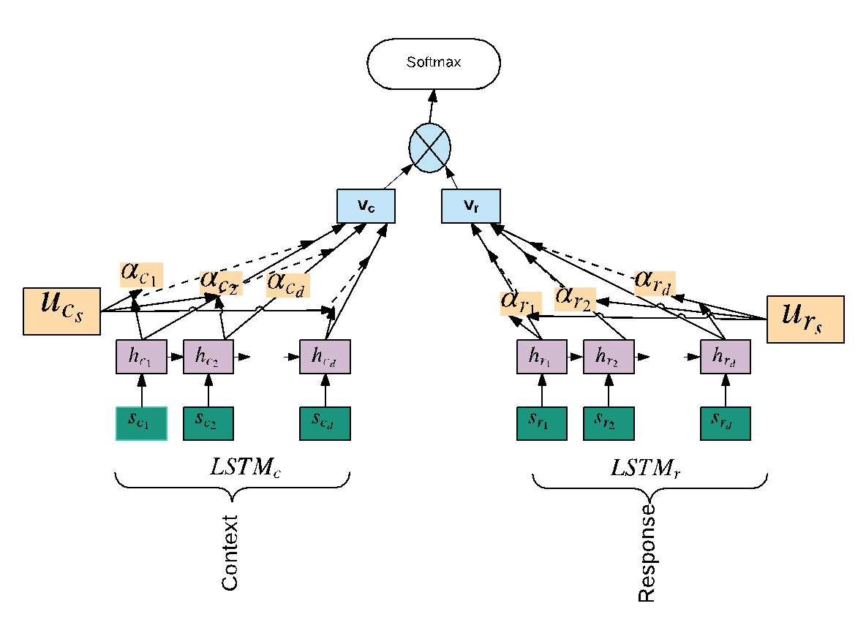
Final Vector Rep.
Attention
Hidden layers
Sentence Embedding
Fig. inspired by Yang et al. 2016
Notes:
The context c contains d sentences and each sentence sci contain Tci words. we first feed the sentence annotation hci through a one layer Multi-layer perceptron to get uci as a hidden representation of hci , then we weight the sentence uci by measuring similarity with a sentence level context vector ucs . This gives a normalized importance weight αci through a softmax function. vc is the vector that summarizes all the information of sentences in the context.
Likewise we compute vr for the response r via LSTMr (similar to eq. 1 and 2; also shown in Figure 1). Finally, we concatenate the vector vc and vr from the two LSTMs for the final softmax decision (i.e., predicting the S or N S class).

Slide 15
Computational Models
Conditional LSTM
  Introduced for textual entailment [Rocktäschel et al. 2015]
  LSTM that reads response is conditioned on representation of the first LSTM built for context
Notes:
\

Slide 16
Data Split: 80/10/10
    Dev data is used for parameter tuning

Slide 17
Results: Prior Turn
Model | Twitter F1 | IAC_{v2} F1 | Reddit F1
SVM^{ct} | 66.5 | 65.8 | 72.54
SVM^{ct+pt} | 67.9 | 63.1 | 67.00
LSTM^{ct} | 67.2 | 67.5 | 68.5
LSTM^{ct+pt} | 68.0 | 69.9 | 74.22
LSTM^{conditional} | 74.5 | 71.8 | 73.03
LSTM_{a}^{ct} | 73.4 | 69.8 | 74.68
LSTM_{a}^{ct+pt} | 75.1 | 71.3 | 75.42
Twitter: using only immediate prior turn: LSMT_{a}^{ct+pt_last}: 73.71
Notes:
Statistically significant differences for the final model– best model for S and NS classes is LSTM(conditional); the LSTM with attention for c and prior turn gives best F1 for S but for NS the LSTM with attention only on prior turn is best

Slide 18
Results: Cross-corpora training
Reddit data is self labeled and is larger
Train on Reddit and Test on IAC_{v2}
Model | F1
LSTM_{a}^{ct} | 65.11
LSTM_{a}^{ct+pt} | 63.23
Possible issues:
- self-labeled vs. crowdsourced labeled
- topics

Slide 19
Train and Test on IAC⁺_{v2}
Model | IAC⁺_{v2} (F1)
SVM^{ct} | 77.89
SVM^{ct+pt} | 76.43
SVM^{ct+st} | 68.83
SVM^{ct+ps+st} | 72.77
LSTM^{ct} | 79.25
LSTM^{ct+pt} | 83.32
LSTM^{ct+st} | 82.60
LSTM^{ct+pt+st} | 83.33
LSTM_{a}^{ct} | 80.05
LSTM_{a}^{ct+pt} | 81.52
LSTM_{a}^{ct+st} | 80.67
LSTM_{a}^{ct+pt+st} | 81.08
Even if dataset is smaller the results are higher….
Possible answer: IAC⁺_{v2} contains mostly Generic type of Sarcasm (95%) while IAC_{v2} contains an equal distribution of Generic, Rhetorical Questions and Hyperbole
Notes:
Larger than IACvs corpus but smaller than Reddit;; using context, prior turn and succeeding turn; Stat significant

Slide 20
Error Analysis
Can capture cases of context incongruity
Misses:
  Use of contextual information outside the text (shared common ground)
  Sarcastic turns with more than 5 sentences
  User of profanity and slang
  Use of rhetorical questions

Slide 21
Attention Weights
Sarcasm markers
  Explicit indicators of sarcasm
  Attention put more weights on markers, such as emoticons (``:p’’) and interjections (``yeah’’, ``hmm’’)
However,
  Interpretations based on attention weights have to be taken with care: classification should not rely solely on attention weights [Rocktäschel et al. 2015]

Slide 22
Conclusion
Conversation context helps, particularly prior context
Results might differ depending on corpora
  Twitter vs. Discussion Forums
  Self-labeled vs. Crowdsourcing labeled
  Topics could have an influence
  Size of data

Slide 23
Overview
Sarcasm Detection: Modeling the conversation context
Pragmatic Role of Sarcasm: Modeling Disagreement Space
Sarcasm Generation

Slide 24
“Laughing at you or with you”
The Role of Sarcasm in
Shaping the Disagreement Space (EACL 2021)
Debanjan Ghosh, Ritvik Shrivastava and Smaranda Muresan

Slide 25
Sarcasm’s Influence in Shaping the Disagreement Space
Agreement
Often used as a persuasive device to gain/give support
Disagreement
Used to convey contempt/mock or attack the opponent through undercutting or ad-hominem arguments.
Notes:
Add subtitle about linguistic theory, citation - show this as a cited theoretical slide, next jump to problem definition

Slide 26
Problem Definition
Study whether modeling sarcasm can improve the detection and classification of argumentative relations in online discussions (agree/disagree/none) using a thorough experimental setup.

Slide 27
Dataset
We use the Internet Argument Corpus (Walker et. al., 2012)
Consists of posts from conversations in online forums on a range of controversial political and social topics such as:
Evolution, Abortion, Gun Control, and Gay Marriage.
This consists of around 10K pairs of conversation turns, we split these into train (80%), dev (10%), and test (10%).

Slide 28
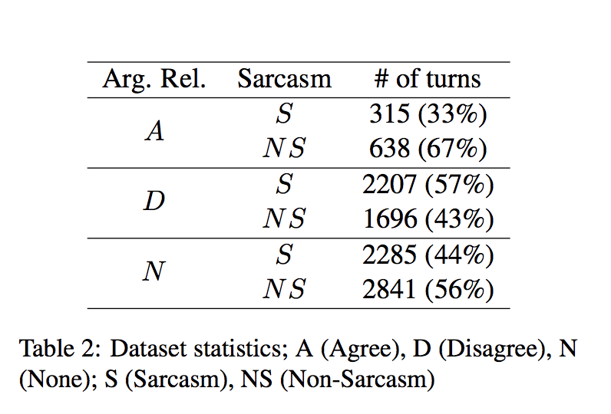
Dataset
All conversation turns have the following structure:
  prior turn pt
  current turn ct
These were annotated using Mechanical Turk for argumentative relations (agree/disagree/none).
Each “current turn” that is part of a pair is also labeled with a Sarcasm (S) or Non-Sarcasm (NS) label.

Slide 29
Our Approach
Joint modelling across two tasks, showcasing their linguistic alignment and how they benefit from each other -
  Sarcasm detection (Sarcastic vs Non-Sarcastic)
  Argumentative Relation Detection (agree/disagree/none)
Show that hypothesis is model-agnostic and holds across both feature-based and deep learning approaches.
Detailed qualitative and quantitative analysis to show when and how joint—modeling is beneficial.

Slide 30
Experimental Setup
We work across three different modelling approaches
  Feature based logistic regression
  Hierarchical-attention based LSTM
  Transformer models (BERT)
Across all of them, we compare the performance of these models on tasks in two settings
  Standalone/independent models for each task
  Joint/feature-shared/multi-task learning across the two tasks

Slide 31
Feature Based – Logistic regression
We use a Logistic Regression (LR) model that uses both argument-relevant (ArgF) and sarcasm relevant (SarcF) features.
We represent this joint (feature-sharing) model across the two platform as LR_{ArgF+SarcF}

Slide 32
Argument-relevant Features (ArgF)
Sarcasm-relevant Features (SarcF)
N-grams
Argument lexicons
Sentiment, opinion lexicons
Hedge features
PDTB discourse markers
Modal verbs
Pronouns
Textual entailment
Lemma overlap
Negation
Linguistic Inquiry Word Count (LIWC) features to capture the linguistic, social, individual, and psychological processes
Measuring sentiment incongruity or reversal of valence, i.e., shift in polarity of sentiment across current and prior turns
Sarcasm markers (capitalization, punctuations, exclamations, quotation marks)

Slide 33
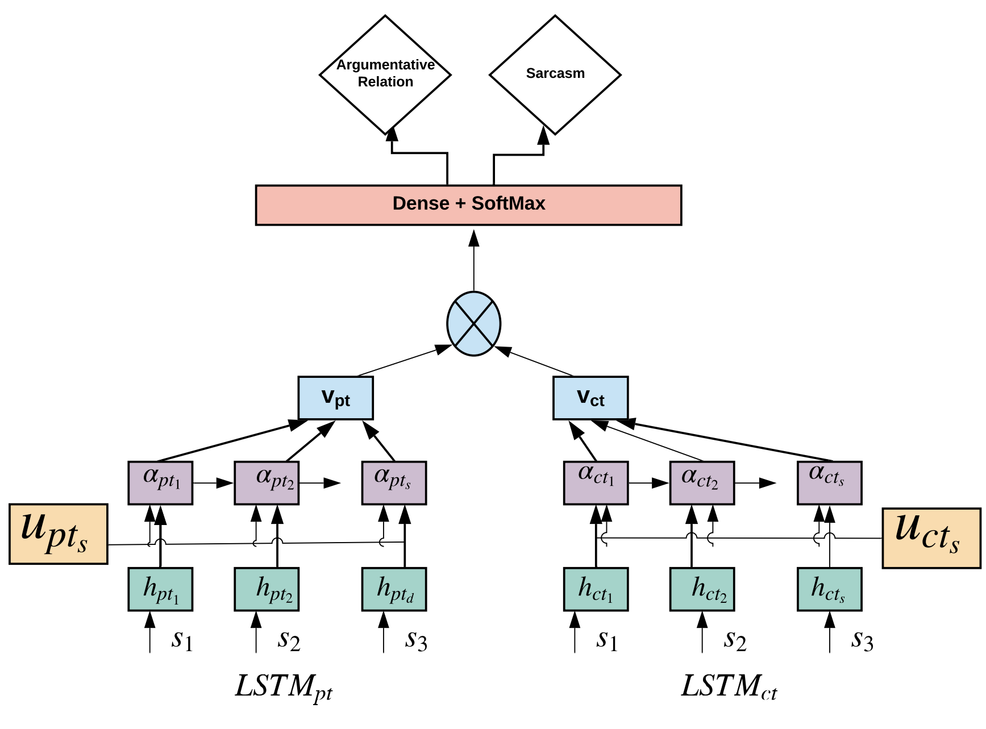
Dual-LSTM with Hierarchical Attention
Dual-LSTMs are used to learn from current and prior turns respectively
This model implements attention both at the word level and sentence level
The final representation from the model is condensed and passed into classification heads for both tasks
This creates shared layers that learn gradients across both tasks and improve cross-task performance.

Slide 34
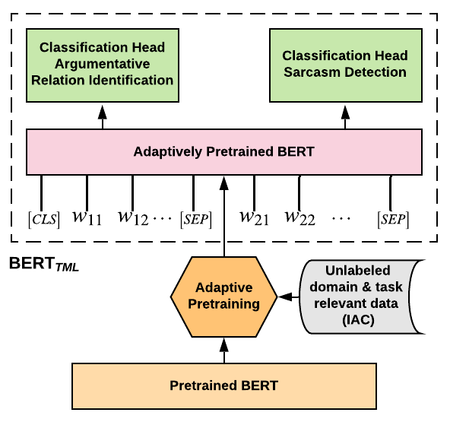
BERT Multi-Task
The base-BERT model is adaptively-pretrained through fine-tuning with domain-specific data from IAC
This model is then used as our new model, with the conversation pairs (pt, ct) as input and output passed into task specific classification heads
The tunable layers of the adaptively-pretrained BERT model learn across both tasks in every iteration, thereby creating a joint-learning setup

Slide 35
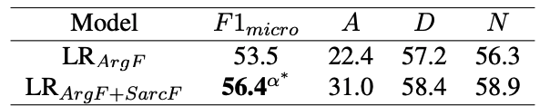
Results
LR_{ArgF}: Logistic Regression model with only argument-relevant features
LR_{ArgF+SarcF}: LR model with shared argument and sarcasm features

Slide 36
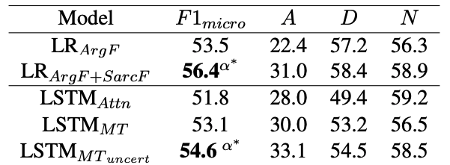
Results
LSTM_{attn}: LSTM standalone model for argument relation detection
LSTM_{MT}: Multi-Task learning LSTM model, with shared parameters and layers across both tasks, with different classification heads for each task.
LSTM_{MTuncert}: Multi-task learning with dynamic weighting of task-specific losses.

Slide 37
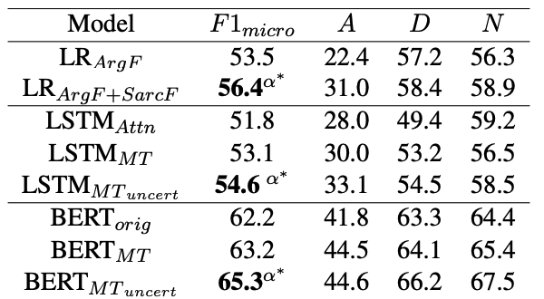
Results
BERT_{orig}: Standalone BERT model for argument relation detection
BERT_{MT}: Adaptively pretrained Multi-Task learning BERT model, with different classification heads for each task.
BERT_{MTuncert}: Multi-task learning with dynamic weighting of task-specific losses.
.
Next time you’re sarcastic in an argument, take some time to notice –
Are you laughing at them, or with them?

Slide 38
Overview
Sarcasm Detection: Modeling the conversation context
Pragmatic Role of Sarcasm: Modeling Disagreement Space
Sarcasm Generation

Slide 39



R³ : Reverse, Retrieve, and Rank for Sarcasm Generation with Commonsense Knowledge (ACL 2020)
Tuhin Chakrabarty Debanjan Ghosh Nanyun (Violet) Peng

Slide 40
Insight: Sarcasm Factors
Be evaluative
Be based on a reversal of valence between the literal and intended meaning
Be based on a semantic incongruity with the context, which can include shared common sense or world knowledge between the speaker and addressee
Be aimed at some target
Be relevant to the communicative situation in some way

Slide 41

Task and Approach
Task: given an evaluative non-sarcastic utterance, generate a sarcastic utterance that keeps the speaker's intended meaning.
Given the lack of training data for sarcasm generation, we propose a novel unsupervised approach that has three main components inspired by the sarcasm factors
Reversal of Valence
Retrieval of Common sense Context
Ranking of Semantic Incongruity

Slide 42
zero visibility in fog makes driving easy
zero visibility in fog makes driving easy. suffered three cracked ribs in the accident.
REVERSE
CONCAT
REVERSAL OF VALENCE
NON-SARCASTIC UTTERANCE REVERSED
TOP RANKED
SENTENCE
SARCASTIC
OUTPUT
RANKING OF
SEMANTIC
INCONGRUITY
NON-SARCASTIC UTTERANCE INPUT
zero visibility in fog makes driving difficult
ROBERTA LARGE
FINE-TUNED ON
MNLI
POS TAGGING
FORM CANDIDATE
PAIRS FOR NLI
INCONGRUITY RANKING
Inputs: zero, visibility,
fog,makes, driving, difficult
RETRIEVAL OF COMMONSENSE CONTEXT
COMET
(GPT-2 FINE-TUNED
ON CONCEPTNET)
Output: accident
RETRIEVAL
suffered three cracked ribs in the accident.
I injured my spine in a riding accident.
…...
CAUSES
COMMONSENSE
TERM / PHRASE

Slide 43
zero visibility in fog makes driving easy
REVERSE
REVERSAL OF VALENCE
NON-SARCASTIC UTTERANCE REVERSED
NON-SARCASTIC UTTERANCE INPUT
zero visibility in fog makes driving difficult

Slide 44
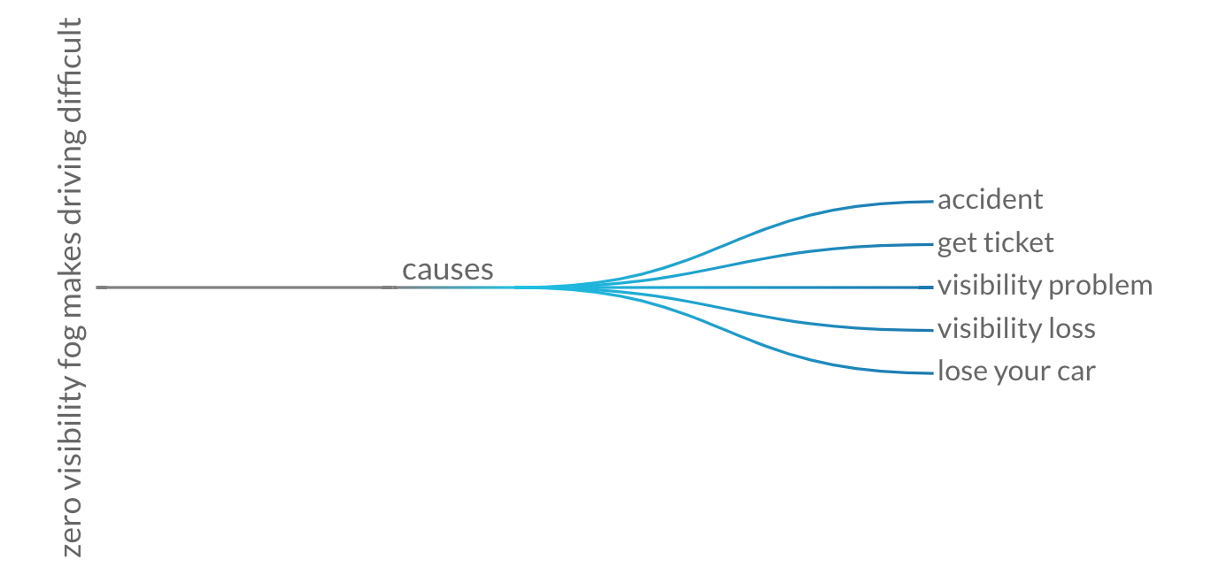
NON-SARCASTIC UTTERANCE INPUT
zero visibility in fog makes driving difficult
POS TAGGING
COMET (Bosselut et al 2019)
Inputs: zero, visibility,
fog,makes, driving, difficult
RETRIEVAL OF COMMONSENSE CONTEXT
COMET
(GPT-2 FINE-TUNED
ON CONCEPTNET)
Output: accident
RETRIEVAL
suffered three cracked ribs in the accident.
I injured my spine in a riding accident.
…...
CAUSES
COMMONSENSE
TERM / PHRASE
Sentencedict.com

Slide 45
zero visibility in fog makes driving easy
zero visibility in fog makes driving easy. suffered three cracked ribs in the accident.
REVERSAL OF VALENCE
CONCAT
NON-SARCASTIC UTTERANCE REVERSED
TOP RANKED
SENTENCE
SARCASTIC
OUTPUT
RANKING OF
SEMANTIC
INCONGRUITY
ROBERTA LARGE
FINE-TUNED ON
MNLI
FORM CANDIDATE
PAIRS FOR NLI
INCONGRUITY RANKING
suffered three cracked ribs in the accident.
I injured my spine in a riding accident.
…...
Sentencedict.com
Notes:
After this Add again the overall slide and add R^3 As name in the corner left.

Slide 46
zero visibility in fog makes driving easy
zero visibility in fog makes driving easy. suffered three cracked ribs in the accident.
REVERSE
CONCAT
REVERSAL OF VALENCE
NON-SARCASTIC UTTERANCE REVERSED
TOP RANKED
SENTENCE
SARCASTIC
OUTPUT
RANKING OF
SEMANTIC
INCONGRUITY
NON-SARCASTIC UTTERANCE INPUT
zero visibility in fog makes driving difficult
ROBERTA LARGE
FINE-TUNED ON
MNLI
POS TAGGING
FORM CANDIDATE
PAIRS FOR NLI
INCONGRUITY RANKING
Inputs: zero, visibility,
fog,makes, driving, difficult
RETRIEVAL OF COMMONSENSE CONTEXT
COMET
(GPT-2 FINE-TUNED
ON CONCEPTNET)
Output: accident
RETRIEVAL
suffered three cracked ribs in the accident.
I injured my spine in a riding accident.
…...
CAUSES
COMMONSENSE
TERM / PHRASE

Slide 47
Evaluation Setup
Test Set
Test on 150 randomly selected non sarcastic utterance
Evaluation Criterion
Creativity
Sarcasticness
Humor
Grammaticality
Notes:
Maybe make this slide Evaluation Setup and have “Test Set” and “Evaluation Criteria” as subbullets.

Slide 48
Ablations
Reversal of Valence (RV)
No Reversal of Valence (NoRV)
No Semantic Incongruity (NSI)
SOTA (Hybrid reinforced seq2seq model Mishra et al 2019)
Our Full Model (FM)
Human (Gold) Sarcasm

Slide 49
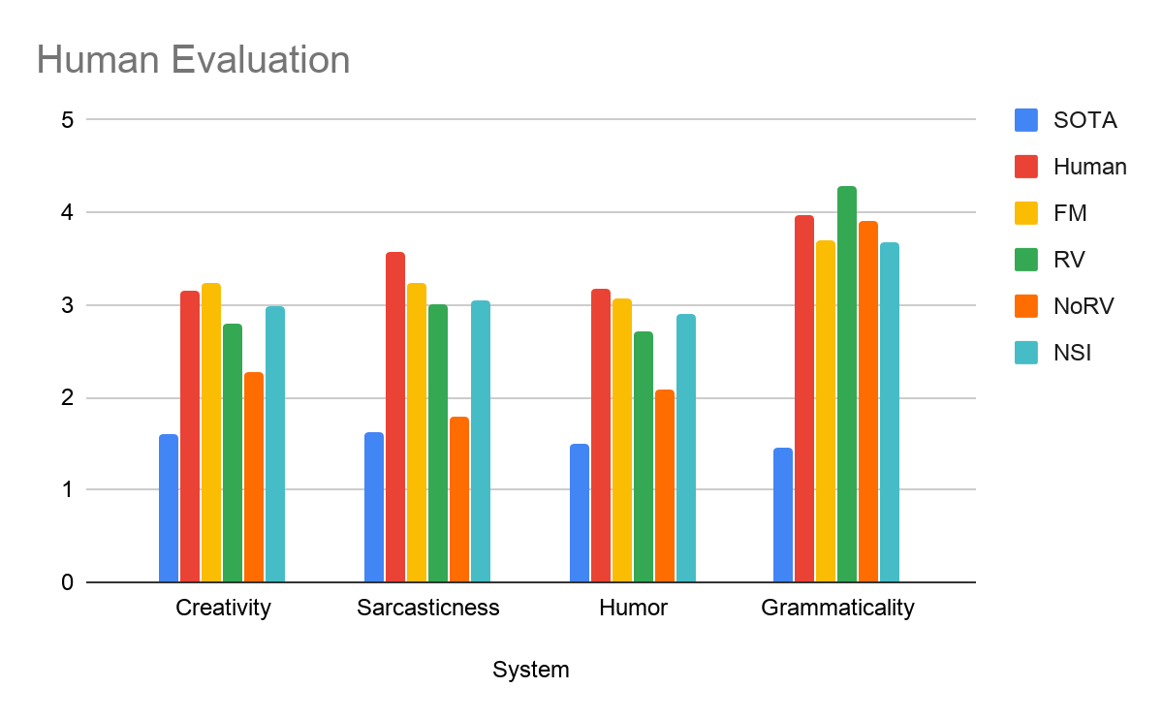
Results

Slide 50
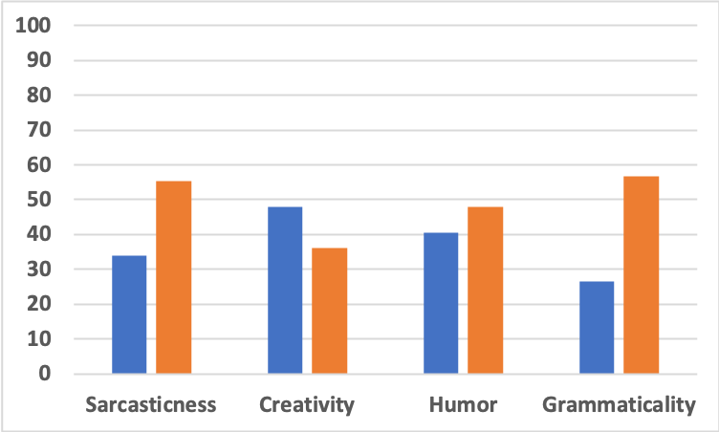
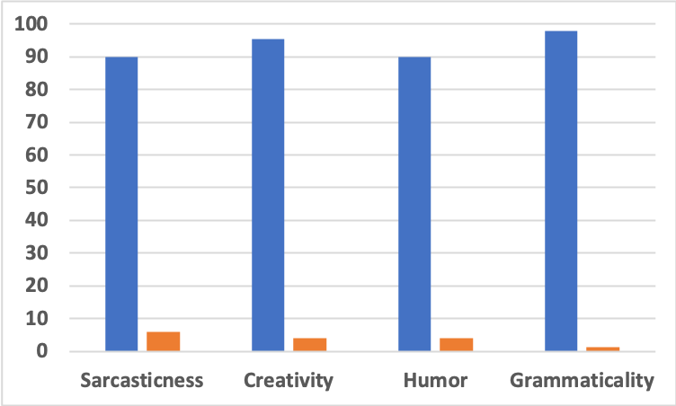
Pairwise Game
FM Vs. Human
FM Vs. SOTA
90.0 6.0 95.3 4.0 90.0 4.0 98.0 1.3
34.0 55.3 48.0 36.0 40.6 48.0 26.6 56.6
Win
Loss

Slide 51
Take Away
Use theoretically inspired approaches
Context is important
  Dialogue context
  Common sense knowledge
  What else?
Neither generation nor detection is a solved problem
Sarcasm understanding/generation is hard and interesting! Come work on it!
We are running a shared task at Figurative Language Processing Workshop at EMNLP 2022 on understanding figurative language as a textual entailment with explanations

Slide 52

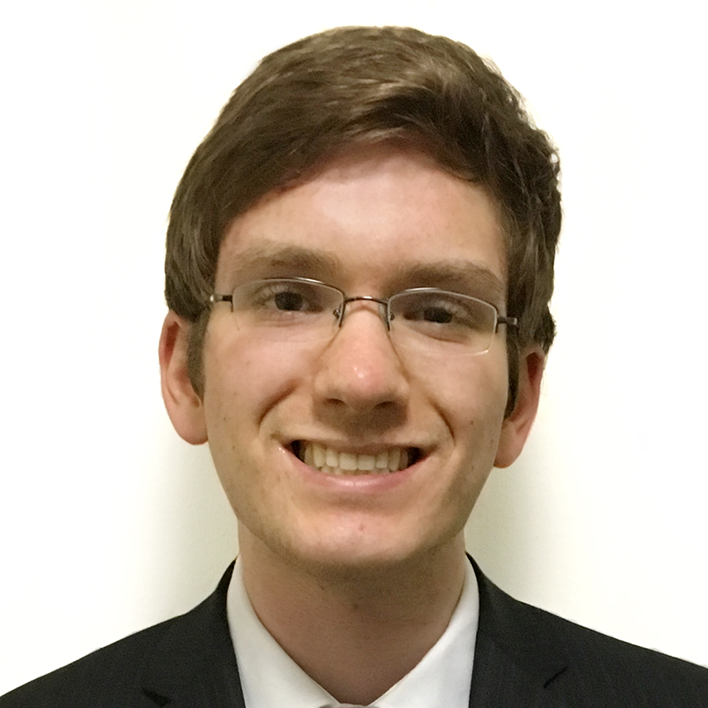
THANK YOU!!
Code and
Data and Code
(role of sarcasm) https://github.com/ritvikshrivastava/multitask_transformers/
(sacasm generation) https://github.com/tuhinjubcse/
Tuhin Chakrabarty Alexander Fabbri Debanjan Ghosh Ritvik Shrivastava Nanyu (Violet)Peng

Slide 53
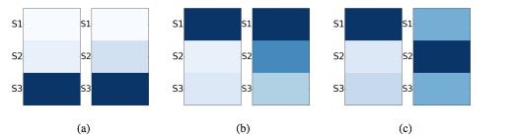
RQ2: Can we Identify What Part of the Context Triggers the Sarcastic Reply?Experiment
  Crowd-sourcing: Given a context and sarcastic reply, identify one or more sentences from the context that you think triggered the sarcastic reply
    Use IAC_{v2} data
    85 HITs (context length between 3-7 sentences)
  Ratings compared to attention weights (41% matches for the top-ranked sentence)
LHS: attention weights; RHS: Turkers’ selections
53
Notes:
Triggerng sentence location differs for different samples but for 41% the attention weights agree with humans

Slide 54
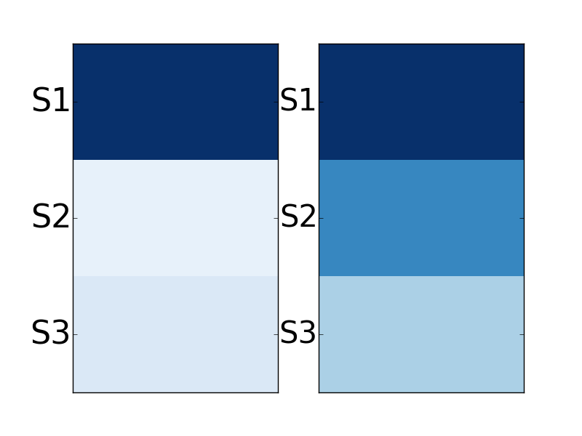
S1. how do we rationally explain these creatures existence so recently in our human history if they were extinct for millions of years?
S2. and if they were the imaginings of bronze age sheep herders as your atheists/evolutionists would have you believe, then how did these ignorant people describe creatures we can now recognize from fossil evidence?
S3. and while your at it, ask yourself if it's reasonable that the bones of dead creatures have survived from 60 million years to some estimated to be more than 200 million years without becoming dust?
LHS: attention weights
RHS: Turkers’ selection
how about this explanation - you're reading waaaaay too much into your precious bible

Slide 55
Crowd-sourcing 2
Given a pair of sarcastic turn and its previous post
  Indicate what sentence inside the sarcastic turn expresses sarcasm
  Identify what triggered that sarcastic sentence
60 examples from IACv2 and 100 from Reddit
  Ratings were compared to attention weights
    For task 2:
      51% matches the top-ranked (attention-rated) sentence for IACv2 data
      30% matches the top-ranked sentence for Reddit data
    For task 1: ~25% matches for both IAC and Reddit

Slide 56
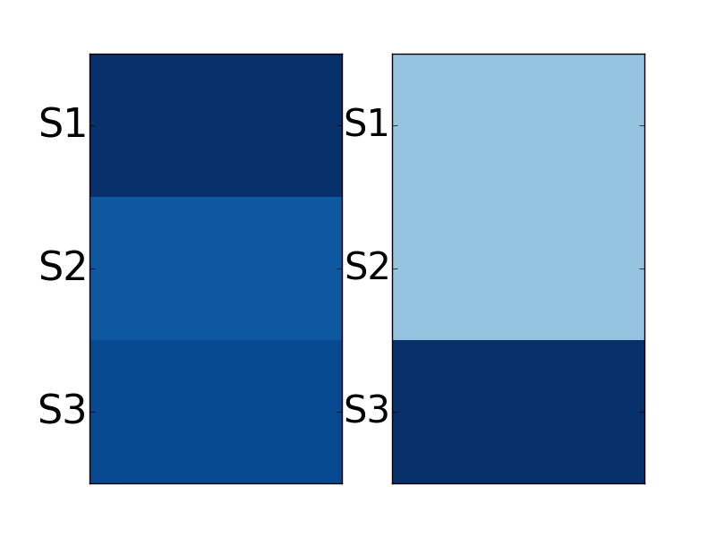
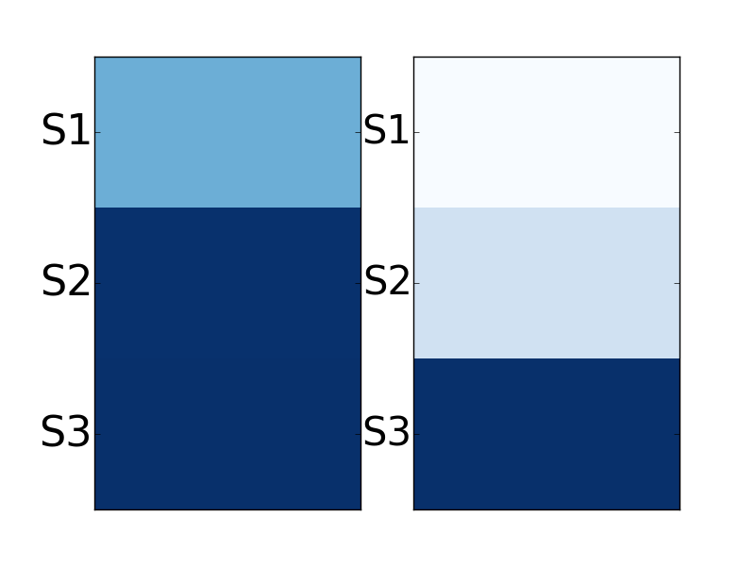
S1. nothing will happen, this is going to die a quiet death like 99.99 \% of other private member motions.
S2. this whole thing is being made into a big ordeal by those that either don't know how our parliament works, or are trying to push an agenda.
S3. feel free to let your mp know how you feel though but i doubt this motion gets more than a few minutes of discussion before it is send to the trashcan.
LHS: attention weights
RHS: Turkers’ selection
S1. the usual ``nothing to see here'' response.
S2. whew!
S3. we can sleep at night and ignore this.
Notes:
Identify what triggered that sarcastic sentence in the previous turn
Indicate what sentence inside the sarcastic turn expresses sarcasm

