Slide 1
Emotion and Sentiment Detection
COMS 6998
SPRing 2023

Slide 2
Outline
Emotion in speech
Emotion theory
Emotional speech corpora
Features for emotional speech
Models for emotion recognition
Expressive synthetic speech
Sentiment and emotion in text

Slide 3
Emotion in Speech

Slide 4
Outline
Emotion in speech
Emotion theory
Emotional speech corpora
Features for emotional speech
Models for emotion recognition
Expressive synthetic speech
Sentiment and emotion in text

Slide 5
What is Emotion?
Two families of theories of emotion
Categorical approach
Emotions are categories
Limited number of basic emotions
Dimensional approach
Emotions are dimensions
Limited number of labels but unlimited number of emotions

Slide 6
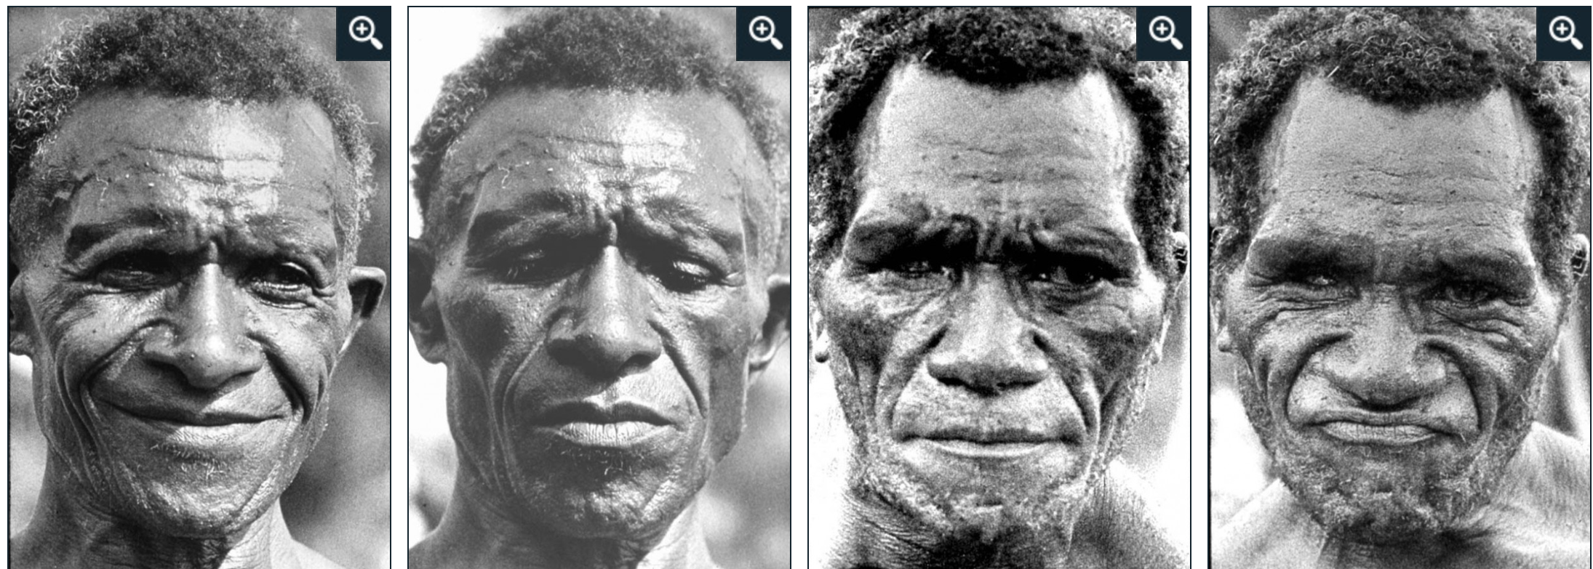
Emotion - Categorical Approach
(Ekman et al., 1987)
Discrete ‘basic emotions’
Originate from facial expressions
?
Anger Sadness Disgust Happiness

Slide 7
Emotion - Categorical Approach
(Ekman et al., 1987)
Discrete ‘basic emotions’
Originate from facial expressions
?
Anger Sadness Disgust Happiness
Notes:
ekman proposed: facial -> speech

Slide 8
Emotion - Dimensional Approach
(Russell and Barrett, 1999)
Continuous multi-dimensional space
Common physiological system

Slide 9
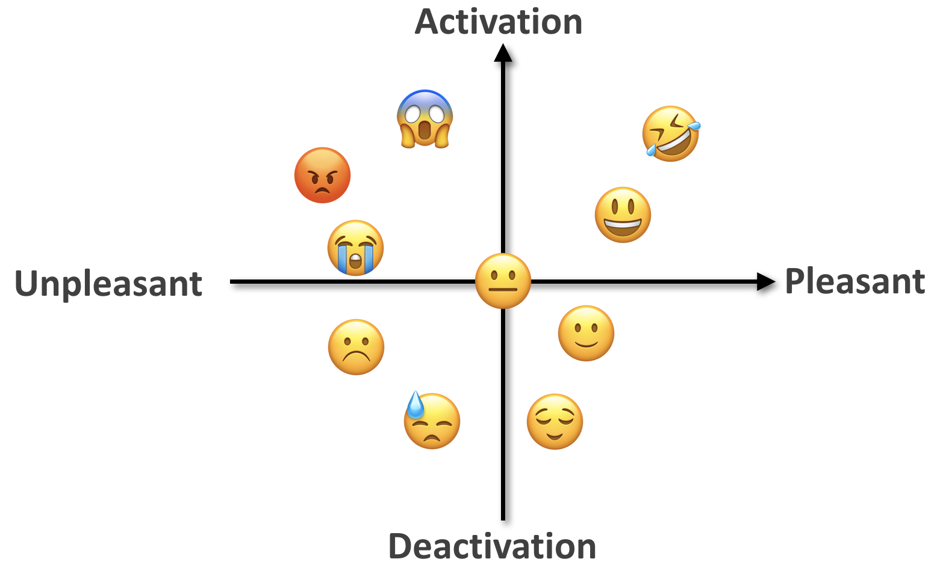
Emotion - Dimensional Approach
(Russell and Barrett, 1999)
Continuous multi-dimensional space
Common physiological system
Arousal-Valence space

Slide 10
Why Study Emotional Speech?
Recognition
Customizing virtual assistants
Anger/frustration in call centers
Confidence/uncertainty in online tutoring systems
“Hot spots” in meetings
Generation
TTS for virtual assistants, computer games, etc.
Other applications: Speaker state identification
Deception, charisma, sleepiness, interest, humor…
Some emotional clues are only in speech

Slide 11
Outline
Emotion in speech
Emotion theory
Emotional speech corpora
Features for emotional speech
Models for emotion recognition
Expressive synthetic speech
Sentiment and emotion in text

Slide 12
Emotion in Speech
Acted speech
Easier to collect & control
Extreme emotions
Mostly categorical approach
Examples: (Emotional Prosody Speech)
Which emotion do you hear?
Spontaneous speech
Harder to collect & annotate
Subtle changes in emotion
Both categorical & dimensional approach

Slide 13
Emotion in Speech
Acted speech
Easier to collect & control
Extreme emotions
Mostly categorical approach
Examples: (Emotional Prosody Speech)
Happy, Sad, Angry, Bored
Spontaneous speech
Harder to collect & annotate
Subtle changes in emotion
Both categorical & dimensional approach

Slide 14
Emotion in Speech
Acted speech
Easier to collect & control
Extreme emotions
Mostly categorical approach
Examples: (Emotional Prosody Speech)
Happy, Sad, Angry, Bored
Spontaneous speech
Harder to collect & annotate
Subtle changes in emotion
Both categorical & dimensional approach
Example: (AT&T “How May I Help You?” System)
Categorical emotion(s)?
Arousal and Valence?

Slide 15
Emotion in Speech
Acted speech
Easier to collect & control
Extreme emotions
Mostly categorical approach
Examples: (Emotional Prosody Speech)
Happy, Sad, Angry, Bored
Spontaneous speech
Harder to collect & annotate
Subtle changes in emotion
Both categorical & dimensional approach
Example: (AT&T “How May I Help You?” System)
Neutral -> frustrated -> angry
Arousal ↑, Valence ↓

Slide 16
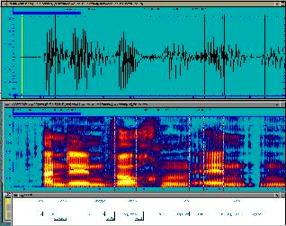
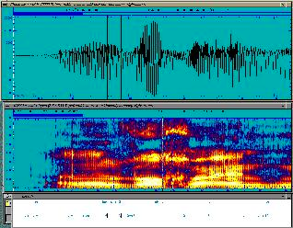
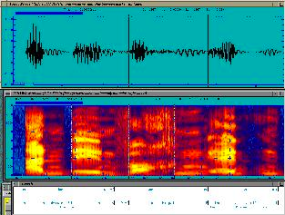
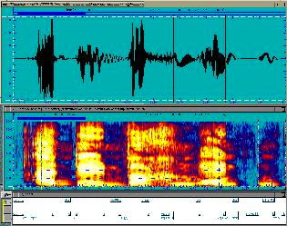
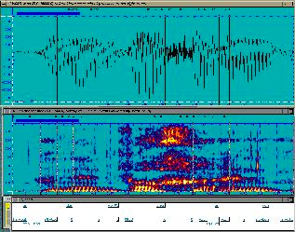
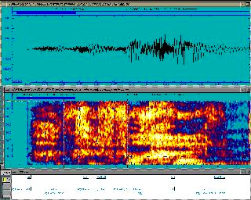
Emotional Speech Corpora - Acted & Categorical
(EmoDB, German)
Neutral
Bored
Angry
Happy
Sad
Frightened
Notes:
how actors understand and interpret emotion
energy from picture
pitch, speaking rate

Slide 17
Acted & Categorical Speech: Actors vs Students (Emotional Prosody Speech) (Mandarin Affective Speech)
Anger
Elation
Neutral
Panic
Sadness
Sad
Happy
Angry
Bored
Interested

Slide 18
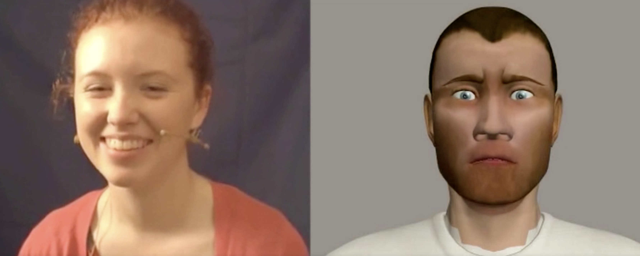
Spontaneous Speech with Dimensional Annotations
(SEMAINE database)
The goal of the Sensitive Artificial Listener operator (right) is to engage the user (left) in emotional conversations
“Anything nice happened this week?” “It’s all rubbish.”
6-8 annotators. Annotations range from -1 to 1 with 20ms intervals.
Valence score : -0.88
Valence score : 0.58
Valence score : 0.83

Slide 19
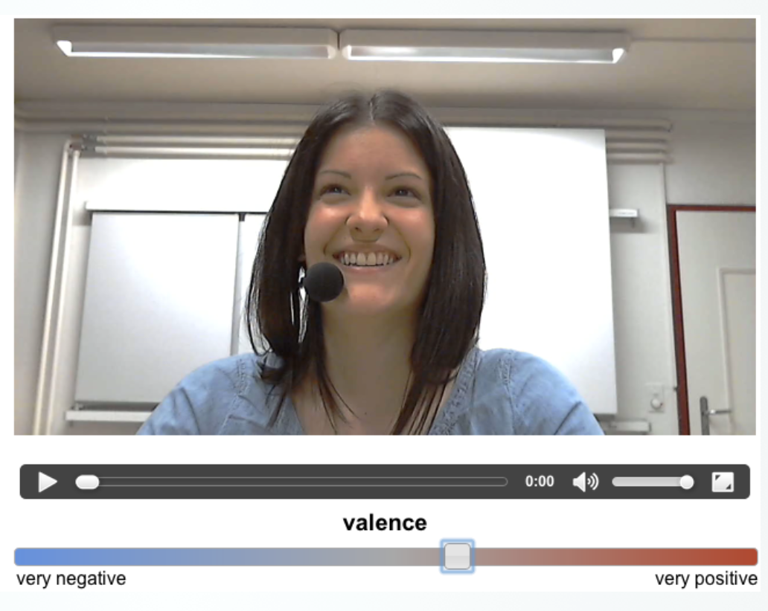
Spontaneous Speech with Dimensional Annotations
(RECOLA database)
3 hours of audio, visual, and physiological recordings of between 46 French speaking participants
Participants were asked to reach consensus on how to survive in a disaster scenario
6 annotators. Annotations range from
-1 to 1 with 40ms intervals.
Notes:
Drag the bar under video

Slide 20
Spontaneous Speech with Dimensional Annotations
(RECOLA database)
Arousal
Valence
Arousal
Valence
Notes:
Annotator difference
natural low agreement
yellow always close to zero
red: extreme score for arousal - high pos and high neg
light blue: skewed towards positive valence - high pos and close-to-zero neg

Slide 21
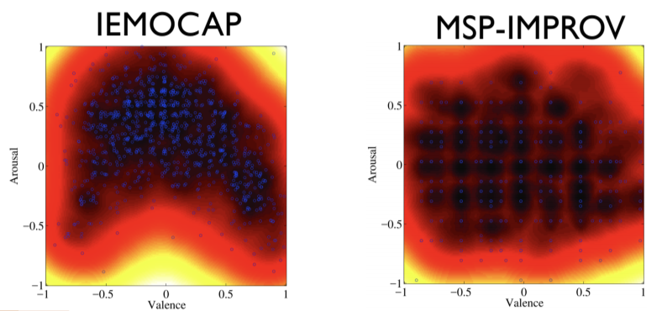
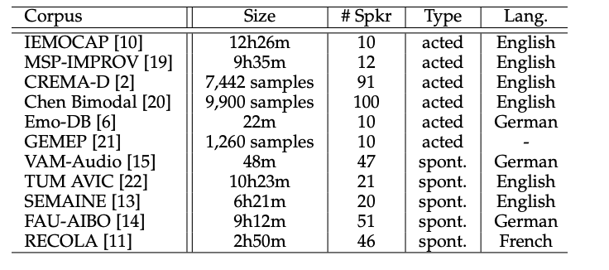
Partial List of the Existing Emotion Corpora
Lack of naturalness (acted)
Unbalanced emotional content (spontaneous)
Limited in size, limited number of speakers
Acted
Spontaneous
Notes:
all collected with different emotion eliciting method, in different noice condition. making them really hard to compare

Slide 22
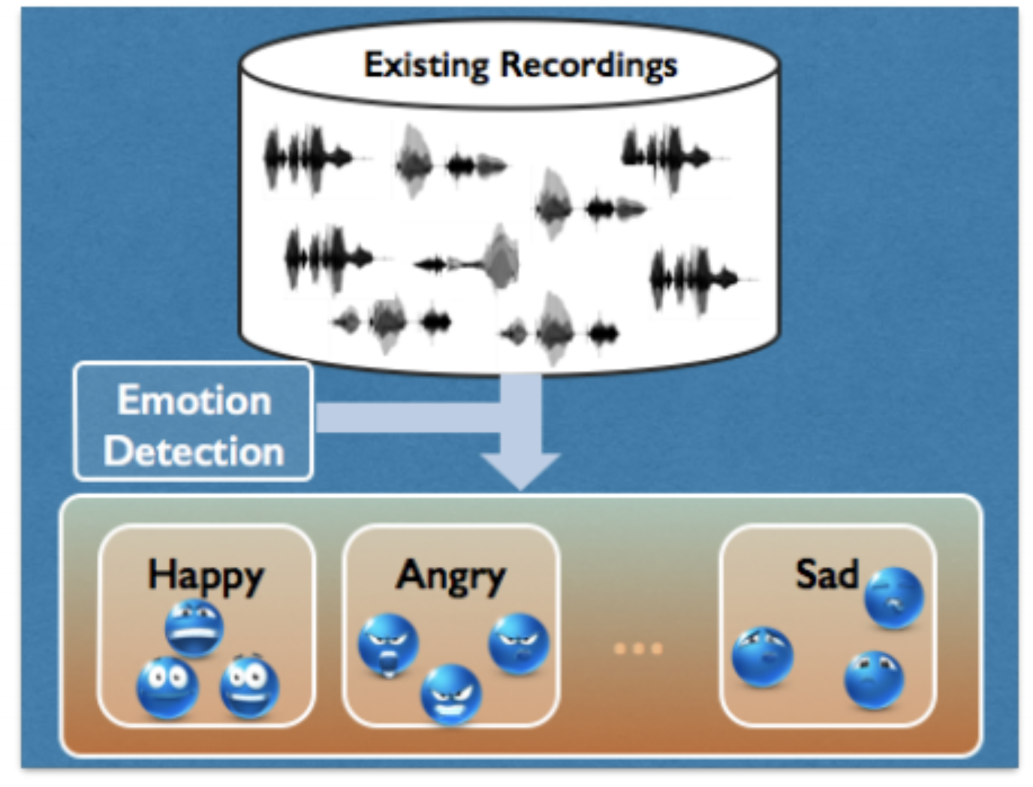
MSP-Podcast Corpus
Use existing podcast recordings, divided into speaker turns
Emotion retrieval to balance the emotional content
Annotate using crowdsourcing framework
62140 speaking turns, ~100 hours of speech
Similar approach: CMU-MOSEI dataset

Slide 23
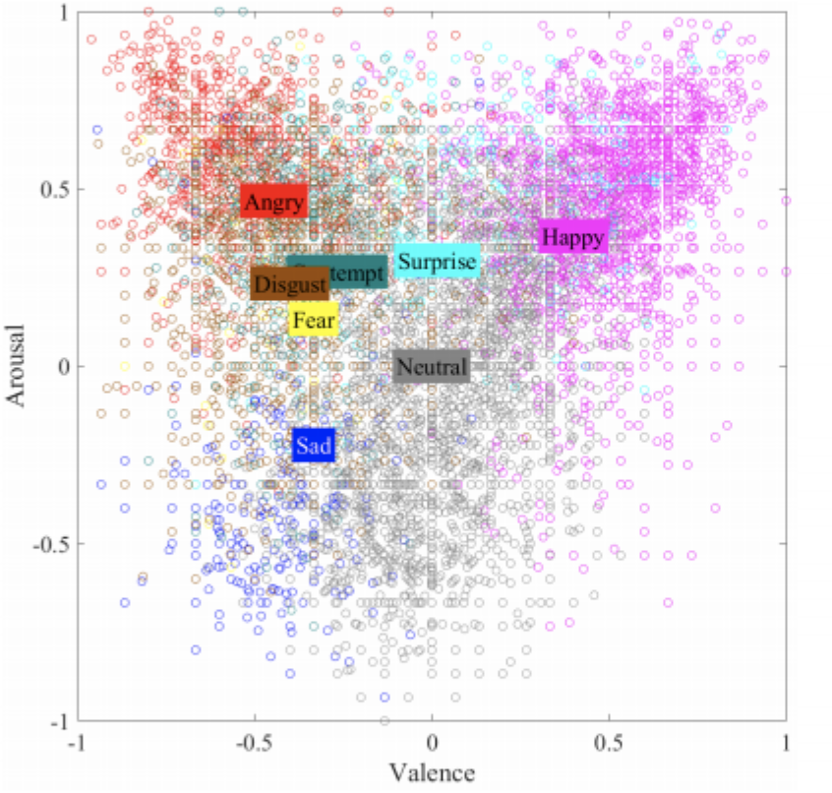
MSP-Podcast Corpus
Annotations
Dimensional: activation, valence, dominance
Categorical: anger, happiness, sadness, disgust, surprised, fear, contempt, neutral and other
Emotion distribution
in arousal/valence space
Rater disagreement per emotion category

Slide 24
Outline
Emotion in speech
Emotion theory
Emotional speech corpora
Features for emotional speech
Models for emotion recognition
Expressive synthetic speech
Sentiment and emotion in text

Slide 25
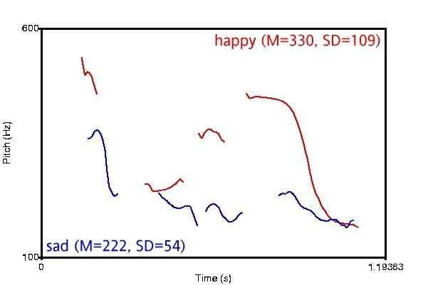
Features for Emotional Speech - Pitch
Different Valence / Different Arousal

Slide 26
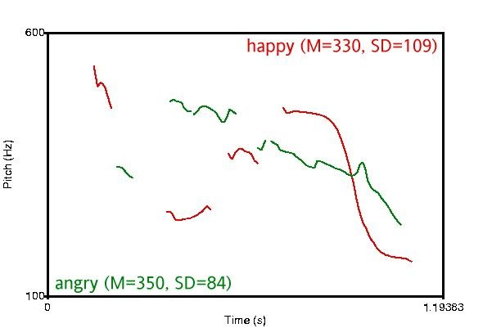
Features for Emotional Speech - Pitch
Different Valence / Same Arousal

Slide 27
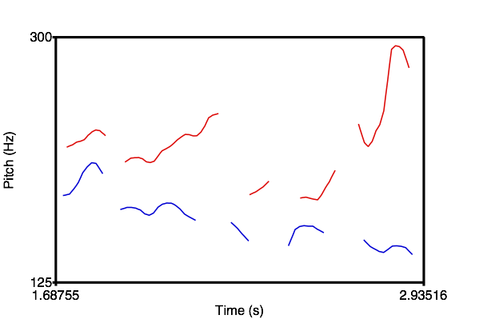
Pitch Contour Differences
Very Frustrated
Somewhat Frustrated

Slide 28
Features for Emotional Speech

Slide 29
Outline
Emotion in speech
Emotion theory
Emotional speech corpora
Features for emotional speech
Models for emotion recognition
Expressive synthetic speech
Sentiment and emotion in text

Slide 30
Emotion Recognition in Speech
Categorical Approach
Discrete ‘basic emotions’
Classification problem
Dimensional Approach
Continuous Arousal - Valence space
Regression problem

Slide 31
Emotion Recognition - Categorical
(Dellaert et al., 1996)
Emotions: happiness, sadness, anger, fear, normal
Data: 5 speakers * 5 emotions * 50 utterances = 1250
Human performance on 4-way classification: 82% (anger easiest, fear hardest)
Features: rhythm, smoothed pitch, individual voiced parts
Best model (KNN with majority voting of specialists): 79.5%

Slide 32
Emotion Recognition - Categorical
(Petrushin, 1999)
Dataset 1
Emotions: happiness, anger, sadness, fear, and normal
Data: (30+5) speakers * 5 emotions * 4 utterances = 700
Human performance: 63.5% (anger easiest, fear hardest)
Features: F0, energy, speaking rate, first three formants and their bandwidths
Best model: feature selection + ensembles of 15 neural networks
Normal: 60-75%, happiness: 60-70%, anger: 70-80%, sadness: 70-85%, fear: 35-55%
Average: ~70%
Notes:
5 people recorded again with different recording settings

Slide 33
Emotion Recognition - Categorical
(Petrushin, 1999)
Dataset 2 (call centers)
Distinguish between two states (arousal):
“Agitation”: anger, happiness and fear
“Calm”: normal state and sadness
Data: 56 telephone messages (15~90 seconds)
Automatically split into 1-3 second chunks
Model: feature selection + ensembles of neural networks
Average accuracy: 77%
Notes:
Spontaneous

Slide 34
Emotion Recognition - Categorical
(Liscombe et al., 2003)
10 emotions and neutral
‘Positive’ valence: confident, encouraging, friendly, happy, interested
‘Negative’ valence: angry, anxious, bored, frustrated, sad
Subset: 4 speakers * (10+1) emotions = 44
Human rating: Emotions in the same valence group are positively correlated; vise versa
Features: Pitch, energy, speaking rate; nuclear accent, pitch contour
Results:
Pitch, energy, and speaking rate are correlated with arousal
Spectral tilt and pitch contour are correlated with valence
Notes:
+ valence

Slide 35
Emotion Recognition - Categorical
(Liscombe et al., 2003)
Full dataset (EPSaT): 1760 utterances
Acoustic-prosodic features:
Pitch, energy, speaking rate; nuclear accent, pitch contour
Accuracy: ~75%
Feature selection:
Some single features performed as well or better than the entire feature set
Notes:
more data! Hundreds to thousands

Slide 36
Emotion Recognition - Categorical
(Jin et al., 2015)
Emotions: happy, angry, sad, and neutral
Data (USC-IEMOCAP): 5531 utterances
Features:
Acoustic: openSMILE (intensity, F0, jitter, shimmer and MFCCs)
Lexical: emotion vector (eVector), Bag-of-Words (BoW)
Best model: SVM, late fusion of acoustic and lexical features
Accuracy: 69.2%
Notes:
More data
add lexical, because the data is improvisation acting

Slide 37
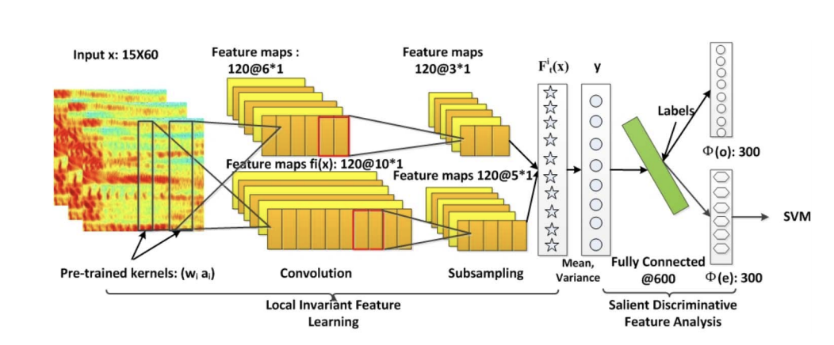
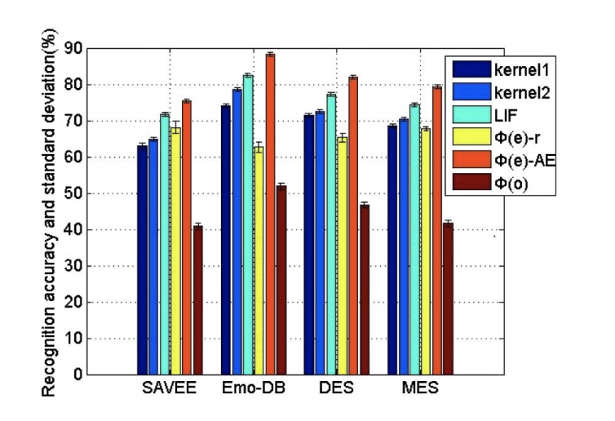
Emotion Recognition - Categorical
(Mao et al. 2014)
Using neural networks on spectrograms
Evaluation on 4 datasets:
anger, disgust, fear, happiness, sadness, surprise, and neutral
anger, disgust, fear, joy, sadness, boredom, and neutral
anger, joy, surprise, sadness, and neutral
anger, joy, surprise, sadness, and disgust

Slide 38
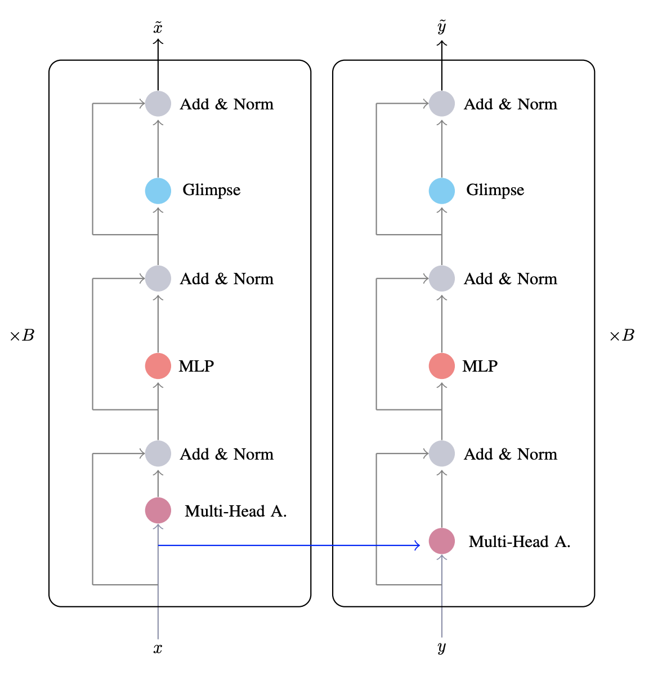
Emotion Recognition - Categorical
(Delbrouck et al. 2020)
Transformer-based multimodal joint-encoding
Dataset: CMU-MOSEI (Youtube video segments)
Modalities:
Linguistic: GloVe word vector
Acoustic: mel-spectrograms
Visual: a pre-trained CNN

Slide 39
Emotion Recognition in Speech
Categorical Approach
Discrete ‘basic emotions’
Classification problem
Dimensional Approach
Continuous Arousal - Valence space
Regression problem

Slide 40
Emotion Recognition - Dimensional
(Karadogan and Larsen, 2012)
Emotion: arousal, valence (discrete value 1~9 for each dimension)
Data: 59 short movie clips (5~25 seconds)
Features and models:
Acoustic: openSMILE, feature selection, support vector regression
Lexical: affective norms for English words (ANEW) for keywords with arousal & valence scores + latent semantics analysis (LSA) to generate emotion scores for other words
Results (mean absolute error): arousal: 1.28, valence: 1.40
Semantic features-> valence, acoustic features -> arousal

Slide 41
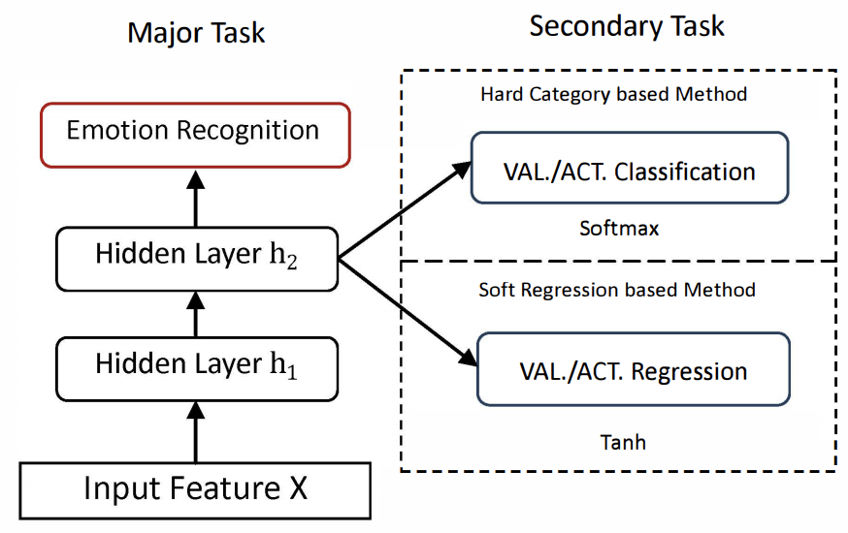
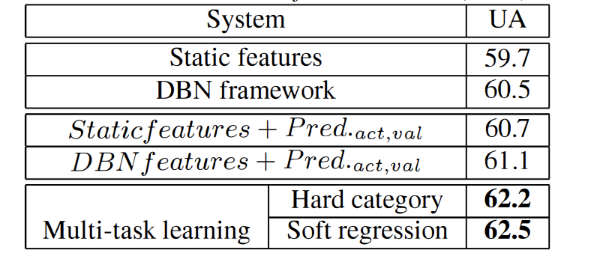
Emotion Recognition - Dimensional
(Xia and Liu, 2015)
Major task: angry, happy, sad, and neutral
Secondary task: valence, activation
Classification
map the continuous labels into low, medium, high
Regression
project the continuous labels into [-1,1] range
Data (USC-IEMOCAP): 5531 utterances
Features: openSMILE
Model: Deep Belief Network (DBN) + SVM

Slide 42
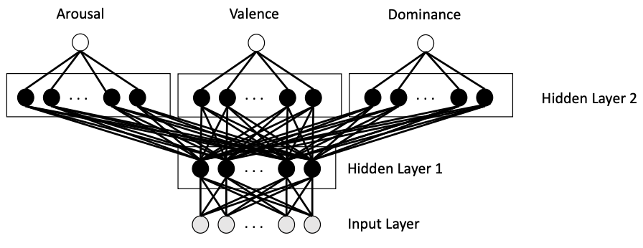
Emotion Recognition - Dimensional
(Parthasarathy and Busso, 2017)
Emotion: arousal, valence, dominance (discrete value 1~7 scaled to [-1,1])
Data (MSP-PODCAST): 12,621 speech segments (2~11 seconds)
Features: openSMILE
Best multi-task learning model: shared first layer, individual second layer
Results: A: 0.7635, V: 0.2894, D: 0.7130
Multi-task learning helps
Dominance > valence > arousal
Learn better representations

Slide 43
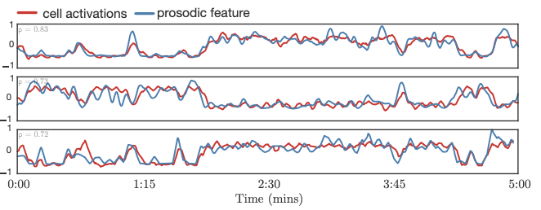
Emotion Recognition - Dimensional
(Trigeorgis et al., 2016)
Emotion: arousal, valence (continuous value [-1,1])
Data (RECOLA): 46 French conversations, 5 min each
Feature: raw waveforms
Model: convolutional recurrent neural networks
Results (Concordance correlation coefficient): arousal: 0.686, valence: 0.261
Some cells learn acoustic features automatically
Range of RMS energy (ρ = 0.81)
Loudness (ρ = 0.73)
Mean of fundamental frequency (ρ = 0.72)

Slide 44
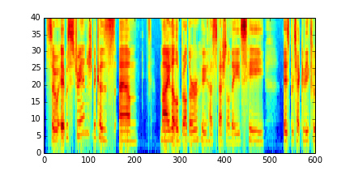
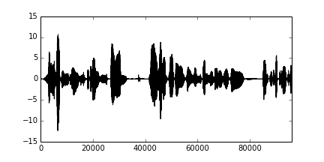
Emotion Recognition - Dimensional
Spectrogram
Waveform
Do spectrograms and waveforms contain complementary information for emotion recognition in speech?

Slide 45
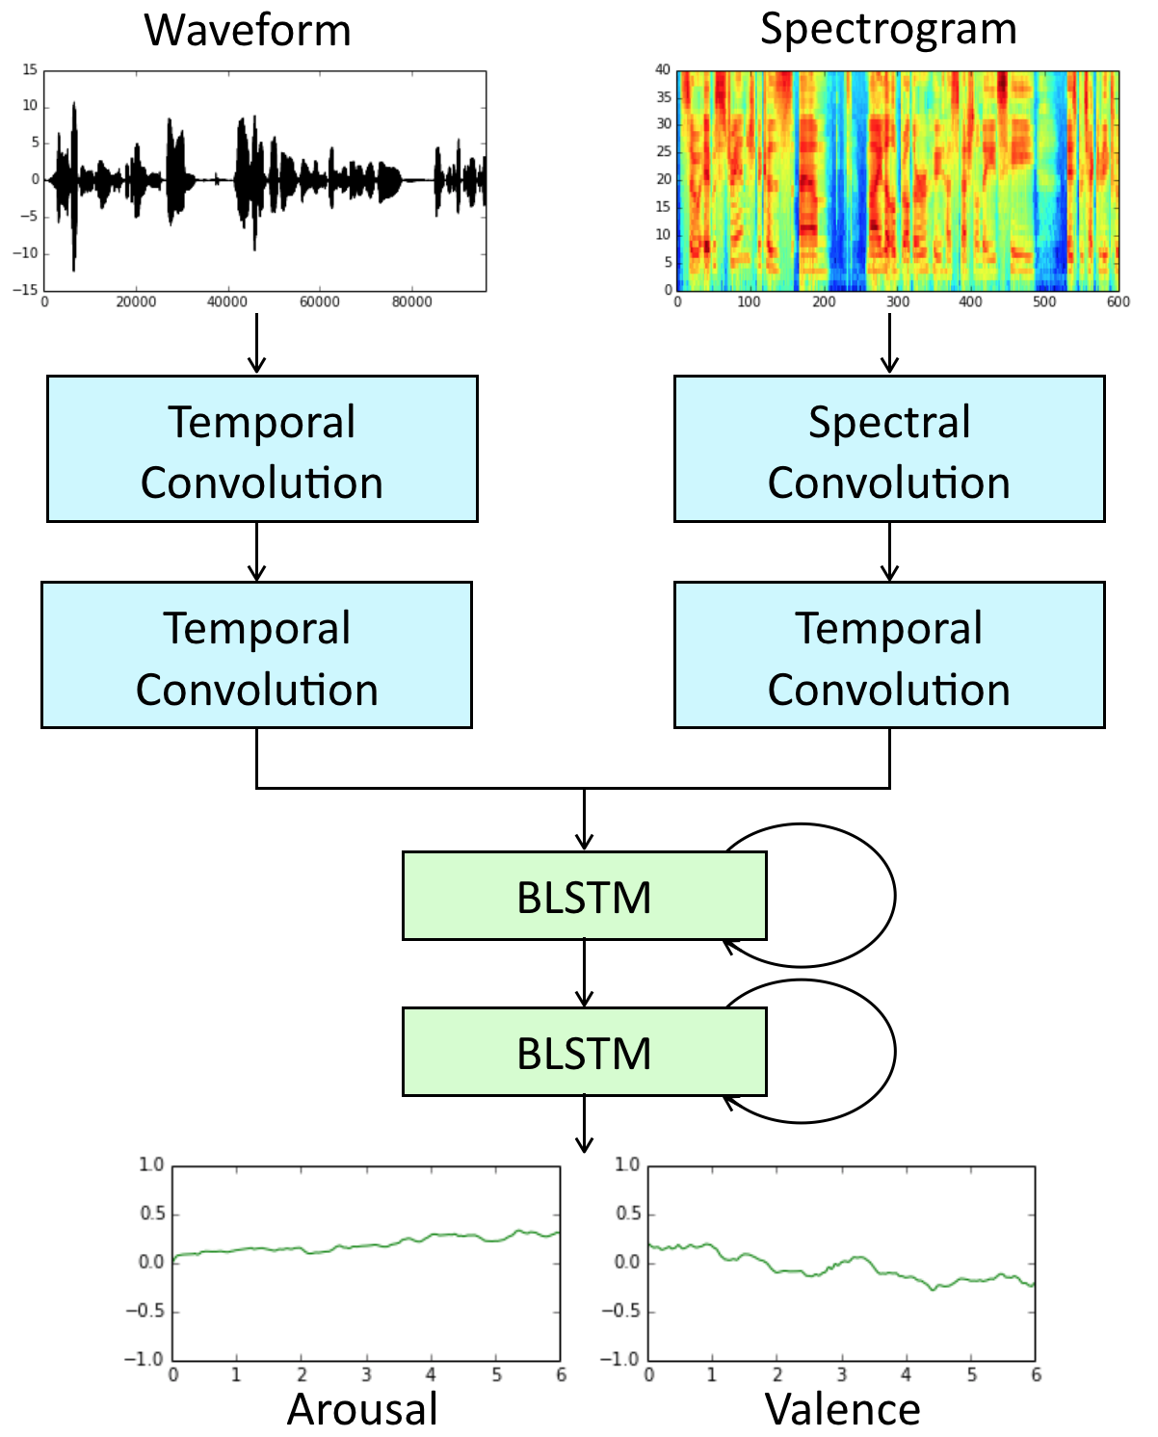
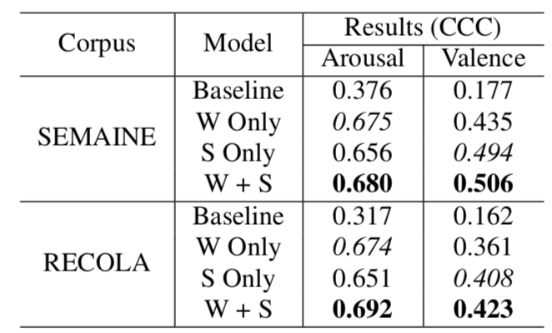
Emotion Recognition - Dimensional
(Yang and Hirschberg, 2018)
Input: raw waveform and spectrogram
Model: convolutional recurrent neural networks
Task: Predict arousal and valence
Continuous in both time and value
Results:

Slide 46
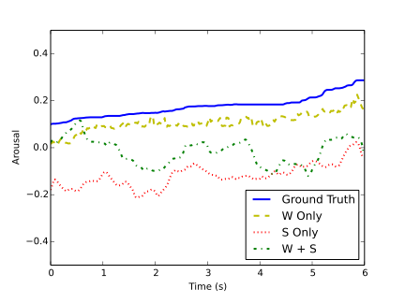
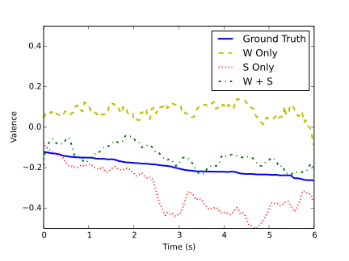
Example Analysis - Dimensional
Arousal
Valence
Local
Interpretable
Modelagnostic
Explanations
(LIME)
“…cos she’s so frigging superior"

Slide 47
Outline
Emotion in speech
Emotion theory
Emotional speech corpora
Features for emotional speech
Models for emotion recognition
Expressive synthetic speech
Sentiment and emotion in text

Slide 48
Expressive Synthetic Speech
http://emosamples.syntheticspeech.de/
Murtaza Bulut (2005): neutral anger
Greg Beller (2005): neutral sad
Acapela (2013): neutral happy sad
bad guy from afar
Laughters: Greg Beller(2009)
Shiva Sundaram(2007)

Slide 49
Expressive Synthetic Speech
Tacotron (/täkōˌträn/): An end-to-end speech synthesis system by Google
Tacotron + Style Tokens (Wang et al. 2018)
“United Airlines five six three from Los Angeles to New Orleans has Landed.”
5 different “styles”:

Slide 50
Expressive Synthetic Speech
Tacotron (/täkōˌträn/): An end-to-end speech synthesis system by Google
Tacotron + Style Tokens (Wang et al. 2018)
“Here you go, a link for Biondo Racing Products and other related pages.”
Style token A (-0.3/0.1/0.3/0.5):

Slide 51
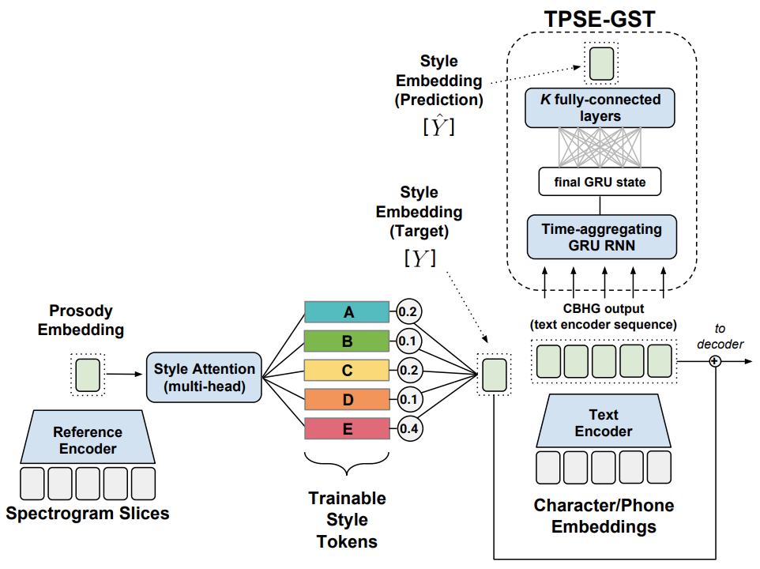
Expressive Synthetic Speech
Tacotron (/täkōˌträn/): An end-to-end speech synthesis system by Google
Tacotron + predicting Style Tokens from text (Stanton et al. 2018)
"Thirty-six," he said, looking up at his mother and father. "That's two less than last year." "Darling, you haven't counted Auntie Marge's present, see, it's here under this big one from Mommy and Daddy.”
Tacotron
Tacotron + predicted style token

Slide 52
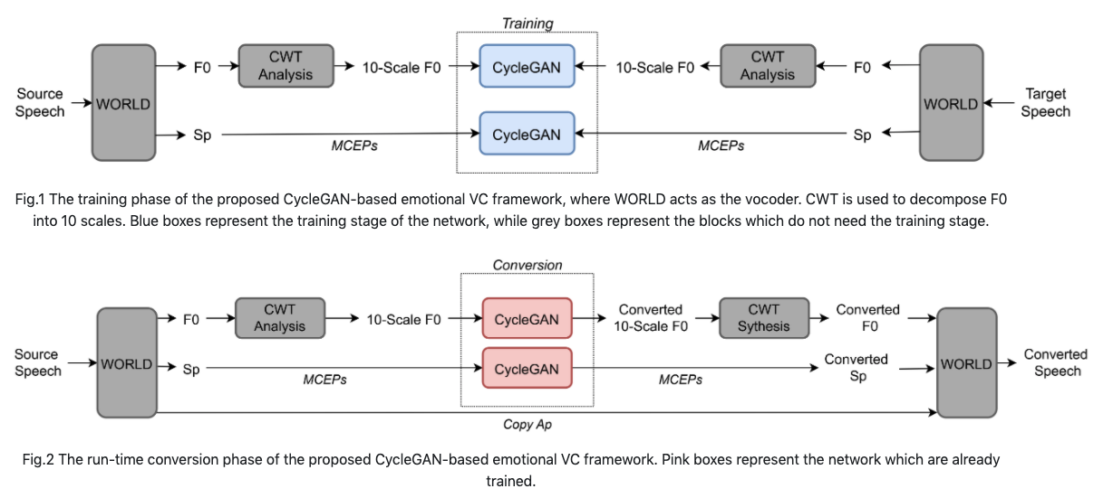
Emotional Voice Conversion
(Zhou et al., 2020)
Neutral
Anger
Converted
Neutral
Sad
Converted

Slide 53
Sentiment and Emotion in Text

Slide 54
English Sentiment Lexicon
The General Inquirer (Stone et al. 1966)
Positive (1915), Negative (2291), Strong vs Weak, Pleasure, Pain, etc.
LIWC (Linguistic Inquiry and Word Count)
Negative emotion (anxiety, anger, sadness); Positive emotion
MPQA Subjectivity Cues Lexicon
2718 positive, 4912 negative
Bing Liu Opinion Lexicon
2006 positive, 4783 negative
SentiWordNet
WordNet synsets automatically labeled with positivity, negativity, and objectiveness
Notes:
Limited size, limited language supported

Slide 55
Polyglot (Multilingual text processing toolkit )
Sentiment polarity lexicons for 136 languages
7,741,544 high-frequency words from 136 languages in Wikipedia
Use Bing Liu Opinion Lexicon (English) as seed
Wiktionary + Google Translation + Transliteration + WordNet to generate edges between words
Propagate sentiment labels through the edges
Notes:
Expand lexicon with cross-lingual transfer

Slide 56
Emotion Theory:
Plutchik’s wheel of emotion
8 basic emotions in four opposing pairs
joy–sadness
anger–fear
trust–disgust
anticipation–surprise

Slide 57
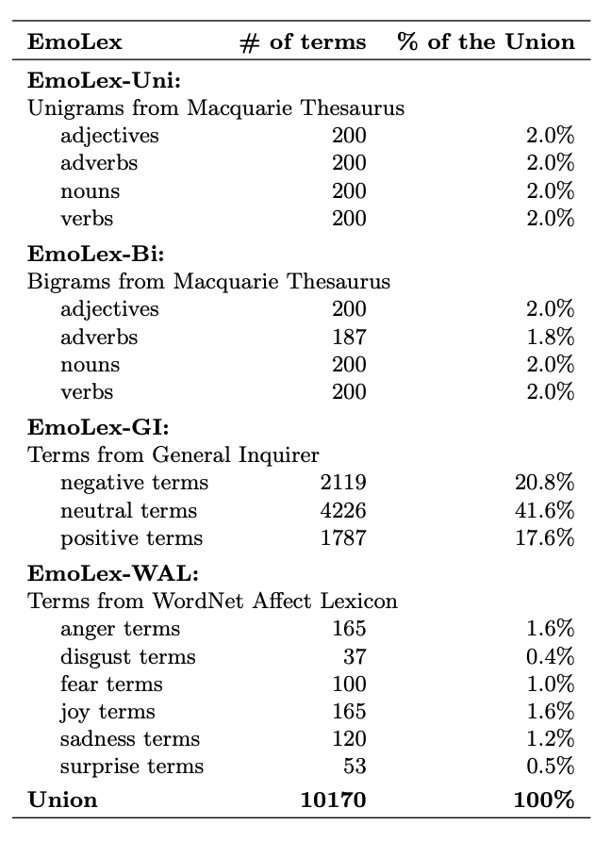
NRC Word-Emotion Association Lexicon
(Mohammad and Turney 2011)
Categorical approach of emotion
10k words chosen mainly from earlier lexicons
Labeled by Amazon Mechanical Turk
Joy, sadness, anger, fear, trust, disgust, anticipation, surprise; positive, negative
Notes:
Expand lexicon by crowd-sourcing annotations

Slide 58
Lexicon of Valence, Arousal, and Dominance
(Warriner at al. 2013)
Dimensional approach of emotion
AMT Ratings for 14,000 words for emotional dimensions
Valence (the pleasantness of the stimulus)
Arousal (the intensity of emotion provoked by the stimulus)
Dominance (the degree of control exerted by the stimulus)
Examples: (range 1-9)
Notes:
Expand lexicon by crowd-sourcing annotations

Slide 59
Detecting Sentiment/Emotion in Text
Simplest unsupervised method
Sum the weights of each positive word in the document
Sum the weights of each negative word in the document
Choose whichever value (positive or negative) has higher sum
Simplest supervised method
Use “counts of lexicon categories” as features (e.g. LIWC)
Baseline: use all unigram/bigram counts + POS tags
Hard to beat, but only works if the training and test sets are very similar

Slide 60
Sentiment in Twitter :) (Go et al. 2009)
Use emoticons to find tweets with sentiment
Training set:
800k tweets with positive emoticons, and 800k tweets with negative emoticons
Seed emoticons are stripped off before training
Test set: 359 tweets manually annotated
Accuracy: ~80%

Slide 61
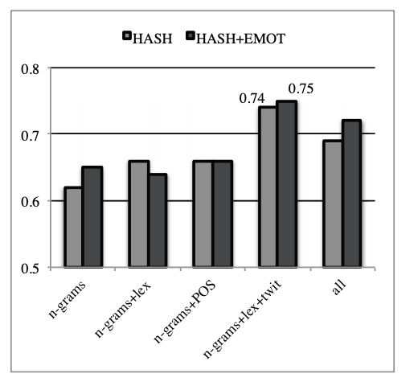
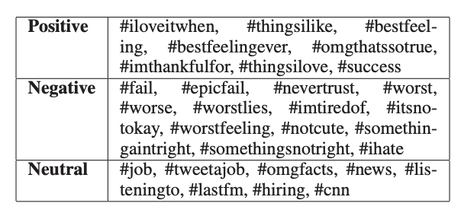
Sentiment in Twitter #thingsilike (Kouloumpis et al. 2011)

Slide 62
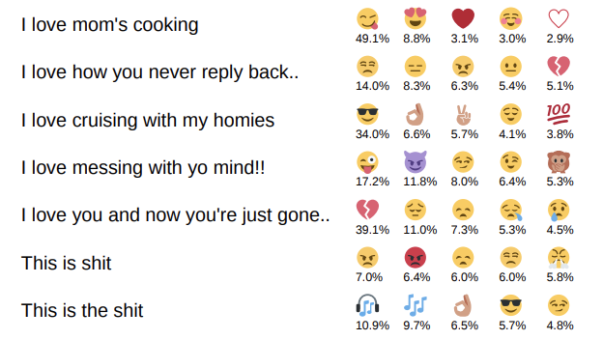
Emoji in Twitter (Felbo et al. 2017)
Number of training data (in millions)
Output: probability of emoji labels

Slide 63
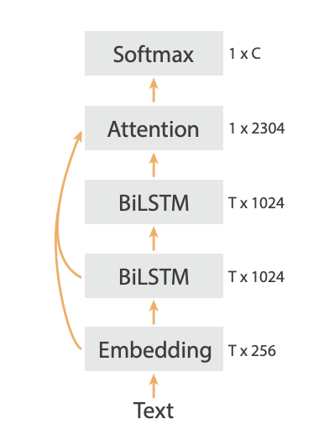
Emoji in Twitter (Felbo et al. 2017)
DeepMoji model architecture

Slide 64
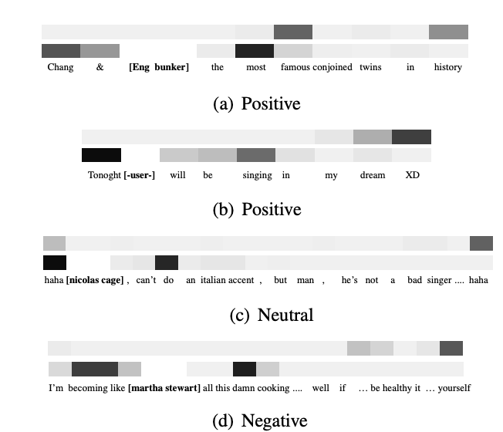
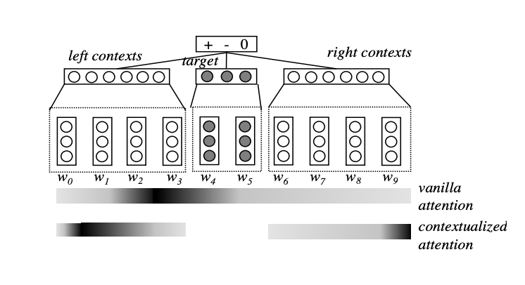
Attention Modeling for Targeted Sentiment
(Liu and Zhang 2017)
Targeted Sentiment
“She began to love miley ray cyrus since 2013 :)”
“#nowplaying lady gaga - let love down”

Slide 65
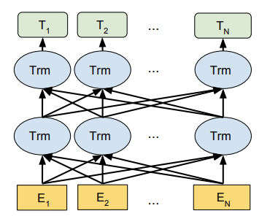
BERT in Sentiment Analysis (Google AI Language)
BERT: Bidirectional Encoder Representations from Transformers
Transformer: stacked self-attention blocks
Training: mask part of the input tokens at random, then predict those masked tokens

Slide 66
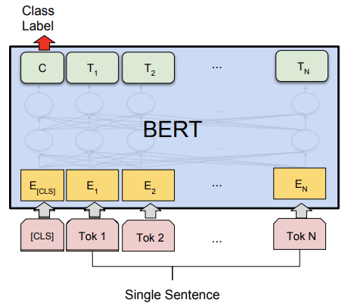
BERT in Sentiment Analysis (Google AI Language)
Fine-tuning for single sentence classification task
Add a classification layer on the output of [CLS] token
Accuracy on the Stanford Sentiment Treebank dataset: 94.9%

Slide 67
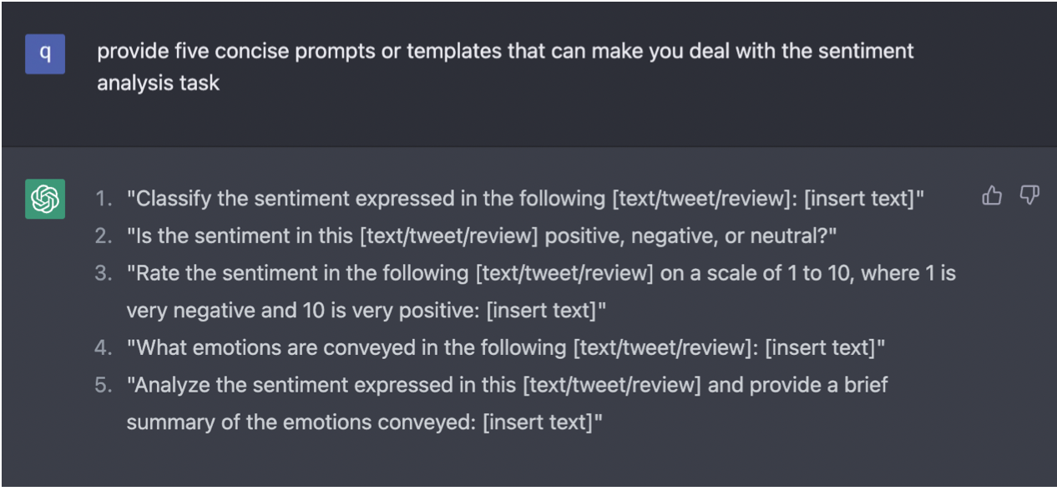
GPT for Sentiment Analysis
Few-shot / zero-shot sentiment prediction
Low-cost data annotation

Slide 68
Text Sentiment Analysis Dataset
Product reviews on Amazon
Multidomain sentiment analysis dataset
Amazon product data, 143 million reviews
Movie reviews on IMDB
Cornell movie review data, labeled with sentiment polarity, scale, and subjectivity
Large Movie Review Dataset v1.0, 25k movie reviews
IMDB Movie Reviews Dataset, 50k movie reviews
Bag of Words Meets Bags of Popcorn, 50k movie reviews
Reviews from Rotten Tomatoes
Stanford Sentiment Treebank, 11k reviews

Slide 69
Text Sentiment Analysis Dataset
Tweets with emoticon
Sentiment140, 160k tweets
Twitter data on US airlines
Twitter US Airline Sentiment, with negative reasons (e.g. “rude service”)
Paper reviews
Paper Reviews

Slide 70
Thank you!
Questions?
brenda@cs.columbia.edu

