Slide 1
Vocal Attractiveness
Charisma, Likability and Style
Andrew Rosenberg
Columbia University
COMS 6998
Advanced Topics in Spoken Language Processing
October 25, 2022

Slide 2


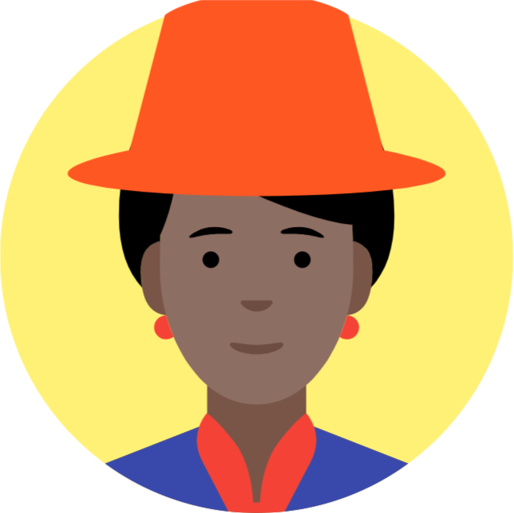



Attractiveness
Notes:
What makes people attractive to each other.
Specific qualities of the perceived
Context
Message
Specific qualities of the perceiver
Made with https://avatar-creator.googleplex.com/

Slide 3

Vocal Attractiveness
speech by Evgeny Filatov from the Noun Project
Notes:
In this talk we’re only discussing vocal attractiveness.
What makes a voice attractive.
Even more, we’re only going to be talking about prosody -- so what is said rather than how it is said.
Made with https://avatar-creator.googleplex.com/
Microphone icon from here: https://drive.google.com/corp/drive/folders/0B5BGWoMfa49QfnRTdEdnN0FwWVJocjNlUjVXbTY4Q2JVM2tibTdlYnZzNnBHLWc1d1o0MjQ

Slide 4
Types of Attractiveness
Political Attractiveness (Charisma)
Business Attractiveness (Charisma)
Trust
Likeability (friendship)
Romantic Attraction

Slide 5
Challenges to Research
Influence of Context and Message
Dependent Variables from both Speaker and Listener
Subjectivity in Listeners
Performance vs. Inherent Qualities
Dynamic Influence of Conversational Partners

Slide 6
Why Study Charismatic Speech?
Speech that leads listeners to perceive the speaker as charismatic can be useful for
  Creating more effective text-to-speech synthesis (ads, games)
  Understanding election results, radicalization efforts on social media
  Helping speakers to improve their own speech production by sounding more charismatic
  …
Notes:
using characteristics of charismatic speech in text- to-speech synthesis can make a computer-generated voice more trustworthy
practicing with acoustic feedback can make humans speak more charismatically

Slide 7
Political Attractiveness
Charisma: The ability to persuade and command authority by virtue of
personal qualities rather than formal institutional structures (Weber, 1947)
Even individuals who rise to power through formal structures (like elections) are generally understood to display charismatic behavior.
Julia just summarized significant results on vocal correlates of
Political Attractiveness (Charisma)

Slide 8
Defining Charisma
Rosenberg and Hirschberg (2005, 2008) asked participants for each stimuli: The speaker is {charismatic, angry, spontaneous, passionate, desperate, confident, accusatory, boring, threatening, informative, intense, enthusiastic, persuasive,charming, powerful, ordinary, tough, friendly, knowledgeable,trustworthy, intelligent, believable, convincing, reasonable} and “the speaker’s message is clear” and “ I agree with the speaker”.
Measure correlations with “the speaker is charismatic”
Statement | Kappa
enthusiastic | 0.606
charming | 0.602
persuasive | 0.561
boring | -0.513
passionate | 0.512
convincing | 0.503

Slide 9
Defining Charisma
Signorello et al. (2012) asked 58 French participants to provide adjectives that are consistent or inconsistent with charisma. Constructed broad categories.
Pathos | passionate, empathetic, enthusiastic, reassuring | cold, indifferent
Ethos Benevolence | extroverted, positive, spontaneous, trustworthy, honest, fair, friendly, easygoing, makes the others feel important | untrustworthy, dishonest, egocentric, individualistic, introverted
Ethos Competence | visionary, organized, smart, sagacious, creative, competent, wise, enterprising, determined, resolute, who propose, seductive, exuberant, sincere, clear, communicative | Inefficient, inadequate, uncertain, faithless, unclear, menacing
Ethos Dominance | dynamic, calm, active, courageous, confident, vigorous, strong, leader, authoritarian, captivating, who persuade, who convince | apathetic, timorous, weak, conformist, unimportant, who scare
Emotional Induction Effects | charming, attractive, pleasant, sexy, bewitching, eloquent, influential | boring

Slide 10
Defining Charisma
Charming, persuasive, enthusiastic and not boring are found by both Rosenberg and Hirschberg (2005) and Signorello et al. (2012) despite using US and French subjects.
US: no relationship with threatening and anger.
French: positive correlation with Authoritarian-Threatening factor
Cullen and Harte (2018) developed Overall Speaker Appeal (OSA) as an average rating of charisma, not boring, enthusiastic, inspiring, likeable.

Slide 11
What Makes an Individual Charismatic?
Message?
Personality?
Speaking style?
What aspects of speech might contribute to the perception of a speaker as charismatic?
  Content of message?
  Lexico-syntactic features?
  Acoustic-prosodic features?
  What you say or how you say it?

Slide 12

American English Experiments
Data: 45 2-30s speech segments, 5 each from 9 candidates for Democratic nomination for U.S. president in 2004
  Speakers: Liberman, Kucinich, Clark, Gephardt, Dean, Moseley Braun, Sharpton, Kerry, Edwards
  Topics: neutral greeting, reasons for running, tax cuts, postwar Iraq, healthcare
  4 genres: stump speeches, debates, interviews, ads
SAE raters for each segment on a Likert scale (1-5) 26 questions (randomized and including “do you agree with the speaker?”)
  8 subjects for Study 1 (2004) and 12 for Study 2 (2006)
Notes:
2 ‘top charismatic’, 2 ‘bottom least charismatic’
Time for first study: avg. 1.5 hrs, min 45m, max ~3hrs

Slide 13
Cross-cultural Perception of Charisma (A Cross-Cultural Comparison of American, Palestinian, and Swedish Perception of Charismatic Speech (Biadsy et al., 2008)
Cross-language ratings
  12 SAE (non-Arabic, non-Swedish speaking) raters rate Palestinian Arabic and Swedish data
  12 Palestinian (English-literate, non-Swedish speaking) raters rate SAE and Swedish data
  9 (English-speaking speaking) Swedish raters rate SAE
Comparison with previous ratings when raters rate their own language speakers

Slide 14
Inter-rater Agreement
American rater agreement was higher when rating Arabic than English
Arabic rater agreement was higher when rating Arabic than English
Speaker affects subject judgments across studies
Topic affects subject judgments:
  Americans rating SAE
  Palestinians rating Arabic
  Palestinians rating English
  Swedish rating English
  Not for raters who do not speak the language

Slide 15
Acoustic/Prosodic Analysis
Correlation with rated charisma in all 5 studies:
  Positive
    Mean pitch
    Mean and stdev intensity
    Token duration
    Pitch range
  Negative
    Disfluency
Rating SAE
  All groups – min f0
  Swedish – max & stdev intensity
  SAE & Swedish – speaking rate
Rating Arabic
  Palestinian – min f0, speaking rate
  All groups – stdev f0, max & stdev intensity

Slide 16
Lexical Features
Rating SAE
  American and Swedish – third person plural pronouns
  All groups – First person plural pronouns, third person singular pronouns, repeated words
Rating Arabic
  Both groups (SAE, Palestinian) – third person plural pronouns, nouns
  Why did SAE raters who did not speak Arabic agree?
    Perhaps these features were correlated with acoustic-prosodic features?
Notes:
`

Slide 17
Charisma Perception across Cultures
SAE vs. Palestinian ratings of SAE tokens
  Mean ratings are not different across groups
  Charisma ratings are positively correlated
Swedish vs. Palestinian ratings of SAE tokens
  Mean ratings are not different across groups
  Charisma ratings are positively correlated
Swedish vs. SAE ratings of SAE tokens
  Mean ratings are different across groups (SAE higher)
  Charisma ratings are positively correlated
Palestinian vs. SAE ratings of Arabic tokens
  Mean ratings are different across groups (Palestinian higher)
  Charisma ratings are positively correlated
Notes:
Mean ratings of charisma may be significantly lower for non-native speakers but still positively correlated

Slide 18
Differences Across Cultures
Rating Arabic
  Greater charisma perception by SAE group correlated with faster speaking rate, smaller stdev speaking rate, greater mean & stdev intensity
  Greater charisma perception by Palestinian group correlated with lower pitch peaks, high stdev f0
Rating SAE
  Greater charisma perception by Swedish group correlated with more compressed pitch range, greater min f0, lower stdev f0

Slide 19
Summary
Some cues are cross-cultural, some are language-specific
Cross-cultural charisma judgments are more conservative but
Native and non-native judgments of a given target language are correlated
    Even when the raters do not speak the target language

Slide 20
Charisma in an Irish Politician
Cullen and Harte (2018) collected 945 utterances from a single speaker of 7 years (2007-2012) as Irish Political Speech Database
Includes a variety of genres including talk shows and parliamentary addresses
Associated with polling data and subject ratings of charisma.
Result: suprasegmental qualities (based on pitch, intensity and duration) show greater correlation with charisma than spectral qualities.

Slide 21
Predicting Winners from Charisma
(Analysis of Speech Transcripts to Predict Winners of U.S. Presidential and Vice Presidential Debates, (Kaplan & Rosenberg, 2012))
  Corpus of political speech
  Determine lexical and acoustic correlates of political success
  Characterize similarities and differences between parties
25 debates spanning 9 election cycles (1976-80)
  Each between one Republican and one Democrat
  Democrats won 68%; Republicans 32%
Binary labels based on post-debate polling
Goal: predict the winner

Slide 22
Features Examined
Total # words
Word usage (stemmed):
  Indicators of friendliness and formality: personal pronouns, # questions asked, pleasantries, contractions, numbers, refs to opponent, refs to both running mates
  Words affiliated with common political topics: god, health, religion, tax, war and synonyms using WordNet
Affective content: Dictionary of Affect in Language
Named entities: using Stanford tagger, # and rate of usage
TF-IDF values for top 10K words for each debater
Turn length: absolute and mean # syls, words, sentences in each turn
Complexity: Flesch-Kincaid grade level readability formula
Notes:
TF-IDF: term frequency (in document X) vs. inverse document frequency (over many other documents)
Analysis using Weka’s SVM (SMO)
Relative value of each speaker using Weka’s chi squared feature analysis

Slide 23
Classification
Train on all preceding debates to predict winner of current year
  Debate-level: which party won using data from both speakers
  Speaker-level: which speaker won, including features only for each speaker w/out ref to opponent

Slide 24

Predicting Poll Results is Tough
Test on 2008; train on all previous years
  Baseline: by debate calculated from most common result /total # debates
  By-debate: use data for both speakers
  By-debater: use data for each speaker in turn
  Unsplit: one data-point per debate
  Split: one data-point every 20 speaker turns
  Accuracy, baseline, p-value above baseline
Notes:
baselines used for by-debate classification are calculated from the most common result (a Democrat win) divided by the total number of data points. (25 debates)
Predicted Accuracy (baseline for debate: democrats win/# datapoints; for debater: 50/50) and significance (p value: calculated by a binomial significance test was above chance for debates but not debaters)
Not so great but small data and interesting study

Slide 25
Feature Analysis
First person plural possessives (“our”) used by Democrats
  Negatively correlates with Democratic wins
Grade level readability of Democrats
  Lower complexity in Democratic wins
Second person singular object pronouns (“you”) used by Republicans
  Negatively correlates with Republican wins altho correlates with individualism
  Important political topics
  “atomic”, “unilateral”, “soviets”
  Politically active words important
  “achieve”, “disagreements,” “advocate”, “achieve”
Notes:
When candidates sound too “typical” they are less successful

Slide 26
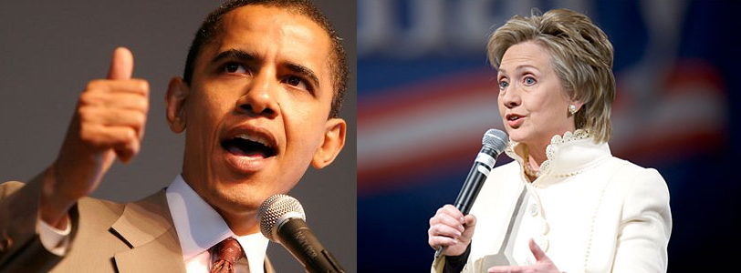
More Recent Debates (Erica Cooper)
Can we predict the Winners?
or
the Losers?

Slide 27
Similar Goals and Research Questions
Investigate emotion and charisma in political discourse
  Collect a corpus of political speech: debates
  Predicting who won each debate from Gallup polls after
  Compare both political parties: Democrats and Republicans
  Determine lexical and acoustic correlates of political success: correlate with subsequent polls
  Characterize similarities and differences between Democrats and Republicans

Slide 28
Corpus Collection
Democratic primaries from 2008:
  Joe Biden, Hillary Clinton, Chris Dodd, John Edwards, Mike Gravel, Dennis Kucinich, Barak Obama, Bill Richardson
  New Hampshire MSNBC Debate, September 26, 2007
Fall 2011 Republican primaries:
  Michelle Bachmann, Herman Cain, Newt Gingrich, Jon Huntsman, Gary Johnson, Ran Paul, Rick Perry, Mitt Romney, Rick Santorum
  Fox News / Google Debate, September 22, 2011
Interviews for all candidates
Notes:
Different primaries since incumbent for the party or not

Slide 29
Gallup Poll Results
Democrats | Poll Results | Republicans | Poll Results
Clinton | 47% | Romney | 20%
Obama | 26% | Cain | 18%
Edwards | 11% | Perry | 15%
Richardson | 4% | Paul | 8%
Biden | 2% | Gingrich | 7%
Dodd | 1% | Bachmann | 5%
Kucinich | 1% | Santorum | 3%
Gravel | 0.5% | Huntsman | 2%
 |  | Johnson | 0%

Slide 30
Features
Lexical For debate speech only
  Word Count
  Laughter, applause, and interruptions
  Number of speaker turns
  Average number of words per turn
  Syllables per word
  Disfluencies per word
  Linguistic Inquiry and Word Count (LIWC) features
Acoustic
  Debates and Interviews: mean, min, max, and standard deviation of f0
  Difference for these values between debates and interviews

Slide 31
Results: Correlates with Post-Debate Poll Standing
Features | Democracts | Republicans
Word Count Laughs Applause Turns Interruptions Avg Words Per Turn Avg Syllables Per Word Disfluencies Per Word Mean-f0 Difference Min-f0 Difference | 0.804 0.084 0.194 0.846 0.052 0.199 0.015 -0.805 0.059 0.002 | 0.582 0.780 0.350 0.381 0.247 0.406 -0.768 -0.130 0.479 0.105

Slide 32
LIWC Positive Correlates for Democrats
Feature | Examples | Correlates
Insight | Think, know consider | 0.74
Inclusive | And, with, include | 0.680
Cognitive | Cause, know, ought | 0.679
Words per sentence |  | 0.661
Common verbs | Walk, went, see | 0.657
Positive emotion | Love, nice, sweet | 0.632
Pronouns | I, them, itself | 0.626
Nonfluencies | Er, hmm, umm | 0.611
Notes:
Correlates here are higher values – when 2 variables (e.g. democrats and “Insight” words move in the same direction, increase or decrease

Slide 33
LIWC Features:
Negative Correlates for Democrats
Features | Examples | Correlation
Articles | A, an, the | -0.684
All Punctuation |  | -0.653
Periods | . | -0.639
Dashes | - | -0.595
Numerals | 12, 38, 156 | -0.581
Questions marks | ? | -0.578
Ingestion | Dish, eat, pizza-0.575 | -0.575
Money | Audit, cash, owe | -0.548
2nd Person Pronouns | You, your | -0.506

Slide 34
LIWC Features:
Positive and Negative Correlates for Republicans
Features | Examples | Correlation
Leisure | Cook, chat, movie | 0.869
Past tense | Went, ran, had | 0.732
“Other” punctuation | !”:%$ | 0.665
Dictionary words |  | 0.541
Personal pronouns | I, them, her | 0.525
6+ letters | Abandon, abrupt, absolute | -0.741
Home | Apartment, kitchen, family | -0.513

Slide 35
General Party Differences
Democrat audiences laughed more
Republican audience applauded more
Democrats got interrupted more
Republicans had more words per turn
Both had about the same number of syllables per word
Democrats' debate speech was more different from their interviews, but Republicans responded slightly more positively to these differences than Democrats did

Slide 36
Conclusions (recommendations?)
Democrats: Talk more, use fewer disfluencies, and use more Insight words
Republicans: Make the audience laugh, use Leisure-related words, and avoid longer words

Slide 37
More to Do in Politics
Investigate additional acoustic features
(intensity, speaking rate, voice quality)
Higher level prosodic features
(intonational contours, phrasing)
More complicated / interesting lexical features
  Cross-cultural similarities and differences
  Entrainment
Connection to broader context. E.g. “soviets” doesn’t carry much political currency in 2022.

Slide 38
Business Attractiveness
Business Attractiveness is valuable internally and externally.
Internally: Management and Leadership
Externally: Investor, Partner, Client, Provider Relationships
Vocal communication here can be similar to political attractiveness. It is typically unidirectional, but can take place in many venues (product launches, presentations, investor calls, interviews). Inspiration and trust are important facets.

Slide 39
Contrastive Analysis of Jobs and Zuckerberg
Niebuhr et al. (2016)
Contrast styles of Steve Jobs and Mark Zuckerberg as exemplars of charismatic and non-charismatic founder CEOs.
Both speak quickly, but Zuckerberg is even faster, leading to more phonetic reduction.
Jobs has a more varied pitch reset across phrases and greater strength of pitch excursions.
Upshot: fast, dynamic speech that is clearly pronounced is charismatic in a business context.

Slide 40
Charisma in start-up entrepreneurs
“A decisive part of their strategy and daily work is to persuade others”
(Niebuhr et al. 2017)
45 participants gave the same elevator pitch. 15 received no feedback, 15 received visual feedback, and 15 received acoustic feedback based on Steve Jobs as an exemplar.
Speakers receiving acoustic feedback were rated as 41% more charismatic after training. No feedback speakers were 24% more charismatic. Speakers who were given visual feedback were 12% more charismatic.

Slide 41
Impact of Gender on perceptions of Charisma
There is a significant gender imbalance in the numbers of political and business leaders in the US and worldwide. Unfortunately, this is followed by gender imbalance in studies of vocal attractiveness
Novák-Tót et al (2017) compared Oprah Winfrey, Ginni Rometty (IBM) and Steve Jobs.
They found that female speech that is judged to be as charismatic as male speech demonstrates more and stronger acoustic cues to charisma.
A possible explanation is that female business leaders are overcoming gender bias in leadership assessments.

Slide 42
Relationship between Trust and Attraction
This is not always an obvious relationship.
Romantically attractive strangers are rated as more trustworthy.
(Wilson and Eckel 2006)
Averaged faces are more trustworthy than attractive faces (Sofer et al 2015)
Attractive men are more trustworthy (by women). Attractive women are less trustworthy (by men) (McGloin and Denes 2018)
Trust expressed via investment and voting grants business and political leaders tangible commercial and political power.

Slide 43
Vocal Correlates of Trust
Levitan et al. (2018) had a two-person deception game where one participant would try to successfully deceive their conversational partner about their resume.
Trust was measured by whether the interviewer believed that the interviewee was telling the truth (regardless of whether they were.)
Both men and women were trusted more when they spoke faster. Male speakers were trusted less by speaking high in their pitch range.
Male interviewers mistrusted speech with high mean pitch and maximum intensity and trusted fast speech.
While female interviewers mistrusted speech with high jitter and shimmer (voice quality measures).

Slide 44
Likeability
“This voice is pleasant” vs. “I like this person”
Weiss and Burkhardt (2012) positive factors of likeability include minimal disfluencies and no discernible accent**.
Negative factors include high pitch, lower articulation rate and lower pronunciation precision.
The presence of negative factors can lead a voice to be unlikeable, while both likeable and unlikeable voices demonstrate positive factors.
**The role of accent and social assessment is much more complicated than this, and too complicated to survey here.

Slide 45
“Would You Buy a Car From Me?” – On the Likability of Telephone Voices
Felix Burkhardt, Björn Schuller, Benjamin Weiss, Felix Weniger

Slide 46
Problem
Speech based classification: “attempts to categorize people based solely on on their voice and way of speaking. The categories may be relatively invariant like age, gender or dialect, or time changing like emotional state.”

Slide 47
Database
Agender database
  940 speakers of mixed and age and gender
  Recorded over telephone (landlines and cell phones)
  Drawbacks:
    Signal less clear (limited bandwidth)
    Short responses
    Not great for likability ratings
  However, more real-world like
    “e.g. if a call center agent would like to test the likability of his/her own voice.”

Slide 48
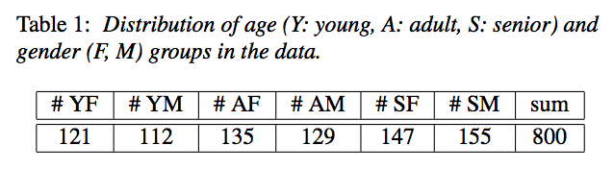
Data Selection
All German speakers in Germany, no balance of dialects
One sentence for each speaker, commands
Longest sentence spoken by speaker
  “mach weiter mit der Liste” (continue with the list)
  “ich hätte gerne die Vermittlung bitte” (I’d like an operator please)

Slide 49
Judging Likability
32 participants
  15 female, 17 male; aged 2—42
Participants rated half of the 800 utterances
Therefore, each utterance from the database rated 16 times
Told to rate likability; ignore quality of recording and lexical content
7 point scale
No significant effect of participants’ age or gender on ratings

Slide 50
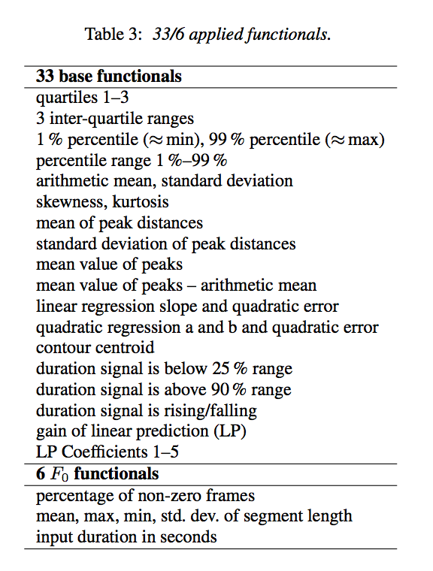
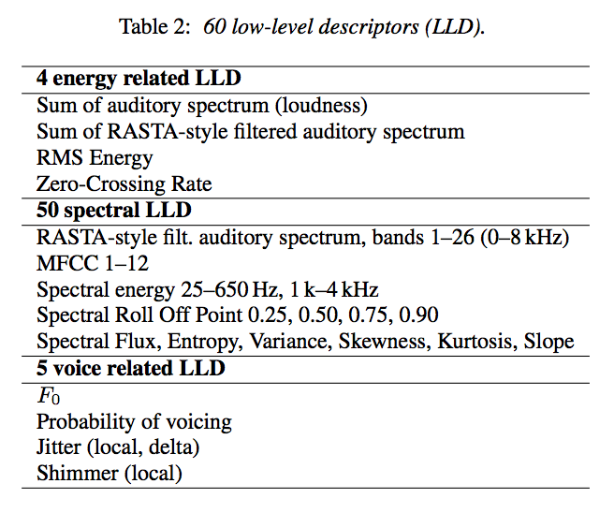
Automatic Analysis

Slide 51
Automatic Analysis
Low Level Descriptors and functionals combined to make 3996 features
Plus other pitch and voice quality features (360)
Plus functionals applies to pitch contour (12)

Slide 52
Results
Divided features into cepstral (CEPS), auditory spectral (AUSP), prosodic (PROS), and voice quality (VOQU) features
“Cepstral features do not enable robust regression or classification - in fact, the mean UA for classification is near chance level (52%). In contrast, auditory spectral features seem to contribute the most to reliable automatic likability analysis for regression as well as classification, followed by prosodic and voice quality features.”
Though raters might not have agreed on likability, robust results for automatic evaluation.

Slide 53
Gender and Likeability
Baumann (2017) collected likeability ratings from 220 speakers and 160 raters.
Very limited consistent acoustic correlations between the speakers’ speech and the raters assessment of likeability.
Both male and female raters rated male speech similarly.
Female speech was rated as more likeable by female raters, than by male raters.

Slide 54
Likeability is a two-way street
Schweitzer et al. (2017) 46 two-party dialogs between 13 speakers all German women. Conversations were 25 minutes long, and participants filled out a questionnaire about how likeable, competent, friendly and self-confident they found their partner.
No standard acoustic correlates of any social attribute.
They did find convergence or entrainment effects. Lexical entrainment correlated with likeability, while convergence of peak F0 height negatively correlated.

Slide 55
Romantic Attractiveness
Romantic attraction is incredibly complicated.
Suggestions that the vocal traits communicate or reinforce attractive physical traits. Attractive physical traits might be evolutionarily advantageous.
Collins and Missing 2003 found broad agreement on 1) which female faces were attractive 2) which female voices were attractive and 3) that attractive voices belonged to attractive faces. (This is found in male faces and voices by Saxton et al. 2016)
Young and small female voices were high pitched while taller women have narrower formant distribution. Men tend to find high pitched voices attractive.
Women tend to find lower-pitched male voices to be attractive.

Slide 56
What is making the voice attractive?
The voice may be communicating and age, height and weight.
Bruckert et al (2006) low-frequency formants correlate with age, height and weight. However, female listeners were unable to use this information to assess this information from male speech.
Gonzalez (2006) found pitch reveals very little about body size, but listeners think it does (Babel et al 2011).
However, low pitch and high speaking rate seem to be consistent correlates in attractive male voices (Quene et al 2016)

Slide 57
Male attractiveness by heterosexual women and homosexual men
Valentová et al. (2013) investigated ratings of attractiveness and masculinity in male faces and voices by homoseuxual men and heterosexual women.
No consistent preference for masculine faces.
Preference for masculine voices only in single homosexual men and coupled heterosexual women.
Homosexual men who considered themselves to be more masculine prefered more masculine voices, but more feminine faces.
Highlights the complexity in this space by considering relationship status,

Slide 58
Communication toward attractive people
Leongomez et al. (2014) used a video dating scenario to investigate how people speak to people they find attractive in Czech and English. They also investigated how the presence of attractive competitor videos impact speech.
Male F0 varied most in speech toward attractive women. Minimum F0 was also lowered.
Female F0 varied most in response to attractive competitors.
Speech directed toward attractive speakers was itself considered more attractive.

Slide 59
Speed Dating
McFarland et al. (2013) describe a very comprehensive collection and analysis of (5 min) speed-dating conversations.
Male partners who were interested in their partner demonstrated laughter, varied loudness and reduced pitch variance.
Female participants raise and vary their pitch, speak softer and took shorter turns. Female participants also described more interest when their partners interrupted them more frequently.

Slide 60
Entrainment in Speed Dating
McFarland et al. (2013) speakers who expressed mutual interest “mimicked” each other’s rate of speech, use of function words and laughter.
In a separate speed-dating study, Michalsky and Schoormann (2017) speakers entrain in pitch register and range over time, but this is stronger by how attractive they find the subject. A follow-up study (2018) showed that attractive male voices are not just low but low in the speaker’s pitch range, and that attractive female voices are not just high, but high in the speaker’s pitch range.

Slide 61
Flirting
“The speaker is attractive”
vs.
“The speaker finds their speaking partner attractive”
Speed dating experiments have enabled researchers to study flirtatious behavior by asking participants “are you attracted to your partner” and “do you think your partner was flirting with you”.
Both men and women who are considered to be flirting spoke spoke faster and with higher pitch. Men also speak more quietly. (Jurafsky et al. 2009)

Slide 62
People are bad at this: the asymmetry of flirting
There are features that are used in the perception of flirting that are not used in the expression of flirting.
Men are perceived to flirt when the overlap less and use fewer “appreciations”. These are not used by men who are flirting.
Speaking rate is a stronger indicator of a perception of flirting than the performance of flirting.
Laughter, taking fewer longer turns and asking repair questions are indicators of women intending to flirt, but are not perceived as flirtatious.

Slide 63
Conclusions
Political Charisma Business Charisma Trust Likeability Romantic Attractiveness
There are some findings on all of these. They tend to be very broad.
Dynamism in political charisma.
Dynamism with intelligibility for business charisma.
Trust is associated with relatively fast speech.
Clear enunciation is likeable.
Male voices with lower pitch and greater formant dispersion are attractive while attractive female voices have higher pitch and are breathier.

Slide 64
Challenges
Increase understanding of how listener characteristics impact
perceptions of attraction.
Investigate the intersection of these types of attraction.
Disentangle inherent and performative qualities of the voice.
Study women in political and business contexts.
Study romantic attractiveness in subjects that are not heterosexual & cisgender
- Questions? -

