Slide 1
Multimodal Humor Detection
Lin Ai
COMS 6998
Spring 2022

Slide 2
Why Study Humor?
To understand human interaction
To detect when people are being humorous rather than serious to evaluate the content of what they say
To learn the characteristics of humorous speech to be able to synthesize it (e.g. for robots, chatbots, games, advertisements)
Because it’s interesting…

Slide 3
How Do We Define Humor?
    Producer + Perceiver
    Positive emotional reactions (laughter)
    Highly individualistic & cultural specific
    Lack of multimedia data annotated with humor

Slide 4
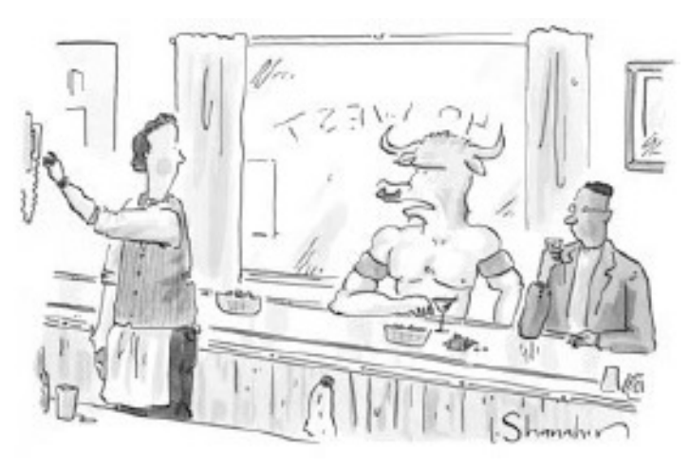
Humor Detection in Text
16k one-liners (Mihalcea and Strapparava, 2005)
  Humor-Specific Stylistic Features: alliteration/rhyme, antonymy, adult slang
    “A clean desk is a sign of a cluttered desk drawer”
One-liners + 1k news article from “The Onion” (Mihalcea and Pulman, 2007)
  Human-centeredness and negative polarity
    “Take my advice; I don’t use it anyway”
The New Yorker Cartoon Caption Contest (Radev et al, 2015)
  Negative sentiment, human-centeredness
    “If that ’s theseus , I ’m not here.”

Slide 5
Humor Detection in Text
Extract humor anchor in one-liners (Yang et al., 2015)
  The subset of candidates that provides the maximum decrement of humor scores
    “The one who invented the door knocker got a No-bell prize.”
1k tweets (Zhang and Liu, 2014)
  Phonetic + morpho-syntactic + lexico-semantic + pragmatic + affective features
    “I generally avoid temptation unless I can't resist it. - Mae West #quote #humor”
TED talk trancripts (Chen and Lee, 2017)
  Sentences containing or immediately followed by markup ‘(Laughter)’
    “If you’re a dog and you spend your whole life doing nothing other than easy and fun things, you’re a huge success! (Laughter) ”

Slide 6
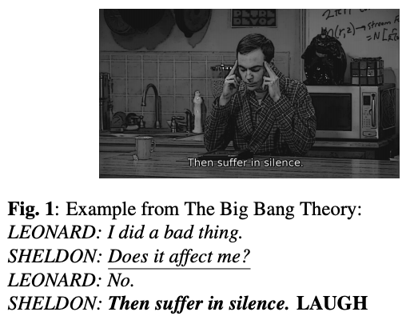
Multimodal Humor Detection
TV sitcoms
  Use canned laughters to label humor
    FRIENDS (Purandare and Litman, 2006)
    The Big Bang Theory (Bertero and Fung, 2016)
    Seinfeld (Bertero and Fung, 2016)
  No study has shown that canned laughter actually represents the audience’s perception of humor.

Slide 7
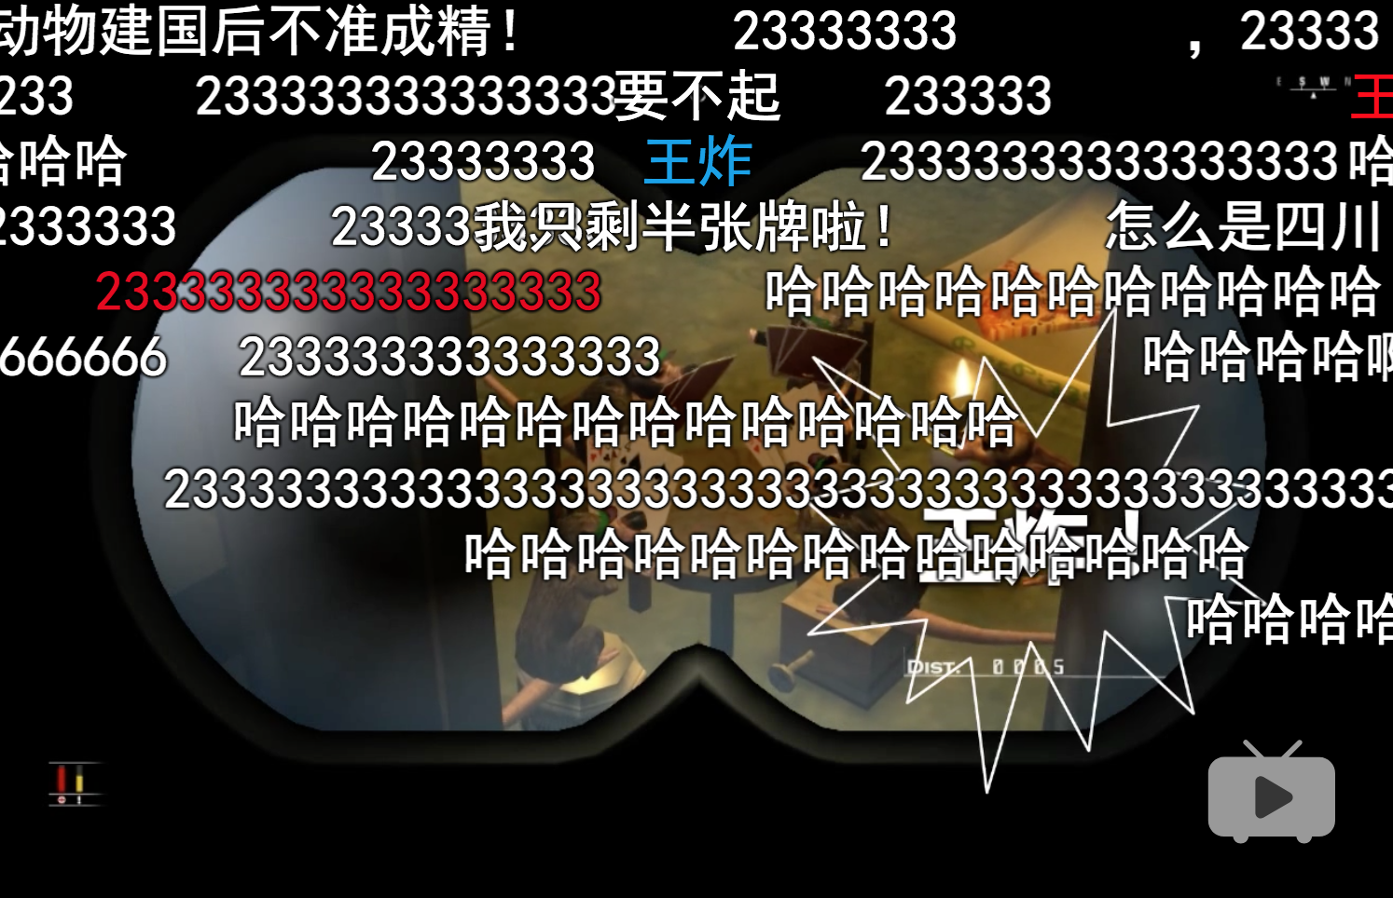
‘bullet curtain’ = Time-aligned Comments
https://www.bilibili.com/
https://www.nicovideo.jp/watch/sm33201605

Slide 8
Hypothesis
Audiences tend to respond to humor in videos with laughing
A high volume of laughing comments at a given time
HUMOR!
Laughing indicators
  ‘233’ (internet meme)
  ‘哈哈’ & ‘hh’ (onomatopoeia of laughter)

Slide 9
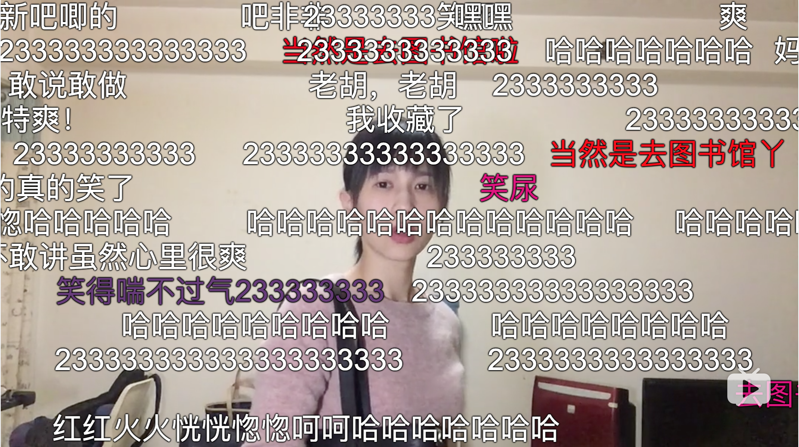
Data Collection
‘Papi酱’
A Chinese online celebrity
Famous for discussing trending topics in a humorous way
4 million subscribers, 296 million views on bilibili.com

Slide 10
Data Collection
We use all videos created by ‘Papi酱’
  Filtered out videos containing dialects and advertisements
  100 videos, 93593 comments
    5064 comments with ‘233’
    7255 comments with ‘哈哈’
    730 with ‘hh’
Segmentation
  One-second unit level
  Inter-pausal unit (IPU) level: 3 seconds on average

Slide 11
Constructing Unsupervised Labels
Users typically do not pause to comment
Response Time = reaction time + typing time
Smooth number of laughing comments by response time
Set threshold to distinguish humor from non-humor segments
One-second unit level
  6,508 humorous segments; 17,847 non-humorous segments
Inter-pausal unit (IPU) level
  2,531 humorous segments; 5,394 non-humorous segments

Slide 12
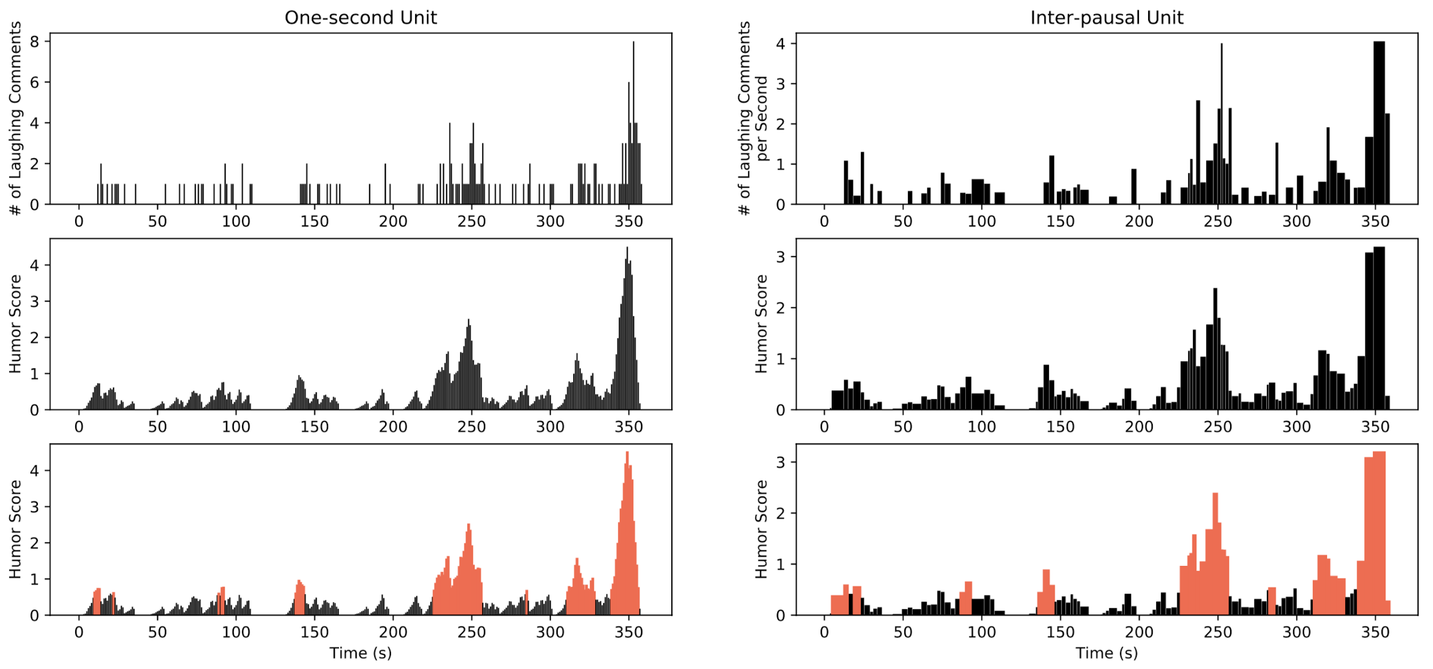
Constructing Unsupervised Labels
Before smoothing
After smoothing
After labeling

Slide 13
Verification: Human Annotation
We need a manually annotated test set to verify our unsupervised labeling method
Three human annotators
  Label each second with humor/non-humor
  Average Cohen’s Kappa: 0.65
  Fleiss’ Kappa: 0.65
Gold labels on test set: majority vote
  Unsupervised labels’ accuracy
    One-second units: 0.78
    Inter-pausal units: 0.76

Slide 14
Features — Acoustic-Prosodic
Tools: Praat, openSMILE, Google ASR API
Features:
  Min, max, mean, range, std of pitch
  Min, max, mean, range, std of intensity
  Pitch existence: whether extractable pitch values exists in the segment
  384 features from openSMILE
    More features, more functions
  Speaking Rate: Number of characters per second (from ASR transcript)

Slide 15
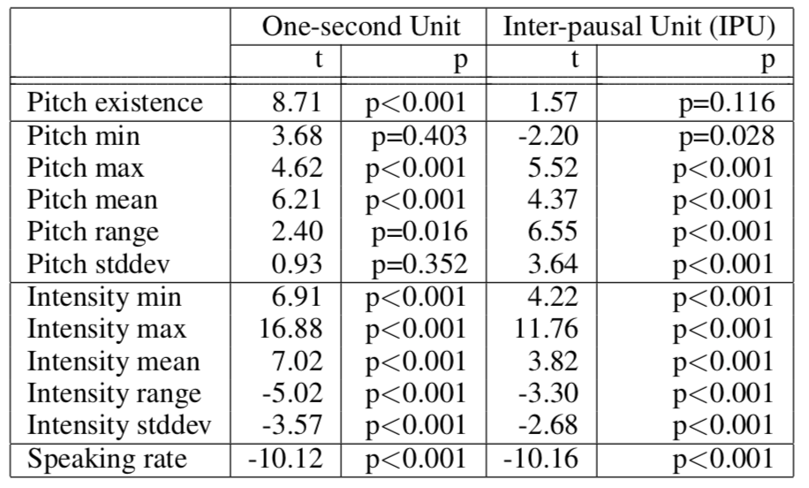
Analysis - Speech Features
The existence of pitch is positively correlated with humor
Exclude segments with no pitch values in the analysis of other speech features

Slide 16
Analysis - Speech Features
Humorous speech has
  Higher pitch value
  Larger change in pitch
  Higher intensity value
  Smaller change in intensity
  Slower speaking rate
Humor techniques
  Exaggeration and bombast

Slide 17
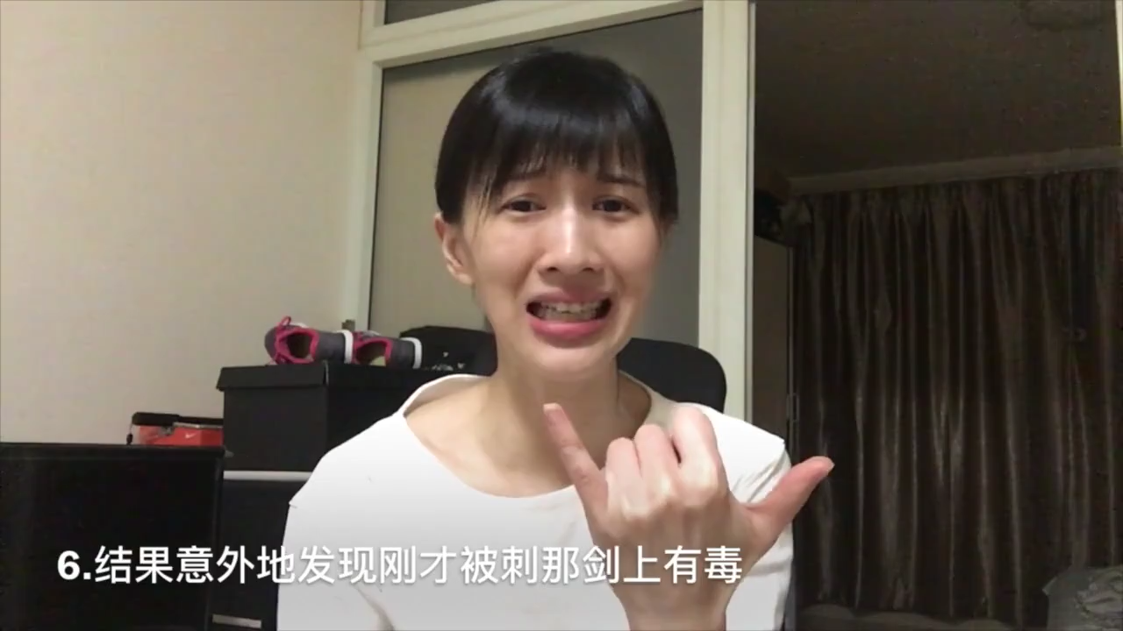
Analysis - Speech Features
(Hamlet) In the end, surprisingly and also not surprisingly — everyone died!

Slide 18
Features — Transcript-based
Tools: Google ASR API, Jieba, LIWC
Audio preprocessing:
  ‘Papi酱’ increases speaking rate in her videos, so slowed down to 0.75 times the original speed for ASR
  Normalized energy and pitch
Transcript preprocessing:
  Word segmentation using ‘Jieba’
LIWC (CLIWC): 91 word categories:
  e.g. function words, affect words, social words, etc.

Slide 19
Analysis - Lexical Features
One-second unit level
Positively correlated with humor:
  Strategy: Anxiety, risk, netspeak, i
  Content: Power, drive, religion
Negatively correlated with humor:
  Strategy: Cognitive process, insight
  Content: Sexual, female, biological process
IPU level
Positively correlated with humor:
  Strategy: i
  Content: religion
Negatively correlated with humor:
  Strategy: Cognitive process, cause, interrogatives, auxverb, they
  Content: Female, biological process, body

Slide 20
Analysis - Lexical Features
Humorous one-liners vs. non-humorous short sentence (Mihalcea and Pulman, 2007)
  Negative polarity, Human-centeredness
Negative polarity
  Negation: not significant
  Negative emotion: ‘anxiety’ significant on one-second unit level
Human-centeredness
  ‘i’ (first person pronouns): significant on both one-second unit and IPU level
  Other personal pronouns: not significant

Slide 21
Features — Visual
Frame similarity:
  Assumption: difference between frames may capture visual patterns such as change of scenes and large body movements
  Extracted 1 frame in each 10ms and compute similarity with neighbouring extracted frames
  Measure: structural similarity index (SSIM)
  Functions: min, max, mean, range, std

Slide 22
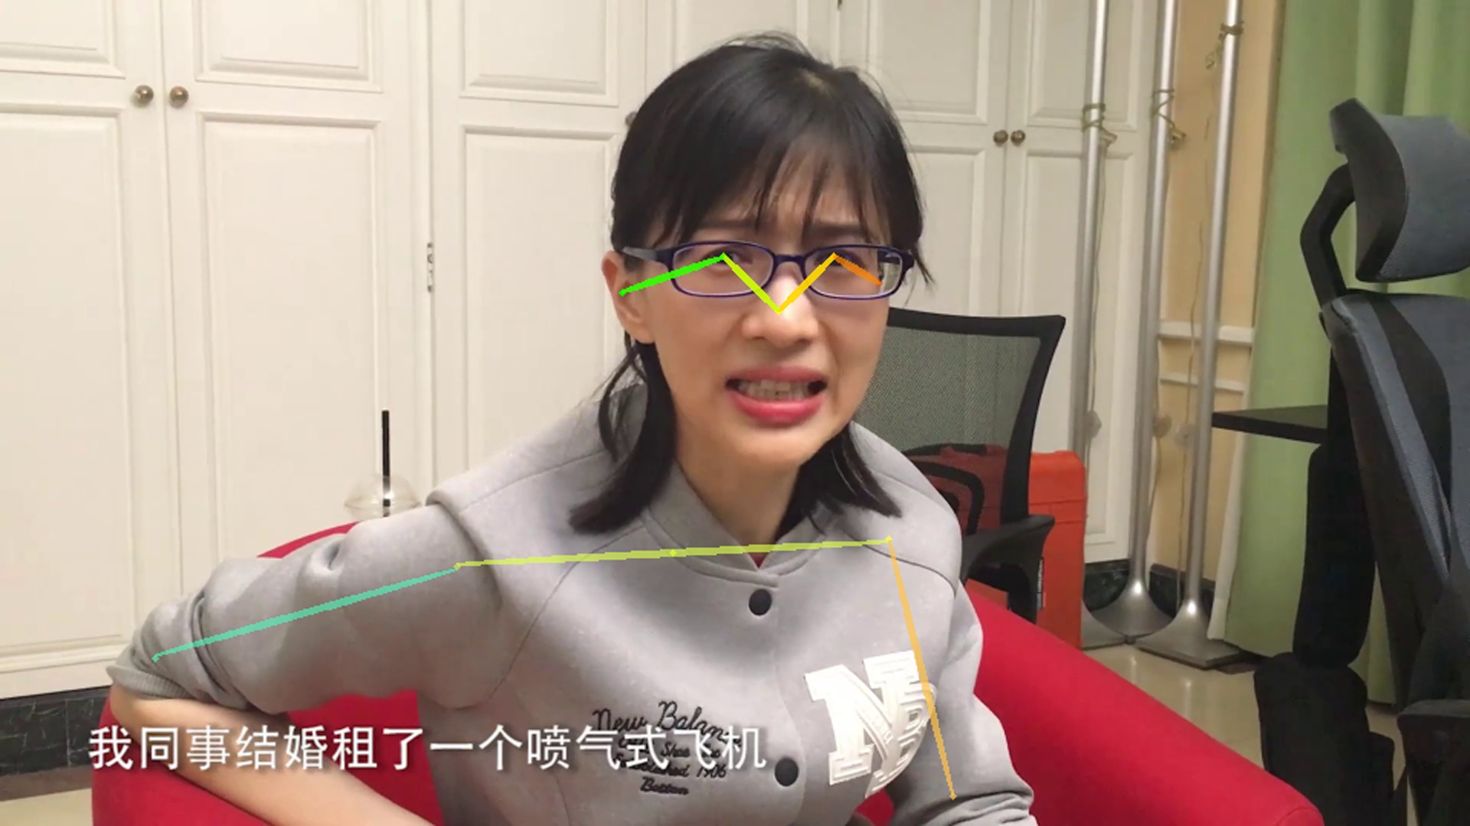
Features — Visual
Body pose
  Extraction: AlphaPose
  17 keypoints of body junctions with confidence scores
  Used binary features to indicate the appearance of hips and legs
  Features: mean, std, mean of frame-level differences, std of differences

Slide 23
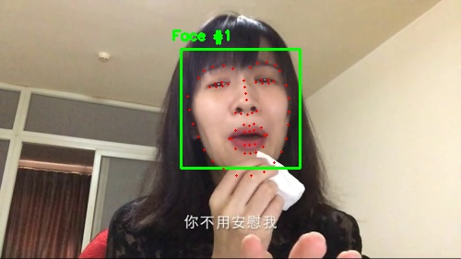
Features — Visual
Facial landmarks:
  Extraction: dlib library
  68 coordinates of facial landmarks
  Preprocessing: rescaled, computed relative position, exclude keypoints for jawline
  Features: mean, std, mean of frame-level differences, std of differences

Slide 24
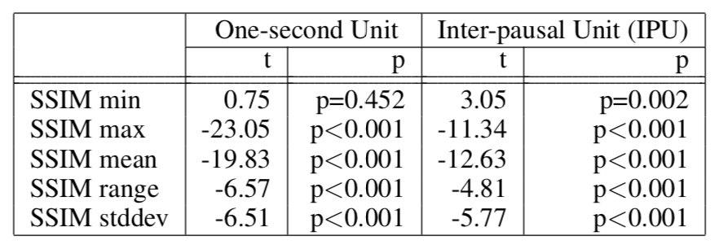
Analysis - Visual Features
SSIM - frame similarity
Humor segments
  Are unlikely to be motionless
  But also have less complete scene changes

Slide 25
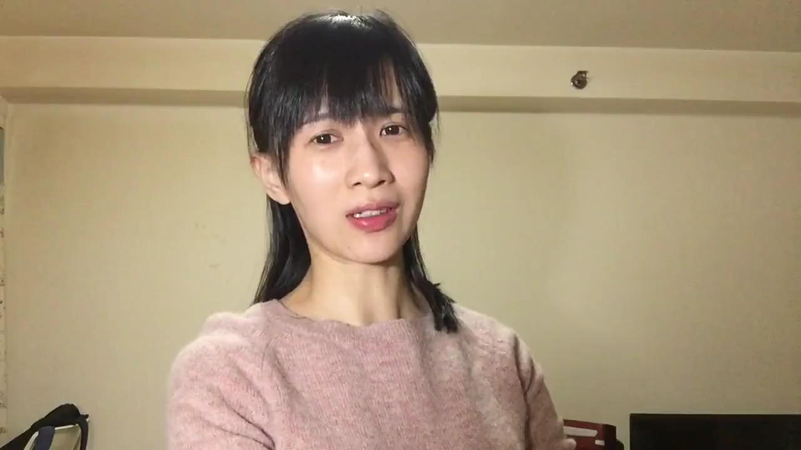
Analysis - Visual Features
Good news for those who are single!
In 2016 — (beautiful whirling) — you will still be a single dog.

Slide 26
Analysis - Visual Features
Body pose:
  One-second unit: keypoints above hips are significant
  IPU unit: keypoints above shoulder are significant
  The movement of keypoints is associated with humor, but the movement direction is not significant
Facial landmarks:
  Most significant keypoints: brows, nose (head-turning information)

Slide 27
Classification Experiments
70 videos (unsupervised labels) in training set, 30 videos (human labels) in test set
Feature dimensions:
  396 speech features (11 from Praat, 384 from openSMILE, speaking rate)
  91 text features (CLIWC)
  522 visual features (5 from frame similarity, 408 from facial landmarks, 109 from body pose)
Model: random forest classifier with 1000 estimators

Slide 28
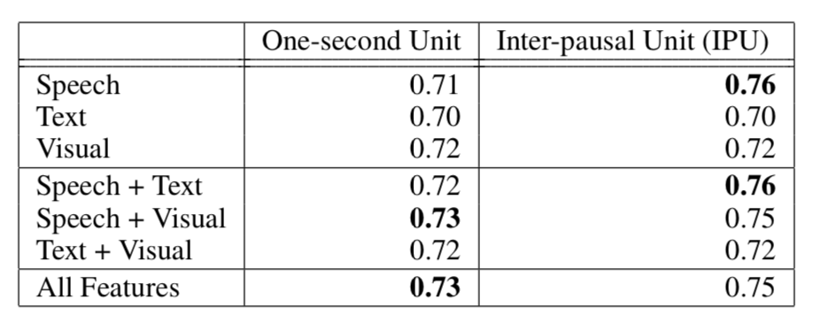
Classification Experiments
IPU segmentation outperforms one-second unit segmentation.
Speech features are the most useful.

Slide 29
Future Directions
Collect more videos from different types of humorous video creators
  Current videos mainly include humor techniques like surprise and clownishness
  Explore larger variety of characteristics in humor
Examine other methods for automatic labeling of video segments
  Use videos collected from other sources such as YouTube live chats
  Apply to different types of emotions and reactions

Slide 30
Thanks233!

Slide 31
Next Week
Topic: Speech Analysis: Deception and Trust
Any questions?

