Slide 1
CHoRaL: Collecting Humor Reaction Labels from Millions of Social Media Users
Zixiaofan (Brenda) Yang, Shayan Hooshmand, Julia Hirschberg

Slide 2
Why study humor?
To understand human interaction
To detect when people are being humorous rather than serious in order to evaluate the content of what they say
Benign vs. malicious intent behind misinformation
To help people improve their humor
To learn the characteristics of humorous expression to be able to generate it

Slide 3
How to define humor?
Receiver
Laughter? Other approbation?
Producer
Intent?

Slide 4
How to define humor?
Receiver
Laughter? Other approbation?
Producer
Intent?
Hard to annotate! Highly individualistic and culture-specific

Slide 6
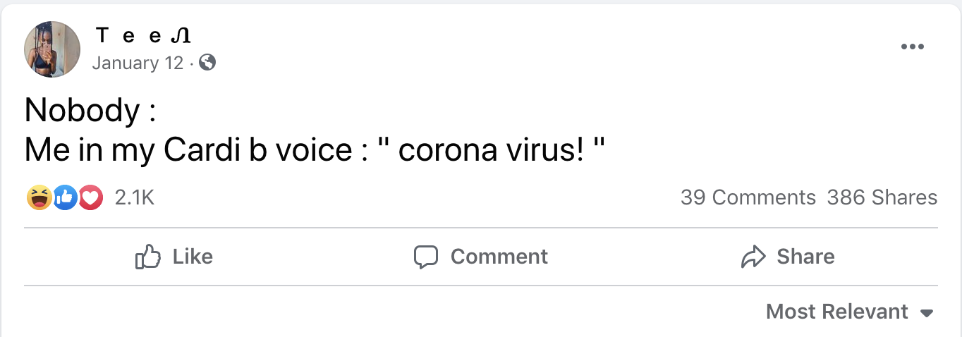

Slide 7
Outline
Scoring Framework
Defining Humor Score
Defining Non-Humorous Score
Collecting our Dataset
Humor Analysis on our Dataset
Model Classification Experiments
Future Work & Limitations

Slide 8
Defining Humor Score
Higher percentage of humor reactions -> higher humor score
Discount unpopular posts

Slide 9
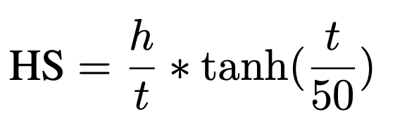
Defining Humor Score
Higher percentage of humor reactions -> higher humor score
Discount unpopular posts
h = # of humor reactions, t = total # of reactions

Slide 10
How do we define non-humorous post?
Need to retrieve non-humorous samples for binary classification
Use opposite of humor score?

Slide 11
How do we define non-humorous post?
Need to retrieve non-humorous samples for binary classification
Use opposite of humor score?

Slide 12
How do we define non-humorous post?
Need to retrieve non-humorous samples for binary classification
Use opposite of humor score?

Slide 13
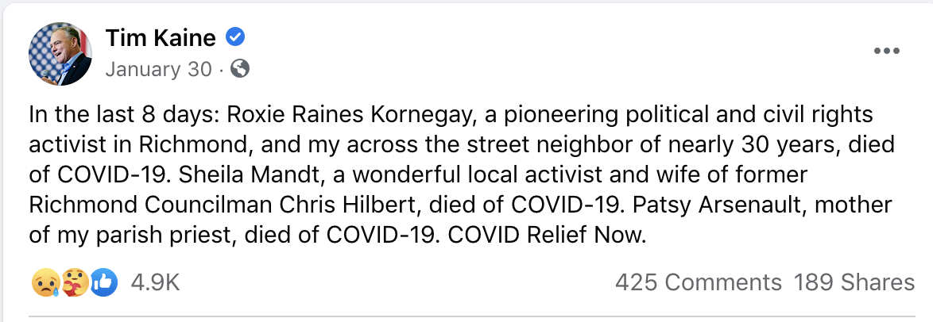
How do we define non-humorous post?
Need to retrieve non-humorous samples for binary classification
Use opposite of humor score?

Slide 14
Defining Non-Humor Score (NS)
Reaction distribution more similar to average facebook post -> more non-humorous
Assumption: average facebook post is not humorous

Slide 15
Defining Non-Humor Score (NS)
Use KL-divergence of post’s reaction distribution from average post reaction distribution
R = set of FB reactions
S = % of reaction r in the standard distribution
O = % of reaction r in the observed post
t = total # of reacts
50 = popularity stretcher

Slide 16
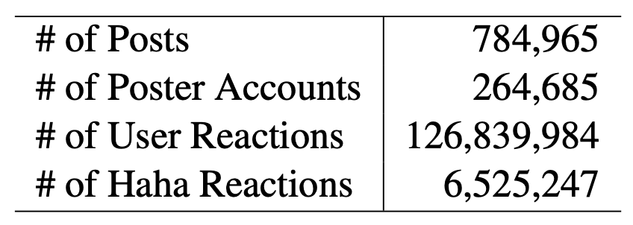
Dataset
Collected using CrowdTangle, a FB insights tool
2M posts retrieved with:
Keywords: “covid, covid-19, coronavirus, corona, covid 19, sars-cov-2, covid, sars cov 2”
Language: English
Type: Text-only
Time Range: Jan 2020-Mar 2021
785K after cleaning; removed posts with
duplicate fields
rendered links
>500 characters
Covid-related FB posts
Language: English
Post type: text-only

Slide 17
Dataset
High HS
High NS

Slide 18
Humor Analysis
Humorous one-liners (Mihalcea and Pulman, 2007)
Negative polarity, Human-centeredness
Our humorous posts have
Human centeredness: singular first-person pronouns, total pronouns
Negative polarity: anger words, negations, negative sentiment
Less detailed and more abstract writing style
Lower complexity

Slide 19
Humor Analysis - Examples from LIWC Analysis
Positive Correlation
Categories:
“Pronouns” (“I”, “Personal Pronouns”)
“Informal Language” (“Swear”) and “Anger”
“Sexual”
Words:
“I” “my” “They” “they’re” “he” “it”
“F***” “shit” “bitch” “c**t” “dumbf***”
“Anal” “blowjob” “chlamydia”
“Zombie
Negative Correlation
Categories:
“Relativity” (“Time”, “Space”)
“Prepositions”
“Work”
“Death”
Words:
“Death” “total” “of” “new”
(Total of new cases/deaths…?)
“County” “health” “positive” “today”

Slide 20
Humor Analysis - Emoji
Humorous posts have more emojis
363 of the 1,621 unique emojis are significantly correlated with humor
Most humorous emoji: ``Face with Tears of Joy'' 😂 😂 😂
Humorous posts have fewer heart emojis 💜💙💚💛, but more broken hearts 💔
Negative polarity

Slide 21
Model Experiments
Experiment settings
Continuous
Continuous HS is used as ground truth of humor
Binary
Positive: High HS posts; Negative: High NS posts
Models
RoBERTa-base
BERTweet: RoBERTa + Tweet
BERTweet-covid: BERTweet + 23M COVID-related Tweets
Human labels
Labels used not as gold standard, but as a baseline

Slide 22
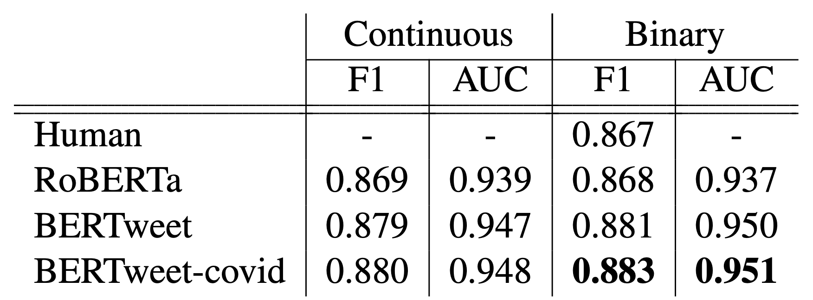
Model Experiments
Notes:
Prob that randomly chosen positive instance ranked above randomly chosen negative instance

Slide 23
Future Work & Limitations
Only covid-19 related data, but easy to expand!
Are we annotating perception or intent? And whose perception?
Use other reactions, like “sad” and “mad”, for collecting new datasets
Receiver
Laughter? Other approbation?
Producer
Intent?

Slide 24
Acknowledgments
Brenda Yang, Julia Hirschberg, and the Speech Lab, of course!
Slides adapted from my 2021 Lab Talk and Brenda’s 2021 EMNLP talk

