Slide 1
Personality and Mental State
Julia Hirschberg
COMS 6998
Columbia University
(thanks to Sarah Ita Levitan for some slides)

Slide 2
Today
Personality
Guest lecture: Professor Michelle Levine
Mental state
Depression, Bipolar, Seasonal Affective Disorder, Post Traumatic Stress Disorder
Schizophrenia
Dementia – Alzheimer’s Disease
Ethics

Slide 3
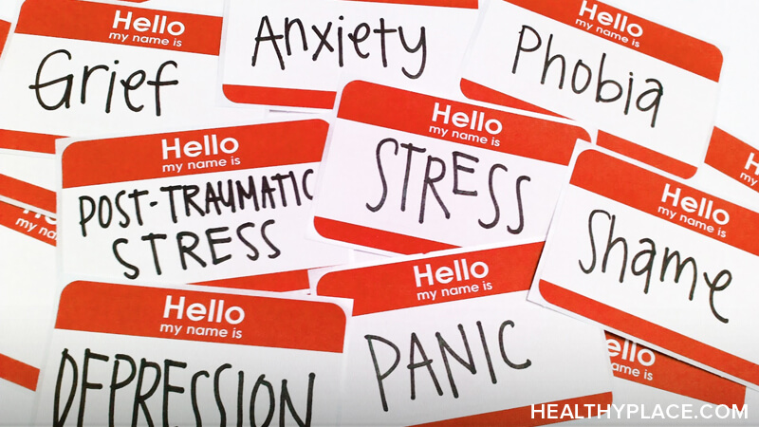
Notes:
Also suicidal tendencies

Slide 4
Language as a Cue for Diagnosis

Slide 5
Quantifying Mental Health Signals in Twitter (Coppersmith et al., 2014)
Automatically identify self-expressions of mental illness diagnoses
Leverage these to construct a labeled dataset
Genuine statements of diagnosis:
@USER The VA diagnosed me with PTSD, so I can’t go in that direction anymore
I wanted to share some things that have been helping me heal lately. I was diagnosed with severe complex PTSD and... LINK
Disingenuous statement of diagnosis:
LOL omg my bro the “psychologist” just diagnosed me with seasonal ADHD AHAHAHAAAAAAAAAAA IM DYING.
Notes:
ADHD: Attention-deficit/hyperactivity disorder

Slide 6
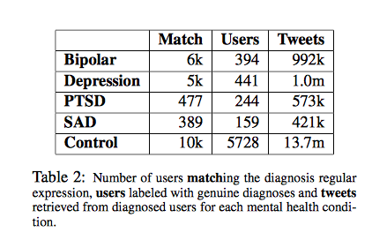
Quantifying Mental Health Signals in Twitter (Coppersmith et al., 2014)
Notes:
Bipolar (was Manic-Depressive)
Depression
PTSD: Post Traumatic Stress Disorder
SAD: Seasonal Affective Disorder
Data from 2008-2013 posts;
First used regular expressions to find tweets likely to indicate diagnosis (match) then manually labeled users who said they’d been diagnosed (Users) then collected 3200 tweets from each.

Slide 7
Features
LIWC
Language Models (LMs)
Unigrams (ULM)
Characters (CLM)
Pattern of life
Social engagement
Insomnia
Exercise
Sentiment
Notes:
Social engagement: User tweet rate: how often a twitter user posts; Proportion of tweets: Number of @mentions: how often the user in question engages other users, while Number of self @mentions: how often the user responds; Size of social network: # of unique users @mentioned and # @mentioned at least 3 times
Insomnia: proportion of tweets user makes between midnight and 4am (in local timezone)
Exercise: tweets mentioning exercise-related terms
Sentiment: # positive or negative or neither words (<0, 0, >0)
Compare to control group of random Twitter users posting with a 2-week window: must have at least 25 tweets and 75% in English to use as neg examples

Slide 8
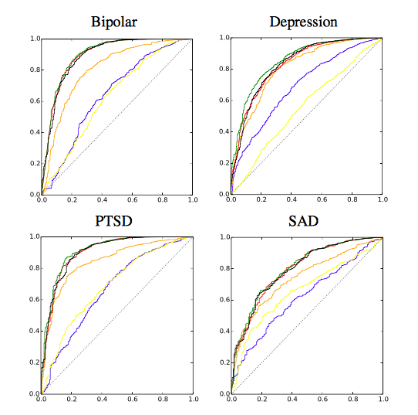
ROC Curves of Analytic Performance
Blue: LIWC
Yellow: Pattern of Life
Red: CLM
Green: ULM
Black: All features
Dotted line: Chance
Notes:
ROC curves of performance of individual analytics for each disorder: LIWC in blue, pattern of life in yellow, CLM in red, ULM in green, all in black. Chance performance is indicated by the dotted black line.
A receiver operating characteristic curve, or ROC curve, is a graphical plot that illustrates the diagnostic ability of a binary classifier system as its discrimination threshold is varied. The ROC curve is created by plotting the true positive rate against the false positive rate at various threshold settings.The Area under the Curve (AUC) tells you how well the classifier is at making binary predictions, e.g. Bipolar or not Bipolar

Slide 9
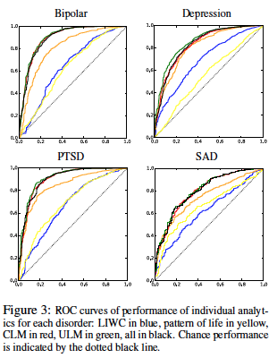
ROC Curves of Analytic (Probabilitic) Performance
Blue: LIWC
Yellow: Pattern of Life
Red: CLM
Green: ULM
Black: All features
Dotted line: Chance
Notes:
Built models to separate diagnosed from non
ROC curves of performance of individual analytics for each disorder: x= TP/TP+FN); y is FP/TN+FP) – correctly predicted positives vs. incorrectly predicted positives.
LIWC in blue, pattern of life in yellow, CLM in red, ULM in green, all in black. Chance performance is indicated by the dotted black line.
Some differences in feature performance over the 4 mental problems (e.g. pattern of life): bipolar and ptsd predicted best by all features
A receiver operating characteristic curve, or ROC curve, is a graphical plot that illustrates the diagnostic ability of a binary classifier system as its discrimination threshold is varied. The ROC curve is created by plotting the true positive rate against the false positive rate at various threshold settings. The Area under the Curve (AUC) tells you how well the classifier is at making binary predictions, e.g. Bipolar or not Bipolar

Slide 10
Depression
Mood disorder that causes a persistent feeling of sadness and loss of interest
Statistics
16 million adults had at least 1 major depressive episode in 2012 (NIMH)
350 million people worldwide suffer from depression (WHO)
Depression is the cause of over 2/3 of suicides in the US each year (White House Conference on Mental Health)
Women experience depression at 2x the rate of men (Journal of AMA)

Slide 11
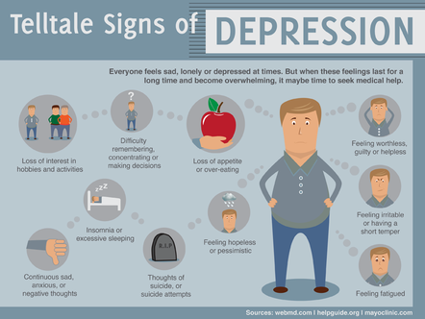

Slide 12
Diagnosis
Diagnostic assessment by GP, psychologist, or psychiatrist
Examine biological, psychological, social factors
Rating scales
Hamilton rating scale for depression
Beck depression inventory
Suicide behaviors questionnaire

Slide 13
Treatments
Psychotherapy
Mediation – antidepressants
Electroconvulsive therapy
Lifestyle
Exercise
Smoking cessation
Diet

Slide 14
Predicting Depression via Social Media (De Choudhury et al., 2013)
Use crowdsourcing to identify Turkers who are Twitter users with Major Depressive Disorder
Measure behavioral attributes from their tweets 1 yr prior to diagnosis
Estimate risk of depression before diagnosis from
Social engagement: volume, retweets, replies, shared links, posted questions
Emotion
Linguistic style:
Ego network: # people they engage with
Medication mentions
Notes:
We explore the potential to use social media to detect and diagnose major depressive disorder in individuals. We first employ crowdsourcing to compile a set of Twitter users who report being diagnosed with clinical depression, based on a standard psychometric instrument. Through their social media postings over a year preceding the onset of depression, we measure behavioral attributes relating to social engagement, emotion, language and linguistic styles, ego network, and mentions of antidepressant medications. We leverage these behavioral cues, to build a statistical classifier that provides estimates of the risk of depression, before the reported onset. We find that social media contains useful signals for characterizing the onset of depression in individuals, as measured through decrease in social activity, raised negative affect, highly clustered ego networks, heightened relational and medicinal concerns, and greater expression of religious involvement.

Slide 15
Data
Depression screening test: CES-D questionnaire
http://cesd-r.com : 20-item self-report on past week
Amazon Mechanical Turk
Workers could opt in to share Twitter username
Quality control: remove workers taking -2m
Self-reported information
Clinical diagnosis of depression?
Estimated time of onset
Using antidepressants?
Notes:
CES-D: Center for Epidemiologic Studies Depression scale – 20 item self-report scale – answer questions about past week
“I thought my life was a failure”, “I felt lonely”, “I had crying spells”
Scores are 0-60
Quality control?
Discard data if workers took less than 2min
Include screening test – BDI (Beck depression inventory) – checked for correlation between the 2 tests

Slide 16
Data
1,583 responses; 40% shared Twitter feeds
476 users with depression diagnosis (after removing noisy responses)
243 male, 233 female
171 users who scored positive for depression on CES-D
2,157,992 tweets retrieved

Slide 17
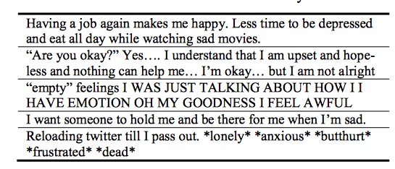
Sample Data

Slide 18
Measuring Depressive Behavior
Engagement: # posts-per-day, replies, retweets, links shared, questions
Insomnia index: %night posts 9pm-6am) vs. day posts
Egocentric social graph of exchanges with others measuring size, density, amount of exchange
Emotion: pos/neg; activation (intensity); dominance (control of emotion)
Linguistic style: LIWC
Depression language: depression lexicon; anti-depressants mentioned
Notes:
Night: 9pm-6am
Egocentric social graph: of a user to be an undirected network of the set of nodes in u ’s
two-hop neighborhood (neighbors of the neighbors of users in our dataset), where an edge between u and v implies
that there has been at least one @-reply exchange each, from u to v , and from v to u on a given day.

Slide 19
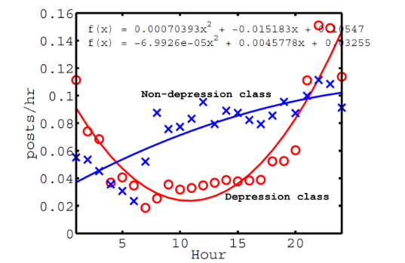
Tweet Activity and Depression
Notes:
All times are local time
Mean num of posts per hour, over entire year history
Depressed persons tend to post later at night and earlier in the morning…

Slide 20
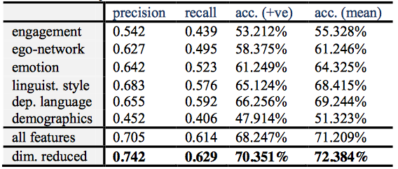
Depression Prediction Pre-Onset
Notes:
3rd col: mean accuracy of predicting positive class
Best performance from ling style features and next best from depressed lang features with emotion 3rd
Dimensionality reduction: use only principal variables

Slide 21
Schizophrenia
Chronic mental disorder
Symptoms:
Positive: hallucination, delusion, thought disorders, movement disorders
Negative: “flat affect”, reduced feelings of pleasure, reduced speaking
Cognitive: poor executive functioning, trouble focusing or paying attention, problems with working memory
Notes:
1% of population

Slide 22
Schizophrenia and Language
“Negative thought disorder”: Alogia
Poverty of speech; inability to speak easily
“Positive thought disorder”:
Derailment
“I always liked geography. My last teacher in that subject was Professor August A. He was a man with black eyes. I also like black eyes. There are also blue and grey eyes and other sorts, too…” (Bleuler, 1950)
Tangentiality:
Disturbance in the thought process that causes the individual to relate excessive or irrelevant detail that never reaches the essential point of a conversation or the desired answer to a question
Notes:
Alogia: inability to speak easily

Slide 23
“Well, in myself I have been okay what with the prices in the shops being what they are and my flat is just round the corner. I keep a watch for the arbiters most of the time since it is just round the corner. There is not all that much to do otherwise.”
Word-level abnormalities
“I got so angry I picked up a dish and threw it at the geshinker”
“So I sort of bawked the whole thing up”

Slide 24
Word Salad
“They’re destroying too many cattle and oil just to make soap. If we need soap when you can jump into a pool of water, and then when you go to buy your gasoline, my folks always thought they should, get pop but the best thing to get, is motor oil, and, money. May… may as well go there and, trade in some, pop caps and, uh, tires, and tractors to grup, car garages, so they can pull cars away from wrecks, is what I believe in. So I didn’t go there to get no more pop when my folks said it. I just went there to get a ice-cream cone, and some pop, in cans, or we can go over there to get a cigarette”

Slide 25
Quantifying the Language of Schizophrenia in Social Media (Mitchell et al., 2015)
Data: 174 Twitter users with self-stated diagnosis of schizophrenia
Age and gender matched controls, balanced dataset
Features:
LIWC
Open-vocabulary approaches
Latent Dirichlet Allocation (LDA), Brown clustering, character n-grams, perplexity
Notes:
LDA: unsupervised topic modeling – imagines a set of topics and tries to map all documents into that set; each user is then matched to a topic

Slide 26
LIWC Analysis
Schizophrenia users had more words from these categories: Cognitive mechanisms, death, function words, negative emotion
And fewer words from these categories: home, leisure, positive emotion

Slide 27
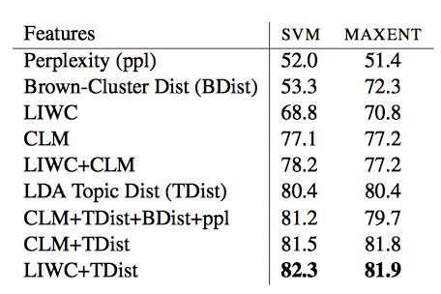
Classification Results using Support Vector Machines or Maximum Entity Modeling
Notes:
Maxent: predicts by identifying distribution that is most spread out or closest to uniform
Topic Distribution is the main LDA topic matched to each user; Bdist is the Brown cluster matched to the user
Perplexity (predictability) of user language

Slide 28
Linguistic Analysis of Schizophrenia in Reddit Posts (Zomick et al., 2019)
Reddit:
No limits on post length
Subreddits on particular topics or for particular groups
Used a Python API Wrapper (PRAW) to streamline process
Notes:
API wrapper provides a way to access an API through a particular programming language or interface, which can help streamline the process of making API calls

Slide 29
Data
Subreddits:
r/schizophrenia
r/schizophrenic
r/AskReddit: “Any Redditors With Schizophrenia?”
Manual inspection for formal diagnosis
e.g. “my diagnosis of schizophrenia”

Slide 30
Data
SZ group: 159 users; 66,454 comments
Control group: 159 users; 113,570 comments
At least 10 posts per user in each group
Notes:
SZ: schizophrenia

Slide 31
LIWC Analysis
Comparison of LIWC findings across 5 studies in multiple domains (Reddit, Twitter, discussion boards)
SZ indicators across multiple studies:
- Increased: negative emotion, first person singular pronouns, tentative, cognitive process, health, anxiety, third person plural pronouns
- Decreased: leisure
New SZ indicators in this Reddit study:
- Increased: Word count, Dictionary words, Common adverbs, Verbs, Reward, and Drives

Slide 32
Decreased: 3rd person singular, Articles, Negations, Anger, Male references, Power, Money, Swear words, Question marks, Dashes, and Other punctuation
Differences may arise from this being the only study done exclusively with Reddit data

Slide 33
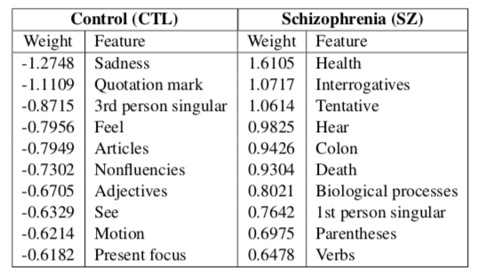
LIWC Analysis
Logistic Regression: 81.56% accuracy
Notes:
Top weighted features for logistic regression

Slide 34
Dementia
Broad category of brain diseases that cause long term decrease in ability to think and remember
Most common type - Alzheimer’s disease (AD)
60%-70% of cases
Affects 27.5 million people
3% of people 65-74
19% of people 75-84
~50% of people >85
$604 billion in costs per year

Slide 35
Alzheimer’s Disease Symptoms
Short-term memory loss
Problems with language
Disorientation
Mood swings
Decreased motivation

Slide 36
Cause
70% of risk is believed to be genetic
Risk factors:
Head injuries
Depression
Obesity
Hypertension
Cardiovascular disease
Smoking and excessive alcohol
Sleep problems

Slide 37
Pathology
Amyloid plaques: protein fragments that clump together in brains killing neurons
Tau tangles: twisted protein fibers that form inside neurons ultimately killing them
Notes:
How to prevent: proper diet and regular exercise but hard to clear these away altho much research and clinical trials

Slide 38
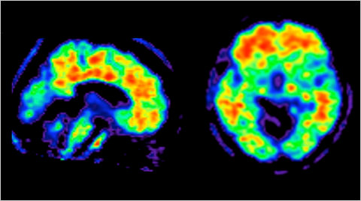
Amyloid Plaques in Brains

Slide 39
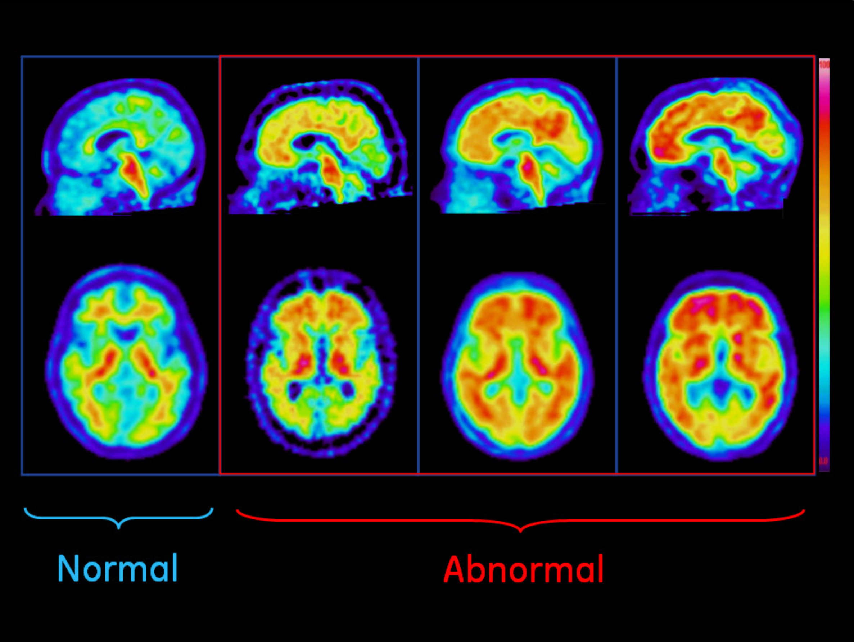
Amyloid Plaques in Normal and Abnormal Brains

Slide 40
Dementia Diagnosis
Can only be definitively diagnosed in a postmortem brain tissue examination
Clinical assessment
Medical history
Physical exam
Neurological exam
Mental status tests

Slide 41
Mental Status Tests
Mini-mental state exam (MMSE)
Mini-Cog: quick screening for diagnosing early dementia
Notes:
dhs16_159601.pdf for MMSE?

Slide 42
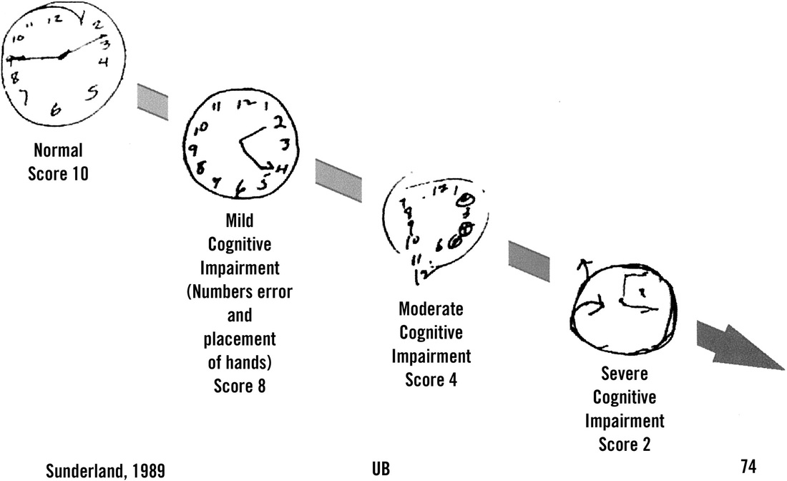
Draw a clock that shows the time at 2:45
Notes:
Draw a clock that represents the time 2:45

Slide 43
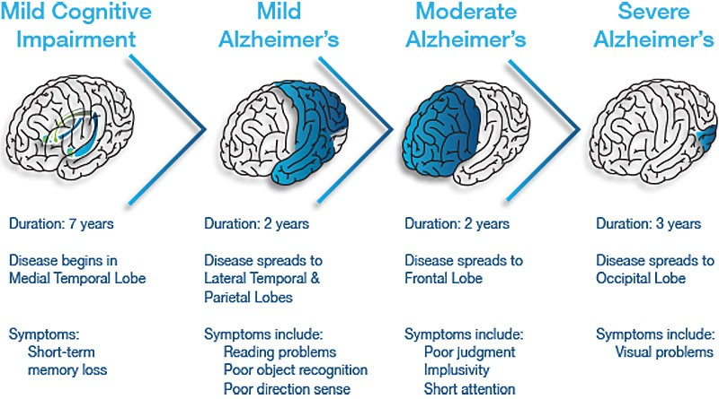
Stages of Alzheimer’s Disease

Slide 44
Stages of Alzheimer’s Disease
Pre-dementia
Mild Cognitive Impairment (MCI)
Short-term memory loss
Early
Increased impairment of learning and memory
Moderate
Increased impairment of learning and memory
Severe
Visual problems appear

Slide 45
Treatment
Medication for symptoms
Clinical trials

Slide 46
Language Indicators of Alzheimer’s
Can we identify/predict AD from writing analysis?

Slide 47
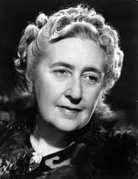
Case Study: Agatha Christie’s Novels
Notes:
Christie never diagnosed with Alzheimer’s but…

Slide 48
Language Use Changes with Age
U Toronto researchers Ian Lancashire, Graeme Hirst counted the numbers of words and word types she used from age 28 to 82
Vocabulary size decreased sharply by 15-30%
Increases in repeated phrases and indefinite nouns (something, thing, anything)
Elephants Can Remember (age 81) showed 30% fewer word than Destination Unknown (age 63)
Similar findings for Iris Murdoch

Slide 49
Dementia Progresses with Age (Snowden 2003, Healthy aging and dementia: findings from the Nun Study)
Longitudinal study, 1986--
678 Roman Catholic sisters 75-107 years old
Homogenous group
Autobiographical essays from archives containing early, mid-life and late-life writings

Slide 50
Excerpts from Different Sisters
Early: "It was about a half hour before midnight between February 28 and 29 of the leap year 1912 when I began to live, and to die, as the third child of my mother, whose maiden name is Hilda Hoffman, and my father, Otto Schmidt...”
Late: "I was born in Eau Claire, Wisconsin on May 24, 1913, and was baptized in St. James Church..."

Slide 51
Nun Study Findings
Sisters who scored poorly on
Idea density
Grammatical complexity
…were much more likely to develop dementia
E.g. sisters in lower third of idea density were 60 times more likely to develop Alzheimer’s than sisters in upper third
Using essays, predict with 92% accuracy whether the brain would contain plaques post-mortem

Slide 52
Vector-space Topic Models for Detecting Alzheimer’s Disease (Yancheva & Rudzicz, 2016)
Measure semantic content deficiency to identify low:
Idea density: ratio of semantic units to total number of words
Efficiency: rate of semantic units over duration of speech sample
Notes:
Less content from what is said

Slide 53
Measuring Semantic Content
Picture description task: humans asked to provide free-form verbal description of visual stimulus
Human-supplied information content units (hsICUs) representing subjects, objects, locations and actions from image
HsICUs then counted for scoring: AD sufferers provide fewer ICUs than healthy persons

Slide 54
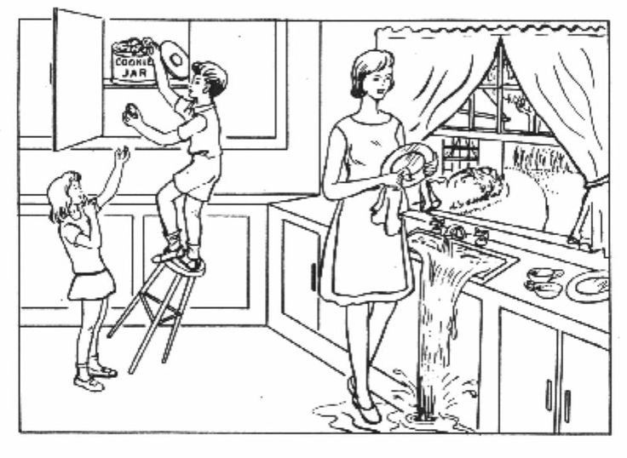

Slide 55
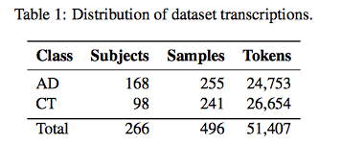
Method
Authors automatically generate Information Content Units from picture descriptions from a very large corpus
Data: DementiaBank (multiple languages)
Notes:
AD vs. controls
Speech samples

Slide 56
Automatic ICU Generation
Train word vector model on large general purpose corpus (GloVe)
Extract vector representations of words in DementiaBank corpus
Cluster vectors separately for AD and CT groups to represent “topics”

Slide 57
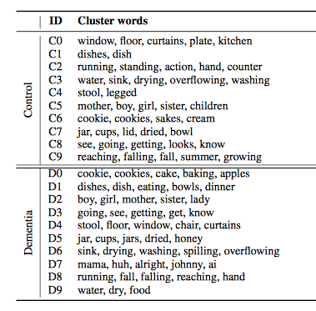
Notes:
Clusters for control and dementia subjects

Slide 58
Cluster Analysis
Do clusters match hsICUs?
Do the topics differ between groups?
Notes:
Human-supplied content units

Slide 59
Cluster Analysis
Do clusters match clinical hsICUs for this image?
Yes (except “dishcloth”)
Do the topics differ between groups?
Yes!
Control group uses: overflowing, sink, indifferent, mother, apron, window, curtain, cupboard, counter and AD group does not
AD group: brother, sister, son, daughter not mentioned by Control

Slide 60
Quantifying Irrelevance
Align pairs of clusters between AD and CT models
All control clusters are aligned with AD models but one AD model (D7) is not aligned with any CT model
AD produces “extraneous terms”: mama, huh, alright, johnny, ai
Notes:
AD: Alzheimers disease
CT: control group

Slide 61
Are Topics Discussed in Same Contexts?
Augment word vectors with local context windows
Results:
All control cluster words were used in the same contexts by both groups
Frequency of control words is higher in control group than AD group

Slide 62
Classification Experiments
Features:
Distance metrics for AD and CT clusters – how far is each item in the topic from the topic centroid (i.e. how coherent is the topic?)
Idea density: # expected topics mentioned/total words in transcript
Idea efficiency: # expected topics mentioned/total duration of recording

Slide 63
Random Forest classifier, 10-fold cross-validation
Compare models: cluster models (CT, AD, combined), feature sets, and with and w/out context
Baseline: hsICU features extracted by Fraser et al 2016

Slide 64
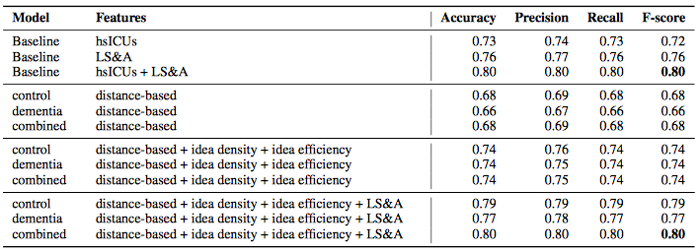
Classification Results
Notes:
Our 12 automatically generated features (i.e., the combined set of distance-based
measures, idea density, and idea efficiency) result in higher F-scores (0.74) than using 85 manually
generated hsICUs (0.72); a two-sample paired t-test shows no difference (using control cluster
model: t(9) = 1.10, p = 0.30; using dementia cluster model: t(9) = 0.74, p = 0.48) indicating
the similarity of our method to the manual gold standard. Furthermore, we match state-of-the-art
results (F-score of 0.80) when we augment the set of LS&A (linguistic syntactic and acoustic) features with our automatically generated
semantic features.

Slide 65
Some More Recent Work
Jiang et al 2020, “Detection of Mental Health Conditions from Reddit via Deep Contextualized Representations,” 11th Int’l Workshop on Health Text Mining and Information Analysis.
Linguistic characteristics of 8 disorders vs. control group using multiple ML models
Jiang et al 2021, “Automatic Detection and Prediction of Psychiatric Hospitalizations From Social Media Posts,” Workshop on Comp Ling and Clinical Psychology.
Predicting how likely people are to need hospitalization by looking at before and after Reddit posts on 8 mental health conditions subreddits
Notes:
obsessive compulsive disorder (OCD), schizophrenia (SZ), borderline personality disorder (BPD), post- traumatic stress disorder (PTSD), eating disorder (ED), major depression dis-order (MDD), general anxiety disorder (GAD) and bipolar disorder

Slide 66
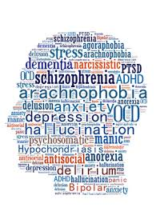
Ethics of Using Social Media for Health Research
Notes:
Discuss concerns about using social media for health research
Ethical guidelines:
IRB – institutional review board – required for all federally funded human subjects research in the US
Informed consent whenever possible
Protections for sensitive data – e.g. usernames
-> separate annotations from user data
De-identify data in public presentations

Slide 67
Ethics in NLP workshop
Why might it be unethical to use human data?
http://www.ethicsinnlp.org
Harvard “Embedded Ethics” in courses

Slide 68
Conclusions
NLP and speech processing are very useful tools for identifying and predicting mental illness
Social media provide rich natural data
But we must take ethical considerations into account

Slide 69
Next Week
Topic: Speech Analysis: Emotion and Sentiment Detection (guest speaker: Zixiaofan Yang)

