Slide 1
Mental State
Julia Hirschberg
COMS 6998
Fall 2022
(thanks to Sarah Ita Levitan for some slides)

Slide 2
Today
Detecting Mental State from Speech and Language
Depression, Bipolar, Seasonal Affective Disorder, Post Traumatic Stress Disorder
Schizophrenia
Dementia – Alzheimer’s Disease
Ethics

Slide 3
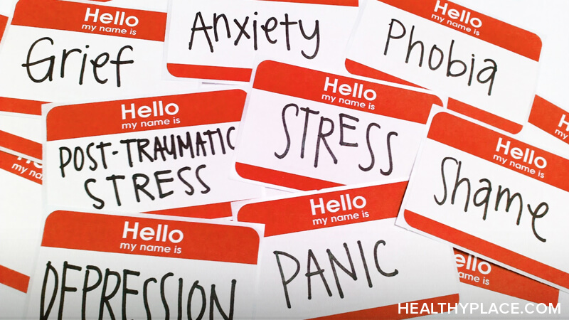
Notes:
Also suicidal tendencies

Slide 4
Language as a Cue for Diagnosis

Slide 5
Quantifying Mental Health Signals in Twitter (Coppersmith et al., 2014)
Automatically identify self-expressions of mental illness diagnoses
Leverage these to construct a labeled dataset
Genuine statements of diagnosis:
@USER The VA diagnosed me with PTSD, so I can’t go in that direction anymore
I wanted to share some things that have been helping me heal lately. I was diagnosed with severe complex PTSD and... LINK
Disingenuous statement of diagnosis:
LOL omg my bro the “psychologist” just diagnosed me with seasonal ADHD AHAHAHAAAAAAAAAAA IM DYING.
Notes:
ADHD: Attention-deficit/hyperactivity disorder

Slide 6
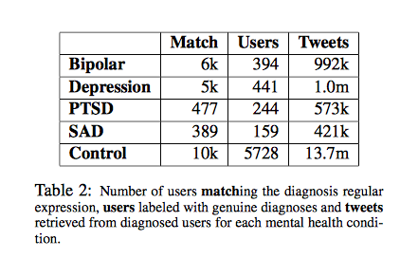
Notes:
Bipolar (was Manic-Depressive)
Depression
PTSD: Post Traumatic Stress Disorder
SAD: Seasonal Affective Disorder
Data from 2008-2013 posts;
First used regular expressions to find tweets likely to indicate diagnosis (match) then manually labeled users who said they’d been diagnosed (Users) then collected 3200 tweets from each.

Slide 7
Features
LIWC
Language Models (LMs)
Unigrams (ULM)
Characters (CLM)
Pattern of life
Social engagement
Insomnia
Exercise
Sentiment
Notes:
Social engagement: User tweet rate: how often a twitter user posts; Proportion of tweets: Number of @mentions: how often the user in question engages other users, while Number of self @mentions: how often the user responds; Size of social network: # of unique users @mentioned and # @mentioned at least 3 times
Insomnia: proportion of tweets user makes between midnight and 4am (in local timezone)
Exercise: tweets mentioning exercise-related terms
Sentiment: # positive or negative or neither words (<0, 0, >0)
Compare to control group of random Twitter users posting with a 2-week window: must have at least 25 tweets and 75% in English to use as neg examples

Slide 8
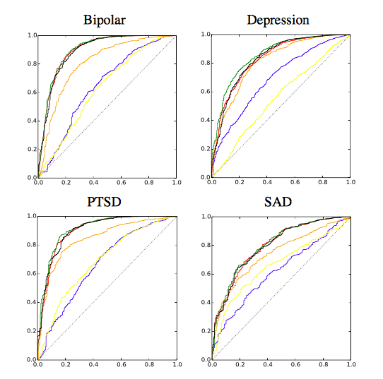
ROC Curves of Analytic Performance
Blue: LIWC
Yellow: Pattern of Life
Red: CLM
Green: ULM
Black: All features
Dotted line: Chance
Notes:
ROC curves (of performance of individual analytics for each disorder: LIWC in blue, pattern of life in yellow, CLM in red, ULM in green, all in black. Chance performance is indicated by the dotted black line.
A receiver operating characteristic curve, or ROC curve, is a graphical plot that illustrates the diagnostic ability of a binary classifier system as its discrimination threshold is varied. The ROC curve is created by plotting the true positive rate against the false positive rate at various threshold settings.The Area under the Curve (AUC) tells you how well the classifier is at making binary predictions, e.g. Bipolar or not Bipolar

Slide 9
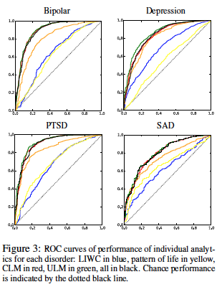
ROC Curves of Analytic (Probabilitic) Performance
Blue: LIWC
Yellow: Pattern of Life
Red: CLM
Green: ULM
Black: All features
Dotted line: Chance
Notes:
Built models to separate diagnosed from non
ROC curves of performance of individual analytics for each disorder: x= TP/TP+FN); y is FP/TN+FP) – correctly predicted positives vs. incorrectly predicted positives.
LIWC in blue, pattern of life in yellow, CLM in red, ULM in green, all features in black. Chance performance is indicated by the dotted black line. Some differences in feature performance over the 4 mental problems (e.g. pattern of life): bipolar and ptsd predicted best by all features
A receiver operating characteristic curve, or ROC curve, is a graphical plot that illustrates the diagnostic ability of a binary classifier system as its discrimination threshold is varied. The ROC curve is created by plotting the true positive rate against the false positive rate at various threshold settings. The Area under the Curve (AUC) tells you how well the classifier is at making binary predictions, e.g. Bipolar or not Bipolar.

Slide 10
Acoustic/prosodic Cues for Bipolar Disorder Monitoring (Farrusetal2021)
Goal: Create app using only acoustic-prosodic information to provide in-home ratings on clinical scales (Hamilton Depression Rating Scale and Young Mania Rating Scale)
Prior work found that F0, formant frequency, voice quality, intonation and rhythm were useful
Collected data from bipolar patients and used Praat to extract mean F0, first and second formant frequencies, jitter, shimmer, NHR and HNR, max/min/range/slope of F0, mean intensity, rhythm (ratio of pauses, speech rate, articulation rate and mean syllable duration
Notes:
In total, we extracted 18 features from each of the patients’ speech. For the extraction of F0 and its
related features, we used the auto-correlation method in Praat with an interval of 10 ms and a Hanning
window of length 40 ms. Although rhythm features could have been accurately extracted from the
corresponding transcripts, they were extracted by adapting the Praat script found in De Jong and
Wempe50 to keep the system language independent. The mean F0 and intensity values were used to
normalise the F0- and intensity-based features, respectively, to avoid speaker dependence. Thus,
F0-based features were computed as distance in semitones with respect to the mean value of the individual.
Voice quality parameters jitter and shimmer were also normalised by means of F0 and intensity,
respectively. After normalisation, F0 and intensity were left out and the remaining 16 features (eight
voice quality and formant features plus eight prosodic features) were used for the detection experiments.

Slide 11
Normalized using mean F0 and intensity to avoid speaker dependence and left those features out
Doctors annotated the recordings on YMRS and HDRS scales for each patient recording and they collected data from non-patients for comparison
Results using linear regression, Random Forest, and SVM models and RMSE values using cross-validation strategies
Best HDRS prediction from only voice quality and formant features
Best YMRS prediction from all speech features, perhaps because manic speech has much higher prosody with higher variation in intonation and rhythm

Slide 12
Depression
Mood disorder that causes a persistent feeling of sadness and loss of interest
Statistics
16 million adults had at least 1 major depressive episode in 2012 (NIMH)
350 million people worldwide suffer from depression (WHO)
Depression is the cause of over 2/3 of suicides in the US each year (White House Conference on Mental Health)
Women experience depression at 2x the rate of men (Journal of AMA)

Slide 13
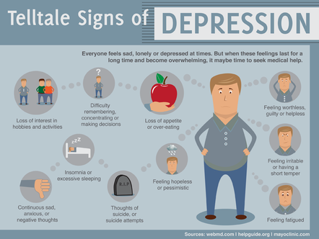

Slide 14
Diagnosis
Diagnostic assessment by GP, psychologist, or psychiatrist
Examine biological, psychological, social factors
Rating scales
Hamilton rating scale for depression
Beck depression inventory
Suicide behaviors questionnaire

Slide 15
Treatments
Psychotherapy
Mediation – antidepressants
Electroconvulsive therapy
Lifestyle
Exercise
Smoking cessation
Diet

Slide 16
Predicting Depression from Speech (Rejaibietal2022)
Identify severity level of Major Depressive Disorder (MDD) on Patient Health Questionnaire scores (24) and binary depression classification
Used normalized Mel Frequency Cepstral Coefficients (MFCCs)
Trained and tested on 3 a/v corpora: DAIC-WOZ depression corpus, RAVDESS (acted) emotion recognition corpus, AViD depression and affects corpus
Added facial features from DAIC-WOZ and tested on AviD
Notes:
MFCCs: energies of cepstrum in non-linear mel scale
DAIZ-WOZ: Distress Analysis Interview Corpus Wizard of Oz, 2014
RAVDES: Ryerson Audio-Visual Database of Emotional Speech and Song
AViD Audio-Visual Depressive Language corpus, 2013

Slide 17
Tried many deep learning models, finding that RNNs using LSTM layers performed best on MFCCs
Results:
76.27% accuracy and RMSE of 0.4 on PHQ scores
RMSE of 0.168 predicting severity of depression
Adding visual action and training on the DAIC-WOZ corpus and testing on the Avi-D corpus achieved 95.6% accuracy
Adding 53 other acoustic features improved voice-only accuracy to 86%
Notes:
.2-.5 is pretty good

Slide 18
Predicting Depression via Social Media (De Choudhury et al., 2013)
Use crowdsourcing to identify Turkers who are Twitter users with Major Depressive Disorder
Measure behavioral attributes from their tweets 1 yr prior to diagnosis
Estimate risk of depression before diagnosis from
Social engagement: volume, retweets, replies, shared links, posted questions
Emotion
Linguistic style:
Ego network: # people they engage with
Medication mentions
Notes:
We explore the potential to use social media to detect and diagnose major depressive disorder in individuals. We first employ crowdsourcing to compile a set of Twitter users who report being diagnosed with clinical depression, based on a standard psychometric instrument. Through their social media postings over a year preceding the onset of depression, we measure behavioral attributes relating to social engagement, emotion, language and linguistic styles, ego network, and mentions of antidepressant medications. We leverage these behavioral cues, to build a statistical classifier that provides estimates of the risk of depression, before the reported onset. We find that social media contains useful signals for characterizing the onset of depression in individuals, as measured through decrease in social activity, raised negative affect, highly clustered ego networks, heightened relational and medicinal concerns, and greater expression of religious involvement.

Slide 19
Data
Depression screening test: CES-D questionnaire
http://cesd-r.com : 20-item self-report on past week
Amazon Mechanical Turk
Workers could opt in to share Twitter username
Quality control: remove workers taking -2m
Self-reported information
Clinical diagnosis of depression?
Estimated time of onset
Using antidepressants?
Notes:
CES-D: Center for Epidemiologic Studies Depression scale – 20 item self-report scale – answer questions about past week
“I thought my life was a failure”, “I felt lonely”, “I had crying spells”
Scores are 0-60
Quality control?
Discard data if workers took less than 2min
Include screening test – BDI (Beck depression inventory) – checked for correlation between the 2 tests

Slide 20
Data
1,583 responses; 40% shared Twitter feeds
476 users with depression diagnosis (after removing noisy responses)
243 male, 233 female
171 users who scored positive for depression on CES-D
2,157,992 tweets retrieved

Slide 21
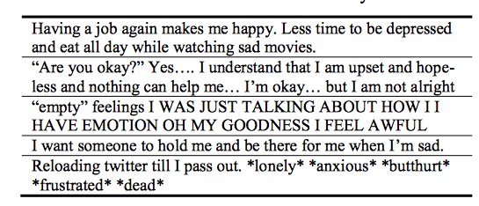
Sample Data

Slide 22
Measuring Depressive Behavior
Engagement: # posts-per-day, replies, retweets, links shared, questions
Insomnia index: %night posts 9pm-6am) vs. day posts
Egocentric social graph of exchanges with others measuring size, density, amount of exchange
Emotion: pos/neg; activation (intensity); dominance (control of emotion)
Linguistic style: LIWC
Depression language: depression lexicon; anti-depressants mentioned
Notes:
Night: 9pm-6am
Egocentric social graph: of a user to be an undirected network of the set of nodes in u ’s
two-hop neighborhood (neighbors of the neighbors of users in our dataset), where an edge between u and v implies
that there has been at least one @-reply exchange each, from u to v , and from v to u on a given day.

Slide 23
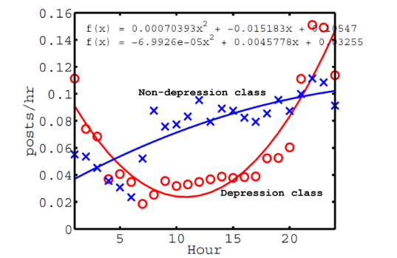
Tweet Activity and Depression
Notes:
All times are local time
Mean num of posts per hour, over entire year history
Depressed persons tend to post later at night and earlier in the morning…

Slide 24
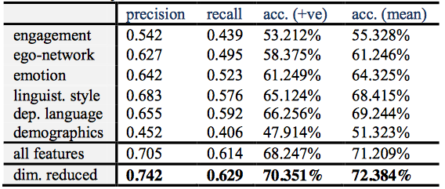
Depression Prediction Pre-Onset
Notes:
3rd col: mean accuracy of predicting positive class
Best performance from ling style features and next best from depressed lang features with emotion 3rd
Dimensionality reduction: use only principal variables

Slide 25
Schizophrenia
Chronic mental disorder
Symptoms:
Positive: hallucination, delusion, thought disorders, movement disorders
Negative: “flat affect”, reduced feelings of pleasure, reduced speaking
Cognitive: poor executive functioning, trouble focusing or paying attention, problems with working memory
Notes:
1% of population

Slide 26
Schizophrenia and Language
“Negative thought disorder”: Alogia
Poverty of speech; inability to speak easily
“Positive thought disorder”:
Derailment
“I always liked geography. My last teacher in that subject was Professor August A. He was a man with black eyes. I also like black eyes. There are also blue and grey eyes and other sorts, too…” (Bleuler, 1950)
Tangentiality:
Disturbance in the thought process that causes the individual to relate excessive or irrelevant detail that never reaches the essential point of a conversation or the desired answer to a question
Notes:
Alogia: inability to speak easily

Slide 27
“Well, in myself I have been okay what with the prices in the shops being what they are and my flat is just round the corner. I keep a watch for the arbiters most of the time since it is just round the corner. There is not all that much to do otherwise.”
Word-level abnormalities
“I got so angry I picked up a dish and threw it at the geshinker”
“So I sort of bawked the whole thing up”

Slide 28
Word Salad
“They’re destroying too many cattle and oil just to make soap. If we need soap when you can jump into a pool of water, and then when you go to buy your gasoline, my folks always thought they should, get pop but the best thing to get, is motor oil, and, money. May… may as well go there and, trade in some, pop caps and, uh, tires, and tractors to grup, car garages, so they can pull cars away from wrecks, is what I believe in. So I didn’t go there to get no more pop when my folks said it. I just went there to get a ice-cream cone, and some pop, in cans, or we can go over there to get a cigarette”

Slide 29
Quantifying the Language of Schizophrenia in Social Media (Mitchell et al., 2015)
Data: 174 Twitter users with self-stated diagnosis of schizophrenia
Age and gender matched controls, balanced dataset
Features:
LIWC
Open-vocabulary approaches
Latent Dirichlet Allocation (LDA), Brown clustering, character n-grams, perplexity
Notes:
LDA: unsupervised topic modeling – imagines a set of topics and tries to map all documents into that set; each user is then matched to a topic

Slide 30
LIWC Analysis
Schizophrenia users had more words from these categories: Cognitive mechanisms, death, function words, negative emotion
And fewer words from these categories: home, leisure, positive emotion

Slide 31
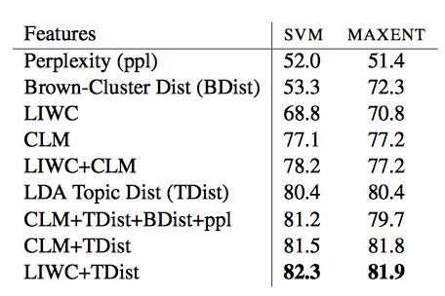
Classification Results using Support Vector Machines or Maximum Entity Modeling
Notes:
Maxent: predicts by identifying distribution that is most spread out or closest to uniform
Topic Distribution is the main LDA topic matched to each user; Bdist is the Brown cluster matched to the user
Perplexity (predictability) of user language is just the inverse of probability of a test set; minimizing perplexity maximizes probability
CLM: corpus vocabulary

Slide 32
Linguistic Analysis of Schizophrenia in Reddit Posts (Zomick et al., 2019)
Reddit:
No limits on post length
Subreddits on particular topics or for particular groups
Used a Python API Wrapper (PRAW) to streamline process
Notes:
API wrapper provides a way to access an API through a particular programming language or interface, which can help streamline the process of making API calls

Slide 33
Data
Subreddits:
r/schizophrenia
r/schizophrenic
r/AskReddit: “Any Redditors With Schizophrenia?”
Manual inspection for formal diagnosis
e.g. “my diagnosis of schizophrenia”

Slide 34
Data
Schizophrenia group: 159 users; 66,454 comments
Control group: 159 users; 113,570 comments
At least 10 posts per user in each group
Notes:
SZ: schizophrenia

Slide 35
LIWC Analysis
Comparison of LIWC findings across 5 studies in multiple domains (Reddit, Twitter, discussion boards)
Schizophrenia indicators across multiple studies:
- Increased: negative emotion, first person singular pronouns, tentative, cognitive process, health, anxiety, third person plural pronouns
- Decreased: leisure
New Schizophrenia indicators in this Reddit study:
- Increased: Word count, Dictionary words, Common adverbs, Verbs, Reward, and Drives

Slide 36
Decreased: 3rd person singular, Articles, Negations, Anger, Male references, Power, Money, Swear words, Question marks, Dashes, and Other punctuation
Differences may arise from this being the only study done exclusively with Reddit data

Slide 37
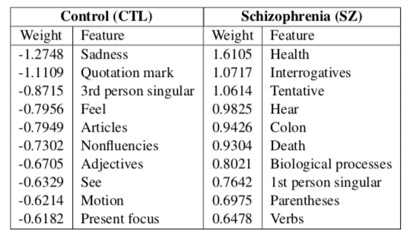
LIWC Analysis
Logistic Regression: 81.56% accuracy
Notes:
Top weighted features for logistic regression

Slide 38
Dementia
Broad category of brain diseases that cause long term decrease in ability to think and remember
Most common type - Alzheimer’s disease (AD)
60%-70% of cases
Affects 27.5 million people
3% of people 65-74
19% of people 75-84
~50% of people >85
$604 billion in costs per year

Slide 39
Alzheimer’s Disease Symptoms
Short-term memory loss
Problems with language
Disorientation
Mood swings
Decreased motivation

Slide 40
Cause
70% of risk is believed to be genetic
Risk factors:
Head injuries
Depression
Obesity
Hypertension
Cardiovascular disease
Smoking and excessive alcohol
Sleep problems

Slide 41
Pathology
Amyloid plaques: protein fragments that clump together in brains killing neurons
Tau tangles: twisted protein fibers that form inside neurons ultimately killing them
Notes:
How to prevent: proper diet and regular exercise but hard to clear these away altho much research and clinical trials

Slide 42
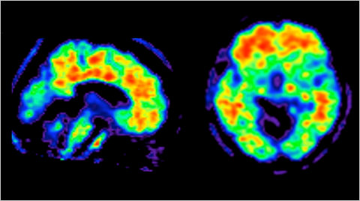
Amyloid Plaques in Brains

Slide 43
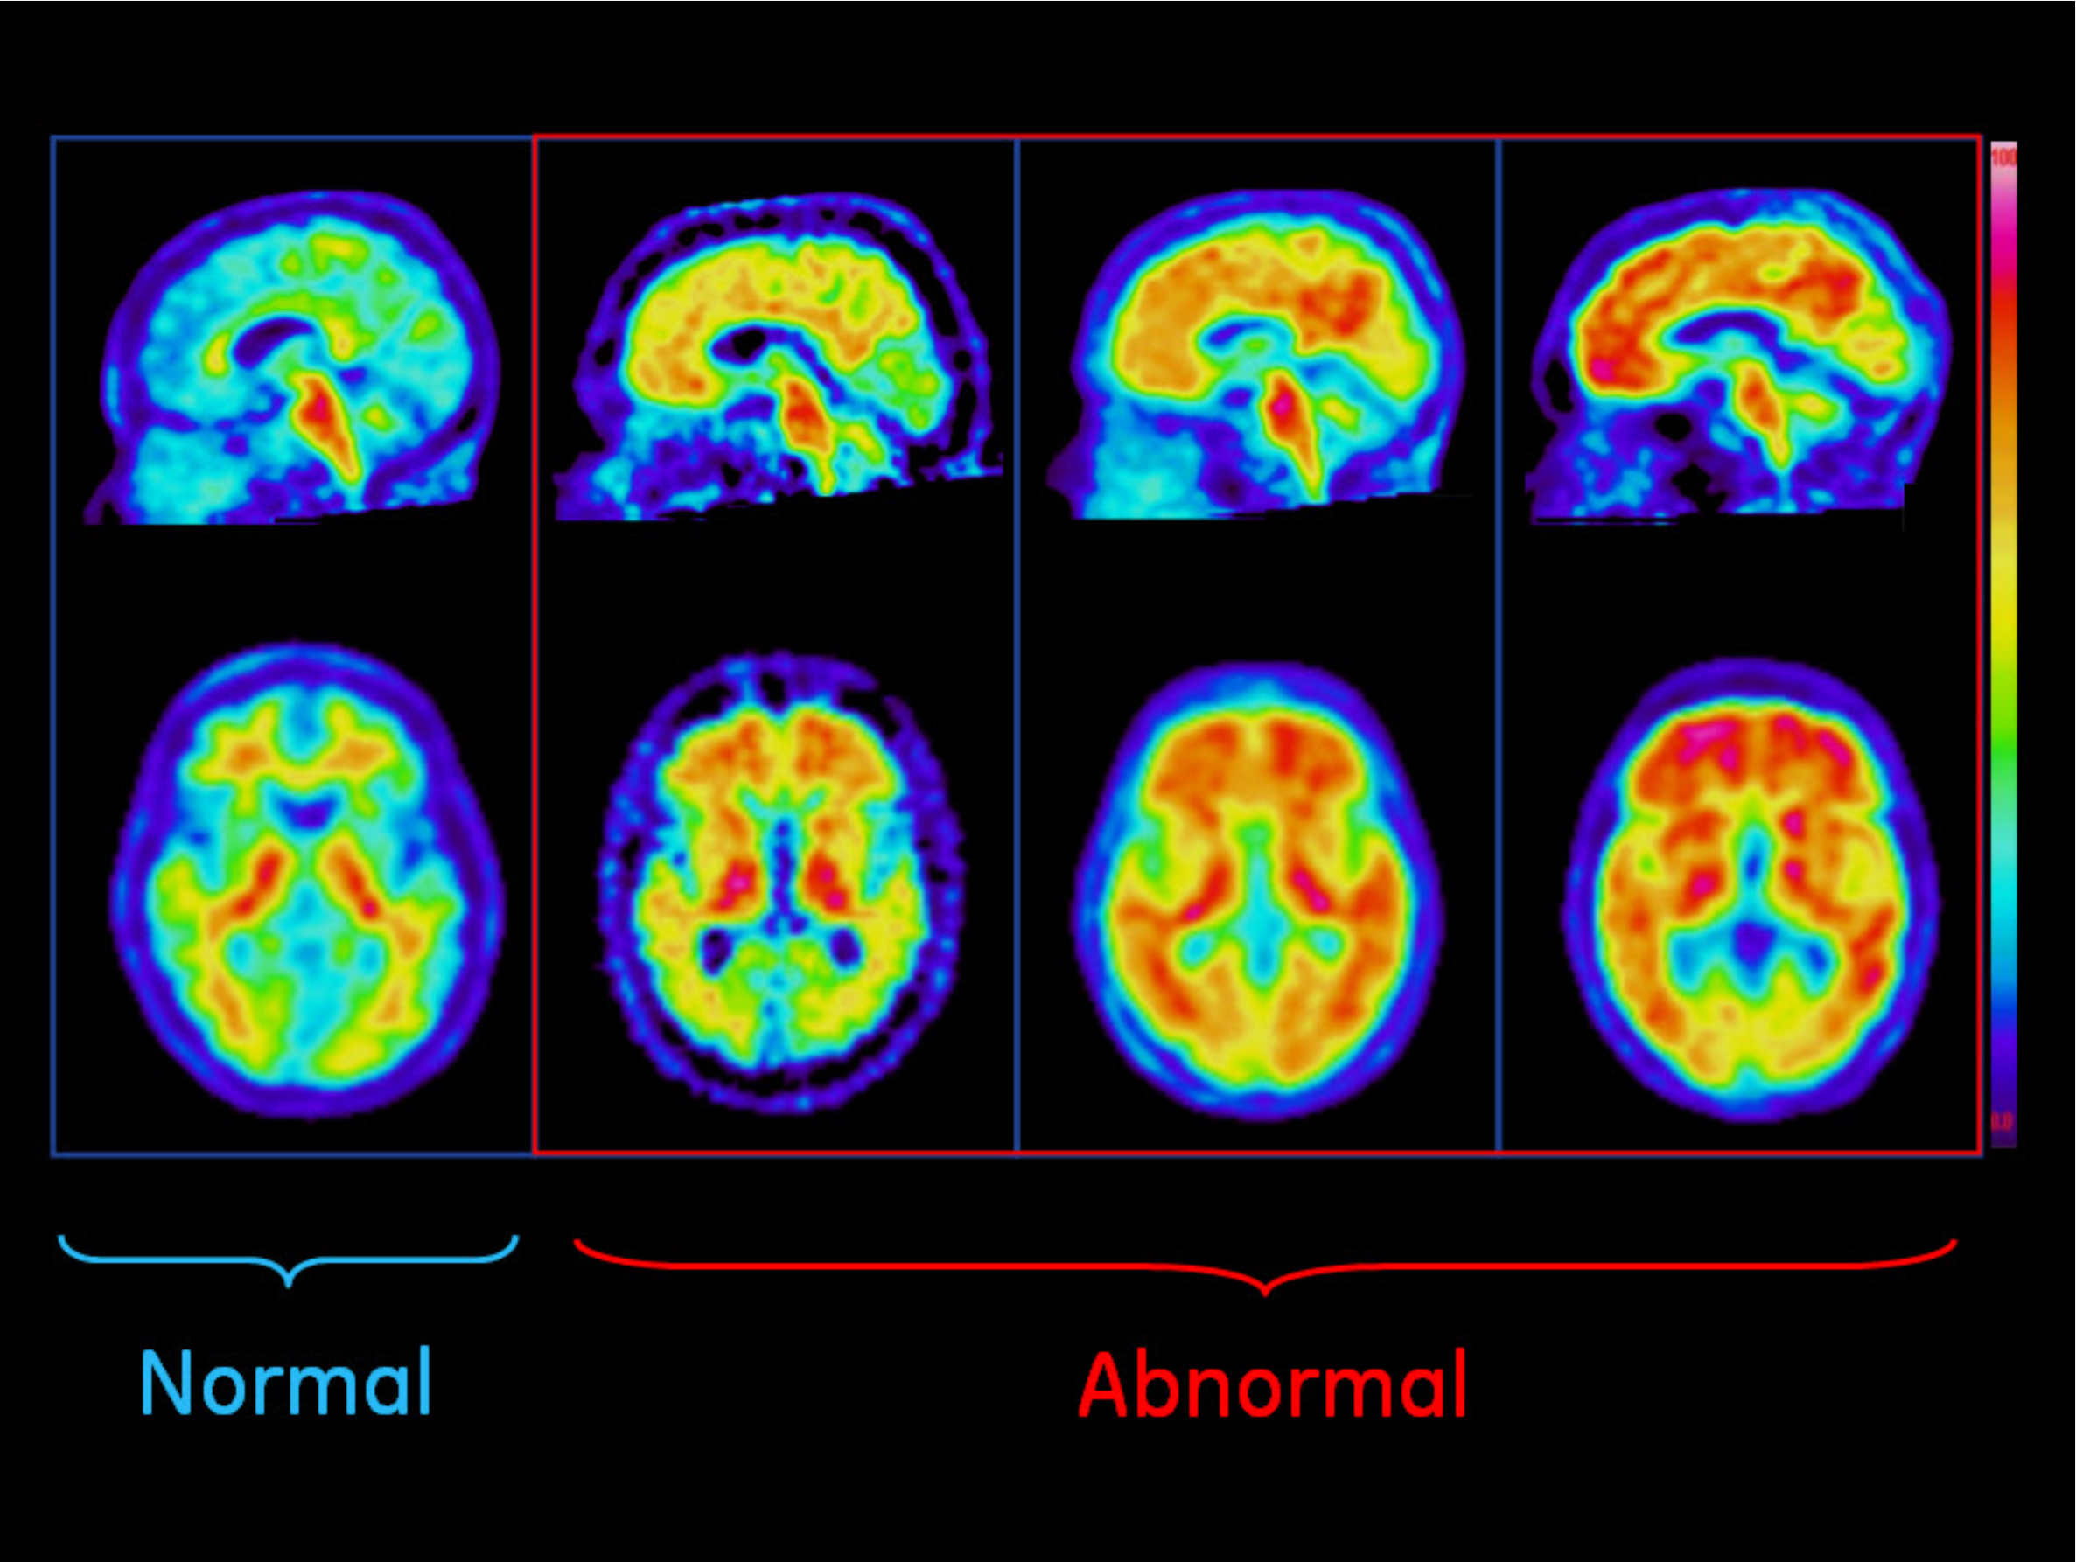
Amyloid Plaques in Normal and Abnormal Brains

Slide 44
Dementia Diagnosis
Can only be definitively diagnosed in a postmortem brain tissue examination
Clinical assessment can provide some information
Medical history
Physical exam
Neurological exam
Mental status tests

Slide 45
Mental Status Tests
Mini-mental state exam (MMSE)
Mini-Cog: quick screening for diagnosing early dementia
Notes:
dhs16_159601.pdf for MMSE?

Slide 46
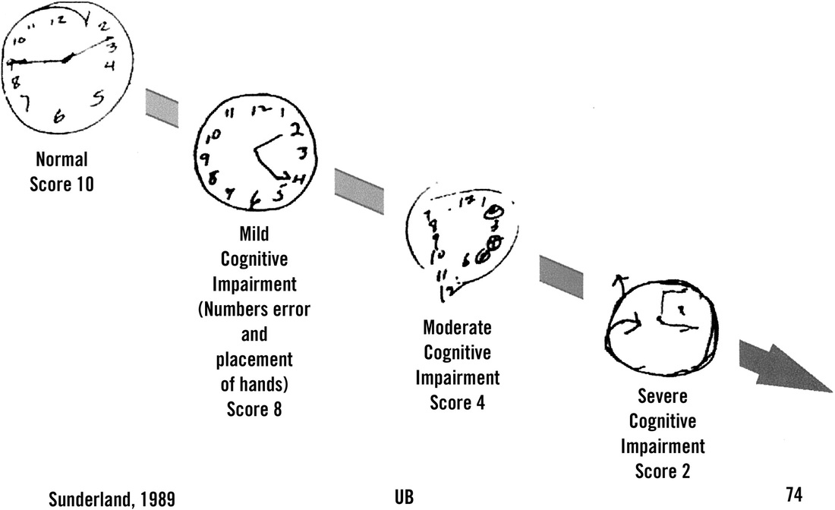
Draw a clock that shows the time at 2:45
Notes:
Draw a clock that represents the time 2:45

Slide 47
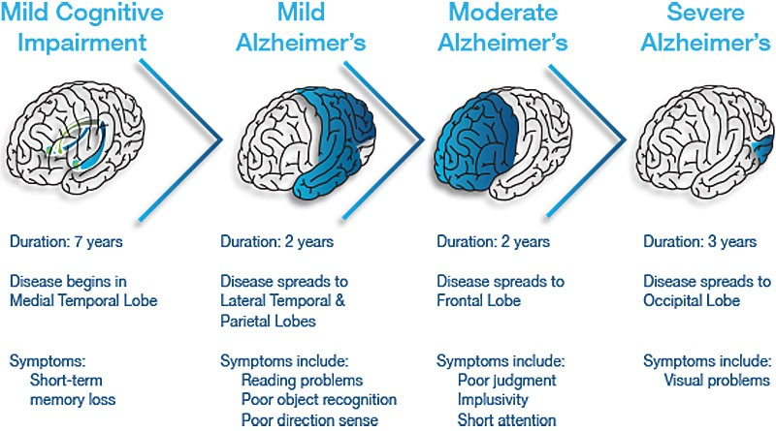
Stages of Alzheimer’s Disease

Slide 48
Stages of Alzheimer’s Disease
Pre-dementia
Mild Cognitive Impairment (MCI)
Short-term memory loss
Early
Increased impairment of learning and memory
Moderate
Increased impairment of learning and memory
Severe
Visual problems appear

Slide 49
Treatment
Medication for symptoms
Clinical trials

Slide 50
Alzheimer’s Dementia Recognition from Speech (Nasreenetal2021)
Prior work showed that acoustic, lexical, syntactic and semantic features identify Alzheimer’s as well as conversational features including disfluencies (fillers, repairs) and inter-speaker silence
Their work: Quantifying some speech features using part of the Carolinas Conversation collection corpus of patients with moderate AD vs. non-AD
Features:
Disfluencies: self-repairs, fillers
Interactional features: overlaps, turn-taking behavior, within-speaker silence and between speaker silence

Slide 51
Findings on discriminating between AD and non-AD:
Significant differences in disfluency features (edit terms, verbatim repetitions, substitutions)
Significant differences in interaction features (lapses, gaps, attributable silences, turn switches per minute, standardized phonation time, turn length)
Accuracy using SVMs
83% with disfluency features
83% with interactional features
90% combining both

Slide 52
Lexical Indicators of Alzheimer’s
Can we identify/predict AD from writing analysis?

Slide 53
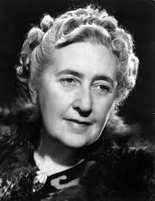
Case Study: Agatha Christie’s Novels
Notes:
Christie never diagnosed with Alzheimer’s but…

Slide 54
Language Use Changes with Age
U Toronto researchers Ian Lancashire, Graeme Hirst counted the numbers of words and word types she used from age 28 to 82
Vocabulary size decreased sharply by 15-30%
Increases in repeated phrases and indefinite nouns (something, thing, anything)
Elephants Can Remember (age 81) showed 30% fewer word than Destination Unknown (age 63)
Similar findings for Iris Murdoch

Slide 55
Dementia Progresses with Age (Snowden 2003, Healthy aging and dementia: findings from the Nun Study)
Longitudinal study, 1986--
678 Roman Catholic sisters 75-107 years old
Homogenous group
Autobiographical essays from archives containing early, mid-life and late-life writings

Slide 56
Excerpts from Different Sisters
Early: "It was about a half hour before midnight between February 28 and 29 of the leap year 1912 when I began to live, and to die, as the third child of my mother, whose maiden name is Hilda Hoffman, and my father, Otto Schmidt...”
Late: "I was born in Eau Claire, Wisconsin on May 24, 1913, and was baptized in St. James Church..."

Slide 57
Nun Study Findings
Sisters who scored poorly on
Idea density
Grammatical complexity
…were much more likely to develop dementia
E.g. sisters in lower third of idea density were 60 times more likely to develop Alzheimer’s than sisters in upper third
Using essays, predict with 92% accuracy whether the brain would contain plaques post-mortem

Slide 58
Vector-space Topic Models for Detecting Alzheimer’s Disease (Yancheva & Rudzicz, 2016)
Measure semantic content deficiency to identify low:
Idea density: ratio of semantic units to total number of words
Efficiency: rate of semantic units over duration of speech sample
Notes:
Less content from what is said

Slide 59
Measuring Semantic Content
Picture description task: humans asked to provide free-form verbal description of visual stimulus
Human-supplied information content units (hsICUs) representing subjects, objects, locations and actions from image
HsICUs then counted for scoring: AD sufferers provide fewer ICUs than healthy persons

Slide 60
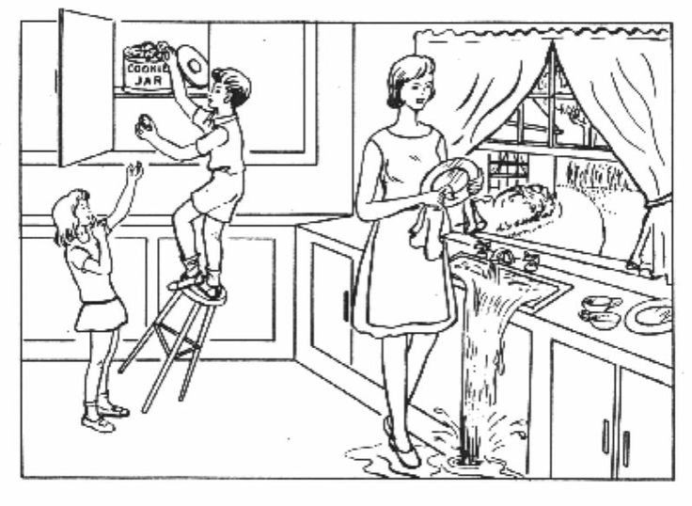

Slide 61
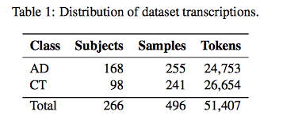
Method
Authors automatically generate Information Content Units from picture descriptions from a very large corpus
Data: DementiaBank (multiple languages)
Notes:
AD vs. controls
Speech samples

Slide 62
Automatic ICU Generation
Train word vector model on large general purpose corpus (GloVe)
Extract vector representations of words in DementiaBank corpus
Cluster vectors separately for AD and CT groups to represent “topics”

Slide 63
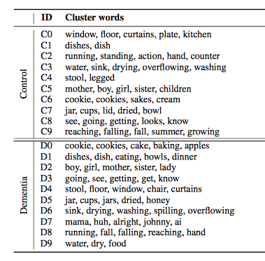
Notes:
Clusters for control and dementia subjects

Slide 64
Cluster Analysis
Do clusters match hsICUs?
Do the topics differ between groups?
Notes:
Human-supplied content units

Slide 65
Cluster Analysis
Do clusters match clinical hsICUs for this image?
Yes (except “dishcloth”)
Do the topics differ between groups?
Yes!
Control group uses: overflowing, sink, indifferent, mother, apron, window, curtain, cupboard, counter and AD group does not
AD group: brother, sister, son, daughter not mentioned by Control

Slide 66
Quantifying Irrelevance
Align pairs of clusters between AD and CT models
All control clusters are aligned with AD models but one AD model (D7) is not aligned with any CT model
AD produces “extraneous terms”: mama, huh, alright, johnny, ai
Notes:
AD: Alzheimers disease
CT: control group

Slide 67
Are Topics Discussed in Same Contexts?
Augment word vectors with local context windows
Results:
All control cluster words were used in the same contexts by both groups
Frequency of control words is higher in control group than AD group

Slide 68
Classification Experiments
Features:
Distance metrics for AD and CT clusters – how far is each item in the topic from the topic centroid (i.e. how coherent is the topic?)
Idea density: # expected topics mentioned/total words in transcript
Idea efficiency: # expected topics mentioned/total duration of recording

Slide 69
Random Forest classifier, 10-fold cross-validation
Compare models: cluster models (CT, AD, combined), feature sets, and with and w/out context
Baseline: hsICU features extracted by Fraser et al 2016

Slide 70
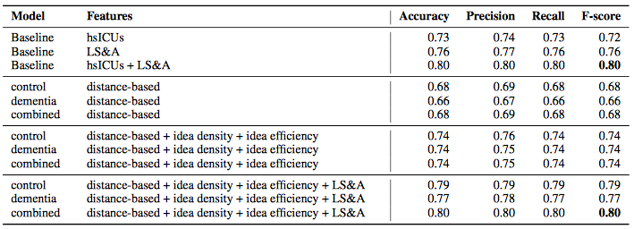
Classification Results
Notes:
Our 12 automatically generated features (i.e., the combined set of distance-based
measures, idea density, and idea efficiency) result in higher F-scores (0.74) than using 85 manually
generated hsICUs (0.72); a two-sample paired t-test shows no difference (using control cluster
model: t(9) = 1.10, p = 0.30; using dementia cluster model: t(9) = 0.74, p = 0.48) indicating
the similarity of our method to the manual gold standard. Furthermore, we match state-of-the-art
results (F-score of 0.80) when we augment the set of LS&A (linguistic syntactic and acoustic) features with our automatically generated
semantic features.

Slide 71
Some Other Recent Work
Jiang et al 2020, “Detection of Mental Health Conditions from Reddit via Deep Contextualized Representations,” 11th Int’l Workshop on Health Text Mining and Information Analysis.
Linguistic characteristics of 8 disorders vs. control group using multiple ML models
Jiang et al 2021, “Automatic Detection and Prediction of Psychiatric Hospitalizations From Social Media Posts,” Workshop on Comp Ling and Clinical Psychology.
Predicting how likely people are to need hospitalization by looking at before and after Reddit posts on 8 mental health conditions subreddits
Notes:
obsessive compulsive disorder (OCD), schizophrenia (SZ), borderline personality disorder (BPD), post- traumatic stress disorder (PTSD), eating disorder (ED), major depression dis-order (MDD), general anxiety disorder (GAD) and bipolar disorder

Slide 72
Shin et al, “Detection of Minor and Major Depression through Voice as a Biomarker Using Machine Learning,” Journal of Clinical Medicine 2021,10, 3046, 1-15.
Wang et al, “Depression Speech Recognition With a Three-Dimensional Convolutional Network,” Frontiers in Human Neuroscience, 15, 713823, 2021.

Slide 73
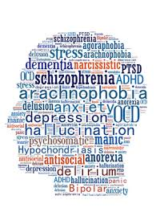
Ethics of Using Social Media for Health Research
Notes:
Discuss concerns about using social media for health research
Ethical guidelines:
IRB – institutional review board – required for all federally funded human subjects research in the US
Informed consent whenever possible
Protections for sensitive data – e.g. usernames
-> separate annotations from user data
De-identify data in public presentations

Slide 74
Ethics in NLP workshop
When might it be unethical to use human data?
Harvard “Embedded Ethics” in courses

Slide 75
Conclusions
NLP and speech processing are very useful tools for identifying and predicting mental illness
Social media also provides rich natural data
But we must take ethical considerations into account

Slide 76
Next Week
Topic: Deception and Trust, Radicalization
Note: Please start on HW3 early if you had some issues getting HW2 done on time

