Slide 1
A Broad Perspective on Large Scale Semi/Self- Supervised Learning for Speech Recognition
Adapted from IEEE ASRU 2021 keynote
Mar. 21, 2021
Bhuvana Ramabhadran

Slide 2
Collaborators
Andrew Rosenberg, Zhehuai Chen, Gary Wang, Yu Zhang, Heiga Zen, Jesse Emond, Yinghui Huang, Murali Karthick Bhaskar, Pedro Moreno
Notes:
The motivation for this work comes from recent developments in various areas. These include augmentation policies, consistency measures and virtual adversarial training or VAT. We will briefly go into details of each of these related areas.

Slide 3
Statistical models require labeled data
Vast amounts of unlabeled data
and
Relatively uncommon languages have less data in general
What are the approaches/techniques that lend themselves to learning from these scenarios?
Notes:
The motivation for this work comes from recent developments in various areas. These include augmentation policies, consistency measures and virtual adversarial training or VAT. We will briefly go into details of each of these related areas.

Slide 4
Self-supervised Learning allows for the efficient use of unlabeled data (audio and text) for speech processing
Historically, in speech and language processing, semi-supervised and unsupervised learning has been used extensively
Notes:
The motivation for this work comes from recent developments in various areas. These include augmentation policies, consistency measures and virtual adversarial training or VAT. We will briefly go into details of each of these related areas.

Slide 5
Machine Learning has focussed on learning speech representations for a variety of tasks in an unsupervised fashion and combined with supervised training for maximum results
Diversity of the data used for unsupervised learning plays a key role
Notes:
The motivation for this work comes from recent developments in various areas. These include augmentation policies, consistency measures and virtual adversarial training or VAT. We will briefly go into details of each of these related areas.

Slide 6
Speech Recognition (ASR)
Aligned to
Speech
Aligned to
Text
graphemic or word-piece outputs
Decoder
(Attention or
RNNT or HAT)
Encoder
filterbank inputs

Slide 7
Speech Synthesis (TTS)
Aligned to
Text
Aligned to
(downsampled) Speech
Aligned to
(audible) Speech
Tacotron 2 based
model
filterbank
(output)
waveform
(output)
Post Net
Vocoder
Encoder
Decoder
(attention)
graphemic or phonemic inputs
speaker id (input)
prosody control latent (input)

Slide 8
Self Supervision in Speech and Audio
Model learns discriminating patterns in the data in contrast to providing the model with annotations and asking the model to be sensitive to those specific annotations.
Cost function
Adversarial Methods
Supervised Fine tuning: tailoring learned representations to downstream tasks
Architectures
Robustness and transferability of speech representations with few examples
Injecting other modalities
Notes:
Model will learn discriminating pattern in the data instead of you giving annotatiiions and asking the model to be sensitive to specific annotations
Originally used Mutual Information - so positive samples from joint distribution say same sentence and negative samples from marginalized distributions say another sentence and maximize this information.
Encoder and discriminator trained together - loss is max mutual info
pretraining
CPC Predict future audio frame using previous frames and discriminates against a random frame contrast in latent space
APC predicts future frames via regression
Joint training encoder and prediictors for set of tasks - spectra, discrimiinators->PASE and PASE+ (regression tasks and binary tasks are solved )
Done so you do not learn a task specific representation and may get a complete view as these workers have to cooperate so more general and robust
Any encoder such as CNNs, transformer blockers etc
Regression tasks: auto encoder or power spectra or F0 so encoder becomes more powerful
Binary tasks: different sampling strategies use MI again
(so everything is self supervised) --can you do with a little supervision some labeled data?
Seq pedictor task--spirit of cpc --all samples from same utterance or different utterance
Cost function is average loss of these tasks.
Mention Chelsea Finn here --Meta learning
Masking and Reconstruction
For example, consistency measure shows up in the recent work self-supervised learning paper such as SimCLR, where input augmentation is coupled with a contrastive consistency loss to allow model to learn without any labels. This was achieved by ensuring that the model predictions were consistent when the input image was augmented with various crops and rotations.

Slide 9
Self Supervision in Speech and Audio
Cost function
Contrastive Predictive Coding (CPC) [1], Autoregressive Predictive Coding (APC) [2], Triplet Loss based approaches[15], Time Contrastive Networks [16]
  Encode underlying shared information in the high-dimensional signal
  Maximize Mutual Information between encoded representations
  Combine predicting future observations (predictive coding) with a probabilistic contrastive loss (NCE variants)
Notes:
Model will learn discriminating pattern in the data instead of you giving annotatiiions and asking the model to be sensitive to specific annotations
Originally used Mutual Information - so positive samples from joint distribution say same sentence and negative samples from marginalized distributions say another sentence and maximize this information.
Encoder and discriminator trained together - loss is max mutual info
pretraining
CPC Predict future audio frame using previous frames and discriminates against a random frame contrast in latent space
Pierre Sermanet, Corey Lynch, Jasmine Hsu, and Sergey Levine. Time-contrastive networks: Self-supervised learning from multi-view observation. arXiv preprint arXiv:1704.06888, 2017.
APC predicts future frames via regression
Joint training encoder and prediictors for set of tasks - spectra, discrimiinators->PASE and PASE+ (regression tasks and binary tasks are solved )
Done so you do not learn a task specific representation and may get a complete view as these workers have to cooperate so more general and robust
Any encoder such as CNNs, transformer blockers etc
Regression tasks: auto encoder or power spectra or F0 so encoder becomes more powerful
Binary tasks: different sampling strategies use MI again
(so everything is self supervised) --can you do with a little supervision some labeled data?
Seq pedictor task--spirit of cpc --all samples from same utterance or different utterance
Cost function is average loss of these tasks.
Mention Chelsea Finn here --Meta learning
Masking and Reconstruction
For example, consistency measure shows up in the recent work self-supervised learning paper such as SimCLR, where input augmentation is coupled with a contrastive consistency loss to allow model to learn without any labels. This was achieved by ensuring that the model predictions were consistent when the input image was augmented with various crops and rotations.

Slide 10
Self Supervision in Speech and Audio
Cost function
Selecting positive and negative samples
  Sampling from joint versus marginalized distributions
  Momentum Contrast (MoCo )in Vision[9] and Speech[17]
Multiple tasks (views) for a more complete representation
  Examples: Regressive, classification tasks
  Multi task learning and self-supervision
    Task Agnostic Speech Embeddings (PASE, PASE+) [7]
Notes:
Model will learn discriminating pattern in the data instead of you giving annotatiiions and asking the model to be sensitive to specific annotations
Originally used Mutual Information - so positive samples from joint distribution say same sentence and negative samples from marginalized distributions say another sentence and maximize this information.
Encoder and discriminator trained together - loss is max mutual info
pretraining
CPC Predict future audio frame using previous frames and discriminates against a random frame contrast in latent space
Pierre Sermanet, Corey Lynch, Jasmine Hsu, and Sergey Levine. Time-contrastive networks: Self-supervised learning from multi-view observation. arXiv preprint arXiv:1704.06888, 2017.
APC predicts future frames via regression
Joint training encoder and prediictors for set of tasks - spectra, discrimiinators->PASE and PASE+ (regression tasks and binary tasks are solved )
Done so you do not learn a task specific representation and may get a complete view as these workers have to cooperate so more general and robust
Any encoder such as CNNs, transformer blockers etc
Regression tasks: auto encoder or power spectra or F0 so encoder becomes more powerful
Binary tasks: different sampling strategies use MI again
(so everything is self supervised) --can you do with a little supervision some labeled data?
Seq pedictor task--spirit of cpc --all samples from same utterance or different utterance
Cost function is average loss of these tasks.
Mention Chelsea Finn here --Meta learning
Masking and Reconstruction
For example, consistency measure shows up in the recent work self-supervised learning paper such as SimCLR, where input augmentation is coupled with a contrastive consistency loss to allow model to learn without any labels. This was achieved by ensuring that the model predictions were consistent when the input image was augmented with various crops and rotations.

Slide 11
Self Supervision in Speech and Audio
Cost function
Unsupervised Latent Variable Model based data generation [4, 5]
  Clustering latent representations, Unsupervised Unit Discovery
    Codebook learning, VQVAE
wav2vec/ wav2vec2 : Combine contrastive loss and discrete representations [10]
HuBERT: Iterative learning of discretized representations (k-means clustering) and representation learning [21]
W2V-BERT [22]: Combines contrastive loss on continuous signal with masked language modeling (MLM) loss on the discretized representations.
Notes:
Model will learn discriminating pattern in the data instead of you giving annotatiiions and asking the model to be sensitive to specific annotations
One of the earliest form of loss was NCE loss.
Originally used Mutual Information - so positive samples from joint distribution say same sentence and negative samples from marginalized distributions say another sentence and maximize this information.
Encoder and discriminator trained together - loss is max mutual info
pretraining
CPC Predict future audio frame using previous frames and discriminates against a random frame contrast in latent space
APC predicts future frames via regression
Joint training encoder and prediictors for set of tasks - spectra, discrimiinators->PASE and PASE+ (regression tasks and binary tasks are solved )
Done so you do not learn a task specific representation and may get a complete view as these workers have to cooperate so more general and robust
Any encoder such as CNNs, transformer blockers etc
Regression tasks: auto encoder or power spectra or F0 so encoder becomes more powerful
Binary tasks: different sampling strategies use MI again
(so everything is self supervised) --can you do with a little supervision some labeled data?
Seq pedictor task--spirit of cpc --all samples from same utterance or different utterance
Mention Chelsea Finn here.
Masking and Reconstruction mainly to prevent the model to learn dummy things
For example, consistency measure shows up in the recent work self-supervised learning paper such as SimCLR, where input augmentation is coupled with a contrastive consistency loss to allow model to learn without any labels. This was achieved by ensuring that the model predictions were consistent when the input image was augmented with various crops and rotations.

Slide 12
Self Supervision in Speech and Audio
Adversarial /Augmentation Methods
SimCLR [3]: input augmentation is coupled with a contrastive consistency loss to allow model to learn without any labels.
Virtual adversarial training(VAT) is a form of model regularization that applies adversarial noise to the model input.
Masking and Reconstruction
  Augmentation methods (SpecAugment) to learn invariant representations [6]
Notes:
Model will learn discriminating pattern in the data instead of you giving annotatiiions and asking the model to be sensitive to specific annotations
Originally used Mutual Information - so positive samples from joint distribution say same sentence and negative samples from marginalized distributions say another sentence and maximize this information.
Encoder and discriminator trained together - loss is max mutual info
pretraining
CPC Predict future audio frame using previous frames and discriminates against a random frame contrast in latent space
Pierre Sermanet, Corey Lynch, Jasmine Hsu, and Sergey Levine. Time-contrastive networks: Self-supervised learning from multi-view observation. arXiv preprint arXiv:1704.06888, 2017.
APC predicts future frames via regression
Joint training encoder and prediictors for set of tasks - spectra, discrimiinators->PASE and PASE+ (regression tasks and binary tasks are solved )
Done so you do not learn a task specific representation and may get a complete view as these workers have to cooperate so more general and robust
Any encoder such as CNNs, transformer blockers etc
Regression tasks: auto encoder or power spectra or F0 so encoder becomes more powerful
Binary tasks: different sampling strategies use MI again
(so everything is self supervised) --can you do with a little supervision some labeled data?
Seq pedictor task--spirit of cpc --all samples from same utterance or different utterance
Cost function is average loss of these tasks.
Mention Chelsea Finn here --Meta learning
Masking and Reconstruction
For example, consistency measure shows up in the recent work self-supervised learning paper such as SimCLR, where input augmentation is coupled with a contrastive consistency loss to allow model to learn without any labels. This was achieved by ensuring that the model predictions were consistent when the input image was augmented with various crops and rotations.

Slide 13
Self Supervision in Speech and Audio
Supervised Fine Tuning
Joint training of encoder and decoders (predictors) as proposed in PASE and PASE+ [7]
Strategies to freeze different parts of the network during fine tuning on a small amount of labeled data
Meta Learning: Self supervision and fine-tuning on few samples [18]
BERT [8] and its variants used in Natural Language Processing tasks
Foundation Models [23] to capture representations that can be fine-tuned for tasks such as, object recognition, image captioning, information retrieval, etc.
Notes:
Model will learn discriminating pattern in the data instead of you giving annotatiiions and asking the model to be sensitive to specific annotations
Originally used Mutual Information - so positive samples from joint distribution say same sentence and negative samples from marginalized distributions say another sentence and maximize this information.
Encoder and discriminator trained together - loss is max mutual info
pretraining
CPC Predict future audio frame using previous frames and discriminates against a random frame contrast in latent space
Pierre Sermanet, Corey Lynch, Jasmine Hsu, and Sergey Levine. Time-contrastive networks: Self-supervised learning from multi-view observation. arXiv preprint arXiv:1704.06888, 2017.
APC predicts future frames via regression
Joint training encoder and prediictors for set of tasks - spectra, discrimiinators->PASE and PASE+ (regression tasks and binary tasks are solved )
Done so you do not learn a task specific representation and may get a complete view as these workers have to cooperate so more general and robust
Any encoder such as CNNs, transformer blockers etc
Regression tasks: auto encoder or power spectra or F0 so encoder becomes more powerful
Binary tasks: different sampling strategies use MI again
(so everything is self supervised) --can you do with a little supervision some labeled data?
Seq pedictor task--spirit of cpc --all samples from same utterance or different utterance
Cost function is average loss of these tasks.
Mention Chelsea Finn here --Meta learning
Masking and Reconstruction
For example, consistency measure shows up in the recent work self-supervised learning paper such as SimCLR, where input augmentation is coupled with a contrastive consistency loss to allow model to learn without any labels. This was achieved by ensuring that the model predictions were consistent when the input image was augmented with various crops and rotations.

Slide 14
Self Supervision in Speech and Audio
Architectures and Transferability
Encoders: Transformers, VGGs, Conformers, SincNet [19], etc.
Multilingual representations and bottleneck features from various architectures
Are the losses used in speech and language transferable to vision or robotics and vice-versa [20] ?
Notes:
Model will learn discriminating pattern in the data instead of you giving annotatiiions and asking the model to be sensitive to specific annotations
Originally used Mutual Information - so positive samples from joint distribution say same sentence and negative samples from marginalized distributions say another sentence and maximize this information.
Encoder and discriminator trained together - loss is max mutual info
pretraining
CPC Predict future audio frame using previous frames and discriminates against a random frame contrast in latent space
Pierre Sermanet, Corey Lynch, Jasmine Hsu, and Sergey Levine. Time-contrastive networks: Self-supervised learning from multi-view observation. arXiv preprint arXiv:1704.06888, 2017.
APC predicts future frames via regression
Joint training encoder and prediictors for set of tasks - spectra, discrimiinators->PASE and PASE+ (regression tasks and binary tasks are solved )
Done so you do not learn a task specific representation and may get a complete view as these workers have to cooperate so more general and robust
Any encoder such as CNNs, transformer blockers etc
Regression tasks: auto encoder or power spectra or F0 so encoder becomes more powerful
Binary tasks: different sampling strategies use MI again
(so everything is self supervised) --can you do with a little supervision some labeled data?
Seq pedictor task--spirit of cpc --all samples from same utterance or different utterance
Cost function is average loss of these tasks.
Mention Chelsea Finn here --Meta learning
Masking and Reconstruction
For example, consistency measure shows up in the recent work self-supervised learning paper such as SimCLR, where input augmentation is coupled with a contrastive consistency loss to allow model to learn without any labels. This was achieved by ensuring that the model predictions were consistent when the input image was augmented with various crops and rotations.

Slide 15
Self Supervision in Speech and Audio
Text Injection
Injecting Text In Self-Supervised Speech Pre-Training [24]
  Combining supervised and unsupervised loss and TTS
Joint training of speech and text using text, speech and multimodal encoders[25,26]
Notes:
Model will learn discriminating pattern in the data instead of you giving annotatiiions and asking the model to be sensitive to specific annotations
Originally used Mutual Information - so positive samples from joint distribution say same sentence and negative samples from marginalized distributions say another sentence and maximize this information.
Encoder and discriminator trained together - loss is max mutual info
pretraining
CPC Predict future audio frame using previous frames and discriminates against a random frame contrast in latent space
Pierre Sermanet, Corey Lynch, Jasmine Hsu, and Sergey Levine. Time-contrastive networks: Self-supervised learning from multi-view observation. arXiv preprint arXiv:1704.06888, 2017.
APC predicts future frames via regression
Joint training encoder and prediictors for set of tasks - spectra, discrimiinators->PASE and PASE+ (regression tasks and binary tasks are solved )
Done so you do not learn a task specific representation and may get a complete view as these workers have to cooperate so more general and robust
Any encoder such as CNNs, transformer blockers etc
Regression tasks: auto encoder or power spectra or F0 so encoder becomes more powerful
Binary tasks: different sampling strategies use MI again
(so everything is self supervised) --can you do with a little supervision some labeled data?
Seq pedictor task--spirit of cpc --all samples from same utterance or different utterance
Cost function is average loss of these tasks.
Mention Chelsea Finn here --Meta learning
Masking and Reconstruction
For example, consistency measure shows up in the recent work self-supervised learning paper such as SimCLR, where input augmentation is coupled with a contrastive consistency loss to allow model to learn without any labels. This was achieved by ensuring that the model predictions were consistent when the input image was augmented with various crops and rotations.

Slide 16
Learning consistent representations from data
Stochastic Augmentation
Consistency Regularization
Consistent Predictions from synthesized speech
Learning from unlabeled text and audio
Notes:
The first motivation comes from recent developments in augmentation policy search, which has shown great performances on ImageNet. The first of the series is auto augment, where a RL controller search for an optimal augmentation policy. It should be pointed out that this requires an inner loop of evaluation on a small proxy task. Subsequent paper such as Fast Auto augment replaces the RL policy search with a more efficient density matching search. And in the most recent work, Rand Augment, it was found that uniform sampling of strong and diverse augmentations were sufficient to achieve good performance, and this can be achieved without a costly inner evaluation loop. In our work, we draw motivation from Rand Augment in our augmentation policy development.

Slide 17
SCADA: Stochastic, Consistent and Adversarial Data Augmentation to Improve ASR
Wang, G., Rosenberg, A., Chen, Z., Zhang, Y., Ramabhadran, B., Moreno, P.J., SCADA: Stochastic, Consistent and Adversarial Data Augmentation to Improve ASR. Proc. Interspeech 2020
Notes:
Hello everyone, my name is Gary Wang and i’m here to present our work. Scada, stochastic, consistent and adversarial data augmentation to improve ASR.
Add a couple of references here -

Slide 18
Motivation
Augmentation Methods and Policies in image processing
Consistency Measures CoDA, augmentation and self supervised learning
VAT Model regularization for robustness
Notes:
The motivation for this work comes from recent developments in various areas. These include augmentation policies, consistency measures and virtual adversarial training or VAT. We will briefly go into details of each of these related areas.

Slide 19
Stochastic
Data Augmentation approaches are selected
at random from a structured inventory
Consistent
Consistency regularization encourages the model
to respond identically to augmented copies
Adversarial
Virtual Adversarial Training (VAT) perturbs data points in the
direction of greatest increase of error

Slide 20
Motivation: Augmentation Policies
Augmentation policies search have shown great performance on ImageNet
AutoAugment: RL controller selects best augmentation policy based on performance on proxy task
Fast AutoAugment: Replace inner loop RL policy search with more efficient density matching search
RandAugment: Uniform random sampling of strong and diverse augmentations perform just as well as policies found by more costly searching
Notes:
The first motivation comes from recent developments in augmentation policy search, which has shown great performances on ImageNet. The first of the series is auto augment, where a RL controller search for an optimal augmentation policy. It should be pointed out that this requires an inner loop of evaluation on a small proxy task. Subsequent paper such as Fast Auto augment replaces the RL policy search with a more efficient density matching search. And in the most recent work, Rand Augment, it was found that uniform sampling of strong and diverse augmentations were sufficient to achieve good performance, and this can be achieved without a costly inner evaluation loop. In our work, we draw motivation from Rand Augment in our augmentation policy development.

Slide 21
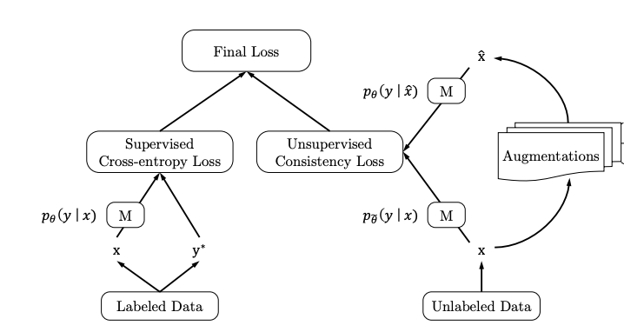
Motivation: Consistency Measures
Consistency measures ensure model predictions are consistent under perturbations/augmentations
Recent semi-supervised/ self-supervised learning show importance consistency loss (a.k.a contrastive learning/loss)
CODA (previous work), shows that consistency measure was crucial in making incorporation of TTS synthesized training work well for ASR performance
Notes:
The second motivation for our work is in the area of consistency measures. Consistency measures have shown their importance in recent line of work in semi-supervised and self-supervised learning. Consistency measure is a broad term defining some sort of loss metric that ensures the model prediction is consistent with different inputs. For example, consistency measure shows up in the recent work self-supervised learning paper such as SimCLR, where input augmentation is coupled with a contrastive consistency loss to allow model to learn without any labels. This was achieved by ensuring that the model predictions were consistent when the input image was augmented with various crops and rotations. And in the area of semi-supervised learning, such as our previous work on CODA, we successfully applied consistency loss in the form of KL divergence on model predictions which allowed us to effectively train ASR models on both TTS synthesized and real speech, despite vast differences in their realizations.

Slide 22
Motivation: Virtual Adversarial Training (VAT)
Model regularization method that applies adversarial perturbation in model input to achieve local distributional smoothing
Used extensively in semi-supervised learning work
Unlike other model regularization methods, VAT works by directly perturbing the model input
VAT is a 2 step process
  Step 1: adversarial noise generation
  Step 2: Minimize Model prediction KL with original and noised inputs
Notes:
And the third motivation comes from recent work in semi-supervised learning that employed a form of model regularization called Virtual adversarial training, or VAT. VAT is a form of model regularization that applies adversarial noise to the model input. Unlike other regularization methods such as L1 / L2 and dropout, which applies regularization either in the loss term or model architecture, VAT applies regularization by modifying the model input directly. In essence, VAT tries to achieve what’s called local distributional smoothing. This simply means that the model predictions should be smooth in local regions near the model input. By achieving local distributional smoothing, we can hope that the model would not be sensitive to small perturbations in the inputs.

Slide 23
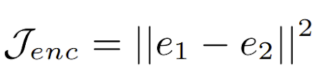
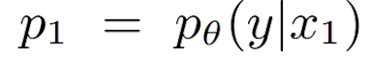
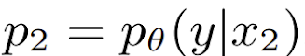

Consistency Measures
Encoder L2 consistency: Given two augmented version of the same input x1, x2, we obtain the model’s encoder outputs as e1, e2
  Loss term is:
Decoder Consistency: Given model prediction posterior distributions p1 and p2, we compute the Jensen Shannon Divergence (JSD) measure as:
Notes:
During training, given each melspectrogram, we apply our stacking randAugment policies two times to obtain two distinct augmented version of the input, which are then passed through the model. We can then enforce some consistency measures on the model predictions of these two inputs. Specifically, we investigated encoder consistency, where we apply L2 loss on the model’s encoder ouptuts. We also investigated using model decoder consistency, where we compute the Jensen Shannon Divergence on the Model decoder outputs, or logits. The formulation is shown Jensen Shannon Divergence is shown here.

Slide 24
VAT Visualized
Step 1: Adv Noise Computation
CE Loss
Logits
Mel
ASR
KL
+
Noise
Noise Logits
gradient
Notes:
Here we briefly cover how VAT is applied to ASR. Initially we have the regular ASR training pipeline, where given melspectrogram features, we pass that through our ASR model, which computes logits and subsequent cross entropy loss. The first step of VAT is to compute the adversarial noise, we do this by first adding small random noise to the input mespectrogram, passing this through our model to obtain noise logits. We can then compute the KL between noised logits and original logits, and use the gradient of this KL loss with respect to the input melspectrogram as the noise direction, scaled by some norm. This gradient directed and scaled noise is our adversarial noise.

Slide 25
VAT Visualized
Step 2: Adding KL Loss Term
CE Loss
Total Loss
Logits
Mel
ASR
KL
+
Adv Noise
Noise Logits
gradient
Notes:
In step 2 of VAT, we add this computed adversarial noise to our melspectrogram, and again obtain noise logits from our model. Now we’d like the model to be robust to this adversarial noise, so we add the KL loss term force the noised logits and original logits to be similar. This is the two step VAT process.

Slide 26
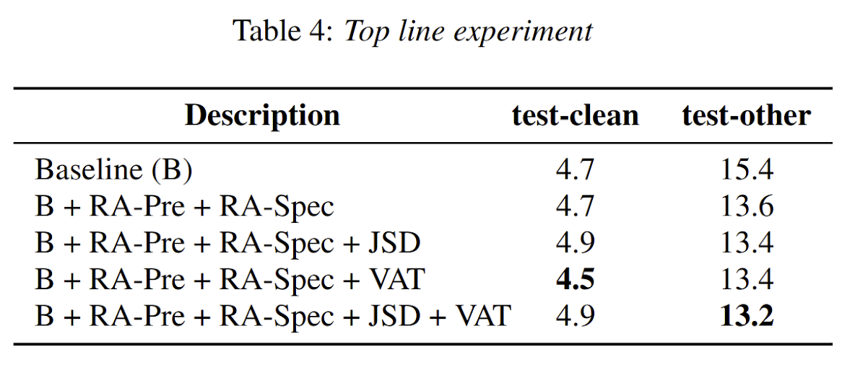
Key Messages
Data Augmentation policies can be combined with consistency regularization and yield gains for ASR, especially for noisier speech
For Librispeech task:
  4 % relative gains with consistency measure such as JSD
  12% relative gains with VAT
  15% relative gains combining the two
Performance of model trained on Librispeech 460 Hrs get close to one trained on 960 Hrs with these techniques
Notes:
In conclusion, we show that data augmentation policies can be combined with consistency measures and model regularization method such as VAT to provide gains for ASR, especially for noisier speech. We were able to achieve significant gains on the Librispeech task, with our model trained on Librispeech 460 hours clean getting close to performance of a system trained on Librispeech 960 Hours with these techniques.

Slide 27
Improving Speech Recognition Using
Consistent Predictions on Synthesized Speech
G. Wang, A. Rosenberg, Z. Chen, Y. Zhang, B. Ramabhadran, Y. Wu, P. Moreno, "Improving Speech Recognition Using Consistent Predictions on Synthesized Speech," IEEE International Conference on Acoustics, Speech and Signal Processing (ICASSP), Barcelona, Spain, 2020.
Notes:
'IMPROVING SPEECH RECOGNITION USING CONSISTENT PREDICTIONS ON SYNTHESIZED SPEECH

Slide 28
Because
TTS Quality is indistinguishable from Human Speech
(in some contexts)
ASR Quality is (most) significantly improved by including
more training data
Notes:
The main motivation for our work comes from two main ideas. In the first case, recent advances in text to speech, or TTS, has shown that synthesized speech is getting closer and closer to human speech. At the same time, it’s been shown that neural network based ASR models can generally be improved with the addition of more training data.

Slide 29
But it’s not that easy...
While having very high quality TTS is not identical to Human Speech
Synthesized speech exhibits much less variation than real speech
  Speaker Diversity
  Noise Diversity
  Pronunciation Diversity
  Acoustic Channel Diversity
Synthesized speech contains minimal speech disfluencies.
Selection of what text to synthesize (Lexical Diversity) remains an open question
Notes:
This, of course, is easier said than done. There are a few problems in directly applying TTS synthesized data into ASR training, and we outline some of them here. The main issue is that TTS exhibits much less variation than real speech. This ranges from speaker diversity, noise diversity, pronunciation diversity, etc etc. Also, TTS synthesized speech contains minimal to no speech disfluencies, which is very different than in the wild ASR data. Lastly, the question of selecting what text to synthesize, aka lexical diversity, remains an open question.

Slide 30
Unsupervised Data Augmentation (UDA)
[Unsupervised Data Augmentation for Consistency Training
Xie et al. 2019]
Training Objective
Notes:
Our work takes inspiration from recent developments in semi-supervised learning, specifically unsupervised data augmentation, or UDA. The UDA set up is shown in the diagram here. We can see regular supervised loss on the left. The right of the diagram shows how unlabelled data is being used. Specifically, unlabelled data X is passed through various different augmentations to generate X hat. Both X and X hat are then passed through the model M to generate their respective model predictions. An unsupervised consistency loss is then applied to these model predictions to ensure that the augmented model predictions are consistent with predictions with no augmentation. Most if not all recent semi supervised work employ some form of consistency loss on unlabelled data. For our work, we adapt this consistency loss to work in the supervised training regime with TTS as data augmentation.

Slide 31


Supervised Extension of UDA with TTS Augmentation
Speech Hypothesis
TTS
Hypothesis
Supervised Losses
ASR
TTS
Consistency Loss
TTS
Training Objective
Speech
Transcript
Notes:
Here we show our consistency based supervised training with TTS augmentation. The diagram on the left shows the general model flow. The left arrow represents the regular ASR forward propagation with ground truth speech resulting in ground truth model predictions. The right arrow represents a two stage process. Firstly, ground-truth transcripts are fed to the TTS to synthesize TTS utterances in the form of melspectrogram. This synthesized speech is then passed through our ASR system in a second forward propagation to obtain TTS model predictions. A consistency loss is then applied on these two model predictions. The right shows the 3 losses contributing to our overall training objective, regular asr loss, TTS loss, and finally the consistency loss.

Slide 32
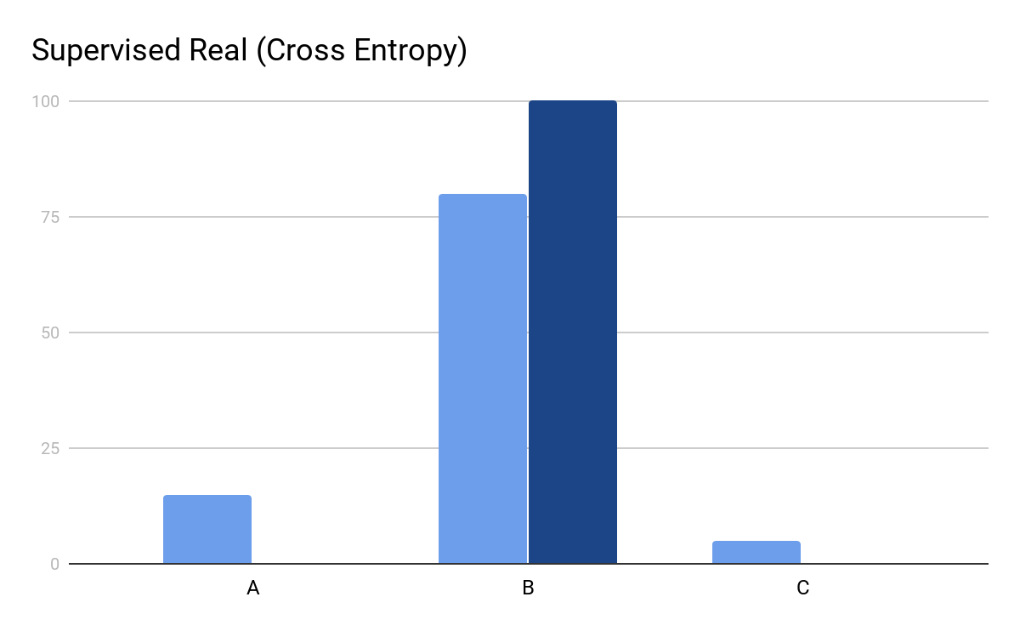
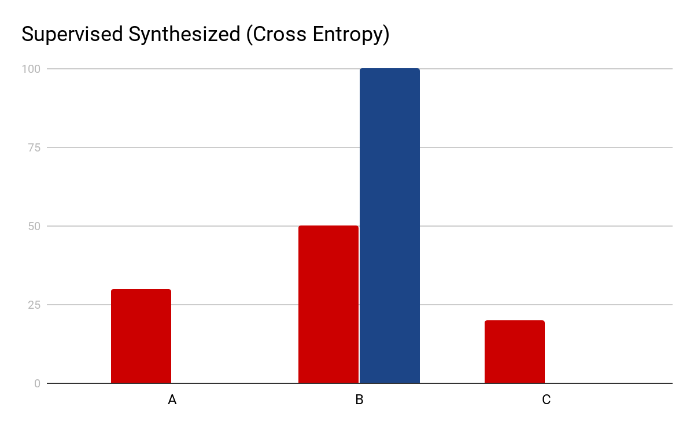
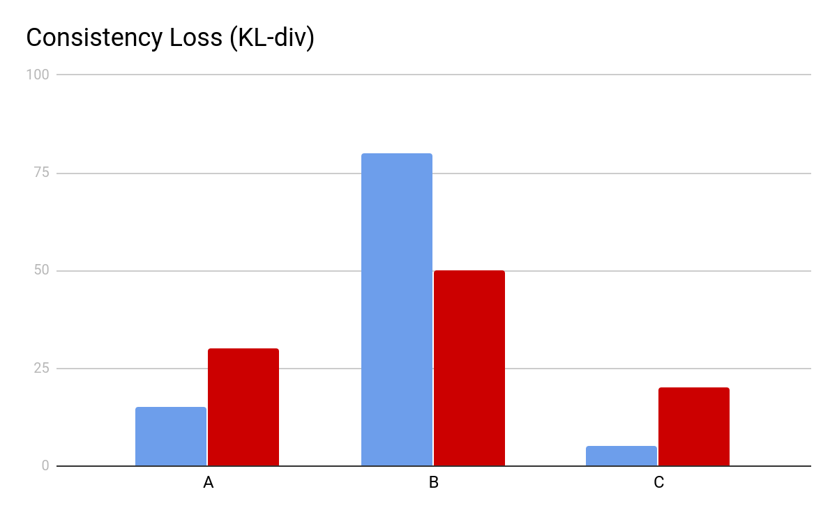
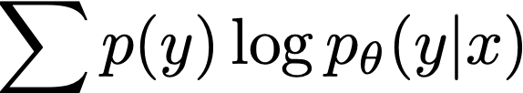
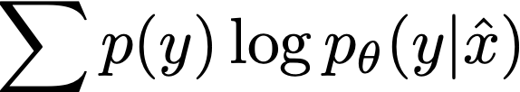

Consistency Loss per ASR Prediction
Attention models are trained with teacher forcing.
Consistency Loss Term is calculated on aligned predictions, not aligned frames
Cross Entropy
Real Speech
Cross Entropy
Synthesized Speech
KL Divergence
Target is a one-hot
Target is a one-hot
Posterior Matching
Notes:
In our work, consistency loss is applied on ASR prediction between real speech and TTS synthesized speech. A point to note is that since attention models are trained with teacher forcing in supervised training setup, the consistency loss term is calculated on aligned output predictions, and not on aligned input frames. The diagram shows the different model logits between real speech and synthesized speech. We then apply KL divergence to enforce posterior matching between real and synthesized model output distributions.

Slide 33
Relationship to Speech Chain
[Listening while Speaking: Speech Chain by Deep Learning Tjandra et al. 2017]
Speech Hypothesis
TTS
Hypothesis
Speech Chain trains both TTS and ASR jointly.
“Consistency” is measured through a “back-translation” loss e.g. x = f(g(x))
True
Transcript
Hypothesized
Transcript
ASR
x
x’
TTS
ASR
TTS
Speech
Transcript
Hypothesized
Audio
True
Audio
Notes:
Here we compare our set up to related work, specifically the work on Speech Chain. In Speech Chain, ASR and TTS models are jointly trained, and updated with a back translation style cycle consistency loss. Given ground-truth speech, Speech Chain applies ASR decoding to get a hypothesis, and these hypotheses are fed back to the TTS to synthesize audio. A consistency loss is then applied on the synthesized audio and original ground-truth audio. A similar chain in the reverse direction is applied to ground-truth text, where a TTS first synthesizes audio from these texts, then an ASR produces hypotheses from these synthesized speech, and a consistency loss is applied on the ground truth and hypothesis text. Our work can be viewed as a variant of Speech Chain where only half the chain is used.

Slide 34
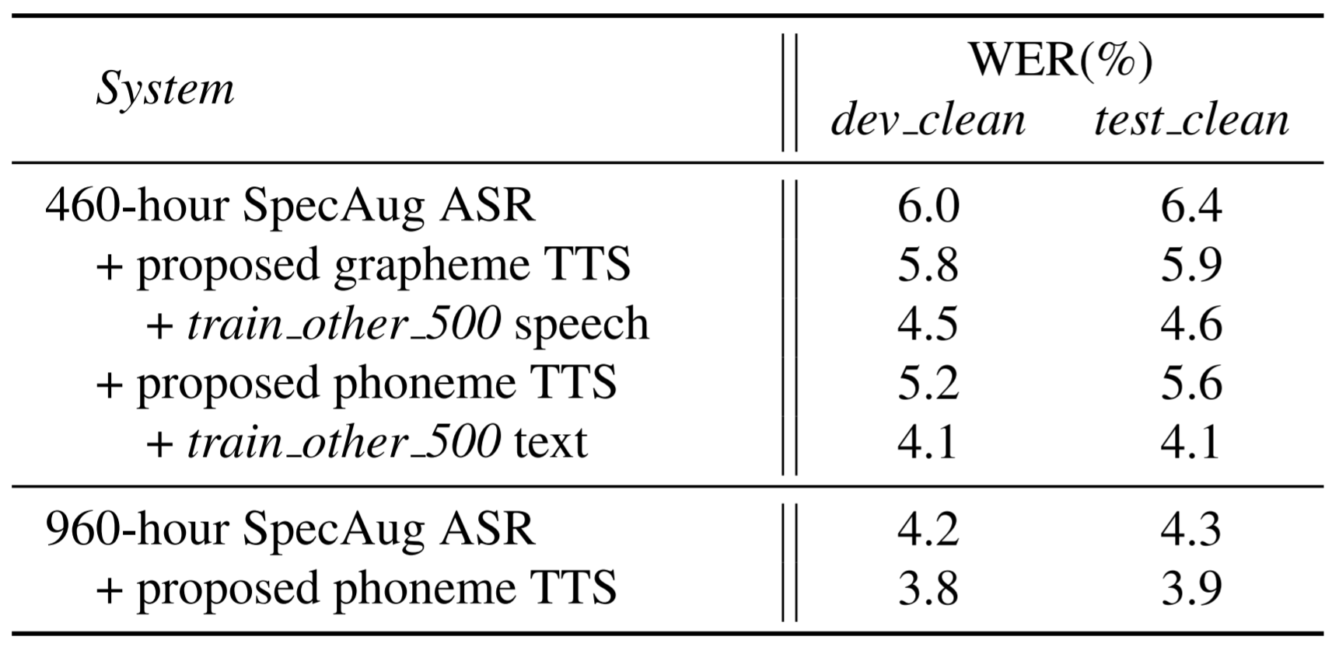
Extension to Semi supervised Training
Notes:
Lastly we examine how TTS augmentation works in the semi-supervised ASR training domain. We apply TTS augmentation with consistency loss to the ASR model trained on Libirspeech clean 460 hours, supplemented with TTS synthesized speech from train other 500 Hrs texts only. We can see that TTS augmentation with consistency gets us to within 0.1 percent word error rate of a baseline system trained on the entire 960 Hr data. This means we can achieve similar performance with around half the amount of speech data.

Slide 35
Key Messages
TTS Data Augmentation and Consistency Loss improve a reasonable baseline of 6.4 to 4.6.
When there is sufficient text available, reliance on transcribed audio can be cut nearly in half
  When we augment with unspoken text, we find improvement to 4.1, as compared to a supervised system that achieves 3.9%.
Notes:
Note, we also find improvement to the 960 comparison by using tts augmentaiton.

Slide 36
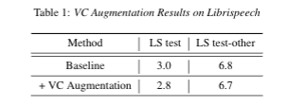
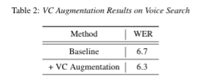
… how about Voice Conversion ?
Instead of generating synthetic features, can we morph speaker accent and prosody through voice conversion and augment ASR training data?
  Short answer: yes
  Long answer: Gains are varied and largely depend on the corpora and amount of training data.
    MOS scores show accent transfer is quite good! (Interspeech 2022 submission)
Notes:
Note, we also find improvement to the 960 comparison by using tts augmentaiton.

Slide 37
Injecting Text in Self-Supervised Speech Pretraining
Chen, Z., Zhang, Y., Rosenberg, A., Ramabhadran, B., Wang, G. and Moreno, “Injecting text in self-supervised speech pretraining", ASRU 2021
Notes:
Hello everyone, my name is Gary Wang and i’m here to present our work. Scada, stochastic, consistent and adversarial data augmentation to improve ASR.
Add a couple of references here -

Slide 38
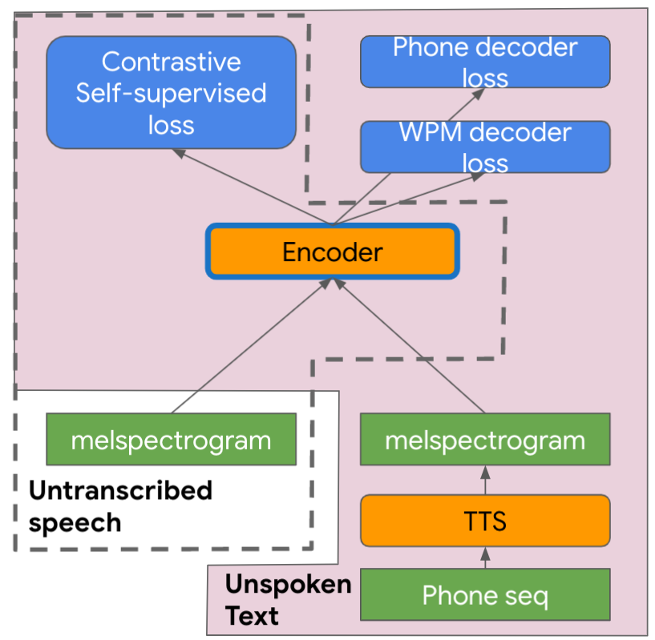
Goal:
Learn joint representations during pretraining from two modalities: speech and text.
Solution: TTS4Pretrain
Synthesize utterances from unspoken text and combine with untranscribed speech during pretraining
Auxiliary ASR-based losses for synthesized inputs
Results:
3.5-15% relative reduction in WER across different domains, languages, and data sizes over wav2vec 2.0
Additional 6% relative reduction in WER with LM fusion
In-domain text in pretraining can compensate for out-of-domain audio
Notes:
In this work, we try to learn joint text and speech representation
Improvement over speech-only across diff domain, lang and data amount

Slide 39
Speech-only Self-supervised Pretrain
Wav2vec 2.0 has shown to be an effective encoder pre-training strategy, especially on in-domain data.
State of the art results when combined with Conformer encoders.
Leverages large amounts of untranscribed data without a good teacher model.
Nevertheless,
No guarantee that the learned representation is optimal for downstream ASR.
Cannot take advantage of unspoken text.
Baevski, Alexei, et al. "wav2vec 2.0: A framework for self-supervised learning of speech representations." arXiv preprint arXiv:2006.11477 (2020).
Hsu, Wei-Ning, et al. "Robust wav2vec 2.0: Analyzing Domain Shift in Self-Supervised Pre-Training." arXiv preprint arXiv:2104.01027 (2021).
Zhang, Yu, et al. "Pushing the limits of semi-supervised learning for automatic speech recognition." arXiv preprint arXiv:2010.10504 (2020).
Notes:
Before coming into details, there are two parts of related works

Slide 40
Introduction: Text Learning for E2E ASR
E2E Training
Back-translation, adversarial and cycle consistency training with text
Speech synthesis for ASR
E2E Inference
LM fusion methods (shallow, deep, component, etc.)
HAT LM fusion
Hayashi, Tomoki, et al. "Back-translation-style data augmentation for end-to-end ASR." 2018 IEEE Spoken Language Technology Workshop (SLT). IEEE, 2018.
Hori, Takaaki, et al. "Cycle-consistency training for end-to-end speech recognition." ICASSP 2019.
Rosenberg, Andrew, et al. "Speech recognition with augmented synthesized speech." 2019 IEEE automatic speech recognition and understanding workshop (ASRU). IEEE, 2019.
Gulcehre, Caglar, et al. "On using monolingual corpora in neural machine translation." arXiv preprint arXiv:1503.03535 (2015).
Variani, Ehsan, et al. "Hybrid autoregressive transducer (hat)." ICASSP 2020-2020 IEEE International Conference on Acoustics, Speech and Signal Processing (ICASSP). IEEE, 2020.
Notes:
There are some efforts to use text data to improve speech recognition perf

Slide 41
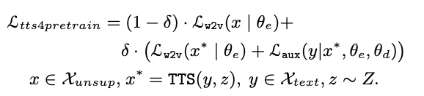
TTS4Pretrain Overview
Motivation
Enable text modality learning by speech synthesis
Enforce text learning and ASR modeling through auxiliary decoders
Formulation
Auxiliary decoders
Take unspoken text as the label for supervision
Phone+Wordpiece decoders to allow for the explicit injection of lexical/phonetic/linguistic information in self-supervised pretraining

Slide 42
TTS4Pretrain Overview
Self-supervised loss
(w2v2, etc)
Auxiliary
decoder loss 1
Auxiliary
decoder loss 2
Multiple views in self-supervision
Encoder
melspectrogram
melspectrogram
TTS
Untranscribed speech
Phone seq
Unspoken Text
Notes:
Framework
For untranscribed speech; for text we
We introduce two decoder losses here
to better capture linguistics.
These losses are available because we use unspoken text. So we have labels for the TTS audio.
The other benefit: use these losses to make sure the representation learnt from text work well in the downstream ASR task

Slide 43
Training on Unspoken Text and Untranscribed Speech
To further encouraging effective generalization from synthetic to real speech
Mix synthetic and real untranscribed utterances within each batch
Apply data augmentation on the synthetic speech when optimizing the auxiliary losses (SpecAugment with time+frequency masking)
Notes:
to further encouraging effective generalization from synthetic to real speech

Slide 44
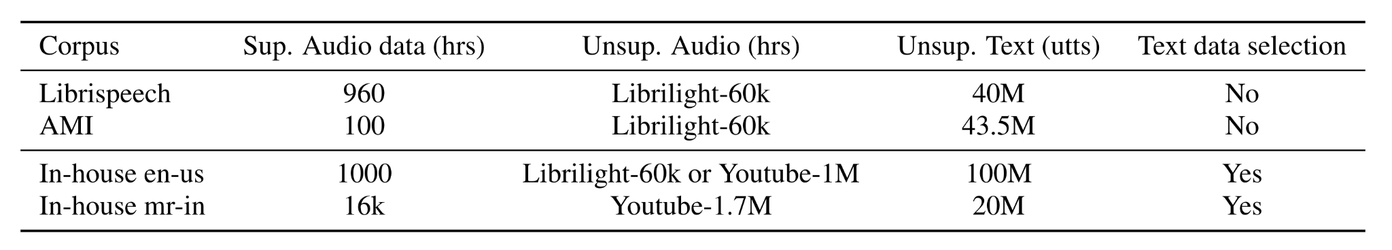
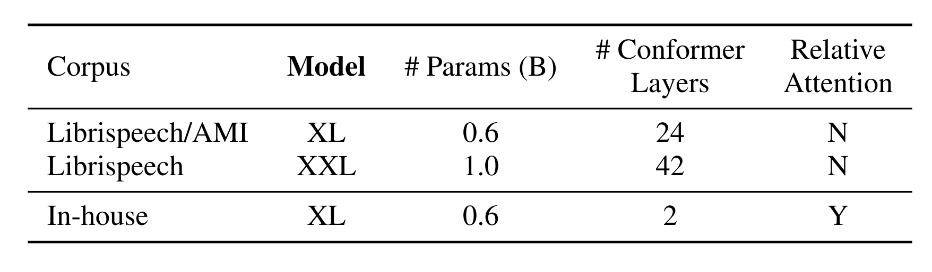
Overview and setups
Experiment on 4 setups
ASR Model: RNNT/HAT
Language Model: 1-pass NN/N-gram LM and 2-pass maximum-entropy LM
Pretrain, finetune hyper-params are in the paper
Notes:
Dff domain, lang
We will also show this pretrain method is even effective in a very large scale supervised dataset
We also compare it to lm shallow fusion

Slide 45
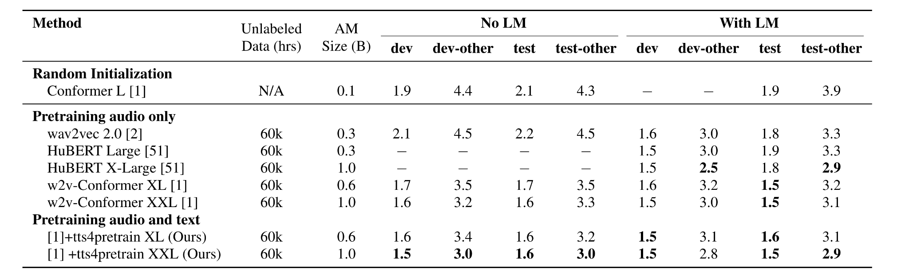
Librispeech
TTS pre-training with in-domain text helps as much as an LM
10% WER reduction on test-other
Notes:
Two conditions w/ w/o lm; first on w/o lm
We apply tech on stoa w2v2 conformer. If you look at the green and the blue boxes, consistent ~10 % on two model sizes
This comes from using 40M LS text data through tts4pretrain.
The gain retains after LM fusion.

Slide 46
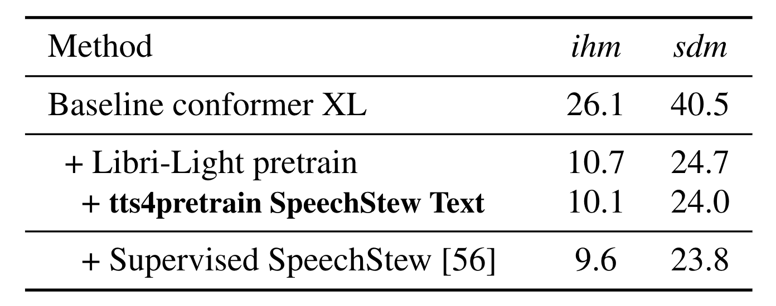
AMI Meeting Transcription
Unsupervised Data:
Librilight 60k hrs
SpeechStew text
Supervised Data
AMI 100 hours or
Supervised SpeechStew 5000 hours
Effectively matching the performance of 5000 hours of transcribed speech with just 100 hours of transcribed speech

Slide 47
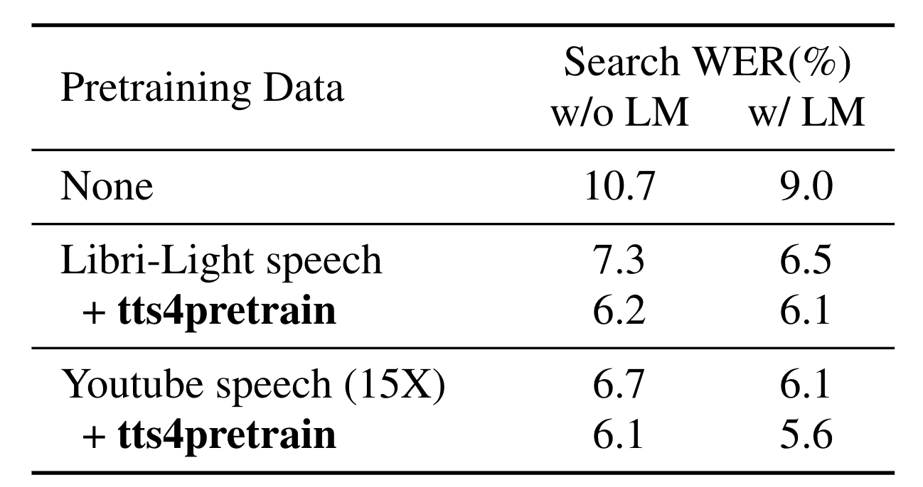
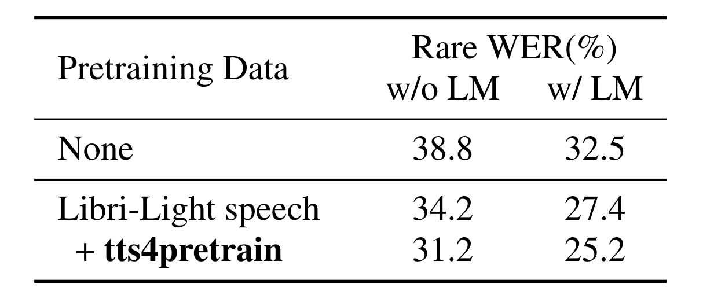
1000 hrs Voice Search (English)
Librilight + TTS surpasses 15x YT data
Improvement holds with an LM
In-domain text can compensate out-domain audio
TTS4Pretrain improves long-tail performance
Notes:
Test on internal VS data with 1000 hrs transcribed speech similar to LS

Slide 48
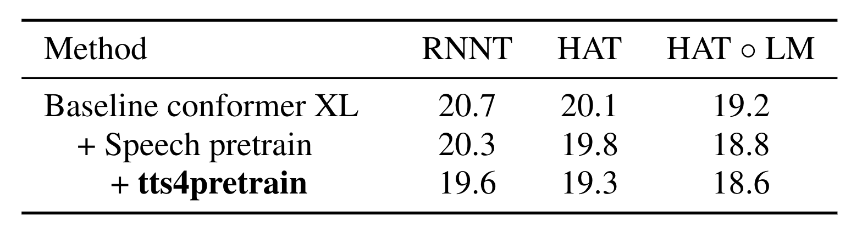
16K hrs Voice Search (Marathi)
Unsupervised Data:
Youtube 1.7M hours
Typed search 20M utts
Supervised Data
Voice search 16k hours
Architecture agnostic
Effective on large-scale supervised data
Additive to LM fusion
Notes:
The last setup is internal VS on a indic lang mr which has 16X more supervised data

Slide 49
Key Messages
Language | English |  |  | Marathi
Domain | Read Speech | Meeting | Voice Query | Voice Query
Sup. Data amount (hrs) | 1k | 0.1k | 1k | 16k
WER reduction over wav2vec2 | 10.0% | 5.6% | 15.0% | 3.5%
Combining speech and text modalities in self supervision (TTS4Pretrain) achieves 3.5-15% relative WER reduction across different domains, languages, and training data sizes when compared to self-supervision with speech modality alone
Notes:
The last setup is internal VS on a indic lang mr which has 16X more supervised data

Slide 50
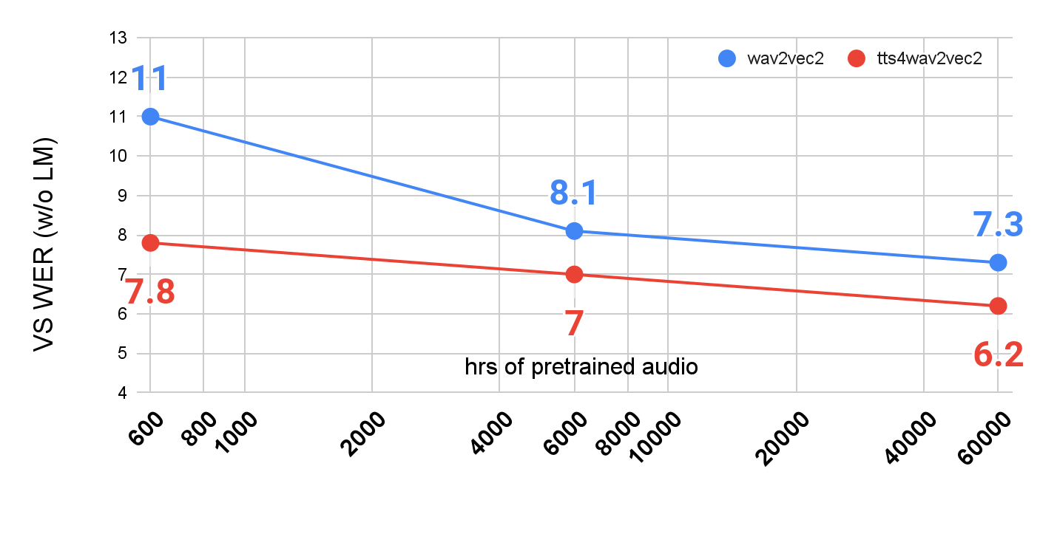
How much audio data for pre-training?
Text can compensate for the lack of speech.
tts4pretrain
10x
10x
Notes:
This figure further shows the performance of diff amounts of audio and comparing with and w/o tts4pretrain
Again with tts4pretrain, the perf can catch up 10X more unsup audio
That means TTS4Pretrain can be applied on langs with different scales of data

Slide 51
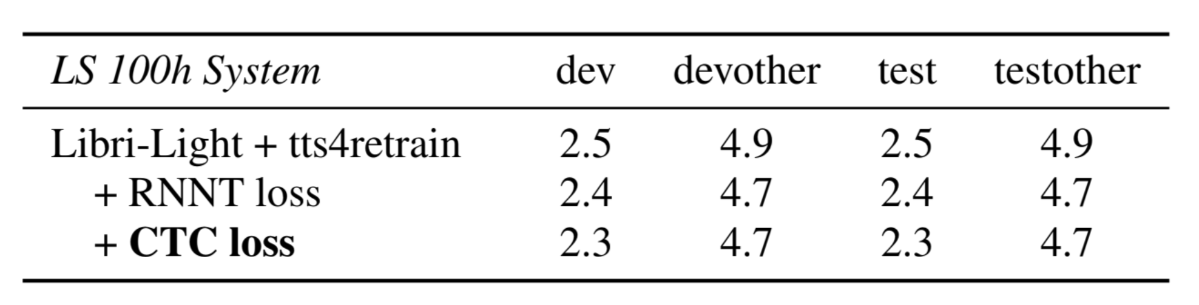
CTC or RNNT objective for text injection?
Conformer-RNNT 600M
Params
Unsupervised Data:
Librilight 60k hrs
Librispeech LM text
Supervised Data
Librispeech 100 hrs
CTC is better than RNNT in enforcing text learning in encoder

Slide 52
Can we make this even better?
How can we learn better shared representations between these two modalities: speech and text?
How can we make the encoder generalized from synthetic to real speech?
  We know regularization always help in training
  Why not enforce consistency between synthesized and real speech?
To enforce decoder consistency (better connected to ASR objective) we need transcribed speech!
We also know that whenever supervised training material is available, it is the best source of training data
  Why not use transcribed speech earlier in pre-training?
Notes:
Break relationship?

Slide 53
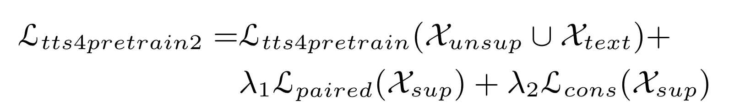
TTS4Pretrain Overview
Self-supervised loss
(w2v2, etc)
Auxiliary
decoder loss 1
Auxiliary
decoder loss 2
Auxiliary
decoder Consistency
Loss
Multiple views in self-supervision
Encoder
melspectrogram
melspectrogram
TTS
Untranscribed speech
Phone seq
Unspoken Text
Notes:
Framework
For untranscribed speech; for text we
We introduce two decoder losses here
to better capture linguistics.
These losses are available because we use unspoken text. So we have labels for the TTS audio.
The other benefit: use these losses to make sure the representation learnt from text work well in the downstream ASR task

Slide 54
tts4pretrain 2.0 Results - Public Corpora
Model: 600M Conformer Model;
Pretrain Data: 60k Hr LibriLight
Finetune Data: Matched: supervised data from only one corpus
SpeechStew: supervised data from all of SpeechStew
“Tts4pretrain 2.0: Advancing the use of text and speech in ASR pretraining with consistency and contrastive losses” Chen et al. IEEE ICASSP 2022
Finetune Corpora |  | Librispeech |  | AMI |  | TED | swb/fisher |  | CV Common Voice
 | Method | clean | other | ihm | sdm |  | swb | chm
Matched | ConformerXL+w2v2 | 1.7 | 3.5 | 11.1 | 25.1 | 6.3 | 5.2 | 13.0 | 9.1
 | +tts4pretrain 1.0 | 1.6 | 3.2 | 10.5 | 24.6 | 6.1 | 5.1 | 12.8 | 8.9
 | +tts4pretrain 2.0 | 1.6 | 3.1 | 10.1 | 23.8 | 5.8 | 4.9 | 11.1 | 8.5
SpeechStew | ConformerXL+w2v2 | 1.7 | 3.3 | 9.6 | 23.8 | 5.7 | 4.9 | 10.8 | 8.5
 | +tts4pretrain 2.0 | 1.7 | 3.2 | 8.7 | 21.9 | 5.1 | 4.5 | 8.0 | 8.4
*
*
Chan, William, et al. "SpeechStew: Simply mix all available speech recognition data to train one large neural network." arXiv preprint arXiv:2104.02133 (2021).
Notes:
The baseline pretrains the encoder using wav2vec 2.0 on Libri-Light and finetunes the model using all SpeechStew corpora.
Tts4pretrain 2.0 uses supervised SpeechStew corpora in pretrain
Moreover, comparing tts4pretrain 2.0 in the matched finetune setting (Row 3) with the supervised SpeechStew baseline: reduce 90% of the data

Slide 55
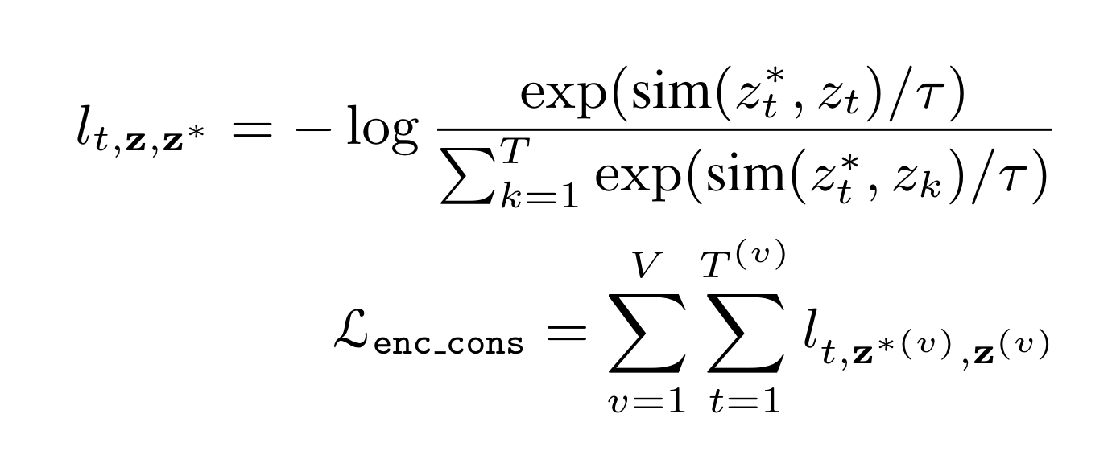
How about Encoder Consistency?
In previous eng-reviews, we’ve discussed using encoder as well as decoder consistency.
Decoder Consistency: The posteriors p(y|x) & p(y|x*) should be identical under augmentation x*=Aug(x)
Encoder Consistency: The encoder activations z=Enc(x) & z=Enc(x*) should be identical under augmentation x*=Aug(x)
Tts4pretrain 2.1 - Introducing encoder consistency
Hierarchical Contrastive Consistency Regularization (HCCR):
make V=3 views with frame-shift=30, 60, 120ms respectively
Notes:
Consistency is enforced on real and TTSed audios, or two augmentations
This is done by getting positive and negative examples of a contrastive loss from a pair of encoder outputs on real and TTSed audios.

Slide 56
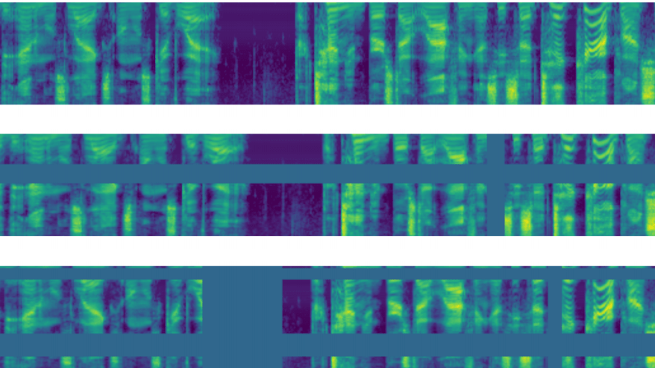
Hierarchical Contrastive Consistency Regularization (HCCR)
2 CNN-layer Stack
128 (3x1) filters ->
BatchNorm ->
32 (3x1) filters
Calc over 3 views:
30,60,120ms
sim(x,y) is cosine sim
attract
attract
repel
. . .
proj
proj
proj
proj
ASR
Encoder
ASR
Encoder
. . .
ASR
Encoder
ASR
Encoder
. . .
Notes:
Given transcribed data, we have real audio and TTSed audios. get enc repr from the two
Try to attract the two repr while repelling them from other utterances
This method can be extended to different granularities
Can be extended to unsupervised data.

Slide 57
tts4pretrain 2.1 Results - CHiME-6
CHiME-6 is very noisy and a different domain from LibriLight and other SpeechStew corpora (dinner party scenario).
Conformer-XL 600M params
Tts4pretrain 2.0 & 2.1 uses supervised data from only Chime-6 and untranscribed 60k LibriLight
SpeechStew pretraining: LL w2v2 then SpeechStew sup finetuning
* Chan, William, et al. "SpeechStew: Simply mix all available speech recognition data to train one large neural network." arXiv preprint arXiv:2104.02133 (2021).
Pretraining | L_{cons} | L_{paired} | CHiME-6 eval
wav2vec2 | no | no | 49.0
tts4pretrain 1.0 | no | no | 47.1
tts4pretrain 2.0 | no | yes | 47.0
 | CoDA | yes | 43.2
 | RNNT loss | yes | 41.2
 | +CoDA | yes | 40.1
tts4pretrain 2.1 | ++HCCR | yes | 39.1
SpeechStew* | - | - | 41.5
Notes:
Mismatch between pretrain and finetune causes less improvement
tts4pretrain 2.0 is able to reduce this problem.
This result also outperforms SpeechStew that uses more supervised data
Enc consist has additive values

Slide 58
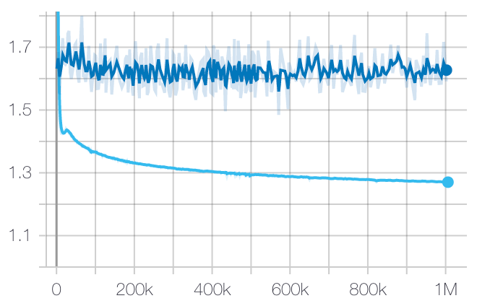
How do you know when to stop pretraining?
dev
Pre-training loss
Repeated reference from 1khr en/us experiments
Pre-training should run over the untranscribed speech 2x-5x
The pre-training loss converges
The finetuning performance does not
Need to balance the relative wins with training time!
train
6.5
VS WER
6.2
VS WER

Slide 59
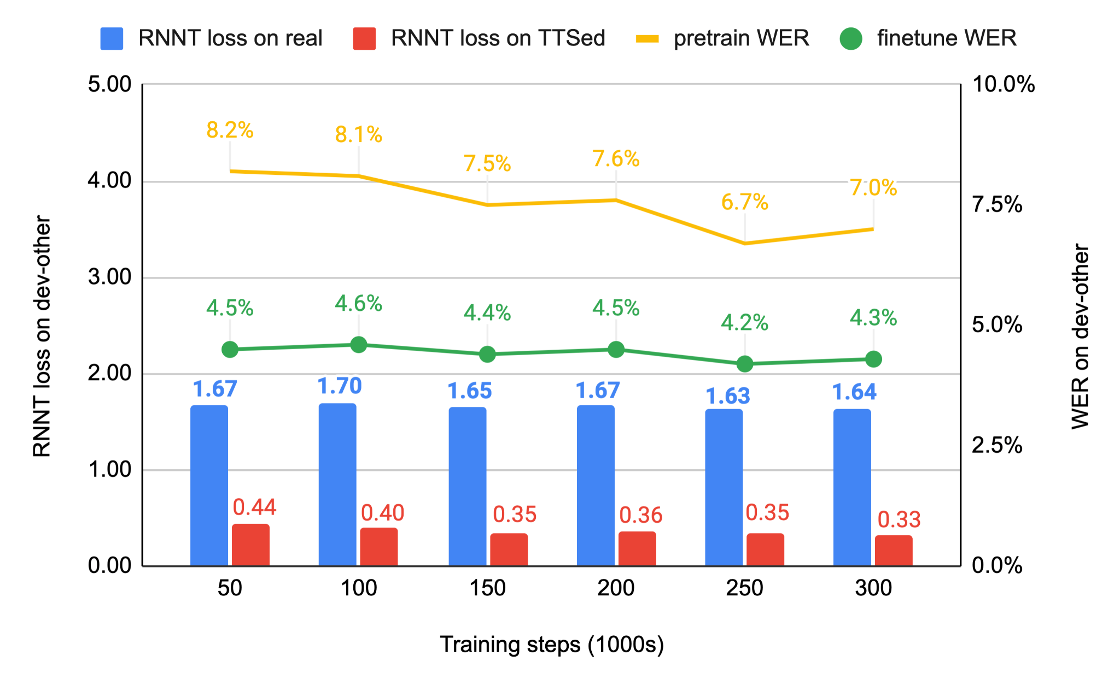
How do you know when to stop pretraining?
Problem: self-supervised loss is a weak predictor of fine-tuned performance.
Solution: look at aux. decoder performance.
Pretrain WER is a strong predictor of finetune WER.
Notes:
This suggests either of these can be agood metric to monitor pretraining for early stopping. Moreover, wehave used the divergence between RNNT loss on real and synthe-sized speech to identify overfitting to synthetic data. This can be anindicator of a lack of generalization from synthetic to real speech

Slide 60
Data selection?
Text dataset >> speech dataset
Costs of TTS and ASR joint training
  Computation of converting text to speech
  Memory consumption of encoding speech
Notes:
Before coming into details, a question here is why don’t we use all the text?
Usually text data is much larger than speech data. The traditional hybrid ASR is possible to integrate all these text data by a separate language modeling stage. However, the different cost of TTS4ASR makes it impossible to blendly use all the text.
The cost comes from both computation and memory
As an example of the different memory consumption between speech and text, 16KHz 960-hour Librispeech corpus takes 100GB
while its ASCII transcription only takes 100MB.
Not to say, the computation of the E2E TTS and ASR models.
In one of our typical setup, we can only afford to use ~1% of the available text data to do TTS4ASR

Slide 61
Selection by LM domain match/mismatch
Use domain language models (LMs) to evaluate the text data
Domain LM
e.g. music
Back-
ground LM
select
Play Taylor Swift’s song.
TTS4ASR
training corpus
unselect
Call Tom please.
?
…...
Notes:
The selection is to match the desired ASR domain or application.
E.g. music domain is what we want
For each utt, we evaluate the prob diff between the target domain LM and a background LM. e.g. the first utt should get much higher prob in the first LM than the second, so we select it
Correspondingly we wont select the second one..

Slide 62
Selection by LM domain match/mismatch
Difference between two LMs
Normalized by length
[logP(W; LM1) - logP(W; LM2)]/length(W)
LM1: paired data; LM2: unspoken text
Notes:
As the example, the selection is based on the difference between two LMs
We further normalize the prob by the number of words to eliminate any length bias
In practice, we use the available paired data to train.. as the 1st…
By this way, we can select text close to the paired data we want

Slide 63
Ablation study of linguistic diversity
# of Unpaired Text Utt. | WER
0 | 17.1
1M | 14.7
5M | 13.7
30M | 13.3
Select 30M from 600M | 11.5
Notes:
We also investigate the linguistic diversity learnt from different amount of the data.
Then we add data selection to use even larger dataset

Slide 64
Promising lines of research
Techniques such as HuBERT, W2V-BERT that employ masked language modeling losses, can we guide the masking during pretraining?
  To prevent learning from erroneous samples in the vast amount of audio
  Need to reduce amount of in-domain data for adapting pre-trained models trained on out-of-domain data [26,27]
  Can we stabilize performance fluctuations that arise from changes in masking ratio?
  Can we use a teacher to guide the samples to mask?
    Yes! Can get an additional 6% relative win when fine tuning with 100 hours of AMI on Librispeech pretrained models!
Can we introduce more supervision into the pre-training process?
  Curriculum training schedule
  Consistency regularization
Notes:
Can we weight these samples differently

Slide 65
Concluding Remarks
Various approaches to learn consistent representations and augmentations from text and speech in semi/un-supervised fashion
These representations combine well with supervised training and allow us to better model the latent structure of the data
Our community has a wealth of experience in speech and language processing tasks; great opportunity to unify all of this in a self-supervised framework.
Notes:
The first motivation comes from recent developments in augmentation policy search, which has shown great performances on ImageNet. The first of the series is auto augment, where a RL controller search for an optimal augmentation policy. It should be pointed out that this requires an inner loop of evaluation on a small proxy task. Subsequent paper such as Fast Auto augment replaces the RL policy search with a more efficient density matching search. And in the most recent work, Rand Augment, it was found that uniform sampling of strong and diverse augmentations were sufficient to achieve good performance, and this can be achieved without a costly inner evaluation loop. In our work, we draw motivation from Rand Augment in our augmentation policy development.

Slide 66
References
Oord, Aaron van den, Yazhe Li, and Oriol Vinyals. "Representation learning with contrastive predictive coding." arXiv preprint arXiv:1807.03748 (2018).
Chung, Yu-An, and James Glass. "Generative pre-training for speech with autoregressive predictive coding." ICASSP 2020-2020 IEEE International Conference on Acoustics, Speech and Signal Processing (ICASSP). IEEE, 2020.
Chen, Ting, et al. "A simple framework for contrastive learning of visual representations." arXiv preprint arXiv:2002.05709 (2020).
Pascual, Santiago, et al. "Learning problem-agnostic speech representations from multiple self-supervised tasks." arXiv preprint arXiv:1904.03416 (2019).
Chorowski, Jan, et al. "Unsupervised Neural Segmentation and Clustering for Unit Discovery in Sequential Data." NeurIPS 2019 workshop-Perception as generative reasoning-Structure, Causality, Probability. 2019.
Park, Daniel S., et al. "Specaugment: A simple data augmentation method for automatic speech recognition." arXiv preprint arXiv:1904.08779 (2019).
Pascual, Santiago, et al. "Learning problem-agnostic speech representations from multiple self-supervised tasks." arXiv preprint arXiv:1904.03416 (2019).
Jacob Devlin, Ming-Wei Chang, Kenton Lee, and Kristina Toutanova. 2019. BERT: Pre-training of deep bidirectional transformers for language understanding. In Proceedings of the 2019 Conference of the North American Chapter of the Association for Computational Linguistics: Human Language Technologies, Volume 1 (Long and Short Papers), pages 4171–4186, Minneapolis, Minnesota. Association for Computational Linguistics.
He, Kaiming, et al. "Momentum contrast for unsupervised visual representation learning." Proceedings of the IEEE/CVF Conference on Computer Vision and Pattern Recognition. 2020.
Baevski, Alexei, et al. "wav2vec 2.0: A framework for self-supervised learning of speech representations." Advances in Neural Information Processing Systems 33 (2020).

Slide 67
References
M. Ravanelli and Y. Bengio, “Learning Speaker Representations with Mutual Information”, Interspeech 2019.
M. Ravanelli, et al. “Multi-Task Self Supervised Learning for Robust Speech Recognition”, ICASSP 2020.
Luyu Wang, Aaron van den Oord, “A simple framework for contrastive learning of visual representations." arXiv preprint arXiv:2002.05709 (2020).
Pascual, Santiago, et al. "Multi-Format Contrastive Learning of Audio Representations." arXiv preprint arXiv:1904.03416 (2019). SAS workshop, NeurIPS, 2020.
Sumit Chopra, Raia Hadsell, and Yann LeCun. Learning a similarity metric discriminatively, with application to face verification. In Computer Vision and Pattern Recognition, 2005. CVPR 2005. IEEE Computer Society Conference on, volume 1, pages 539–546. IEEE, 2005.
Pierre Sermanet, Corey Lynch, Jasmine Hsu, and Sergey Levine. Time-contrastive networks: Self-supervised learning from multi-view observation. arXiv preprint arXiv:1704.06888, 2017.
Dong Yu, “ Weak Supervision”, SAS workshop, NeurIPS, 2020.
Finn, Chelsea, Pieter Abbeel, and Sergey Levine. "Model-agnostic meta-learning for fast adaptation of deep networks." arXiv preprint arXiv:1703.03400 (2017).
Ravanelli, Mirco, and Yoshua Bengio. "Speaker recognition from raw waveform with sincnet." 2018 IEEE Spoken Language Technology Workshop (SLT). IEEE, 2018.
Trapit Bansal, Rishikesh Jha, Tsendsuren Munkhdalai, Andrew McCallum, “Self-Supervised Meta-Learning for Few-Shot Natural Language Classification Tasks”, arXiv:2009.08445v2 (2020).
Wei-Ning Hsu, Benjamin Bolte, Yao-Hung Hubert Tsai, Kushal Lakhotia, Ruslan Salakhutdinov, and Abdelrahman Mohamed, “HuBERT: Self-supervised speech representation learning by masked prediction of hidden units,” arXiv preprint arXiv:2106.07447, 2021
Yu-An Chung, Yu Zhang, Wei Han, Chung-Cheng Chiu, James Qin, Ruoming Pang, Yonghui Wu,”W2v-BERT: Combining Contrastive Learning and Masked Language Modeling for Self-Supervised Speech Pre-Training”, arXiv:2108.06209, ASRU 2021.
Bommasani, Rishi, et al. "On the opportunities and risks of foundation models." arXiv preprint arXiv:2108.07258 (2021)
Chen, Z., Zhang, Y., Rosenberg, A., Ramabhadran, B., Wang, G. and Moreno, P., 2021. Injecting text in self-supervised speech pretraining. arXiv preprint arXiv:2108.12226, ASRU 2021

Slide 68
References
Bapna, Ankur, et al. "SLAM: A Unified Encoder for Speech and Language Modeling via Speech-Text Joint Pre-Training." arXiv preprint arXiv:2110.10329 (2021).
Hsu, Wei-Ning, et al. "Robust wav2vec 2.0: Analyzing Domain Shift in Self-Supervised Pre-Training." arXiv preprint arXiv:2104.01027 (2021)
Chan, William, et al. "SpeechStew: Simply mix all available speech recognition data to train one large neural network." arXiv preprint arXiv:2104.02133 (2021).
”,arXiv preprint arXiv: 2108.12226 (ASRU 2021)”
Chen, Z. et al. “Injecting Text in Self-Supervised Speech Pretraining”,arXiv preprint arXiv: 2108.12226 (ASRU 2021).
Chen, Z. et al. “Tts4pretrain 2.0: Advancing the use of text and speech in ASR pretraining with consistency and contrastive losses”, ICASSP 2022.

Slide 69
Thank you!

Slide 70
LibriSpeech results
Model: Full-Context Conformer-RNNT 1B parameters
Unsupervised Data:
Librilight 60k hrs
LS LM training data
Supervised Data
LS 960 hours
Pre-training | LM | dev | devother | test | testother
baseline Wav2vec | No | 1.6 | 3.2 | 1.6 | 3.3
 | Yes | 1.5 | 3.0 | 1.5 | 3.1
tts4pretrain | No | 1.5 | 3.0 | 1.6 | 3.0
 | Yes | 1.5 | 2.8 | 1.5 | 2.9
#1: TTS pre-training with in-domain text helps as much as an LM
#2: TTS pre-training provides some additional improvement over an LM
“Injecting text in self-supervised speech pretraining” Chen et al. IEEE ASRU 2021
Notes:
Noisy Student Training on top of w2v2 gets to 1.4/2.6 - hubert 1.8/2.9 after rescoring
We have some ablation study to show the importance of Phone and WPM CTC losses
Very strong baseline on 1000hrs
Best pretrain only number (w/o semi-sup learning)

Slide 71
tts4pretrain 2.0
Multiple views in self-supervision
Self-supervised loss
(w2v2, w2v-bert, etc)
Auxiliary
decoder loss 1
Auxiliary
decoder loss 2
Auxiliary
decoder Consistency
Loss
However, we known that Consistency Regularization is important from TTS4ASR
Encoder
melspectrogram
melspectrogram
TTS
Transcribed speech
Phone seq

