Slide 1
Tools for Speech Analysis
Julia Hirschberg and Sarah Ita Levitan
CS6998
Thanks to Jean-Philippe Goldman, Fadi Biadsy, and many more...

Slide 2
A Speech Analysis Tool: Praat
Developed by Paul Boersma and David Weenink at the Institute of Phonetic Sciences, University of Amsterdam
General purpose speech tool : editing, segmentation and labeling, prosodic manipulation, many tutorials, large user community, yahoo group
Notes:
first aim of Praat was to give students and scientists of Phonetics a handy tool for manipulating speech data and for creating stimuli for perception experiments,

Slide 3
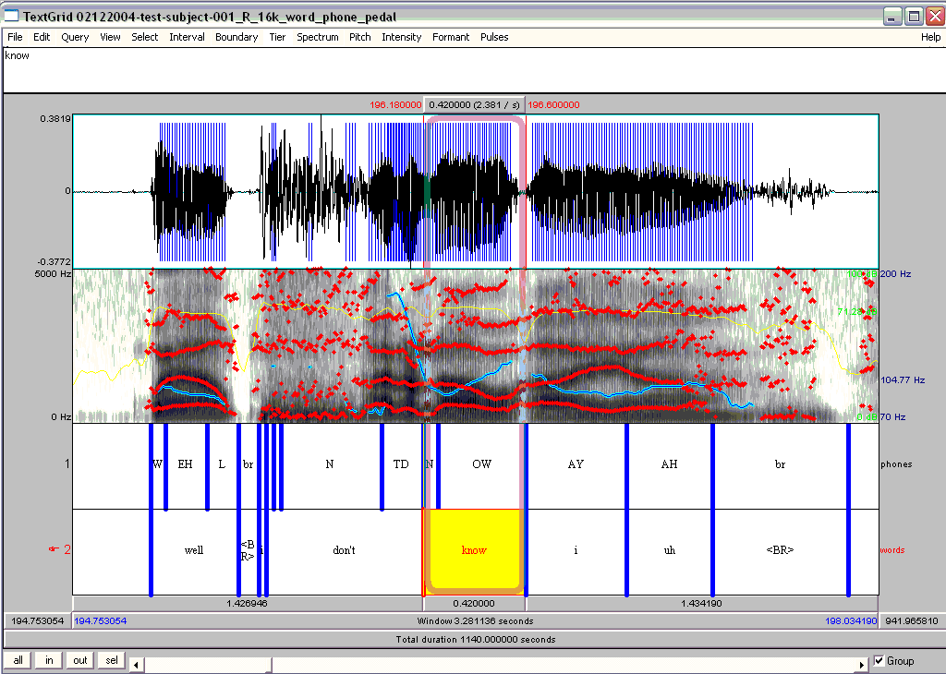

Slide 4
File Management
Recording files and saving them
  New menu
Opening files
  Read menu
    Long and short sound files
    Other file types
  Write menu
  Exercise: Record a file saying “My mama lives in Memphis” mono, play it to check, call it ‘<your name>’, save it to list, write it to a .wav file on disk, remove it from the objects list, read it back in

Slide 5
Display Options from Objects Window
Select and view&edit your ‘mama’ file
Spectrum:
  Show a spectral slice
  Show a spectrogram
  Play each word using phonetic information
Pitch:
  Show pitch
  Change the pitch range of the window in pitch settings
  Get pitch information: get pitch, get min/max pitch
  Can you describe the pitch contour?

Slide 6
Intensity:
  Get intensity information: mean, min and max
  Check the settings
Formant: Display
  Do the formant values match those you expect for these vowels?

Slide 7
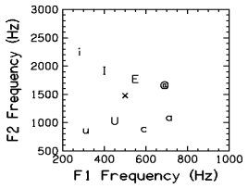
[i] - as in heed
[I] - as in hid
[E] - as in head
[@] - as in had
[a] - as in hod
[c] - as in hawed
[U] - as in hood
[u] - as in who'd
[x] - as in hud

Slide 8
Annotation: Textgrids
Select your first recording
From objects window, w/ sound file selected
  Annotate → To textgrid
  Point vs. interval tiers
Add a point tier and an interval tier and insert some labels
NB: remember to select the interval or point circle first in the waveform or spectrogram before trying to insert a label

Slide 9
Scripting
From history:
  Praat → new Praatscript → Edit → Paste history
  NB: you can run all or part of the script (select and run selection)
Writing scripts
Modifying existing scripts:
  Tutorials, scripts, resources, user groups, search

Slide 10
Sample Praat Script
# This script will create a new text-grid for a wav file
form Make a text-grid for a .wav file
comment Source Directory?
sentence Directory C:\Documents and Settings\julila\My Documents\
comment File name?
sentence Filename
comment Tier Name?
sentence Tier
endform
Read from file... 'directory$‘ ‘filename$'
stem$ = left$(filename$,length(filename$)-4)
select Sound 'stem$'
To TextGrid... 'tier$' 'tier$‘ # tier names, which tiers are point tiers
Write to text file... 'directory$'\'stem$'.TextGrid
Remove

Slide 11
Task 1
Read in your ‘mama’ file; View & Edit
Zoom in on the most prominent word and find a single cycle in the waveform – select – what is the frequency?
Select the entire contour
  Display the pitch and intensity contours
  What is the minimum pitch? Maximum? Mean?
  What is the minimum intensity? Maximum? Mean?

Slide 12
Task 8: Voice Quality
Record “My mama lives in Memphis”
  in a whisper
  in a creaky voice
Study pitch contour in normal vs. whisper vs. creaky. What do you notice?
Analyze jitter and shimmer of the 3 recordings
  Sound -> analyze periodicity -> to Pitch
  Pitch -> to PointProcess
  PointProcess -> query -> get jitter
  Sound + PointProcess -> get shimmer

Slide 13
Task 2: Contours
Record a statement
Record a yes-no question
Record a wh-question
What are the similarities in F0? Differences?

Slide 14
Task 3: Clipping
Record something in a very loud voice, to produce clipping, and see what the waveform looks like – how do you identify clipping? Avoid it?

Slide 15
Modifying Data
Changing the pitch contour of your ‘mama’ file:
    Go to Manipulate → To manipulation
    Go to View & Edit
    Go to Pitch → Stylize pitch (2st)
    Modify Pitch by dragging points up and down
    Turn your statement into a question by lowering earlier pitch and raising final pitch; play the result
    Modify duration (Dur):
      Add points in duration tier at cursor
      Drag points up and down to change rate
    To save: File -> Publish resynthesis

Slide 16
Modifying Emotion
Record a very happy version of “mama”
  Go to Manipulate → To manipulation
  Go to View & Edit
  Go to Pitch → Stylize pitch (2st)
  Modify Pitch by dragging points up and down
  Turn your happy speech into sad speech; play the result
  To save: File -> Publish resynthesis

Slide 17
Task 4: Changing the Pitch Range
Record a file using falling intonation
Modify it to produce a rising intonational contour
Edit the new contour to
  Raise the pitch range (select the contour and use ‘shift pitch frequencies’)
  Stylize the pitch contour

Slide 18
Task 6: Emotional Speech
Record “My mama lives in Memphis” again
  As angry speech
  As sad speech
  As happy speech
For each token answer the following:
  What is the mean pitch? Maximum?
  What is the mean intensity? Maximum?
  What is the duration?
  Do you see any differences in the F0 contour?

Slide 19
Task 7: Masking
Edit a mama file
Convert → Change Gender
Filter →filter (pass) Hann band
  Find a pass band that masks the words but retains the intonation
  Find a pass band that masks the intonation but retains the words
Modify → Reverse
Notes:
keeping lower bands keeps intonation; higher bands (500-1000) keep words

Slide 20
Task 8: Formant Analysis
Extract F1 and F2 values for the vowels in your mama file
  Formant -> show formants
  Get first formant… (F1 shortcut)
submit the values in this form:
https://goo.gl/forms/ZIOvmXOP5ubIq1rS2

Slide 21

Task 5: Pitch contour cloning
Replace the pitch contour in beach.wav
with the contour in speech.wav
  Read in both files
  Create a manipulation object for beach.wav
  Extract the pitch tier
  Create a manipulation object for speech.wav
  Select the pitch tier of beach.wav and the manipulation object for speech.wav and click ‘Replace pitch tier’
  Select the manipulation object for speech.wav and click ‘Get resynthesis…’
  Compare the original file and the new file

Slide 22
Help
Online help, FAQ, manual
Links from http://www.praat.org
Additional tutorials, scripts, resources, user groups

Slide 23
Next Class
Homework 1 due
Read the ToBI Conventions, Modeling Prosody and Prosody and Meaning (links from the syllabus)
No class participation questions due next week

