Slide 1
Evaluating Spoken Dialogue Systems
Julia Hirschberg
CS 4706

Slide 2
Dialogue System Evaluation
Key point about SLP.
Whenever we design a new algorithm or build a new application, need to evaluate it
Two kinds of evaluation
  Extrinsic: embedded in some external task
  Intrinsic: some sort of more local evaluation.
How to evaluate a dialogue system?
What constitutes success or failure for a dialogue system?

Slide 3
Dialogue System Evaluation
Need evaluation metric because
  1) Need metric to help compare different implementations
    Can’t improve it if we don’t know where it fails
    Can’t decide between two algorithms without a goodness metric
  2) Need metric for “how good a dialogue went” as an input to reinforcement learning:
    Automatically improve our conversational agent performance via learning

Slide 4
Evaluating Dialogue Systems
PARADISE framework (Walker et al ’00)
“Performance” of a dialogue system is affected both by what gets accomplished by the user and the dialogue agent and how it gets accomplished
Maximize
Task Success
Minimize
Costs
Efficiency
Measures
Qualitative
Measures

Slide 5
Task Success
% of subtasks completed
Correctness of each questions/answer/error msg
Correctness of total solution
  Attribute-Value matrix (AVM)
  Kappa coefficient
Users’ perception of whether task was completed

Slide 6
Task Success
    Task goals seen as Attribute-Value Matrix
        ELVIS e-mail retrieval task (Walker et al ‘97)
        “Find the time and place of your meeting with Kim.”
Attribute Value
Selection Criterion Kim or Meeting
Time 10:30 a.m.
Place 2D516
Task success can be defined by match between AVM values at end of task with “true” values for AVM
Slide from Julia Hirschberg

Slide 7
Efficiency Cost
Polifroni et al. (1992), Danieli and Gerbino (1995) Hirschman and Pao (1993)
Total elapsed time in seconds or turns
Number of queries
Turn correction ration:
  Number of system or user turns used solely to correct errors, divided by total number of turns

Slide 8
Quality Cost
# of times ASR system failed to return any sentence
# of ASR rejection prompts
# of times user had to barge-in
# of time-out prompts
Inappropriateness (verbose, ambiguous) of system’s questions, answers, error messages

Slide 9
Another Key Quality Cost
“Concept accuracy” or “Concept error rate”
% of semantic concepts that the NLU component returns correctly
I want to arrive in Austin at 5:00
  DESTCITY: Boston
  Time: 5:00
Concept accuracy = 50%
Average this across entire dialogue
“How many of the sentences did the system understand correctly”

Slide 10
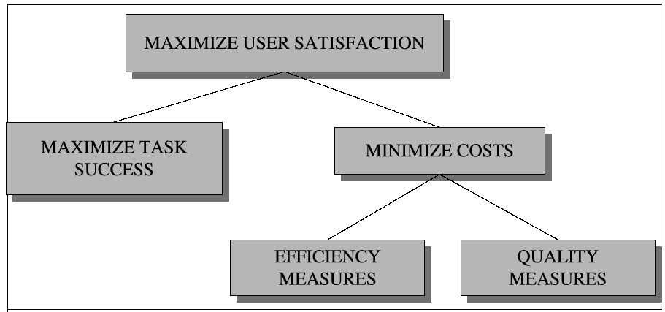
PARADISE: Regress against user satisfaction

Slide 11
Regressing against User Satisfaction
Questionnaire to assign each dialogue a “user satisfaction rating”: dependent measure
Cost and success factors: independent measures
Use regression to train weights for each factor

Slide 12
Experimental Procedures
Subjects given specified tasks
Spoken dialogues recorded
Cost factors, states, dialog acts automatically logged; ASR accuracy,barge-in hand-labeled
Users specify task solution via web page
Users complete User Satisfaction surveys
Use multiple linear regression to model User Satisfaction as a function of Task Success and Costs; test for significant predictive factors

Slide 13
User Satisfaction:
Sum of Many Measures
Was the system easy to understand? (TTS Performance)
Did the system understand what you said? (ASR Performance)
Was it easy to find the message/plane/train you wanted? (Task Ease)
Was the pace of interaction with the system appropriate? (Interaction Pace)
Did you know what you could say at each point of the dialog? (User Expertise)
How often was the system sluggish and slow to reply to you? (System Response)
Did the system work the way you expected it to in this conversation? (Expected Behavior)
Do you think you'd use the system regularly in the future? (Future Use)

Slide 14
Performance Functions from Three Systems
ELVIS User Sat.= .21* COMP + .47 * MRS - .15 * ET
TOOT User Sat.= .35* COMP + .45* MRS - .14*ET
ANNIE User Sat.= .33*COMP + .25* MRS +.33* Help
  COMP: User perception of task completion (task success)
  MRS: Mean (concept) recognition accuracy (cost)
  ET: Elapsed time (cost)
  Help: Help requests (cost)

Slide 15
Performance Model
Perceived task completion and mean recognition score (concept accuracy) are consistently significant predictors of User Satisfaction
Performance model useful for system development
  Making predictions about system modifications
  Distinguishing ‘good’ dialogues from ‘bad’ dialogues
  Part of a learning model

Slide 16
Now that we have a Success Metric
Could we use it to help drive automatic learning?
  Methods for automatically evaluating system performance
  Way of obtaining training data for further system development

Slide 17
Recognizing `Problematic’ Dialogues
Hastie et al, “What’s the Trouble?” ACL 2002
Motivation: Identify a Problematic Dialogue Identifier (PDI) to classify dialogues
What is a Problematic Dialogue
  Task is not completed
  User satisfaction is low
Results:
  Identify dialogues in which task not completed with 85% accuracy
  Identify dialogues with low user satisfaction with 89% accuracy

Slide 18
Corpus
1242 recorded dialogues from DARPA Communicator Corpus
  Logfiles with events for each user turn
  ASR and hand transcriptions
  User information: dialect
  User Satisfaction survey
  Task Completion labels
Goal is to predict
    User Satisfaction (5-25 pts)
    Task Completion (0,1,2): none, airline task, airline+ground task

Slide 19
DATE Dialogue Act Extraction
Notes:
DATE: automatic dialogue act tagger used on logfiles
Estimated classification accuracy of 96% of utterances

Slide 20
Features Used in Prediction

Slide 21
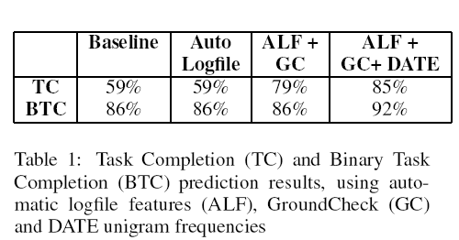
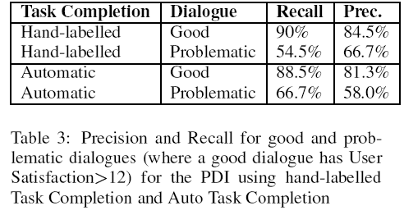
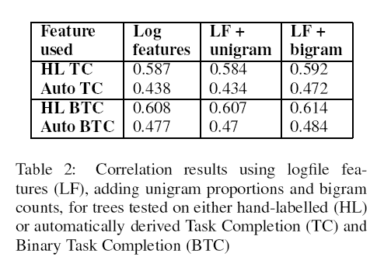
Results
Notes:
GC: existence of DATE tags related to ground reservations
TC (ternary task completion); BTC (binary task completion, none or some tasks completed)

Slide 22
Next
Final exam in class

