Slide 1
Intonation and Computation:
Personality
Julia Hirschberg (and thanks to Michelle Levine)
LSA 2017
julia@cs.columbia.edu

Slide 2
Today
Personality
  How do we define personality?
  How is personality measured?
  Can we automatically classify personality?

Slide 3
What is Personality?
Who you are – your characteristic style of behaving, thinking, and feeling
How can we assess differences in personality?
  4 main approaches in psychology:
    Trait
    Psychodynamic
    Humanistic
    Social-Cognitive

Slide 4
What is Personality?
This is about who you are – your characteristic style of behaving, thinking, and feeling.
How can we assess differences in personality?
  4 main approaches in psychology:
    Trait
    Psychodynamic
    Humanistic
    Social-Cognitive
Notes:
As we’ve seen with attitudes, emotions, and beliefs, personality is thought to determine behavior.

Slide 5
Trait Models
Personality = a combination of traits
  Traits are consistent ways of behaving and so can predict future actions.
  Challenge: Find a taxonomy (classification scheme) for core traits that define personality
Notes:
Trait theory assumes that people differ from one another in relatively stable ways.
Examples: honest, dependable, moody, impulsive

Slide 6
Dimensions of Personality
18,000 words for potential traits (Allport & Odbert, 1936)
Goal: sort words into underlying dimensions
Uses both self-report and informant data to measure personality
Notes:
Why dimensions of personality vs types of personality? allows for infinite variations in personality, rather than a few basic types.

Slide 7
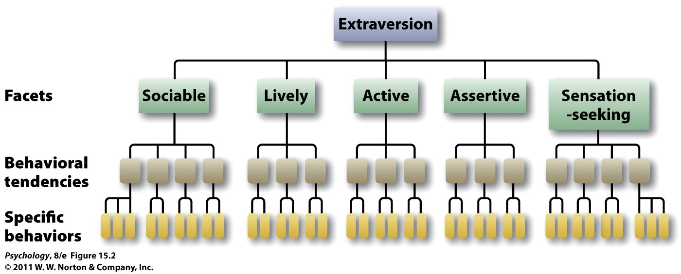
Determining Core Traits
Notes:
15.2 The hierarchical organization of personality One of the Big Five personality traits, extraversion, encompasses a broad summary of many, more specific, facets of personality, each of which is defined by particular behavioral tendencies and still more specific behaviors.

Slide 8
The Big Five
Openness to experience
Conscientiousness
Extraversion
Agreeableness
Neuroticism

Slide 9
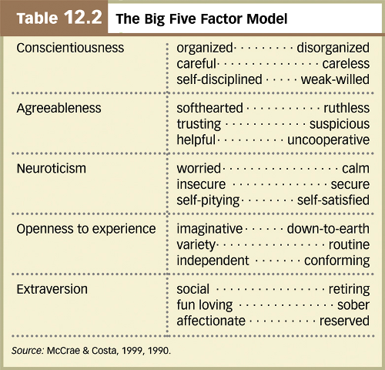
Notes:
Neuroticism – sometimes considered “emotional instability”
Measured in % -- ie. 80% on openness scale

Slide 10
Questions About The Big Five
How stable are the traits? Thought to
  Change over development
  Become stable in adulthood
How heritable are they?
  ~50% for each trait (.40 to .55 heritability)
How about cultural differences?
  Traditionally thought to be common across cultures but…
  Research has shown cultural differences in personality (e.g. in mean levels of Big 5)
Notes:
HEREDITY:
adopted children: zero correlation between adopted children and their adoptive siblings
identical twins: strong correlation between identical twins reared together or apart
E.g., Temperament:
There is growing evidence that personality traits develop from an individual’s temperament, which is evident from an early age and thought to be genetically determined.
Twin studies of the Big Five dimensions confirm a high heritability
extraversion—genetic influences depend on level of central nervous system reactivity, with introverts more reactive than extraverts
- sensation seeking and inhibited temperament
Culture can influence personality, as evidenced by the observation of national character and the fact that different cultures vary in average levels of the Big Five traits.

Slide 11
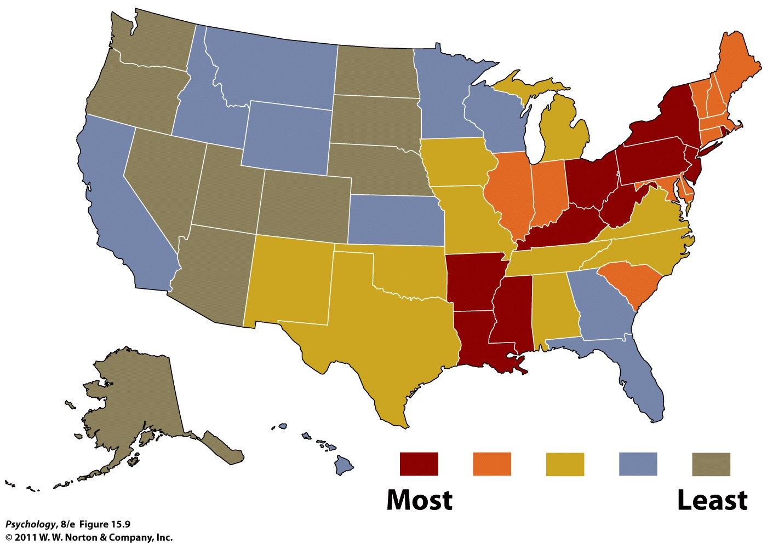
Where are the most “neurotic” places to live?
Notes:
15.9 Map of neuroticism in the United States According to these data, the eastern side of the country is a more “neurotic” place to live than the western side (Rentfrow, Gosling, & Potter, 2008).

Slide 12
Are Traits Really Constant?
Personality paradox: people often behave less consistency than might be expected
  Part of the explanation dox is the power of the situation
  Person-Situation Controversy
    E.g., Walter Mischel (1968, 1984, 2004)
  Counter-argument from trait theorists
    Behaviors from a situation may be different, but average behavior remains the same. So, traits do matter.
Notes:
Person-situation controversy: points out that traits may be enduring, but the resulting behavior in various situations is different. Therefore, traits are not good predictors of behavior.
Critics of the trait approach (e.g., Mischel) argue that there is no such thing as stable personality traits because behaviors appear to vary considerably from one situation to the next. In other words, they argue that there is no consistent expression of a trait across different situations.

Slide 13
Is Consistency of Behavior a Trait?
Interaction between personality and situations
  Situations interact with individual differences, with some strong situations (like what?) producing nearly uniform behavior among different individuals
  Some people are more consistent in their behaviors—the Self-Monitoring Scale
Notes:
Both personality and situations matter, usually in interaction.
Consistency of behavior, in and of itself, appears to be a trait that varies from person to person and is mediated by the degree to which individuals self-monitor their behavior to fit the situation.
It turns out, however, that some degree of cross-situational consistency can be observed if we look at specific types of situations.
Thus, for example, someone might be consistently helpful with friends and consistently not helpful with strangers, and thus appear inconsistent in helpfulness if we combine these different types of situations.

Slide 14
Assessing Traits
Personality inventories: questionnaires (often with true-false or agree-disagree items) designed to gauge a wide range of feelings and behaviors assessing several traits at once
The Minnesota Multiphasic Personality Inventory (MMPI) is the most widely researched and clinically used of all personality tests.
  567 item T/F report (~1.5h to complete)
Notes:
The MMPI-2 is a 567 item, true/false self-report measure of a person's psychological state.
Takes around 1.5 hours to complete.

Slide 15
NEO-FFI
Short questionnaire to assess the big 5 traits
60 items (12 per trait)
Likert scale from SD—SA
Widely used in research

Slide 16
Personality and Emotions
Emotions = transient
Personality = consistent
Robert Plutchik
Notes:
Before we move on, it’ll be good to consider the relationship between personality and emotions.

Slide 17
Automatic Personality Detection
What type of cues are more/less useful:
  Written language
  Nonverbal vocal behaviors
  Spoken/conversational language

Slide 18
Personality From Written Language
Does written language use predict personality?
Pennebaker and King (1999), Linguistic styles: Language use as an individual difference
  Stream-of-conscious essays
  Big 5 personality assessment
  Lexical features (LIWC)
Notes:
One of the original studies on this looked at whether language use reflects personality style.
They did many different experiments in this article but let’s focus on the one about LIWC and five factors of personality

Slide 19
  Findings, e.g.
    Agreeableness
      more positive emotion words
      fewer negative emotion words
      fewer articles
      more first-person

Slide 20
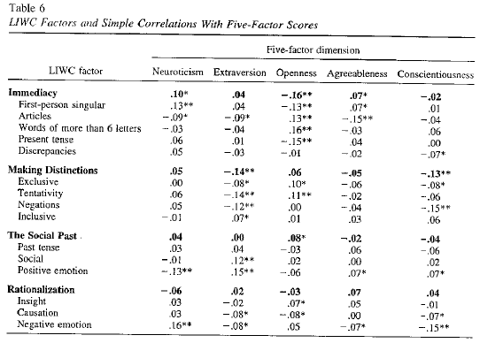
Notes:
Patterns that emerge:
Openness to experience and immediacy
Extroversion and making distinctions
Conscientiousness and making distinctions

Slide 21
Personality from Social Media
More recent work includes personality detection from:
  Blogs
  Twitter posts
  Facebook posts

Slide 22
Computer-based personality judgments are more accurate than those made by humans
Youyou, Kosinski & Stillwell (2015)
Jacob Pawlak presenting

Slide 23
Computer-based personality judgments are more accurate than those made by humans
Jacob Pawlak

Slide 24
Abstract and Idea
Comparing human accuracy v.s. computer accuracy at predicting personality characteristics
What opportunities did the research open up?

Slide 25
Previous Relevant Studies
Recent developments in machine learning and statistics show that computer models are capable of making valid personality judgments by using digital records of human behavior.

Slide 26
Experiment and Methodology
A total of 86,220 volunteers made up the sample for the experiment
Each volunteer was given a 100-item International Personality Item Pool (IPIP) questionnaire, which measures the following five traits: Openness, Conscientiousness, Extraversion, Agreeableness, Neuroticism
70,520 agreed to share their Facebook Likes for the computer-based judgements

Slide 27
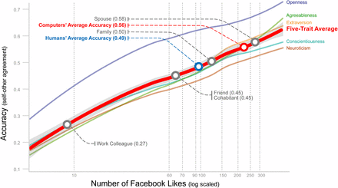

Slide 28
Results
My favorite result: The computer model only needed 100 Likes from your Facebook profile to predict your personality better than an average human, and 300 Likes to predict better than a spouse.
From the sample, each volunteer with Facebook had an average of 227 Likes. The expected computer accuracy for 227 Likes is ~.56, which was tested to be significantly higher (z = 3.68, P < 0.001) than an average human judge (~.49) and was comparable to an average spouse.
Computer models also showed a high rate of interjudge agreement

Slide 29
Takeaways
These computer-based personality assessment tools can work for marketers, job recruiters, retail services, other personality experiments, etc. by sending user-specific messages, targets adds, and help with decision making.
Of course, some people might be distrusting of computer systems using social media, personal browser history, and online habits to predict their personality more accurately than their family members

Slide 30
Computer vs Human Judgments
Youyou, Kosinski & Stillwell (2015)
  Assessed accuracy of personality judgments by humans vs computers with:
    Self-other agreement
    Interlabeler agreement
    External validity
Notes:
Self-other agreement – personality inventory & Likes on FB versus personality inventory & judgments of friends/family/spouse
found: Likes-based models are more diagnostic of some traits, such as openness.
Interjudge agreement – is it better accuracy between human judges or computer judges?
Used agreement of judgments of two friends VS agreement between two models each using half of the FB Likes
- found: consensus across computer models was much higher than for human judges
External validity – personality scores, humans’ judgments and computers’ judgments ability to predict 13 life outcomes and traits linked to personality
- found: external validity of computer judgments was higher than that of human judges in 12/13 outcomes/traits
Overall findings: computer judgments more accurate than ones made by close others and acquaintances
Why?
Personality ratings more accurate with more information. Computers can store more information can more readily access it/recall it.
Statistical modeling optimizes accuracy vs humans are affected by biases (although one can argue that advantage of human flexiblity may capture the nuances of persanlity better)

Slide 31
Conversational Language (Mairesse & Walker (2006)
Daily life conversations, collected and transcribed
  Features/analyses:
    5-7 judges scored Big 5
    LIWC (linguistic features)
    MRC psycholinguistic database (word features)
    Utterance type (ie, commands, back-channels)
    Praat (pitch, intensity, speech rate)
Notes:
*Assigned reading
Research has shows that speech factors help, such as:
Fundamental frequency
Voice quality
Intensity
Frequency and duration of silence pauses

Slide 32
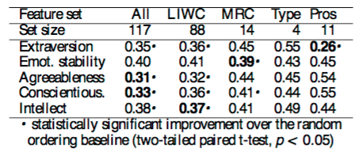
Results
Notes:
Table 3: Ranking errors over a 10 fold cross- validation for different feature sets (Type=utterance type, Pros=prosody). Best models are in bold.

Slide 33
Nonverbal Behaviors Only
Nonverbal vocal (prosodic) behaviors → personality (Mohammadi, Vinciarelli & Mortillaro, 2010)
  10sec audio clips extracted from 40ms segments -> 640 samples
  Labeled by 3 Farsi speakers who did not speak French
  Rated the speakers on Big 5
  Using extracted prosodic features achieved accuracy up to 75% (on the judges’ scores)
Notes:
Prosodic features: pitch, rate, formants, energy
What’s wrong with this picture….they were able to judge what the judges thought were the prosodic correlates of the Big 5…

Slide 34
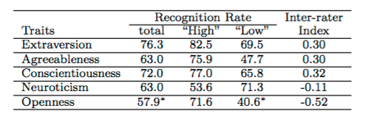
Results
Notes:
Table 2: Trait attribution performance. The results of this table have been obtained by using the average of the personality scores over the three assessors. When the difference with respect to a random classifier is not statistically significant, the values are denoted with a ’*’. The negative inter-rater agreement values are due to the errors of one of the assessors that has misunderstood one of the assessors that has misunderstood one of the questions in roughly 15% of the questions.
FOUND:
recognition rate significantly higher than chance for all dimensions except openness
Only dimensions for which performance can be considered satisfactory are extraversion and conscientiousness

Slide 35
Personality Detection for Deception
General observation: subjects display differences when telling lies vs. truth in many aspects of behavior (pitch, body gestures, eye gaze)
Finding: human judges’ ability to detect deception is correlated with their NEO-FFI scores (Enos et al 2006)
Finding: automatically identified personality information (from text) can be used for deception detection (Fornaciari et al 2013)
  http://clic.cimec.unitn.it/fabio/pr2demo.php
Notes:
(Feldman, 1979; Cody et al., 1989), who have found that culture-specific deception cues do exist. (For- naciari et al., 2013) found that personality informa- tion can be successfully used as features for decep- tion detection.

Slide 36
Hypothesis: the individual differences we observe in subjects behavior in lie vs. truth are are also correlated with manually-collected NEO-FFI scores

Slide 37
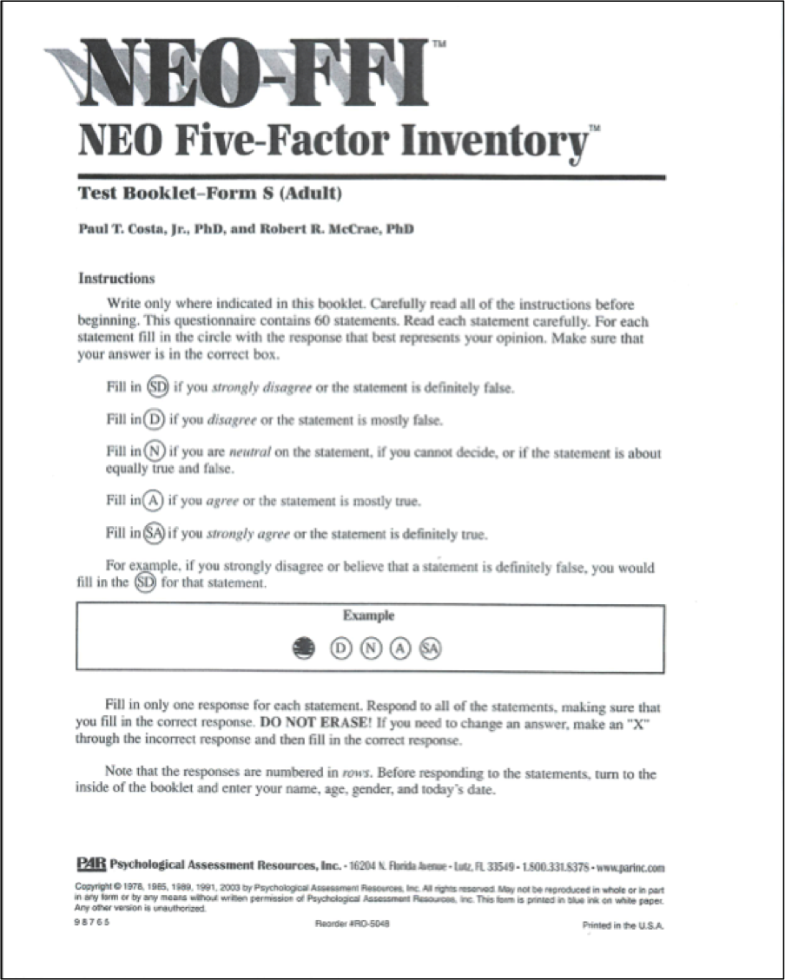
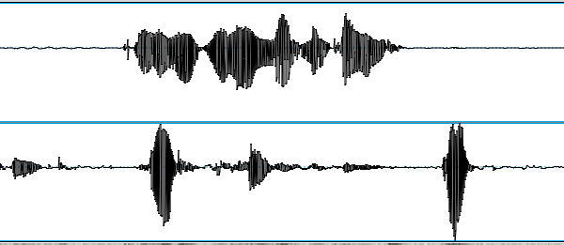
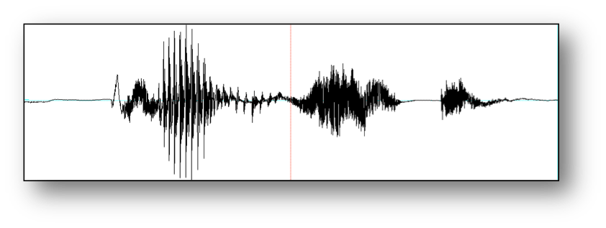
Recall: CxC Experiment
NEO-FFI
Survey
Background
survey
Lying game
Biographical
Questionnaire
Baseline sample

Slide 38
Baseline Interview
Tell me how you decided to come to Columbia.
What are your favorite things to do in New York City?
What do you like the most about living in New York City?
What do you like the least about living in New York City?
Describe a typical weekend for you, from Friday night through Sunday night.
What was the best food you ever ate, where did you have it, and what made it so good?
Where was the last place you traveled, and what are some things you did while you were there?
What was the last movie you saw, and what was the premise of it?
Besides work or school, what do you do with your time?
What did you do this past summer?

Slide 39
Recall: CxC Experiment
NEO-FFI
Survey
Background
survey
Lying game
Biographical
Questionnaire
Baseline sample

Slide 40
The Big Five (Costa & McCrae, 1992)
Openness to Experience: intellect/imagination, originality, curiosity, ingenuity, imaginative, insightful “I have a lot of intellectual curiosity.”
Conscientiousness: orderliness, responsibility, dependability, organized, thorough, planful
“I strive for excellence in everything I do.”
Extraversion: talkativeness, assertiveness, energy “I like to have a lot of people around me.”
Notes:
Costa & McCrae (1992) NEO-FFI Personality Measures
Openness to Experience: intellect/imagination, originality, curiosity, ingenuity, imaginative, insightful
“I have a lot of intellectual curiosity.”
Conscientiousness: orderliness, responsibility, dependability, organized, thorough, planful
“I strive for excellence in everything I do.”
Extraversion: talkativeness, assertiveness, energy
“I like to have a lot of people around me.”
Agreeableness: good-naturedness, cooperativeness, sympathetic, kind, affectionate, trust
“I would rather cooperate with others than compete with them.”
Neuroticism: anxiety, emotional instability,intense, moody,
“I often feel inferior to others.”

Slide 41
Neuroticism: anxiety, emotional instability, intense, moody, “I often feel inferior to others.”
Agreeableness: good-naturedness, cooperativeness, sympathetic, kind, affectionate, trust “I would rather cooperate with others than compete with them.”

Slide 42
Findings
3-4 minutes of ’normal’ speech turn out to yield good classification of ethnicity, gender, and success at deception detection, with some success at predicting NEO-FFI personality scores as well
Promising results for future work on classifying speakers from small amounts of ‘normal’ speech
Notes:
Provides a reliable way of identifying ethnicity, gender, and even success at detecting deception (altho not at deceiving)
Also predicts self-reported NEO-FFI personality scores well

Slide 43
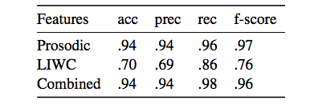
Classifying Gender
Baseline: 61% (female)
Prosodic features (f0) best predictors
Useful LIWC categories:
  ‘anger’, ‘money’, ‘certainty’ -> male
  ’home’, ‘anxious’, neg_emotion -> female
Gender Classification
Notes:
LIWC is a useful feature, even though everyone is answering the same questions
acoustic-prosodic features are highly predictive of gender. It is in- teresting that LIWC categories are also somewhat predictive of gender, with an f-score of .76 – de- spite the fact that all subjects answered almost the same questions. Some of the most useful cate- gories were ‘home’, ‘anxious’, and ‘negative emo- tion’, which all were predictive of ‘female’. On the other hand, ‘anger’, ‘certainty’, and ‘money’ cate- gories were predictive of male. Note that combining LIWC features with acoustic-prosodic features very slightly improves over using acoustic-prosodic fea- tures alone.

Slide 44
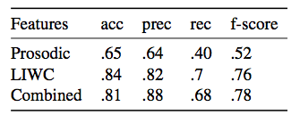
Classifying Native Language
Baseline: 57% (English L1)
Useful LIWC categories: ‘apostrophe’ -> English (contractions)
‘dash’ -> Mandarin (false starts)
Native Language
Notes:
LIWC features are more predictive than acoustic- prosodic features for native language/ethnicity identification. Combining both feature sets results in the best performance, with an f-score of .78. When analyzing the LIWC categories, we find that the punctuation counts are especially useful for this task. For example, use of ‘apostrophe’ is predictive of English, while dash is predictive of Mandarin. In our transcription, dashes are used to represent false starts, so it makes sense that this is a marker of less fluent speech. Apostrophes were used exclusively for transcribing contractions, which are less com- monly used by non-native speakers of English, so it is plausible that apostrophes are predictive on English.

Slide 45
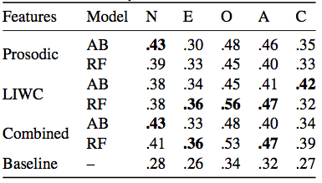
Personality Classification (F measure) (f1)measures)
Binning: high, medium, low for each factor, based on population means (all ages tho…and these are students)
Compare AdaBoost and RandomForest classifiers
Useful LIWC categories:
  Neuroticism: ‘power’, ‘money’
  Extraversion: ‘drives’, ‘focus future’
  Openness to experience: ‘interrogation’, ‘focus past’
  Agreeableness: ‘social’, ‘assent’
  Conscientiousness: ‘work’, ‘time’
Notes:
The relative improvements in f-score range from 38% (Extroversion) to 64% (Openness to experience), and the absolute improvements in f-score range from 10% to 22%.

Slide 46
Success at Deception Detection Ability
Baseline for ability to detect deception : 52%
  AdaBoost, prosodic + LIWC features: 61%
  Adding knowledge of gender, native language, personality: 65%
  Useful features: ‘focuspresent’, speaking rate
Currently unable to predict success at deception production above chance – but not yet using full set of lexical features

Slide 47
Next Class and Meetings
Sarcasm: record some examples!
Meetings about projects (make an appointment after class today)
  Tuesday, 7/25: 10:30-1:15; 3:30-5:30
  Wednesday, 7/26: 10:30-3

