Slide 1
Tools for Speech Analysis
Julia Hirschberg CS6998
Thanks to Jean-Philippe Goldman, Fadi Biadsy, and many more...

Slide 2
A Speech Analysis Tool: Praat
Developed by Paul Boersma and David Weenink at the Institute of Phonetic Sciences, University of Amsterdam
General purpose speech tool : editing, segmentation and labeling, prosodic manipulation and analysis, many tutorials, large user community, yahoo group
Notes:
first aim of Praat was to give students and scientists of Phonetics a handy tool for manipulating speech data and for creating stimuli for perception experiments,

Slide 3
Today
We’ll go through some exercises recording and analyzing files through Praat
First, make sure you have the latest version of Praat, 6.1.09
Put on your headphones and adjust the microphone so that it is slightly to one side of your mouth
Note: you can do many things with Praat (see Praat intro and many tutorials on line) but today we will go through some basics

Slide 4
Notes:
This is what a well-nnotated speech file looks like in Praat.

Slide 5
How do we Record and Manage Files?
Open Praat on your laptop
You’ll see 2 windows, an Objects window and a Picture window
Today we’ll focus on the first
Recording files and saving them
In the New menu:
Record a mono file “My mama lives in Memphis”, as a statement, play it, save to list as “<your name>-mama” and close New menu
In the Save menu:
Notes:
Picture window basically let’s you save results in a more legible way

Slide 6
Write to wav file on disk and then remove from objects window
Opening files from disk
In the Open menu: Choose “Read from file” and open “<your name>-mama” in Praat again
Select this file in the Objects window and you’ll see many options on the right
Select View and Edit
Select only the speech portion of the file, not the silences before and after

Slide 7
Display Options from Objects Window
From the menus in the sound file
Spectrum:
Select Spectrum → Show spectrogram
Select a point in sound file and Spectrum → View spectral slice
Select segment in sound file, then Spectrum → Extract visible spectrogram and select in Objects window
Play words one by one via spectrogram
Pitch:

Slide 8
Pitch → Show pitch
Lower pitch max of window in Pitch → Pitch settings; then change to min 75 max 600
Pitch → Get Pitch →Get pitch, Get min pitch, Get max pitch
Can you describe the pitch contour?
Intensity:
Intensity → Show intensity
Intensity → Get intensity, Get min intensity, Get max intensity
Check Intensity → Intensity settings

Slide 9
Pulses:
Pulses → Show pulses
Select segment in speech file
Pulses → Voice report
Formant:
Formant → Show formants
Do the formant values match those you expect for these vowels?

Slide 10
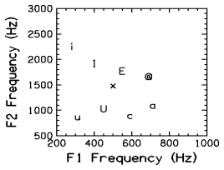
[i] - as in heed
[I] - as in hid
[E] - as in head
[@] - as in had
[a] - as in hod
[c] - as in hawed
[U] - as in hood
[u] - as in who'd
[x] - as in hud

Slide 11
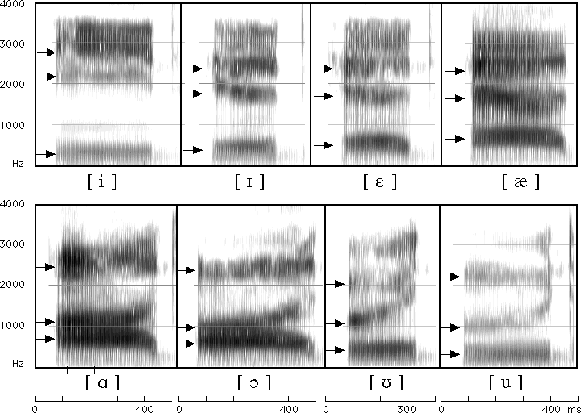
Formants for English Vowels
Notes:
My (a i/5 1) mama (a/5) lives (i/2) Memphis (e i/3 2).

Slide 12
How do we Set Parameters?
Select the speech segment from Sound Mama
For pitch extraction:
Open Pitch menu on Sound Mama
Select Show pitch and then Pitch settings
Set pitch floor to 75Hz, and pitch ceiling to 600Hz
For jitter (local only):
In Objects window select Sound mama
On right select Analyse periodicity
Select first To PointProcess menu

Slide 13
In Objects window Select PointProcess mama
Choose Query → Get jitter (local) and set parameters: floor=0.0001s; ceiling=0.02s, period max=1.3
For shimmer (local only):
Select both Sound and PointProcess
Choose Query → Get shimmer (local) and set period floor to 0.0001s, period ceiling to 0.02s, max period factor to 1.3, and max amplitude factor to 1.6
For HNR:
In Objects window select Sound mama

Slide 14
On right select Analyse periodicity
Select To harmonicity (cc) and set time step to 0.01, min pitch to 75Hz, silence threshold to 0.1, and periods per window to 1.0
Speaking rate: Count #words/duration.

Slide 15
Task 1
Read in your ‘mama’ file to Praat; View & Edit
Select the most prominent word and find a single cycle in the waveform – select – what is the frequency (1/cycle length)?
Select the entire contour
Display the pitch and intensity contours
What is the minimum pitch? Maximum? Mean?
What is the minimum intensity? Maximum? Mean?

Slide 16
Task 2: Voice Quality
Record “My mama lives in Memphis”
in a whisper
in a creaky voice
Study the pitch contours in normal vs. whisper vs. creaky. What do you notice?
Analyze jitter, shimmer and HNR of the 3 recordings using Pulses → Voice report
Notes:
Or
Sound -> analyze periodicity -> to Pitch
Pitch ->Analyze-> to PointProcess
PointProcess -> query -> get jitter
Sound + PointProcess -> get shimmer

Slide 17
Task 3: Contours
Record “My mama lives in Memphis” as a yes-no question
Compare to your Mama statement
What are the similarities in F0? Differences?
Now record a wh-question: “Where does my mama live?”
Which of the other 2 contours is it most similar to?

Slide 18
Task 6: Emotional Speech
Record “My mama lives in Memphis” again
As angry speech
As sad speech
As happy speech
For each token answer the following:
What is the mean pitch? Maximum?
What is the mean intensity? Maximum?
What is the duration?
Do you see any differences in the F0 contour?

Slide 19
Task 4: Changing the Pitch Contour
Take the first (statement) version of your mama file
Modify it to produce a rising intonational contour
Go to Manipulate → To manipulation
Go to View & Edit
Go to Pitch → Stylize pitch (2st)
Modify Pitch by dragging points up and down
Turn your statement into a question by lowering earlier pitch and raising final pitch

Slide 20
Play the result
To save: File -> Publish resynthesis
Compare it to the yes-no question version you recorded
Now modify the duration:
Place cursor at a point in the duration manipulation band where you want to change the duration
Dur → Add duration point at cursor
Drag points up (slower) and down (faster) to change rate
Play the result

Slide 21
Task 5: Modifying Emotion
Record a very happy version of “mama”
Go to Manipulate → To manipulation
Go to View & Edit with Manipulation object
Go to Pitch → Stylize pitch (2st)
Modify Pitch by dragging points up and down
Modify Dur by dragging points up and down
Turn your happy speech into sad speech; play the result
To save: File -> Publish resynthesis to get a new sound file “Sound from ManipulationEditor

Slide 22
Task 6: Pitch Contour Cloning
Record a sad version of ”mama” and read both the happy.wav and sad.wav versions into Praat
Create a manipulation object for happy.wav
Extract the pitch tier
Create a manipulation object for sad.wav
Select the pitch tier of happy.wav and the manipulation object for sad.wav and click ‘Replace pitch tier’
Select the manipulation object for sad.wav and click ‘Get resynthesis…’

Slide 23
Compare the original sad.wav file and the new sad.wav
Compare the new sad.wav and the original happy.wav

Slide 24
Task 7: Masking
Select original mama file each time
Convert → Change Gender
Filter →filter (pass) Hann band
Passes specified range through
Find a pass band that masks the words but retains the intonation
Find a pass band that masks the intonation but retains the words
Modify → Reverse
Notes:
Filter: keeping lower bands keeps intonation; higher bands (e.g. 500-1000) keep words
Modify Formant Shift Ratio (lower is male; 1.0 is no change; higher is female); New Pitch Median can also be reset to a lower or higher value for male vs. female
To change female to male try things like 0.8 or 0.9 for formant shift and 65 for pitch median…

Slide 25
Task 8: Clipping
Record a short phrase in a very loud voice, to produce clipping, and see what the waveform looks like
How do you identify clipping?
Avoid it?
Increase the resolution (sampling rate)
Decrease the amplitude

Slide 26
Task 8: Formant Analysis
Extract F1 and F2 values for the vowels in your mama file
Formant -> show formants
Get first formant… (F1 shortcut)
submit the values in this form:
https://goo.gl/forms/ZIOvmXOP5ubIq1rS2

Slide 27
Task 9: Annotation using Textgrids
Select Sound file in Objects window
Annotate → To textgrid
Point vs. interval tiers
Add a point tier and an interval tier and insert some labels
NB: remember to select the interval or point circle first in the waveform or spectrogram before trying to insert a label

Slide 28
Help
Online Praat help, FAQ, manual
Links from http://www.praat.org
Additional tutorials, scripts, resources, user groups
Parselmouth vs. Praat Scripting
Notes:
For a quick check, you can use Praat → New Praat Script --> Edit → Paste history

Slide 29
Scripting
From history:
Praat → new Praatscript → Edit → Paste history
NB: you can run all or part of the script (select and run selection)
Writing scripts
Modifying existing scripts:
Tutorials, scripts, resources, user groups, search

Slide 30
Sample Praat Script
# This script will create a new text-grid for a wav file
form Make a text-grid for a .wav file
comment Source Directory?
sentence Directory C:\Documents and Settings\julila\My Documents\
comment File name?
sentence Filename
comment Tier Name?
sentence Tier
endform
Read from file... 'directory$‘ ‘filename$'
stem$ = left$(filename$,length(filename$)-4)
select Sound 'stem$'
To TextGrid... 'tier$' 'tier$‘ # tier names, which tiers are point tiers
Write to text file... 'directory$'\'stem$'.TextGrid
Remove

Slide 31
Next Class
Read the ToBI Conventions, Modeling Prosody and Prosody and Meaning (links from the syllabus)
Post 5 on these due next Monday (2/17/20) at 11:59 am
HW 1 assigned: due 2/25/20 at 4:10 pm

