Slide 1
Acoustics of Speech
Julia Hirschberg
CS 6998
Spring 2020

Slide 2

Goal 1: Distinguishing One Phoneme from Another, Automatically
ASR: Did the caller say ‘I want to fly to Newark’ or ‘I want to fly to New York’?
Forensic Linguistics: Did the accused say ‘Kill him’ or ‘Bill him’?
What evidence is there in the speech signal?
  How accurately and reliably can we extract it?

Slide 3
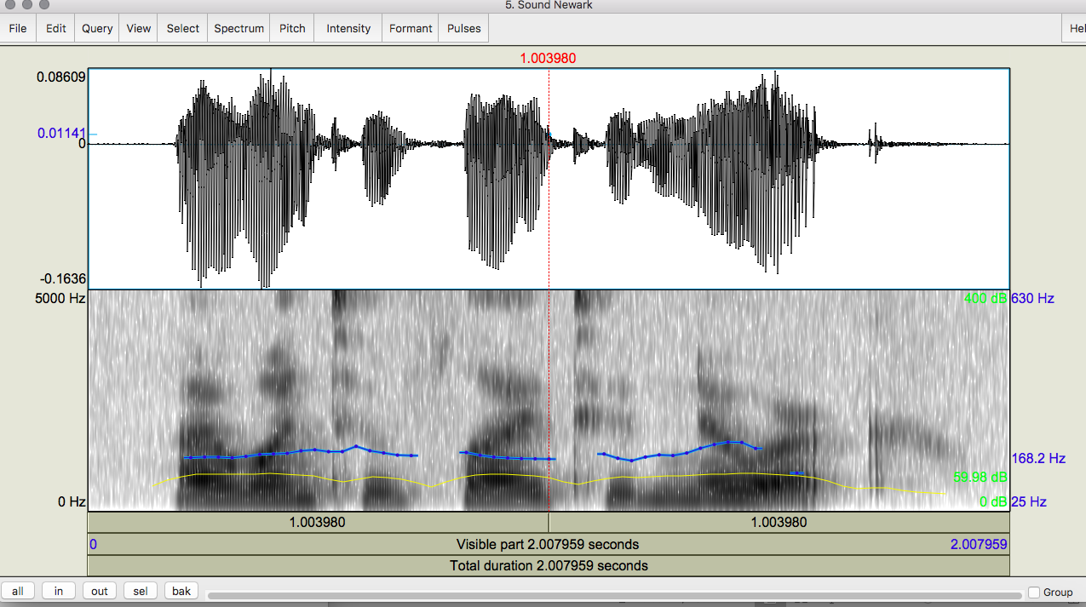
Notes:
Newark

Slide 4
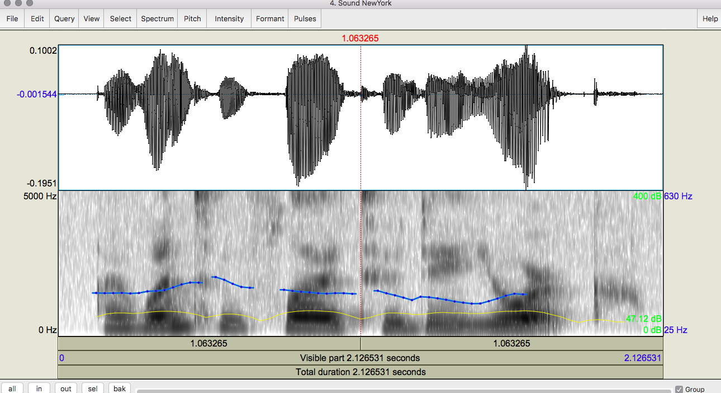
Notes:
New York

Slide 5
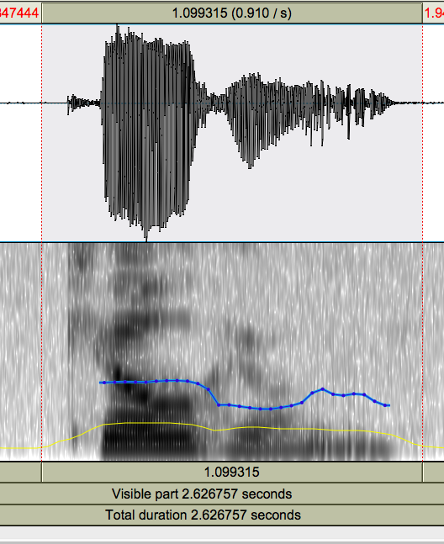
Notes:
Kill – voiceless stop with VOT (voice onset time) following

Slide 6
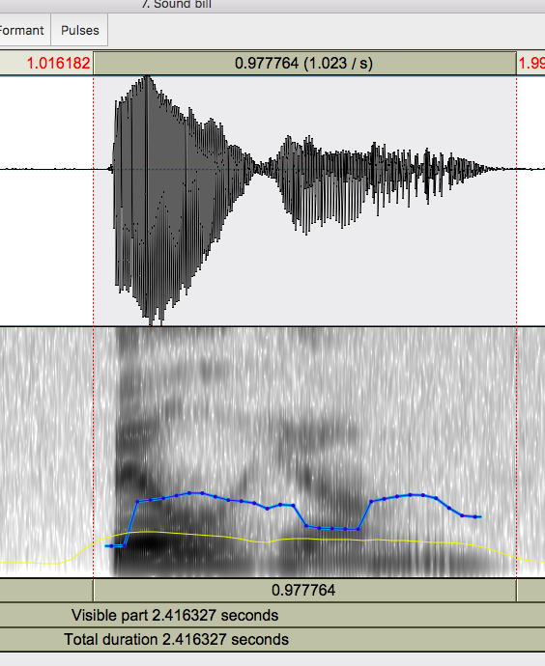
Notes:
Bill – voiced consonant, no VOT

Slide 7
Goal 2: Determining How things are said is sometimes critical to understanding
Intonation
  Forensic Linguistics: ‘Kill him!’ or ‘Kill him?’
  TTS: ‘Are you leaving tomorrow./?’
  What information do we need to extract from or generate in the speech signal?
  What tools do we have to do this?

Slide 8
Today and Next Class
How do we define cues to segments and intonation?
  Fundamental frequency (pitch)
  Amplitude/energy (loudness/intensity)
  Spectral features (formant frequencies)
  Timing (pausing, speaking rate)
  Voice Quality (jitter, shimmer, HNR)
How do we extract them?
  Praat
  openSMILE
  libROSA…
Notes:
Formant frequencies correspond to resonances in the vocal tract

Slide 9
Outline
Sound production
Capturing speech for analysis
Feature extraction
Spectrograms

Slide 10
Sound Production
Pressure fluctuations in the air can be caused by a musical instrument, a car horn, a voice…
  Sound waves propagate thru e.g. air (marbles slow, stone-in-lake ripples)
  Cause the eardrum (tympanum) to vibrate
  Auditory system translates into neural impulses
  Brain interprets as sound
  Plot sounds as change in air pressure over time
From a speech-centric point of view, sound not produced by the human voice is noise
  Ratio of speech-generated sound to other simultaneous sound: Signal-to-Noise Ratio

Slide 11
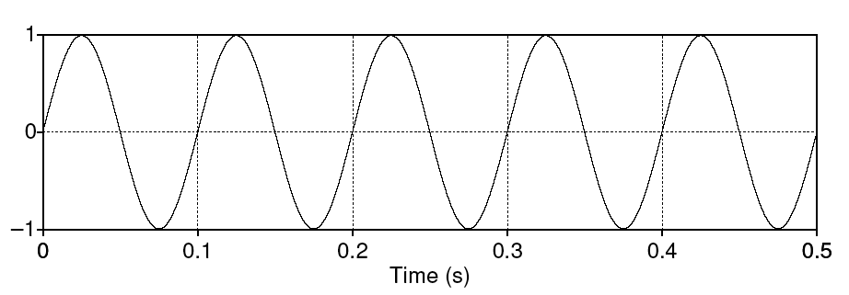
Simple Periodic Waves
Characterized by frequency and amplitude
Frequency (f) – cycles per second
Amplitude – maximum value in y axis
Period (T) – time it takes for one cycle to complete

Slide 12
Simple Periodic Waves
Characterized by frequency and amplitude
Frequency (f) – cycles per second
Amplitude – maximum value in y axis
Period (T) – time it takes for one cycle to complete

Slide 13
Complex Periodic Waves
Cyclic but composed of multiple sine waves
  Fundamental frequency (F0): rate at which largest pattern repeats (also GCD of component frequencies)
  Harmonics: faster repeating patterns
Any complex waveform can be analyzed into its component sine waves with their frequencies, amplitudes, and phases (Fourier’s theorem)

Slide 14
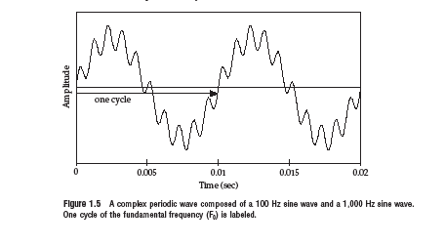
2 Sine Waves → 1 Complex Periodic Wave

Slide 15
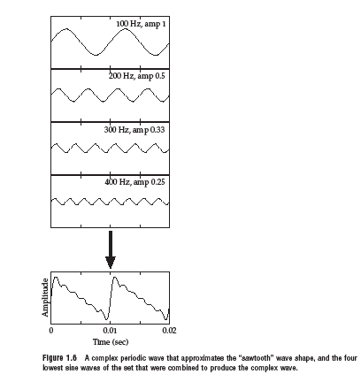
4 Sine Waves→ 1 Complex Periodic Wave

Slide 16
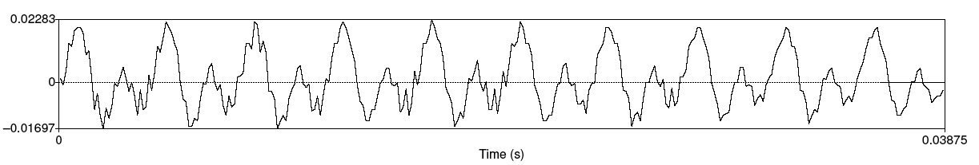
Speech Sound Waves: /iy/
X-axis: time
Y-axis: air pressure above (+ Compression), at (0 Normal air pressure) and below (- Rarefaction (decompression)) normal air pressure
Combined sound waves of different frequencies

Slide 17
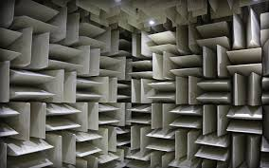
How do we Capture Speech for Analysis?
Recording conditions
  Quiet office, sound booth, anechoic chamber

Slide 18
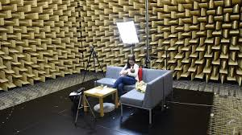

Slide 19
What do we need to Capture Speech?
Good recording conditions: please remember this when recording!
Microphones convert sounds into electrical current: oscillations of air pressure become oscillations of voltage in an electric circuit
  Analog devices (e.g. tape recorders) store these as a continuous signal
  Digital devices (e.g. computers, DAT) first convert continuous signals into discrete signals (digitizing)

Slide 20
Speech Sampling
Sampling rate: how often do we need to sample?
  At least 2 samples per cycle to capture periodicity of a waveform component at a given frequency – why?
    100 Hz waveform needs 200 samples per sec
    Nyquist frequency: highest-frequency component captured with a given sampling rate (half the sampling rate) – e.g. 8K sampling rate (telephone speech) captures frequencies up to 4K
Notes:
Positive and negative wav components

Slide 21
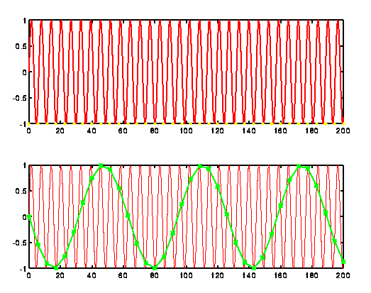
Ideal Sampling
Notes:
Take the speech signal at the top and sample the min and max over a longer segment to get a reasonable estimation of the signal.

Slide 22
Sampling/Storage Tradeoff
Human hearing: ~20K top frequency
  Do we really need to store 40K samples per second of speech?
Telephone speech: 300-4K Hz (8K sampling)
  But some speech sounds (e.g. fricatives, stops) have energy above 4K…
44k (CD quality audio) vs.16-22K (usually good enough to study pitch, amplitude, duration, …)
Golden Ears…
Notes:
Steve crandall: It was at Oberlin College, The Cleveland Orchestra (we learned a lot from the concertmaster) and Telarc Records in Cleveland. TCO and Telarc had certified Tone Masters. What we learned was hearing is much better if you’re under 30 and you can train students in a few hours to be as good as a tone master. We used students from the music conservatory and tried some from other departments. The best two or three (out of the dozen we trained for the tests) weren’t in music:) One was an art major — I can’t remember the others. A very strange finding was asking people to list music genres. Most people can do six to eight. Music students up to 20 with a few outliers. Niki Fallen was the statistical sport with over 150… that’s where I first learned about Calgary (Canada) Sugar Pop. The mind wobbles.

Slide 23
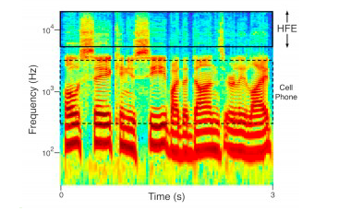
What your Phone is not Telling You
High frequency samples
Notes:
Listen to only the high frequencies and report what you hear. We can do this using conventional signal processing methods: cut out everything below 6,000 Hz thereby only transmitting sounds above 6,000 Hz to the ear of the listener. When we do this, some listeners only hear chirps and whistles, but most normal-hearing listeners report hearing voices in the high frequencies. Strangely, some voices are very easy to hear out in the high frequencies, while others are quite difficult. The reason for this difference is not yet clear. You might experience this phenomenon if you listen to the following clips of high frequencies from several different voices. (You’ll need a good set of high-fidelity headphones or speakers to ensure you’re getting the high frequencies.)

Slide 24
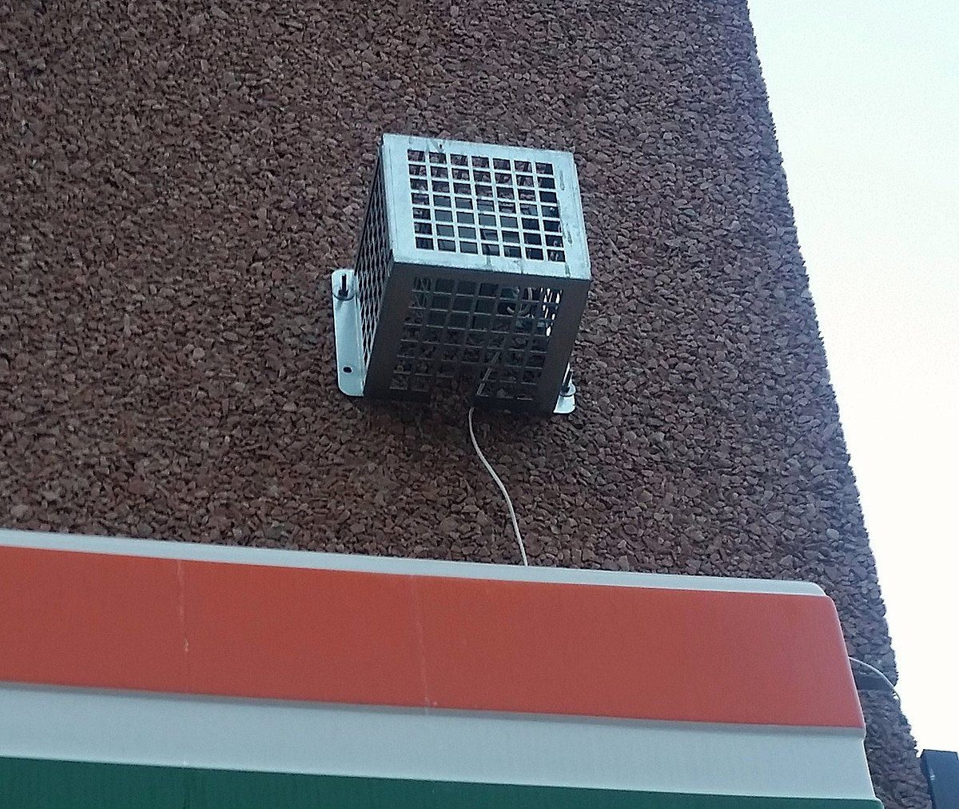
The Mosquito
Listen (at your own risk)
Notes:
Can you hear this?
machine used to deter loitering by young people by emiting sound at high frequency so that it can be heard mostly by young people -- human rights concerns

Slide 25
Sampling Errors
Aliasing:
  Different signals become indistinguishable (aliases) of one another
  Signals with frequency higher than the Nyquist frequency
  Solutions:
    Increase the sampling rate
    Filter out frequencies above half the sampling rate (anti-aliasing filter)
Notes:
causes different signals to become indistinguishable (or aliases of one another) when sampled. It also often refers to the distortion or artifact that results when a signal reconstructed from samples is different from the original continuous signal.

Slide 26
Quantization Issues
Measuring the amplitude at sampling points: what resolution should you choose?
  Integer representation
  8, 12 or 16 bits per sample
Noise due to quantization steps can be avoided by higher resolution -- but requires more storage
  How many different amplitude levels do we need to distinguish?
  Choice depends on data and application (44K 16bit stereo requires ~10Mb storage)

Slide 27
  But clipping occurs when input volume (i.e. amplitude of signal) is greater than the range that can be represented
  Watch for this when you are recording…
  Solutions
    Increase the resolution
    Decrease the amplitude

Slide 28
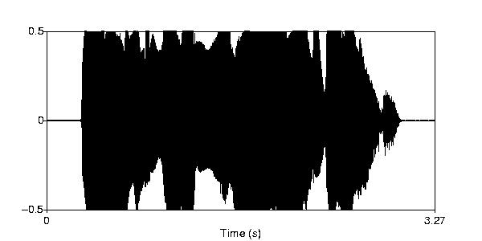

Clipping

Slide 29
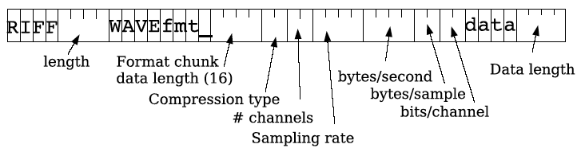
Speech File Formats: WAV
Many formats, trade-offs in compression, quality
Sox can be used to convert speech formats
Notes:
Resource Interchange File Format: RIFF file: M$ wave file format with header and data.

Slide 30
Frequency
How fast are the vocal folds vibrating?
  Vocal folds vibrate for voiced sounds, causing regular peaks in amplitude
F₀ – Fundamental frequency of the waveform
Pitch track – plot of F₀ over time

Slide 31
Estimating Pitch
Frequency = cycles per second
Simple approach: count the zero crossings in a time range

Slide 32
F0 Measure: Autocorrelation Process
Idea: Identify the period between successive cycles of the wave
  F₀ = 1/period length
Where does one cycle end and another begin?
  Find the similarity between the signal and a shifted version of itself
  Period is the chunk of the segment that matches best with the next chunk

Slide 33
Parameters
  Window size (chunk size)
  Step size
  Frequency range

Slide 34
Common Problems in Pitch Tracking
Microprosody effects of consonants (e.g. /v/)
Creaky voice → no pitch track
Errors to watch for in reading pitch tracks:
  Halving: shortest lag calculated is too long → estimated cycle too long, too few cycles per sec (underestimate pitch)
  Doubling: shortest lag too short and second half of cycle similar to first → cycle too short, too many cycles per sec (overestimate pitch)

Slide 35
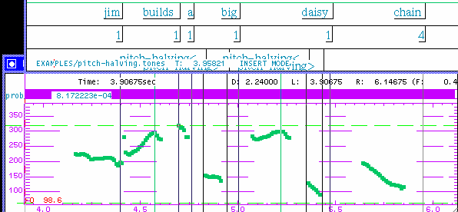

Pitch Halving
pitch is halved

Slide 36
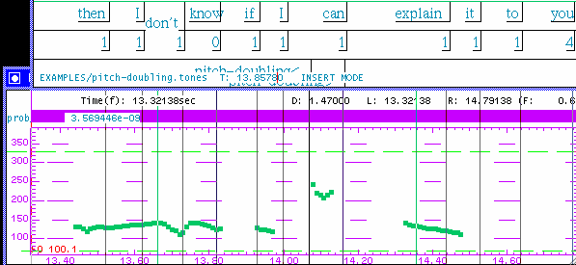
Pitch Doubling
pitch is doubled

Slide 37
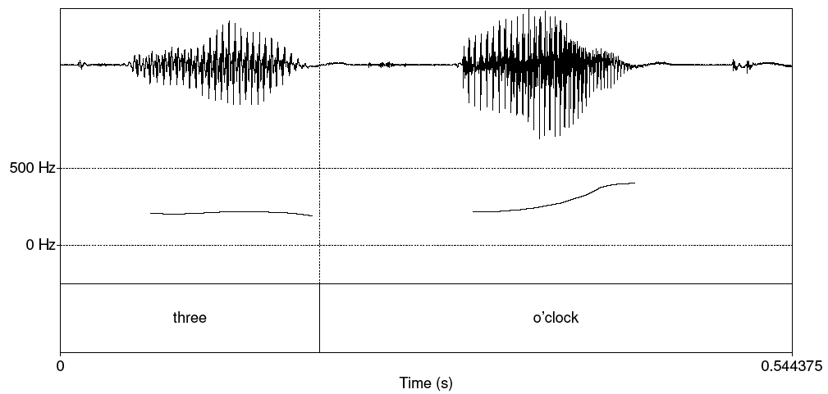
Pitch track

Slide 38
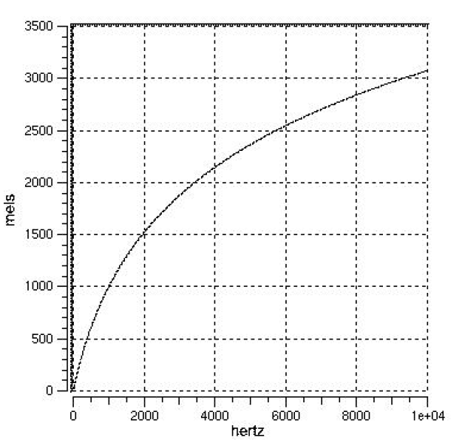
Pitch vs. F0
Pitch is the perceptual correlate of F0
  Human hearing is not equally sensitive to all frequency bands;
    Most accurate between 100Hz and 1000Hz
    Less sensitive at higher frequencies, roughly > 1000 Hz

Slide 39
Mel scale
  Psycho-acoustc model of pitch
  Unit of pitch defined so pairs of sounds which are perceptually equi-distant in pitch are separated by an equal number of mels
  Frequency in mels = 1127 ln (1 + f (F0)/700)

Slide 40
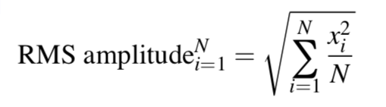
Amplitude
Measuring amplitude over a speech segment
  Square each peak value of units on y axis over a speech segment and take the average

Slide 41
Intensity
Perceived loudness
Measured in decibels (dB) logarithmically (how humans perceive sound and relate one to another)
10 log₁₀ (S₁/S₂), where S₁ and S₂ the power ratio between two sounds
Notes:
Pa = Pascal = unit of pressure named after Blais Pascal – used to measure pressure of sound on an object (like an eardrum)
https://en.wikipedia.org/wiki/Decibel

Slide 42
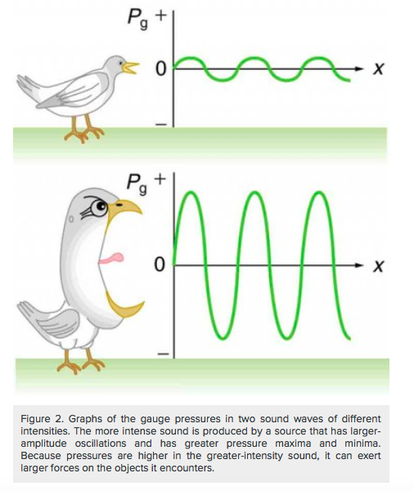
Notes:
The larger the pressure max and min, the more intense the sound

Slide 43
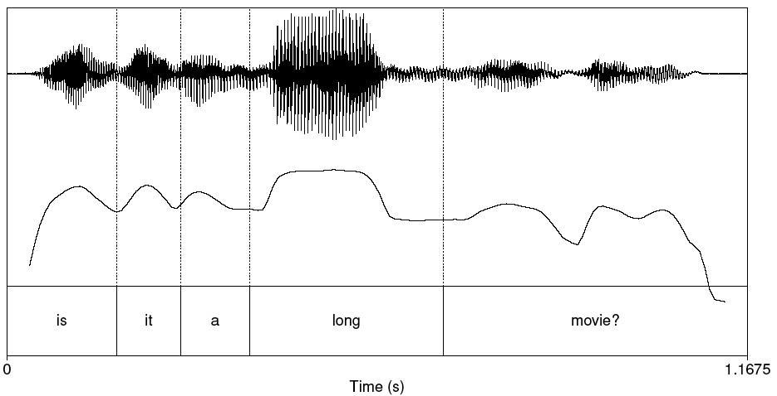
Plot of Intensity

Slide 44
How ‘Loud’ are Common Sounds – How Much Pressure Generated?
Event Pressure (Pa) Db
Absolute 20 0
Whisper 200 20
Quiet office 2K 40
Conversation 20K 60
Bus 200K 80
Subway 2M 100
Thunder 20M 120
*DAMAGE* 200M 140
Notes:
Pa = Pascal presure metric
Db = Decibel

Slide 45
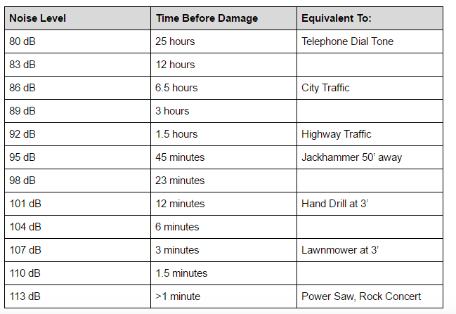

Slide 46
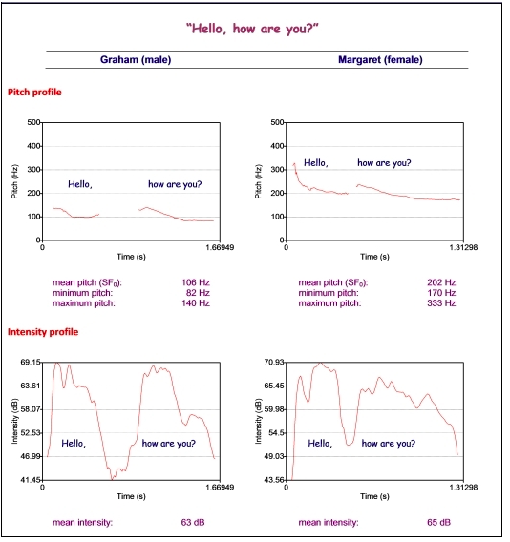

Slide 47
Voice quality
Jitter
Shimmer
Harmonics to Noise Ratio (HNR)

Slide 48
Voice quality
Jitter
  Random cycle-to-cycle variability in F₀
  Pitch perturbation/irregularity
Shimmer
  Random cycle-to-cycle variability in amplitude
  Amplitude perturbation/irregularity

Slide 49
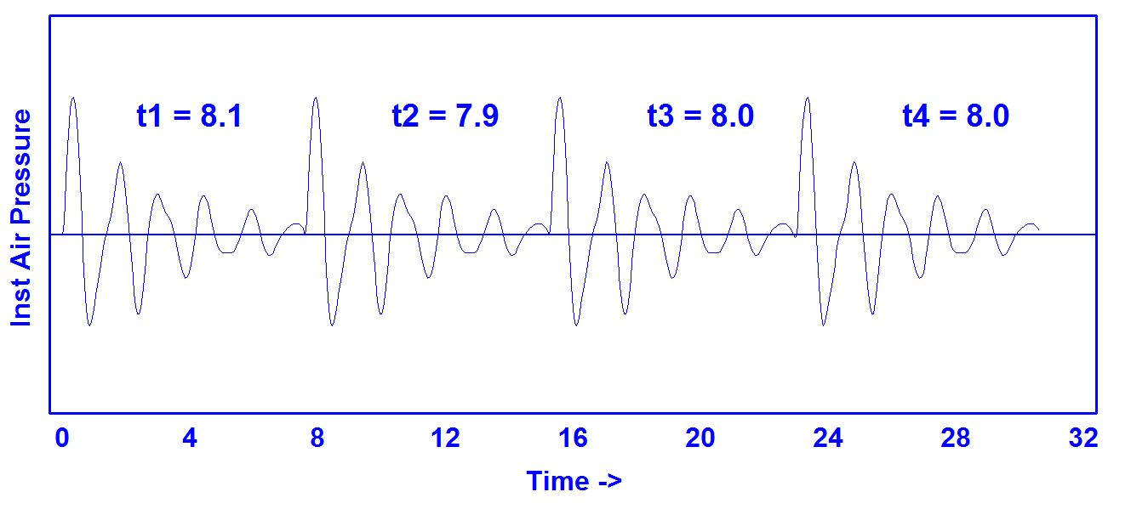
Jitter
https://homepages.wmich.edu/~hillenbr/501.html
Notes:
Pitch irregularity

Slide 50
Synthetic Continuum Varying in Jitter
0.0% 2.0%
0.2% 2.5%
0.4% 3.0%
0.6% 4.0%
0.8% 5.0%
1.0% 6.0%
1.5%
https://homepages.wmich.edu/~hillenbr/501.html

Slide 51
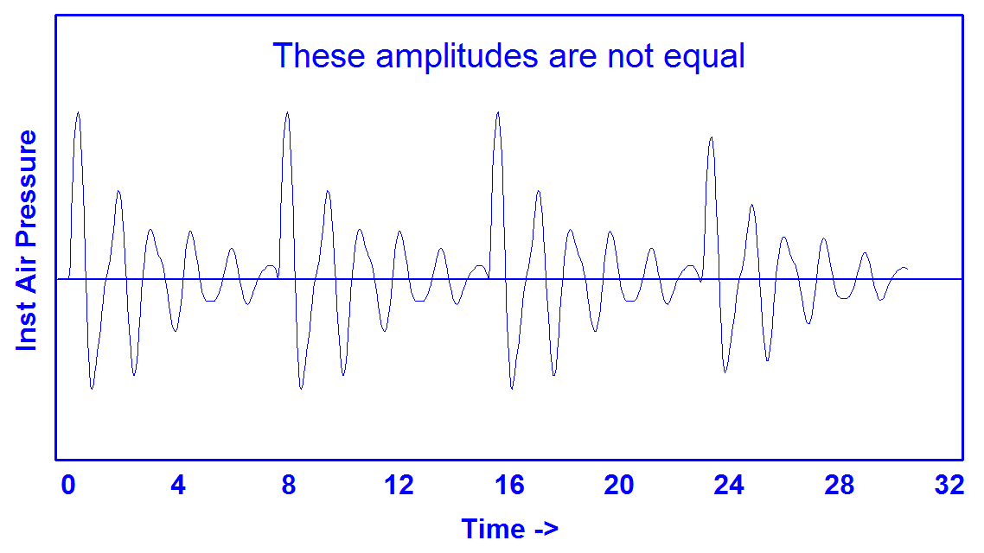
Shimmer
https://homepages.wmich.edu/~hillenbr/501.html
Notes:
Amplitude irregularity

Slide 52
Synthetic Continuum Varying in Shimmer
0.00 dB 1.60 dB
0.20 dB 1.80 dB
0.40 dB 2.00 dB
0.60 dB 2.25 dB
0.80 dB 2.50 dB
1.00 dB 2.75 dB
1.20 dB 3.00 dB
1.40 dB
https://homepages.wmich.edu/~hillenbr/501.html

Slide 53
HNR
Harmonics to Noise Ratio
  Ratio between periodic and aperiodic components of a voiced speech segment
Periodic: vocal fold vibration
Non-periodic: glottal noise
Lower HNR -> more noise in signal, perceived as hoarseness, breathiness, roughness
Notes:
Harmonics: good; Noise: not

Slide 54
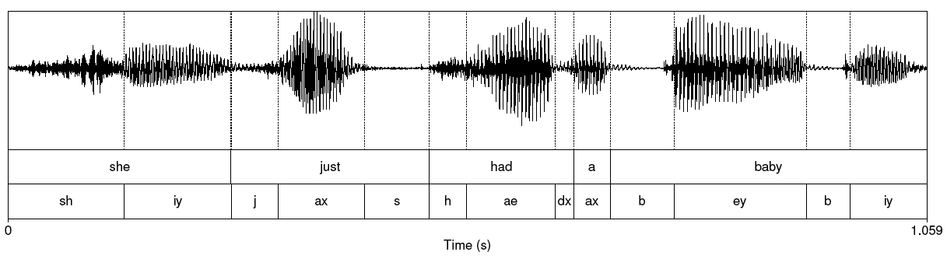
Reading waveforms

Slide 55
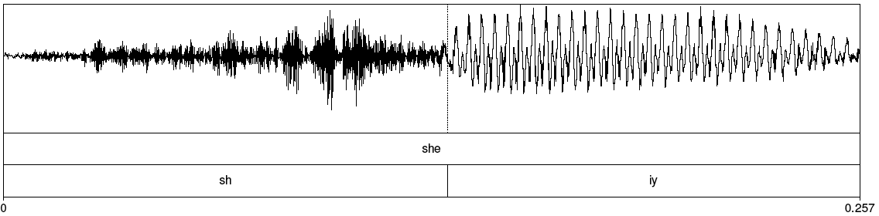
Fricative
Notes:
Sh in she

Slide 56
Spectrum
Representation of the different frequency components of a wave
  Computed by a Fourier transform
  Linear Predictive Coding (LPC) spectrum – smoothed version

Slide 57
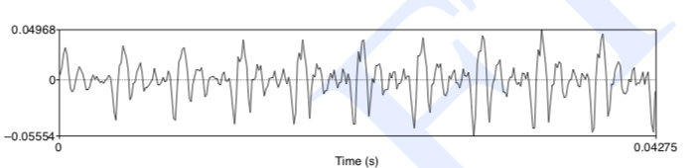
Part of [ae] Waveform from “had”
Complex wave repeated 10 times (~234 Hz)
Smaller waves repeated 4 times per large (~936 Hz)
Two tiny waves on the peak of 936 Hz waves (~1872 Hz)

Slide 58
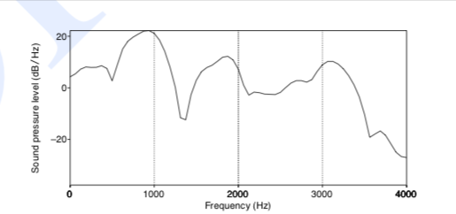
Spectrum
Represents frequency components
Computed by Fourier transform
Peaks at 930 Hz, 1860 Hz, and 3020 Hz

Slide 59
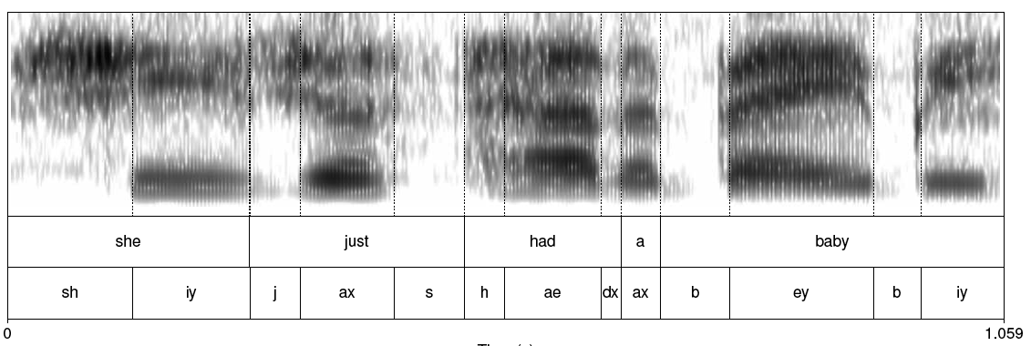
Spectrogram

Slide 60
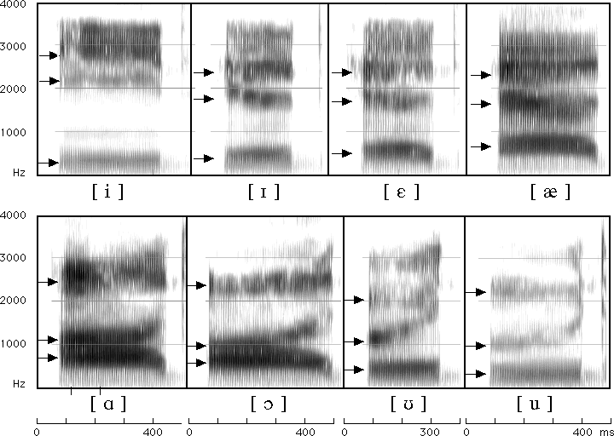
Formants for English Vowels

Slide 61
Source-filter Model
Why do different vowels have different spectral signatures?
  Source = glottis
  Filter = vocal tract
When we produce vowels, we change the shape of the vocal tract cavity by placing articulators in particular positions

Slide 62
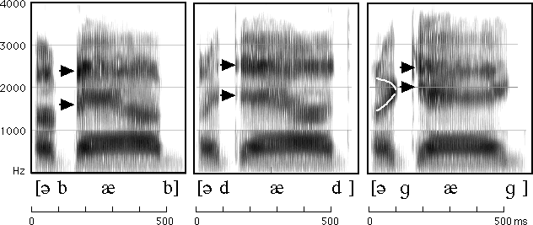
Reading Spectrograms
Notes:
Abab…

Slide 63
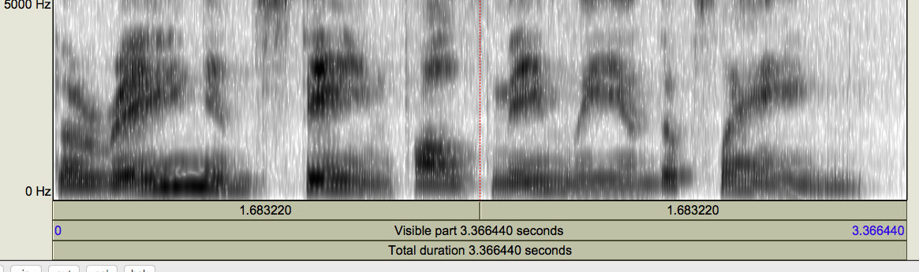
Mystery Spectrogram

Slide 64
MFCC
Sounds that we generate are filtered by the shape of the vocal tract (tongue, teeth etc.)
If we can determine the shape, we can identify the phoneme being produced
Mel Frequency Cepstral Coefficients are widely used features in speech recognition

Slide 65
MFCC calculation
Frame the signal into short frames
Take the Fourier transform of the signal
Apply mel filterbank to power spectra, sum energy in each filter
Take the log of all filterbank energies
Take the DCT of the log filterbank energies
Keep DCT coefficients 2-13

Slide 66
Next class
Download Praat from the link on the course syllabus page
Read the Praat tutorial linked from the syllabus
Bring a laptop and headphones with mic to class
If you have a chance, record yourself in a quiet room and check your pitch, intensity, and voice quality in Praat

