Slide 1
From Sounds to Language
Julia Hirschberg
CS 6998
Spring 2020

Slide 2
Some Important Tasks
Please make sure you are enrolled in Courseworks
    If you are auditing the class and not enrolled, let me know
    If you are a CVN student and not enrolled, tell Becky and cc me
Please sign up for Piazza in Courseworks now so you can post questions and see answers to others’ questions
Please go to NameCoach and record your name so we can pronounce it correctly – only 20 have done

Slide 3
Most important: Weekly posts are due at 11:59 am on the Monday before class.
  Posting late removes 1pt (of the 4 possible) for each late day.
  This rule will be enforced from now on – not for Week 2’s posts. But please submit those today if you have not done so already.

Slide 4
Jessica, Becky and I will be posting our office hours tonight/tomorrow morning

Slide 5
Linguistic Sounds
What is the sound inventory of a language X?
How are these sounds produced?
What sounds are shared by languages X and Y? Which are different?
How do particular sounds in a given language vary in different contexts?
Why do we need to know all this to study a language?

Slide 7
A Tale of Discounts and Advertisers
(1) A burger costing $4.59 is on sale for $2.33 at Mel’s
Close your eyes and repeat the sale price to yourself 3 times
(2) A taco costing $4.53 is on sale for $2.22 at Noche Mexicana
Repeat the sale price to yourself 3 times
Which is the better deal? 1 or 2?
Notes:
Saving 2.26 (49%) for the burger vs. saving 2.31 (51%) for the taco

Slide 8
Coulter & Coulter 2010
Notes:
Sounds produced in the back of the mouth (“uw”) (2) seem larger than sounds produced at the front (“ee”) (3)
Comparing two languages: but the opposite is true in Chinese; and Coulter and Coulter found that English speakers and Chinese speakers had opposite opinions of two prices. Is this true? Does $2.33 sound smaller than $2.22?
So this is why we need to understand the sounds of different languages

Slide 9
Notes:
Are you going to buy these avocados? 9 is pronounced “n ah-ee n” in english – does it sound small or large?

Slide 10
Phonetics: Studying and Classifying Speech Sounds
Production and Perception
  Auditory phonetics: the perception of speech sounds
  Articulatory phonetics: the articulation of speech sounds
  Acoustic phonetics: the acoustic features of speech sounds

Slide 11
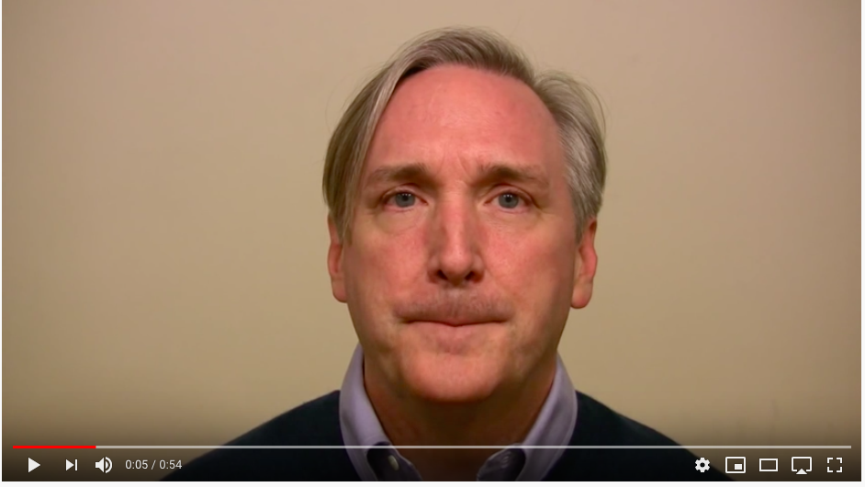
The McGurk Effect

Slide 12
Sound in Language: Phones vs. Phonemes vs. Allophones
Phones: any distinct sound in a language, whether it conveys meaning or not
  English: n vs nnnn does not convey meaning
  But for Quantity languages (e.g. Finnish, Amharic): sound length matters
    Changes the meaning of a word
    Doubled vowels for Finnish
    Doubled consonants (gemination) for Amharic (e.g. “still” (/gəna/) vs. “Christmas” (/gənna/)
Notes:
Qnatity languages: some Arabic dialects, Finnish, Japanese, Estonian

Slide 13
Phonemes: collections of sounds that convey the same meaning and can change the meaning of a word if exchanged with another phoneme
  /t/ in top, stop, butter, winter or /k/ in cat, kitten
  /t/ → /m/ top → mop
Allophones: the different realizations of a phoneme
  E.g. Sounds that correspond to /t/ in English
    E.g. butter vs bu*tt*er

Slide 14
How should we Represent Speech Sounds?
Why do we need to?
  How do we translate between sounds and words (ASR, TTS, MT, keyword search), learn pronunciations new languages, compare language similarities and differences?
So…how should we represent sounds?
  Regular orthography: jump
  Special-purpose symbol sets: /jh uh m p/
  Abstract sound classes based upon sound similarities across languages: /dz ʌ m p/
Notes:
How many of you have used Duolingo?

Slide 15
Orthographic Representation?
As we know now…a single letter may have many different acoustic realizations, e.g., in English
  o comb, tomb, bomb oo blood, food, good
  c court, center, cheese s reason, surreal, shy
And…a single sound may be represented differently in orthography
  [i] sea, see, scene, receive, thief [s] cereal, same
  [u] true, few, choose, lieu, do [ay] prime, buy, rhyme
Is orthography a good choice for English?
For Japanese? Spanish? Chinese?
Notes:
It depends on how many sounds are associated with each orthographic symbol/letter and how many symbols/letters can convey the same sound

Slide 16
Phonetic Symbol Sets
Special Purpose: ARPAbet, TIMIT, …
  Ascii but uses multiple characters for sounds
  English specific, so new symbol sets required for each new language to be represented
Abstract: International Phonetic Alphabet (IPA)
  Single character for each sound
  Represents all sounds of the world’s languages but is quite large and requires special fonts
  Interactive IPA chart: http://www.ipachart.com
Notes:
From IPA play clicks and others

Slide 17
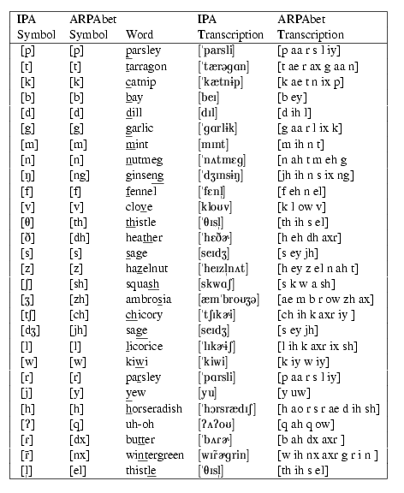
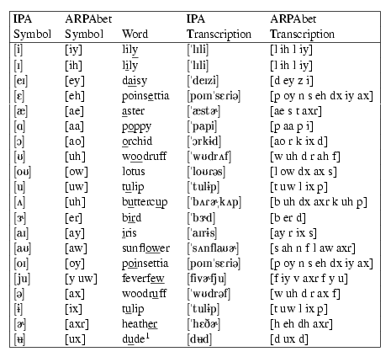
Figures 7.1 and 7.2:
Jurafsky & Martin
Exercise:
Write your first name in English
Orthography, in ARPAbet, and in IPA.
Notes:
Julia
jh uw l iy uh
Dz u(-) l i ^
What are the differences?

Slide 18
Other IPA Charts
Albanian
Amharic
Bengali
Cantonese
Catalan
Farsi
Finnish
French
German
Gujarati
Hebrew
Hindi and Urdu
Japanese
Korean
Malayalam
Mandarin
Marathi
Punjabi
Portuguese
Russian
Spanish
Tamil
Thai

Slide 19
Articulatory Phonetics: How do we produce speech?
How articulation works:
  Air passes from lungs through windpipe (trachea) leaving via mouth (mostly) and nose (nasals) (e.g. [m], [n])
  Air passing thru trachea goes thru larynx, which contains vocal folds – space between them is the glottis
  When vocal folds vibrate, we get voiced sounds (e.g. [v]); o.w. voiceless (e.g. [f])
Notes:
Say puff; say mama

Slide 20
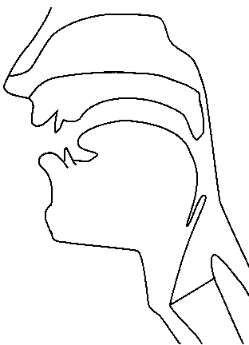
Places of Articulation
alveolar
post-alveolar/palatal
dental
velar
uvular
labial
pharyngeal
laryngeal/glottal
http://smu-facweb.smu.ca/~s0949176/sammy/
Notes:
Labial: p, b, m, w
Dental: f, v
Alveolar: t, d, s, z, n, l, r
Palatal: sh, zh, ch, jh, y
Velar: k, g, ng
Glottal: q, h

Slide 21
Consonants and Vowels
Consonants:
  Restriction/blockage of air flow (e.g. [s] [p])
  Voiced [z] or voiceless [s]
Vowels:
  Generally voiced, less restriction (e.g. [u])
Semivowels (glides): [w], [y]
Notes:
Say s, z, f, g, b

Slide 22
Vowels
Mainly voiced
Vowel height
  How high is the tongue? high or low vowel
  Where is its highest point? front or back vowel
How rounded are the lips?
Mono- [eh] vs. diphthong, e.g. [ey]
  1 vowel sound or 2 combined

Slide 23
American English Vowel Space
HIGH
iy
uw
ih
ix
ux
uh
oy
ey
ow
ax
FRONT
BACK
eh
ah
aw
ao
ay
ae
aa
LOW
Notes:
Touch your tongue when you say iy, uw, ae, aa

Slide 24
Places of Articulation
alveolar
post-alveolar/palatal
dental
velar
uvular
labial
pharyngeal
laryngeal/glottal
http://smu-facweb.smu.ca/~s0949176/sammy/
Notes:
Labial: p, b, m, w
Dental: f, v
Alveolar: t, d, s, z, n, l, r
Palatal: sh, zh, ch, jh, y
Velar: k, g, ng
Glottal: q, h

Slide 25
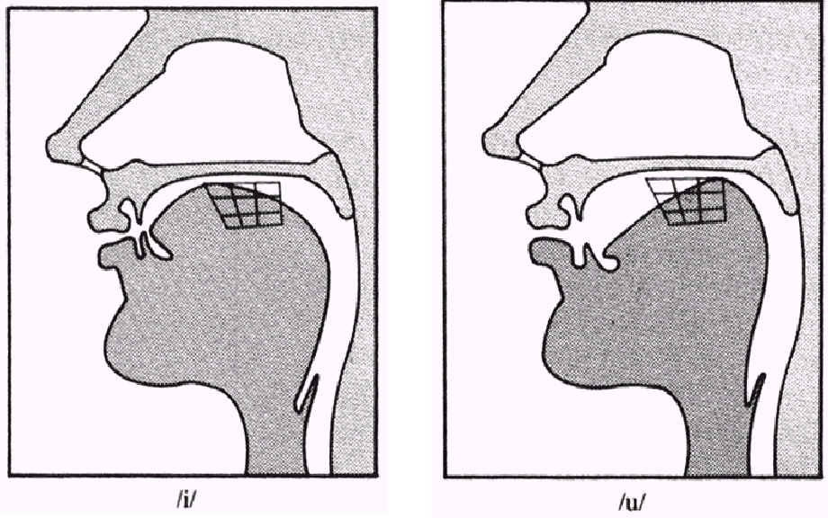
High Front or Back [iy] vs. [uw]
(From a lecture given by Rochelle Newman)

Slide 26
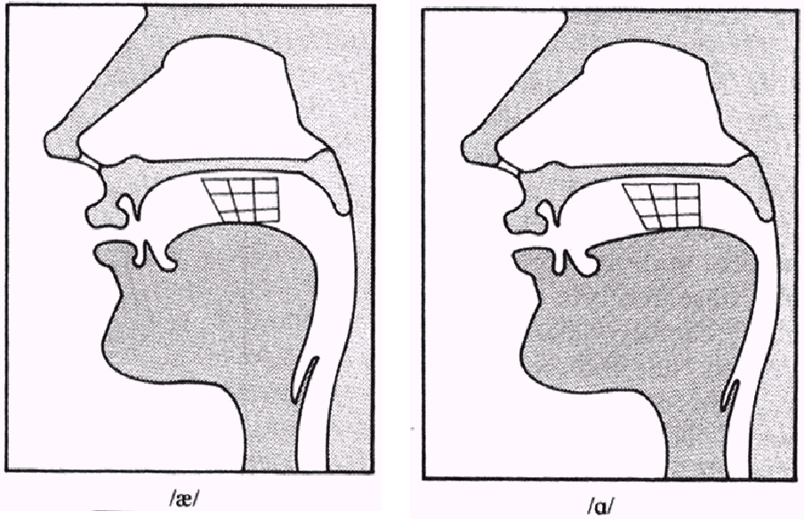
Low Front or Back [ae] vs. [aa]
(From a lecture given by Rochelle Newman)

Slide 27
Many Forms of English
Compare to British English, Indian English, Swedish, Spanish, Japanese, Mandarin
Vowel differences make it difficult to learn to produce new languages effectively

Slide 28
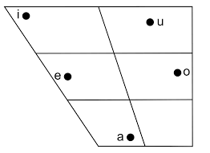
Japanese Vowel Space

Slide 29
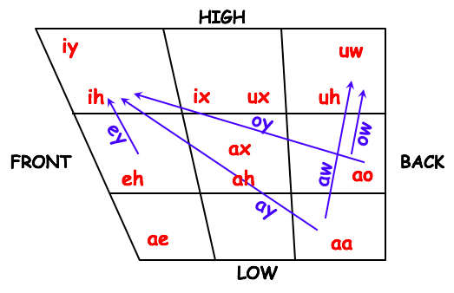
Comparing English and Japanese Vowels

Slide 30
Consonants: A True story about Noa
Noa’s ability to communicate is quite developed. But sometimes the fact that she she can’t make 3 consonant sounds - K, L and G - gets in the way. Here she shares her success at Little Kickers (soccer practice for kids 3 and under) with her mother (“ima”) named Mir:
Noa - Ima, I stored a dole at YittoTitters.
Mir - What?
Noa - I stored a dole.
Mir - What sweetie? I didn’t understand you.
Noa - At YittoTitters! I stored a dole!!
Mir - Oh. You scored a goal. That’s great!
Noa - Ima, what’s a dole?

Slide 31
Consonants: Place of Articulation
What is the point of maximum (air) restriction?
  Labial: bilabial [b], [p]; labiodental [v], [f]
  Dental: [θ], [δ] thief vs. them
  Alveolar: [t], [d], [s], [z]
  Palatal: [∫], [t∫] shrimp vs. chimp
  Velar: [k], [g]
  Glottal: [?] glottal stop
Notes:
Two things are used to define consonant types: place of articulation and manner of articulation

Slide 32
Consonants: Manner of Articulation
How is the airflow restricted?
  Stop: [p],[t],[g] … aka plosive
    Airflow completely blocked (closure), then released (release)
    Glottal stop, e.g. before word-initial vowels in English after pause (extra)
  Nasal: air released thru nose [m],[ng] …
  Fricative: [s], [z], [f] air forced thru narrow channel
  Affricates [t∫] begin as stops and end as fricatives (chimp)
Notes:
Say p, extra, mmmm, s, z v, ch

Slide 33
  Approximant: [w],[y]
    2 articulators come close but don’t restrict much
    Between vowels and consonants
    Lateral: [l] (lab)
  Tap or flap: [ ] e.g. butter
Notes:
Say you, why (with your hand touching your lips
Say lab
Say butter

Slide 34
 | Standard American English PLACE OF ARTICULATION
 |  | bilabial |  | labio-dental |  | inter-dental |  | alveolar |  | palatal |  | velar |  | glottal
 | stop | p | b |  |  |  |  | t | d |  |  | k | g | q
 | fric. |  |  | f | v | th | dh | s | z | sh | zh |  |  | h
 | affric. |  |  |  |  |  |  |  |  | ch | jh
 | nasal |  | m |  |  |  |  |  | n |  |  |  | ng
 | approx |  | w |  |  |  |  |  | l/r |  | y
 | flap |  |  |  |  |  |  | dx
MANNER OF ARTICULATION
VOICING:
voiceless | voiced
Notes:
Ma mama married Manny often used for voice analysis – fully voiced and sonorant.
Think of a sentence in any language which is fully voiced and sonorant.

Slide 35
Places of Articulation
alveolar
post-alveolar/palatal
dental
velar
uvular
labial
pharyngeal
laryngeal/glottal
http://smu-facweb.smu.ca/~s0949176/sammy/
Notes:
Labial: p, b, m, w
Dental: f, v
Alveolar: t, d, s, z, n, l, r
Palatal: sh, zh, ch, jh, y
Velar: k, g, ng
Glottal: q, h

Slide 36
A Problem: Coarticulation
Same phone is produced differently depending on phonetic context
Occurs when articulations overlap as articulators are moving in different timing patterns to produce different adjacent sounds
  Eight vs. Eighth
    Place of articulation of /ei/ moves forward as /t/ is dentalized
  Met vs. Men
    Vowel (/ɛ/ is nasalized
Notes:
A major issue in speech recognition!!

Slide 37
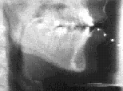
Articulators in action
(Sample from the Queen’s University / ATR Labs
X-ray Film Database)
More Examples
Notes:
French Canadian subjects from the early 1970s
Play 1, 3, 4
Due to ethical concerns about the high radiation dosages necessary, x-ray imaging technology using normal subjects is no longer practiced and it has become imperative to preserve those films which were origially captured on the fragile medium of 35 mm film.

Slide 38
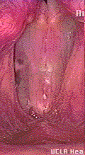
How do we Produce Speech: Vocal Fold Vibration
[UCLA Phonetics Lab demo]

Slide 39
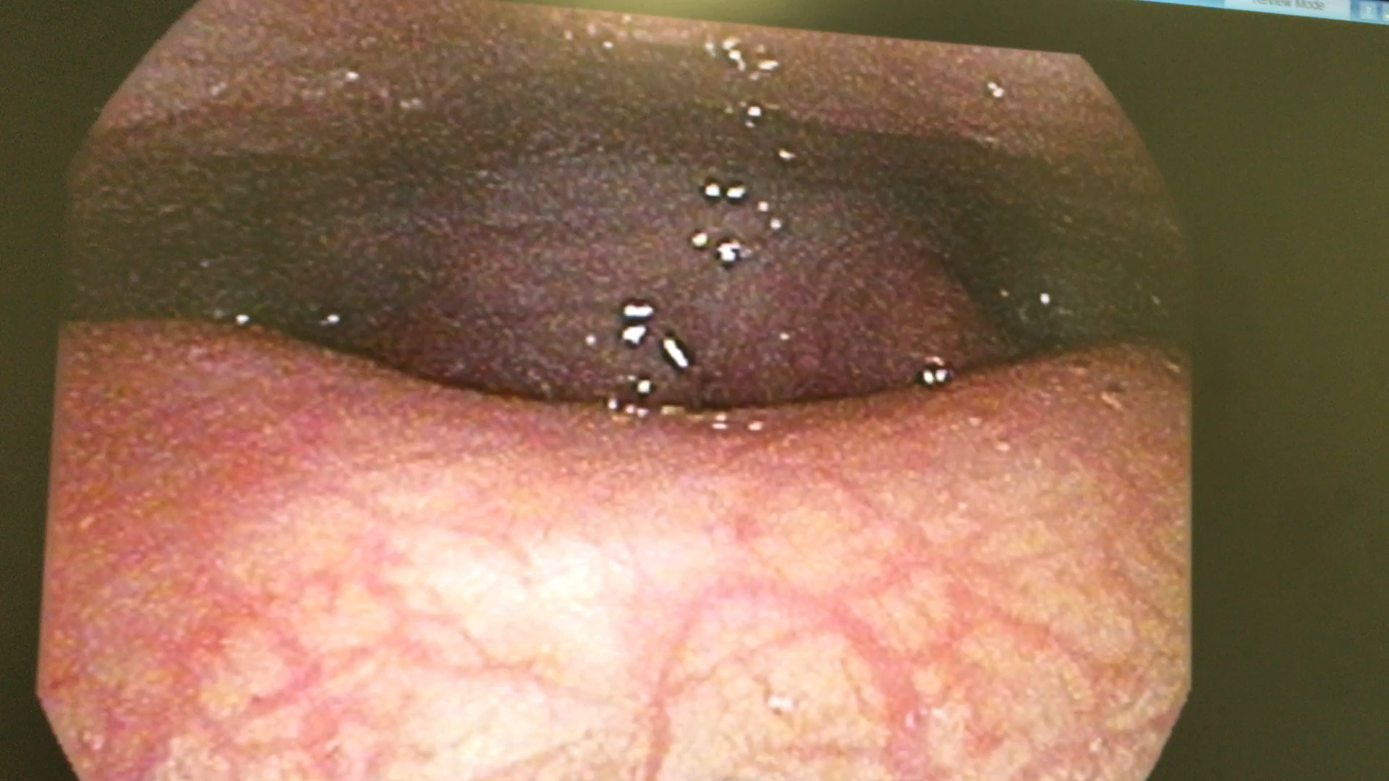
Less Thank Perfect
Notes:
Dr. michael pittman (columbia doctors’ otolaryngologist – treated Hamilton start Lin-Manuel Miranda)/ Kim Duncan, therapist

Slide 40
How do we Capture This Articulatory Data?
X-ray Film archive
  Created by Kevin Munhall (Queen's University) and Eric Vatikiotis-Bateson and Yoh'ichi Tohkura (ATR Human Information Processing Research Laboratories, Kyoto) in 1960s
  Cine-radiographic vocal tract footage for speech research community to develop techniques for automated digital processing of speech images
  Some of best dynamic view of entire vocal tract provide important information about time-varying properties, espcialially of tongue movements
  Ethical concerns about high radiation dosages necessary, imaging technology no longer used on normal
Notes:
Collaborative project by Dr. Kevin Munhall of Queen's University and Drs. Eric Vatikiotis-Bateson and Yoh'ichi Tohkura of ATR Human Information Processing Research Laboratories, Kyoto, started in 1960s
Preserves cine-radiographic vocal tract footage to make the images available to the speech research community and to develop techniques for the automated digital processing of the images.
High speed x-ray films yield some of the best dynamic view of the entire vocal tract and provide important information about its time-varying properties. In particular, they accurately depict the complex movements of the tongue.
Due to ethical concerns about the high radiation dosages necessary, x-ray imaging technology using normal subjects is no longer practiced and it has become imperative to preserve those films which were originally captured on the fragile medium of 35 mm film.

Slide 41
X-Ray Microbeam Database
  Sample output slides
  Wisconsin Physical Sciences Lab
  One of only 2 machines of its type ever created
  Analyzed speech patterns by tracking small pellets placed on the subject’s tongue, teeth and nose using very narrow x-ray beam passing through the subject area and detected by a sodium iodide crystal located behind the head.
  Dense pellets block x-rays from reaching crystal
  Allowed study of speech patterns in real time

Slide 42
Electroglottography measures how tightly the vocal folds are touching together (tighter -> louder) from disks placed on neck
CT (computed tomography) and MRI (magnetic resonance imaging) give us 3D pictures of vocal structures
Videostroboscopy uses a tiny camera to record vocal fold activity
Electromagnetic articulography (EMA)
    3 transmitters on helmet produce alternating magnetic fields at different frequencies, forming equilateral triangle
    Creates alternating current in 5-15 sensors to calculate sensor positions via XY coordinates

Slide 43
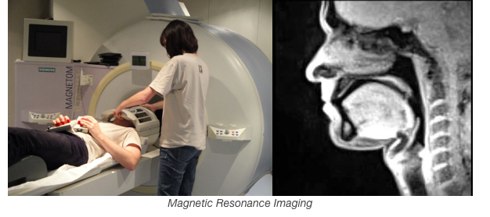

Slide 44
MOCHA-TIMIT corpus
  Created in Edinburgh in 1999
  460 English sentences, 1M 1F speaker
  Laryngograph (measures vocal fold vibration) and electromagnetic articulograph (measures movement in mouth) information

Slide 45
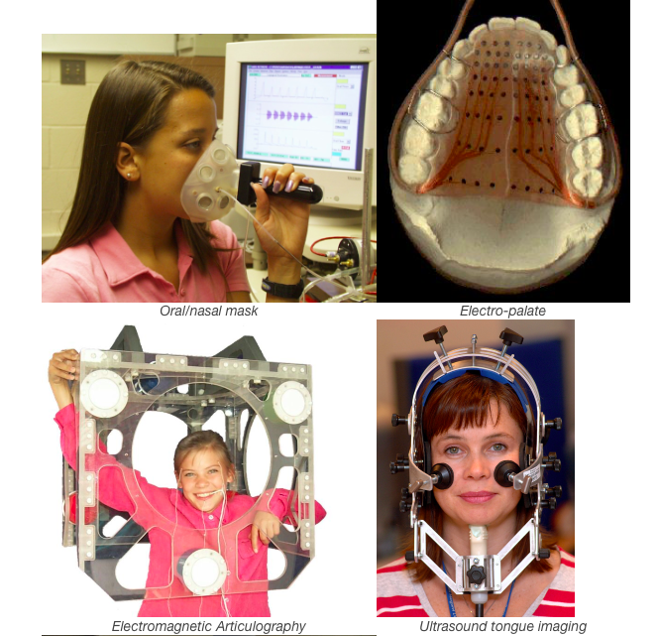

Slide 46
Representations for Sounds
Now we have ways to represent the sounds of a language (IPA, Arpabet…) and to classify similar sounds and compare sounds in different languages
Why is this important?
  Automatic speech recognition (ASR)
  Speech synthesis (TTS)
  Machine translation (MT)
  Keyword search

Slide 47
  Speech pathology, language Id, speaker Id
  Basic representations critical for any speech research or application
But…how can we recognize these sounds automatically?
  What are the acoustic correlates of these differences in sound that allow us to recognize speech?
  How can we use the relationship between representation and acoustics to identify speech automatically?
  Can technology help?

Slide 48
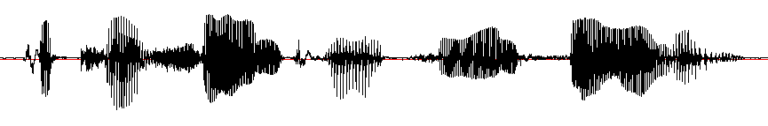

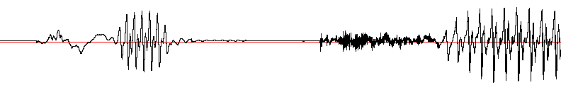
Acoustic Landmarks in a .wav File
[p]
[ix]
[t]
[ih]
[sh]
[ax]
[n]
[p]
[ae]
[t]
[s]
[iy]
[n]
[s]
[ae]
[l]
[iy]
“Patricia and Patsy and Sally”
[p]
[ix]
[t]
[ih]
Notes:
Could you recognize such patterns automatically

Slide 49
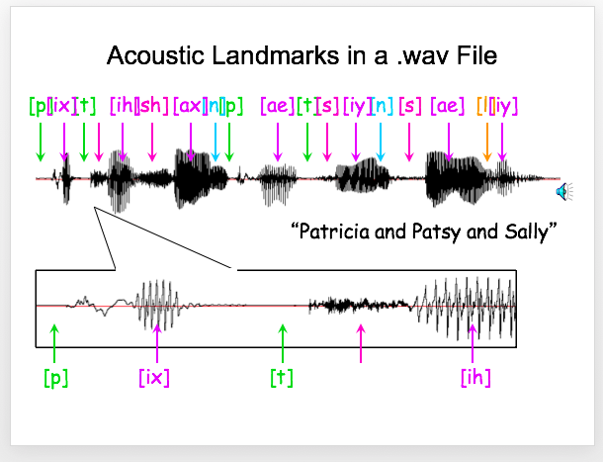

Slide 50
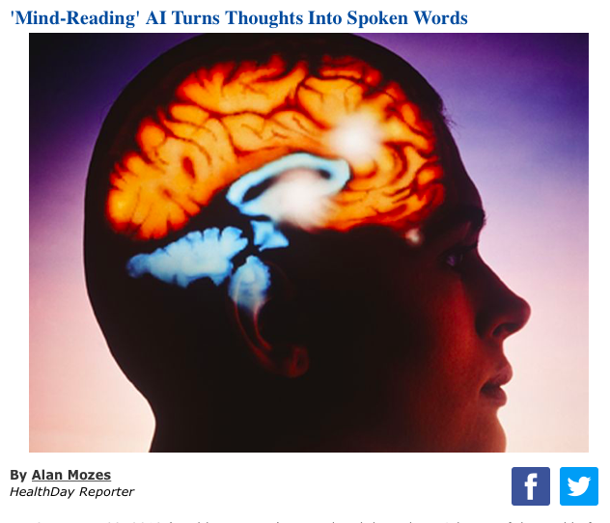
Can Our Brain (or a Ferret’s) Help?

Slide 51
Engineers translate brain signals directly into speech
Advance marks critical step toward brain-computer interfaces that hold immense promise for those with limited or no ability to speak
  Nima Mesgarani: in a scientific first, neuroengineers have created a system that translates thought into intelligible, recognizable speech. This breakthrough, which harnesses the power of speech synthesizers and artificial intelligence, could lead to new ways for computers to communicate directly with the brain.

Slide 52
Next Class
Readings: J&M 7.4-7 (use syllabus link)
Post for Week 3 in Courseworks
Remember to enroll in Piazza and record your names in NameCoach in Courseworks!
We’ll send information on our office hours tonight/tomorrow
Any questions?

