Slide 1
Charisma, Likability and Style in Speech
Julia Hirschberg
COMS 6998
Spring 2020

Slide 2
Defining Charisma
Compelling attractiveness or charm that can inspire devotion in others
The ability to attract, and retain followers by virtue of personality as opposed to tradition or laws == not traditional or political office . (Weber)
Or….Speech that encourages listeners to perceive the speaker as “charismatic”

Slide 3
Why Study Charismatic Speech?
Speech that leads listeners to perceive the speaker as charismatic can be useful for
  Creating more effective text-to-speech synthesis (ads, games)
  Understanding election results, radicalization efforts on social media
  Helping speakers to improve their own speech production by sounding more charismatic
  …
Notes:
using characteristics of charismatic speech in text- to-speech synthesis can make a computer-generated voice more trustworthy
practicing with acoustic feedback can make humans speak more charismatically

Slide 4

Some Samples from Students
A
B
C
D

Slide 5

Which of these speakers sound charismatic?
1 | 2 | 3 | 4

Slide 6
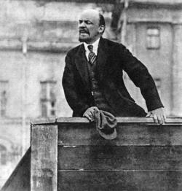
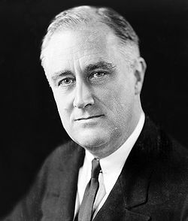
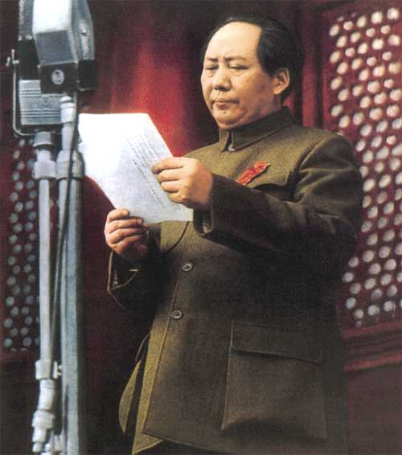
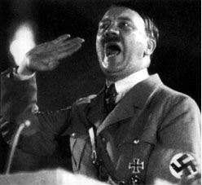
1. Vladimir Lenin
2. Franklin D. Roosevelt
3. Mao Zedong
4. Adolf Hitler

Slide 7
What Makes an Individual Charismatic?
Message?
Personality?
Speaking style?
What aspects of speech might contribute to the perception of a speaker as charismatic?
  Content of message?
  Lexico-syntactic features?
  Acoustic-prosodic features?
  What you say or how you say it?

Slide 8
Within- and Cross-cultural Charisma Perception
Within culture differences
  Do perceptions differ across gender, personality types, educational level?
Cross-culture differences
  Is charisma in L1 perceived differently by L1, L2, and Lx speakers?
  Is the judgment of charisma correlated with different features for different speakers? Hearers?
How important is the content of the message vs. they way it is spoken?
Experiments: Standard American English, Palestinian Arabic, Swedish

Slide 9
Early Study: Experimental Design
Listen to speech tokens via web form
Rate each token for 25 traits, 5-pt Likert scale:
  The speaker is:
  Reasonable, charming, threatening, friendly, angry, intelligent, tough, passionate, confident, clear, knowledgeable, boring, spontaneous, powerful, desperate, intense, charismatic, informative, believable, trustworthy, persuasive, enthusiastic, ordinary, convincing, accusatory

Slide 10

First American English Experiments
Data: 45 2-30s speech segments, 5 each from 9 candidates for Democratic nomination for U.S. president in 2004
  Speakers: Liberman, Kucinich, Clark, Gephardt, Dean, Moseley Braun, Sharpton, Kerry, Edwards
  Topics: neutral greeting, reasons for running, tax cuts, postwar Iraq, healthcare
  4 genres: stump speeches, debates, interviews, ads
SAE raters for each segment on a Likert scale (1-5) 26 questions (randomized and including “do you agree with the speaker?”)
  8 subjects for Study 1 (2004) and 12 for Study 2 (2006)
Notes:
2 ‘top charismatic’, 2 ‘bottom least charismatic’
Time for first study: avg. 1.5 hrs, min 45m, max ~3hrs

Slide 11
Palestinian Arabic Experiment
12 native Palestinian Arabic raters (6 male/6 female)
44 speech tokens (mean duration=14s)
Tokens selected from Al-Jazeera News Channel talk shows in 2005
Topics: assassination of Hamas leader, debate among Palestinian groups, Intifada, Israeli separation wall, Palestinian Authority, calls for reform
22 male speakers, 2 segments each

Slide 12
Cross-Subject Agreement for Study 2
Weighted Cohen’s kappa statistic with quadratic weighting (used to measure degree of inter-labeler agreement/disagreement) f
  Agreement fairly low
  English: mean k=0.207
  Arabic: mean k=0.225
Notes:
http://www.real-statistics.com/reliability/interrater-reliability/weighted-cohens-kappa/

Slide 13
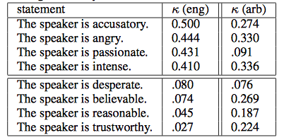
Cross-Subject Agreement on Judgments: English Compared to Arabic Ratings of Same Traits
Notes:
Accusatory
Angry
Passionate
Intense
--------------------
Desperate
Believable
Reasonable
trustworthy

Slide 14
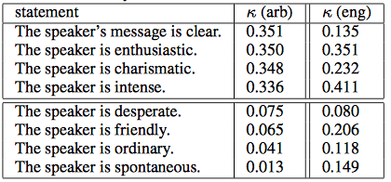
Cross-Subject Agreement on Judgments: Top Arabic Compared to English Ratings of Same Traits
Notes:
Accusatory
Angry
Passionate
Intense
--------------------
Desperate
Believable
Reasonable
trustworthy

Slide 15
Within-Subject Correlation of Ratings
Which attributes are most strongly correlated with charisma ratings?
English:
  Enthusiastic (k=0.62)
  Persuasive (k=0.58)
  Charming (k=0.58)
  Passionate (k=0.54)
  Convincing (k=0.50)
  Not boring (k=-0.51)
  Not ordinary (k=-0.40)

Slide 16
Within-Subject Correlation of Ratings
Which attributes are correlated with charisma ratings?
Arabic:
  Tough (k=0.69)
  Powerful (k=0.69)
  Persuasive (k=0.68)
  Charming (k=0.66)
  Enthusiastic (k=0.65)
  Not boring (k=-0.45)
  Not desperate (k=-0.26)
Notes:
English:
Enthusiastic (k=0.62)
Persuasive (k=0.58)
Charming (k=0.58)
Passionate (k=0.54)
Convincing (k=0.50)
Not boring (k=-0.51)
Not ordinary (k=-0.40)

Slide 17
Influence on Charisma Ratings
Speaker identity significantly influences subjects’ overall ratings of charisma but only SAE raters rated recognized speakers as more charismatic
  English:
    Mean speakers recognized = 5.8 (of 9)
    Recognized speakers were rated as more charismatic
  Arabic:
    Mean speakers recognized = 0.55 (of 22)
    No correlation between charisma rating and speaker recognition
Notes:
P values: one-way ANOVA with repeated measures

Slide 18
Influence on Charisma Ratings
Topic
  Affected charisma perception in both English and Arabic: mean charisma ratings
    Speech about healthcare (3.31), postwar Iraq (3.29), reasons for running (3.28), greeting (3.07),taxes (2.97) rated more charismatic for SAE speakers
    Speech about Israeli separation wall (3.96), assassinations of Hamas leader (3.37), debate among Palestinian groups (3.21), Intifada and calls for reform (3.17)
  Stronger effect in Arabic

Slide 19
Acoustic/Prosodic Comparison
Features: duration, pitch (z-score normalized), intensity (normalized to -12 dBFS max for SAE), speaking rate
Results:
  Duration – positive correlation across both cultures (more material…)
  Speaking rate: more variation for Arabic
    Positive correlation for English (faster is better)
    Negative correlation for Arabic (fast is worse)
    Fastest IPUs only – positive correlation across cultures
  Higher pause to word ratio
    Positive correlation for Arabic
Notes:
Why?

Slide 20
  Greater standard deviation of pause length
    Negative correlation for English
    Positive correlation for Arabic (more variation)
  Mean f0
    Positive correlation across cultures
  Min f0
    Positive correlation for English
    Negative correlation for Arabic
  Max f0, stdev f0
    Positive correlation for Arabic
  Mean, stdev intensity
    Positive correlation across cultures
Notes:
Why? What would these sound like?

Slide 21
  Max intensity (normalized for SAE but not Aragic)
  Positive correlation for Arabic
ToBI labels
  !H* and L+H* positively correlated with charisma ratings in both
  L* negatively correlated in both cultures
  Why?

Slide 22
Lexical Comparative Analysis
Number of words per token (longer speech)
  Positive correlation across cultures
Disfluency rate (lack of confidence)
  Negative correlation across cultures
Ratio of repeated words (rhetorical device)
  Positive correlation across cultures
First person plural pronouns (personal empathy)
  Positive correlation for English

Slide 23
Third person pronouns
  Plural
    Negative correlation for English
    Positive correlation for Arabic
  Singular - positive correlation for English
Parts of speech
  Arabic: negative correlations with ratio of adverbs, prepositions, nouns
  English: negative correlations with adverbs, adjectives

Slide 24
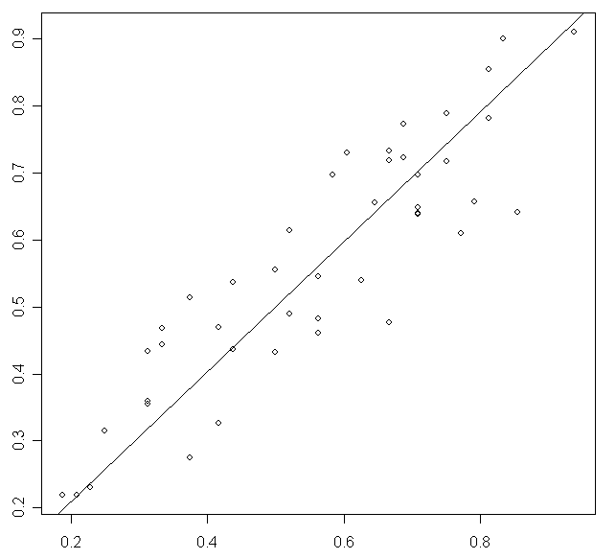
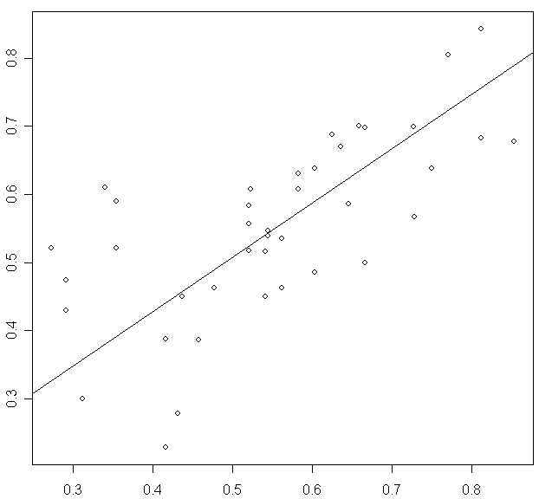
Predicting Charisma Using Linear Regression on Acoustic-Prosodic Features
Arabic English
Notes:
Prediction using RMSE with the sample mean charisma rating as the baseline.
Did feature selection acoustic/prosodic and lexical features,
Construct a single rating of charisma for each token, calculated as
the mean of the twelve individual subject ratings of
charisma. These aggregated scores are then normalized
to the closed interval [0-1].
Use simple multiple linear regression model on selected features.
Features selected : mean pitch, disfluency
density, density of third person plural pronouns,
mean pitch values of HiF0, maximum of the mean
of pitch across intonational phrases, mean normalized
HiF0, density of adjectives, rate of H- use,
rate of L+H* use, and rate of L* use.
For English got RMSE of 0.112 (predicted versus actual values,
pearson correlation=0.69, p=6.9e-7). And RMSE
of .088 (correlation = 0.89, p=1.5e-8), with 10-fold
cross-validation we obtain a RMSE of .090 for Arabic.
In the English experiment, recall that we have
one female speaker. We decided to exclude this
speaker's tokens from the prediction procedure to
avoid gender-dependent variation in unnormalized
pitch features. We take the sample mean as the baseline
for these experiments. In the English study, the
mean of the normalized 40 scores is 0.55 and the
standard deviation is 0.154. In the Arabic experiment,
the mean of the normalized 44 scores is 0.56
and the standard deviation is 0.197. The sample
standard deviation is equal to the root mean squared
error (RMSE) associated with the sample mean regression
line. We report our prediction results in
terms of RMSE, therefore our baselines for English
and Arabic are 0.154 and 0.197, respectively.
To perform the prediction experiments, we used
a simple multiple linear regression model (LRM).
Starting with the subset of analyzed features described
in Sections 4 and 5 that significantly correlate
with charisma, we utilize a greedy feature selection
algorithm to reduce the dimensionality of
the feature space. The algorithm iteratively selects
the feature that minimizes the leave-one-out crossvalidation
RMSE. We included the optimal feature
in our model and then repeat the process using this
model until no improvement was achieved.
For the English study, the feature-selection algorithm
provided the following 10 features — from
most to least descriptive: mean pitch, disfluency
density, density of third person plural pronouns,
mean pitch values of HiF0, maximum of the mean
of pitch across intonational phrases, mean normalized
HiF0, density of adjectives, rate of H- use,
rate of L+H* use, and rate of L* use. Using these
features, we evaluated the LRM prediction using
leave-one-out-cross-validation. The model yielded
an RMSE of 0.112 (predicted versus actual values,
pearson correlation=0.69, p=6.9e-7). Using the
same features, with 10-fold cross-validation (leave
four samples out in our case) experiment, we obtain
an RMSE of 0.110.
Similarly, we ran the feature selection algorithm
on the Arabic corpus to obtain the following 9 features
for our Arabic LRM: disfluency density, rms
intensity of the word with maximum HiF0, density
IPs with L%, density of the word "yaEony", total
number of words, minimum pitch, standard deviation
of the standard deviation values of pitch values
across IPs, maximum pitch, and maximum of the
mean normalized pitch across IPs. The leave-oneout
corss-validation experiment resulted in a RMSE
of .088 (correlation = 0.89, p=1.5e-8), with 10-fold
cross-validation we obtain a RMSE of .090.
Overall, we achieve low cross-validation errors in
both experiments that significantly surpass the baseline.
We can see that the prediction of charisma
for Palestinian Arabic is more accurate than that of
American English when compared to the baseline.
This may be due the fact that the subject agreement
on charisma in the Arabic study is higher than that in
the English experiment Alternately, the selected features
could be more predictive for Arabic charisma
than those selected for English. However, we hesitate
to presume that the models will be able to predict
charisma with such high accuracy for any external
distribution because of the limited amount of
data on which they are trained.

Slide 25
Summary
Shared functional definition of charisma across English and Arabic
  Persuasive, charming, enthusiastic, not boring
Cultural differences in charisma perception
  English – passionate, convincing
  Arabic – tough, powerful
Similarities but interesting differences in acoustic/prosodic and lexical correlates of charisma across cultures

Slide 26
Cross-cultural Perception of Charisma (A Cross-Cultural Comparison of American, Palestinian, and Swedish Perception of Charismatic Speech (Biadsy et al., 2008)
Cross-language ratings
  12 SAE (non-Arabic, non-Swedish speaking) raters rate Palestinian Arabic and Swedish data
  12 Palestinian (English-literate, non-Swedish speaking) raters rate SAE and Swedish data
  9 (English-speaking speaking) Swedish raters rate SAE
Comparison with previous ratings when raters rate their own language speakers

Slide 27
Inter-rater Agreement
American rater agreement was higher when rating Arabic than English
Arabic rater agreement was higher when rating Arabic than English
Speaker affects subject judgments across studies
Topic affects subject judgments:
  Americans rating SAE
  Palestinians rating Arabic
  Palestinians rating English
  Swedish rating English
  Not raters who do not speak the language

Slide 28
Acoustic/Prosodic Analysis
Correlation with rated charisma in all 5 studies:
  Positive
    Mean pitch
    Mean and stdev intensity
    Token duration
    Pitch range
  Negative
    Disfluency

Slide 29
Language-Specific Indicators
Rating SAE
  All groups – min f0
  Swedish – max & stdev intensity
  SAE & Swedish – speaking rate
Rating Arabic
  Palestinian – min f0, speaking rate
  All groups – stdev f0, max & stdev intensity

Slide 30
Lexical Features
Rating SAE
  American and Swedish – third person plural pronouns
  All groups – First person plural pronouns, third person singular pronouns, repeated words
Rating Arabic
  Both groups (SAE, Palestinian) – third person plural pronouns, nouns
  Why did SAE raters who did not speak Arabic agree?
    Perhaps these features were correlated with acoustic-prosodic features?
Notes:
`

Slide 31
Charisma Perception across Cultures
SAE vs. Palestinian ratings of SAE tokens
  Mean ratings are not different across groups
  Charisma ratings are positively correlated
Swedish vs. Palestinian ratings of SAE tokens
  Mean ratings are not different across groups
  Charisma ratings are positively correlated
Swedish vs. SAE ratings of SAE tokens
  Mean ratings are different across groups
  Charisma ratings are positively correlated
Palestinian vs. SAE ratings of Arabic tokens
  Mean ratings are different across groups
  Charisma ratings are positively correlated

Slide 32
Differences Across Cultures
Rating Arabic
  Greater charisma perception by SAE group correlated with faster speaking rate, smaller stdev speaking rate, greater mean & stdev intensity
  Greater charisma perception by Palestinian group correlated with lower pitch peaks, high stdev f0
Rating SAE
  Greater charisma perception by Swedish group correlated with more compressed pitch range, greater min f0, lower stdev f0

Slide 33
Summary
Some cues are cross-cultural, some are language-specific
Cross-cultural charisma judgments are more conservative
Native and non-native judgments of a given target language are correlated
    Even when the raters do not speak the target language

Slide 34
Predicting Winners from Charisma (Analysis of Speech Transcripts to Predict Winners of U.S. Presidential and Vice Presidential Debates, (Kaplan & Rosenberg, 2012))
  Corpus of political speech
  Determine lexical and acoustic correlates of political success
  Characterize similarities and differences between parties

Slide 35
Corpus collection
25 debates spanning 9 election cycles (1976-80)
  Each between one Republican and one Democrat
  Democrats won 68%; Republicans 32%
Binary labels based on post-debate polling
Goal: predict the winner
Notes:
We construct data sets from this set of transcripts in two ways. In one experimental paradigm, each debate is a data point, where the label is whether the Democratic or Republican participant won. In a second paradigm, we extract a feature vector for every 20 speaker turns in the debate, ensuring that no two feature vectors from the same debate appear in a training and test set. Democrats won 65% of the split sections, with Republicans winning 35%.

Slide 36
Features Examined
Total # words
Word usage (stemmed):
  Indicators of friendliness and formality: personal pronouns, # questions asked, pleasantries, contractions, numbers, refs to opponent, refs to both running mates
  Words affiliated with common political topics: god, health, religion, tax, war and synonyms using WordNet
Affective content: DAL
Named entities: using Stanford tagger, # and rate of usage
TF-IDF values for top 10K words for each debater
Notes:
TF-IDF: term frequency (in document X) vs. inverse document frequency (over many other documents)
Analysis using Weka’s SVM (SMO)
Relative value of each speaker using Weka’s chi squared feature analysis

Slide 37
Turn length: absolute and mean # syls, words, sentences in each turn
Complexity: Flesch-Kincaid grade level readability formula
Notes:
F-K formula: The formula defines the grade level of text as (0.39*words per sentence) + (11.8*syllables per word)-15.59

Slide 38
Classification
Train on all preceding debates to predict winner of current year
  Debate-level: which party won using data from both speakers
  Speaker-level: which speaker won, including features only for each speaker w/out ref to opponent

Slide 39

Predicting Poll Results Tough
Test on 2008; train on all previous years
  Baseline: by debate calculated from most common result /total # debates
  By-debate: use data for both speakers
  By-debater: use data for each speaker in turn
  Unsplit: one data-point per debate
  Split: one data-point every 20 speaker turns
  Accuracy, baseline, p-value
Notes:
Predicted Accuracy (baseline for debate: democrats win/# datapoints; for debater: 50/50) and significance (p value)
Not so great but small data and interesting study

Slide 40
Feature Analysis
First person plural possessives (“our”) used by Democrats
  Negatively correlates with Democratic wins
Grade level readability of Democrats
  Lower complexity in Democratic wins
Second person singular object pronouns (“you”) used by Republicans
  Negatively correlates with Republican wins altho correlates with individualism
  Important political topics
  “atomic”, “unilateral”, “soviets”
  Politically active words important
  “achieve”, “disagreements,” “advocate”, “achieve”
Notes:
When candidates sound too “typical” they are less successful

Slide 41
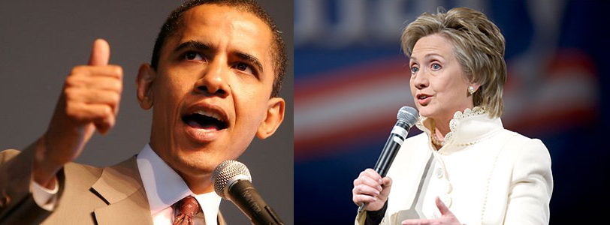
More Recent Debates (Erica Cooper)
Can we predict the Winners?
or
the Losers?

Slide 42
Similar Goals and Research Questions
Investigate emotion and charisma in political discourse
  Collect a corpus of political speech: debates
  Compare both political parties: Democrats and Republicans
  Determine lexical and acoustic correlates of political success: correlate with subsequent polls
  Characterize similarities and differences between Democrats and Republicans

Slide 43
Corpus Collection
Democratic primaries from 2008:
  Joe Biden, Hillary Clinton, Chris Dodd, John Edwards, Mike Gravel, Dennis Kucinich, Barak Obama, Bill Richardson
  New Hampshire MSNBC Debate, September 26, 2007
Fall 2011 Republican primaries:
  Michelle Bachmann, Herman Cain, Newt Gingrich, Jon Huntsman, Gary Johnson, Ran Paul, Rick Perry, Mitt Romney, Rick Santorum
  Fox News / Google Debate, September 22, 2011
Interviews for all candidates
Notes:
Different primaries since incumbent for the party or not

Slide 44
Gallup Poll Results
Democrats | Poll Results | Republicans | Poll Results
Clinton | 47% | Romney | 20%
Obama | 26% | Cain | 18%
Edwards | 11% | Perry | 15%
Richardson | 4% | Paul | 8%
Biden | 2% | Gingrich | 7%
Dodd | 1% | Bachmann | 5%
Kucinich | 1% | Santorum | 3%
Gravel | 0.5% | Huntsman | 2%
 |  | Johnson | 0%

Slide 45
Lexical Features
For debate speech only
  Word Count
  Laughter, applause, and interruptions
  Number of speaker turns
  Average number of words per turn
  Syllables per word
  Disfluencies per word
  Linguistic Inquiry and Word Count (LIWC) features

Slide 46
Acoustic Features
Debates and Interviews: mean, min, max, and standard deviation of f0
Difference for these values between debates and interviews

Slide 47
Results: Correlates with Post-Debate Poll Standing
Features | Democracts | Republicans
Word Count Laughs Applause Turns Interruptions Avg Words Per Turn Avg Syllables Per Word Disfluencies Per Word Mean-f0 Difference Min-f0 Difference | 0.804 0.084 0.194 0.846 0.052 0.199 0.015 -0.805 0.059 0.002 | 0.582 0.780 0.350 0.381 0.247 0.406 -0.768 -0.130 0.479 0.105

Slide 48
LIWC Positive Correlates for Democrats
Feature | Examples | Correlates
Insight | Think, know consider | 0.74
Inclusive | And, with, include | 0.680
Cognitive | Cause, know, ought | 0.679
Words per sentence |  | 0.661
Common verbs | Walk, went, see | 0.657
Positive emotion | Love, nice, sweet | 0.632
Pronouns | I, them, itself | 0.626
Nonfluencies | Er, hmm, umm | 0.611

Slide 49
LIWC Features: Negative Correlates for Democrats
Features | Examples | Correlation
Articles | A, an, the | -0.684
All Punctuation |  | -0.653
Periods | . | -0.639
Dashes | - | -0.595
Numerals | 12, 38, 156 | -0.581
Questions marks | ? | -0.578
Ingestion | Dish, eat, pizza-0.575 | -0.575
Money | Audit, cash, owe | -0.548
2nd Person Pronouns | You, your | -0.506

Slide 50
LIWC Features: Positive and Negative Correlates for Republicans
Features | Examples | Correlation
Leisure | Cook, chat, movie | 0.869
Past tense | Went, ran, had | 0.732
“Other” punctuation | !”:%$ | 0.665
Dictionary words |  | 0.541
Personal pronouns | I, them, her | 0.525
6+ letters | Abandon, abrupt, absolute | -0.741
Home | Apartment, kitchen, family | -0.513

Slide 51
General Party Differences
Democrat audiences laughed more
Republican audience applauded more
Democrats got interrupted more
Republicans had more words per turn
Both had about the same number of syllables per word
Democrats' debate speech was more different from their interviews, but Republicans responded slightly more positively to these differences than Democrats did

Slide 52
Conclusions
Democrats: Talk more, use fewer disfluencies, and use more Insight words
Republicans: Make the audience laugh, use Leisure-related words, and avoid longer words

Slide 53
More to Do in Politics
Investigate additional acoustic features (intensity, speaking rate, voice quality)
Higher level prosodic features (intonational contours, phrasing)
More complicated / interesting lexical features
  Cross-cultural similarities and differences
  Entrainment

Slide 54
Optional article on Courseworks: ProsodyVocalAttractivenes-Draft.pdf

Slide 55
What makes a speaker credible?
Christopher Tuppen, “Dimensions of communicator credibility: An oblique solution”, Speech Monographs(41), 1974.
101 subjects read a booklet containing ten character sketches.
  Student, professor, ad exec, farmer, unethical businessman, doctor, ret. Army officer, man of religion, hippie, TV personality
  Topics: how much sleep you need, marijuana and health, duration of US envolvement in SE Asia, and tuition at State Colleges
The subjects rated each communicator on 64 scales.
  28 bipolar adjective, 36 seven-point Likert scales.

Slide 56
Subject ratings grouped using cluster analysis
Cluster 1: “Trustworthiness”
  Trustworthy, honest, safe, dependable, reputable, etc.
Cluster 2: “Expertise”
  Qualified, skilled, informed, experienced, etc.
Cluster 3: “Dynamism”
  Bold, active, aggressive, strong, emphatic, etc.

Slide 57
Cluster 4: “Co-orientation”
  Created a favorable impression, stood for a group whose interests coincided with the rater, represented acceptable values, was someone to whom the rater would like to listen.
Cluster 5: “Charisma”
  Convincing, reasonable, right, logical, believable, intelligent, whose opinion is respected, whose background is admired, in whom the reader has confidence.

Slide 58
Forcefulness, Persuasion and Social Influence
M. Hamilton & B. Stewart, “Extending an Information Processing Model of Language Intensity Effects”, Communication Quarterly (41:2), 1993
“How forceful should my language be in order to maximize my social influence?”
  I.e., what is the relationship between language intensity and persuasion?
Notes:
The information processing model of persuasion was used as the basis for a mathematical model of language intensity effects. The model proposes that attitude change is a product of message discrepancy, source evaluation, and message strength. The results show strong support for the model. The salient source evaluation dimension was perceived trustworthiness. Language intensity enhanced attitude change directly, by acting as a multiplier of message strength, and indirectly, by increasing message discrepancy. These effects held for female as well as male sources. Path analysis indicated the presence of source evaluation heuristics. Intensity enhanced source ratings through a positively linked causal chain from intensity to dynamism to expertise to trustworthiness. Intensity also had negative effects on post‐message expertise and trustworthiness unmediated by dynamism.

Slide 59
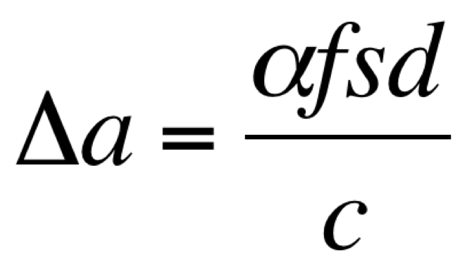
Intensity manipulated by varying two language features: emotionality and specificity
  Emotionality: degree of affect present in the language, ranging from stolid displays to histrionics
  Specificity: degree to which precise reference is made to attitude objects
Attitude change is a product of message discrepancy, perceived source credibility and message strength
a - attitude, f - force, s - source credibility
d - discrepancy, c - counterargument
α - impact parameter

Slide 60
518 subjects presented with a “persuasive message” with manipulated intensity
Message’s language evaluated on 11 terms using a 7-point bipolar adjective scale
  Intense, strong, active, extreme, forceful, emotional, vivid, vigorous, powerful, assertive, potent
Perceived source competence, trustworthiness and dynamism were assessed

Slide 61
Correlations between subject ratings and manipulated features were calculated using a causal modeling program, PATH.
Extremity of
position
.42
“charisma sequence”
-.32
Manipulated
intensity
Perceived
intensity
Source
dynamism
Source
competence
Source
trustworthiness
.64
.78
.52
.73
-.18
Notes:
Results show strong support for the model.
The salient source evaluation dimension was perceived trustworthiness.
Language intensity enhanced attitude change directly, by acting as a multiplier of message strength, and indirectly, by increasing message discrepancy.
These effects held for female as well as male sources.
Path analysis indicated the presence of source evaluation heuristics: Intensity enhanced source ratings through a positively linked causal chain from intensity to dynamism to expertise to trustworthiness. Intensity also had negative effects on post‐message expertise and trustworthiness unmediated by dynamism.

Slide 62
“Would You Buy a Car From Me?” – On the Likability of Telephone Voices
Felix Burkhardt, Björn Schuller, Benjamin Weiss, Felix Weniger

Slide 63
Problem
Speech based classification: “attempts to categorize people based solely on on their voice and way of speaking. The categories may be relatively invariant like age, gender or dialect, or time changing like emotional state.”

Slide 64
Database
Agender database
  940 speakers of mixed and age and gender
  Recorded over telephone (landlines and cell phones)
  Drawbacks:
    Signal less clear (limited bandwidth)
    Short responses
    Not great for likability ratings
  However, more real-world like
    “e.g. if a call center agent would like to test the likability of his/her own voice.”

Slide 65
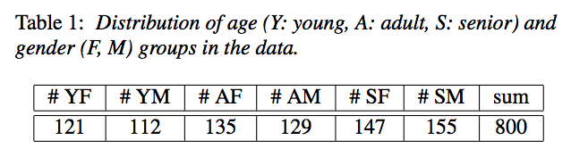
Data Selection
All German speakers in Germany, no balance of dialects
One sentence for each speaker, commands
Longest sentence spoken by speaker
  “mach weiter mit der Liste” (continue with the list)
  “ich hätte gerne die Vermittlung bitte” (I’d like an operator please)

Slide 66
Judging Likability
32 participants
  15 female, 17 male; aged 2—42
Participants rated half of the 800 utterances
Therefore, each utterance from the database rated 16 times
Told to rate likability; ignore quality of recording and lexical content
7 point scale
No significant effect of participants’ age or gender on ratings

Slide 67
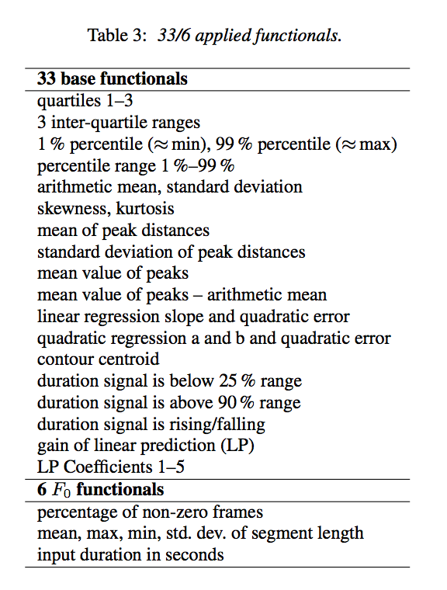
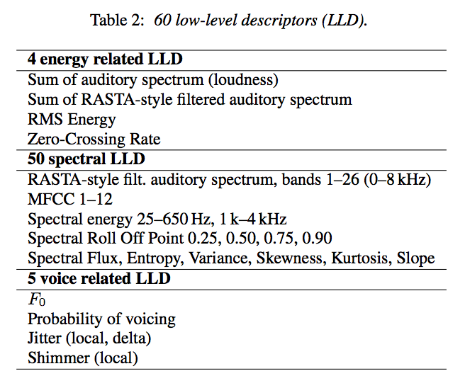
Automatic Analysis

Slide 68
Automatic Analysis
LLDs and functionals combined to make 3996 features
Plus other pitch and voice quality features (360)
Plus functionals applies to pitch contour (12)

Slide 69
Results
Divided features into cepstral (CEPS), auditory spectral (AUSP), prosodic (PROS), and voice quality (VOQU) features
“Cepstral features do not enable robust regression or classification - in fact, the mean UA for classification is near chance level (52%). In contrast, auditory spectral features seem to contribute the most to reliable automatic likability analysis for regression as well as classification, followed by prosodic and voice quality features.”
Though raters might not have agreed on likability, robust results for automatic evaluation.

Slide 70
Other Research on Charismatic Speech
Research on adjectives useful for charisma definition (Signorello et al 2012)
  Asked 58 French raters to list adjectives they associated with charisma and found 50 positive and 27 negative terms
More language/cultural comparisons (Pejcic 2014)
  Compared Serbian to British speakers using our 26 adjective ratings finding larger F0 excursions correlated positively for Serbian speakers but negatively for British
More research on politicians’ speech
  Descriptive studies of Venezuelan politicians (Perez 2016) and Obama vs. George W. Bush (Ryant and Liberman (2016) found that charismatic speakers should be charming, convincing and persuasive and not boring
Notes:
larger F0 excursions correlated positively for Serbian speakers but negatively for British

Slide 71
  Longitudinal study (Irish Political Speech Db) from a single speaker (2007-12) (Cullen and Harte 2018) correlated charisma features on 945 utterances with polling data and charisma found classification using acoustic-prosodic features better than spectral features
Charisma in business leaders
  Weininger et al (2012) collected charisma ratings of 143 business leaders’ speeches on Youtube and built models to classify charisma using 1582 acoustic/prosodic and lexical features with 61.9% accuracy
  Niebuhr et al (2016) studied compared Steve Jobs to Mark Zuckerberg noting Jobs’ high and varied pitch and intensity, fast speaking rate, few disfluencies and many emphatic words, shorter phrases and Zuckerberg who speaks even faster but produces more phonetic reductions
  Niebuhr et al (2017) studied startup pitches and trained speakers to imitate Jobs, finding that speakers with training 41% more charismatic that those without; also (2018) fuller and less breathy voices were rated higher
Notes:
One thread of work undertaken by Oliver Niebuhr and colleagues has been to study Steve Jobs, former CEO and co-founder of
Apple Inc., as an exemplar of a charismatic business leader. Niebuhr et al. (2016b)
posits a profile of charismatic speech based on a reading of previous political studies
(cf. Section 1.2). This is summarized as having high and varied pitch, high and varied
intensity, a fast speaking rate, few disfluencies, a large number of emphatic words,
but with varied realizations and high rhythmic variation. By automatic analysis of
10 Andrew Rosenberg and Julia Hirschberg
two landmark speeches (launching the iPhone 4 and iPad 2) they find that Steve Jobs
does in fact fit this profile.
This research direction is continued in a number ofworks via a contrastive analysis
of Steve Jobs and Mark Zuckerberg, founder and CEO of Facebook (Mixdorff et al.,
2018; Niebuhr et al., 2016a, 2018b). The approach here is based on the common
perceptions of Steve Jobs as a charismatic speaker and Mark Zuckerberg as a less
charismatic speaker, though both were CEOs of major corporations at the time their
speech was collected for analysis.
Niebuhr et al. (2016a) find that Jobs has shorter phrases, fewer and shorter
hesitations and a more dynamic use of pitch and rhythm than Zuckerberg. While
Jobs speaks quickly (compared to “normal” speech), Zuckerberg’s speaking rate
is even higher. This contributes to strong phonetic reductions in his speech which
may negatively impact perceptions of charisma

Slide 72
  Mixdorff et al (2018) found important differences in how Jobs and Zuckerberg reset their pitch ranges across phrases
  Novak et al (2017) compared 2 female business leaders (Oprah Winfrey and Ginni Rometti) to Jobs, finding females used stronger vocal cues
    Other occupations:
      Chen et al (2016) found that lawyers rated as less masculine on opening sentences to U. S. Supreme Court were more likely to win
Notes:
Ruth Bader Ginsburg having some influence??

Slide 73
New Research on Charismatic Speech (Yang, Huynh, Tabata, Cestero, Aharoni, Hirschberg, 2020)
Goal: Understand gender differences in production and perception of charisma
60 20sec clips from online talks
  30 male, 30 female speakers (rated by lab votes as charismatic, not charismatic, or in between)
Amazon Mechanical Turk ratings:
  97 English-speaking raters: 15-20 rated each clip
  Surveyed for gender, sexual preference, education level, TIPI personality traits
  Asked to provide 2 voice samples of same text: one normal, one “charismatic”
Notes:
TIPI: Ten Item Personality Inventory

Slide 74
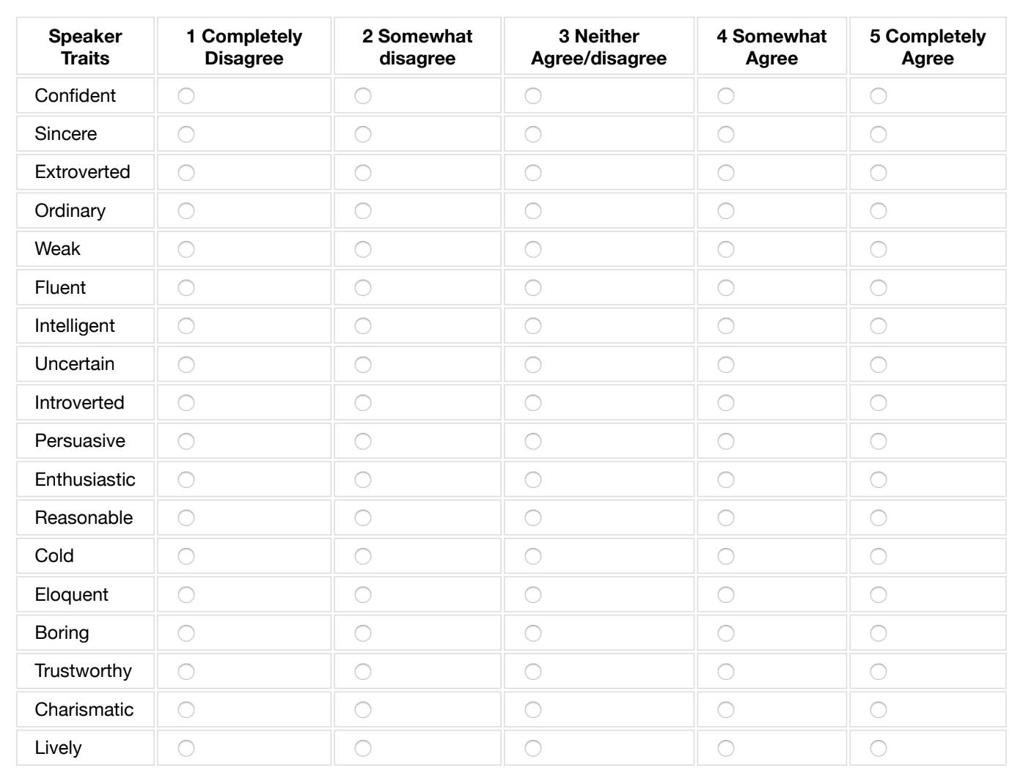
Rate Speakers on 18 Traits

Slide 75
Rater Information
  Rater demographics:
    60 female, 36 male, 1 no report
    68 heterosexual, 16 homosexual, 11 bi-sexual
    42 attracted to females and 65 to males
    Highest grade: Phd (1), MA/S (10), BA/S (45), Assoc (19), HS (21), Less (1)
  Raters’ average score on the TIPI Big-Five personality dimensions (1~7)
    5.12 openness, 5.54 conscientiousness, 3.70 extroversion, 5.39 agreeableness, 4.91 emotional stability
    Distribution was skewed towards a higher score for the four personality dimensions except for extroversion.

Slide 76
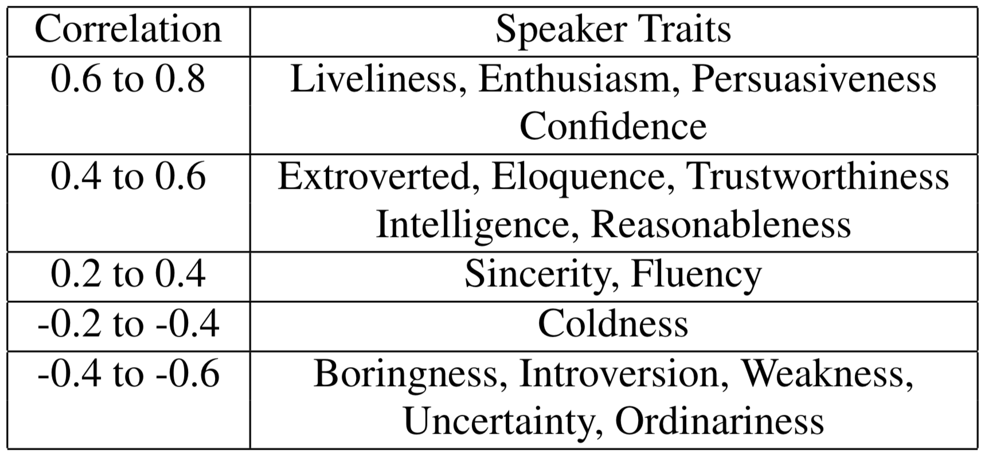
What Speaker Traits do Raters Associate with Charisma ?
Correlation between charisma and speaker traits
Consistent across both speaker and rater genders

Slide 77
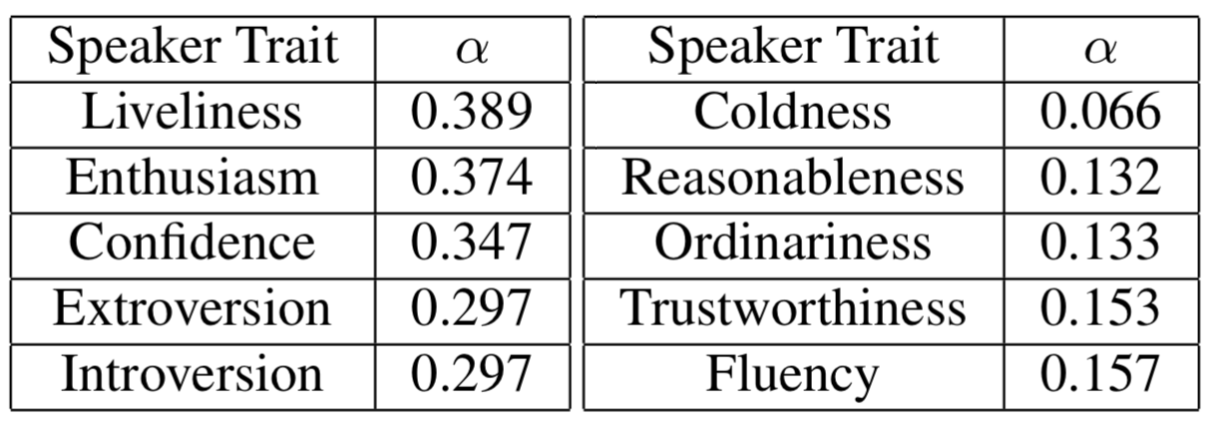
How do Raters Define Charisma in Terms of Speaker Traits?
Inter-rater agreement of traits
  Charisma: 0.296
  5 most and 5 least agreed-upon traits
Higher activated traits are more agreed upon, and lower activation traits more open to interpretation

Slide 78
Does Recording Genre Influence Charisma Ratings?
14 interviews, 19 educational lectures, 27 talks to more general audiences
  Interviews rated less charismatic than educational lectures (p = 0.03) and talks (p = 0.001)
  Why?
    Goal is different?
Notes:
when the speaker may be trying to get the point across, they may seem more charismatic. For in- terviews, the goal of the genre may be more for factual transfer, so the speaker may appear less charismatic.

Slide 79
Does Speaker Gender Influence Raters’ Charisma Rating or Ratings of Other Traits?
Female speakers rated higher for charisma on average than male speakers, but not statistically significant (p = 0.153)
Male speakers rated less sincere (p = 0.014), less fluent (p = 0.022), and less extroverted (p = 0.038) , but more boring (p = 0.001) and more introverted (p = 0.014) than females
Is the lower charisma score of males due to genre and not gender?
Notes:
A possible explanation is that 18 out of 27 talks were from females and talks were generally rated as more charismatic than other genres.

Slide 80
What are the Acoustic-Prosodic Properties of Charismatic Speech?
Normalized male/female speech features using mean values for American English speakers
  Features positively correlated with charisma:
    mean intensity (p = 0.013), mean pitch (p = 0.002), speaking rate (p = 0.001), standard deviation of pitch (p < 0.001)
  Charismatic speech: louder, higher, faster, and with greater fluctuation in pitch
Notes:
normalized the mean pitch of males by 119 Hz with standard deviation 19 Hz and females by 210 Hz with standard deviation 27 Hz using mean values for American English speakers

Slide 81
Are there Differences in Gender for Speech Rated as Charismatic?
Positive correlates:
  Female speakers: mean intensity (p = 0.041), standard deviation in pitch (p = 0.028)
  Male speakers: mean pitch (p = 0.005), speaking rate (p = 0.011), standard deviation in pitch (p = 0.001)
Notes:
male raise pitch, female raise intensity

Slide 82
What are the Lexical Features of Speech Rated as Charismatic?
Linguistic Inquiry and Word Count (LIWC)
  Positive correlations: interrogative words (p = 0.037)
  Negative correlations: first-person pronouns (p = 0.017), negative emotion words (p = 0.014), sadness words (p = 0.002), discrepancies (p = 0.013), words of feeling (p = 0.024)
Gender-specific correlates:
  Some lexical correlates differ between male and female
  Speakers using negative emotional words rated less charismatic -- regardless of gender
Notes:
containing 73 word categories such as affect words, social words, time orientation words, and words for cognitive, perceptual, and biological pro- cess
speakers using questions had high charisma ratings, while speakers who often referred to themselves and talked about their feelings, es- pecially with negative emotion, received low ratings

Slide 83
Do Raters’ Demographics and Personality Influence their Ratings?
Birth gender:
  Male raters rated speakers as weaker (p = 0.015) and colder (p = 0.001) than female raters did
  When judging male speakers, male raters rated them as weaker (p = 0.019) and less fluent (p = 0.040) than female raters did
  When judging female speakers, male raters rated them as colder (p = 0.003), more introverted (p = 0.022) and less extroverted (p = 0.015) than female raters did
Education
  Raters with higher education level rated speakers as

Slide 84
    Less ordinary (p < 0.001), boring (p = 0.017), intelligent (p = 0.039), and fluent (p = 0.015)
    More eloquent (p = 0.007) and lively (p = 0.044)
  Raters may use themselves as a reference?
Personality
  Raters with higher scores in openness, conscientiousness, agreeableness, and emotional stability, tended to rate speakers higher in charisma and in traits that positively correlated with charisma, but lower in traits that negatively correlated with charisma.
  Raters may project some of their own personalities in ratings others?
Notes:
However, raters with higher scores in extroversion tend to rate speakers lower in charisma and in traits that positively correlated with charisma while higher in traits that negatively correlated with charisma
This could be explained by the correlations between personal- ity and self charisma rating, described below in 4.7, in which extroversion is positively correlated with self charisma scores. The more extroverted the raters are, the higher they assess them- selves in charisma, and thus perhaps the lower they may evalu- ate other speakers’ charisma

Slide 85
Raters’ Normal vs. Charismatic Speech
In their charismatic recordings
  Raters increased their mean intensity (p < 0.001), mean pitch (p < 0.001) and standard deviation of pitch (p < 0.001), and decreased their HNR (p = 0.028) when asked to be charismatic
  Becoming similar to how they rated speaker charisma in voice clips
  Gender-specific rater groups
    Female raters increased their mean intensity (p < 0.001)
    Male raters increased their mean pitch (p < 0.001) and speaking rate (p = 0.025), but they also increased mean intensity (p < 0.001), jitter (p = 0.025) and decreased their HNR (p = 0.015).
Notes:
raters do change their voices based on what they believe sounds more charismatic, but they also increase other acoustic features they may be less aware of when rating others.

Slide 86
Analysis and Results - Raters
Does raters’ own speech correlate with their charisma ratings or their demographics/personality?
Birth gender
  Male raters have a higher positive difference in mean pitch (p < 0.001), speaking rate (p = 0.012), and variance of their pitch (p < 0.001) than females
  Males increase their variation in pitch (p = 0.049) the more charismatic they think they are
Notes:
males exaggerate the features we found to be associated with charisma more than females do when producing speech they believe charismatic, and that male raters who see themselves as more charismatic tend to exagger- ate their charismatic speech even more

Slide 87
Analysis and Results - Raters
Does raters’ own speech correlate with their charisma ratings or their demographics/personality?
Personality
  Raters with higher extroversion score had a higher increase in the variance in their pitch (p = 0.037)
  Raters with higher agreeableness had a lower increase in their mean pitch (p = 0.001)
  Raters with higher emotional stability had a slightly higher positive difference in their speaking rate (p = 0.012).
Notes:
males exaggerate the features we found to be associated with charisma more than females do when producing speech they believe charismatic, and that male raters who see themselves as more charismatic tend to exagger- ate their charismatic speech even more

Slide 88
Analysis and Results - Raters
Does raters’ own speech correlate with their charisma ratings or their demographics/personality?
Personality & self charisma ratings
  Raters scored themselves higher on charisma if they had a higher openness (p = 0.008), conscientiousness (p < 0.001), extroversion (p < 0.001), or agreeableness (p = 0.037) scores
Notes:
males exaggerate the features we found to be associated with charisma more than females do when producing speech they believe charismatic, and that male raters who see themselves as more charismatic tend to exagger- ate their charismatic speech even more

Slide 89
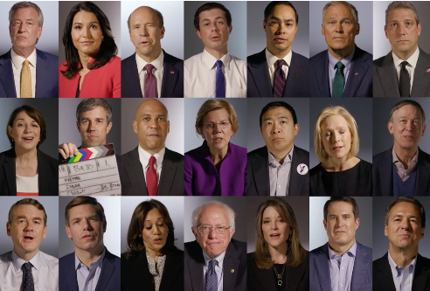
Current Research (Zixoafan Yang, Jessica Huynh, Brandon Liang)
Politicians’ speech:
  Democratic candidates running for office in 2020
  4 genres: Debates, Campaign Ads, Interviews, Stump Speeches
  Future steps
    Voice clip analysis
    AMT charisma ratings
    Raters’ demographic and TIPI information

Slide 90
Some Examples for You to Rate
One
Two
Three
Four
2.31
4.50
4.10
2.06
Notes:
Female:
*One 5b650640-a9b2-4a47-ae61-c2c8ba624575.wav charisma 2.31
*Two 3a2299c7-abf2-4da6-9ef5-60226a8db7cf.wav charisma 4.5
*4af13342-7dd0-4c7c-9888-5f2ef3d66168.wav 4,1
*7b56f3d0-a154-48fe-9d29-f7490ee949d2.wav 2.06

Slide 91
Data Collection
Raters’ average charisma score:
  1: 2.69
  2: 4.27
  3: 2.31
  4: 3.85
Notes:
One 54c1a234-a75f-48ce-b87c-7720067e9eec charisma 2,69
Two 2b45812e-f8f6-430a-8135-bb2d262eb7ba.wav charisma 4.27
Three 5b650640-a9b2-4a47-ae61-c2c8ba624575.wav charisma 2.31
Four b13592f3-3ead-476d-a734-f0f2799ef279.wav charisma 3,85

Slide 92
Why is Sounding Charismatic so Important?
An example from the recent past….

Slide 93
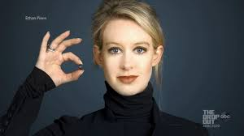
Why is Charisma so Important?
An example from the recent past….
  Former CEO of Theranos, who lowered her voice to command respect from venture capitalists: who gave her ~$750M. Current net worth ~$4.5Billion…Theranos no longer exists….and Holmes charged with fraud…but she can certainly sound charismatic!
Notes:
Elizabeth Holmes, former CEO of Theranos, who trained a lower voice to command respect from venture capitalists -- who gave her $750M before realizing Theranos was not doing what they thought it was – doing hundreds of blood test using new technology on a few drops of blood. Her current net worth is still estimated at $4.5Billion… so charisma pays ☺

Slide 94
Next Steps
Analyze multimodal features of charisma for current speakers and build models to identify them
Rate current political candidates from multimodal data and build models to predict winners and losers
Generate charismatic speech using TTS and voice conversion
Build games that will allow users to train themselves to sound much more charismatic and perhaps be more successful ☺ ☺ ☺

Slide 95
Good-bye!
Thanks for keeping up with the course, despite the hard times
Stay safe and well!

